Slide 1

Status and Prospects for the Measurement of the Pion Vector Form Factor
Riccardo Aliberti, JGU Mainz
MESON 2026
Krakow 30.06.2026

Slide 2
The Muon Anomaly
A charged particle with spin carries a magnetic moment $\vec{µ}$
From Dirac equation: $\left|\vec{S}\right|=1/2$ ➝ $g_{μ}=2$
Going beyond tree level, contribution from loop
The Anomaly
B field
µ
µ
Schwinger term

Slide 3
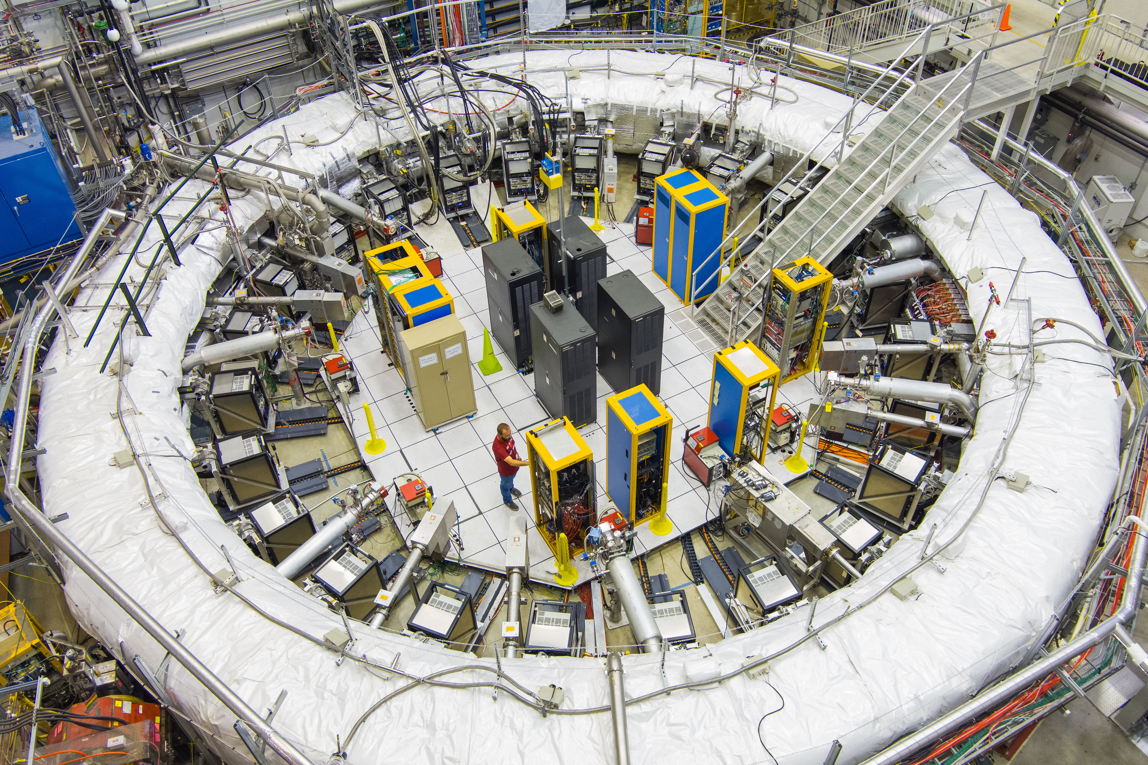
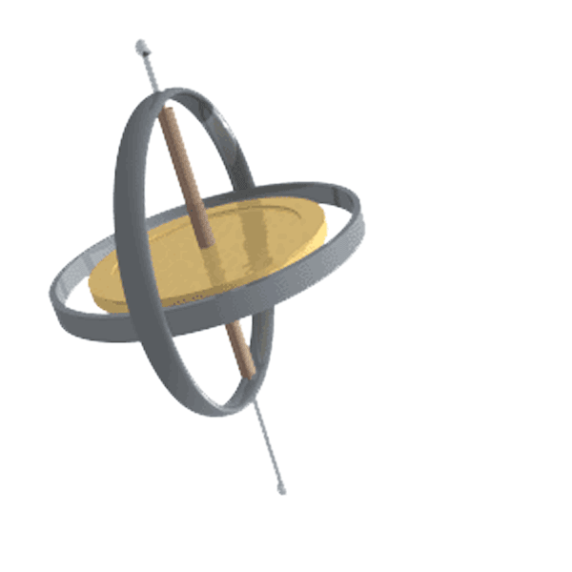
Theory and Experiment
B
e
µ
e
e
e
Measure spin precession frequency:
Frequency determined by a_{µ}
Measured at BNL and FNAL
Precision: 0.19 ppm
(Phys.Rev.D 110 (2024) 3, 032009)

Slide 4
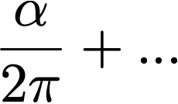
The SM Prediction
QED
99.993%
EW
0.0002%
+
(Phys.Rept. 1143 (2025) 1-158)
QCD
0.006%
HLbL
HVP
???
(Phys.Rept. 1143 (2025) 1-158)

Slide 5
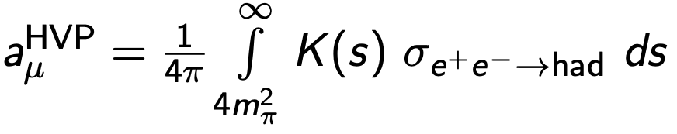
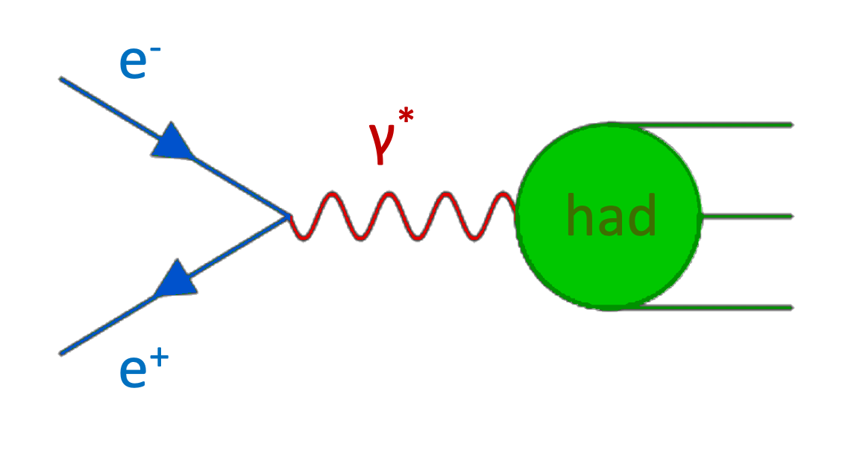
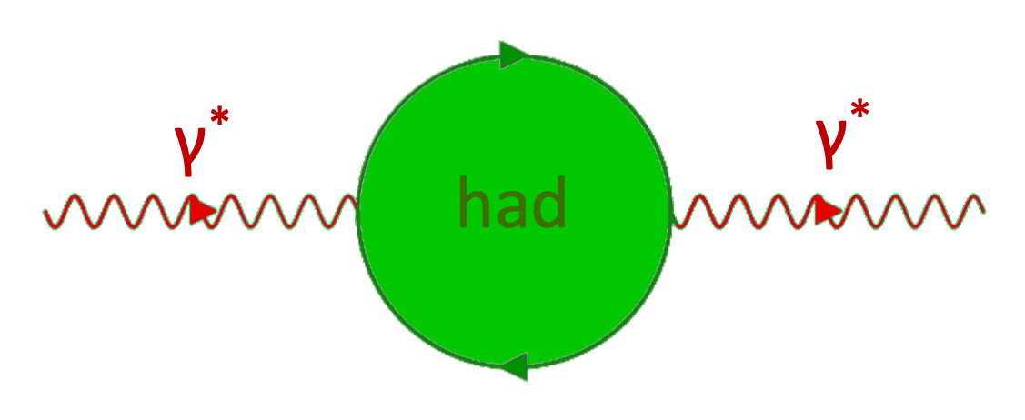
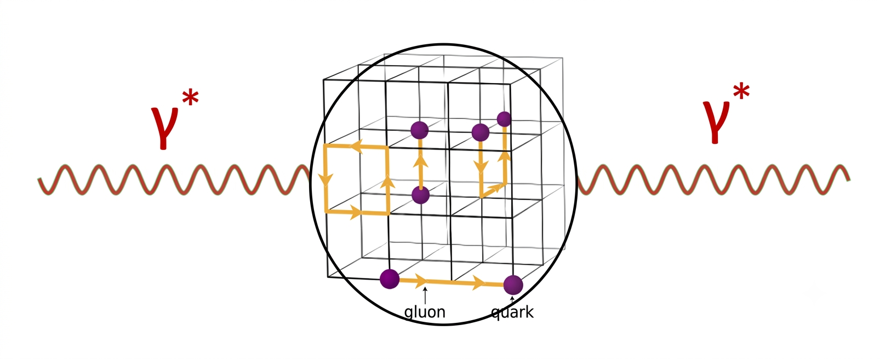
The SM Prediction: HVP
Dispersive evaluation
Optical Theorem
(Phys.Rept. 887 (2020) 1-166)
(Phys.Rept. 1143 (2025) 1-158)
Discretization
Lattice QCD

Slide 6
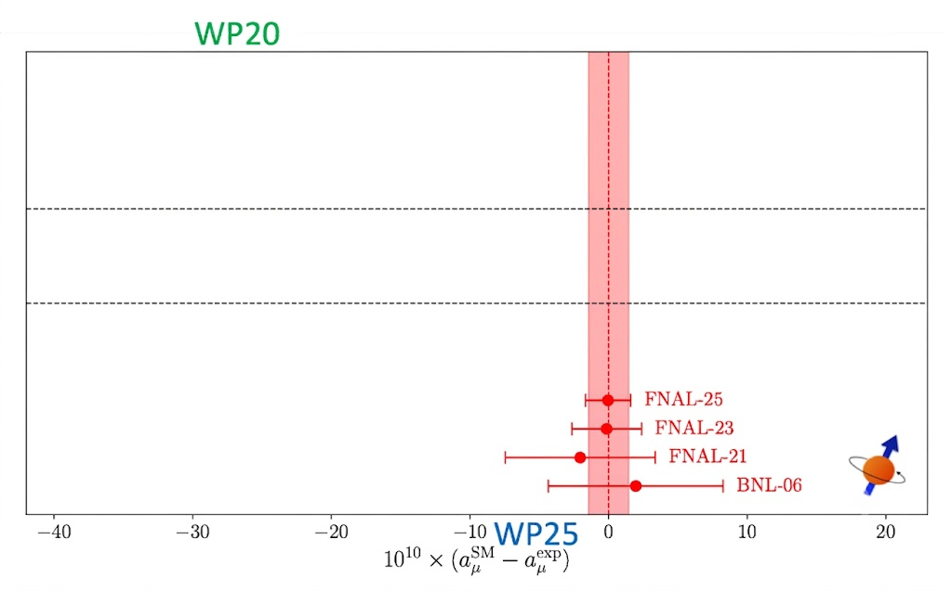
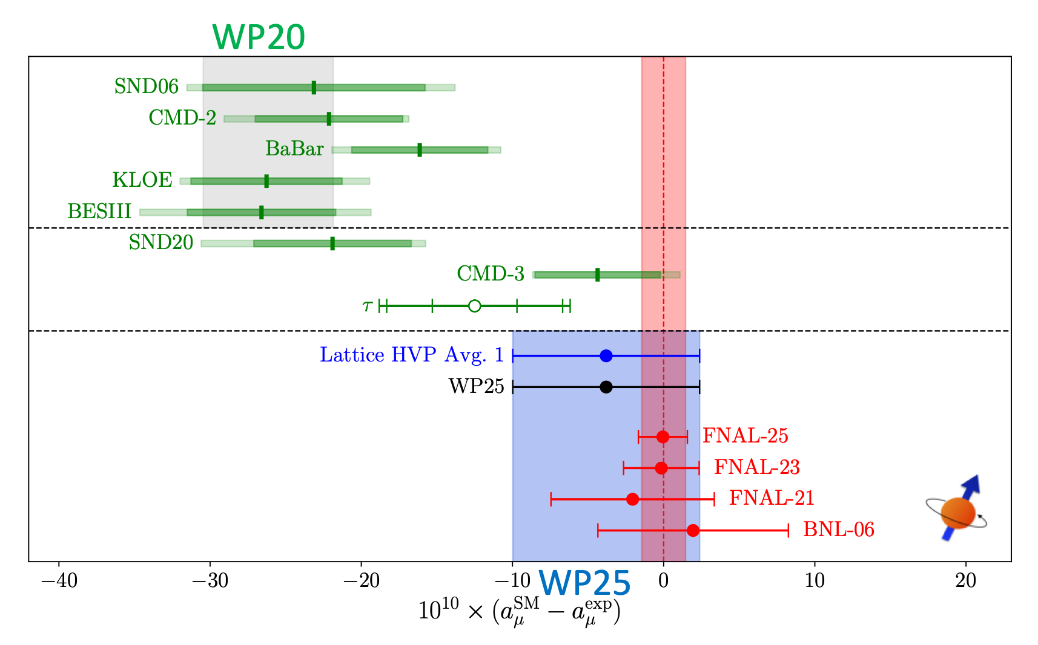
The HVP Puzzle
(Phys.Rept. 887 (2020) 1-166)
ρ(770)
White Paper 2020 (WP20)
Tension between data sets
Underestimation of systematics?
Combination with inflated uncertainty
No precise Lattice QCD calculation
(Phys.Rept. 1143 (2025) 1-158)
CMD-3 Pion FF (2023)
New result published after WP2020
Result in strong disagreement to previous measurements
Good agreement with lattice and experimental result
White Paper 2025 (WP25)
Pion FF data sets are incompatible
A combination is not possible
Only combination of Lattice QCD results

Slide 7
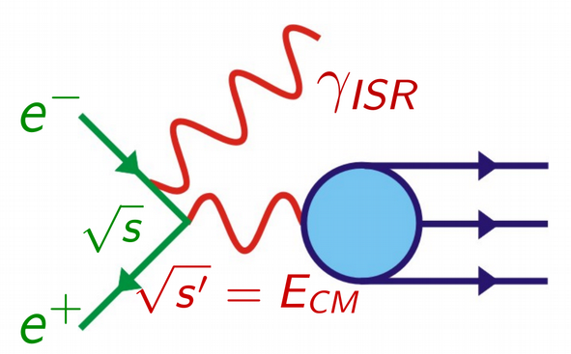
The HVP Puzzle
KLOE
Initial-State-Radiation technique (ISR)
Uncertainty: 0.6% (on a_{µ})
Result is a combination of 3 measurements:
  Untagged analysis of 240 pb⁻¹ @ m_{Φ} (KLOE08)
  Tagged analysis of 250 pb⁻¹ @ 1 GeV (KLOE10)
  KLOE08 with normalization to e⁺e⁻ → µ⁺µ⁻ (KLOE12)
Good agreement of σ(e⁺e⁻ → µ⁺µ⁻) to QED predictions
Event generator: Phokhara
ρ(770)
[JHEP 03 (2018) 173]
[JHEP 03 (2018) 173]
[Phys.Lett.B 670 (2009)]
[Phys.Lett.B 720 (2013) 336-343]
[Phys.Lett.B 700 (2011)]
[Phys.Lett.B 720 (2013)]
White Paper 2025 (WP25)
Pion FF data sets are incompatible
A combination is not possible
Only combination of Lattice QCD results

Slide 8
The HVP Puzzle
BaBar
Initial-State-Radiation technique (ISR)
Tagged analysis (ISR photon at large angle)
232 fb⁻¹ @ ϒ(4S)
Normalization to e⁺e⁻ → µ⁺µ⁻
Uncertainty: 0.7% (on a_{µ})
Analysis built to accept µµ𝛾(𝛾), ππ𝛾(𝛾) events
Good agreement of σ(e⁺e⁻ → µ⁺µ⁻) to QED predictions
Event generator: AfkQED + corrections from Phokhara
ρ(770)
[Phys. Rev. Lett. 103 (2009)]
[Phys.Lett.B 720 (2013) 336-343]
White Paper 2025 (WP25)
Pion FF data sets are incompatible
A combination is not possible
Only combination of Lattice QCD results

Slide 9
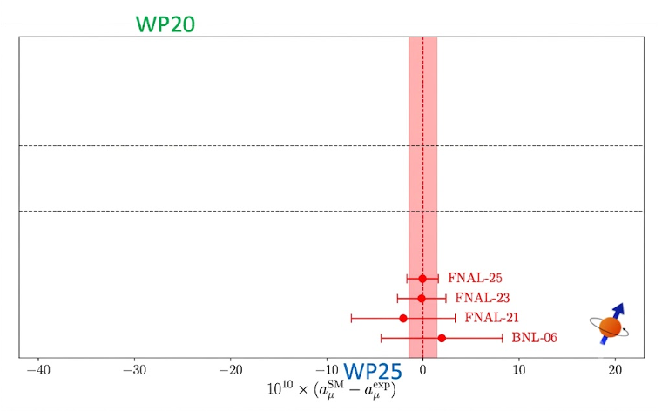
The HVP Puzzle
(Phys.Rept. 887 (2020) 1-166)
ρ(770)
White Paper 2020 (WP20)
Tension between data sets
Underestimation of systematics?
Combination with inflated uncertainty
No precise Lattice QCD calculation
(Phys.Rept. 1143 (2025) 1-158)
CMD-3 Pion FF (2023)
New result published after WP2020
Result in strong disagreement to previous measurements
Good agreement with experimental result
White Paper 2025 (WP25)
Pion FF data sets are incompatible
A combination is not possible
Only combination of Lattice QCD results

Slide 10
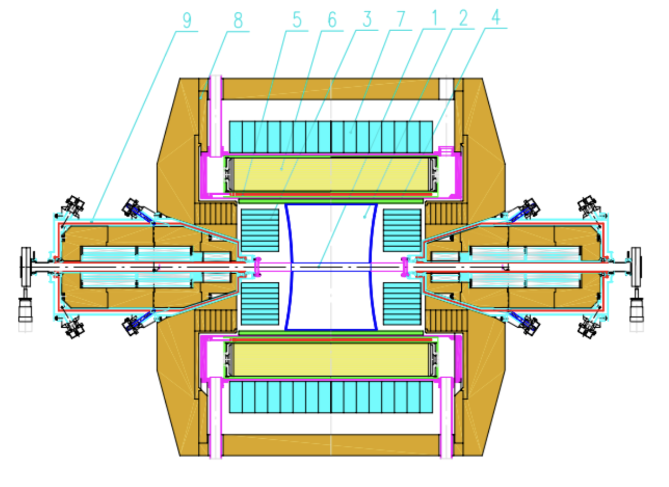
CMD-3 Analysis Strategy
[Phys. Rev. D 109, 112002 (2024)]
Data collected at VEPP-2000 collider
  CM : 0.3 < √s < 1.2 GeV
  Three data sets (2013,18,20)
  Different data taking conditions
Simple selection conditions
  Back-to-back topology
  Timing
Three methods for signal extraction:
  Momentum
  Energy deposit in LXe calorimeter
  Angular distribution
Careful check of systematic effects
  Acceptance, Radiative corrections, …
BGO Calorimeter
Drift Chamber
π⁺
LXe Calorimeter
π⁻
TOF

Slide 11
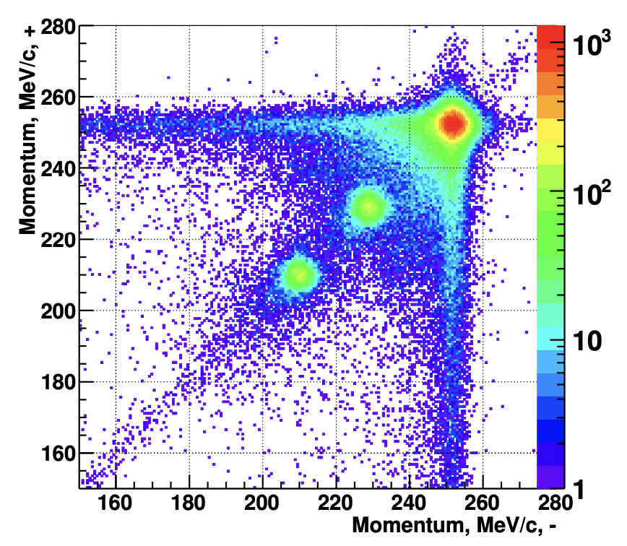
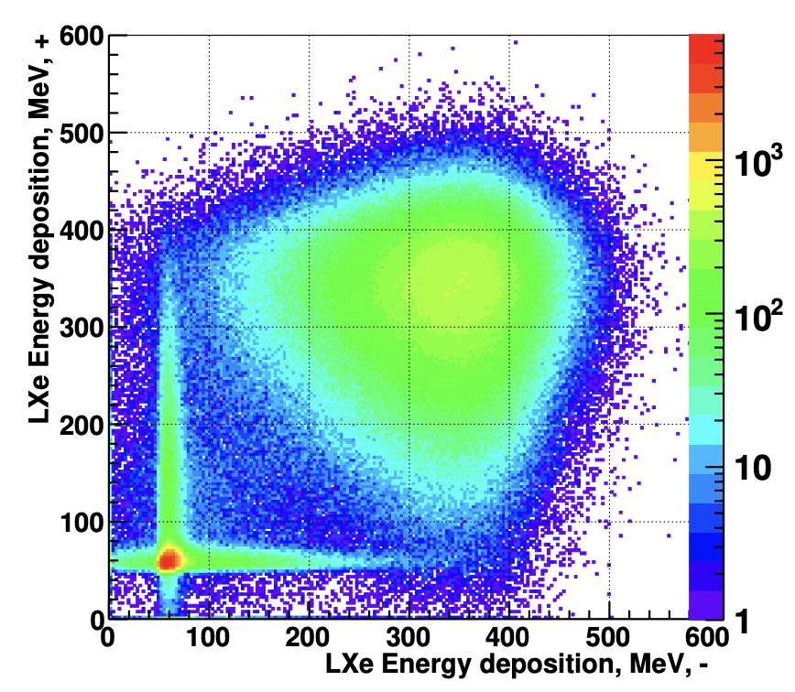
CMD-3 Analysis Strategy
[Phys. Rev. D 109, 112002 (2024)]
Data collected at VEPP-2000 collider
  CM : 0.3 < √s < 1.2 GeV
  Three data sets (2013,18,20)
  Different data taking conditions
Simple selection conditions
  Back-to-back topology
  Timing
Three methods for signal extraction:
  Momentum
  Energy deposit in LXe calorimeter
  Angular distribution
Careful check of systematic effects
  Acceptance, Radiative corrections, …
Momentum
Energy
Angle

Slide 12
CMD-3 Analysis Strategy
Data collected at VEPP-2000 collider
  CM : 0.3 < √s < 1.2 GeV
  Three data sets (2013,18,20)
  Different data taking conditions
Simple selection conditions
  Back-to-back topology
  Timing
Three methods for signal extraction:
  Momentum
  Energy deposit in LXe calorimeter
  Angular distribution
Careful check of systematic effects
  Acceptance, radiative corrections, …
[Phys. Rev. D 109, 112002 (2024)]

Slide 13
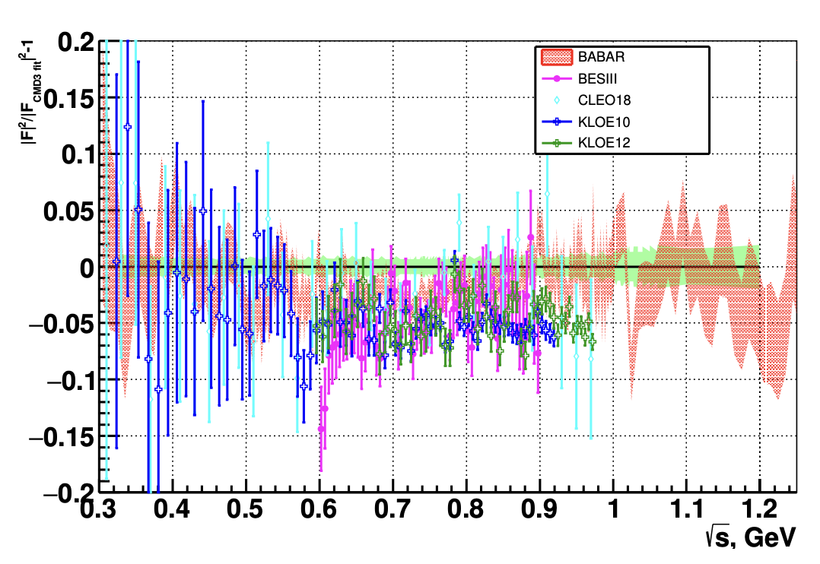
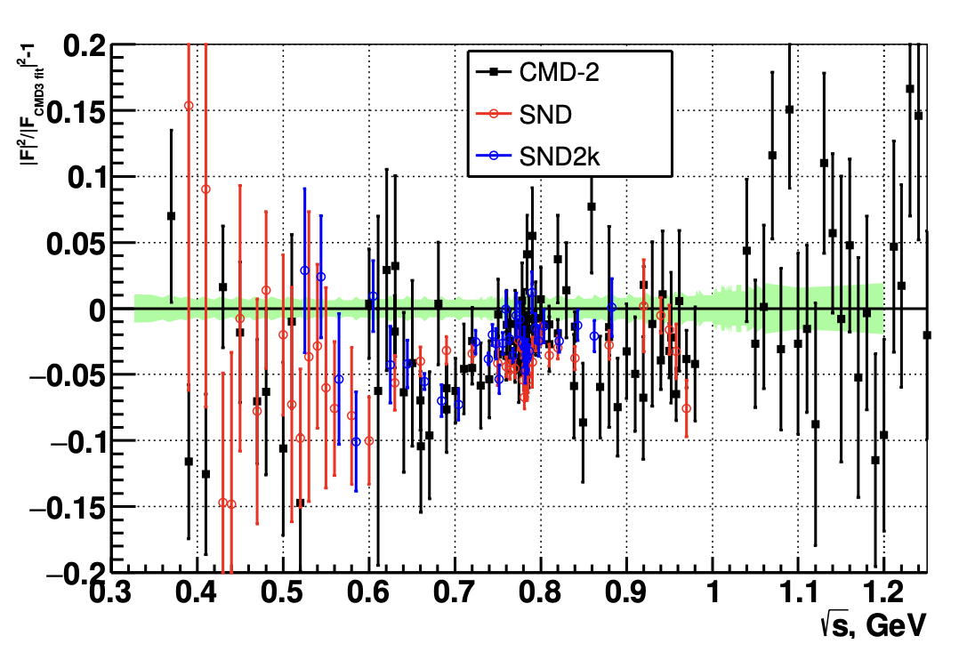
CMD-3: Result and Comparisons
[Phys. Rev. D 109, 112002 (2024)]
ISR
Scan
Measurement accuracy of about 0.8%, close to KLOE and BaBar (0.6-0.7%)
Common (and flat) disagreement around ρ(770)
Consistency at larger and smaller energies
Source of CMD 2 vs 3 disagreement still unclear

Slide 14
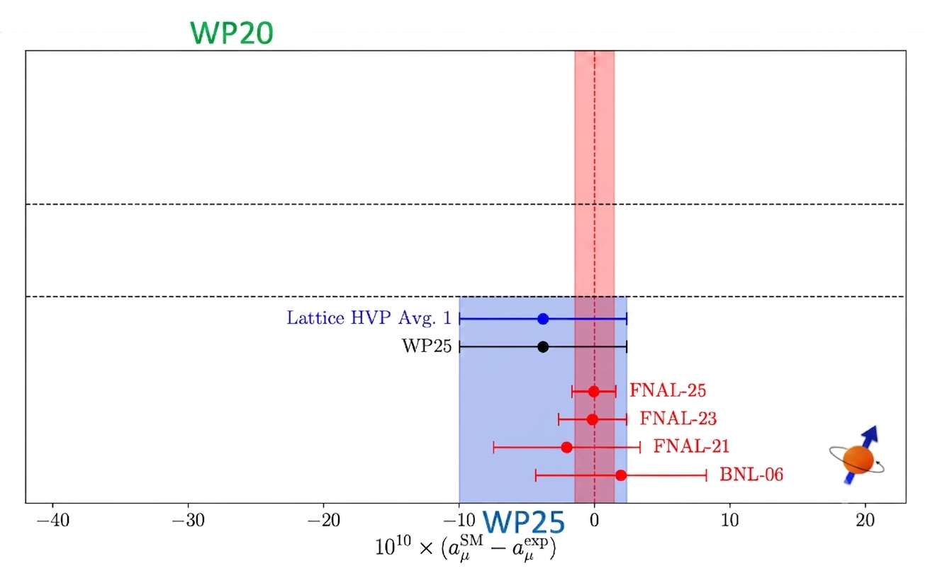
The HVP Puzzle
(Phys.Rept. 887 (2020) 1-166)
ρ(770)
White Paper 2020 (WP20)
Tension between data sets
Underestimation of systematics?
Combination with inflated uncertainty
No precise Lattice QCD calculation
(Phys.Rept. 1143 (2025) 1-158)
CMD-3 Pion FF (2023)
New result published after WP2020
Result in strong disagreement to previous measurements
Good agreement with lattice and experimental result
White Paper 2025 (WP25)
Pion FF data sets are incompatible
A combination is not possible
Only combination of Lattice QCD results

Slide 15
The HVP Puzzle
(Phys.Rept. 887 (2020) 1-166)
ρ(770)
White Paper 2020 (WP20)
Tension between data sets
Underestimation of systematics?
Combination with inflated uncertainty
No precise Lattice QCD calculation
Resolving the pion FF “puzzle” is crucial for the evaluation of a dispersive value of a_{µ}
(Phys.Rept. 1143 (2025) 1-158)
CMD-3 Pion FF (2023)
New result published after WP2020
Result in strong disagreement to previous measurements
Good agreement with lattice and experimental result
White Paper 2025 (WP25)
Pion FF data sets are incompatible
A combination is not possible
Only combination of Lattice QCD results

Slide 16
How to clarify the picture?
Several activities worldwide on-going to understand:
Improvement of event generators (RadioMonteCarLow 2)
New scan measurement: SND
New ISR measurements: BaBar, BESIII, KLOE and Belle II
Joint effort to investigate the discrepancies from both experiment and theory perspective

Slide 17
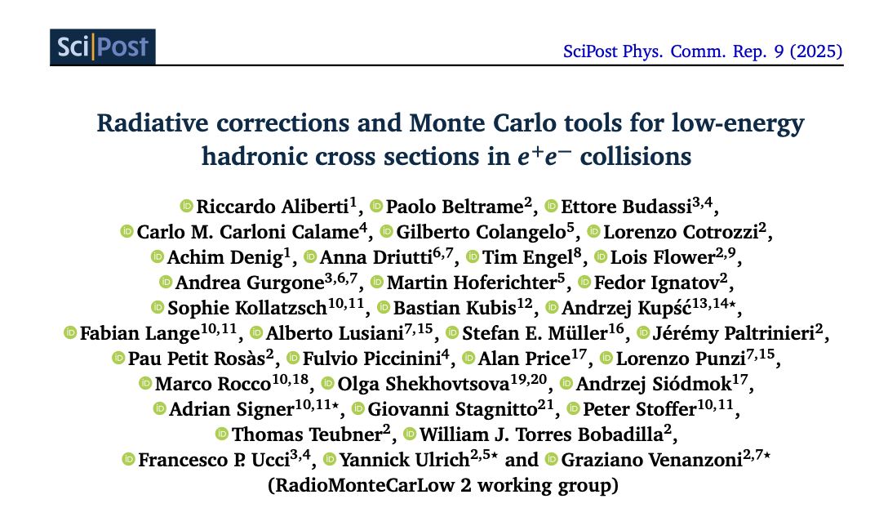
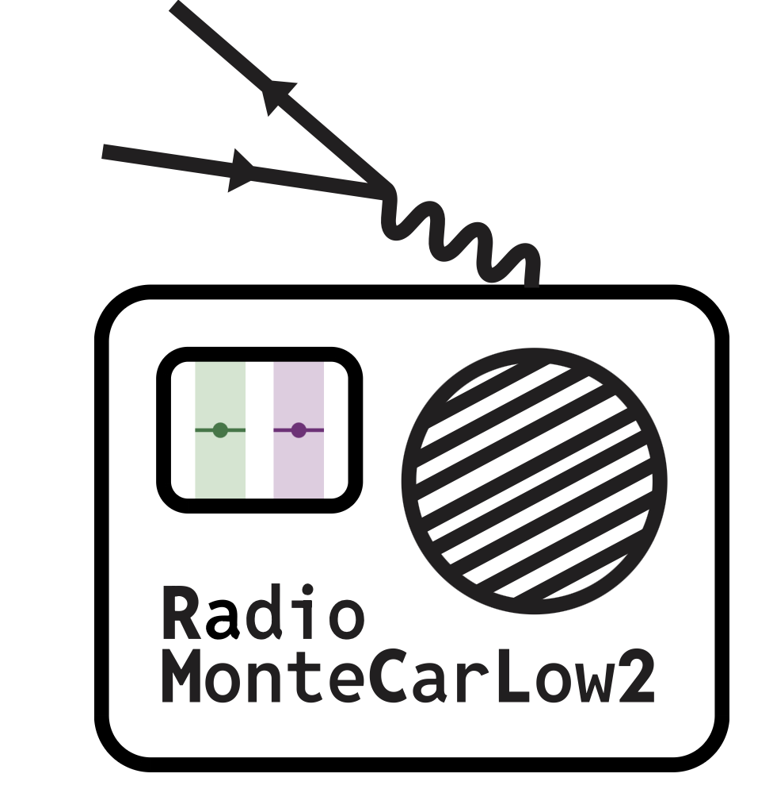
Radiative Corrections
Investigation of events with 2 radiated photons by BaBar
Phokhara is found to overestimate the contribution!
Impact on various ISR analyses?
Need dedicated studies, but which generators to use?
The RadioMonteCarLow 2 Working Group
  Review of available generators and radiative corrections
  Improve codes with new theoretical inputs
    First beyond NLO generator for ISR: BaBayaga@NLO v2.0
    Pion structure beyond scalar QED
    e⁺e⁻ → µ⁺µ⁻𝛾 @ NNLO (work on going)
[Phys. Rev. D 108, L111103 (2023)]

Slide 18
Radiative Corrections
Investigation of events with 2 radiated photons by BaBar
Phokhara is found to overestimate the contribution!
Impact on various ISR analyses?
Need dedicated studies, but which generators to use?
The RadioMonteCarLow 2 Working Group
  Review of available generators and radiative corrections
  Improve codes with new theoretical inputs
    First beyond NLO generator for ISR: BaBayaga@NLO v2.0
    Pion structure beyond scalar QED
    e⁺e⁻ → µ⁺µ⁻𝛾 @ NNLO (work on going)
[Phys. Rev. D 108, L111103 (2023)]
[JHEP 05 (2026) 221]
[ arXiv:2603.28621, arXiv:2603.13171]
[ Phokhara-Liverpool, McMule]
[F. Piccinini @ muon (g-2) T.I. Meeting (2025)]

Slide 19
News from SND
Preliminary result presented at PhiPsi 2026
Experiment on VEPP-2000 collider (as CMD-3)
Selection based on:
  back-to-back topology
  PID with BDT
Uncertainty: ~0.7%
In agreement with CMD-3
Hint: unaccounted tracking inefficiency in old analysis
This would be the first confirmation of CMD-3

Slide 20
News from SND
Preliminary result presented at PhiPsi 2026
Experiment on VEPP-2000 collider (as CMD-3)
Selection based on:
  back-to-back topology
  PID with BDT
Uncertainty: ~0.7%
In agreement with CMD-3
Hints of unaccounted tracking inefficiency in old analysis
This would be the first confirmation of CMD-3
Reanalysis of old data

Slide 21
News from SND
Preliminary result presented at PhiPsi 2026
Experiment on VEPP-2000 collider (as CMD-3)
Selection based on:
  back-to-back topology
  PID with BDT
Uncertainty: ~0.7%
In agreement with CMD-3
Hints of unaccounted tracking inefficiency in old analysis
If confirmed, first validation of CMD-3 result with explanation!
Reanalysis of old data

Slide 22
New BaBar Measurement
Preliminary results presented at Lepton Photon 2025 [arXiv:2601.16587]
Full BaBar data set: 460 fb⁻¹@ ϒ(4S)
Normalization to e⁺e⁻ → µ⁺µ⁻
New technique for muon – pion separation
  Fit to helicity angle distribution
  Exploit different spins (µ = 1/2, π = 0)
  Simultaneous measurement of µµ𝛾(𝛾) and ππ𝛾(𝛾)
Blind Analysis

Slide 23
New BaBar Measurement
Preliminary results presented at Lepton Photon 2025 [arXiv:2601.16587]
Full BaBar data set: 460 fb⁻¹@ ϒ(4S)
Normalization to e⁺e⁻ → µ⁺µ⁻
New technique for muon – pion separation
  Fit to helicity angle distribution
  Exploit different spins (µ = 1/2, π = 0)
  Simultaneous measurement of µµ𝛾(𝛾) and ππ𝛾(𝛾)
QED test accuracy: 0.5%
Blind Analysis

Slide 24
New BaBar Measurement
Preliminary results presented at Lepton Photon 2025 [arXiv:2601.16587]
Full BaBar data set: 460 fb⁻¹@ ϒ(4S)
Normalization to e⁺e⁻ → µ⁺µ⁻
New technique for muon – pion separation
  Fit to helicity angle distribution
  Exploit different spins (µ = 1/2, π = 0)
  Simultaneous measurement of µµ𝛾(𝛾) and ππ𝛾(𝛾)
QED test accuracy: 0.5%
Pion FF in agreement with published result!
a_{µ}^{ππ}(0.5 -1.4 GeV) = 4562(28) vs 4556(33) (x 10⁻¹¹)
Blind Analysis

Slide 25
What comes next?
BESIII:
  New measurements on-going
  Aiming to achieve a final accuracy of O(0.5%)
  First results, with O(0.7%) accuracy, expected soon
Belle II:
  Analysis of 427 fb⁻¹ on-going
  BaBar 2009 approach
  Aim to O(0.5%) accuracy
KLOE(-nxt): [L. Punzi@PhiPsi 2026]
  Analysis of full KLOE data set (2 fb⁻¹ vs 0.25 fb⁻¹)
  Aimed accuracy 0.4%, of which 0.2% from theory
[Phys.Rept. 1143 (2025) 1-158]
[Q. Liu@Muon g-2 TI meeting 2025]
All blind analyses

Slide 26
Conclusion
Muon g-2 is (still) one of the most promising channels to test the SM
Extremely successful experimental measurement at 0.19 ppm
Now waiting for SM prediction to match the accuracy!
Main limitation from hadronic contribution (HVP): Pion FF
Huge effort on-going to understand the origin of the tensions
  Theory: RadioMonteCarLow 2 initiative
  New measurements: SND, BaBar, BESIII, Belle II, KLOE
Preparing for the next step in accuracy!

Slide 27
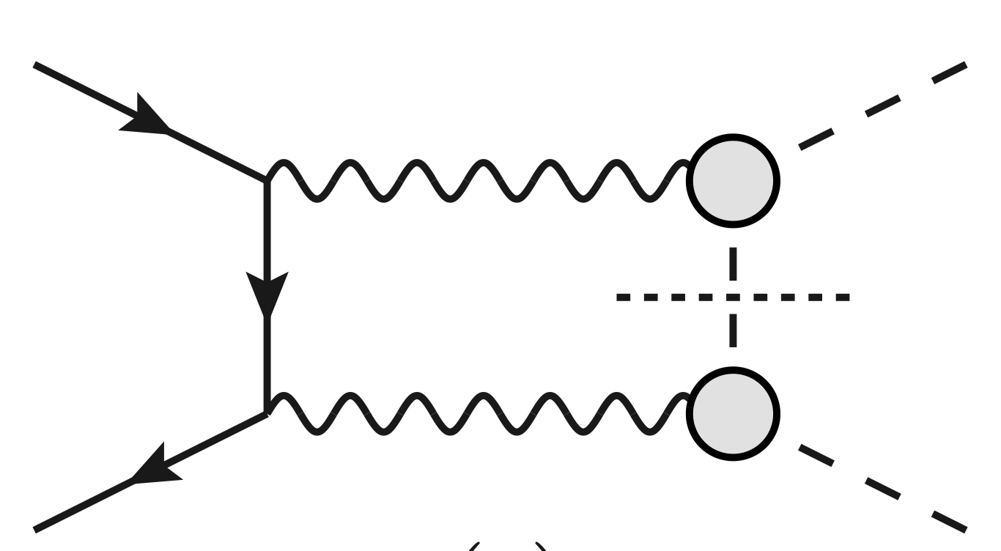
CMD-3 Analysis Strategy
[Phys. Rev. D 109, 112002 (2024)]
Data collected at VEPP-2000 collider
  CM : 0.3 < √s < 1.2 GeV
  Three data sets (2013,18,20)
  Different data taking conditions
Simple selection conditions
  Back-to-back topology
  Timing
Three methods for signal extraction:
  Momentum
  Energy deposit in LXe calorimeter
  Angular distribution
Careful check of systematic effects
  Acceptance, radiative corrections, …

