Slide 1
Search for New Hidden Sector Particles in the 3-60 MeV Mass Range:
Focusing on the Hypothetical X17 Particle
(JLab Experiment E12-21-003)
A. Gasparian (author)
NC A&T State University, NC USA
Presented by William Briscoe (GWU)
for the PRad/X17 collaboration
Co-spokespersons: A. Gasparian, D. Dutta, H. Gao, N. Liyanage, T. Hague, C. Peng, R. Paremuzyan

Slide 2
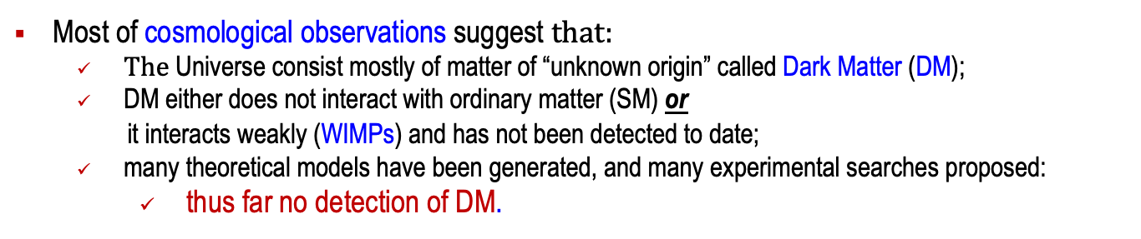
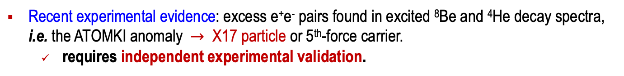
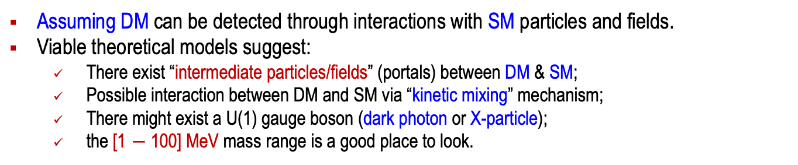
Physics Goals of the Experiment
Most of cosmological observations suggest $that:$
  $The$ Universe consist mostly of matter of “unknown origin” called Dark Matter (DM);
  DM either does not interact with ordinary matter (SM) or
  it interacts weakly (WIMPs) and has not been detected to date;
  many theoretical models have been generated, and many experimental searches proposed:
    thus far no detection of DM.
Assuming DM can be detected through interactions with SM particles and fields.
Viable theoretical models suggest:
  There exist “intermediate particles/fields” (portals) between DM & SM;
  Possible interaction between DM and SM via “kinetic mixing” mechanism;
  There might exist a U(1) gauge boson (dark photon or X-particle);
  the [1 $−$100] MeV mass range is a good place to look.
Recent experimental evidence: excess e⁺e⁻ pairs found in excited ⁸Be and ⁴He decay spectra, i.e. the ATOMKI anomaly $→$ X17 particle or 5th-force carrier.
  requires independent experimental validation.
We propose a search for possible hidden-sector particles in low MeV mass range
We propose using a direct detection method.

Slide 3
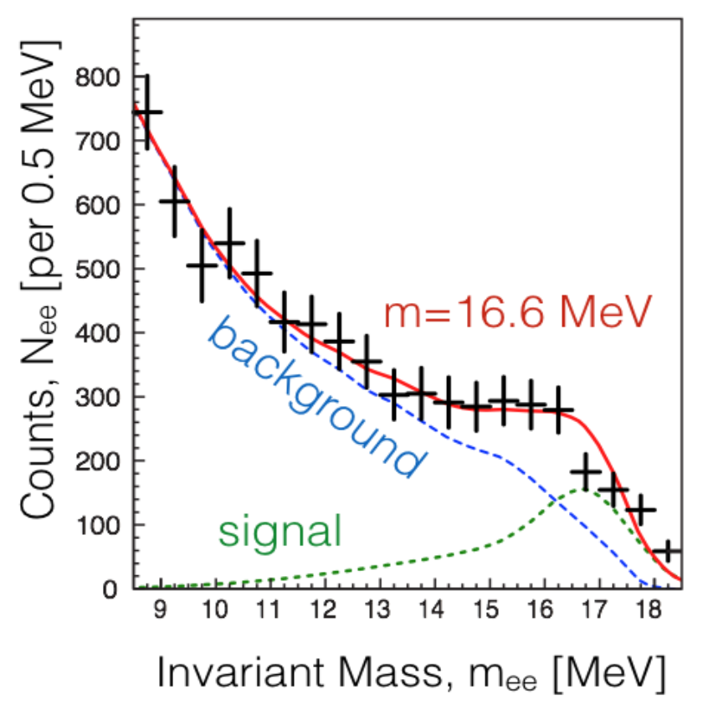
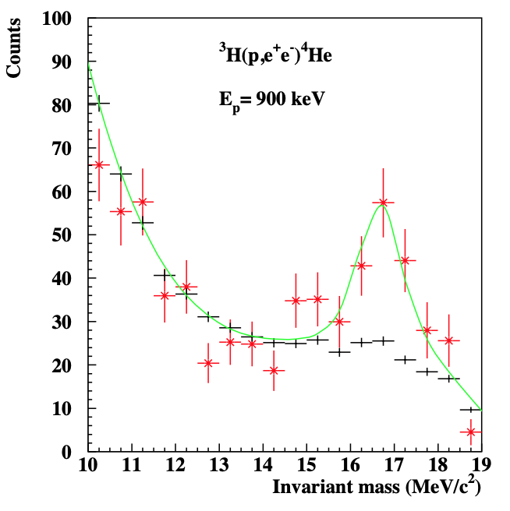
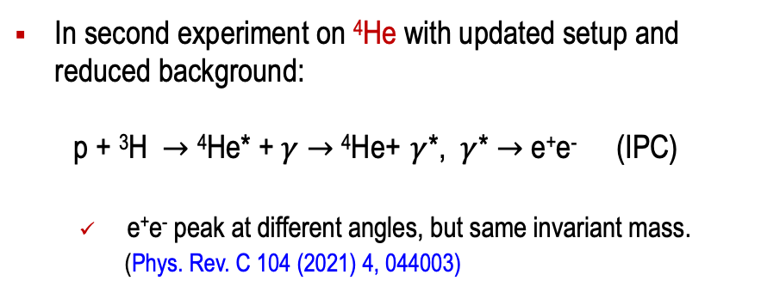
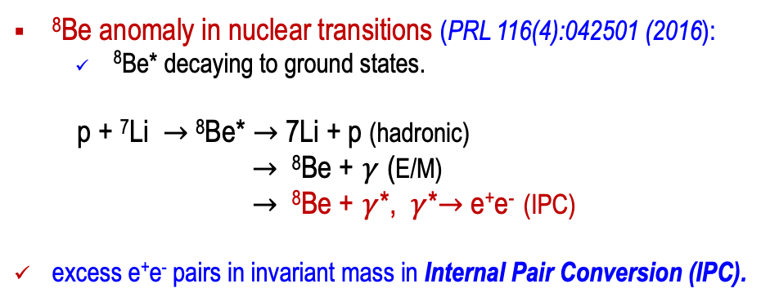
ATOMKI Anomalies in the ⁸Be and ⁴He Experiments
⁸Be anomaly in nuclear transitions (PRL 116(4):042501 (2016):
  ⁸Be* decaying to ground states.
p + ⁷Li $→$ ⁸Be* $→$ 7Li + p (hadronic)
$→$ ⁸Be + $γ$ (E/M)
$→$ ⁸Be + $γ$*, $γ$*$→$ e⁺e⁻ (IPC)
excess e⁺e⁻ pairs in invariant mass in Internal Pair Conversion (IPC).
In second experiment on ⁴He with updated setup and reduced background:
p + ³H $→$ ⁴He* + $γ$ $→$ ⁴He+ $γ$*, $γ$* $→$ e⁺e⁻ (IPC)
  e⁺e⁻ peak at different angles, but same invariant mass.
  (Phys. Rev. C 104 (2021) 4, 044003)

Slide 4
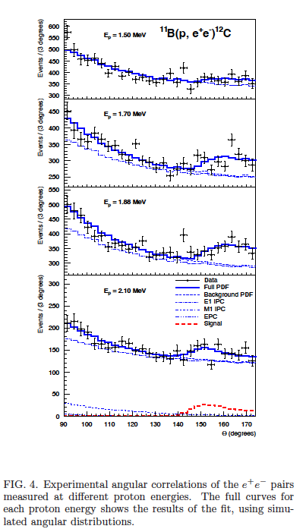
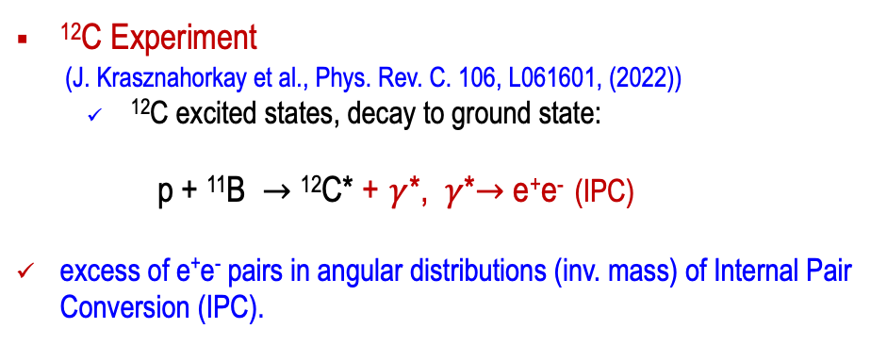
ATOMKI ¹²C Experiment also Found Anomaly
¹²C Experiment
(J. Krasznahorkay et al., Phys. Rev. C. 106, L061601, (2022))
  ¹²C excited states, decay to ground state:
p + ¹¹B $→$ ¹²C* + $γ$*, $γ$*$→$ e⁺e⁻ (IPC)
excess of e⁺e⁻ pairs in angular distributions (inv. mass) of Internal Pair Conversion (IPC).
“… Our results suggest that the X17 particle was generated mainly in E1 radiation. The derived mass of the particle is M_{X} =17.03±0.11(stat) ±0.20(syst) MeV. According to the mass, and to the derived branching ratio (Bx = 3.6(3)Å~10−6), this is likely the same X17 particle that we recently suggested for describing the anomaly observed in the decay of ⁸Be and 4He….”
No required independent confirmation thus far!

Slide 5
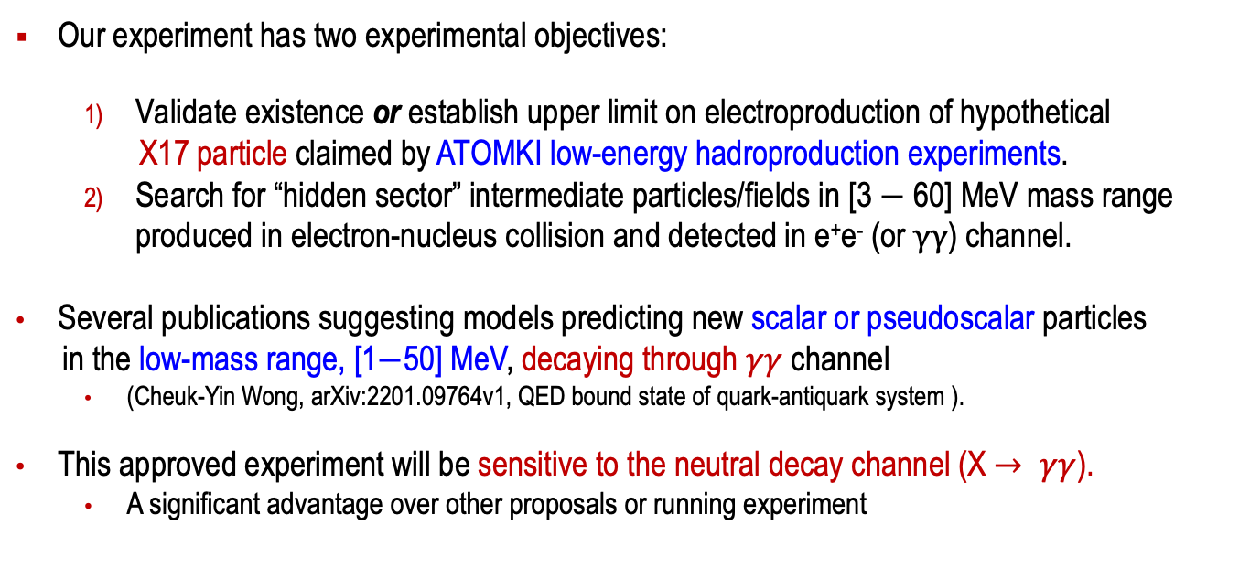
Objectives of this Proposed Experiment
Our experiment has two experimental objectives:
  Validate existence or establish upper limit on electroproduction of hypothetical
  X17 particle claimed by ATOMKI low-energy hadroproduction experiments.
  Search for “hidden sector” intermediate particles/fields in [3 $−$ 60] MeV mass range produced in electron-nucleus collision and detected in e⁺e⁻ (or $γγ$) channel.
Several publications suggesting models predicting new scalar or pseudoscalar particles
in the low-mass range, [1$−$50] MeV, decaying through $γγ$ channel
  (Cheuk-Yin Wong, arXiv:2201.09764v1, QED bound state of quark-antiquark system ).
This approved experiment will be sensitive to the neutral decay channel (X$→ γγ$).
  A significant advantage over other proposals or running experiment

Slide 6
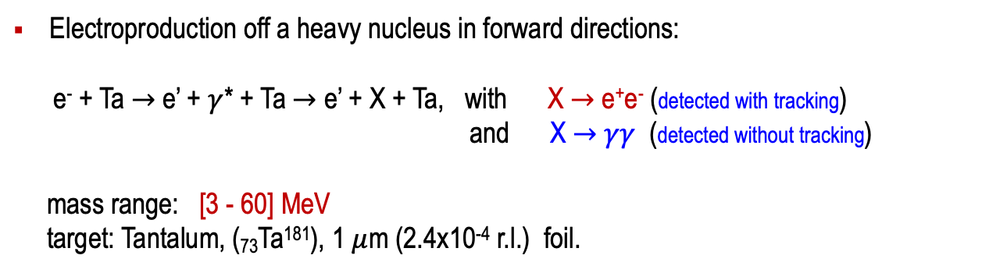
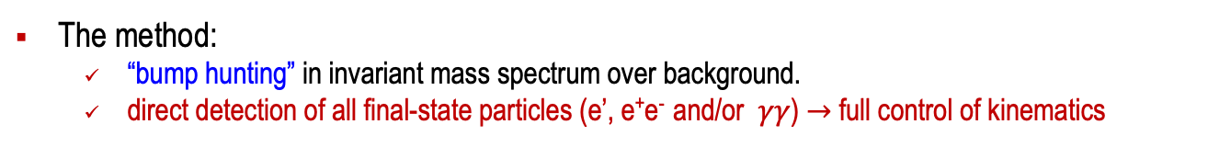
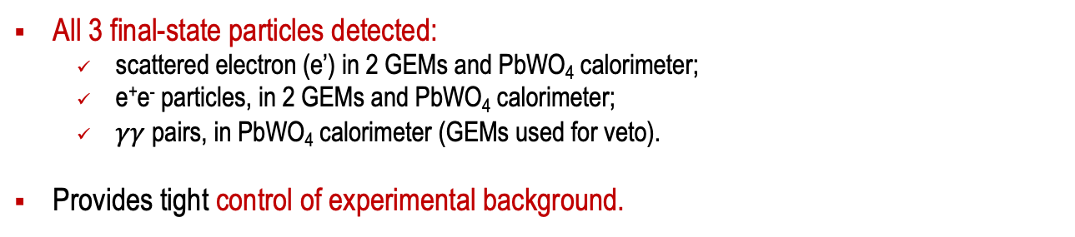
Experimental Method
The method:
  “bump hunting” in invariant mass spectrum over background.
  direct detection of all final-state particles (e’, e⁺e⁻ and/or $γγ$) $→$ full control of kinematics
Electroproduction off a heavy nucleus in forward directions:
e⁻ + Ta $→$ e’ + $γ$* + Ta $→$ e’ + X + Ta, with X $→$ e⁺e⁻ (detected with tracking)
and X $→$ $γγ$ (detected without tracking)
mass range: [3 - 60] MeV
target: Tantalum, (₇₃Ta¹⁸¹), 1 $μ$m (2.4x10⁻⁴ r.l.) foil.
All 3 final-state particles detected:
  scattered electron (e’) in 2 GEMs and PbWO₄ calorimeter;
  e⁺e⁻ particles, in 2 GEMs and PbWO₄ calorimeter;
  $γγ$ pairs, in PbWO₄ calorimeter (GEMs used for veto).
Provides tight control of experimental background.

Slide 7
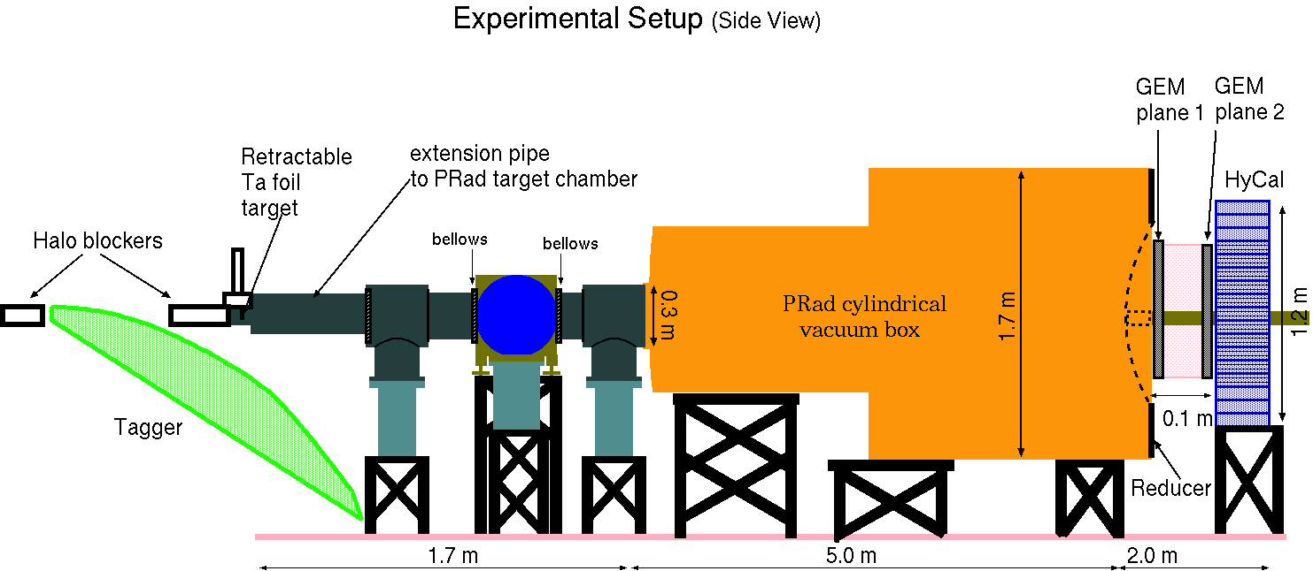
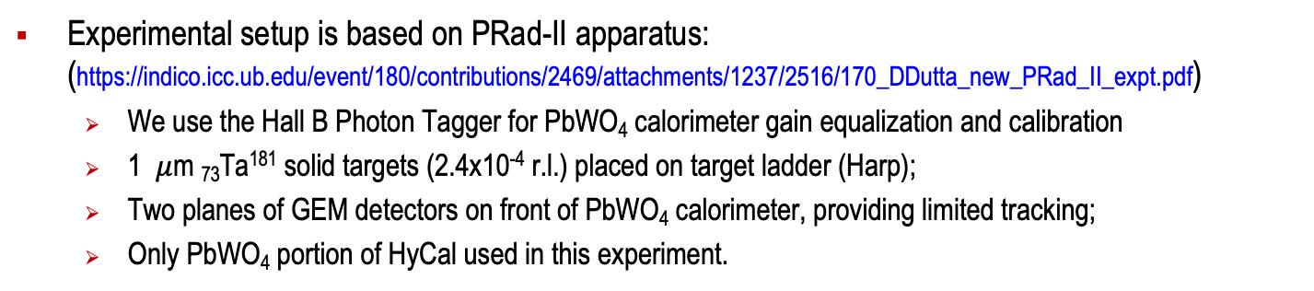
Experimental Setup in Hall B at JLab
Experimental setup is based on PRad-II apparatus: (https://indico.icc.ub.edu/event/180/contributions/2469/attachments/1237/2516/170_DDutta_new_PRad_II_expt.pdf)
  We use the Hall B Photon Tagger for PbWO₄ calorimeter gain equalization and calibration
  1 $μ$m ₇₃Ta¹⁸¹ solid targets (2.4x10⁻⁴ r.l.) placed on target ladder (Harp);
  Two planes of GEM detectors on front of PbWO₄ calorimeter, providing limited tracking;
  Only PbWO₄ portion of HyCal used in this experiment.
e - beam

Slide 8
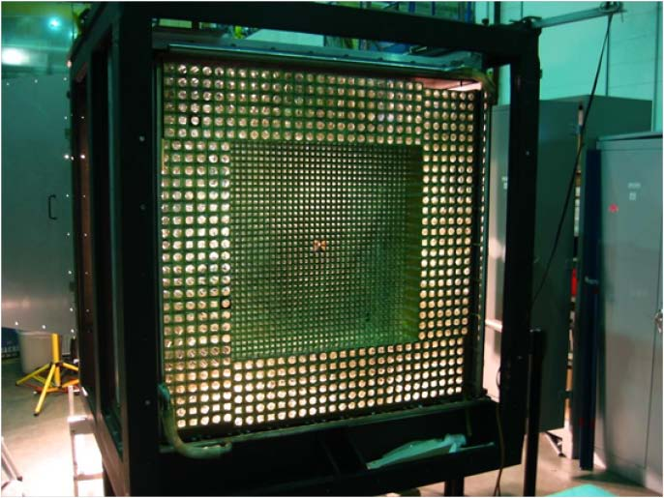
Experimental Apparatus: PbWO₄ Electromagnetic Calorimeter
Only inner PbWO₄ portion of HyCal used:
  34 x 34 =1156 crystal modules, each 2x2x18 cm³;
  68 x 68 cm² total detection area;
  Central 2x2 crystals removed for beam passage
e-beam

Slide 9
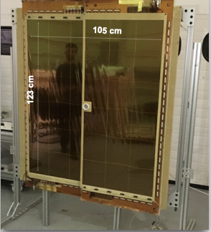
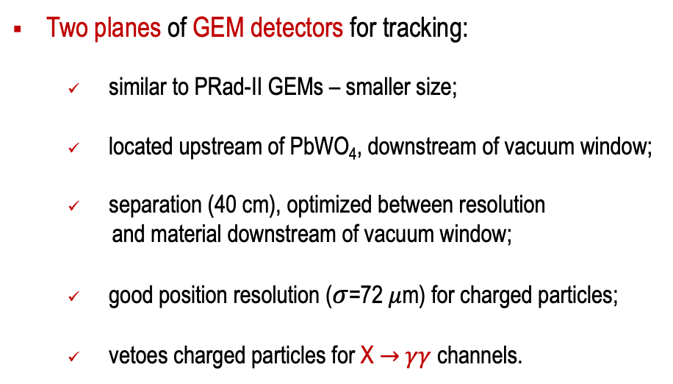
Experimental Apparatus: GEM Position Detectors (Tracking)
Two planes of GEM detectors for tracking:
  similar to PRad-II GEMs – smaller size;
  located upstream of PbWO₄, downstream of vacuum window;
  separation (40 cm), optimized between resolution
  and material downstream of vacuum window;
  good position resolution ($σ$=72 $μ$m) for charged particles;
  vetoes charged particles for X $→$ $γγ$ channels.
Electronics: APV-25 based readout system.
(UVA group)
PRad GEMs

Slide 10
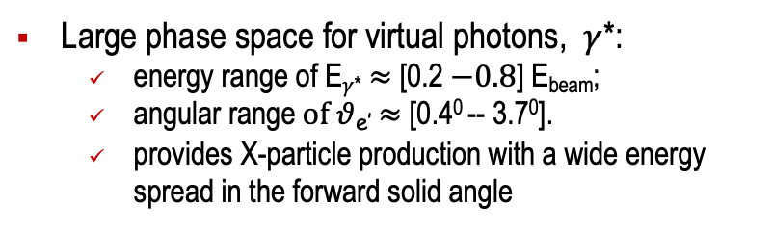
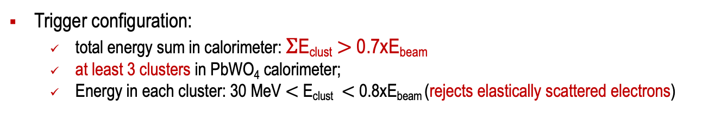
Geometrical Acceptance and Detection Efficiency
Trigger configuration:
  total energy sum in calorimeter: $Σ$E_{clust} $>$ 0.7xE_{beam}
  at least 3 clusters in PbWO₄ calorimeter;
  Energy in each cluster: 30 MeV $<$ E_{clust} $<$ 0.8xE_{beam} (rejects elastically scattered electrons)
Large phase space for virtual photons, $γ$*:
  energy range of E$γ$* $≈$ [0.2 $−0.8$] E_{beam};
  $\text{angular} \text{range} of θ$_{e’}$≈$ [0.4⁰ -- 3.7⁰].
  provides X-particle production with a wide energy spread in the forward solid angle
Target to detector distance: L = 7.5 m provides a good (integrated) detection efficiency in the [3 - 60] MeV range.
E_{e} = 2.2 and 3.3 GeV were chosen for relative ease of scheduling during CEBAF low-energy runs. (There are limits in energy to each experimental hall at JLAB.)

Slide 11
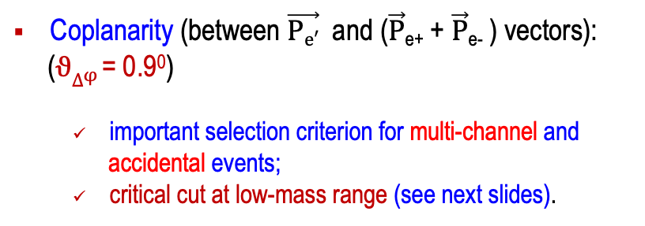
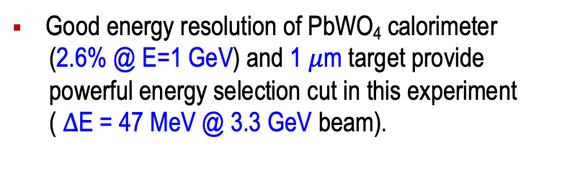
Experimental Resolutions
Good energy resolution of PbWO₄ calorimeter
(2.6% @ E=1 GeV) and 1 $μ$m target provide
powerful energy selection cut in this experiment
( $∆$E = 47 MeV @ 3.3 GeV beam).
Coplanarity (between $\vec{Pe′}$ and ($\vec{P}$_{e+} + $\vec{P}$_{e-} ) vectors):
($ϑ∆φ$ = 0.9⁰)
  important selection criterion for multi-channel and
  accidental events;
  critical cut at low-mass range (see next slides).

Slide 12
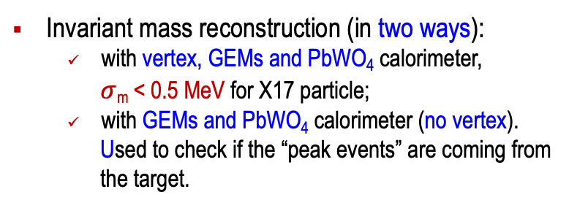
Experimental Resolutions (invariant mass and vertex plane)
Invariant mass reconstruction (in two ways):
  with vertex, GEMs and PbWO₄ calorimeter,
  $σ$_{m} < 0.5 MeV for X17 particle;
  with GEMs and PbWO₄ calorimeter (no vertex).
  Used to check if the “peak events” are coming from
  the target.
The two GEM planes (with PbWO₄) will effectively discriminate events not originating from the target
(e.g. from the vacuum chamber exit window).
However, in this experiment the GEMs are not designed to measure the “decay length”.
Thus, this is not a “displaced vertex” search.

Slide 13
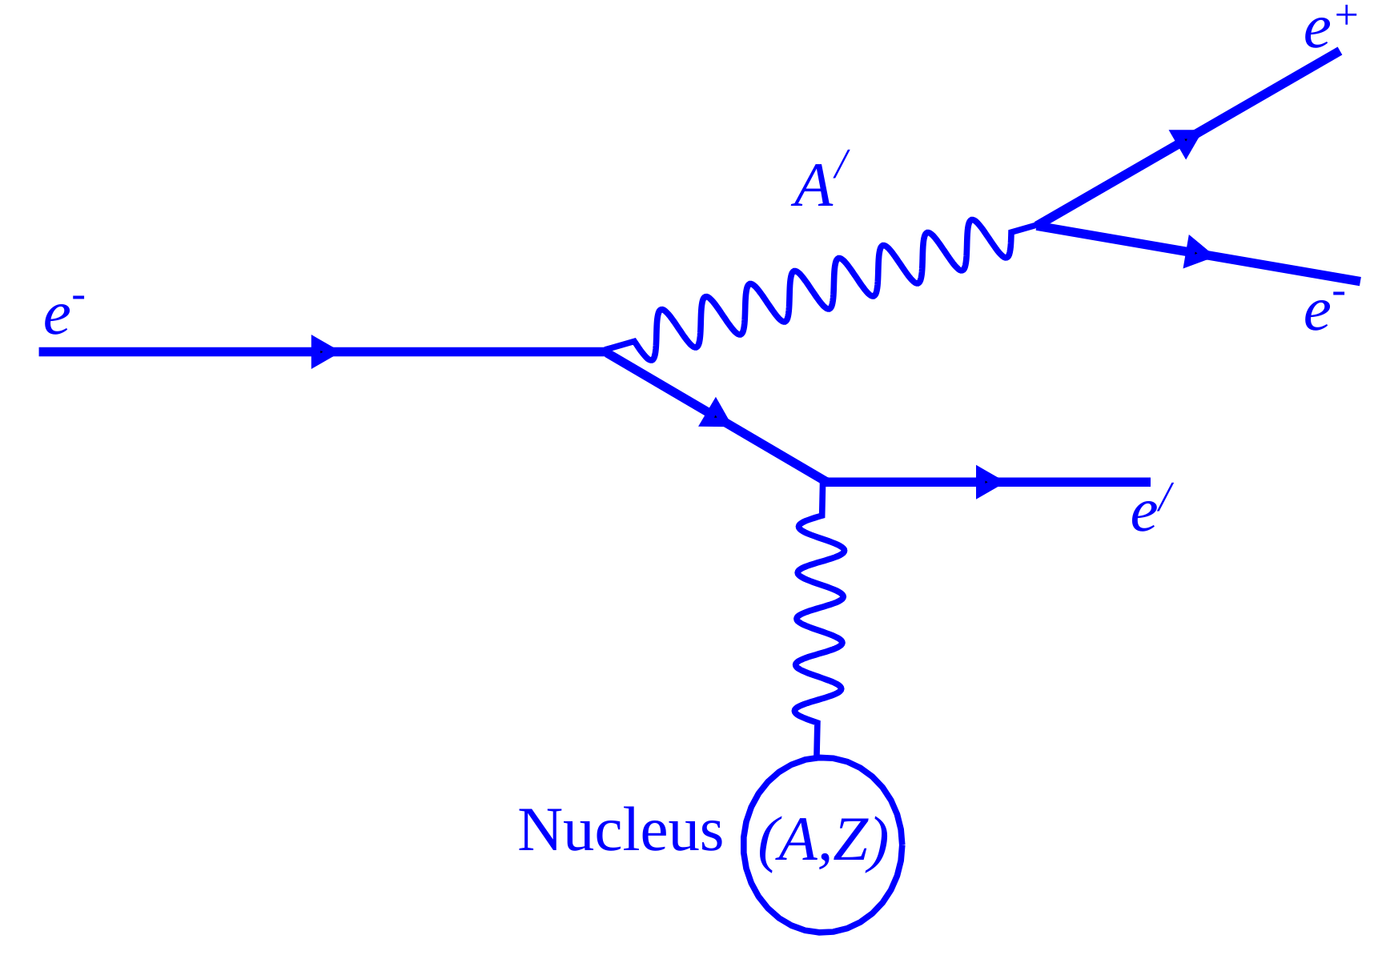
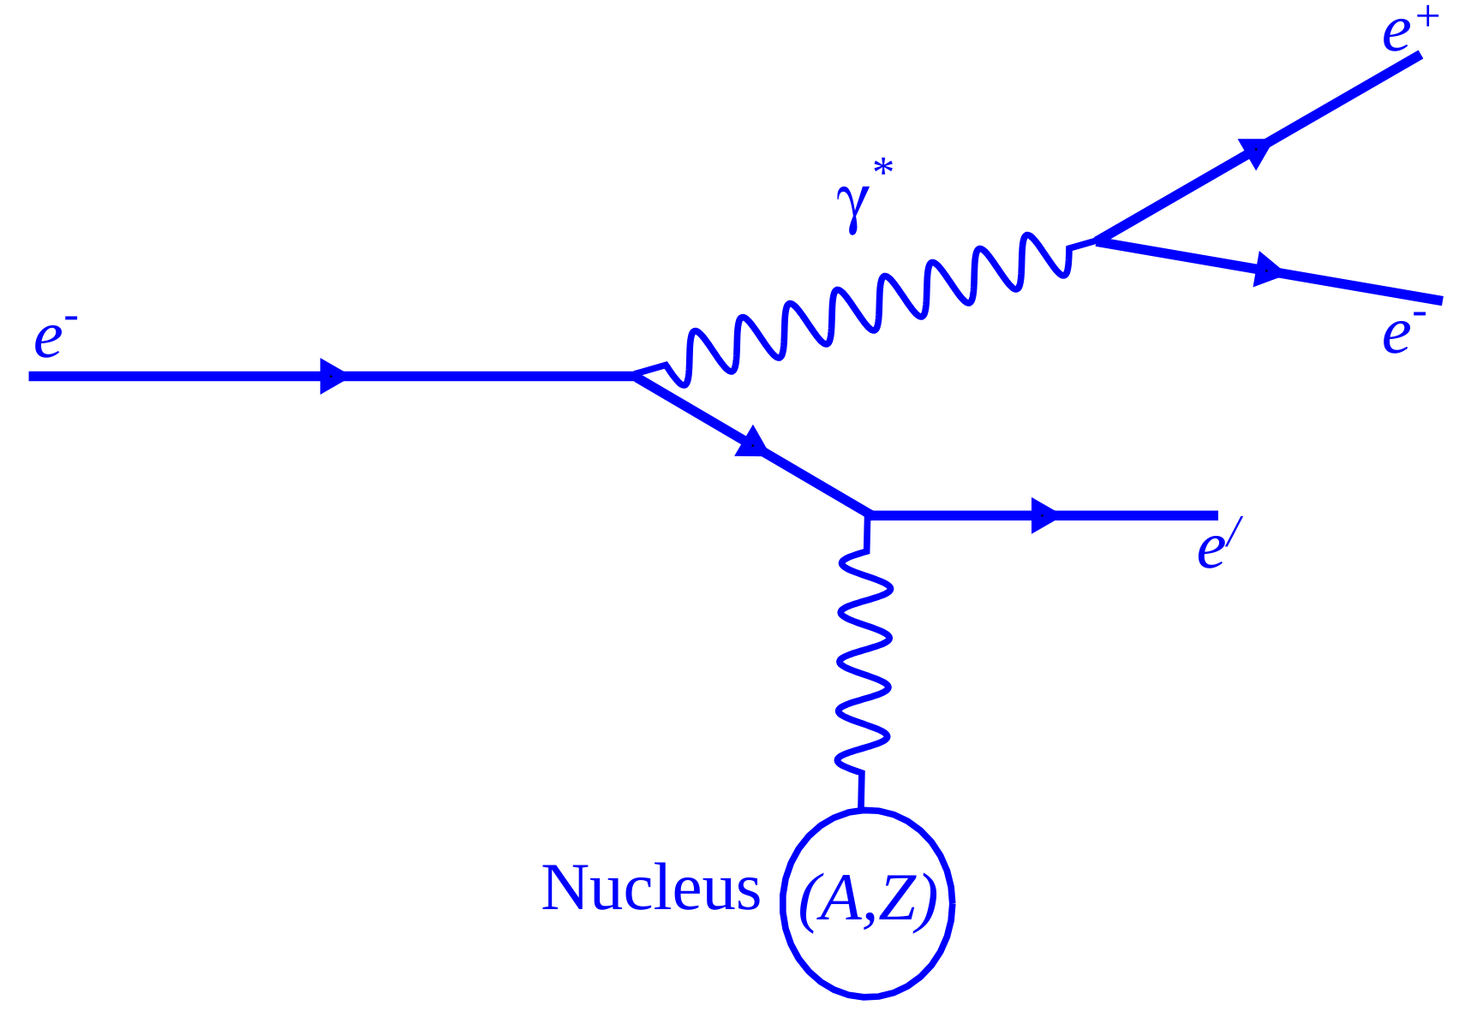
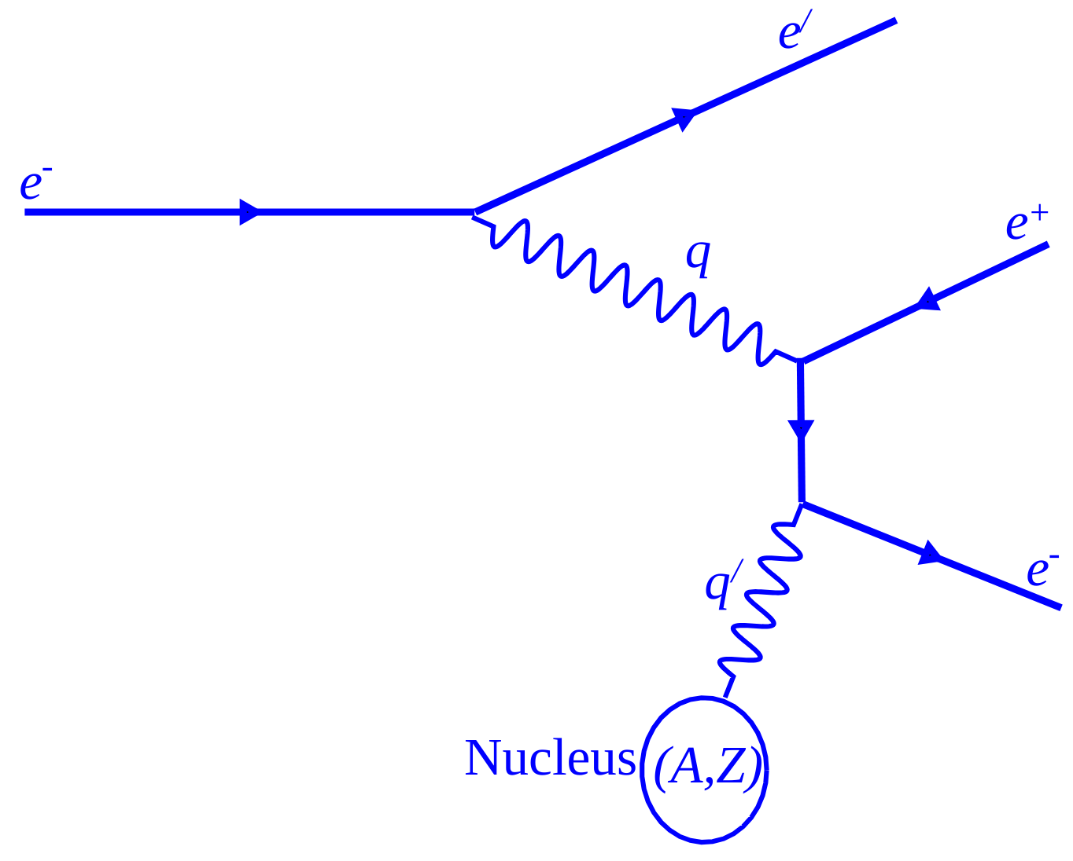
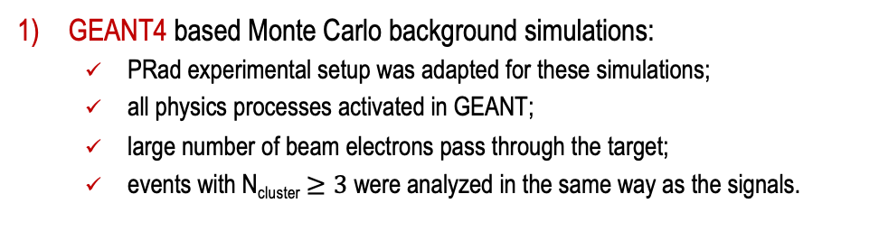
Physics Background Simulations
Physics background was simulated in two different ways:
  Using a GEANT4 based MC simulation package.
  Using the MADGRAPH5 EM event generator and GEANT4 for secondary interaction while tracking included processes such as:
    Bethe-Heitler
    Radiative and
    Interference between them
X production channel
GEANT4 based Monte Carlo background simulations:
  PRad experimental setup was adapted for these simulations;
  all physics processes activated in GEANT;
  large number of beam electrons pass through the target;
  events with N_{cluster} $≥3$were analyzed in the same way as the signals.
Rad tridents
MadGraph5 EM event generator-based background simulations:
  yield large statistics (~2M) for trident events;
  these events were fed into the GEANT MC simulation package;
  same analysis procedure was applied for these events as above.
Bethe-Heitler

Slide 14
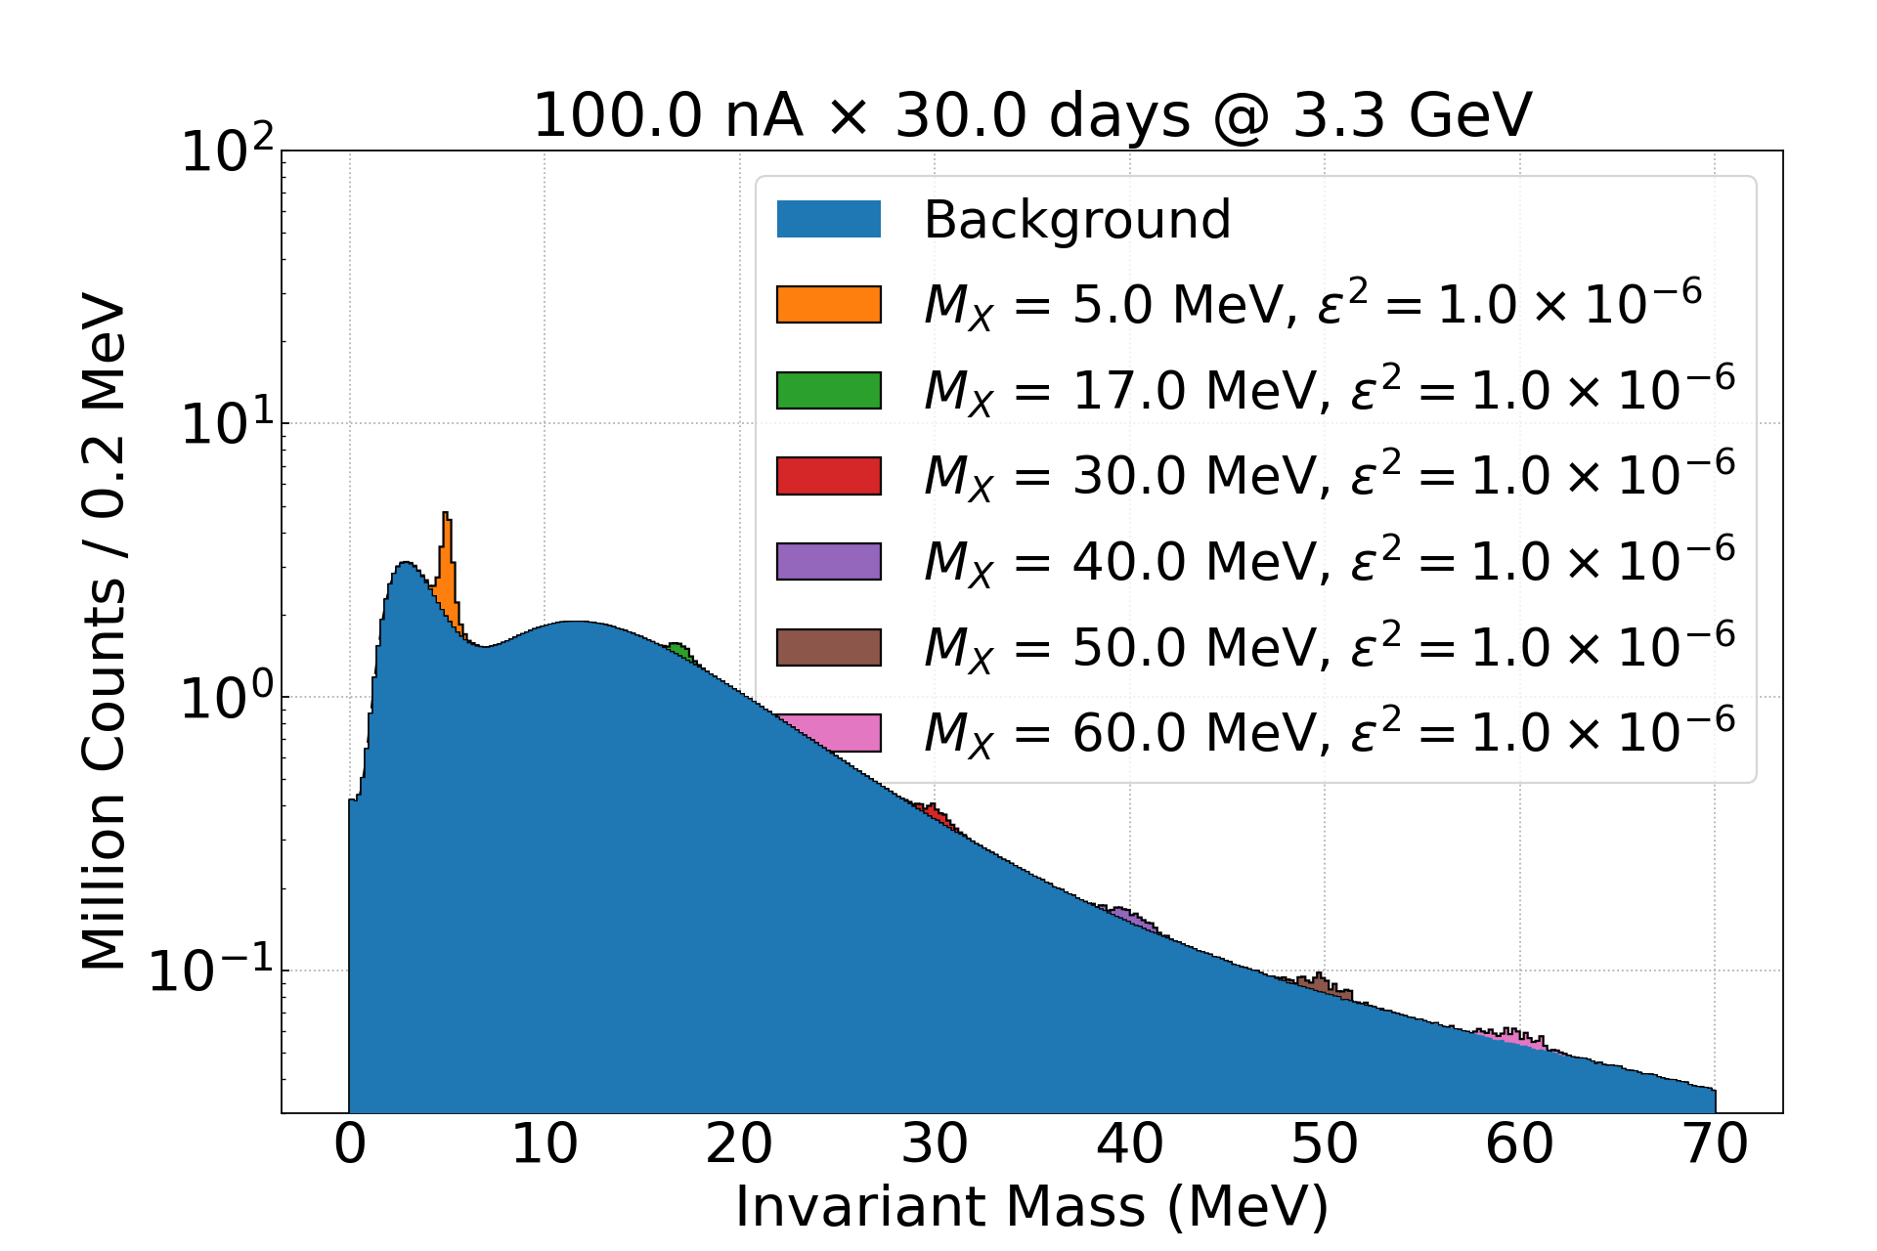
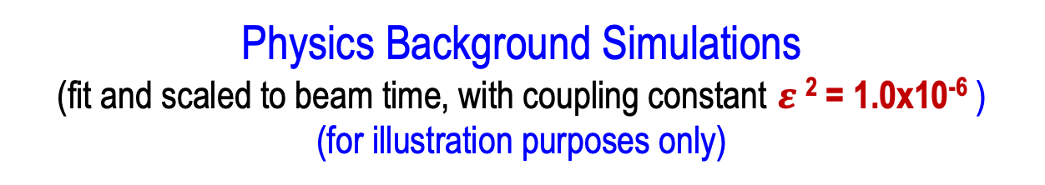

Physics Background Simulations
(fit and scaled to beam time, with coupling constant $ε$ ² = 1.0x10⁻⁶ )
(for illustration purposes only)
The simulated hybrid background
was scaled to 30 days of beam
time, with
I_{e} = 100 nA, 1$μ$m ₇₃Ta¹⁸¹ target
projected signal events with
coupling constant$ε$ ² = 1.0x10⁻⁶

Slide 15
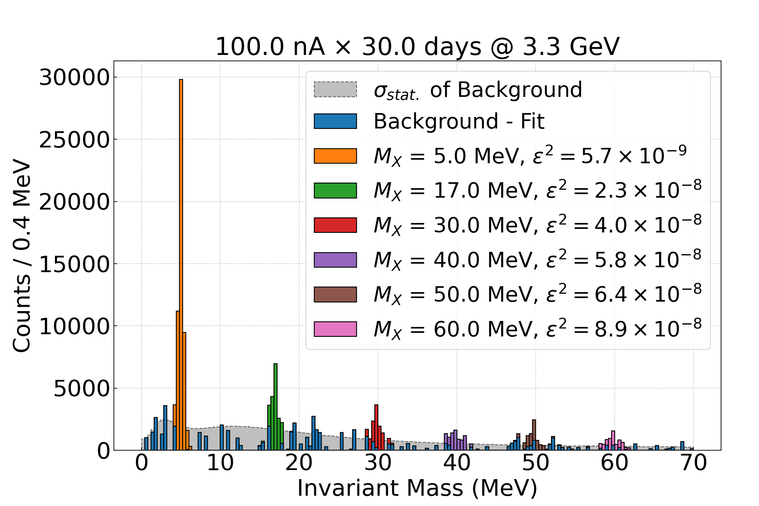
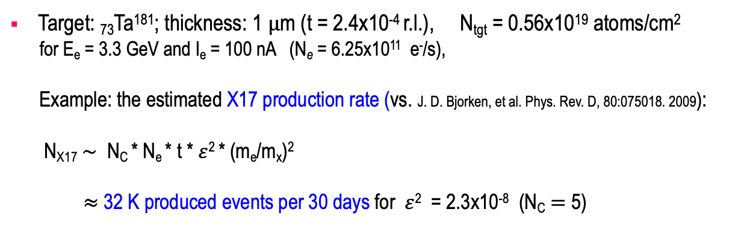
Estimated Beam Time and Statistics
Target: ₇₃Ta¹⁸¹; thickness: 1 $μ$m (t = 2.4x10⁻⁴ r.l.), N_{tgt} = 0.56x10¹⁹ atoms/cm²
for E_{e} = 3.3 GeV and I_{e} = 100 nA (N_{e} = 6.25x10¹¹ e⁻/s),
Example: the estimated X17 production rate (vs. J. D. Bjorken, et al. Phys. Rev. D, 80:075018. 2009):
N_{X17} $\sim$ N_{C} * N_{e} * t * $ε$² * (m_{e}/m_{x})²
$≈$ 32 K produced events per 30 days for $ε$² = 2.3x10⁻⁸ (N_{C} $=$ 5)
 | Time (days)
Setup checkout, calibration | 4.0
Production at 2.2 GeV, 50 nA | 20.0
Production at 3.3 GeV, 100 nA | 30.0
Energy change | 0.5
Empty target runs | 5.5
Total | 60

Slide 16
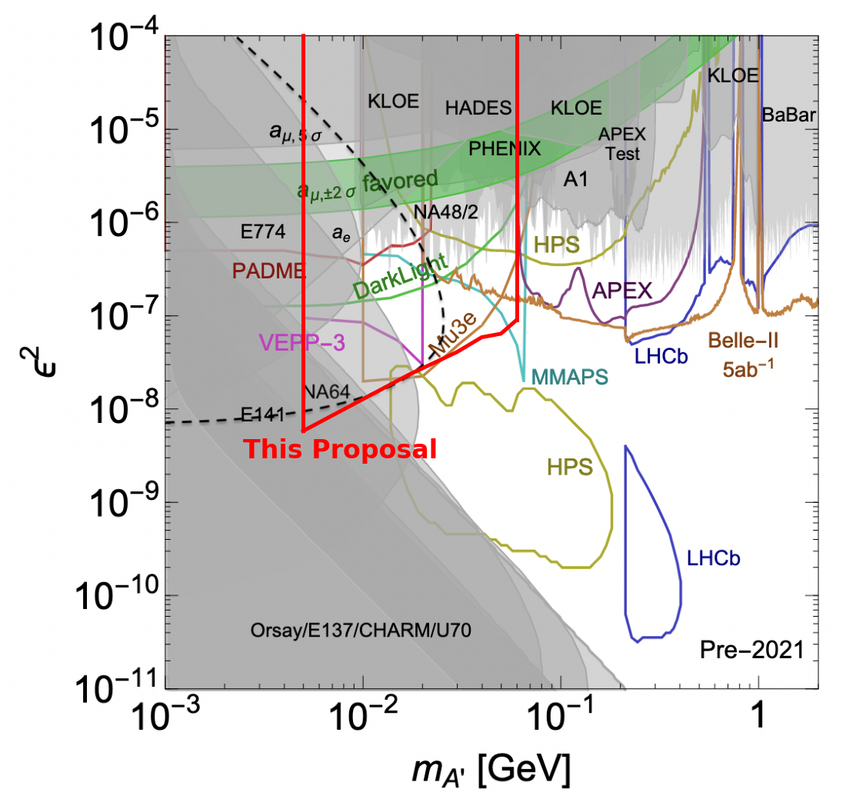
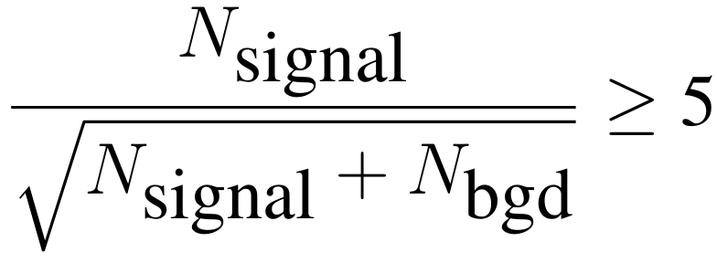
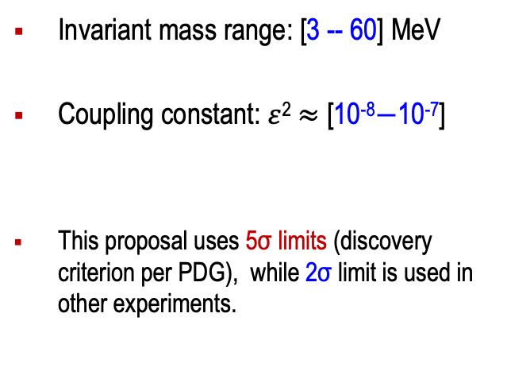
Physics Reach: Parameter Space ($ε$² vs. Mass)
Invariant mass range: [3 -- 60] MeV
Coupling constant: $ε$² $≈$ [10⁻⁸$−$10⁻⁷]
This proposal uses 5σ limits (discovery criterion per PDG), while 2σ limit is used in other experiments.

Slide 17
Current Status of the Experiment Preparation
Conceptual design of all beamline elements (including target) is finalized.
Engineering design is in active progress.
Refurbishment and testing of HyCal calorimeter started summer 2024.
Construction of two GEM detectors is on track at UVa:
  construction, late 2024;
  cosmic ray tests in JLab, starting Spring 2025.
DAQ electronics procured (based on fADC-250 modules), ready Spring 2025.
Work on cables and other experimental parts underway in Hall B at JLab.
Experiment is (very) tentatively scheduled for the Fall 2025.

Slide 18
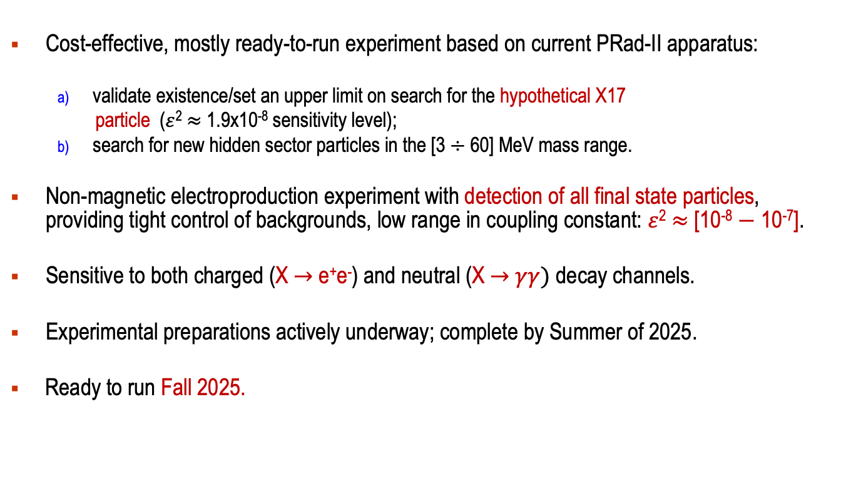
Summary and Outlook
Cost-effective, mostly ready-to-run experiment based on current PRad-II apparatus:
  validate existence/set an upper limit on search for the hypothetical X17
  particle ($ε$² $≈$ 1.9x10⁻⁸ sensitivity level);
  search for new hidden sector particles in the [3 $÷$ 60] MeV mass range.
Non-magnetic electroproduction experiment with detection of all final state particles, providing tight control of backgrounds, low range in coupling constant: $ε$² $≈$ [10⁻⁸ $−$ 10⁻⁷].
Sensitive to both charged (X $→$ e⁺e⁻) and neutral (X $→$ $γγ)$ decay channels.
Experimental preparations actively underway; complete by Summer of 2025.
Ready to run Fall 2025.

Slide 19
Backup Slides

Slide 20
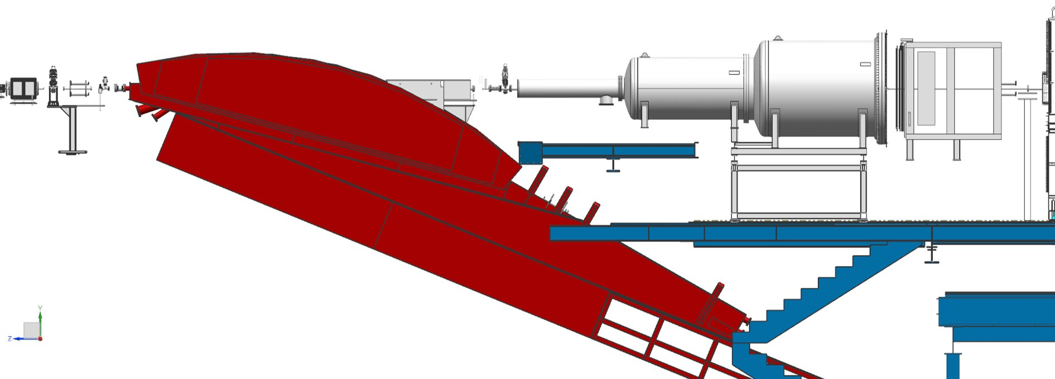
X17 Experimental Setup
Two collimators
X17 target will be installed on the harp stick.
Vacuum chamber
2 layers of GEM
Hybrid calorimeter (HyCal)
PRad target will be replaced by 1.7 m beam pipe
New collimator will be installed on before the tagger magnet
Hall-B protection collimator

Slide 21
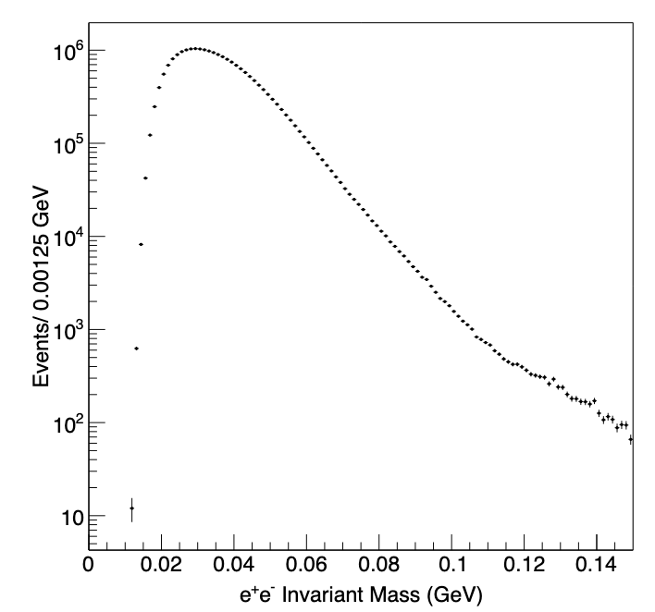
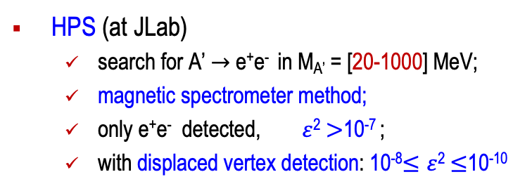
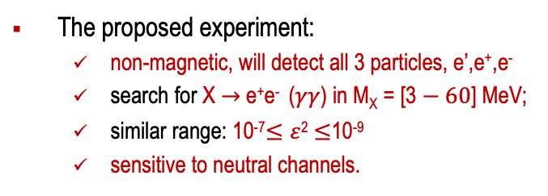
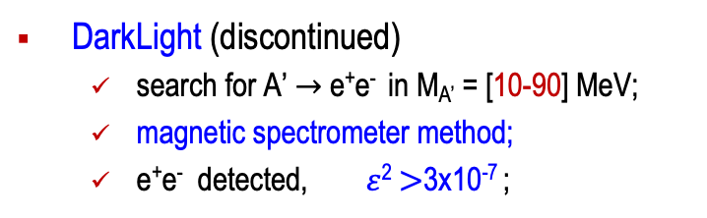
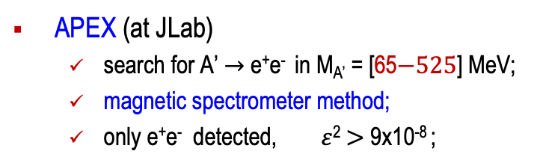
Other Similar Experiments/Projects at JLab
HPS (at JLab)
  search for A’ $→$ e⁺e⁻ in M_{A’} = [20-1000] MeV;
  magnetic spectrometer method;
  only e⁺e⁻ detected, $ε$² $>$10⁻⁷ ;
  with displaced vertex detection: 10⁻⁸$≤ε$² $≤$10⁻¹⁰
APEX (at JLab)
  search for A’ $→$ e⁺e⁻ in M_{A’} = [65$−525$] MeV;
  magnetic spectrometer method;
  only e⁺e⁻ detected, $ε$² $>$ 9x10⁻⁸ ;
HPS: [hep-ex] arXiv:1807.11530, 2018
DarkLight (discontinued)
  search for A’ $→$ e⁺e⁻ in M_{A’} = [10-90] MeV;
  magnetic spectrometer method;
  e⁺e⁻ detected, $ε$² $>$3x10⁻⁷ ;
The proposed experiment:
  non-magnetic, will detect all 3 particles, e’,e⁺,e⁻
  search for X $→$ e⁺e⁻ ($γγ$) in M_{X} = [3 $− 60$] MeV;
  similar range: 10⁻⁷$≤ε$² $≤$10⁻⁹
  sensitive to neutral channels.

Slide 22
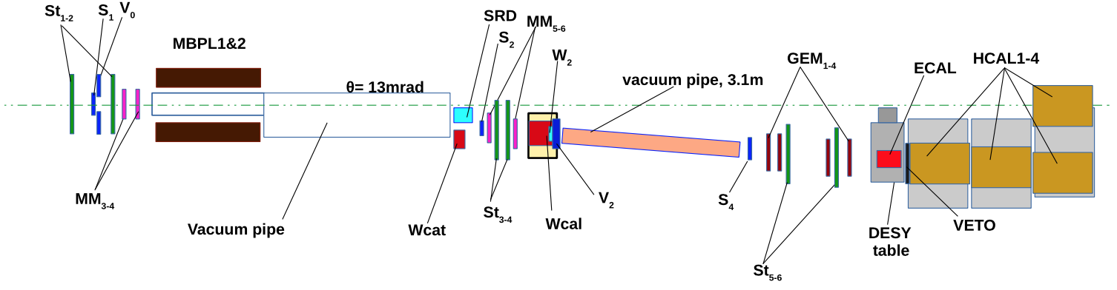
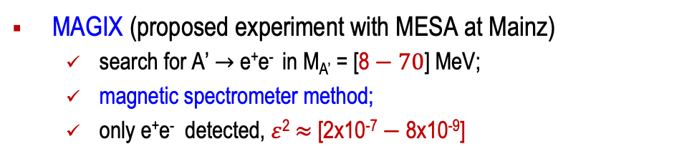
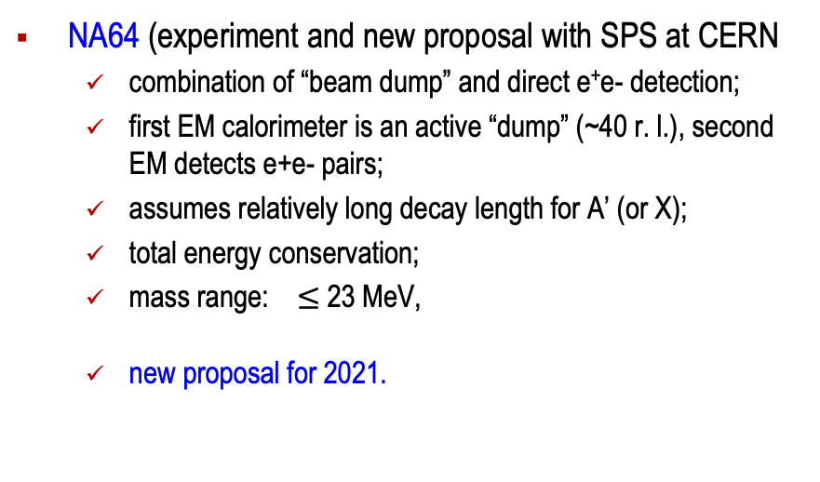
Other Similar Experiments/Projects
NA64 (experiment and new proposal with SPS at CERN
  combination of “beam dump” and direct e⁺e- detection;
  first EM calorimeter is an active “dump” (~40 r. l.), second EM detects e+e- pairs;
  assumes relatively long decay length for A’ (or X);
  total energy conservation;
  mass range: $≤$ 23 MeV,
  new proposal for 2021.
MAGIX (proposed experiment with MESA at Mainz)
  search for A’ $→$ e⁺e⁻ in M_{A’} = [8 $− 70$] MeV;
  magnetic spectrometer method;
  only e⁺e⁻ detected, $ε$² $≈$ [2x10⁻⁷ $−$ 8x10⁻⁹]

Slide 23
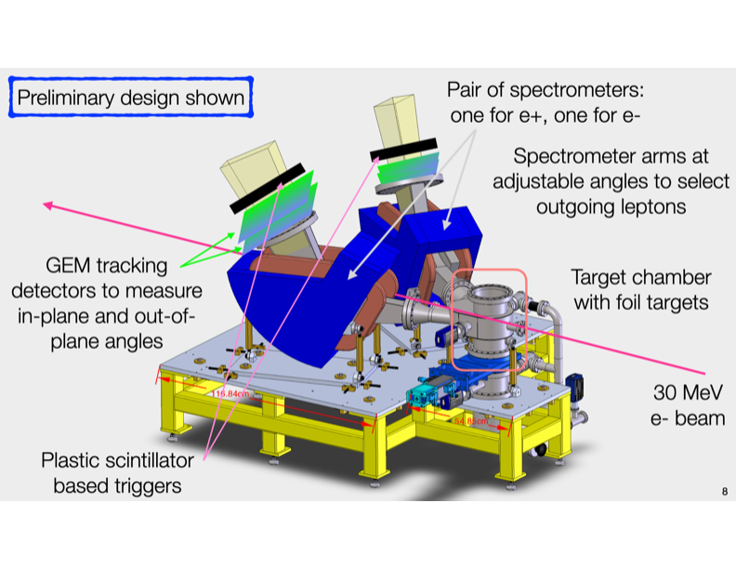
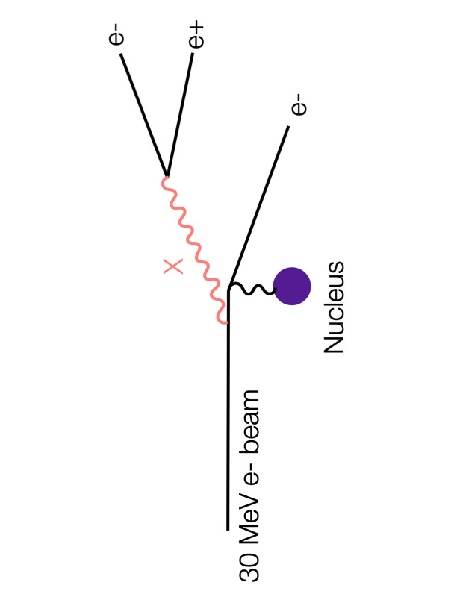
Other Similar Experiments/Projects
DarkLight X17 search at TRIUMF (2022-2026)
  30 MeV e⁻ beam

Slide 24
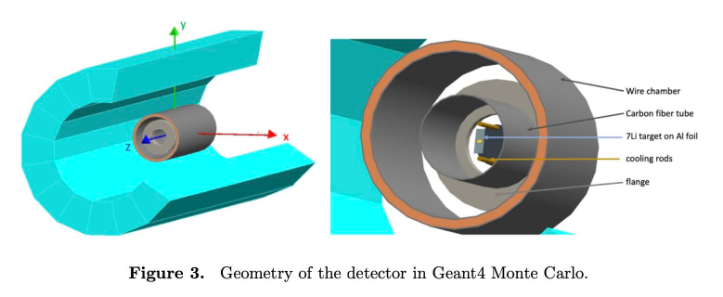
Other Similar Experiments/Projects (ATOMKI Type)
Montreal Tandem Project (2022-2023)
  Similar to ATOMKI ⁸Be experiment
MAGIX (proposed experiment with MESA at Mainz)
  search for A’ $→$ e⁺e⁻ in M_{A’} = [8 $− 70$] MeV;
  magnetic spectrometer method;
  only e⁺e⁻ detected, $ε$² $≈$ [2x10⁻⁷ $−$ 8x10⁻⁹]

Slide 25
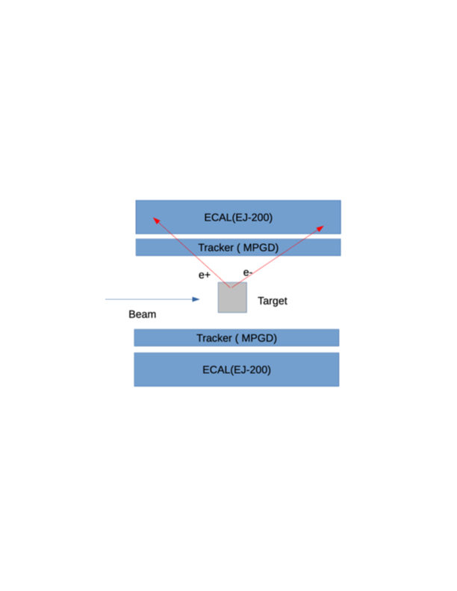
Other Similar Experiments/Projects (ATOMKI Type)
EAR2 with Neutron Beam Project at Torino, Italy (2023)

