Slide 1
JLab Eta Factory (JEF) experiment
Presented by
William J. Briscoe
The George Washington University
Washington DC
(Contributions from the collaboration)
The Jlab Eta Factory (JEF) is a GlueX endorsed experiment which is supported by the USDOE and NSF.
Spokespersons: Liping Gan - University of North Carolina at Wilmington
Alexander Somov – Jefferson Lab
Simon Taylor – Jefferson Lab
Zisis Papandreou – University of Regina

Slide 2
Challenges in Physics at the 1Gev Scale
Confinement QCD
Nature of QCD confinement
Relation to dynamical chiral symmetry breaking
Physics Beyond the Standard Model (BSM)
New sources of CP violation
Dark matter
Dark energy
η and ηꞌ decays provide sensitive probes to explore both fundamental issues

Slide 3
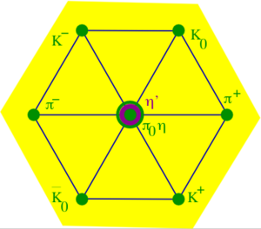

The η is a unique probe for QCD and BSM physics
The η is a Goldstone boson due to spontaneous breaking
of QCD chiral symmetry.
The η is key to bridging the understanding
of low-energy hadron dynamics and
underlying QCD.
Its strong and EM decays are forbidden in lowest order; it has a
narrow decay width (Γ_{η} = 1.3KeV compared to Γ_{ω}= 8.5 MeV)
    Enhances higher-order contributions (factor of ~7000
    compared to ω decays); sensitive to weakly interacting forces.
Eigenstate of P, C, CP, and G:
η provides tests of fundamental symmetries through rare decays
quantum numbers ~ the same as Higgs or vacuum (except for parity);
decays are flavor-conserving
effectively free of SM backgrounds in BSM searchs.

Slide 4
Rich η (ηꞌ) Physics
Standard Model Tests:
Chiral symmetry and anomalies
Extract η-ηꞌ mixing angle
Quark mass ratio
Theory inputs to HLbL for (g-2)_{μ}
QCD scalar dynamics
Fundamental Symmetry Tests:
C, CP violations
P, CP violations
Lepton flavor violations
BSM Physics in Dark Sector:
Vector bosons (B boson, dark photon and X boson)
Dark scalars
Pseudoscalars (ALPs)
BSM weak decays
Phys. Rept. 945 (2022) 1-105
Notes:
Hadron light by light HLbL ALP axion-like particles

Slide 5
Low-Energy QCD Symmetries and Light Mesons
QCD Lagrangian in Chiral limit (m_{q}→0) is invariant under group algebra:
Chiral symmetry SU_{L}(3)xSU_{R}(3) spontaneously breaks to SU(3)
  8 Goldstone Bosons (GB)
U_{A}(1) explicitly broken:
(Chiral anomalies)
  Γ(π⁰→γγ), Γ(η→γγ), Γ(η′→γγ)
  Non-zero mass of η₀
SU_{L}(3)xSU_{R}(3) and SU(3) are explicitly broken:
  GB are massive
  Mixing of π⁰, η, η′
  The π⁰, η, η′ system provides a rich laboratory to study the symmetry structure of QCD at low energies.

Slide 6
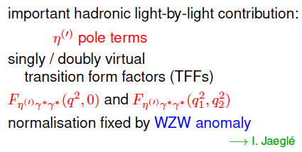
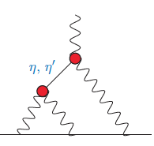

Transition Form Factor and ${(g−2)}_{μ}$
HLbL
*WZW - Wess–Zumino–Witten
Notes:
Wess–Zumino–Witten model Muon g − 2 experiment at Fermilab to measure anomalous magnetic dipole moment of the muon

Slide 7
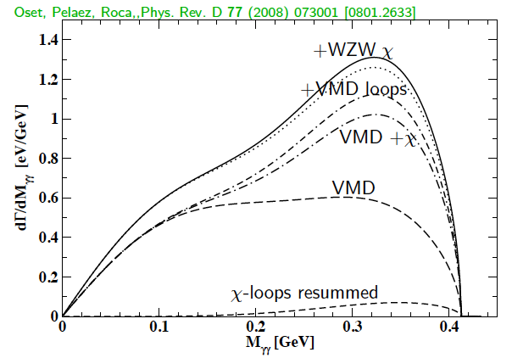
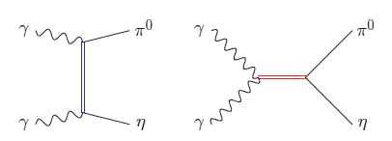
SM allowed η→π⁰γγ
Rare window to probe interplay of VMD & scalar resonances in
ChPT to calculate the chiral Lagrangian of O(p⁶)
Major contributions to η →π⁰γγ - two O(p⁶) counter-terms in chiral Lagrangian unique probe for high-order ChPT.
L. Ametller, J, Bijnens, and F. Cornet, Phys. Lett., B276, 185 (1992)
Shape of Dalitz distribution sensitive to role of scalar resonances.
LEC’s are dominated by resonances
Gasser, Leutwyler 84; Ecler, Gasser, Pich, de Rafael1989; Donoghue, Ramirez, Valencia 1989
a₀, a₂
ρ, ω
Notes:
Low-energy constants (LEC) VMD – Vector Meson Domance

Slide 8
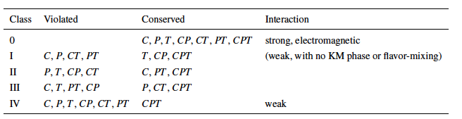
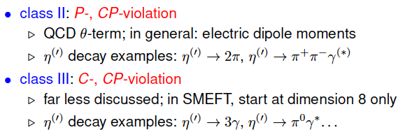
Discrete Symmetries
Class III has weaker experimental constraint, offer an opportunity for new physics search.
n.b. - Kobayashi–Masakawa (KM)
Notes:
Kobayashi–Masakawa (KM) phase

Slide 9
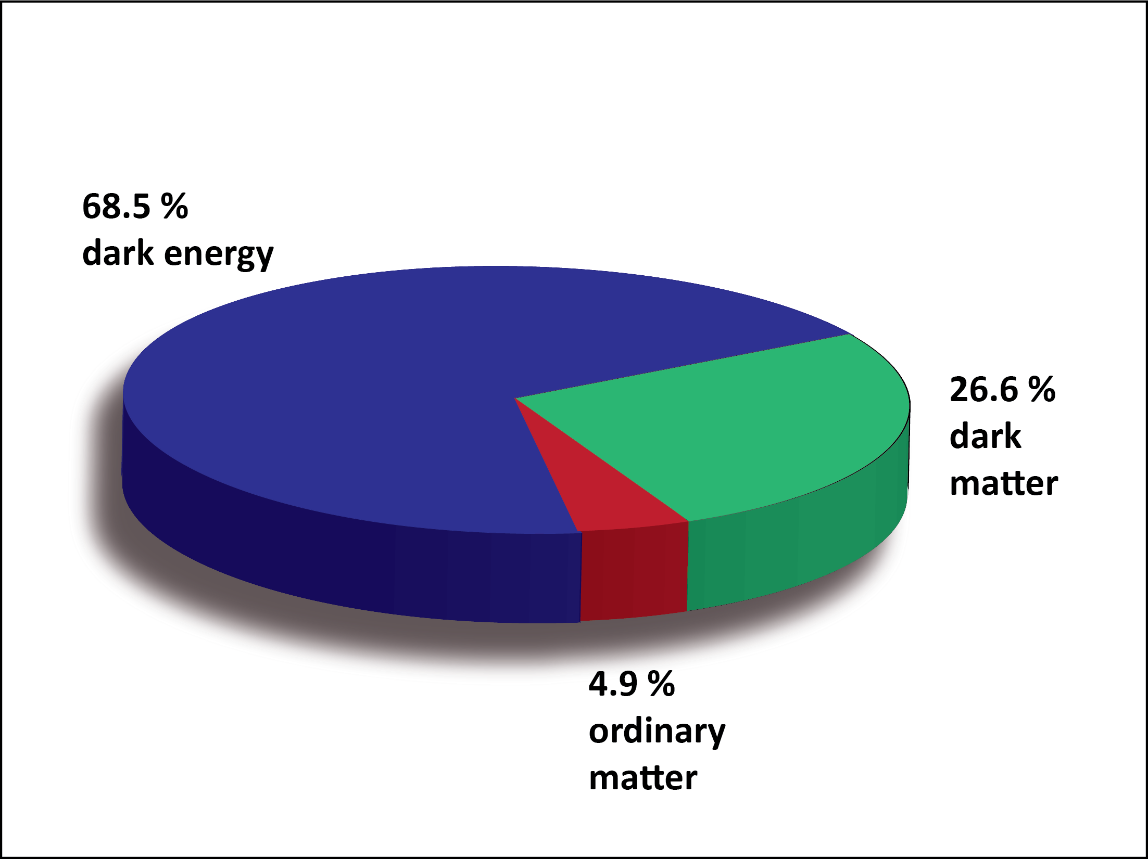
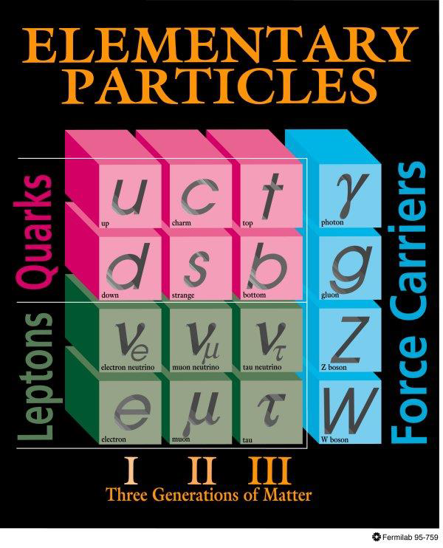
BSM Physics in Dark Sector
Dark Sector
New gauge forces, bosons and fermions beyond SM.
The stability of dark matter can be explained by the dark charge conservation.
Look for portals between SM and DM

Slide 10
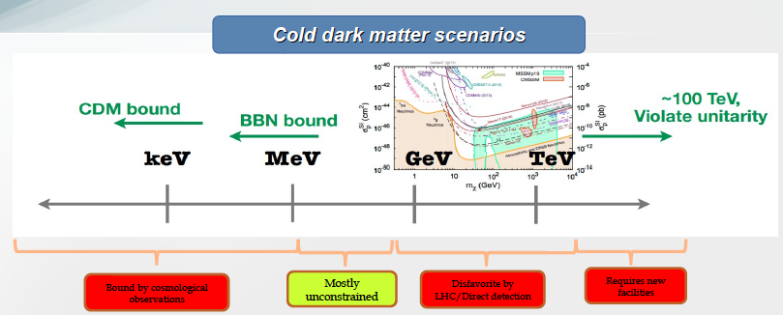
Where to Search in the Dark Sector?
Sub-GeV region represents a good discovery opportunity
BBN - big bang nucleosynthesis
CDM - cold dark matter

Slide 11
JLab Eta Factory (JEF) Experiment
FCAL-II
Simultaneously produce η/ηꞌ on LH₂ target with 8.4-11.7 GeV tagged photon beam via γ+p → η/ηꞌ+p so decay products get forward boost.
Reduce non-coplanar backgrounds by detecting recoil protons with GlueX detector.
Upgraded Forward Calorimeter with High resolution, high granularity
PWO insertion (FCAL-II) to detect multi-photons from the η/ηꞌ decays.
The GlueX detector will detect charged products from the η/ηꞌ decays
11

Slide 12
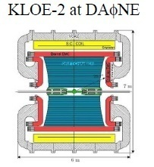
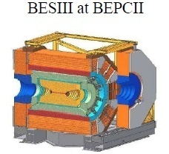
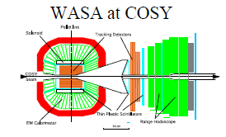
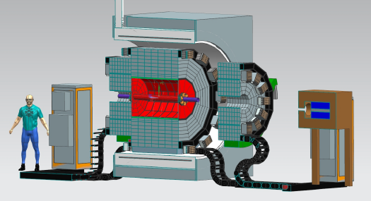
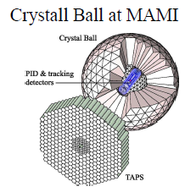
World Competition in η Decays
e⁺e⁻ Collider
Proposed REDTOP
Fixed-target
hadroproduction
CBELSA/TAPS at ELSA
JEF at JLab
Photoproduction

Slide 13
Uniqueness of JEF Experiment
Large background suppression compared to other experiments:
a) η/η’ energy boost; b) FCAL-II; c) exclusive detections
JEF: γp→ηp (E_{γ}=8.4-11.7 GeV)
1 day’s running
Signal+backgrounds
η→π⁰γγ signal
η →π⁰π⁰π⁰ background
other backgrounds
N.B. No 2pi0 background
included – will be
added soon.
2. Capability of running in parallel with GlueX and other experiments in Hall D
high-statistics data set
3. Simultaneously produce tagged η and ηꞌ with similar rates

Slide 14
Estimated Design Production Rate
JEF for 100 days of beam:
 | η | η’
Tagged mesons | ~5 x 10⁷ | ~ 5 x 10⁷
Previous Experiments:
Experiment | Total η | Total η’
CB at AGS | 10⁷ | -
CB MAMI-B | 2x10⁷ | -
CB MAMI-C | 6x10⁷ | 10⁶
WASA-COSY | ~3x10⁷ (p+d), ~5x10⁸ (p+p) | -
KLOE-II | 3x10⁸ | 5x10⁵
BESIII | ~10⁷ | ~5x10⁷
JEF offers a competitive η/η’ production rate with cleaner backgrounds.
New estimates are in progress using more up to date cross sections.

Slide 15
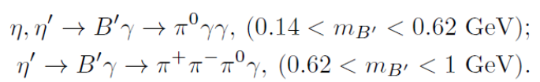

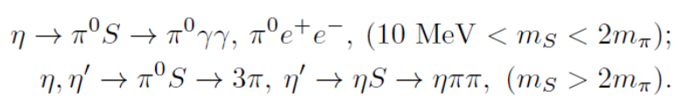





Main JEF Physics Objectives
1. Search for sub-GeV hidden bosons
vector:
    Leptophobic vector B ꞌ
    Hidden or dark photon:
scalar S:
Axion-Like Particles (ALP):
2. Directly constrain CVPC new physics:
3. Precision tests of low-energy QCD:
  Interplay of VMD & scalar dynamics in ChPT:
  Transition Form Factors of η⁽ꞌ⁾ :
4. Improve the quark mass ratio via Dalitz distributions of η→3π
$$η^{(′)}→3γ,{ η}^{(′)}→2π^{0}γ,{ η}^{(′)}→π^{+}π^{−}π^{0}$$
Notes:
C violating, P conserving reactions (CVPC)

Slide 16
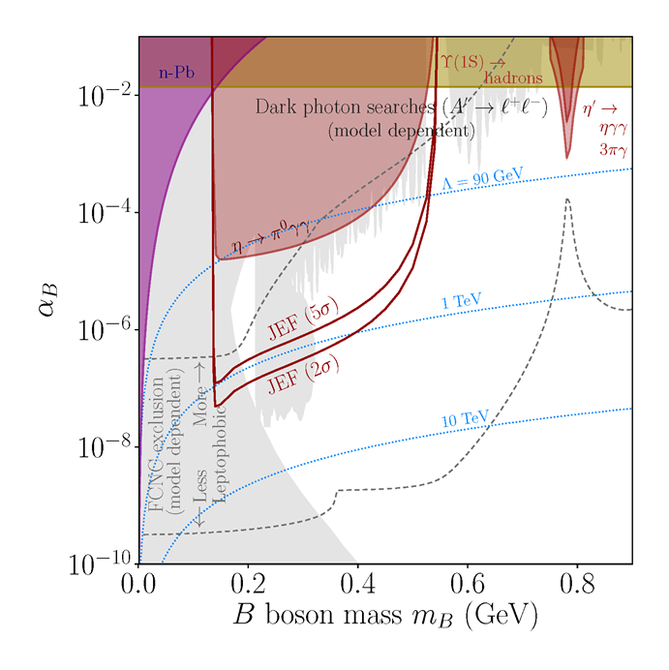
Preliminary Estimate of JEF Experimental
Reach for B’
Search for leptophobic dark B’ boson coupled to baryon number; complementary to searches for a dark photon
η→ B’γ →π⁰γγ
B’
γ
200 days’ beam
PL, B221, 80 (1989)
PR,D89,114008

Slide 17
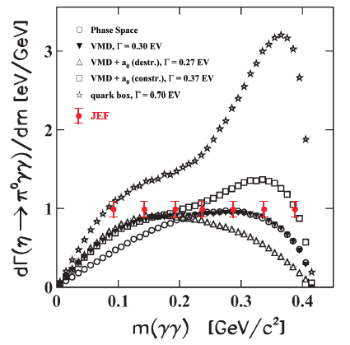
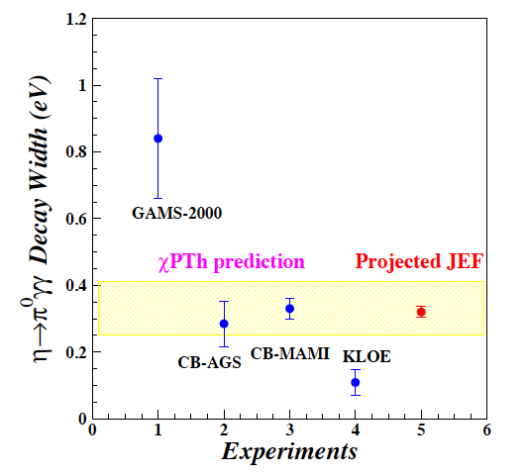
Projected* JEF on SM Allowed η→π⁰γγ
J.N. Ng and D.J. Peters, Phys. Rev. D47, 4939
χPTh by Oset et al., Phys. Rev. D77, 073001
(200 days’ beam)
We measure both BR and Dalitz distribution
model-independent determination of two LEC’s of the O(p⁶) counter-terms
probe role of scalar resonances to calculate other unknown O(p⁶) LEC’s
* N.B. New estimated projections are underway and will be ready for proceedings
Notes:
Low-energy constants (LEC)

Slide 18
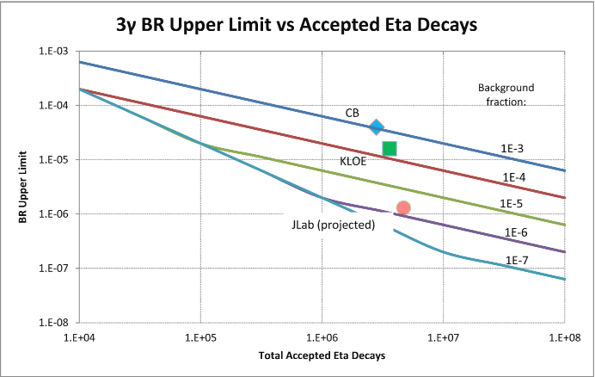
Estimated Experimental Improvement on C-violating η→3γ
SM contribution:
BR(η→3γ) <10⁻¹⁹ via P-violating
weak interaction.
A calculation due to new
physics by Tarasov suggests:
BR(η→3γ)< 10⁻²
Sov.J.Nucl.Phys.,5,445 (1967)
Proj. JEF
(200 days’ beam)
Aim to Improve BR upper limit by about an order of magnitude to tighten constraint on CVPC physics

Slide 19
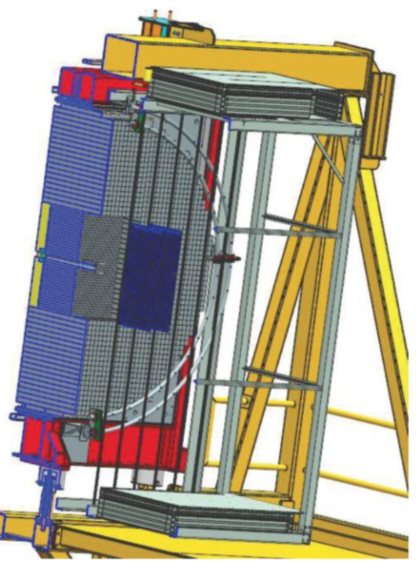
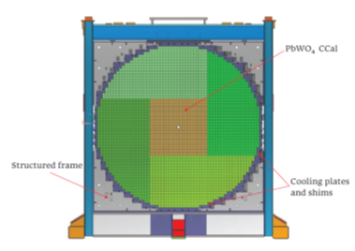
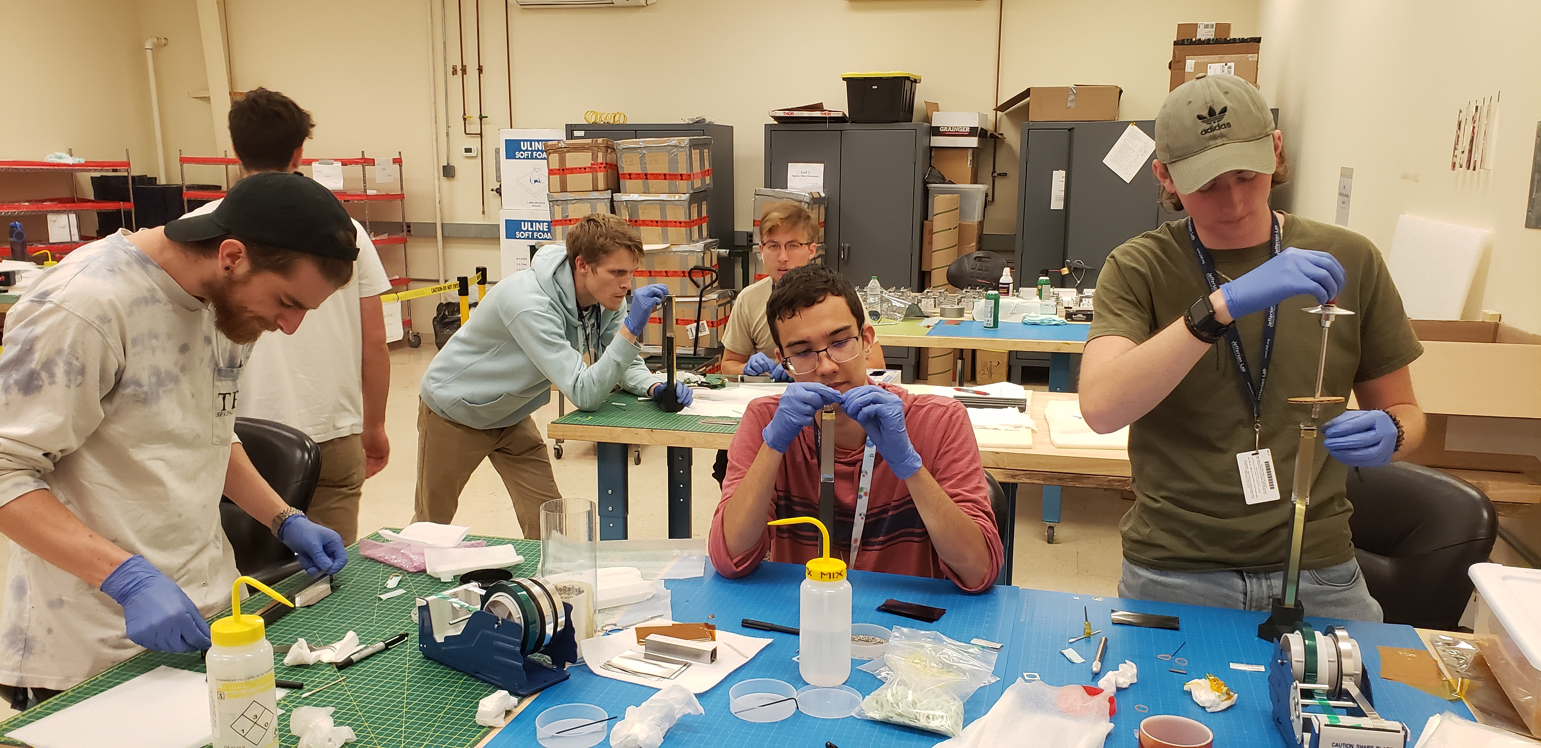
Current Status of the JEF Experiment
Non-rare decay data has been collecting with GlueX since 2016.
Upgraded FCAL-II with new PWO insert.:
  Production of the 1600 PWO modules is complete.
  Installation into the upgraded FCAL-II is almost complete.
  Testing in progress and will be completed this fall (2024).
PWO module
Undergraduate workforce
(2x2x20 cm³)
  Rare decay data with FCAL-II expected in Spring 2025.

Slide 20

Summary
12 GeV tagged photon beam with GlueX offers a unique η/ηꞌ factory to test SM and search for new BSM physics, with background reduction in the neutral rare decay mode.
New estimated projections are underway and will be ready for proceedings
Simultaneously measure η/η’ decays with physics goals to:
  Search for sub-GeV hidden bosons: vector, scalar, and ALP
  Directly constrain new CVPC physics
  Precision tests of low-energy QCD: role of scalar dynamics in ChPT; transition form factors of η/η’ to calculate HLbL contributions in (g-2)_{μ}
  Improve light quark mass ratio via η→3π, ηꞌ→3π
Data collection for non-rare decays on-going with GlueX since 2016.
Rare decays require upgraded FCAL-II with PWO insert.
Installation almost complete & testing in progress; complete Fall 2024.
Data taking starts in Spring 2025.
Scan for acknowledgments

