Slide 1
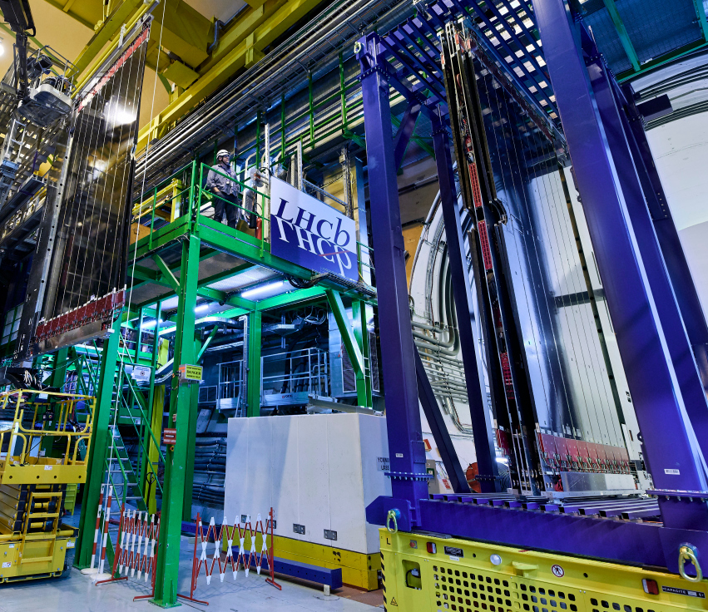
Exotic Hadrons from LHCb
Misha MIkhasenko
on behalf of LHCb
Meson 2023, Krakow

Slide 2
LHCb experiment
1630 members (1118 authors)
96 institutes (21 countries)
An experiment on LHC (symmetric pp collision)
Forward spectrometer: 2 < η < 5
Excellent vertex reconstruction, track reconstruction, particle identification
[LHCb proposal], [Perform. paper]
High statistics: $3{\text{fb}}^{−1}+6{\text{fb}}^{−1}$(Run-1+2)
Upgrade I is finished, currently taking data (Run3)
$\sim 50 {\text{fb}}^{−1}$ is expected by 2032

Slide 3
QCD variety
[Midjourney 2023, MM]

Slide 4
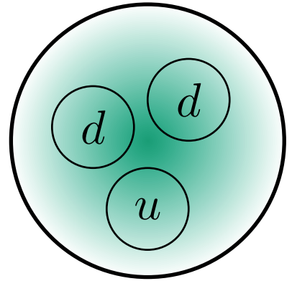
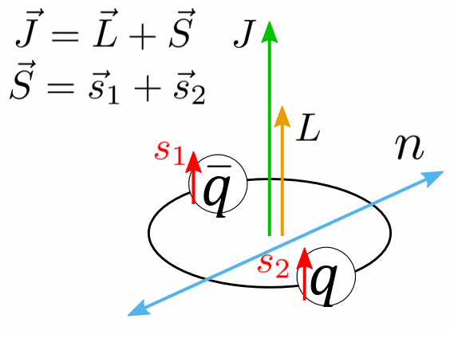
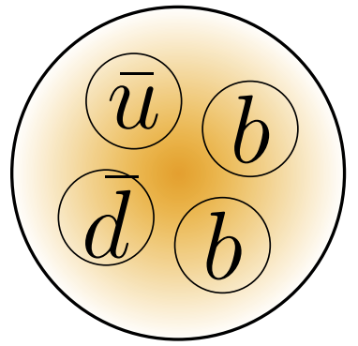
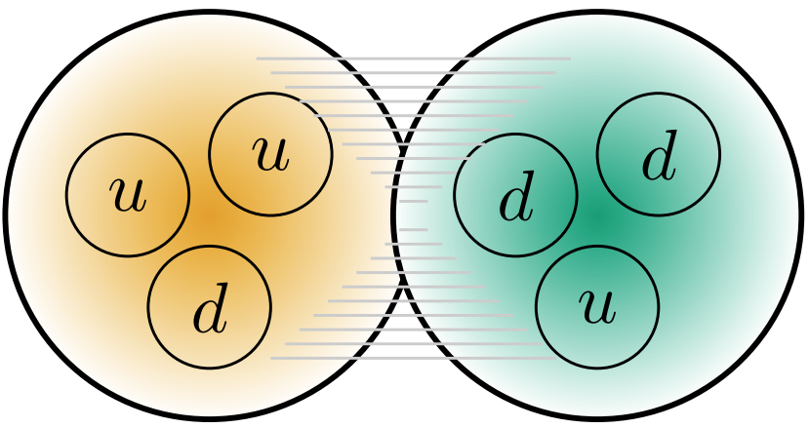
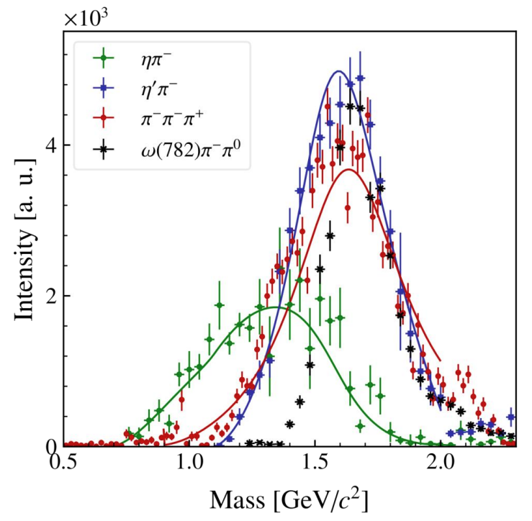
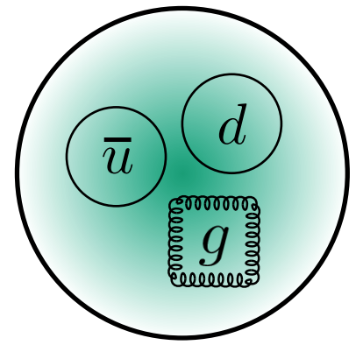
Possible configurations of hadrons
Conventional Quark Model: $\left(q\overline{q}, qqq\right)$
Bigger Quark Model $\left(q\overline{q}q\overline{q}, qqqq\overline{q}, …\right)$
Conventional Hadronic Molecules = Nuclei: $\left(qqq\right)\left(qqq\right)$
Heavy-Flavor Hadronic Molecules: $\left(Qqq\right)\left(Qqq\right)$, $\left(Q\overline{q}\right)\left(Qqq\right)$, …
Admixed Molecules: $q\overline{q}→\left(q\overline{q}\right)\left(q\overline{q}\right)$
Hybrids: $q\sim g\sim \overline{q}$
Glueballs: $g\sim g$
+ excitations
+ nuclei chart
$$J^{PC}=1^{−+}$$
[BESIII data]
[B-G analysis]
$$J/ψ→γG(→ππ)$$
[JPAC analysis]
[P.Haas, HADRON2023]
[D. Spülbeck, B3 / 194]
Solution 1
Solution 2

Slide 5
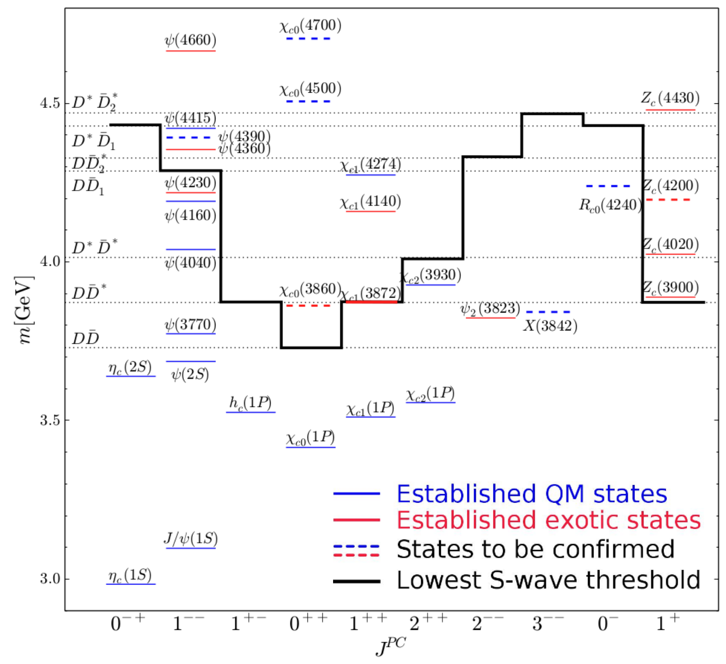
QM states and thresholds
An example: charmonium spectrum
[A.Nefediev talk, MIAPbP2023]
Most of hadrons are not isolated:
near hadron-hadron threshold,
e.g. $q\overline{q}→\left(q\overline{q}\right)\left(q\overline{q}\right)$,
hadronic states are coupled to hadron-hadron continuum
Molecule component: a part of the state wave function is $\left(q\overline{q}\right)\left(q\overline{q}\right)$

Slide 6
How molecule is often a good model
Transition: bound state $→$ virtual state $→$ resonance. No fundamental difference
The state is mostly molecular in vicinity of the threshold
[GitHub/mmikhasenko]

Slide 7
Tetraquarks
[Midjourney 2023, MM]

Slide 8
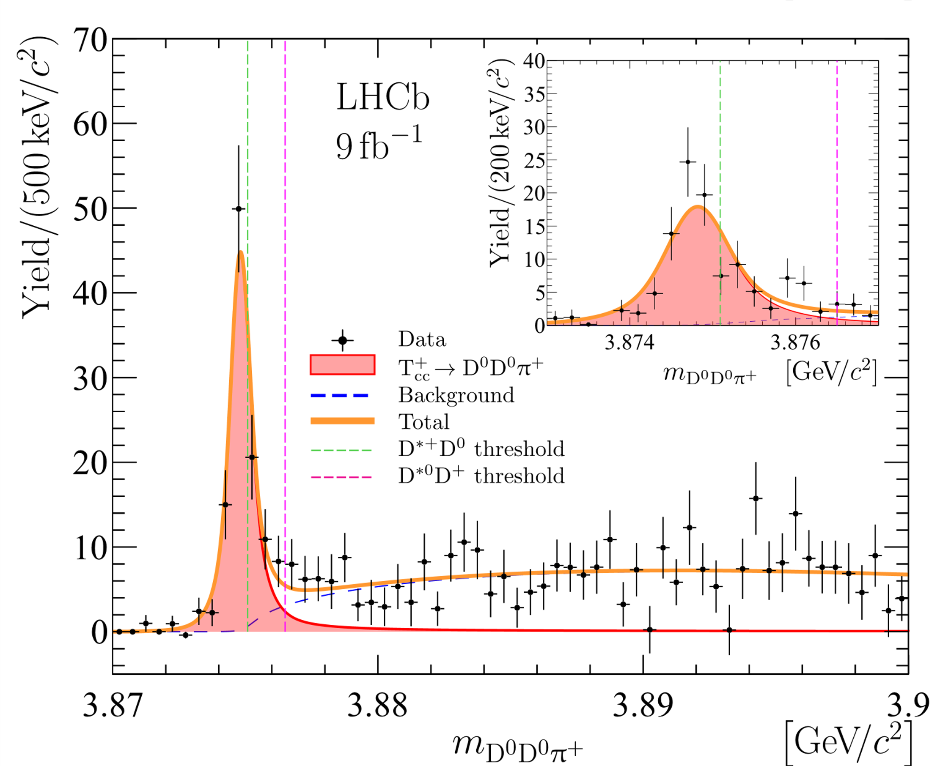
Observation of $T_{cc}^{+}$
[LHCb, NP 18 (2022) 751-754]
BW fit
Peak in ${D^{0}D}^{0}π^{+}$ just below ${D^{∗+}D}^{0}$ threshold
~190 signal events, high significance
Extremely narrow, ~300keV (resolution)

Slide 9
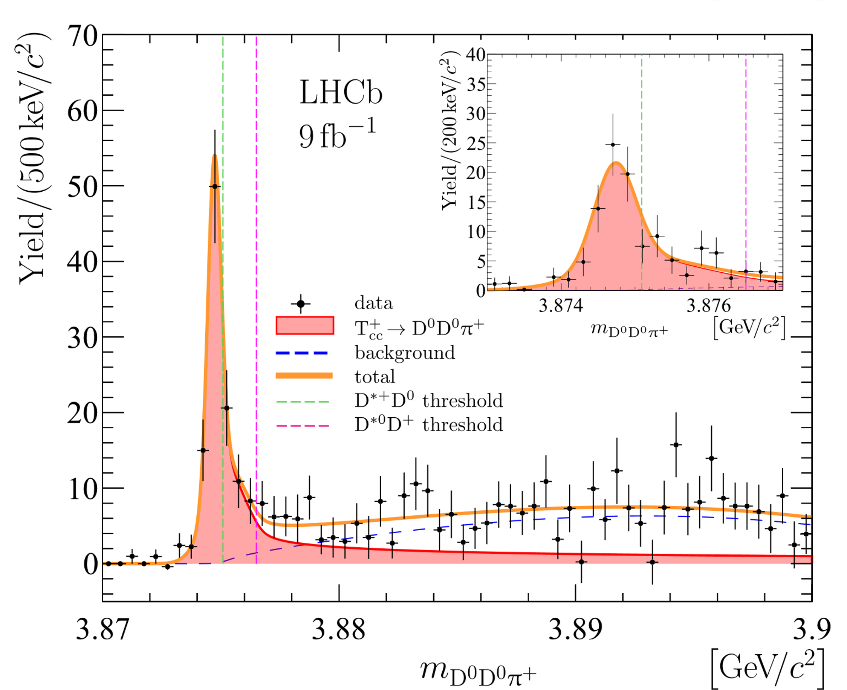
Studies of $T_{cc}^{+}$
[LHCb, NC 13 (2022) 3351]
Default fit
QN: isoscalar ($I=0$), axial ($J^{PC}=1^{++}$)
Coupled channel model
${D^{∗+}D}^{0}+{D^{∗0}D}^{+}$
$→{{\{D}^{0}D}^{0}π^{+}$, ${D^{0}D}^{+}π^{0}$, ${D^{0}D}^{+}γ\}$
Yields pole parameters:
Binding energy: $−360±{40}_{−0}^{+4}$ keV
Width: $48±2_{−14}^{+0}$ keV

Slide 10
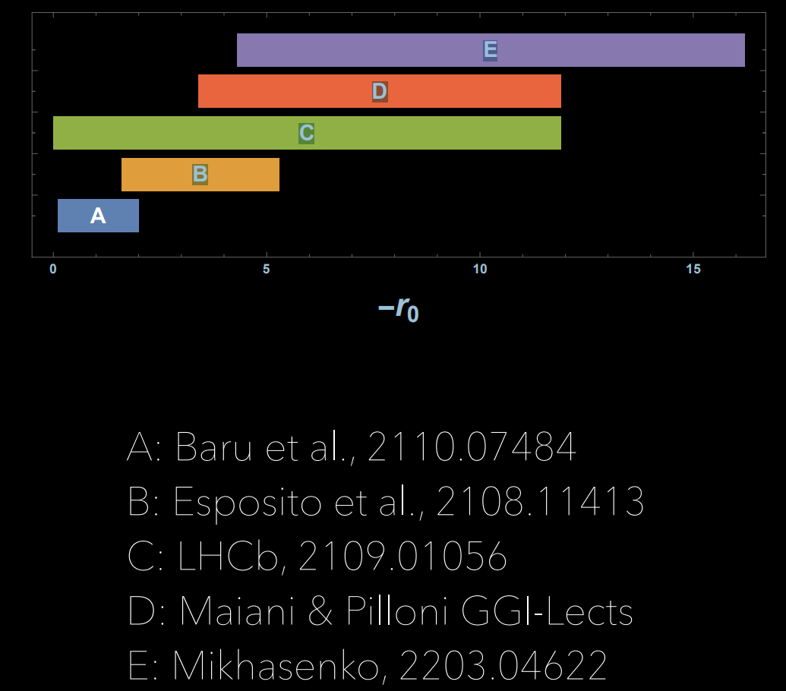
Effective range discussion
[A.Polosa talk, HADRON 2023]
Scattering parameters (a,r) gives simplified description of the amplitude near threshold.
Scattering length is well constrained by the binding energy
Limit is set in the effective range (related to the width)
High Weinberg compositeness is obtained

Slide 11
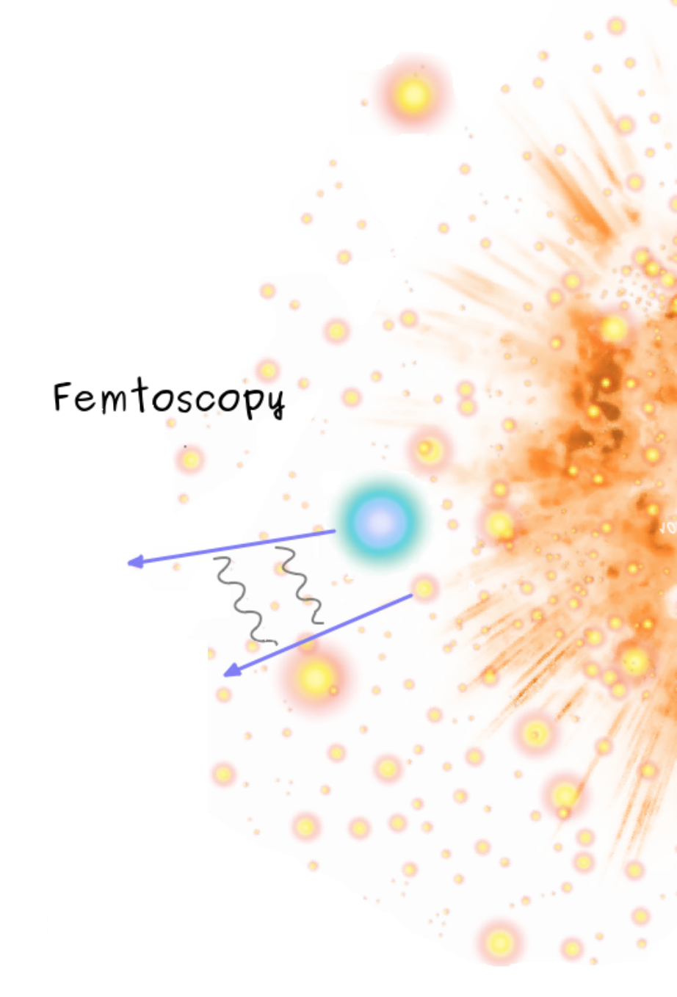
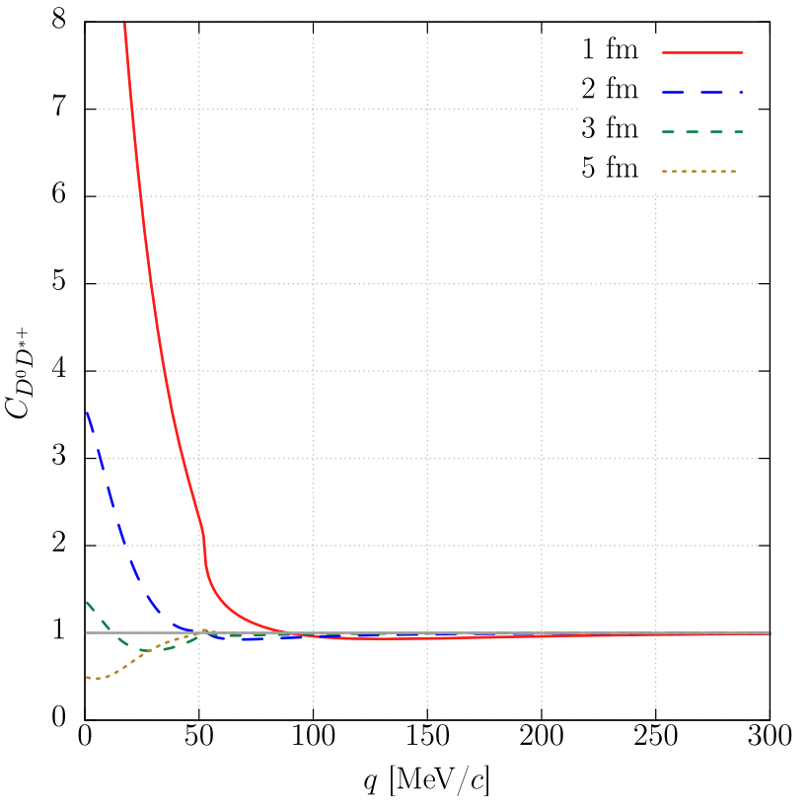
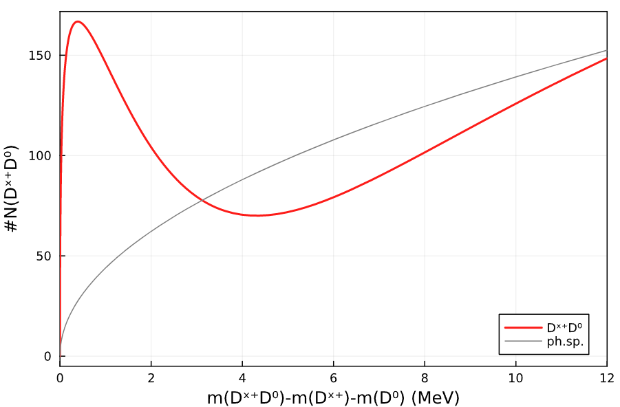
Discussion on production
On-shell $D^{∗+},$ $D^{0}$ produced independently may experience residual $T_{cc}^{+}$-interaction
[Kamiya et al., Eur.Phys.J.A 58 (2022) 7, 131]
[Vidaña et al., 2303.06079]
$$C(m_{{D^{∗+}D}^{0}})=\frac{\#N({D^{∗+}D}^{0})}{{\#N}_{mix}({D^{∗+},D}^{0})}$$
[GitHub/mmikhasenko]
[Image credit Wioleta Rzęsa talk]

Slide 12
New class of hadrons $QQ\overline{q}\overline{q}$
$$J^{P}=1^{+}$$
$$J^{P}=0^{+}$$
[Karliner, Rosner 1707.07666]
Decay strongly/el.mag.
$$bb\overline{u}\overline{d}$$
stable*
$$bc\overline{u}\overline{d}$$
stable*
Decay weakly
distance from threshold
nearly stable
$$cc\overline{u}\overline{d}$$
$$cs\overline{u}\overline{d}$$
resonance (?*)
$$ss\overline{u}\overline{d}$$
resonance*
* not yet observed

Slide 13
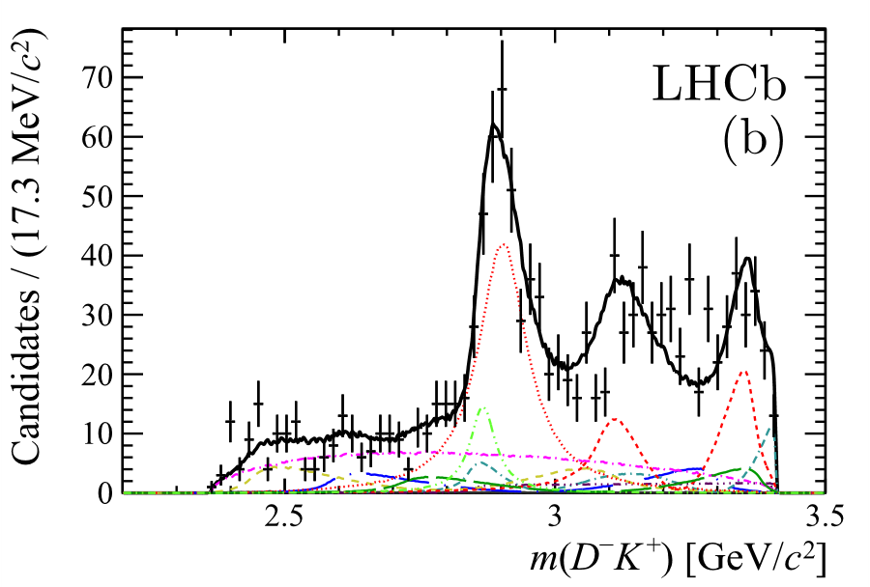
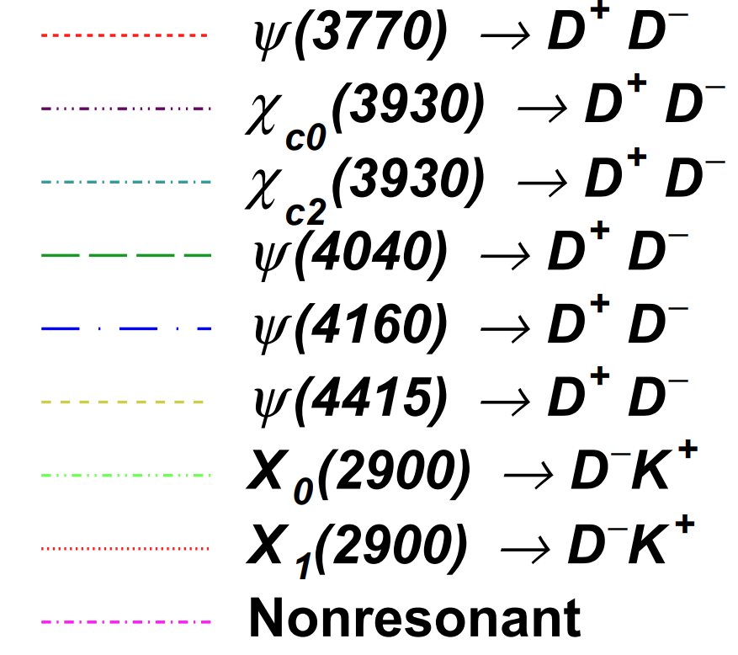
Resonance in $D^{−}K^{+}$
[LHCb, PRD 102 (2020) 112003, PRL 125 (2020) 242001]
$$B^{+}→D^{+}D^{−}K^{+}$$
Three body decay of $B^{+}$ (1374 cand. for R1&2)
Many $D^{+}D^{−}$ resonances
Structure at ~8.5 GeV²
Both quantum numbers $J^{P}=1^{−}$and $0^{+}$ are required in the fit
$$T_{cs}^{0}(cs\overline{u}\overline{d})$$
isoscalar, the lowest $J^{P}=0^{+}$

Slide 14
Surprising enhancement at 2.9 GeV
$B^{0}→{\overline{D}}^{0}$($D_{s}^{+}π^{−}$)
[LHCb, 2212.02716]
$B^{+}→D^{−}$($D_{s}^{+}π^{+}$)
[LHCb, 2212.02716]
$$T_{cs}^{0}(c\overline{s}d\overline{u})$$
$$T_{cs}^{0}(c\overline{s}u\overline{d})$$

Slide 15
Pentaquarks
[Midjourney 2023, MM]

Slide 16
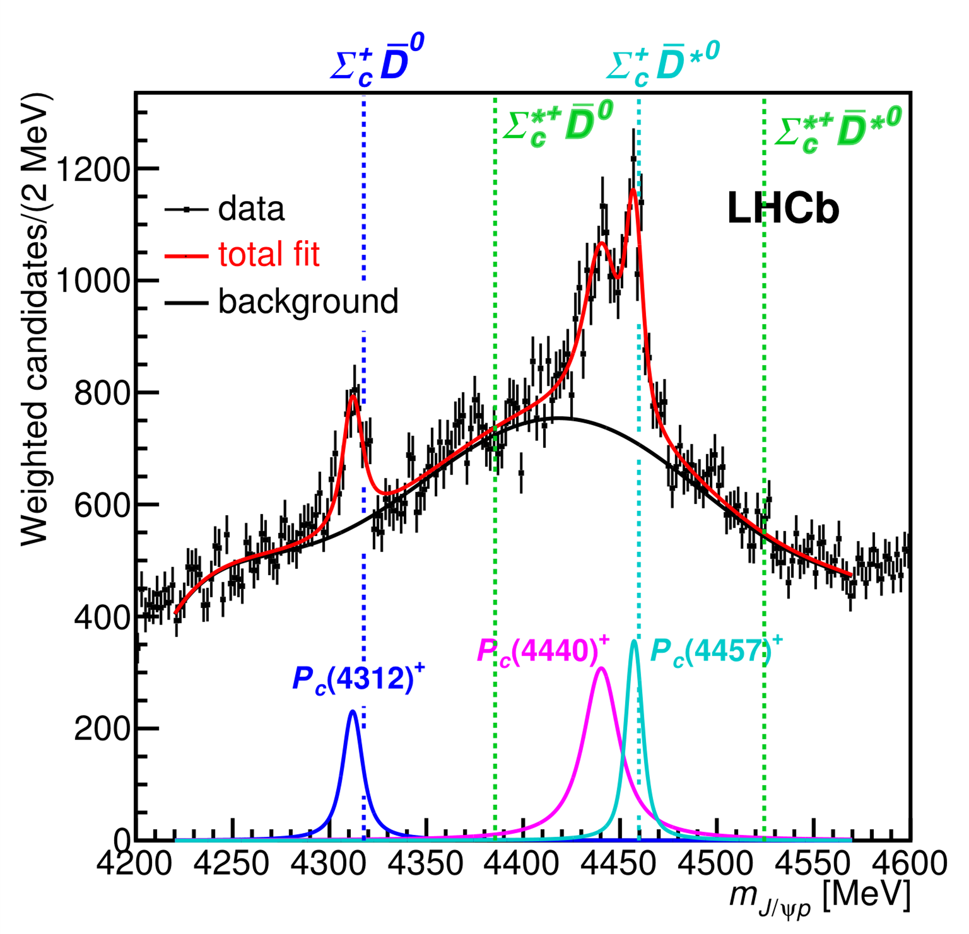
Famous Pentaquarks
$Λ_{b}^{0}→K^{−}(p J/ψ$)
Near threshold
Multiplicity matches threshold spin algebra
QM states are complex and unknown
[LHCb, PRL 122 (2019) 22, 222001]
[LHCb, PRL 115 (2015), 072001]

Slide 17
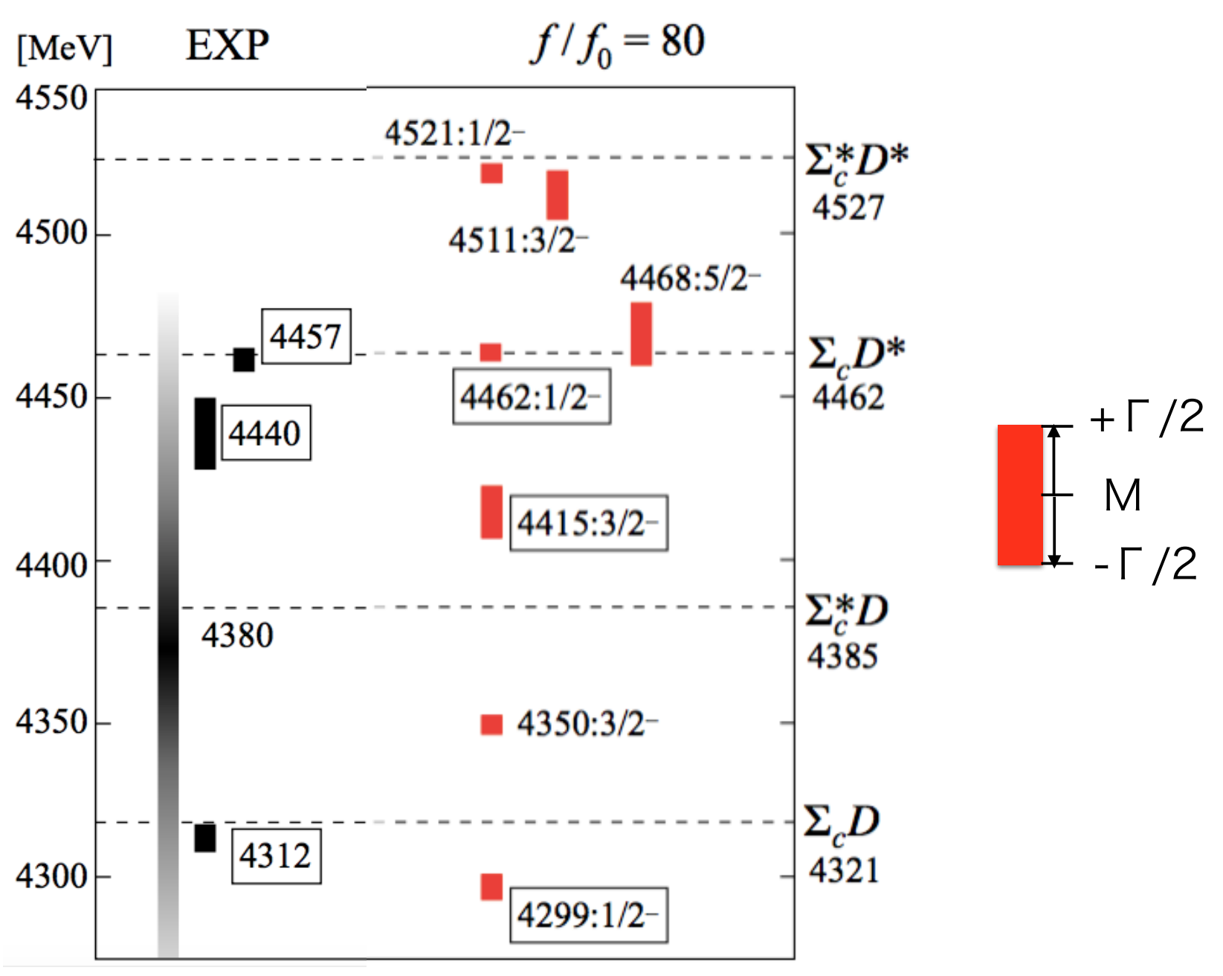
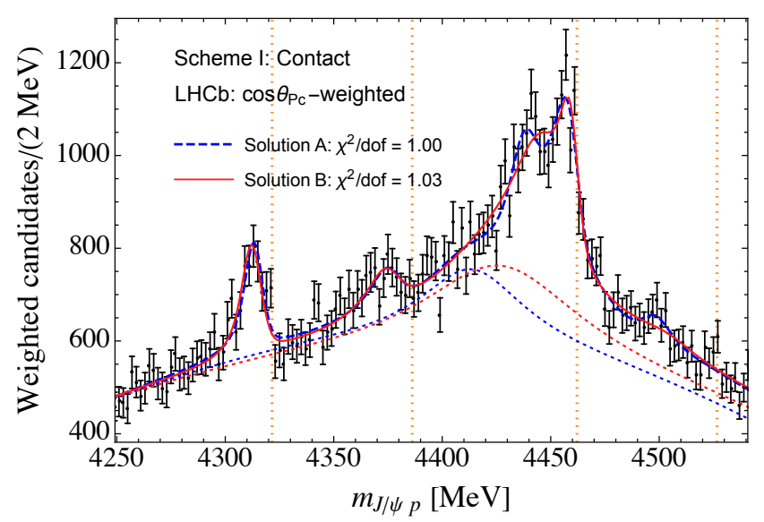
A potential model
As an example, molecule spectrum of$P_{c\overline{c}}^{+}$. It explicitly includes:
Contact $V_{5q}+$ One-pion exchange $V_{π}$
Tensor interaction is important
[Meng-Lin Du et al., JHEP 08 (2021) 157]
describes the projection
with coupled-channel model
Full-dim. fit is the next step
[Yamaguchu et al., 2303.06079]

Slide 18
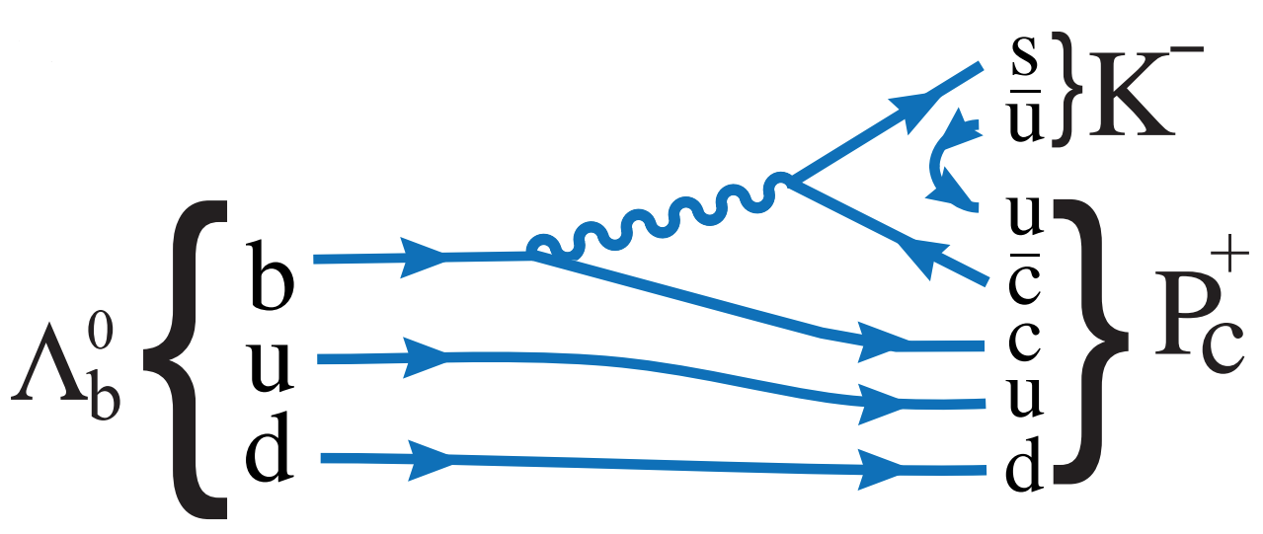
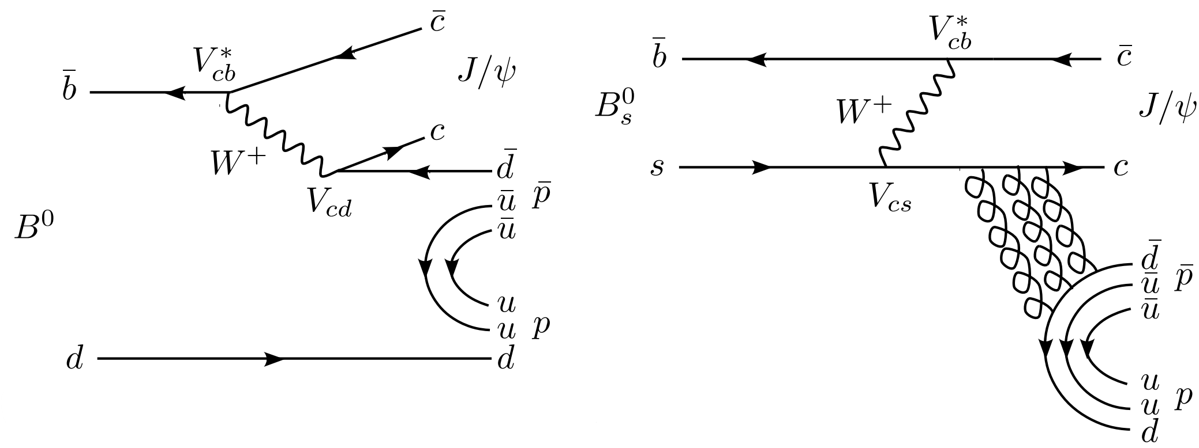
Exploration of similar final states
$$Λ_{b}^{0}→{J/ψK}^{−}p$$
(2015,2019)
$$Σ_{b}^{0}→{J/ψK}^{−}p$$
$$B_{(s)}^{0}→J/ψp\overline{p}$$
(2021)
more diff. to produce
$$B^{−}→J/ψΛ\overline{p}$$
$$Ξ_{b}^{−}→{J/ψK}^{−}Λ$$
smaller ph.sp
(2022)
(2021)
$$Ω_{b}^{−}→{J/ψK}^{−}Ξ^{0}$$
$$B_{s}^{0}→J/ψΛ\overline{Λ}$$

Slide 19
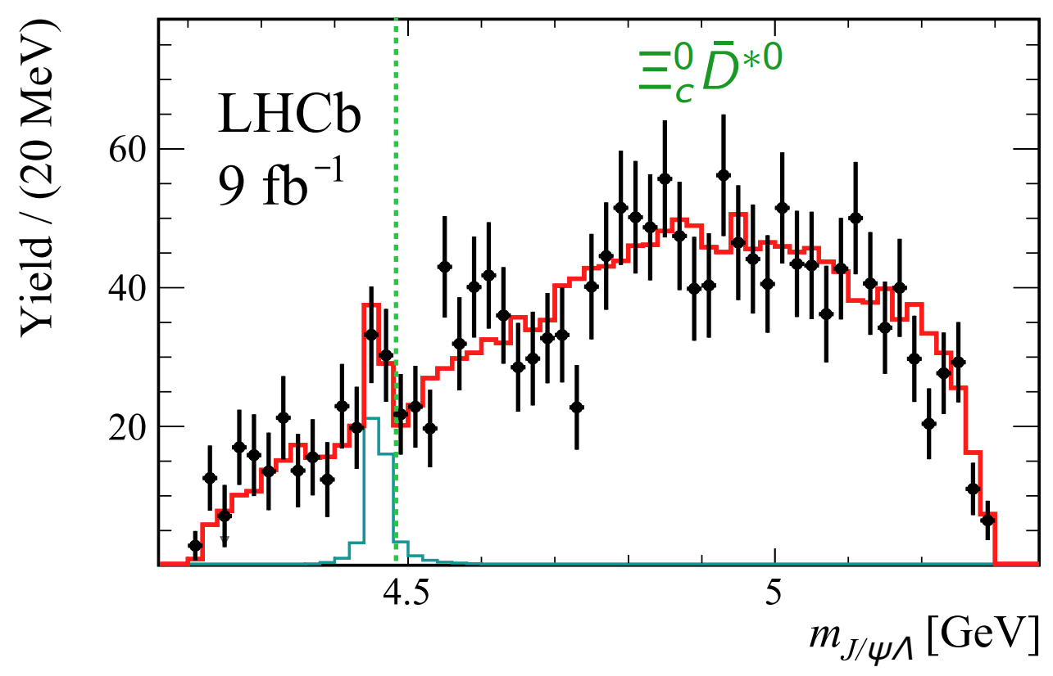
Strange Partner-I*
$$Ξ_{b}^{−}→{J/ψK}^{−}Λ$$
[LHCb, Sci.Bull. 66 (2021) 1278-1287]
The $Ξ_{b}^{−}$ decay amplitude built as
${ Ξ}_{b}^{−}→{J/ψΞ}^{∗∗−}$ (dominant)
$J/ψΛ$ resonance near $Ξ_{c}^{0}{\overline{D}}^{∗0}$ threshold caused by discrepancy for large ${(K}^{−}Λ)$ mass
If two states, 1/2, 3/2, they cannot be resolved.

Slide 20
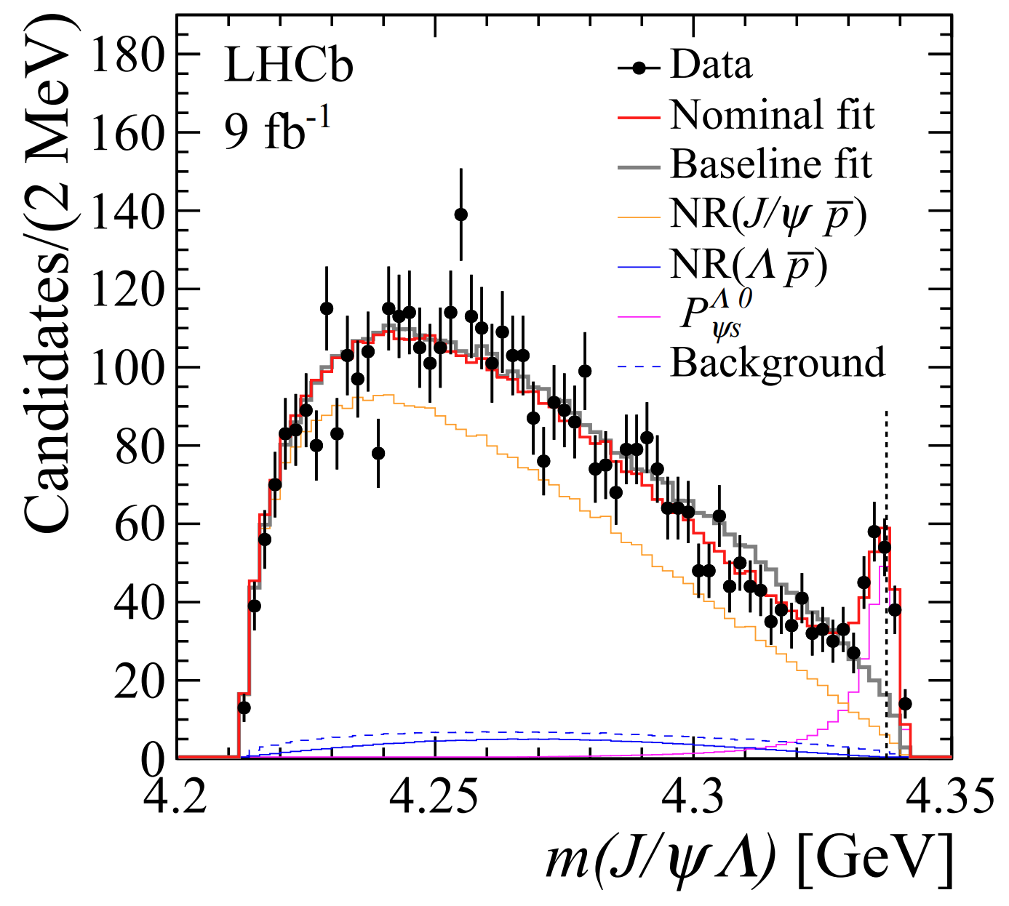
Strange Partner-II*
$$B^{−}→(J/ψΛ)\overline{p}$$
[LHCb, 2210.10346 ]
Prominent peak near $Ξ_{c}\overline{D}$ threshold
0.8±0.7 MeV above $Ξ_{c}^{+}D^{−}$
2.9±0.7 MeV above $Ξ_{c}^{0}{\overline{D}}^{0}$
$J^{P}={1/2}^{−}$ is preferred
Aligned with $Ξ_{c}^{+}D^{−}$ molecule

Slide 21
LHCb Run3 and Outlook
[Midjourney 2023, MM]

Slide 22
Planned schedule
Today
[W. Altmannshofer, F. Archilli, 2206.11331]

Slide 23
Conclusion
QM states and molecular components are closely connected:
QM state may look like a pure molecule when appear in a vicinity of the S-wave hadron-hadron threshold
$QQ\overline{q}\overline{q}$ tetraquarks is a new class of hadrons:
$T_{cc}^{+}$ is almost stable, $T_{bb}^{−}$ decays weakly, $T_{cs}^{0}$ could be the seen $D^{−}K^{+}$resonance.
There might be a chance to observe stable $T_{bc}^{0}$
Pentaquarks appearance is consistent with pure molecules. New states $P_{c\overline{c}s}^{0}$ in $J/ψΛ$ could be SU(3) partners of the $P_{c\overline{c}}^{+}$ states.

Slide 24
Thank you for the attention

Slide 25
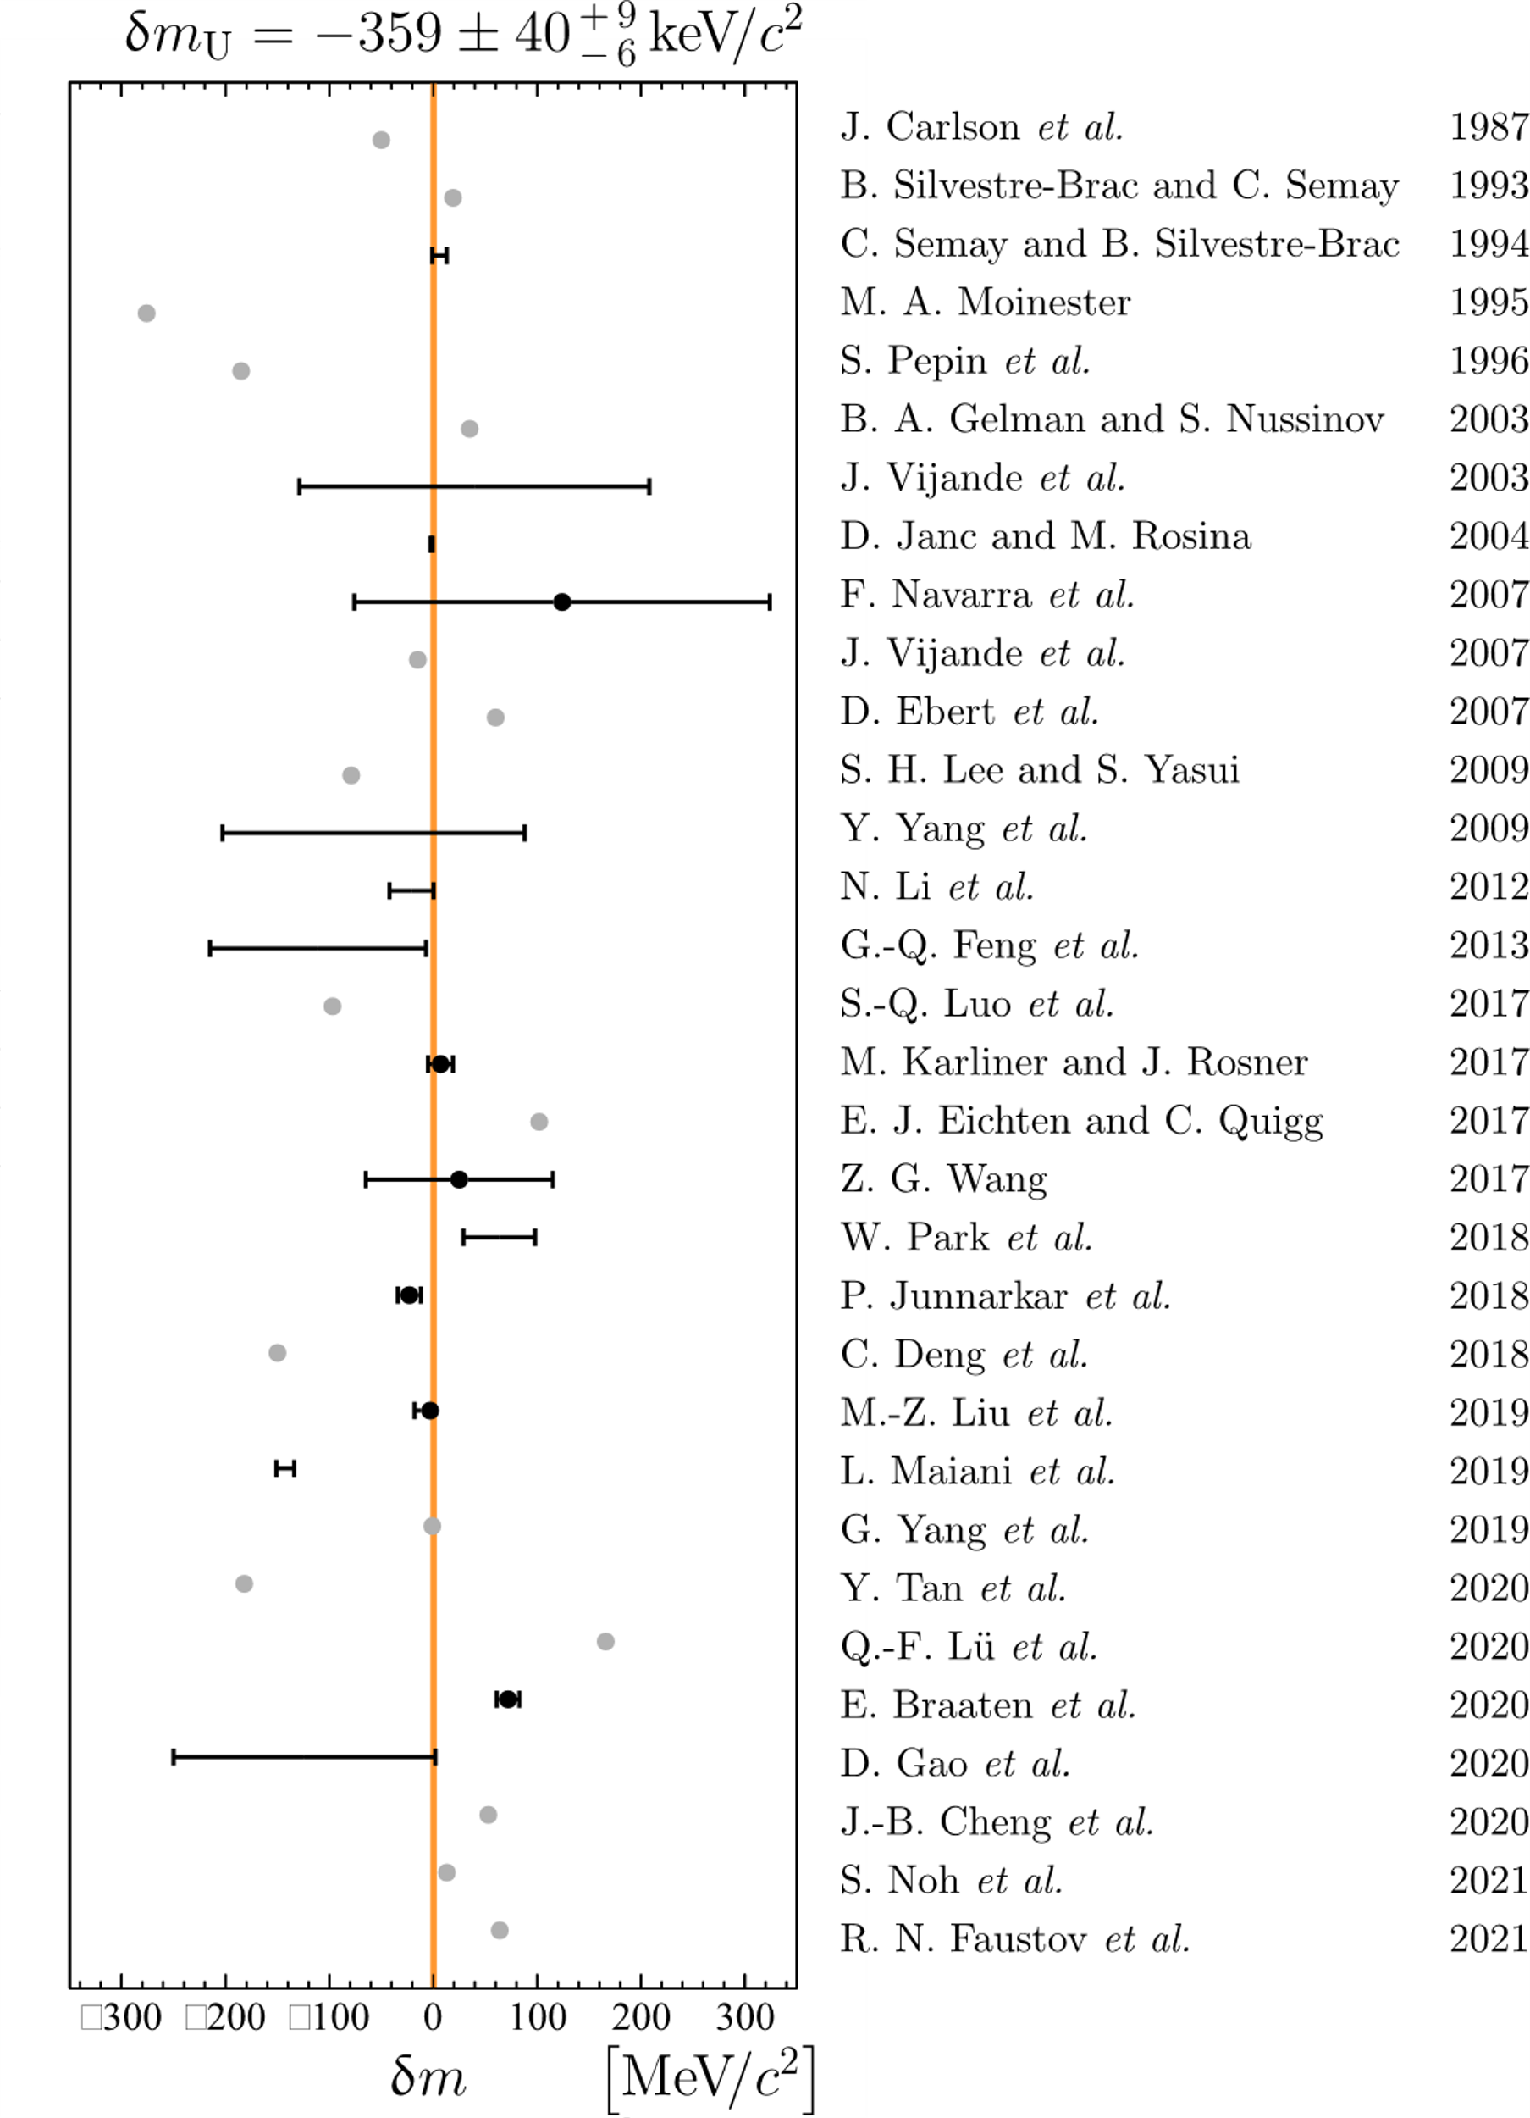
More references

