Slide 1
The FAIR Phase-0 Hyperon Program at HADES
Jana Rieger
Uppsala University
for the HADES and PANDA@HADES
Collaborations
June 23rd
MESON 2023

Slide 2
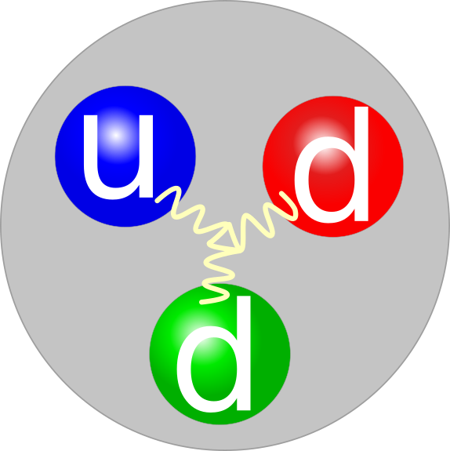
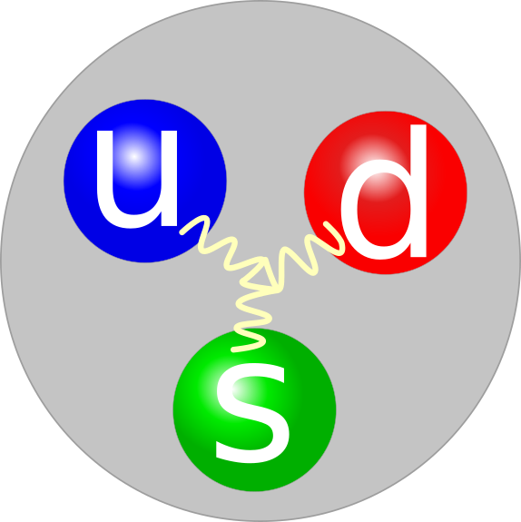
The Hype about Hyperons
They are strange!
replace
neutron
lambda

Slide 3
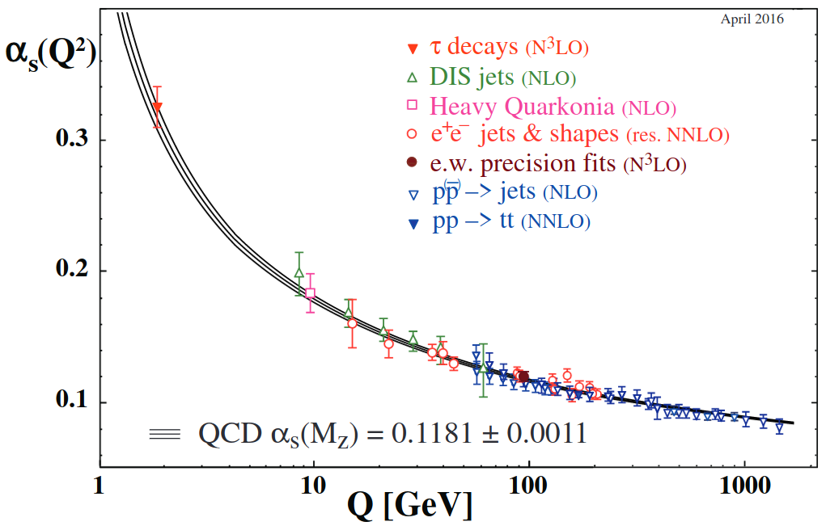
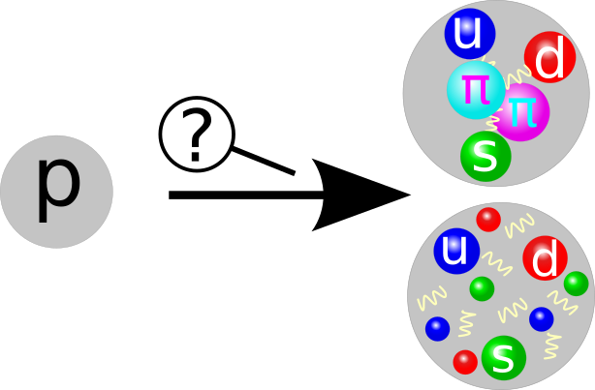
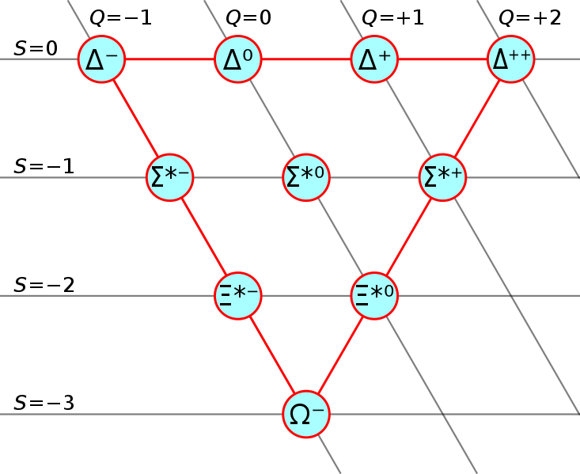
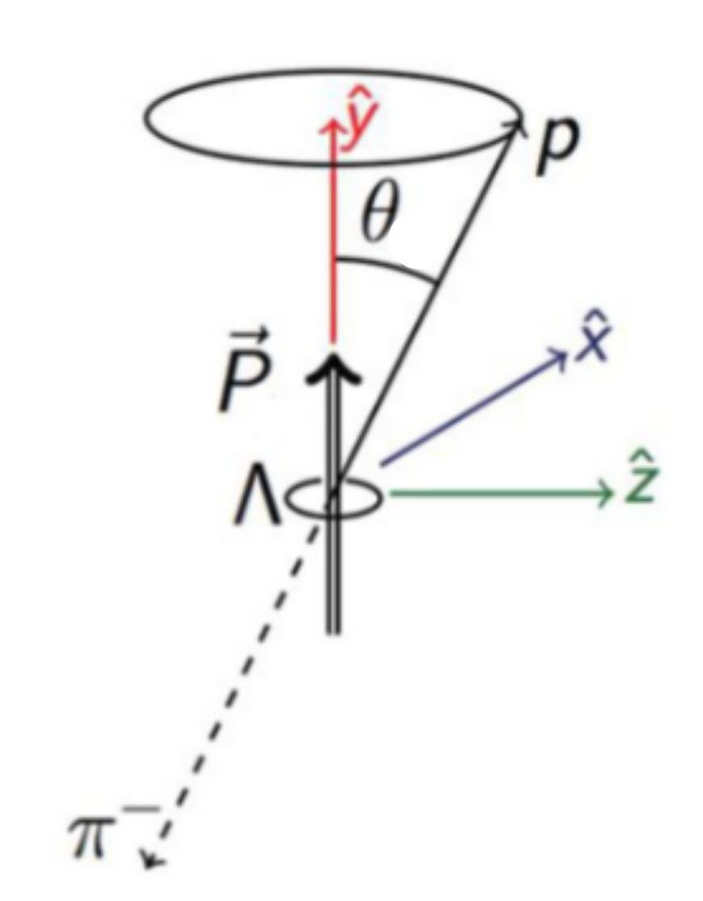
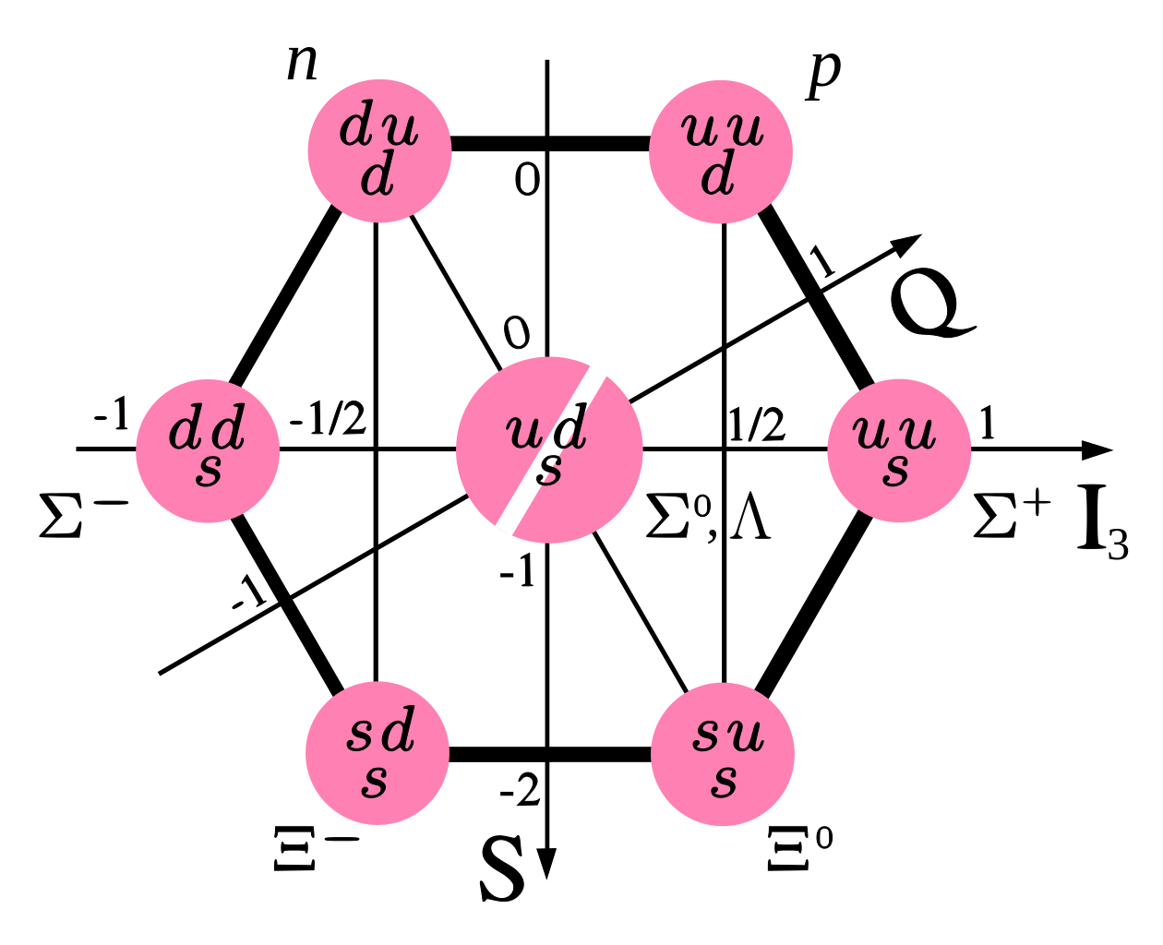
The Hype about Hyperons
New Angle to the Strong Interaction
m_{s} at scale of hadron
formation Phys. Rev. D 98, 030001
New degree of freedom
Ideal to probe strong interaction in non-perturbative regime
Hyperon Polarization
Polarized hyperons from unpolarized beams
Learn about production mechanism
Hyperon spin perpendicular to production plane
Parity violating weak decay → Asymmetry in proton emission angle θ

Slide 4
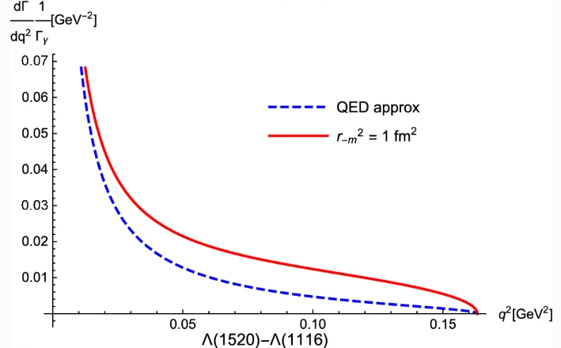
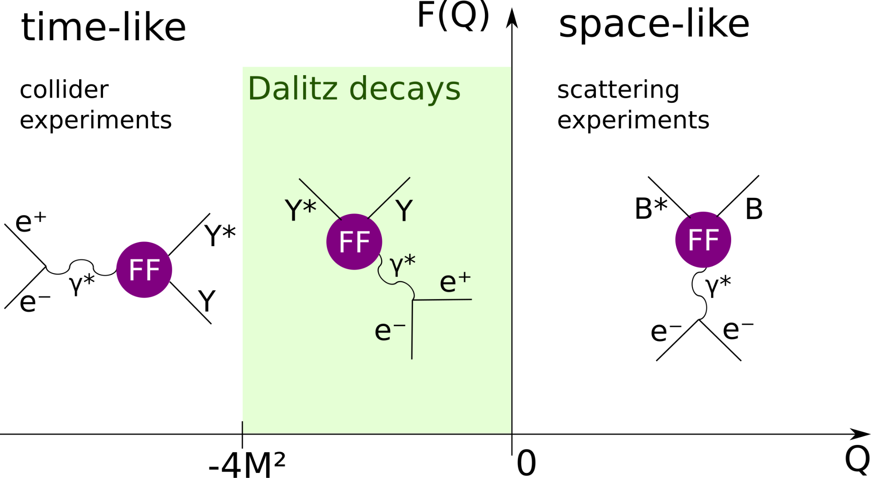
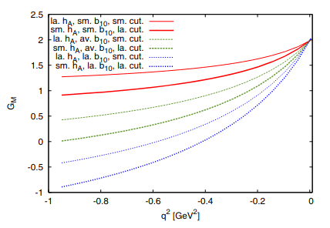
Hyperon Transition Form Factors
Size matters!
Eur. Phys. J. A (2021) 57:183
Σ⁰ → Λ
Structure of strange resonances
Coupling of virtual photon
Probe strong interaction at low q²:
Vector Meson Dominance model, effects of pion cloud
provide input to dispersion theory calculations
Dispersion theory
Eur. Phys. J. A (2017) 53: 117

Slide 5
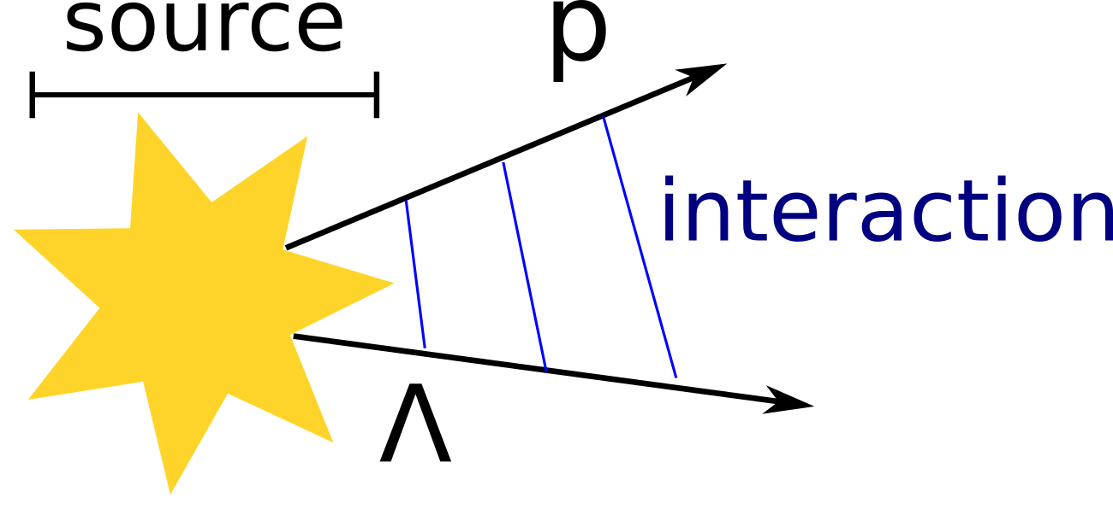
Hyperons in Neutron Stars
Neutron Star Equation of State
Presence of hyperons in neutron star core energetically favourable
Pauli principle provides less repulsive force
Softening of Equation of State
Cannot explain high mass neutron stars
→ “hyperon puzzle”
Additional repulsive force is needed!
Femtoscopy method
Correlation function provides relation between particle interaction and source size
= =
low relative momenta
study scattering lengths and effective ranges
Wikimedia Commons, Casey Reed - Penn State University

Slide 6
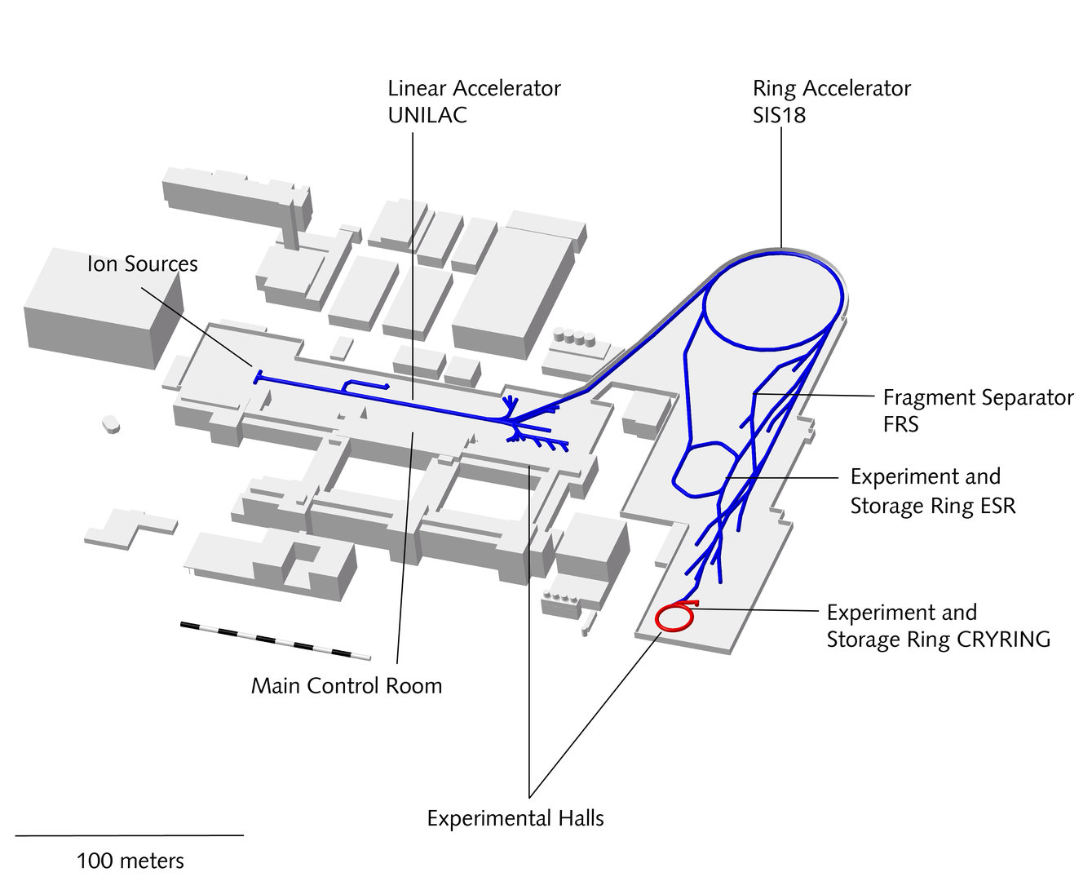
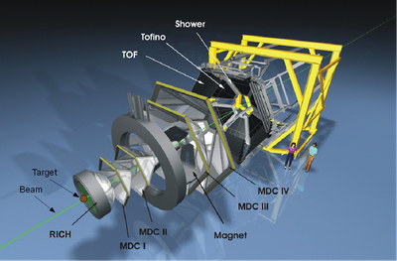
HADES – High Acceptance Di-Electron Spectrometer
GSI, Darmstadt

Slide 7
Hyperons in the Past
p+p and p+Nb @ 3.5 GeV beam energy

Slide 8
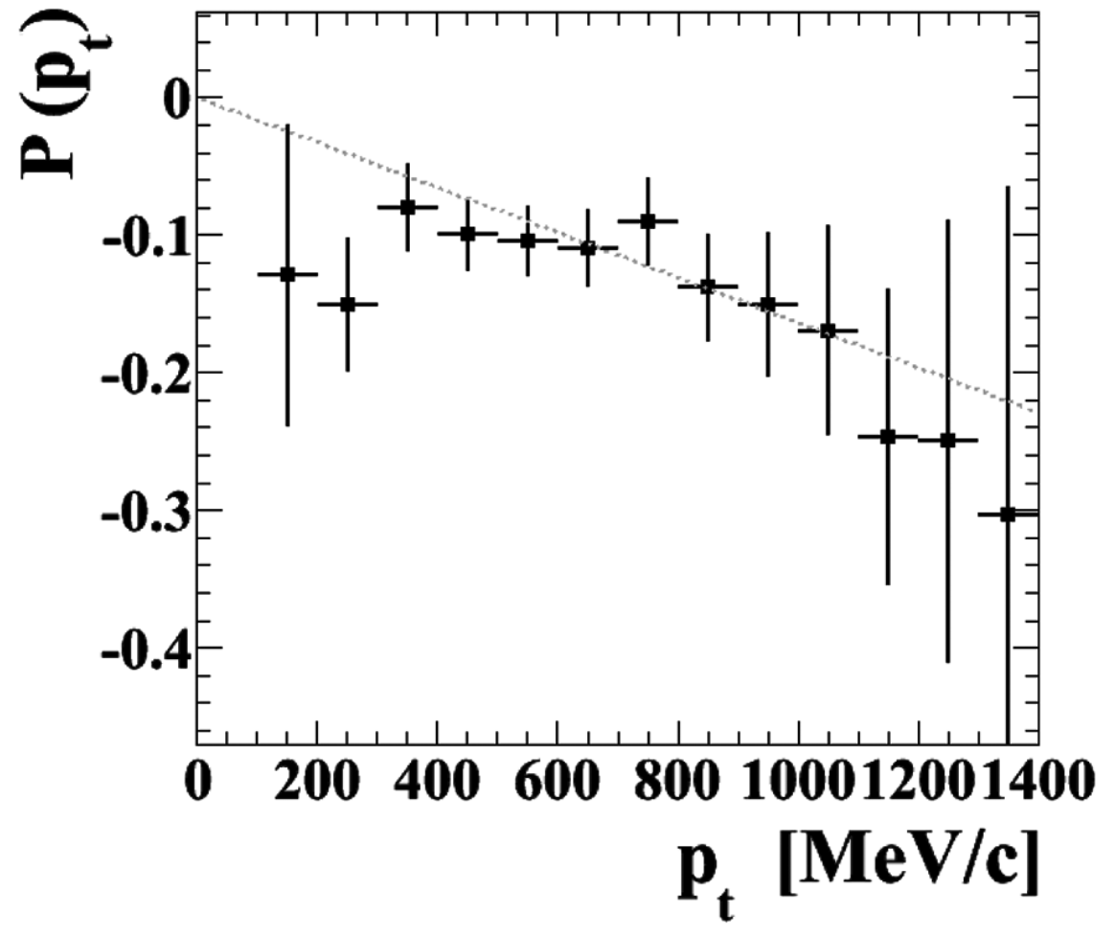
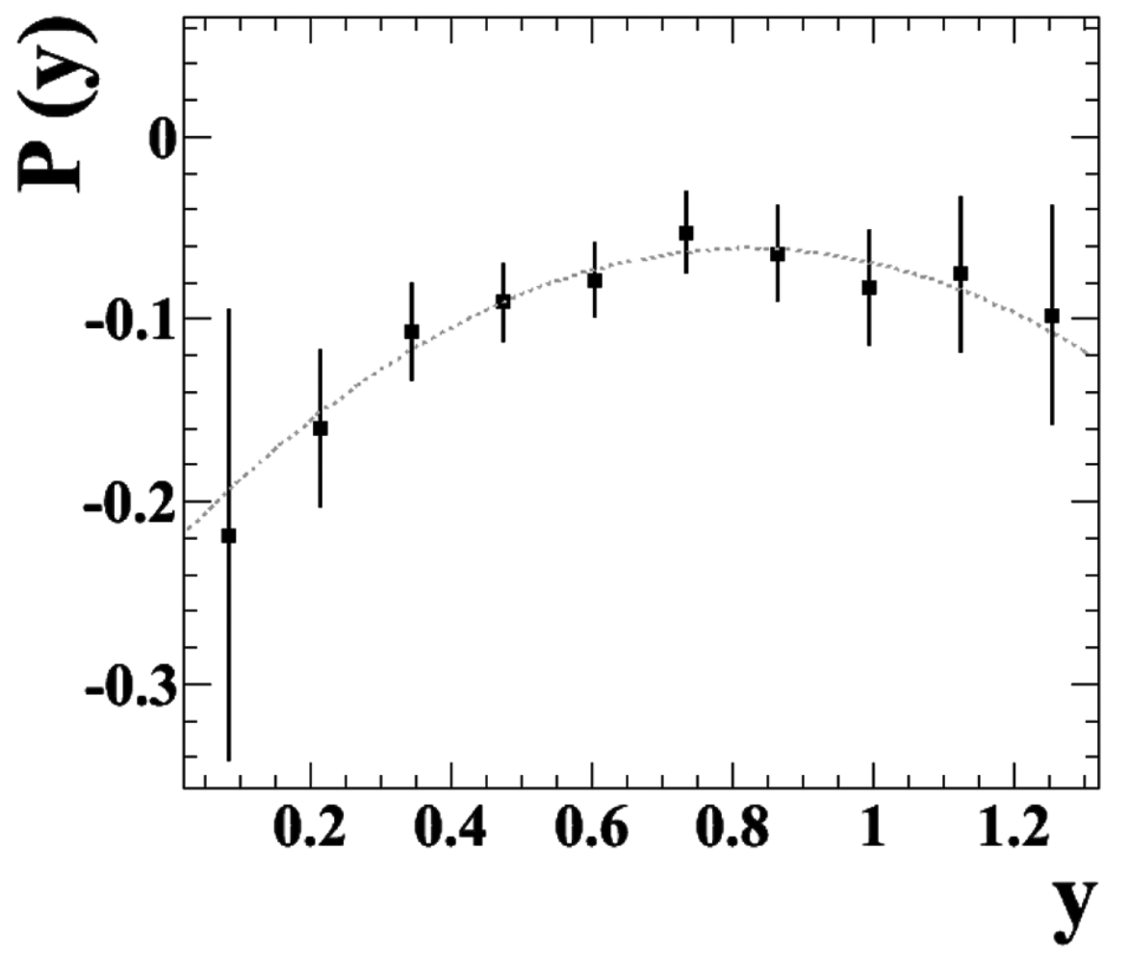
Λ polarization in p+Nb at 3.5 GeV beam energy
HADES results
Total: <P> = −0.119 ± 0.005 ± 0.016
Λ mostly from target hemisphere
→ Λ or p has experienced medium effects
Eur. Phys. J. A (2014) 50: 81
The mystery of Λ polarization
Λ polarization established, even with unpolarized beam
Origin unclear – quark exchange or meson exchange?
pA collisions as link between NN and heavy-ion collisions
Notes:
is scattering/slowing down/secondary protons a medium effect?

Slide 9
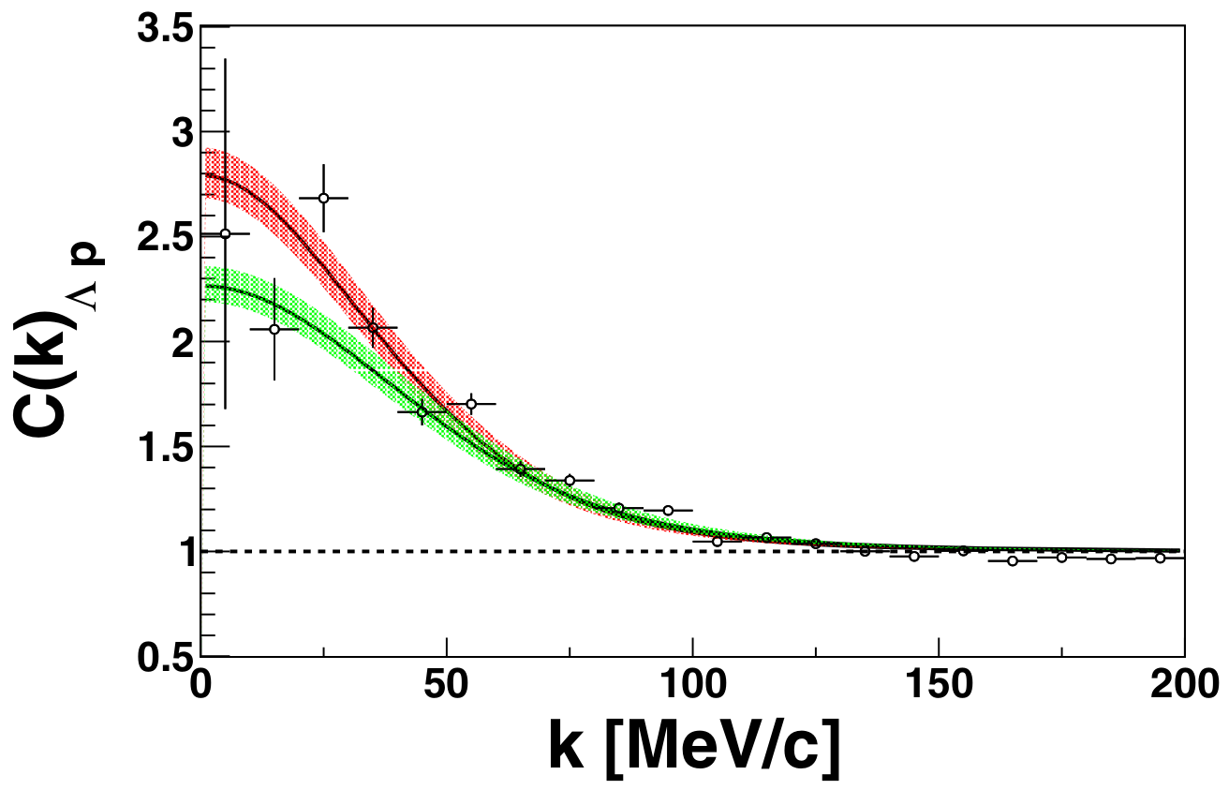
Λ-N interaction in p+Nb at 3.5 GeV beam energy
“Hyperon Puzzle” of neutron stars
Hyperons in inner core?
Additional repulsive force is needed!
Study Λ-N interaction
In hyper-nuclei, scattering experiments
Femtoscopy method!
study scattering lengths and effective ranges
HADES results
First measurement of pΛ and pp correlations via femtoscopy in pA reactions!
Study Λ-N interaction while determining source size from p-p interaction
Phys. Rev. C 94, 025201 (2016)
Similar study by ALICE (pp@√s =7TeV):
Phys. Rev. C 99, 024001 (2018)
Wikimedia Commons, Casey Reed - Penn State University
circles: HADES data
Theory bands: χEFT
green: LO scattering param.
red: NLO scattering param.
→ see also talk from Narendra Rathod
on Saturday at 16:00
p-Lambda in AgAg
Notes:
which ALICE study? There are a lot…
NLO solution
From HADES paper:
claims the presence of a negative phase shift in the p spin
singlet channel for momenta larger than P > 600 MeV/c.
This translates into a repulsive core of the interaction at small
distances.

Slide 10
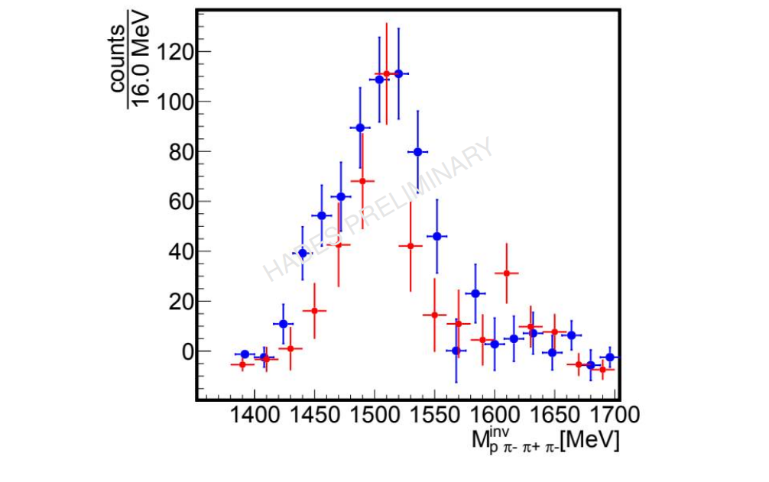
Λ(1520) in p+p and p+Nb at 3.5 GeV beam energy
HADES results – preliminary
In-medium effects on Λ(1520)
Larger width than in free space
Could be explained by πΣ*(1385) contribution
Only accessible in medium
Phys. Rev. C 73, 045213
→ Inclusive analysis of Λπ+π− final state
→ see next talk by Konrad Sumara
Notes:
were only decay channels with lambda considered?

Slide 11
Hyperons NOW
p+p @ 4.5 GeV beam energy

Slide 12
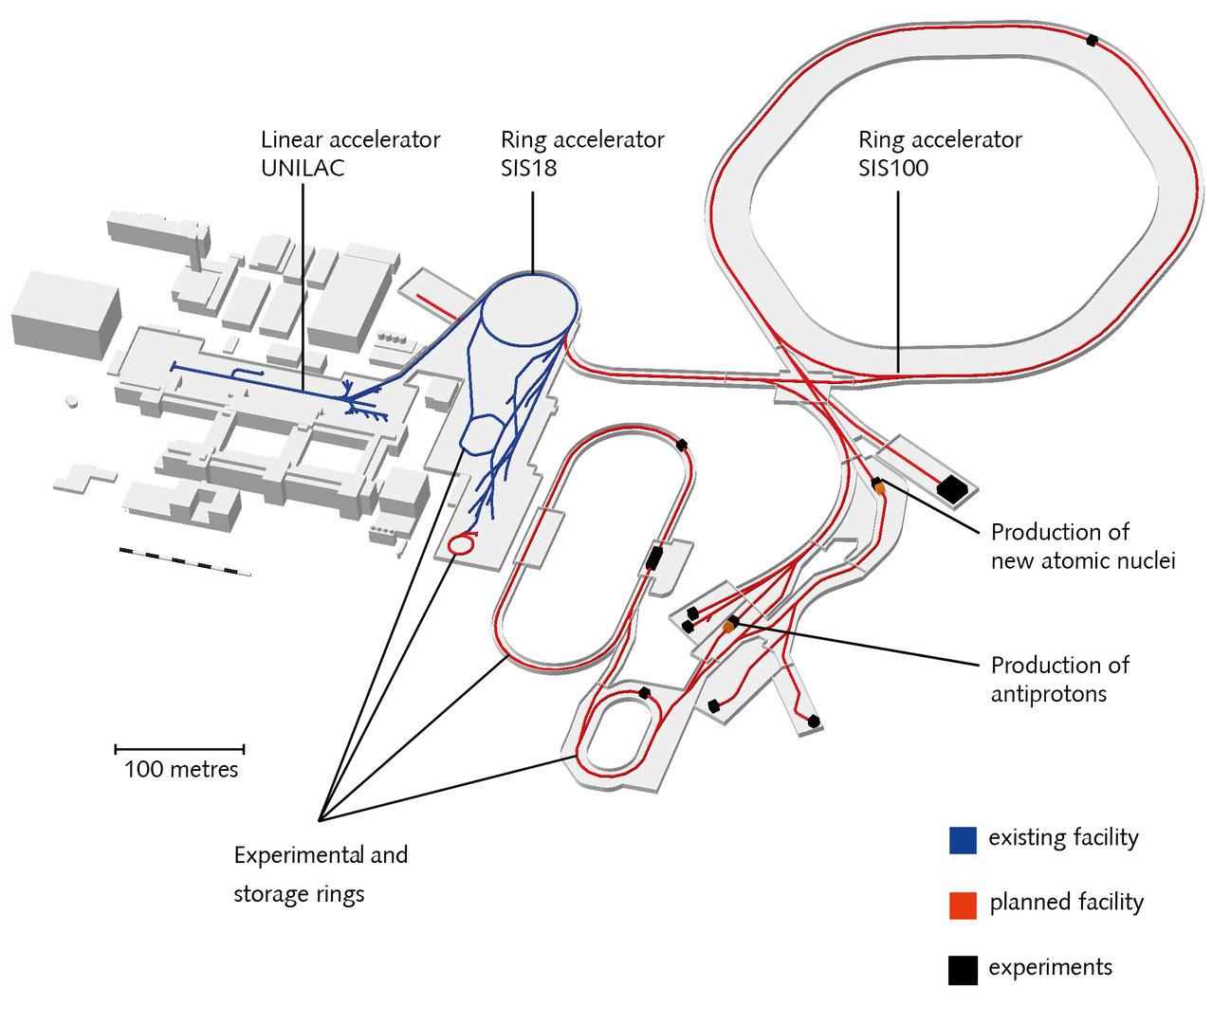
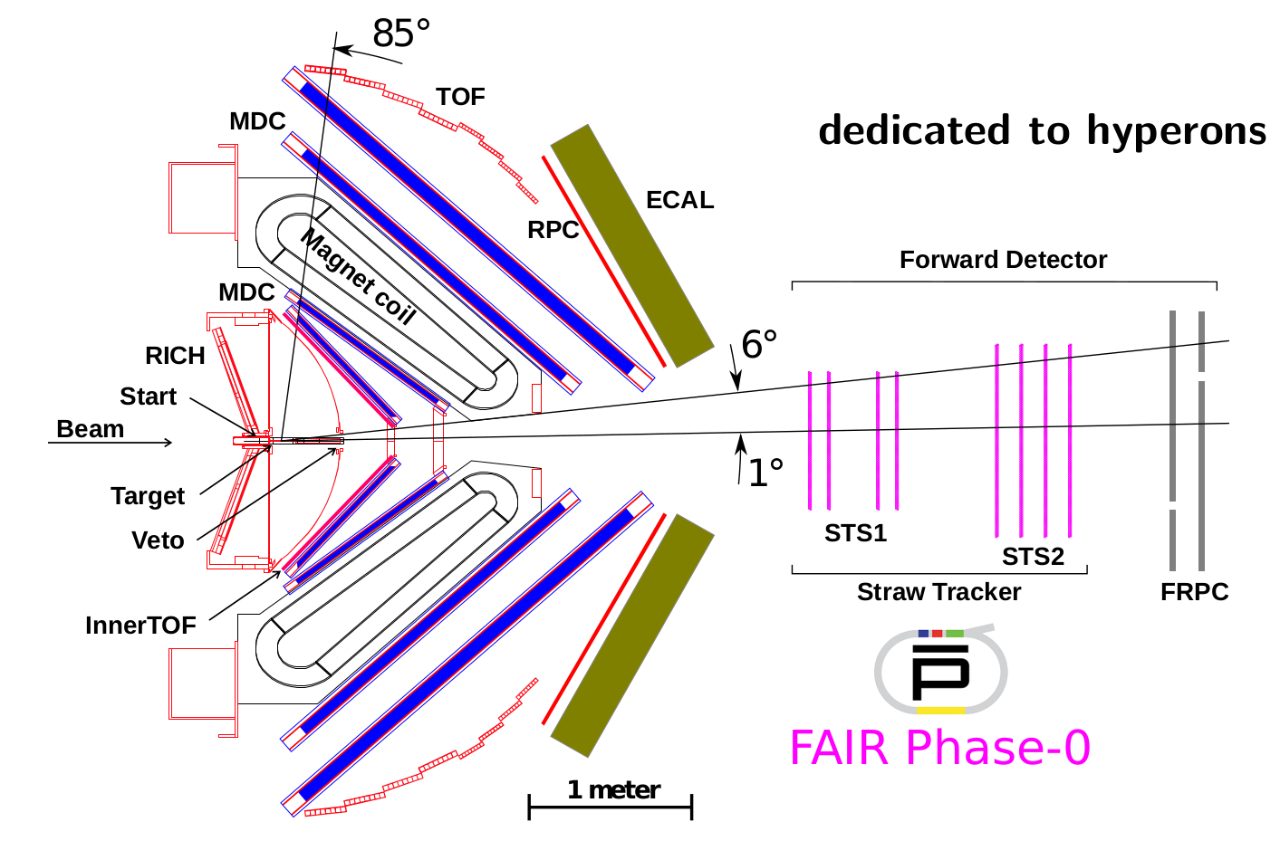
PANDA @ HADES Upgrade
FAIR, Darmstadt
Recent Upgrades:
ECAL (2017-2021)
RICH upgrade (2018)
iTOF (2021)
new START (2021)
Forward Detector (2021)
fRPC (time of flight)
STS, designed and built for PANDA (tracking)
Increase acceptance for Hyperons!

Slide 13
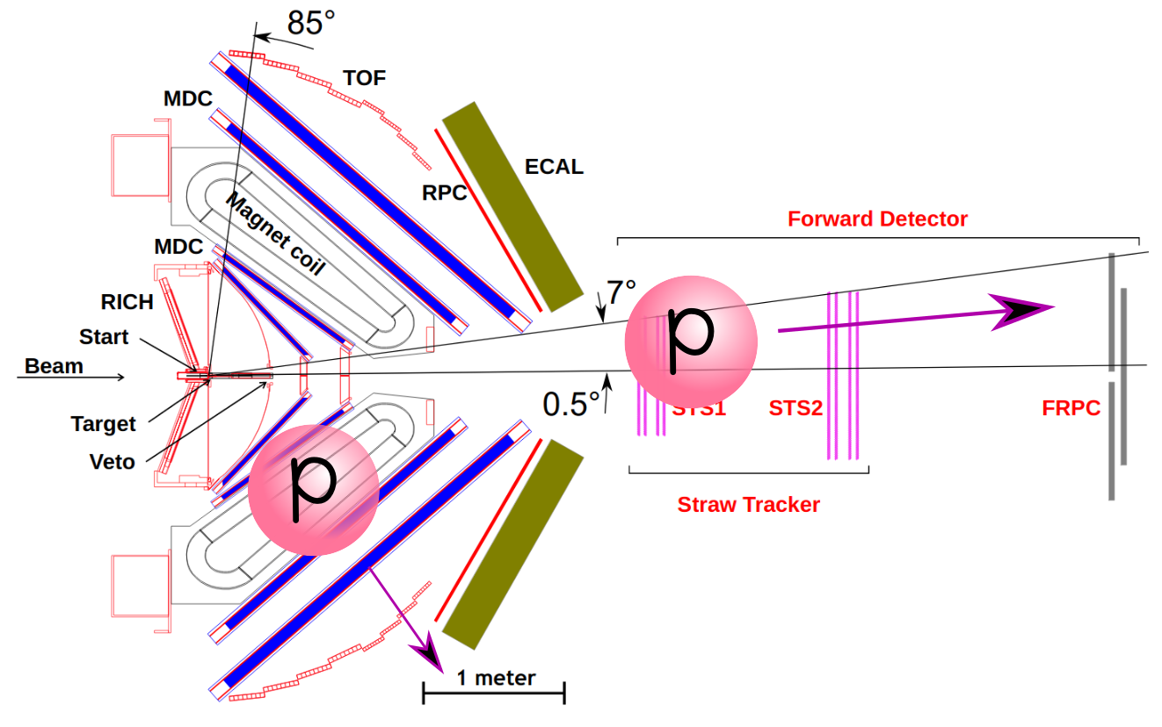
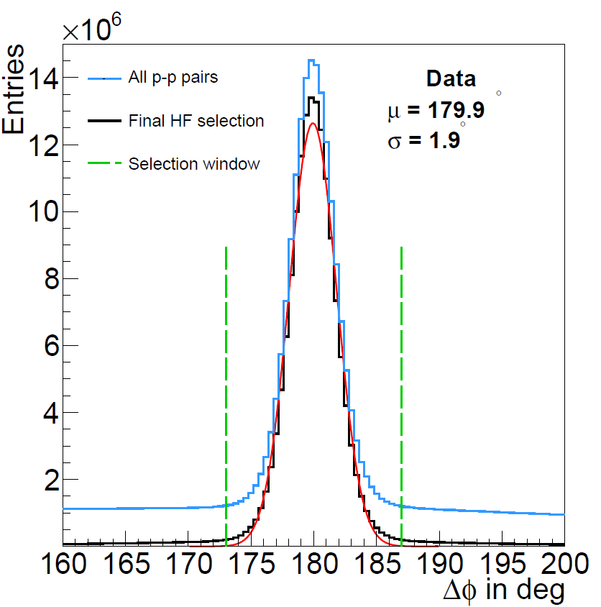
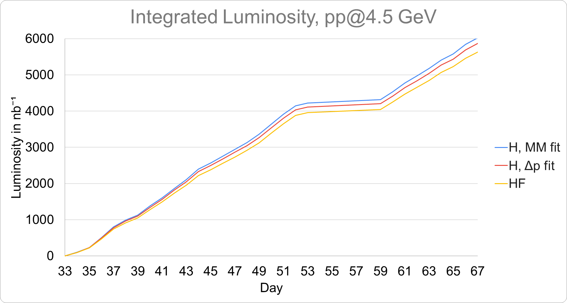
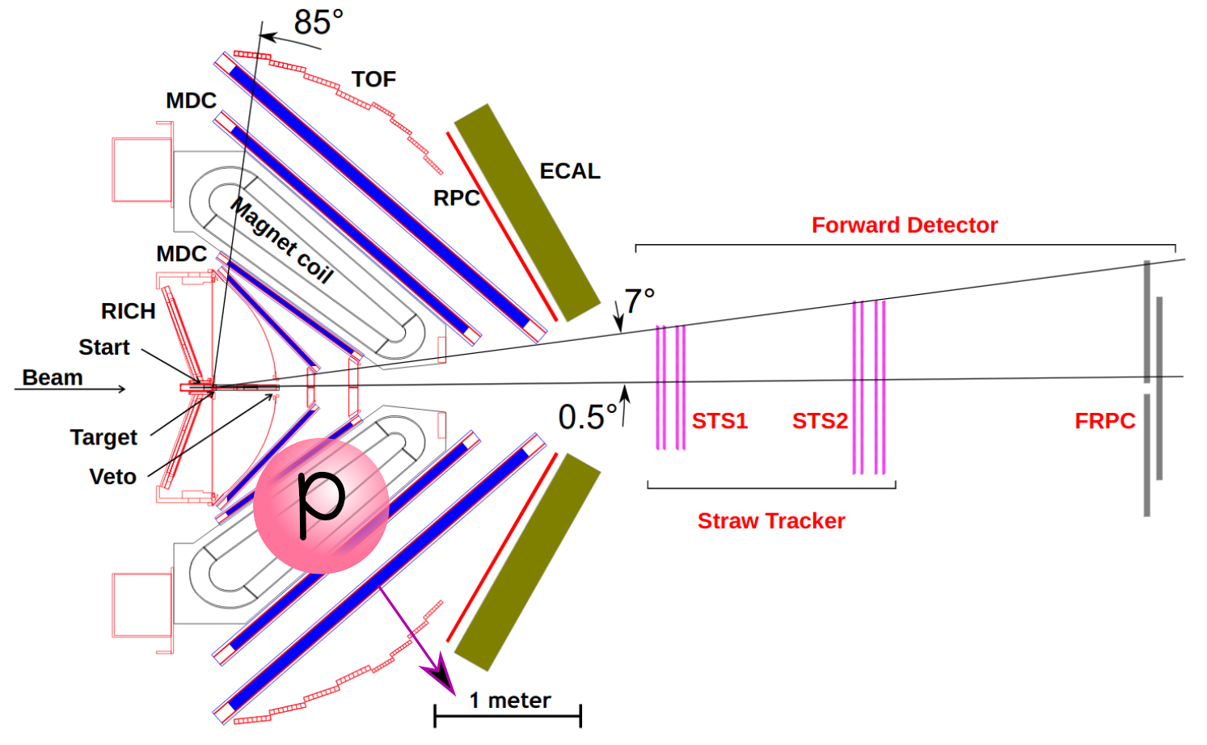
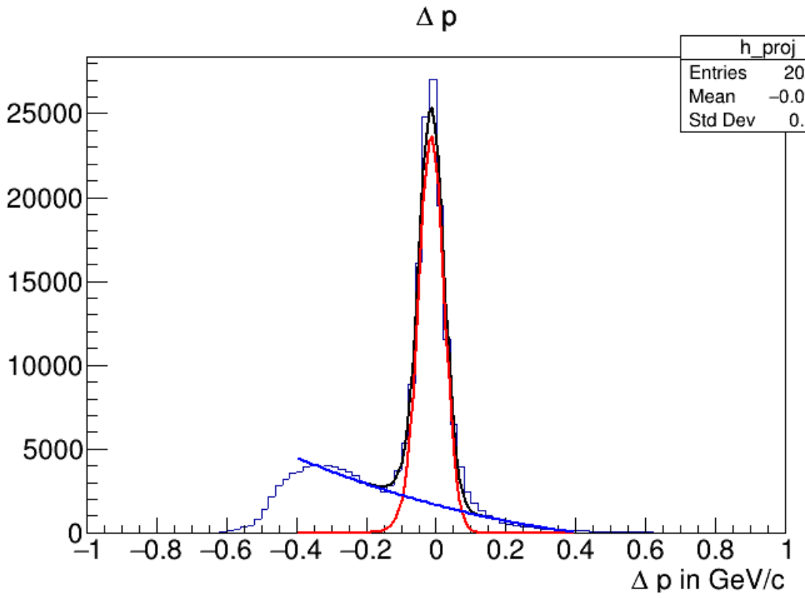
Luminosity
from elastic scattering
HF
HADES preliminary
pp@4.5 GeV
Luminosity of pp@3.5 GeV: 0.1 pb⁻¹
6 pb⁻¹
H
Huge increase in statistics!
HADES preliminary
pp@4.5 GeV
HADES preliminary
pp@4.5 GeV

Slide 14
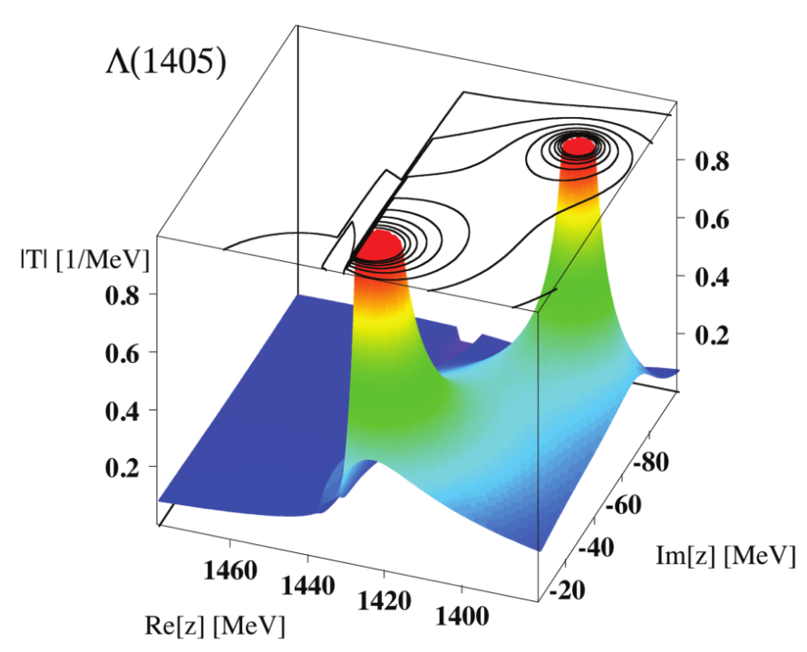
Excited hyperons
Possibilities in HADES
Λ(1405) line shape measurement
increase precision
exclude contribution from Σ(1385) by decay via Σ⁰π⁰ → pπ⁻3γ
Production of Σ⁺(1385)
Λ(1520)
→ see next talk by Konrad Sumara
Hadronic decays
Collect data on production close to threshold
Double-pole structure of Λ(1405)
https://doi.org/10.1016/j.ppnp.2011.07.002
Notes:
why can sigma not decay to neutral sigma?

Slide 15
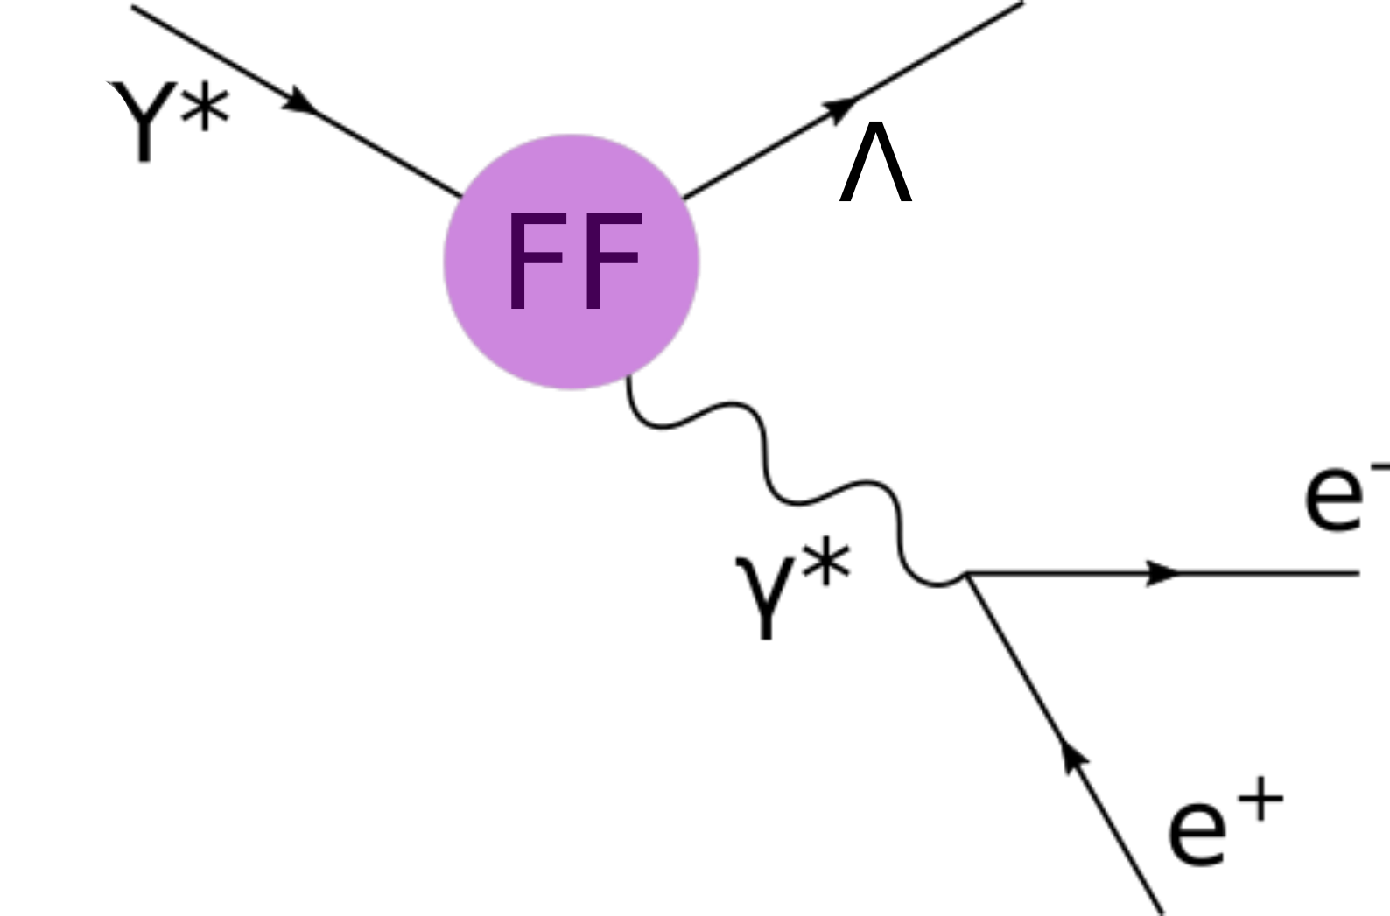
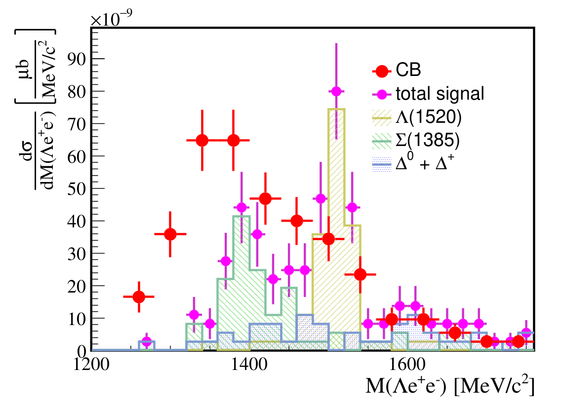
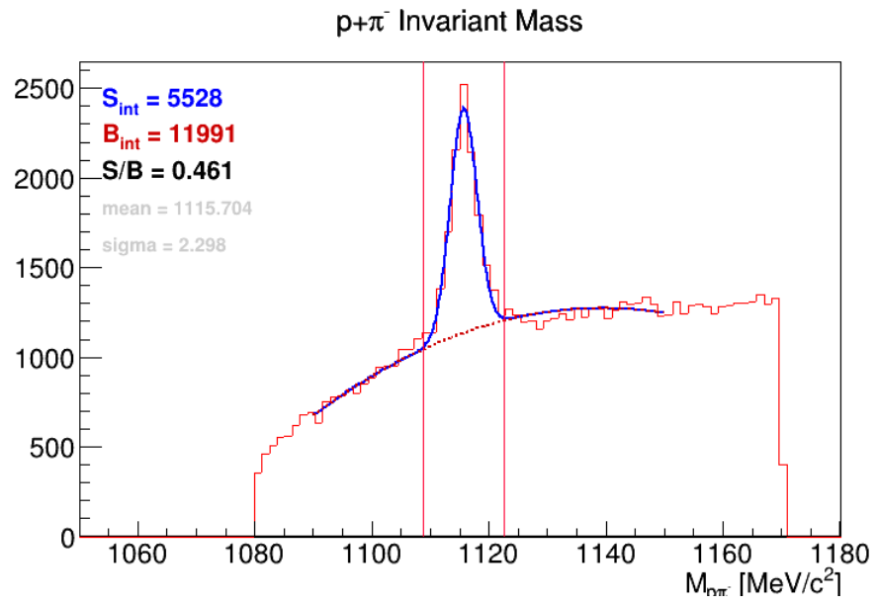
Hyperon Dalitz decays
Possibilities in HADES
Great detector: Leptons + hadrons
Σ⁰ – Λ (my PhD project)
Σ(1385) – Λ
Λ(1520) – Λ
Assumed luminosity: 15 pb⁻¹
Eur. Phys. J. A (2021) 57:138
aim for first measurement!
HADES preliminary
pp@4.5 GeV
HADES pp@4.5GeV simulation
e⁺ and e⁻ in same event

Slide 16
Double strangeness production
Correlation studies
Hyperon-hyperon interaction
neutron star core
double hyper nuclei
Ξ⁻ production mechanism
Possibilities in HADES
ΛΛ: cross section, correlation
Wikimedia Commons, Casey Reed - Penn State University
HADES preliminary
pp@4.5 GeV

Slide 17
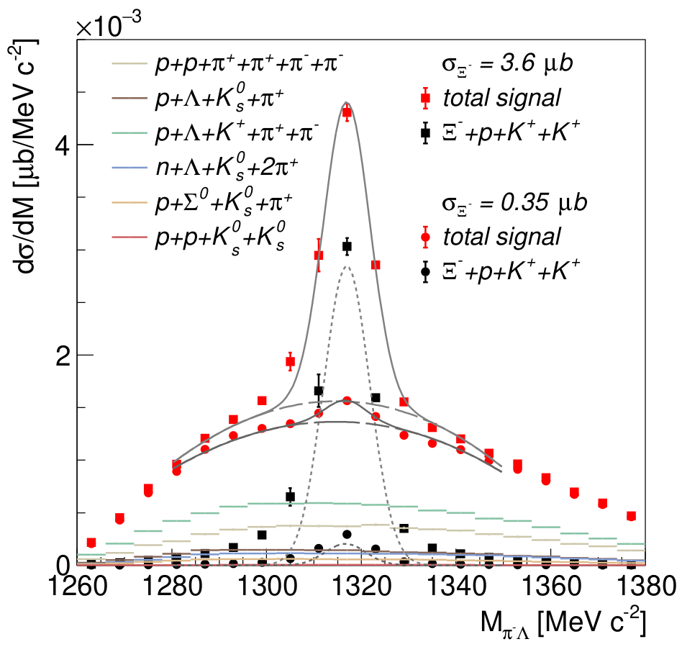
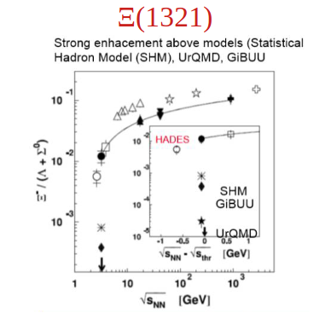
Double strangeness production
In-medium effects of Ξ⁻ production
Excess of Ξ⁻ measured in Ar+KCl and p+Nb (Phys. Rev. Lett. 103, 132301; Phys. Rev. Lett. 114, 212301)
Feed-down from resonances?
Possibilities in HADES
Ξ⁻ : cross section, spectroscopy
Eur. Phys. J. A (2021) 57:138
HADES pp@4.5GeV simulation

Slide 18
Hyperons in the Future

Slide 19
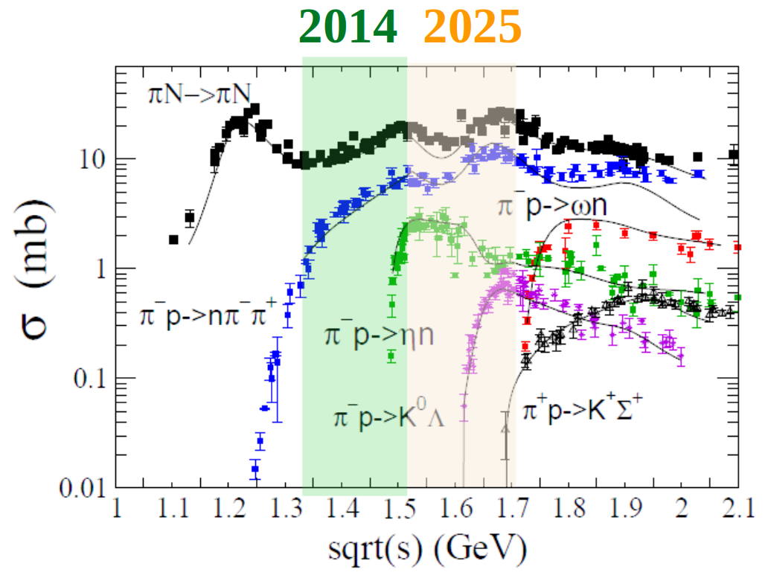
Possibilities of a π beam experiment at √s = 1.7 GeV/c²
HADES at SIS18 has the unique possibility to do experiments with a π beam!
π-p interactions open many doors:
Baryon - meson couplings
well suited for partial wave analysis
→ ππN, ωn, ηn, K⁰Λ, K⁰Σ⁰, …
Time-like electromagnetic TFF
test of VDM for ρ and ω
B* → Be⁺e⁻
Cold nuclear matter studies
strangeness production
ω absorption
ρ spectral function
→ see also talk from Izabela Ciepal
on Saturday at 11:30

Slide 20
Conclusion
HADES has shown its capability of hyperon studies in the past,
however still many open questions to be answered…
There are a lot of exciting hyperon analyses ongoing right now
→ Successful pp@4.5GeV campaign with new detectors
HADES has great potential for more hyperon studies in a π beam experiment at GSI in the future
Stay tuned!
polarization, correlations, electromagnetic TFF, heavy resonances…

