Slide 1

The phi meson in nuclear matter from theory and experimental data
Philipp Gubler
Japan Atomic Energy Agency (JAEA)
Talk at the “17th International Workshop on Meson Physics”
Krakov, Poland
June 23, 2023
Based on work done in collaboration with
Elena Bratkovskaya (Frankfurt/GSI),
Taesoo Song (GSI)

Slide 2
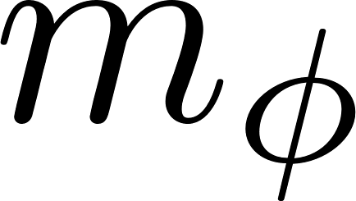
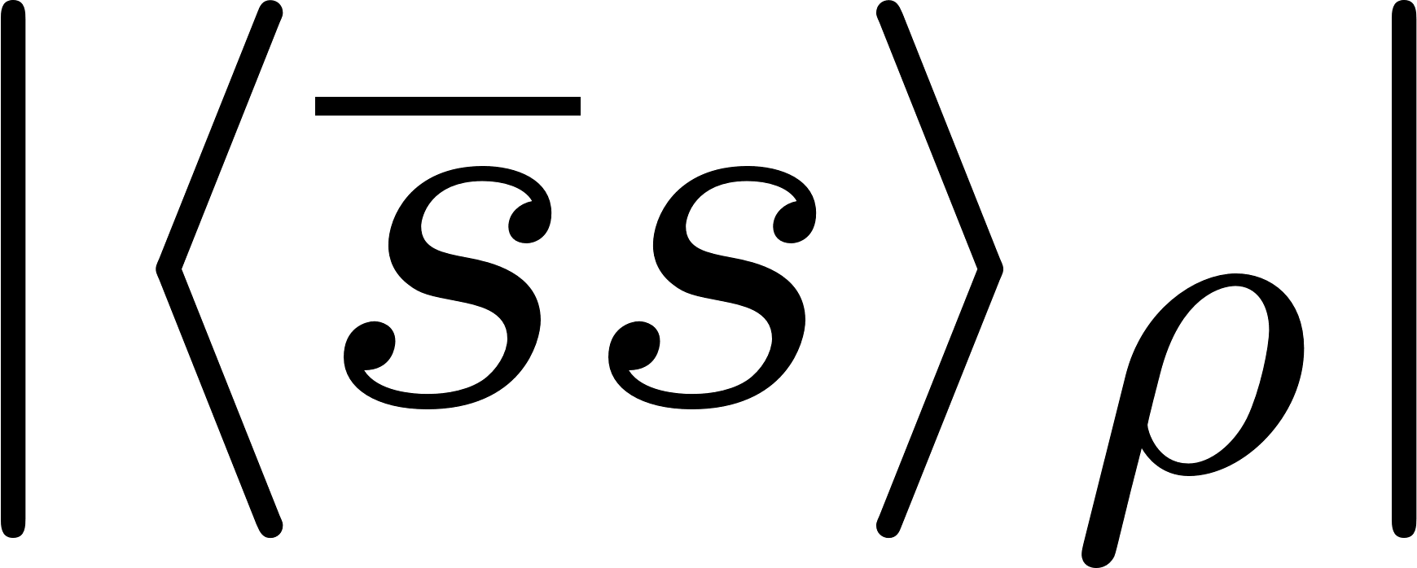
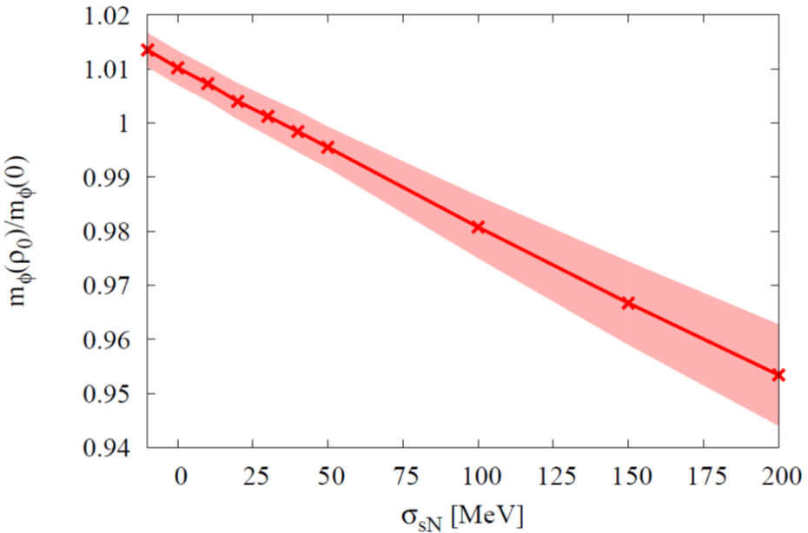


Why should we be interested?
The ϕ meson mass in nuclear matter probes the strange quark condensate at finite density!
?
P. Gubler and K. Ohtani, Phys. Rev. D 90, 094002 (2014).
ϕ meson mass at normal nuclear matter density from QCD sum rules
φ

Slide 3
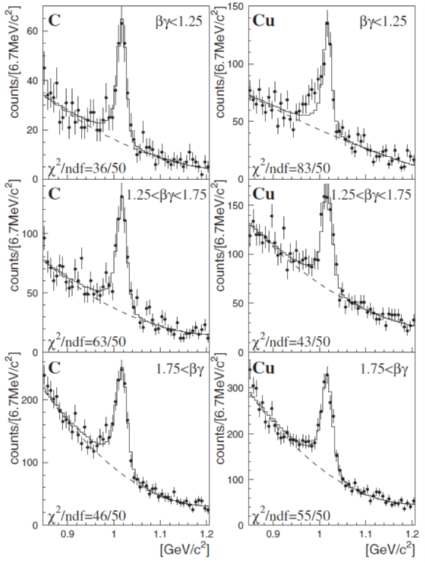
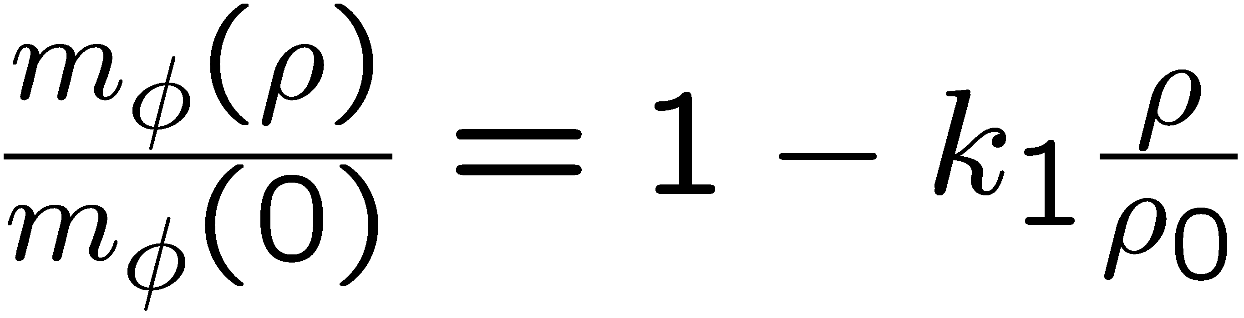

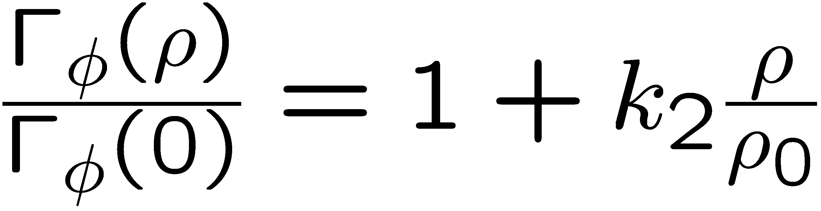
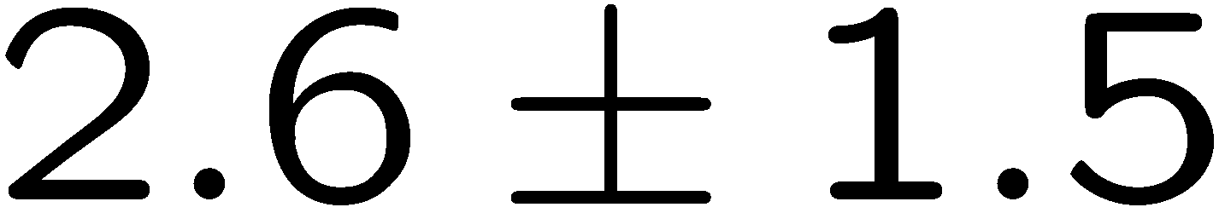
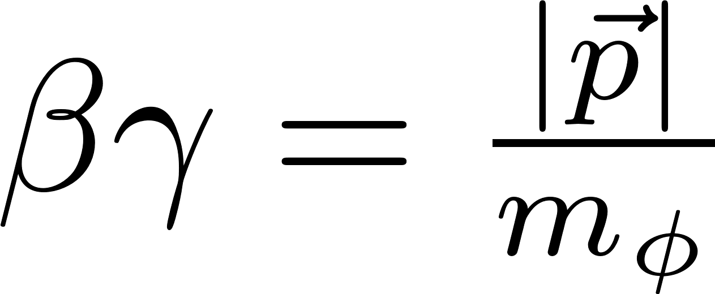
Previous experimental results
e
KEK
E325
12 GeV
pA-reaction
p
slow ϕs
φ
e
Pole mass:
intermediate ϕs
Pole width:
fast ϕs
Measurement is being repeated with 100x increased statistics at the J-PARC E16 experiment!
~
R. Muto et al. (E325 Collaboration), Phys. Rev. Lett. 98, 042501 (2007).

Slide 4
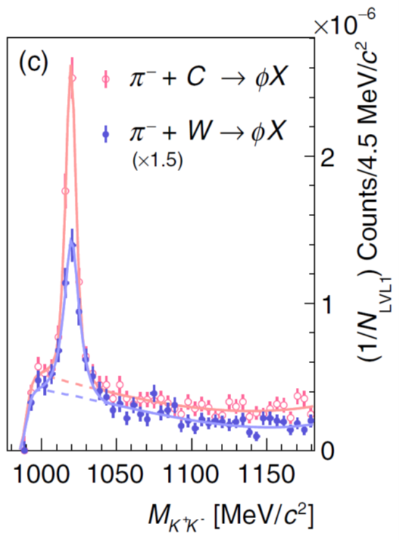
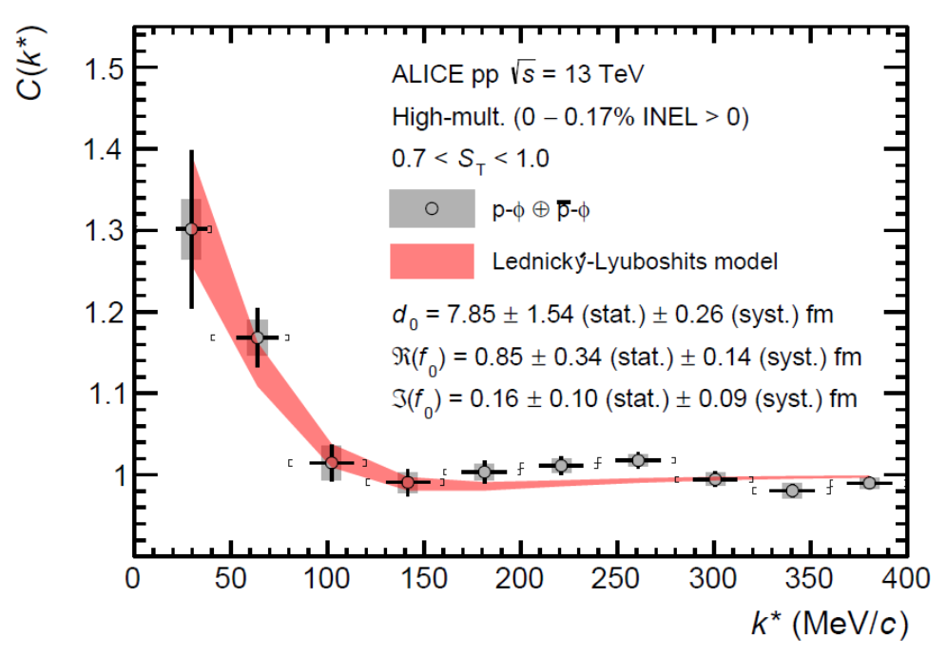
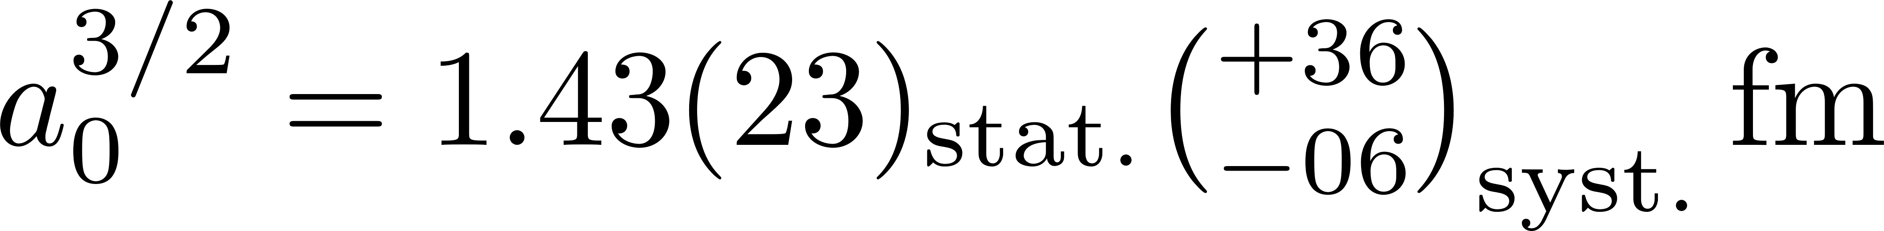
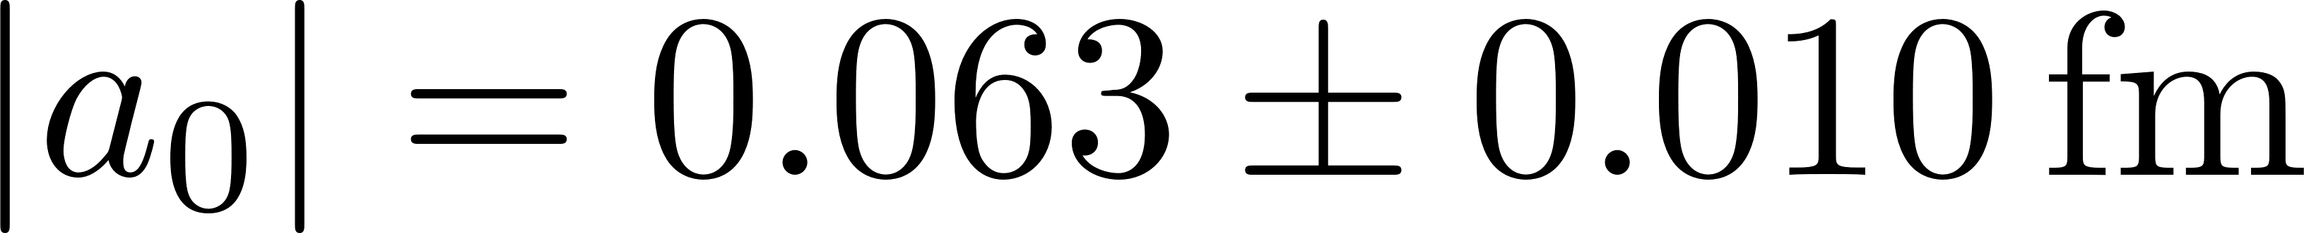
More recent results
HADES:
1.7 GeV π⁻A-reaction
ALICE: pp
K⁺K⁻ - invariant mass spectrum
Measurement of ϕN correlation
Theoretical analysis of the of the total ϕ meson production cross section:
Attractive ϕ-nucleus potential:
-(50 - 100) MeV
Attraction!
Small imaginary part:
20 – 25 MeV
E. Ya. Paryev, Nucl. Phys. A 1032, 122624 (2023).
Large negative mass shift?
Small broadening?
S. Acharya et al. (ALICE Coll.),
Phys. Rev. Lett. 127, 172301 (2021).
J. Adamczewski-Musch et al. (HADES Coll.),
Phys. Rev. Lett. 123, 022002 (2019).
Photoproduction measurements
Y. Lyu et al. (Lattice QCD, HAL QCD Collaboration),
Phys. Rev. D 106, 074507 (2022).
I.I. Strakovsky et al. (CLAS),
Phys. Rev. C 101, 045201 (2020).
Hadronic Effective theory calculations

Slide 5
Even more recent results
Combination of ALICE pp-data and
HAL QCD (spin 3/2) calculation
Bound state?
Repulsive?
Bound state
Spin 1/2 correlator
Repulsive
Evidence for ϕ-N bound state!
E. Chizzali et al., arXiv:2212.12690 [nucl-ex].

Slide 6
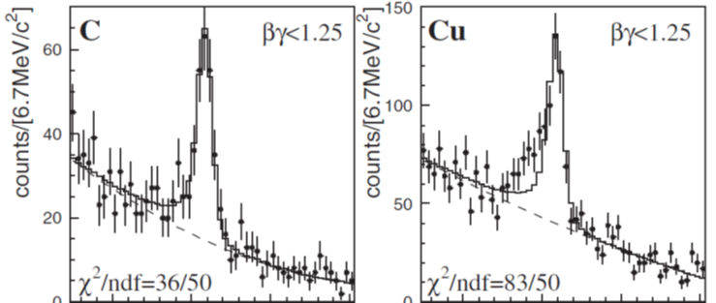
How compare theory with experiment?
Information useful for theory
Experimental data
Spectral function as a function of density
Mass at normal nuclear matter density
Decay width at normal nuclear matter density
e
Realistic simulation of pA reaction is needed!
p
e
φ

Slide 7
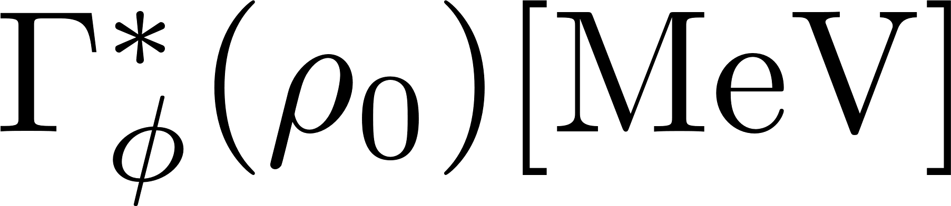
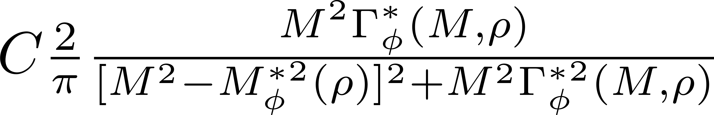
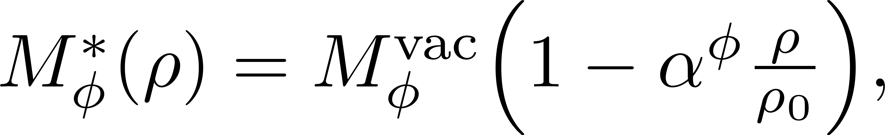
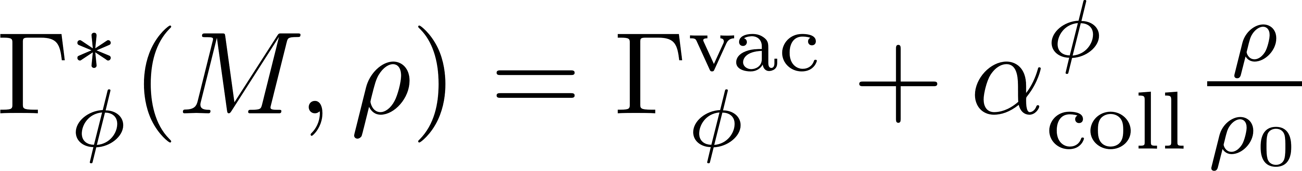
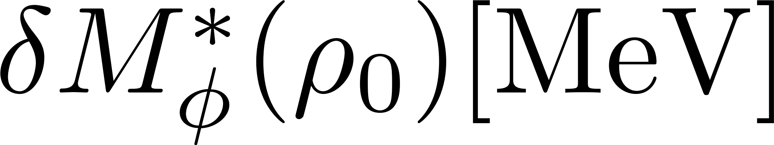
Our tool: transport simulation
PHSD (Parton Hadron String Dynamics)
Off-shell dynamics of vector mesons and kaons
(dynamical modification of the mesonic spectral function during the simulated reaction)
E.L. Bratkovskaya and W. Cassing, Nucl. Phys. A 807, 214 (2008).
W. Cassing and E.L. Bratkovskaya, Phys. Rev. C 78, 034919 (2008).
Simulated scenarios:
Used spectral function:
Relativistic Breit-Wigner with density dependent mass and width
vacuum
75
150
E325 result
-30
-60
-90
with
-120
-150

Slide 8
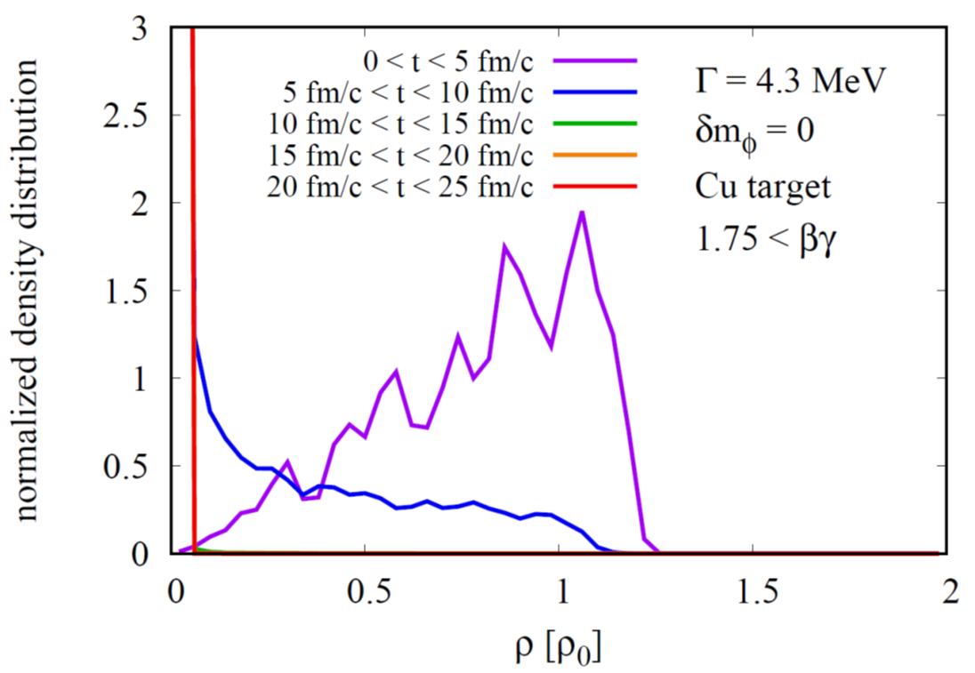
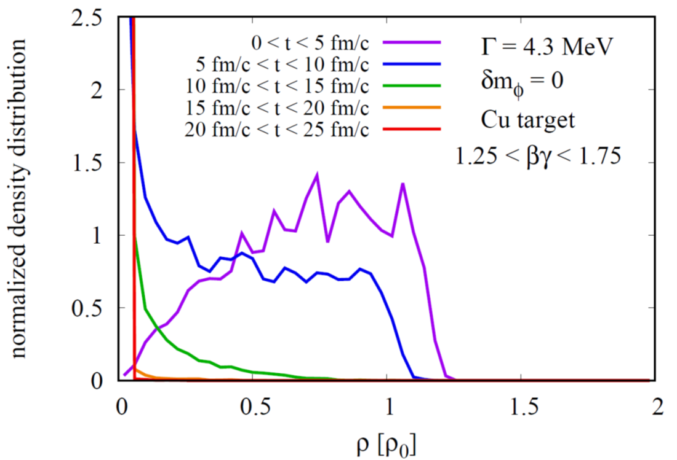
What density does the ϕ feel in the reaction (p+Cu at 12 GeV)?
slow ϕs
intermediate ϕs
fast ϕs

Slide 9
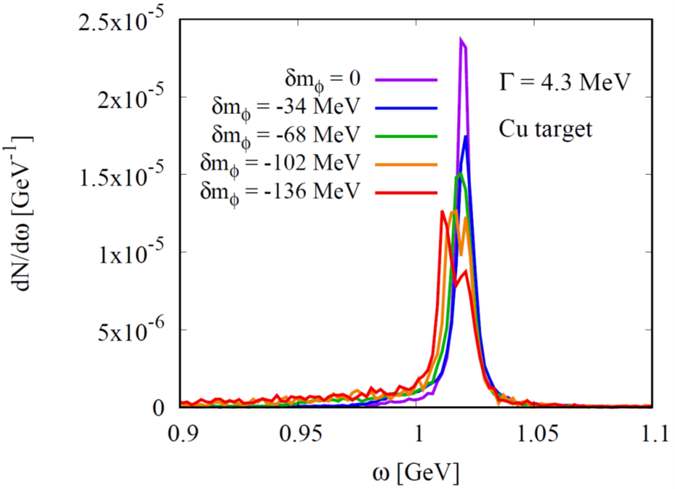
The dilepton spectrum in the ϕ meson region
p + Cu at 12 GeV
No acceptance corrections!
No finite resolution effects!
No QED effects!

Slide 10
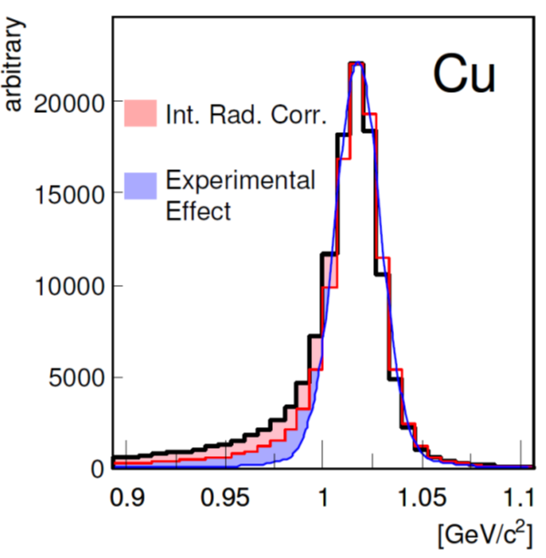
How do experimental rescattering and QED effects modify the dilepton spectrum?
PhD Thesis of R. Muto, Kyoto U., 2007
Rescattering effect
(multiple scattering, energy loss)
Similar to the shape expected for a negative mass shift

Slide 11
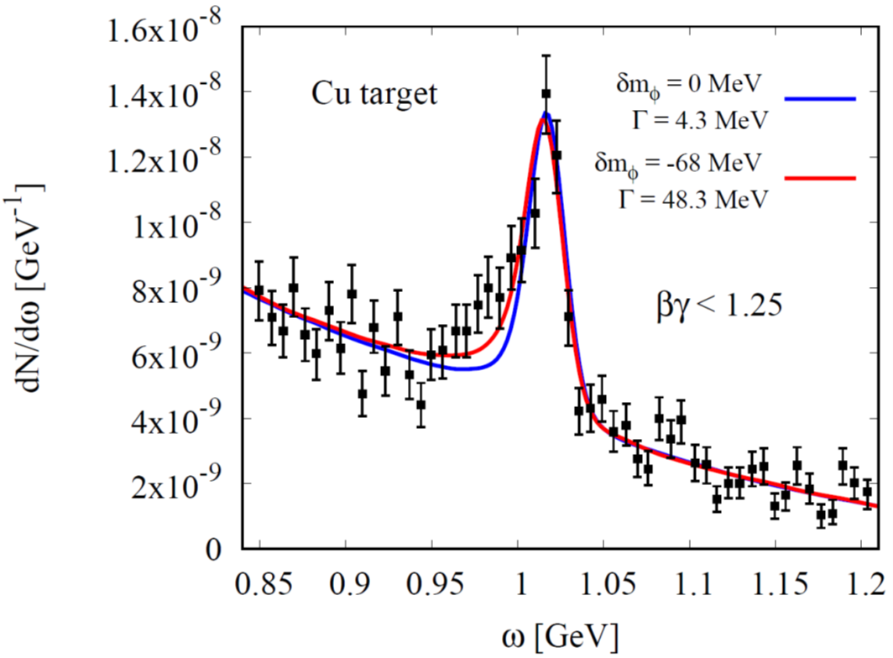
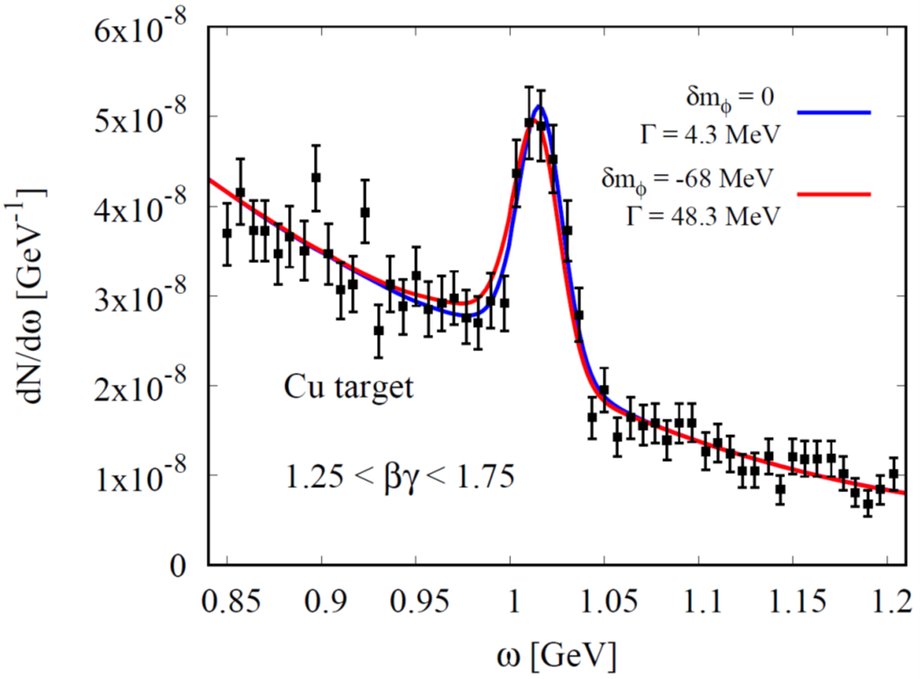
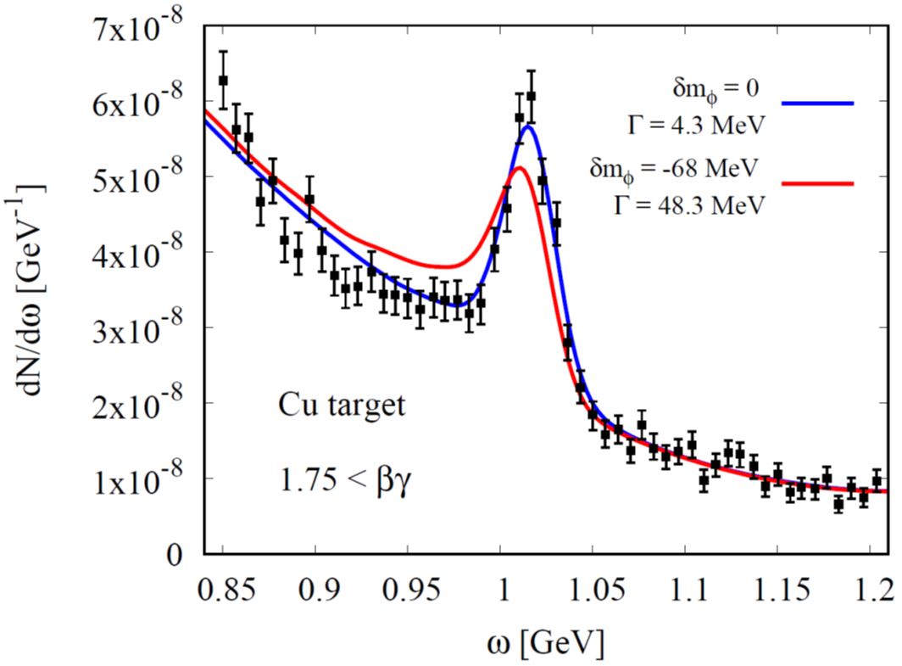
Fits to experimental Copper target data (KEK, E325)
Preliminary
slow ϕs
intermediate ϕs
fast ϕs

Slide 12
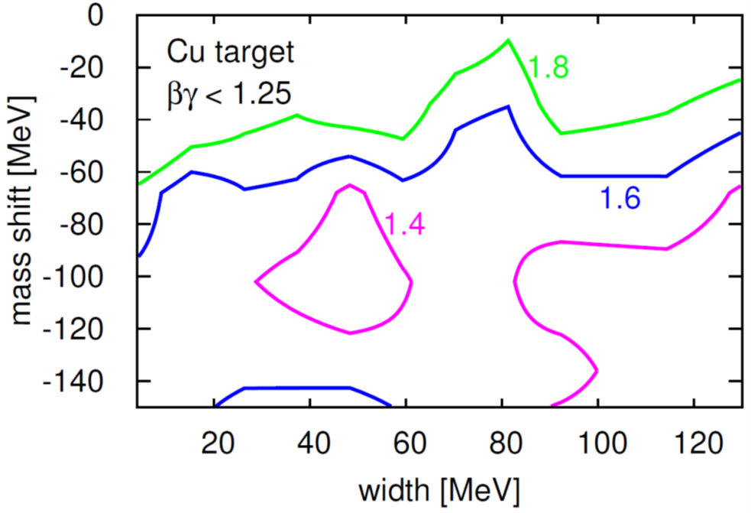
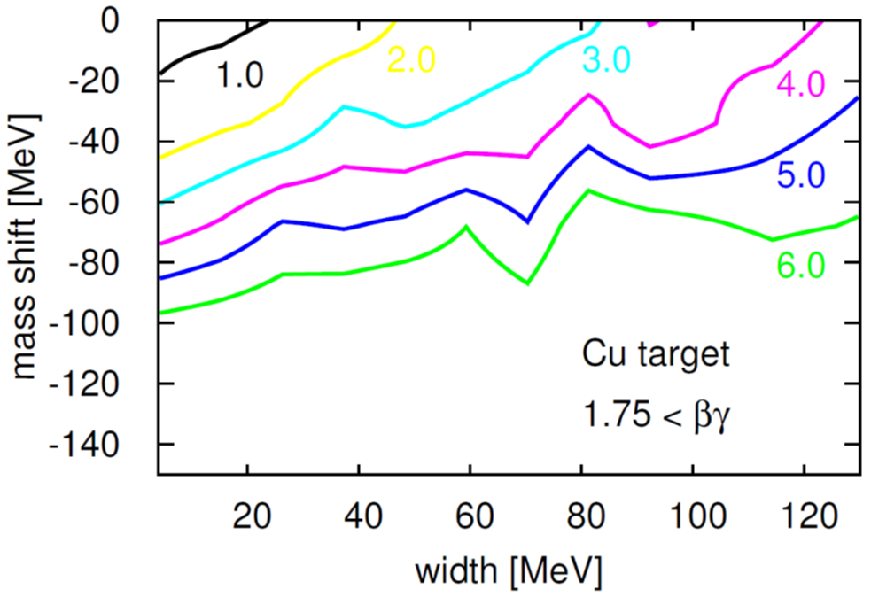
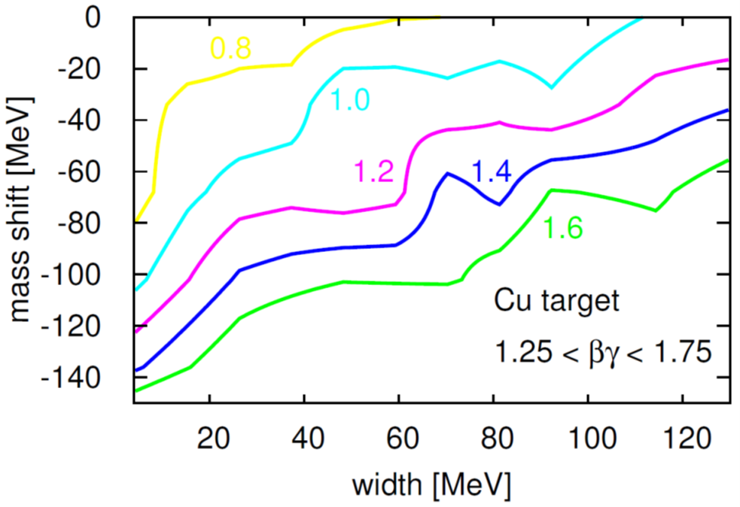
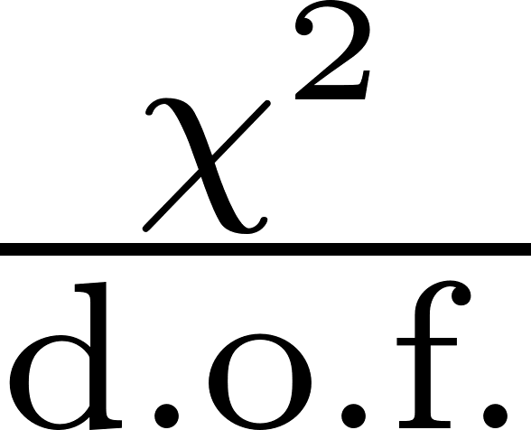
Fits to experimental Copper target data (KEK, E325)
Preliminary
slow ϕs
intermediate ϕs
fast ϕs
large momentum dependence needed to explain the data!

Slide 13
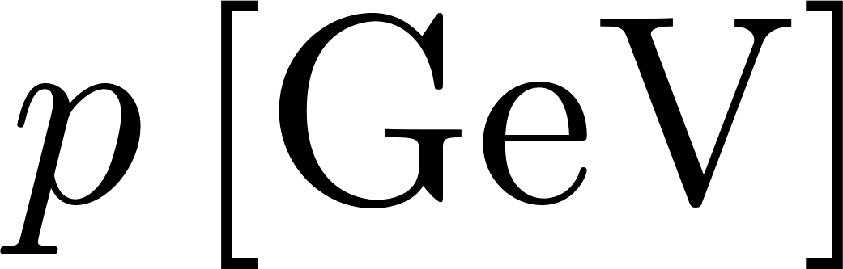
Summary of results for Copper target data (E325)
1
2
3
-30
-60
-90
-120

Slide 14
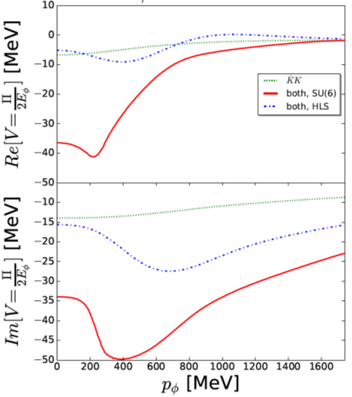
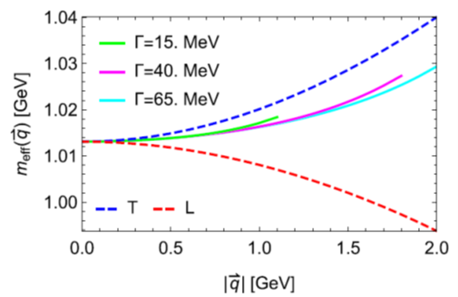
Most natural interpretation of our results
Momentum dependent mass shift
Hadronic effective theory
QCD sum rules
H.J. Kim and P. Gubler, Phys. Lett. B 805, 135412 (2020).
D. Cabrera et al., Phys. Rev. C 95, 015201 (2017).

Slide 15
Summary and Conclusions
A lot of new experimental information about the ϕN and ϕ-nucleus interactions is becoming available (LHC, J-PARC, HADES, …)
Many opportunities for theorists!
We conducted numerical simulations of the pA reactions measured at the E325 experiment at KEK, using the PHSD transport code
Momentum-dependent mass shift is needed to explain the data

Slide 16
Backup slides

Slide 17
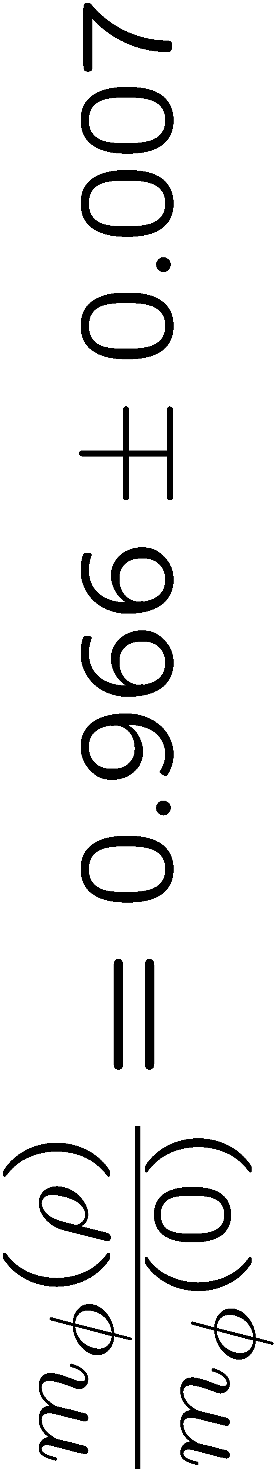
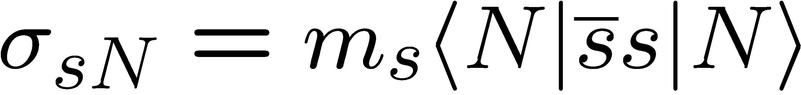
Consistency with QCD sum rules and lattice calculations?
Sum Rules + Experiment
Consistency would get much worse if the ϕ meson mass shift is about -100 MeV!!
Lattice QCD
Experiment
Big puzzle!!

Slide 18
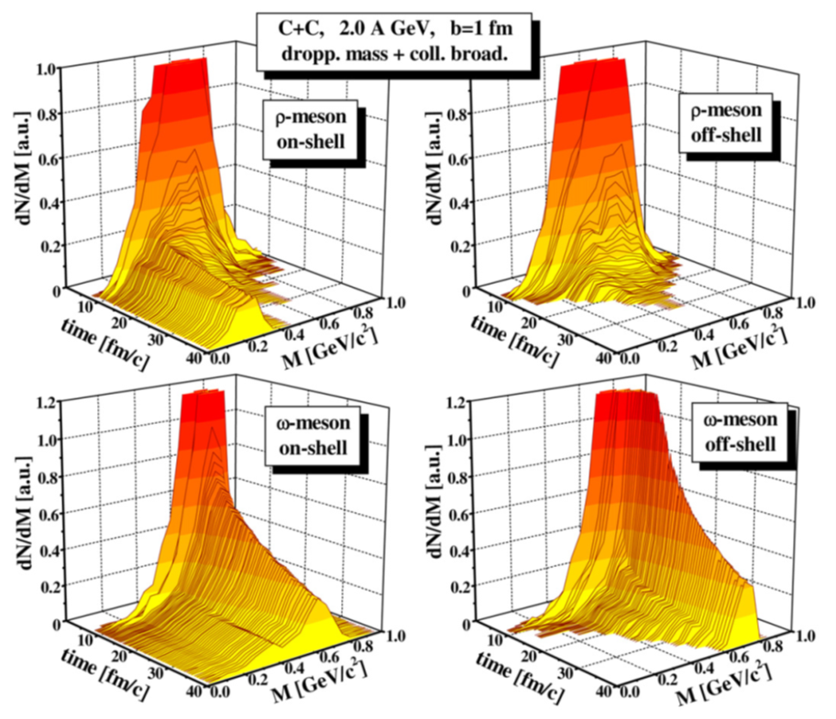
The importance of off-shell contributions
Only on-shell contributions:
Vacuum spectral function are not recovered at late time of the reaction
Off-shell contributions included:
correct behavior
Taken from: E.L. Bratkovskaya and W. Cassing, Nucl. Phys. A 807, 214 (2008).

Slide 19
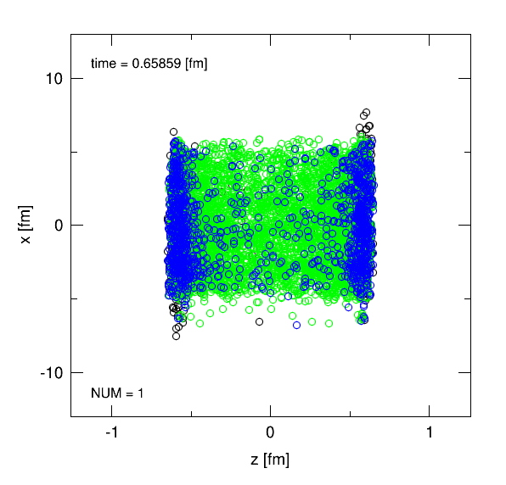
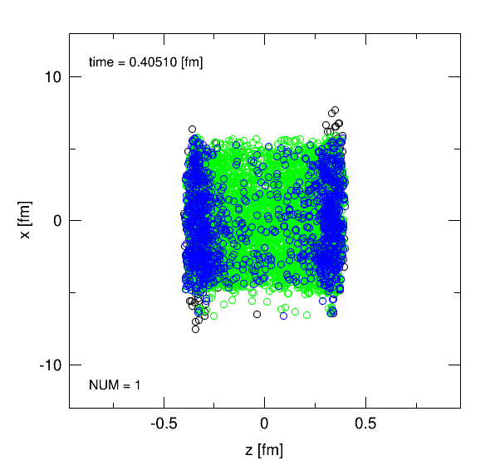
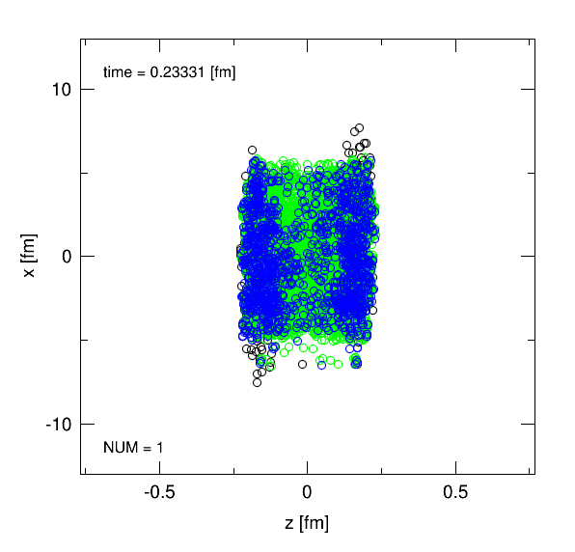
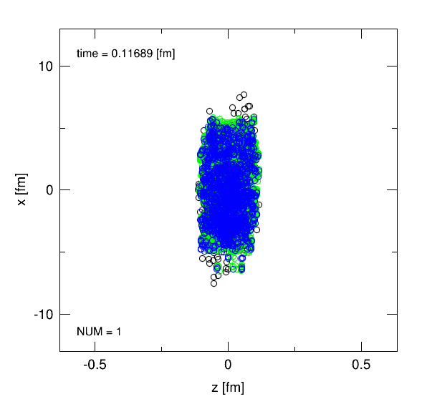
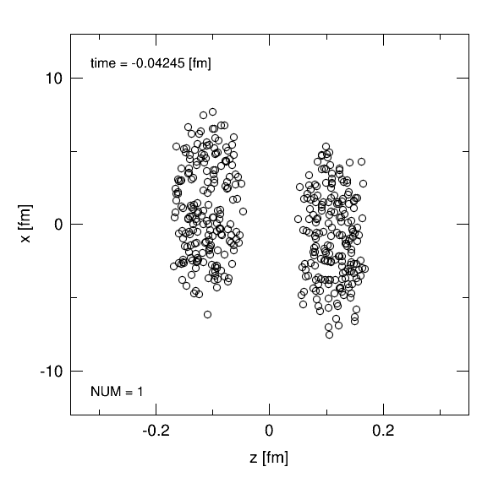
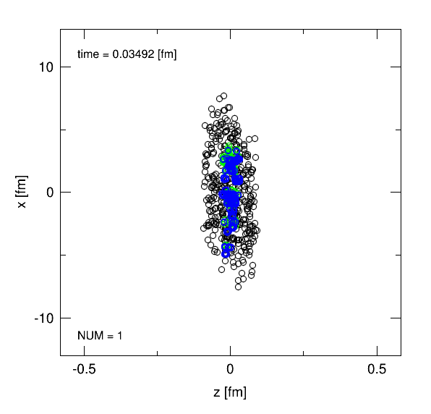
Example of a transport calculation
Au+Au collision at s^{1/2} = 200 GeV, b = 2 fm
nucleons
quarks
gluons
will not be included in the simulations shown in this talk

Slide 20
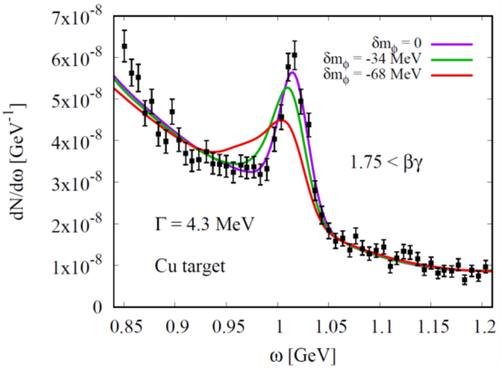
Reason for large modification for fast ϕ mesons
Initial stage of ϕ meson production?
φ
ϕ mesons are generated from high energy collisions (via strings)
p
large momentum
high density
φ
ϕ mesons are generated from low energy hadronic collisions
K⁻
K⁺
p
small momentum
K⁻
low density

Slide 21
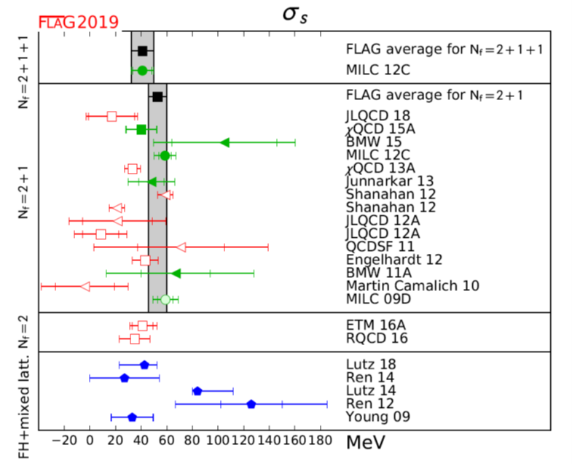
What does lattice QCD say about the strange sigma term?
http://flag.unibe.ch/2019/
See also the most recent result of the BMW collaboration: Sz. Borsanyi et al., arXiv:2007.03319 [hep-lat].

Slide 22
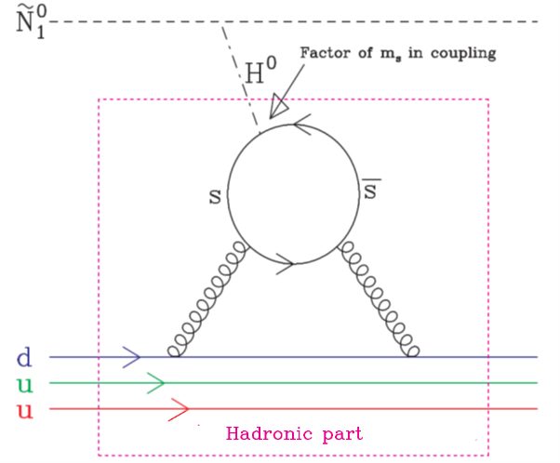
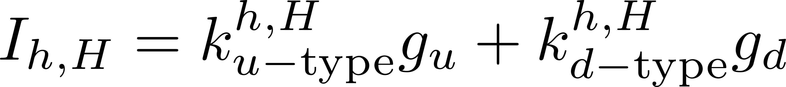
The strangeness content of the nucleon:
Important parameter for dark-matter searches!
Neutralino: Linear superposition of the Super-partners of the Higgs, the photon and the Z-boson
Adapted from:
W. Freeman and D. Toussaint (MILC Collaboration), Phys. Rev. D 88, 054503 (2013).
most important contribution
dominates
A. Bottino, F. Donato, N. Fornengo and S. Scopel, Asropart. Phys. 18, 205 (2002).

Slide 23
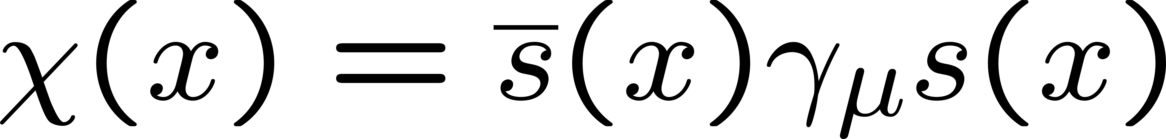
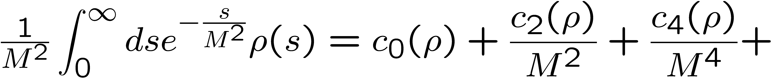
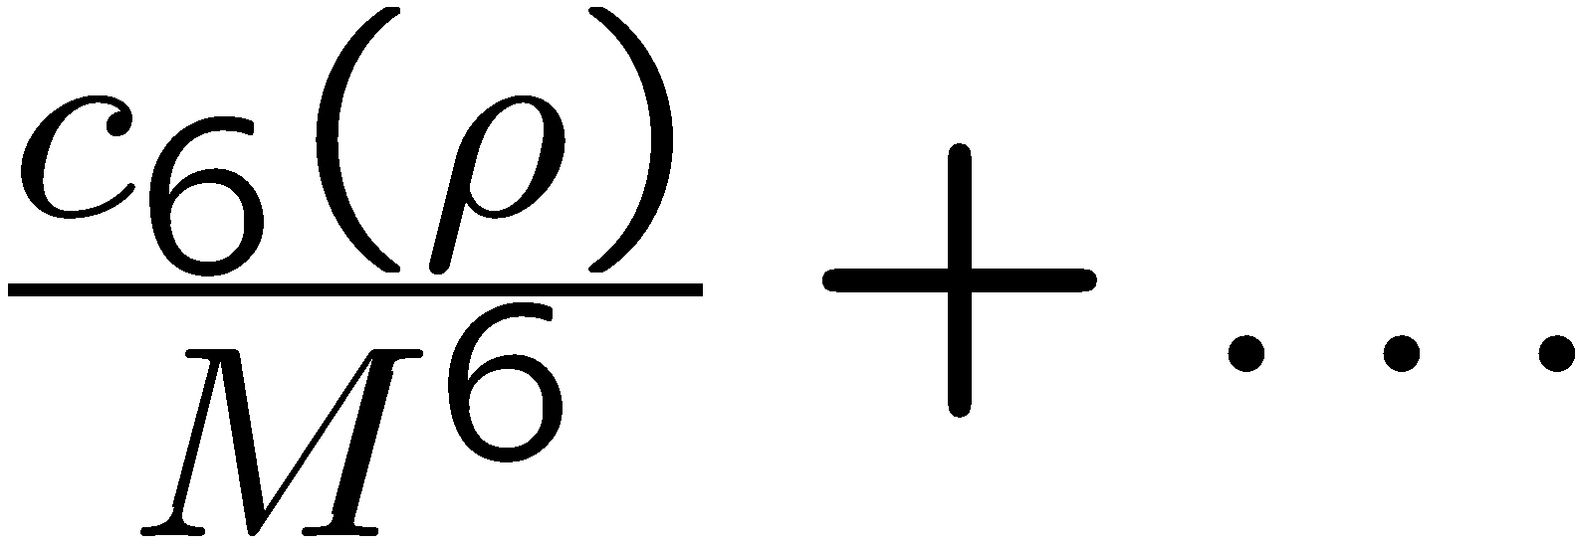
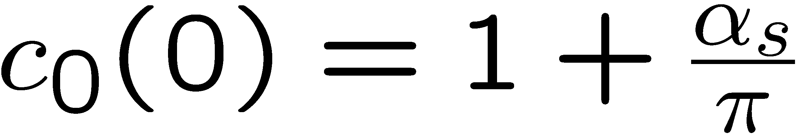
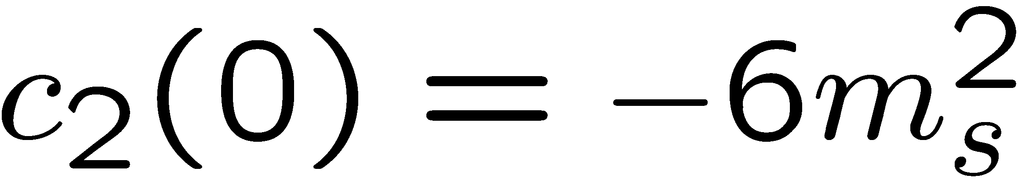

Structure of QCD sum rules for the ϕ meson channel
(after application of the Borel transform)
In Vacuum
Dim. 0:
Dim. 2:
Dim. 4:
Dim. 6:

Slide 24









Structure of QCD sum rules for the ϕ meson
At finite density
(within the linear density approximation)
Dim. 0:
Dim. 2:
Dim. 4:
Dim. 6:

Slide 25

Results for the φ meson mass at rest
Most important parameter, that
determines the behavior of the φ meson mass at finite density:
Strangeness content of the nucleon
P. Gubler and K. Ohtani, Phys. Rev. D 90, 094002 (2014).

Slide 26
Final step: comparison to experimental data
Potential issues:
Experimental background is not included in the simulation
Normalization of the experimental dilepton spectrum is not given
Fit to experimental data is necessary!
Background
φ meson signal
Dilepton spectrum:
Fitted to the experimental dilepton spectrum independently for each βγ-region

Slide 27


Treatment of KN-interactions
Density dependent cross sections based on the chiral unitary model (including coupled channels and s-/p-wave of KN interactions)
Vacuum and density dependent KN cross sections
Density dependent K spectral functions
T. Song et al., Phys. Rev. C 103, 044901 (2021).
See talk by Laura Tolos on Tuesday

