Slide 1
Dynamical Generation of Axial-vector Mesons
Hyun-Chul Kim
Inha University
In Collaboration with Samson Clymton
Meson 2023@Kraków, June 22, 2023

Slide 2
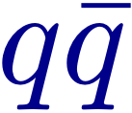
Motivation
Are axial-vector mesons ordinary states?
from the quark model
R. L. Jaffe, PD15 (1977)
Close and Tornqvist, JPG 28 (2002)
L.Maiani et al., PRL 93 (2004)
The low-lying pseudoscalar mesons are states, but their scalar partners are preferably tetraquark states.
Dynamical generation of the axial-vector mesons:
Constructing pseudoscalar and vector meson interactions

Slide 3
Fully off-mass-shell coupled channel formalism
Blankenbecler-Sugar Equation (3-D reduction)
R. Blankenbecler and R. Sugar, PR 142 (1966)

Slide 4
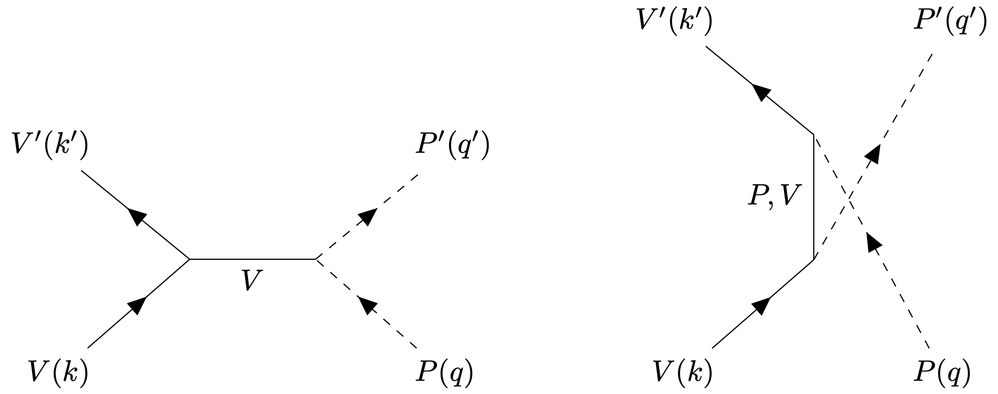
Kernel Amplitudes
Born amplitudes
(No s-channel)
SU(3) Effective Lagrangians
Amplitude for each diagram

Slide 5
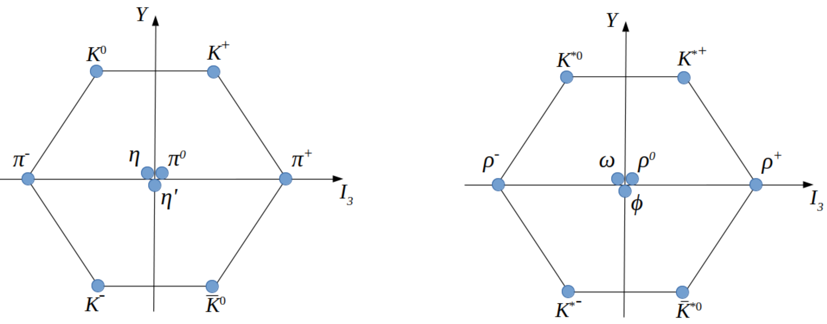
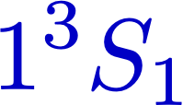
Axial-vector mesons
Pseudoscalar meson octet
Vector-meson octet
Axial-vector mesons:
from the quark models
(?)

Slide 6
Axial-vector mesons
PDG (2022)
We will consider the mesons in boxes.
We use the decay modes to construct the coupled channels.
We will produce them dynamically, using the coupled-channel formalism.

Slide 7
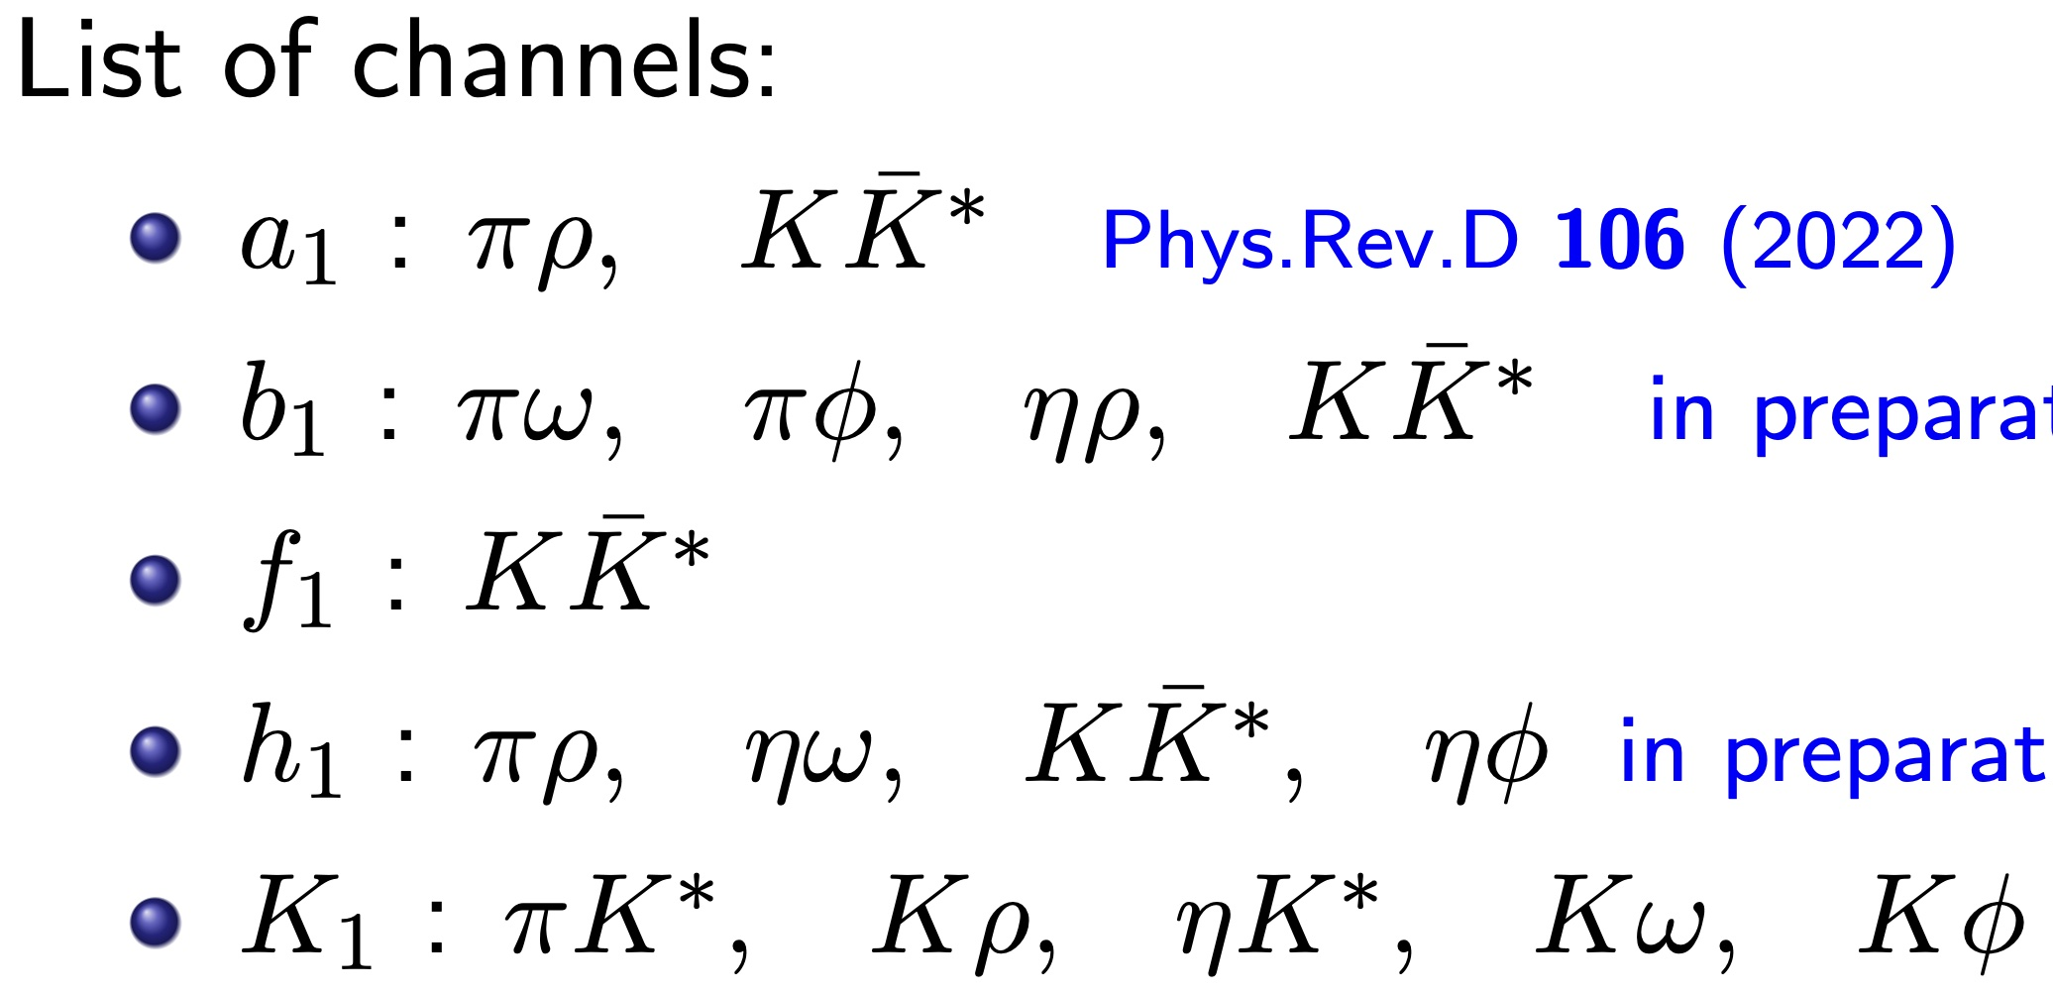
Axial-vector mesons
PDG (2022)
: Future work
Constructing the coupled channels for each meson

Slide 8
a1 mesons

Slide 9
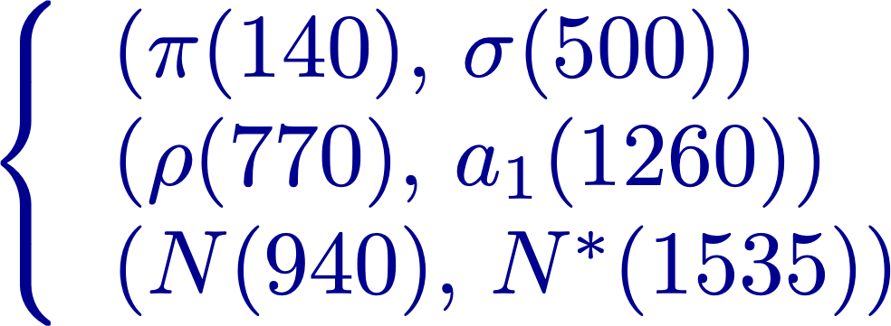
a1 meson
meson as a chiral partner of the meson.
S. Weinberg, PRL 18 (1967)
Experimental status
Its existence was confirmed in 1980.
Chiral partners have complex internal structures.
DESY data from
ZfP C 33, 7 (1986)
CLEO data from
PRD 61, 012002 (2000)
LHCb data from
EPJ C 78, 443 (2018)

Slide 10
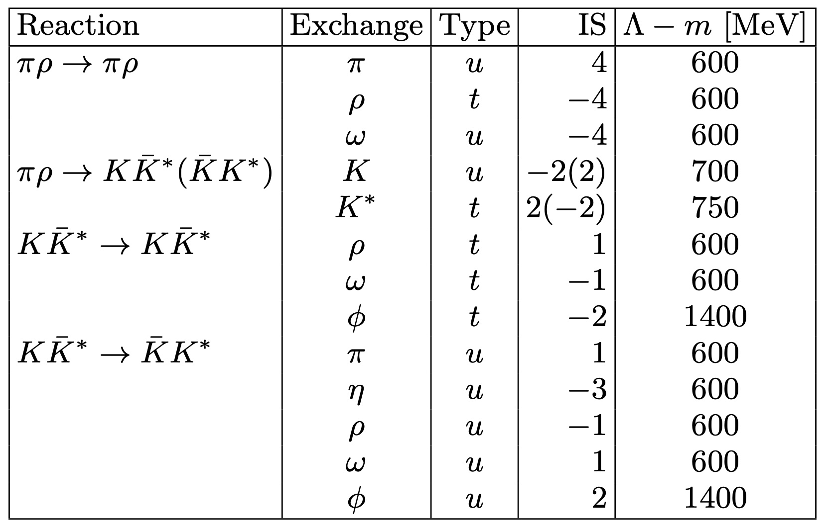
a1 meson
S. Clymton & HChK, PRD 106, 114015 (2022)
n=1 for the pseudoscalar-meson exchange
n=2 for the vector-meson exchange
Coupling constants are determined by hidden local gauge symmetry and flavor SU(3) symmetry.
Bando et al. PRL 54, 1215 (1985)

Slide 11
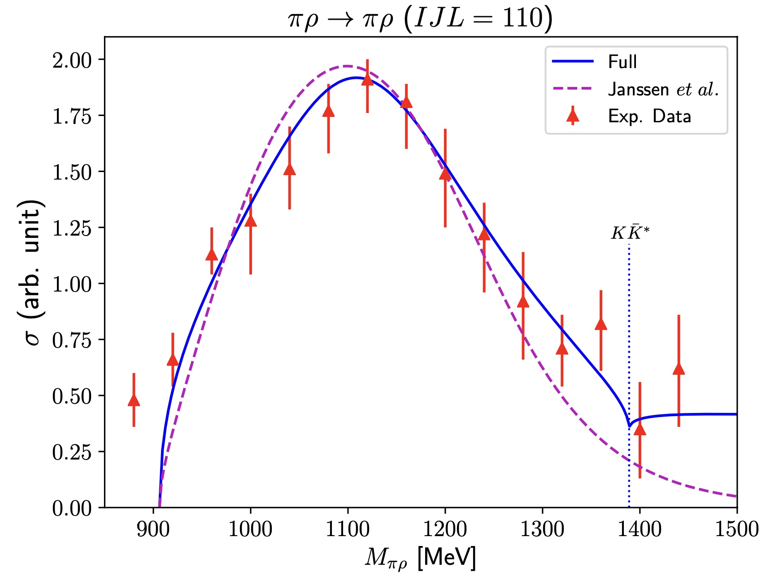
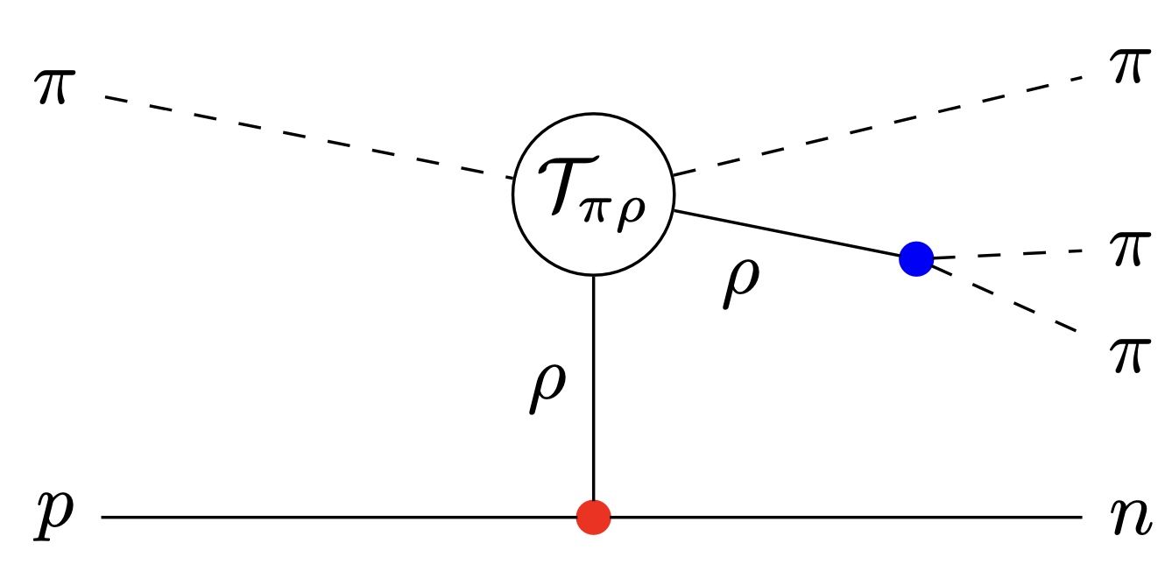
a1 meson
S. Clymton & HChK, PRD 106, 114015 (2022)
Experimental data from the charge-exchange reaction:
with PWA
J.A.Dankowych et al. PRL 46 (1981)
Janssen et al. PRC 54 (1996): a1 as a pole diagram in the s-channel. No coupled channel

Slide 12
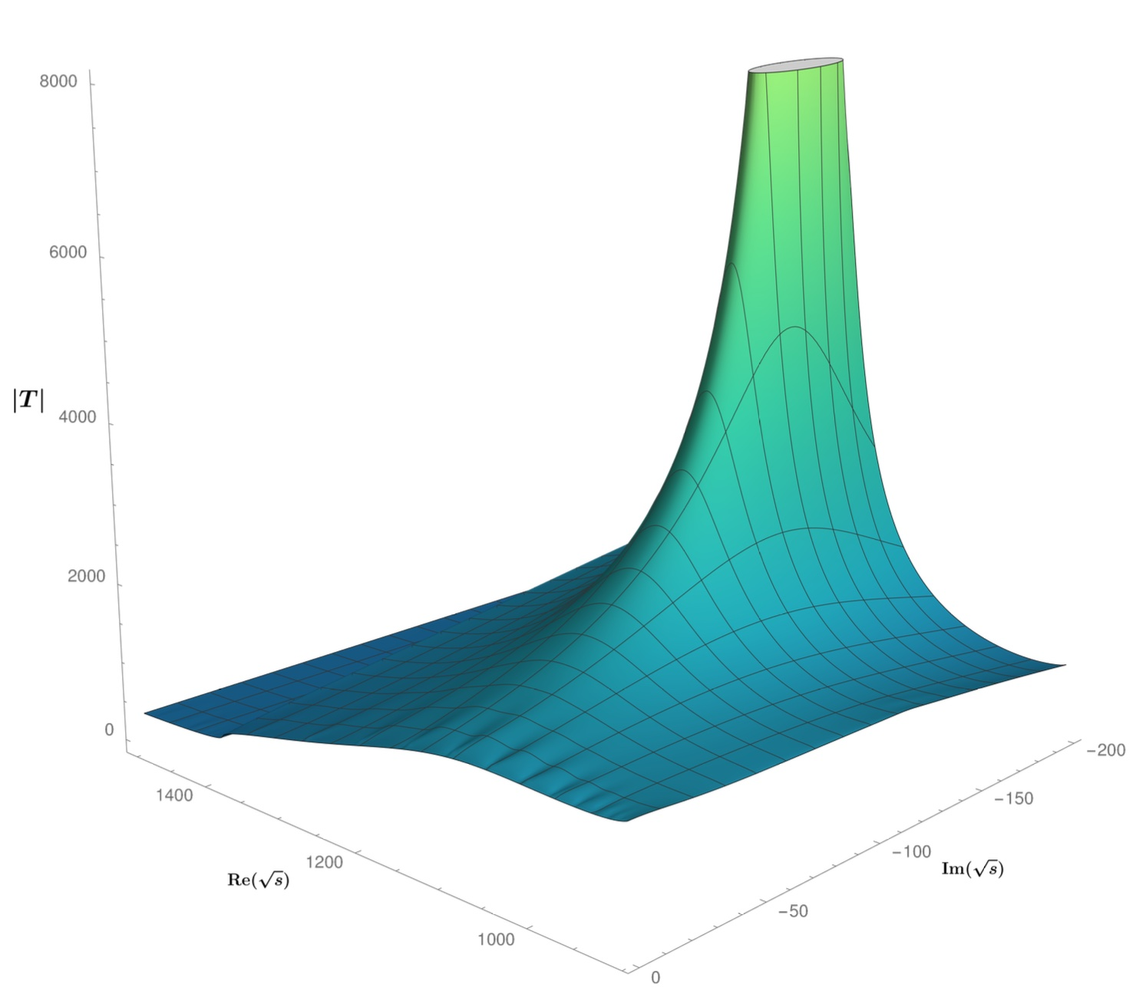
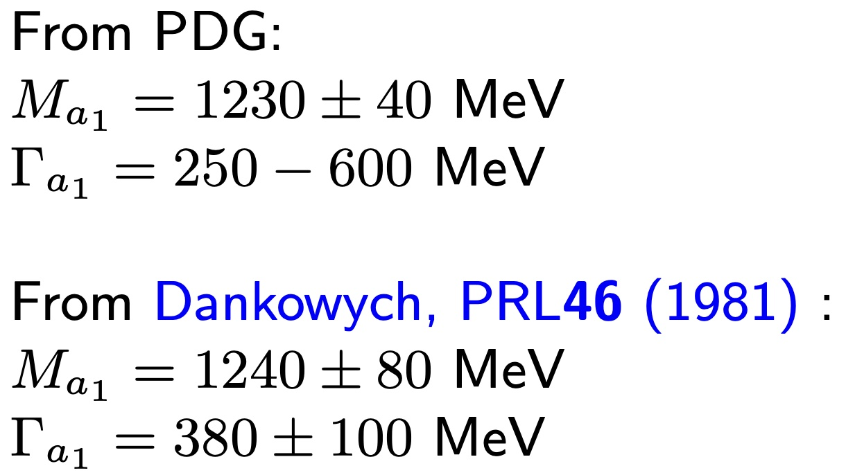
a1 meson
S. Clymton & HChK, PRD 106, 114015 (2022)
We find the pole position at
LHCb data:

Slide 13
a1 meson: Conclusion
S. Clymton & HChK, PRD 106, 114015 (2022)
The a1 meson is possibly a molecular state of a kaon and a vector-kaon.
J. L. Basdevant and E. L. Berger, PRD 16 (1977)
M. F. M. Lutz and E. E. Kolomeitsev, NPA 730 (2004) L. Roca, E. Oset, and J. Singh, PRD 72, 014002 (2005)
H. Nagahiro et al. Phys. Rev. D 83 (2011)
in contrast with the picture from the quark model
Similar to the case of f0(980), a kaon-antikaon molecular state from the pion interaction.

Slide 14
b1 mesons

Slide 15
b1 meson
One very interesting thing: No excited states are found.
: The only known state
Experimental status
PRL 11 (1963).
Though there are many experiments, but all are in 1980s and 1990s.
No new data.

Slide 16
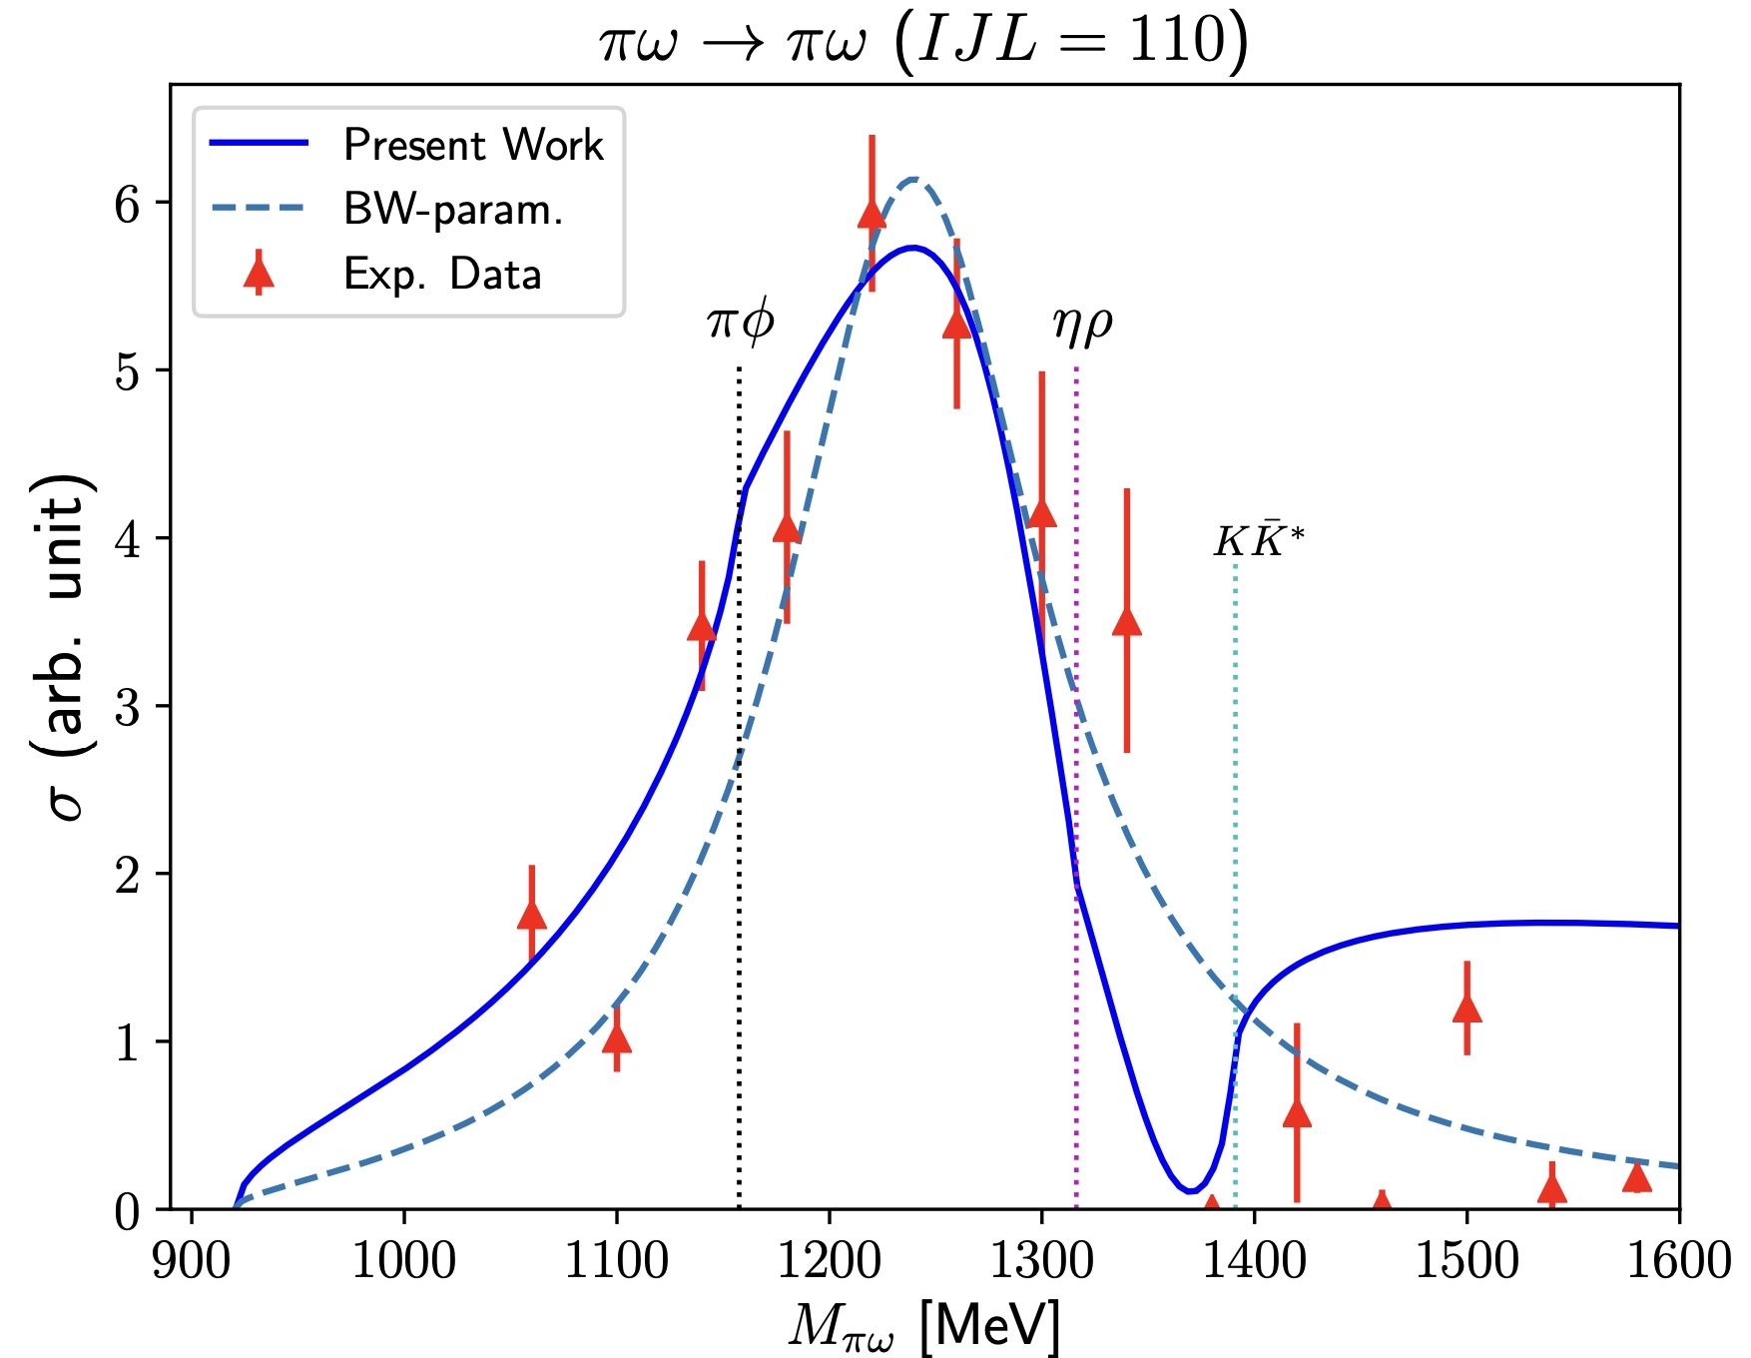
b1 meson
S. Clymton & HChK 2305.14812 [hep-ph]
Experimental data from the charge-exchange reaction:
with PWA
For the Breit-Wigner parametrization, we use
S.Fukui et al. PLB257 (1991)

Slide 17
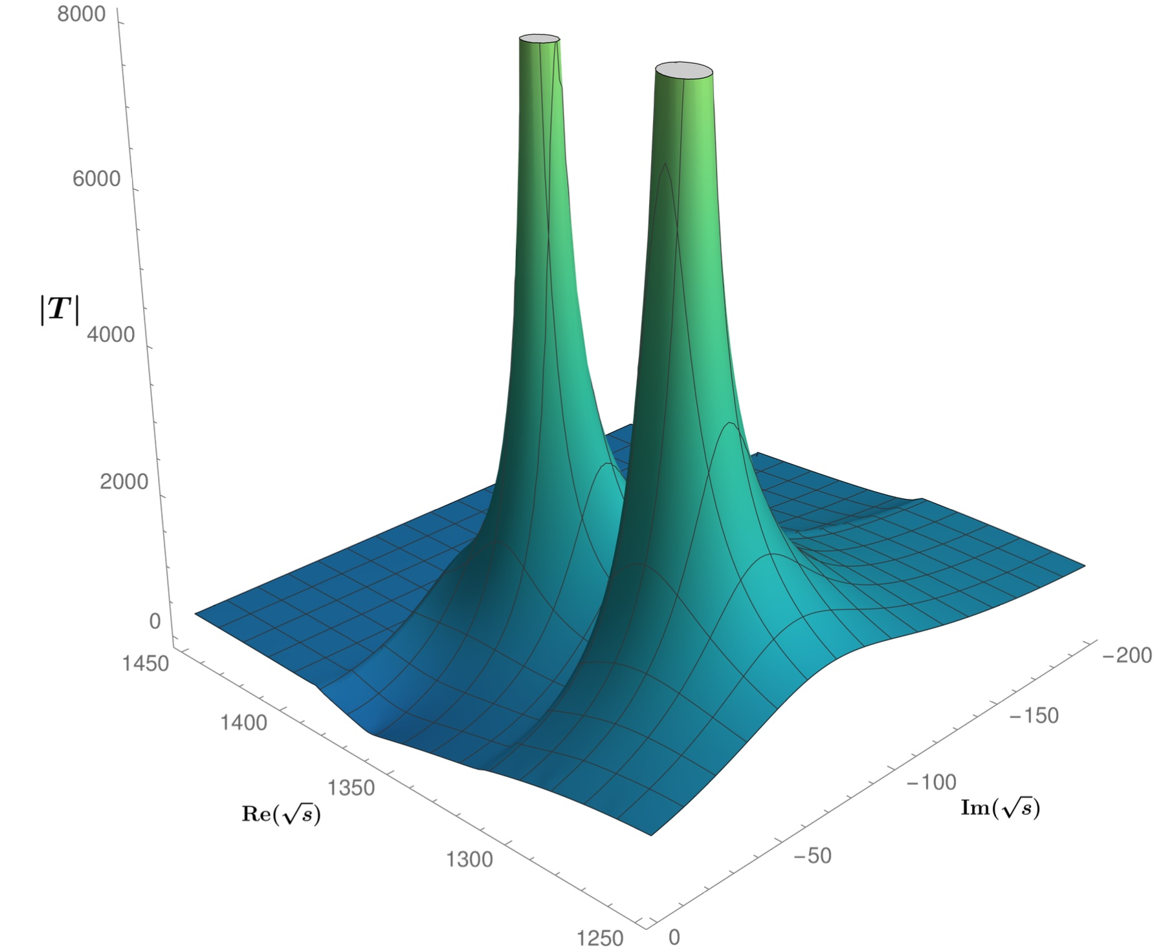
Two-pole structure of the b1 meson
By searching for the poles, we have found the two poles for the b1 meson.
The 1st pole:
The 2nd pole:
We identify the first pole as the b1.
PDG (2022)
S. Clymton & HChK 2305.14812 [hep-ph]

Slide 18
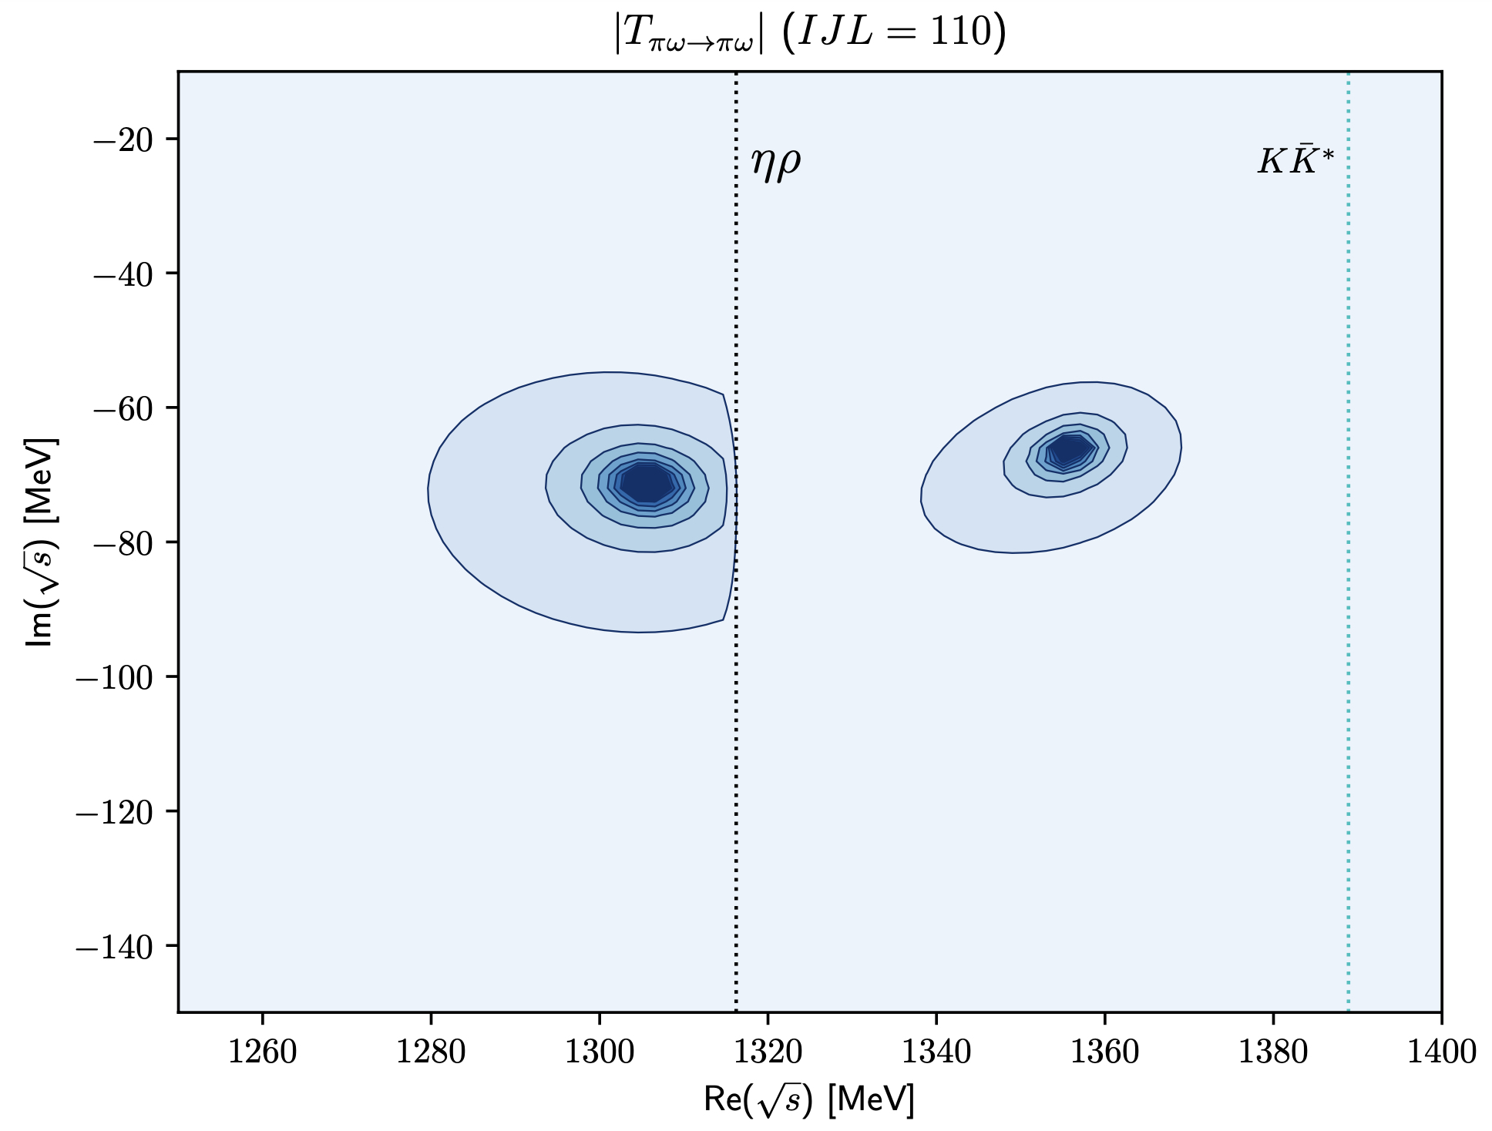
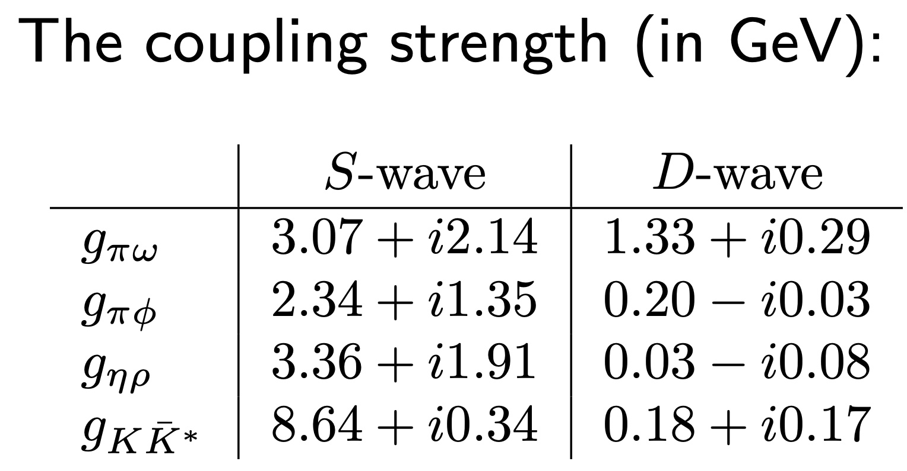
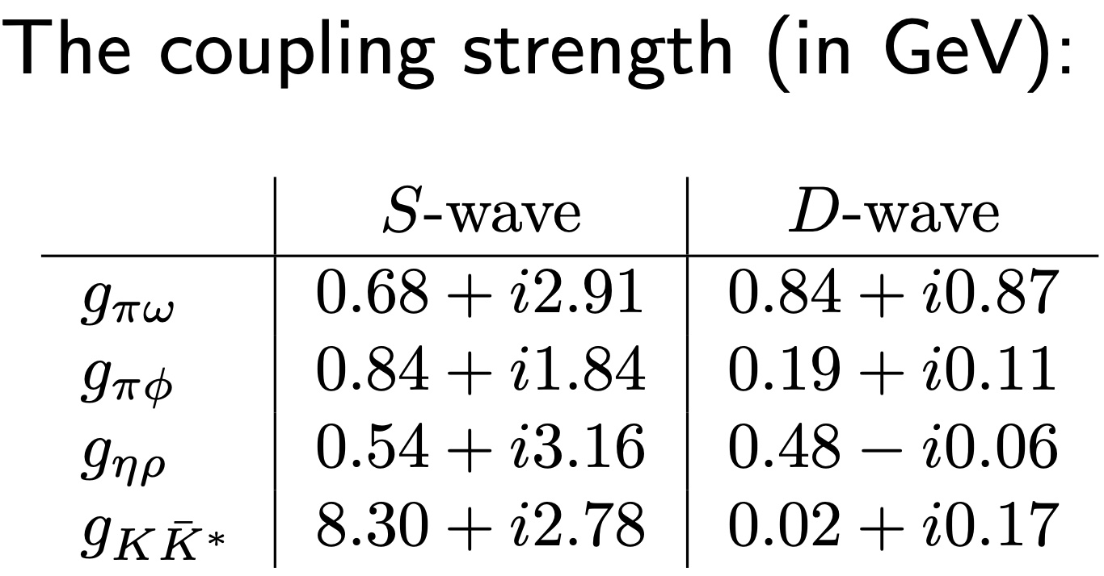
Two-pole structure of the b1 meson
For the 1st pole
2nd pole
For the 2nd pole
1st pole
S. Clymton & HChK 2305.14812 [hep-ph]

Slide 19
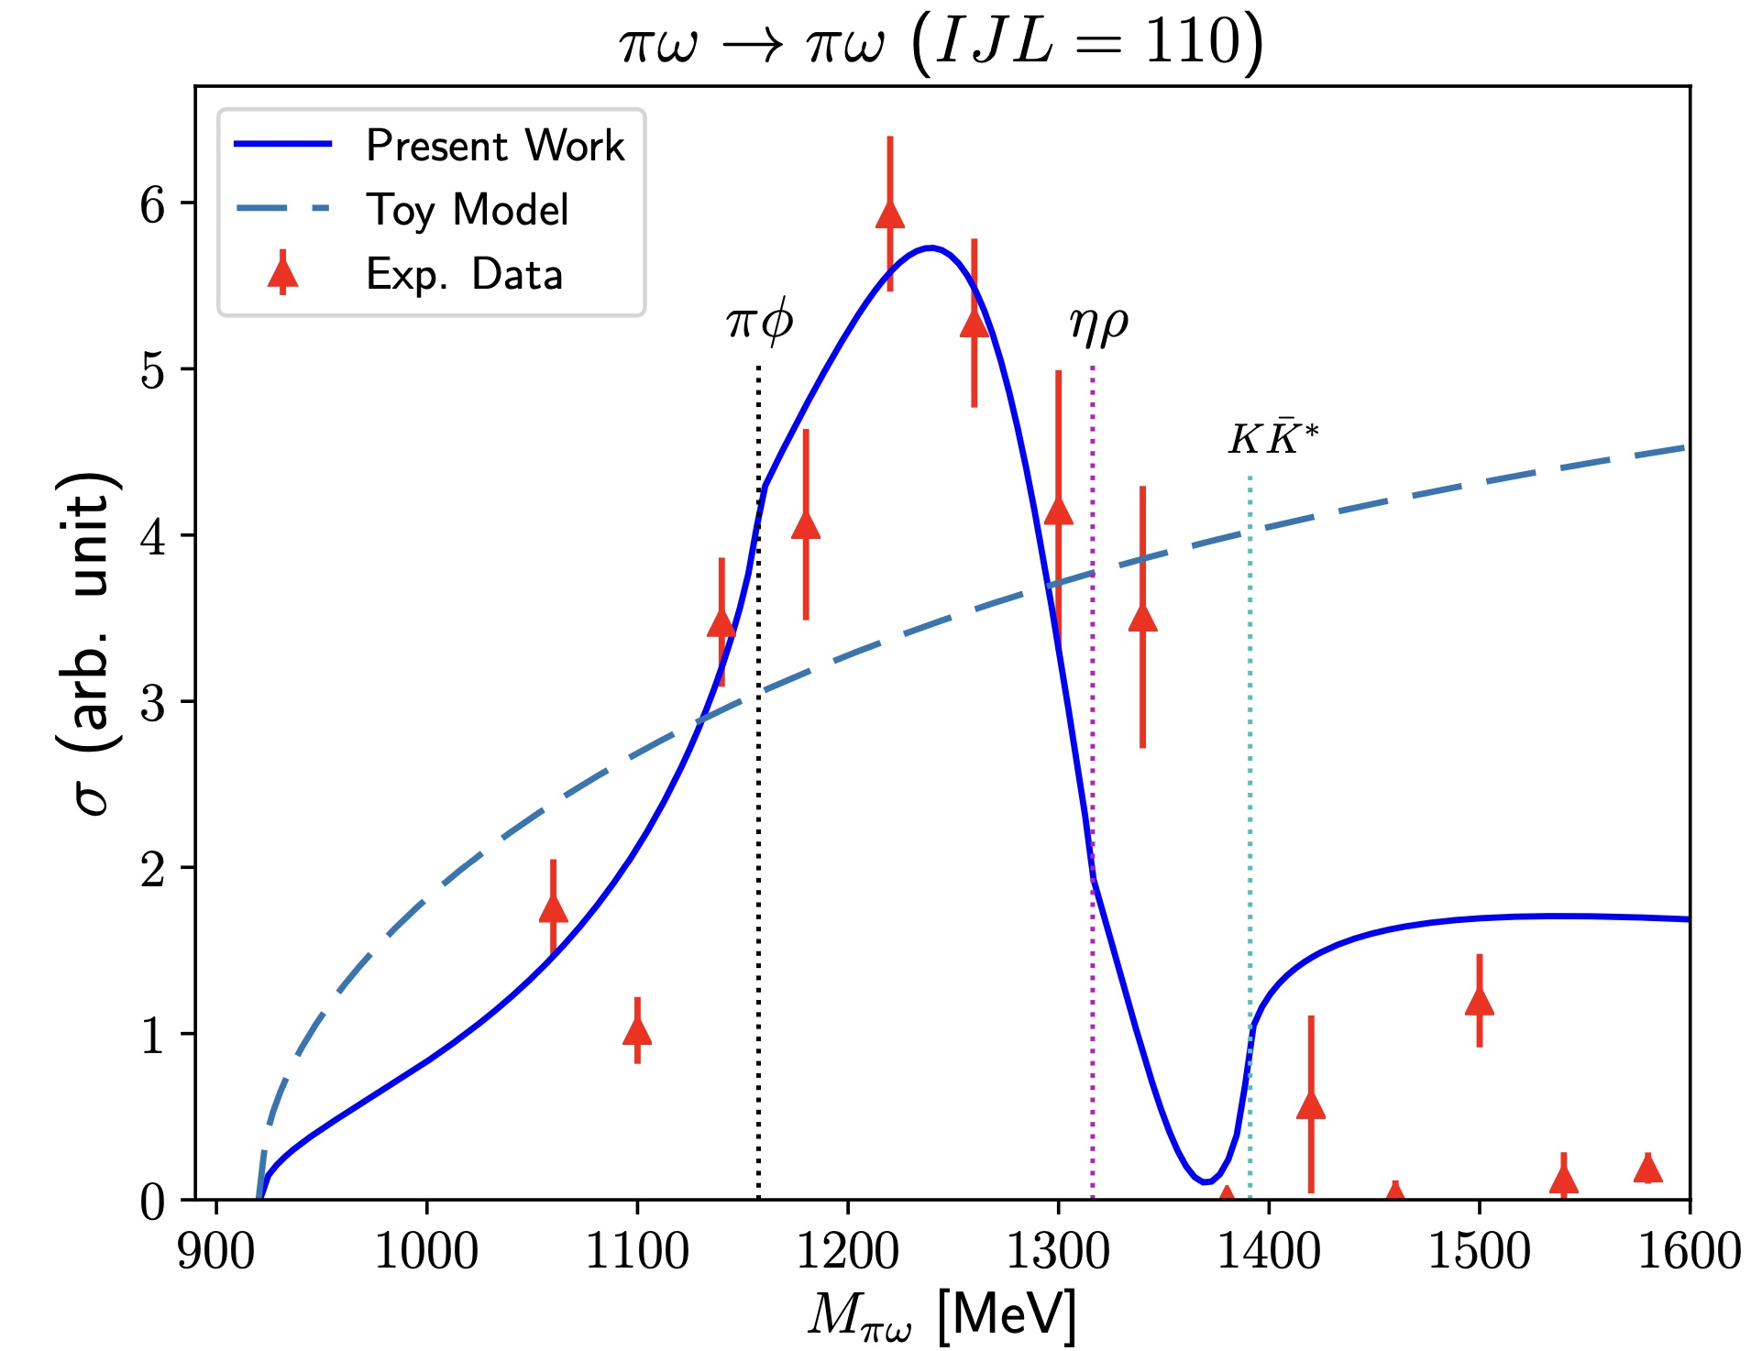
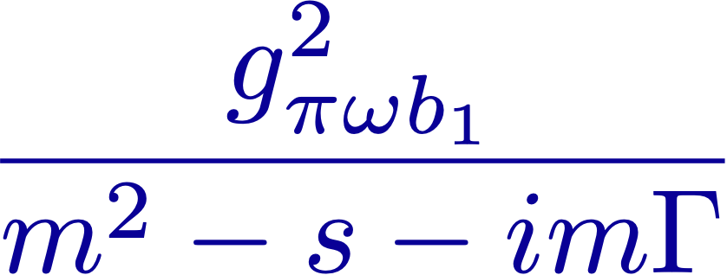
Two-pole structure of the b1 meson: Toy model
A Toy model to understand the two-pole structure
The pole of the T matrix
S. Clymton & HChK 2305.14812 [hep-ph]

Slide 20
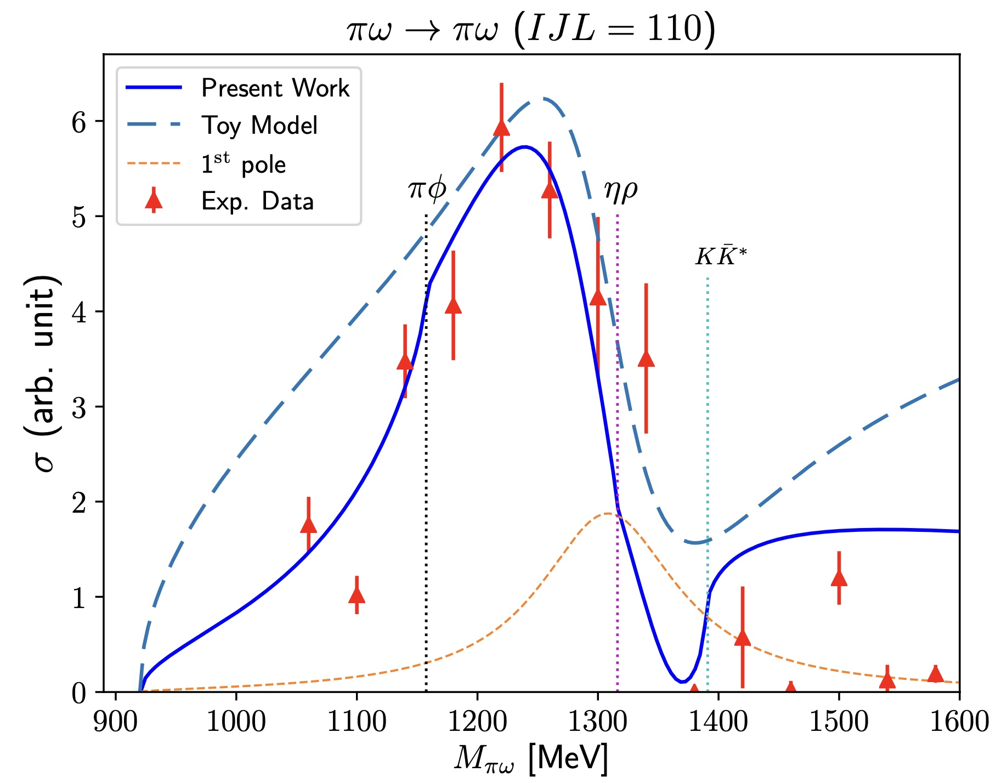
Two-pole structure of the b1 meson: Toy model
A Toy model to understand the two-pole structure
The pole of the T matrix
The first pole of the T matrix
S. Clymton & HChK 2305.14812 [hep-ph]

Slide 21
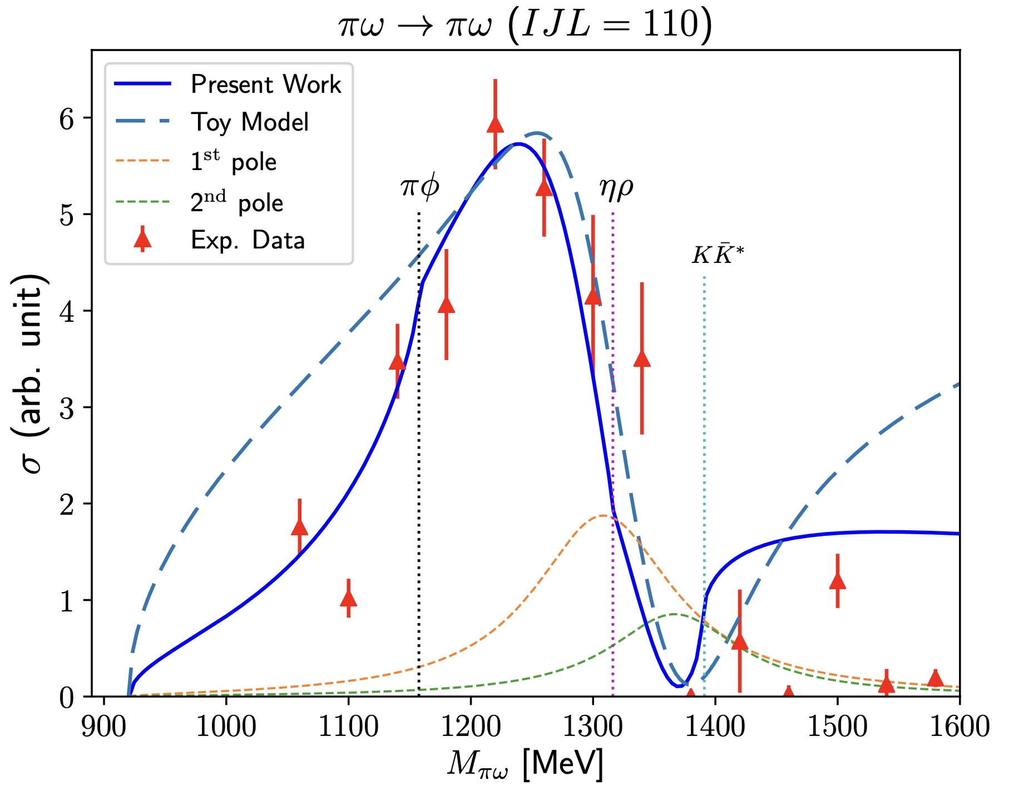
Two-pole structure of the b1 meson: Toy model
A Toy model to understand the two-pole structure
The pole of the T matrix
The second pole of the T matrix
S. Clymton & HChK 2305.14812 [hep-ph]

Slide 22
Two-pole structures in general

Slide 23
h1 meson

Slide 24
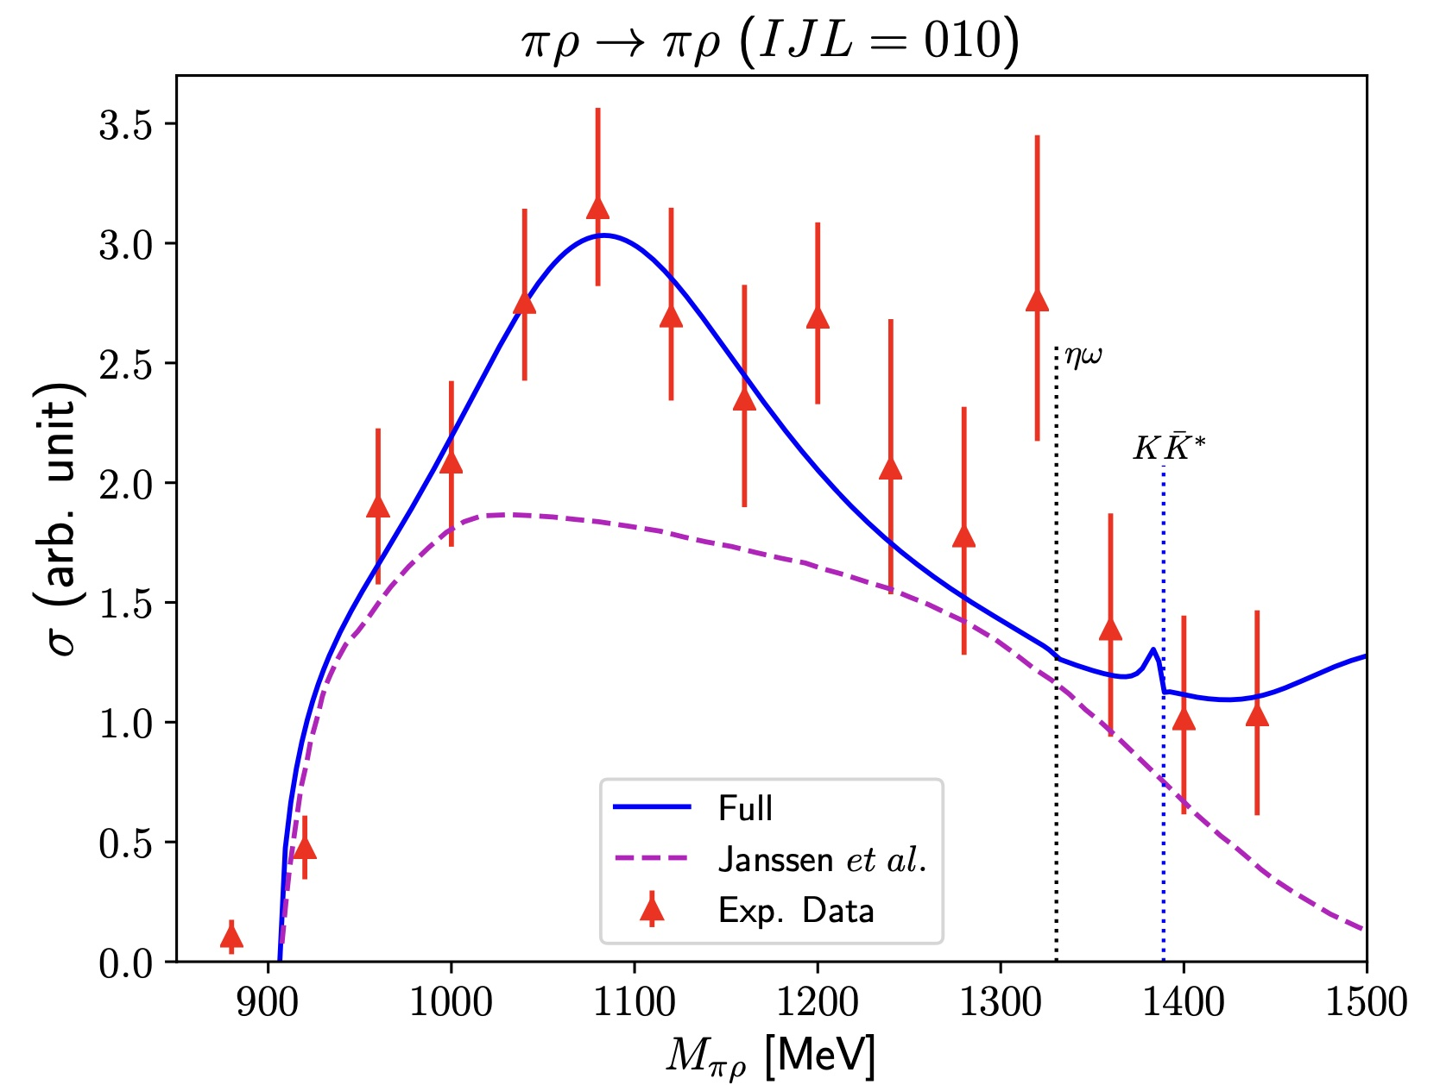
b1 meson
Experimental data from the charge-exchange reaction:
with PWA
J.A.Dankowych et al. PRL 46 (1981)
We have explicitly included h1(1595).
Janssen et al. PRC 54 (1996): h1 as a pole diagram in the s-channel. No coupled channel

Slide 25
b1 meson
S. Clymton & HChK, in preparation
We have found four different h1 states.
Two-pole Structure?
Experimentally, three h1 were known.
(It was formerly known as h1(1380).)

Slide 26
Summary & Conclusion

Slide 27
Summary & Conclusion
Three main results
a1(1260) meson: Kaon and vector kaon molecular state
b1(1235) meson: Two-pole structure
h1 meson: We need to introduce h1(1595) explicitly. h1(1409) may have a possible two-pole structure that may arise from interference of two h1 mesons.
Extension to the meson-baryon and heavy-flavor systems
Dynamical generation of multiquark states (tetra- and pentaquarks)

Slide 28
Though this be madness,
yet there is method in it.
Hamlet Act 2, Scene 2
Bardzo dziękujemy!
Thank you very much!
대단히 감사합니다!

