Slide 1
Signatures for tetraquark mixing from experimental partial decay widths of the two light-meson nonets
Hungchong Kim (Korea University)
K.S. Kim (Korea Aerospace University)
Based on EPJC (2022) 82, 1113
6/22-6/27 Krakow, Poland

Slide 2
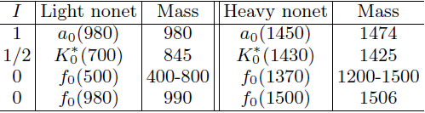

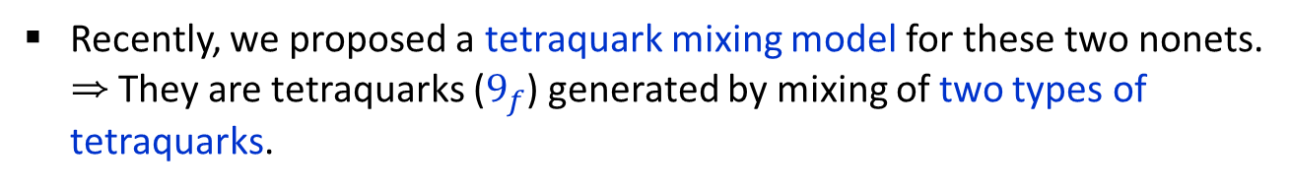
Overview
There are two set of resonances in $J^{P}=0^{+}$, which we call ‘light’ and ‘heavy’ nonets .
$∆M≳500$ MeV
Recently, we proposed a tetraquark mixing model for these two nonets.
⇒ They are tetraquarks ($9_{f}$) generated by mixing of two types of tetraquarks.
There are various signatures that support this mixing model.
In this presentation, we focus on a strong signature from the experimental partial decay widths of the two nonets.

Slide 3












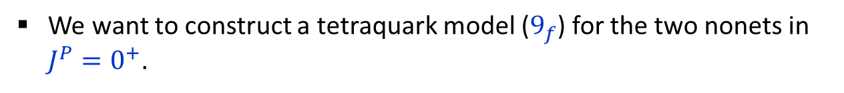








Tetraquark mixing model
We want to construct a tetraquark model ($9_{f}$) for the two nonets in $J^{P}=0^{+}$.
Light nonet
$${ a}_{0}\left(980\right),K_{0}^{∗}\left(800\right),f_{0}\left(500\right), f_{0}\left(980\right)$$
Heavy nonet
$${ a}_{0}\left(1450\right),K_{0}^{∗}\left(1430\right), f_{0}\left(1370\right),f_{0}\left(1500\right)$$
$$K_{0}^{∗0}\left(800\right)$$
$$K_{0}^{∗+}\left(700\right)$$
$$K_{0}^{∗0}\left(1430\right)$$
$$K_{0}^{∗+}\left(1430\right)$$
$$a_{0}^{−}\left(980\right)$$
$$a_{0}^{0}\left(980\right)$$
$$a_{0}^{+}\left(980\right)$$
$$a_{0}^{−}\left(1450\right)$$
$$a_{0}^{0}\left(1450\right)$$
$$a_{0}^{+}\left(1450\right)$$
$$f_{0}\left(500\right)$$
$$f_{0}\left(980\right)$$
$$f_{0}\left(1370\right)$$
$$f_{0}\left(1500\right)$$
$${\overline{K}}_{0}^{∗−}\left(800\right)$$
$${\overline{K}}_{0}^{∗0}\left(800\right)$$
$${\overline{K}}_{0}^{∗−}\left(1430\right)$$
$${\overline{K}}_{0}^{∗0}\left(1430\right)$$
To do this, two types of tetraquarks are required.

Slide 4
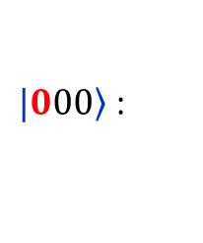
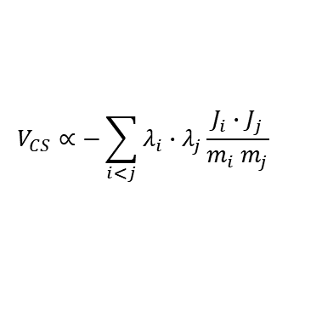


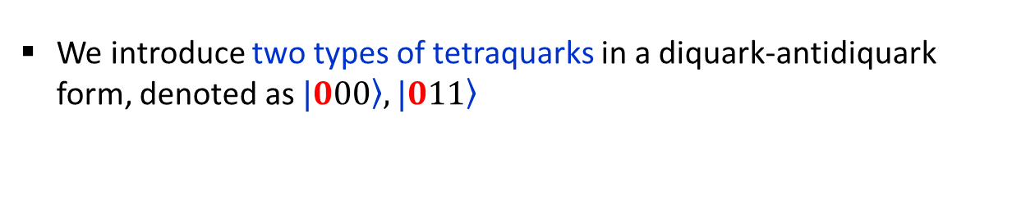


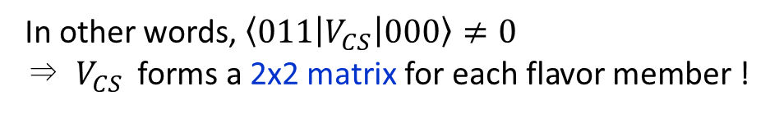


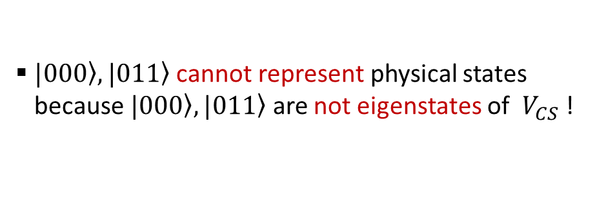
We introduce two types of tetraquarks in a diquark-antidiquark form, denoted as $\left.|000\right\rangle ,\left.|011\right\rangle$
$$qq$$
$$\overline{q}\overline{q}$$
($q=u,d,s)$
“inverted mass ordering”
$\left.|000\right\rangle$ :
$$\left[qq∈\left({J=0,{\overline{3}}_{c},\overline{3}}_{f}\right)\right]⨂\left[\overline{q}\overline{q}∈(J=0,3_{c},3_{f})\right]$$
$⟹$ $qq\overline{q}\overline{q}∈\left({J=0,1}_{c}, 9_{f}\right)$
Well-known tetraquark type, originally constructed for the light nonet (Jaffe).
$\left.|011\right\rangle$ :
$$\left[qq∈\left({J=1,6_{c},\overline{3}}_{f}\right)\right]⨂\left[\overline{q}\overline{q}∈(J=1,{\overline{6}}_{c},3_{f})\right]$$
$⟹$ $qq\overline{q}\overline{q}∈\left({J=0,1}_{c}, 9_{f}\right)$
Another type proposed by us in 2017.
$\left.|000\right\rangle ,\left.|011\right\rangle$ cannot represent physical states
because $\left.|000\right\rangle ,\left.|011\right\rangle$ are not eigenstates of $V_{CS}$ !
$$V_{CS}∝−\sum_{i<j}{λ_{i}∙λ_{j}\frac{J_{i}∙J_{j}}{m_{i} m_{j}}}$$
  In other words, $\left\langle 011 | V_{CS} | 000\right\rangle ≠0$
  ⇒ $V_{CS}$ forms a 2x2 matrix for each flavor member !
Color-spin interaction

Slide 5
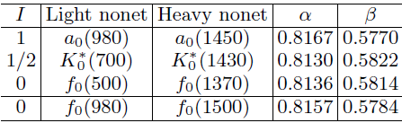
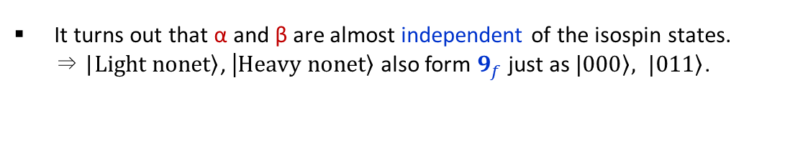
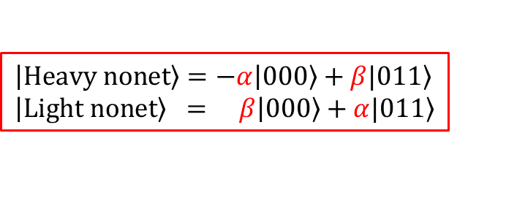


Physical states can be constructed by diagonalizing the 2x2 matrix of $V_{CS}$.
The diagonalization process produces two sets of “physical” states,
$$\left|\left.Heavy nonet\right\rangle =−α\right|\left.000\right\rangle +β\left.|011\right\rangle \\ \left|\left.Light nonet\right\rangle = β\right|\left.000\right\rangle +α\left.|011\right\rangle$$
⇒${ a}_{0}\left(1450\right),K_{0}^{∗}\left(1430\right), f_{0}\left(1370\right),f_{0}\left(1500\right)$
⇒${ a}_{0}\left(980\right),K_{0}^{∗}\left(800\right),f_{0}\left(500\right), f_{0}\left(980\right)$
and the mixing parameters, $α,β,$ for each flavor member,
It turns out that α and β are almost independent of the isospin states.
⇒ |$\left.Light nonet\right\rangle$, |$\left.Heavy nonet\right\rangle$ also form $9_{f}$ just as $\left.|000\right\rangle , \left.|011\right\rangle$.
This is tetraquark mixing model for the two nonets !
EPJC 77 (2017) 3, EPJC 77 (2017) 7, 435,
PRD 97 (2018) 9, 094005, PRD 99 (2019) 1, 014005,
PRD 100 (2019) 3, 034021, EPJC 82 (2022) 12, 1113

Slide 6
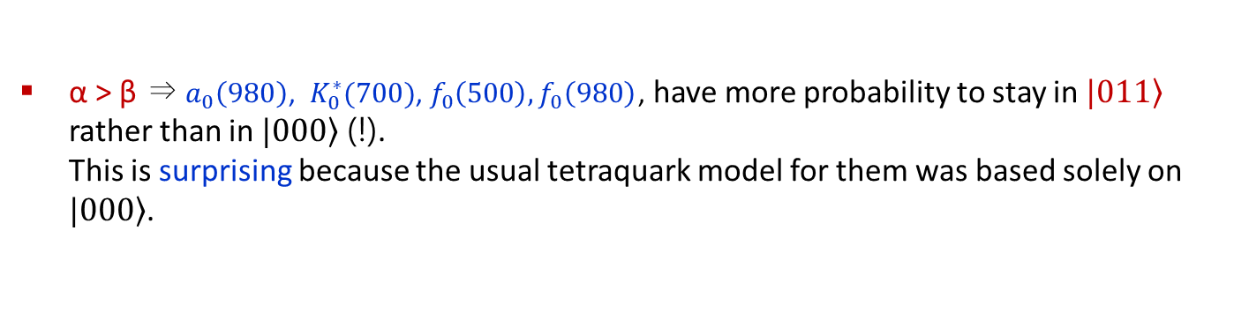
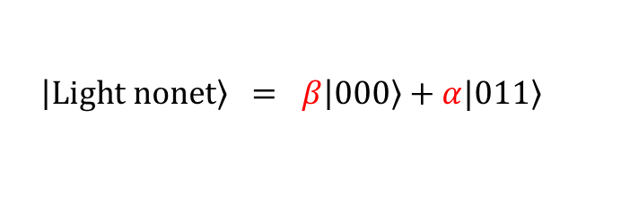
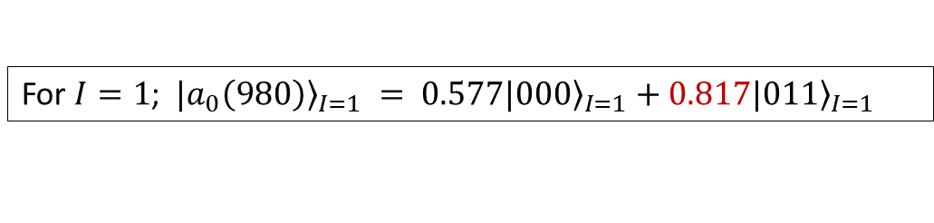
Skip
One remarkable feature of the tetraquark mixing model
$$\left|\left.Light nonet\right\rangle = β\right|\left.000\right\rangle +α\left.|011\right\rangle$$
α > β ⇒ $a_{0}\left(980\right)$, $K_{0}^{∗}(700)$, $f_{0}\left(500\right),f_{0}\left(980\right)$, have more probability to stay in $\left.|011\right\rangle$ rather than in $\left.|000\right\rangle$ (!).
This is surprising because the usual tetraquark model for them was based solely on $\left.|000\right\rangle$.
For $I=1$; ${\left.|a_{0}\left(980\right)\right\rangle }_{I=1} = 0.577|{\left.000\right\rangle }_{I=1}+0.817|{\left.011\right\rangle }_{I=1}$

Slide 7
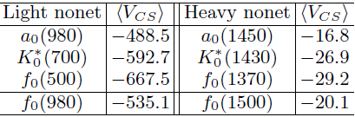
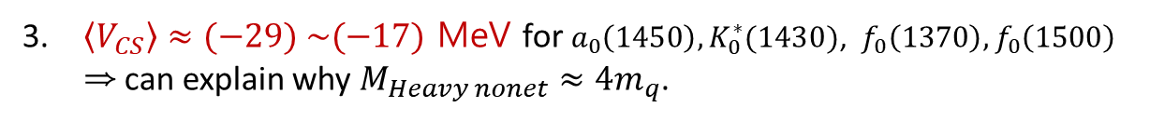
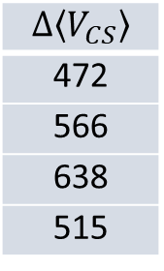

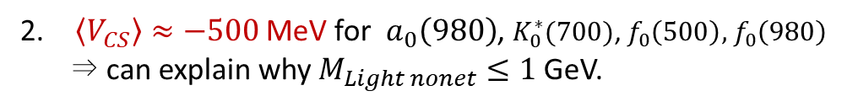
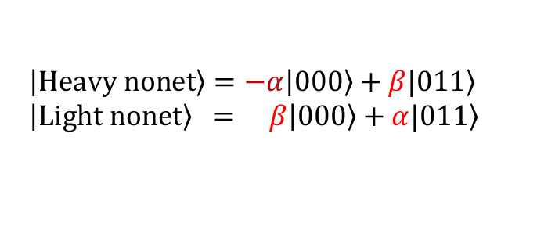

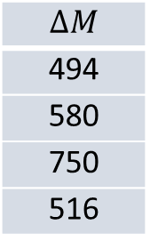
Skip
Successful features that support the tetraquark mixing model
$$\left|\left.Heavy nonet\right\rangle =−α\right|\left.000\right\rangle +β\left.|011\right\rangle \\ \left|\left.Light nonet\right\rangle = β\right|\left.000\right\rangle +α\left.|011\right\rangle$$
$ΔM≈Δ\left\langle V_{CS}\right\rangle$ !
$\left\langle V_{CS}\right\rangle ≈−500$ MeV for $a_{0}\left(980\right)$, $K_{0}^{∗}(700)$, $f_{0}\left(500\right),$ $f_{0}\left(980\right)$ ⇒ can explain why $M_{Light nonet}≤1$ GeV.
$\left\langle V_{CS}\right\rangle ≈(−29) \sim (−17)$ MeV for $a_{0}\left(1450\right),K_{0}^{∗}(1430)$, $f_{0}\left(1370\right),f_{0}\left(1500\right)$
⇒ can explain why $M_{Heavy nonet}≈4m_{q}$.
$$ΔM$$
494
580
750
516
$$Δ\left\langle V_{CS}\right\rangle$$
472
566
638
515
$\left\langle V_{CS}\right\rangle$ in the physical basis
QCD sum rules for $a_{0}\left(980\right)$ support this result (Lee et.al. PRD2019).

Slide 8



The most striking prediction of the tetraquark mixing model
is that the coupling strengths into PP satisfy
$\left|G\right|$(light nonet) $≫$ ${|G}^{′}|$ (heavy nonet)
Light nonet ⇒ PP
Heavy nonet ⇒ PP
P
P
Light nonet
$$G$$
Heavy nonet
$$G^{′}$$
P
P
ex) For $a_{0}\left(980\right)→ηπ, a_{0}\left(1450\right)→ηπ$, the coupling strengths are defined by
$G=\left\langle π^{+}η | a_{0}^{+}(980)\right\rangle , G^{′}=\left\langle π^{+}η | a_{0}^{+}(1450)\right\rangle$

Slide 9



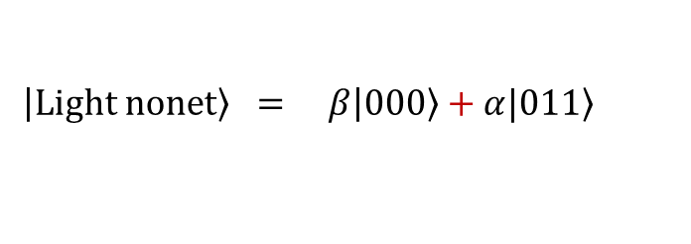
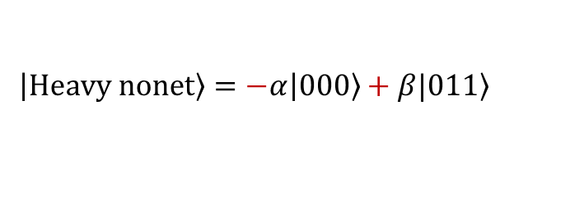


Why $\left|G\right|$ $≫$ ${|G}^{′}|$ in tetraquark mixing model ?
Tetraquarks decay into two mesons mainly through the fall-apart mechanism.
(24)
$$q_{1}q_{2}{\overline{q}}_{3}{\overline{q}}_{4}$$
$$[$$
$$]_{1_{c}}$$
$$⟹[{\left(1_{c}\right)}_{13}⊗{\left(1_{c}\right)}_{24}]_{1_{c}}⊕[{\left(8_{c}\right)}_{13}⊗{\left(8_{c}\right)}_{24}]_{1_{c}}$$
(13)
2-meson modes
$$\left|\left.Heavy nonet\right\rangle =−α\right|\left.000\right\rangle +β\left.|011\right\rangle$$
$qq\overline{q}\overline{q}$ fall-apart decay
$$\left|\left.Light nonet\right\rangle = β\right|\left.000\right\rangle +α\left.|011\right\rangle$$
Due to the difference in relative signs,
☞ the coupling strengths for the PP modes are enhanced in the light nonet but suppressed in the heavy nonet.

Slide 10
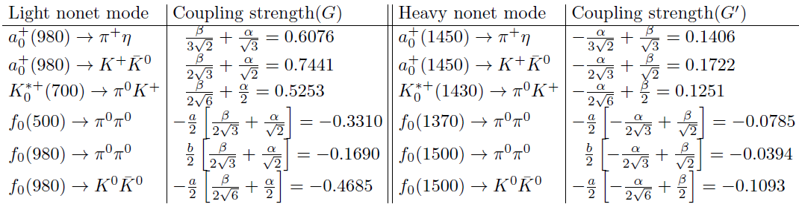




Coupling strengths to PP mesons
$a,b$ are flavor mixing parameters for the isoscalar resonances.
So, the tetraquark mixing model predicts that
$\left|G\right|$(light nonet) $≫$ ${|G}^{′}|$ (heavy nonet)
⇒ $\frac{G}{G^{′}}≈4 !$
Interesting prediction that may not be made from other models.
This prediction can be experimentally verified by examining partial decay widths.
$$Γ_{partial}=G^{2}Γ_{kin}$$
Notes:
There are inequalities between the coupling strengths. They are enhanced in the light nonet but suppressed in the heavy nonet.
Experimentally, this inequalities can be tested from the corresponding partial decay widths because the
width is proportional to the coupling strength square times the other part depending only kinematics.

Slide 11
Qualitative verification
of our prediction from experimental partial widths

Slide 12
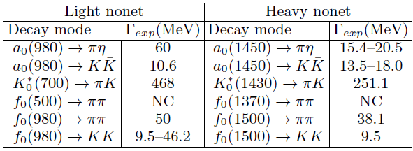
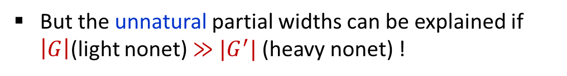
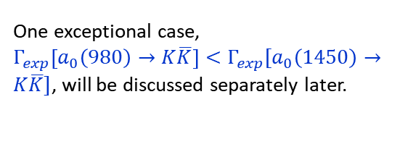
Experimental partial widths estimated from PDG (2022)
NC: Not conclusive
Mostly, $Γ_{exp}$(light nonet) $≳Γ_{exp}$(heavy nonet).
One exceptional case,
$Γ_{exp}\left[a_{0}\left(980\right)→K\overline{K}\right]<Γ_{exp}\left[a_{0}\left(1450\right)→K\overline{K}\right]$, will be discussed separately later.
$$Γ_{exp}\left[f_{0}\left(980\right)→K\overline{K}\right]≳Γ_{exp}\left[f_{0}\left(1500\right)→K\overline{K}\right]$$
These experimental partial widths are not natural.
(Not easy to understand intuitively!)
But the unnatural partial widths can be explained if
$\left|G\right|$(light nonet) $≫$ ${|G}^{′}|$ (heavy nonet) !
Notes:
1. Some partial widths are not known until recently.
ex) $K_{0}^{∗}(700)⟹πK$, $f_{0}(980)⟹ππ$ were not listed in 2016 PDG.
2. Some partial widths still have large uncertainty.
ex) $f_{0}(980)⟹K\overline{K}$ .
Purely from the kinematical point of view, this inequality is quite unnatural.

Slide 13

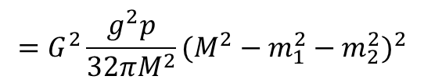
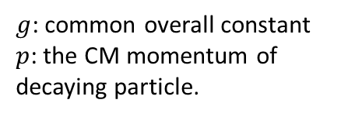
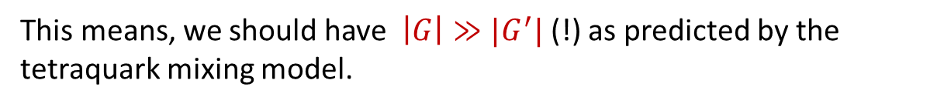
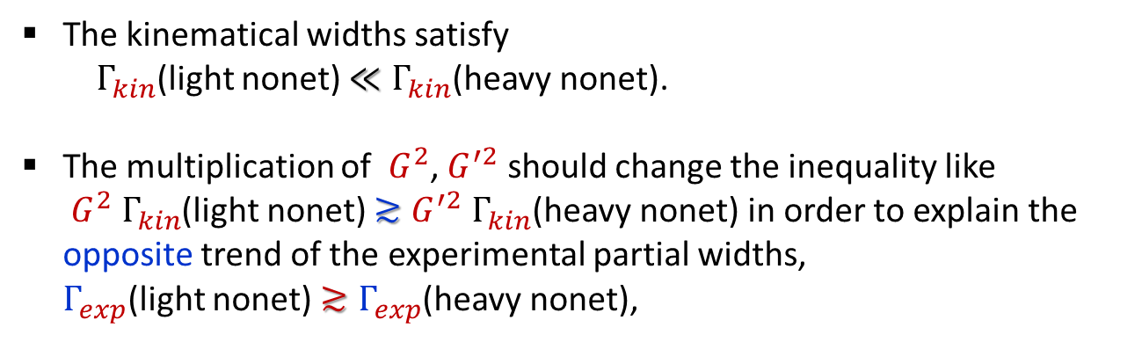

The partial decay width can be calculated by
$$Γ\left[M⟶m_{1},m_{2}\right]≡G^{2}{ Γ}_{kin}$$
$g$: common overall constant
$p$: the CM momentum of decaying particle.
$$=G^{2}\frac{g^{2}p}{32πM^{2}}(M^{2}−m_{1}^{2}−m_{2}^{2})^{2}$$
using Lagrangian, $Gg∂_{μ}ψ_{m_{1}}∂^{μ}ψ_{m_{2}}ψ_{M}$, [PRD 61,074001 Black et.al.]
The kinematical widths satisfy
$Γ_{kin}$(light nonet) $≪Γ_{kin}$(heavy nonet).
The multiplication of $G^{2}$, $G^{′2}$ should change the inequality like
$G^{2} Γ_{kin}$(light nonet) $≳{G^{′2} Γ}_{kin}$(heavy nonet) in order to explain the opposite trend of the experimental partial widths,
$Γ_{exp}$(light nonet) $≳Γ_{exp}$(heavy nonet),
ex) $\frac{Γ_{kin}[a_{0}(1450)⟶πη]}{Γ_{kin}[a_{0}(980)⟶πη]}≈1.68$
This means, we should have $\left|G\right|≫{|G}^{′}|$ (!) as predicted by the tetraquark mixing model.
Notes:
To get the experimental ratio, we need to have different couplings for the two nonets. And the light nonet couplings must be a lot larger than the heavy nonet couplings.

Slide 14


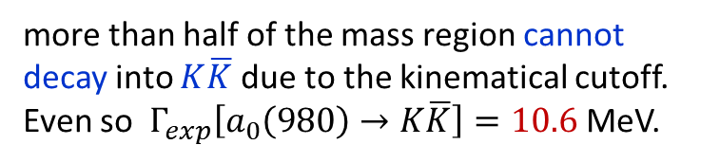


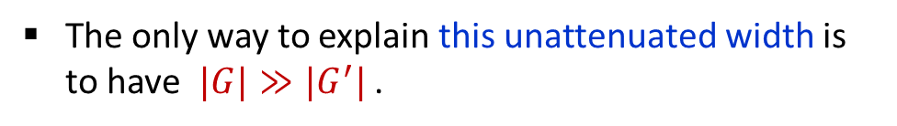


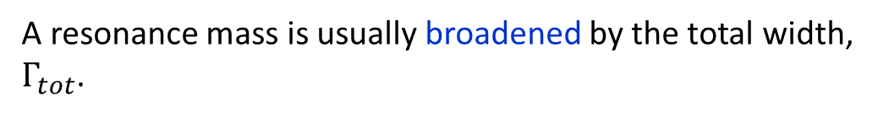


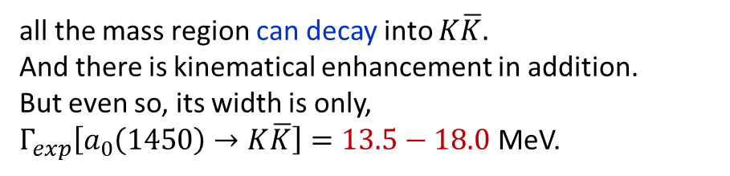
The exceptional case is the isovectors decaying into $K\overline{K}$
$Γ_{exp}\left[a_{0}\left(980\right)→K\overline{K}\right]<Γ_{exp}\left[a_{0}\left(1450\right)→K\overline{K}\right]$ still implies that $|G|≫{|G}^{′}|$.
A resonance mass is usually broadened by the total width, $Γ_{tot}$.
$$Γ_{tot}$$
For $a_{0}\left(980\right)→K\overline{K}$ (the light nonet)
more than half of the mass region cannot decay into $K\overline{K}$ due to the kinematical cutoff.
Even so $Γ_{exp}\left[a_{0}\left(980\right)→K\overline{K}\right]=10.6$ MeV.
$$M_{c}$$
$K\overline{K}\sim 987$MeV
$$Γ_{tot}$$
For $a_{0}\left(1450\right)→K\overline{K}$ (the heavy nonet)
all the mass region can decay into $K\overline{K}$.
And there is kinematical enhancement in addition.
But even so, its width is only,
$Γ_{exp}\left[a_{0}\left(1450\right)→K\overline{K}\right]=13.5−18.0$ MeV.
$${M[a}_{0}(980)]$$
$$K\overline{K}$$
The only way to explain this unattenuated width is to have $|G|≫{|G}^{′}|$ .
$${M[a}_{0}(1450)]$$
Notes:
For isovector case, we have the opposite inequality in the experimental partial widths, light nonet width is smaller than the heavy nonet one. Even in this case, we expect
the same enhancement in the couplings.
For $a_{0}\left(980\right)→K\overline{K}$, most region cannot decay to $K\overline{K}$ due to the kinematical cutoff. Only the mass region above the $K\overline{K}$ threshold can decay.
But for $a_{0}\left(1450\right)→K\overline{K}$, all the mass region can decay to $K\overline{K}$.

Slide 15
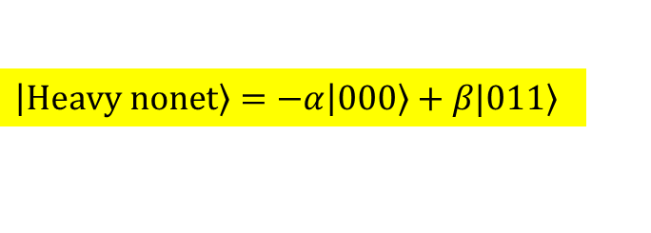
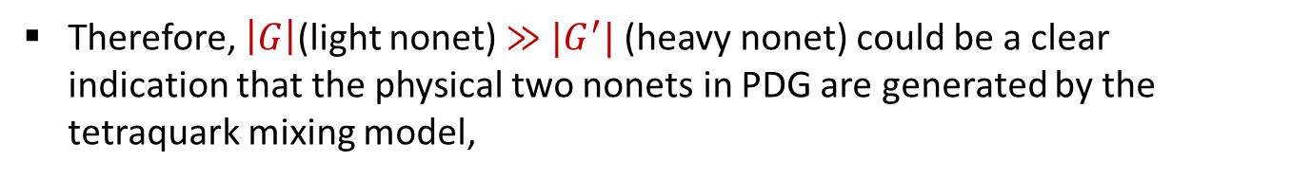
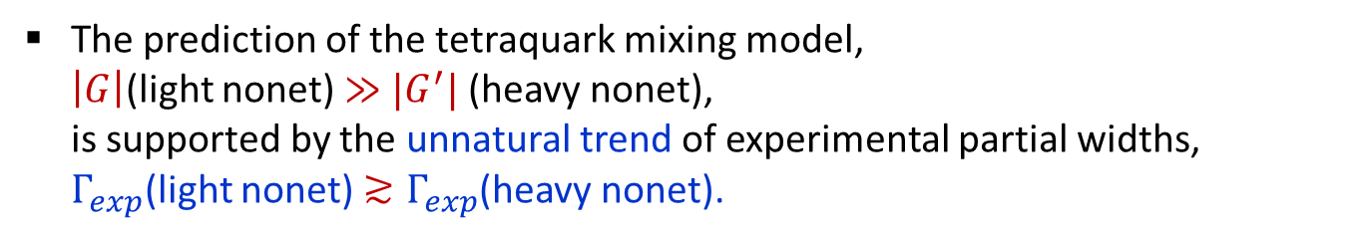
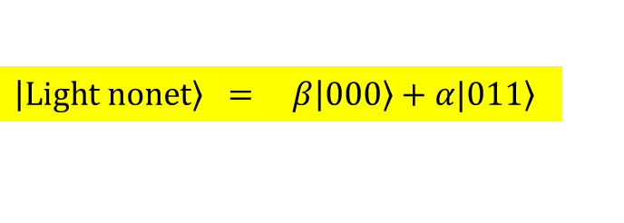
Upshot
The prediction of the tetraquark mixing model,
$\left|G\right|$(light nonet) $≫$ ${|G}^{′}|$ (heavy nonet),
is supported by the unnatural trend of experimental partial widths,
$Γ_{exp}$(light nonet) $≳Γ_{exp}$(heavy nonet).
The tetraquark mixing model is likely the only one that can explain this unnatural experimental partial decay widths.
Therefore, $\left|G\right|$(light nonet) $≫$ ${|G}^{′}|$ (heavy nonet) could be a clear indication that the physical two nonets in PDG are generated by the tetraquark mixing model,
$$\left|\left.Heavy nonet\right\rangle =−α\right|\left.000\right\rangle +β\left.|011\right\rangle$$
$$\left|\left.Light nonet\right\rangle = β\right|\left.000\right\rangle +α\left.|011\right\rangle$$

Slide 16
Quantitative verification

Slide 17

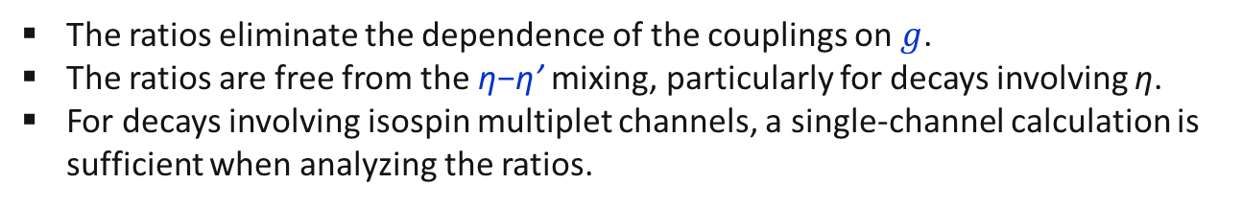
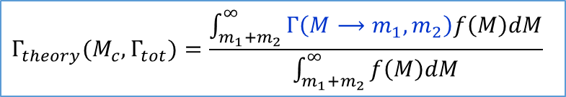
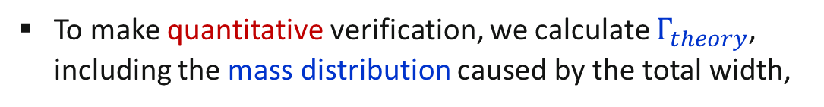
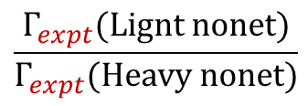
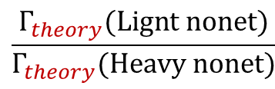
To make quantitative verification, we calculate $Γ_{theory}$, including the mass distribution caused by the total width,
$$Γ_{theory}(M_{c}, Γ_{tot})=\frac{\int_{m_{1}+m_{2}}^{∞}{Γ\left(M⟶m_{1}, m_{2}\right)f\left(M\right)dM}}{\int_{m_{1}+m_{2}}^{∞}{f\left(M\right)dM}}$$
$$Γ_{tot}$$
$$M_{c}$$
We use $G, G^{′}$ fixed by the tetraquark mixing model.
Next calculate the ratios,
$$\frac{Γ_{theory}(Lignt nonet)}{Γ_{theory}(Heavy nonet)}$$
and compare them to the experimental ratios,
$$\frac{Γ_{expt}(Lignt nonet)}{Γ_{expt}(Heavy nonet)}$$
Why ratios ?
The ratios eliminate the dependence of the couplings on $g$.
The ratios are free from the η−η’ mixing, particularly for decays involving η.
For decays involving isospin multiplet channels, a single-channel calculation is sufficient when analyzing the ratios.

Slide 18
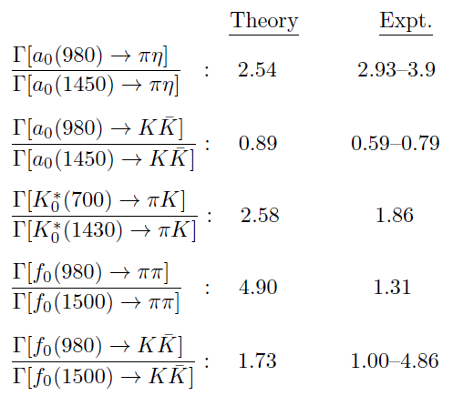


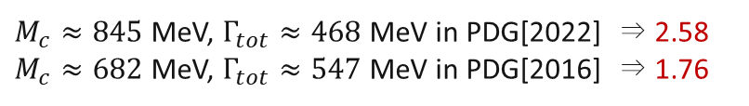
comments
acceptable(?)
not good
Expt. data is very uncertain.
This comparison is insufficient for quantitative validation.
But(!) none of the ratios undermine the qualitative conclusion that,
$\left|G\right|$(light nonet) $≫$ ${|G}^{′}|$ (heavy nonet)
This inequality remains valid. Some improvements may be needed in the future.
Note, theoretical ratios are sensitive to expt. inputs from PDG data.
For $K_{0}^{∗}\left(700\right)$,
$M_{c}≈845$ MeV, $Γ_{tot}≈468$MeV in PDG[2022] ⇒ 2.58
$M_{c}≈682$ MeV, $Γ_{tot}≈547$MeV in PDG[2016] ⇒ 1.76

Slide 19
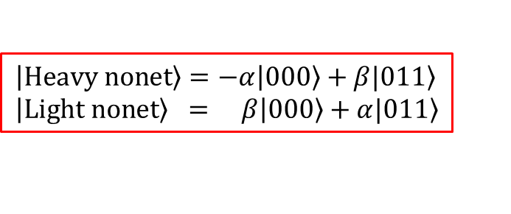
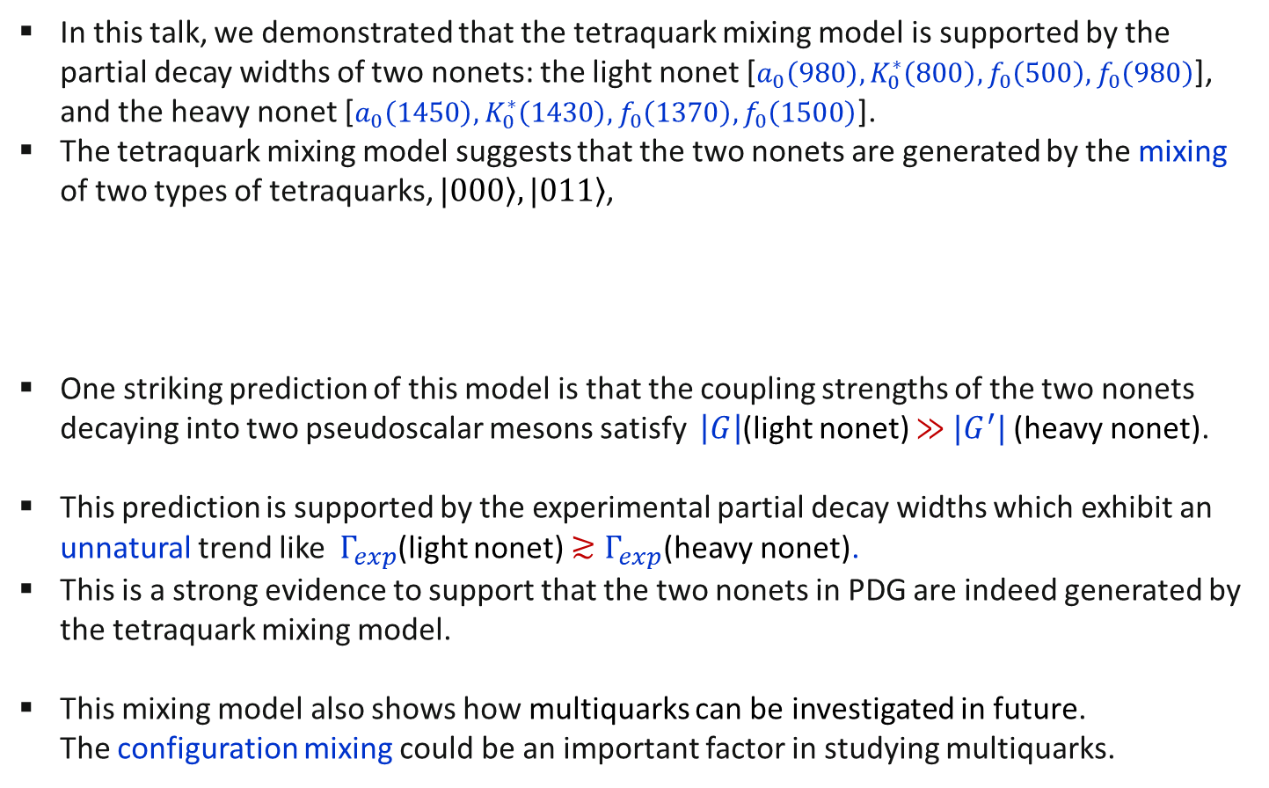
Summary
In this talk, we demonstrated that the tetraquark mixing model is supported by the partial decay widths of two nonets: the light nonet [$a_{0}\left(980\right),K_{0}^{∗}\left(800\right),f_{0}\left(500\right), f_{0}\left(980\right)$], and the heavy nonet [$a_{0}\left(1450\right),K_{0}^{∗}\left(1430\right), f_{0}\left(1370\right),f_{0}\left(1500\right)$].
The tetraquark mixing model suggests that the two nonets are generated by the mixing of two types of tetraquarks, $\left.|000\right\rangle ,\left.|011\right\rangle$,
One striking prediction of this model is that the coupling strengths of the two nonets decaying into two pseudoscalar mesons satisfy $\left|G\right|$(light nonet) $≫$ ${|G}^{′}|$ (heavy nonet).
This prediction is supported by the experimental partial decay widths which exhibit an unnatural trend like $Γ_{exp}$(light nonet) $≳Γ_{exp}$(heavy nonet).
This is a strong evidence to support that the two nonets in PDG are indeed generated by the tetraquark mixing model.
This mixing model also shows how multiquarks can be investigated in future.
The configuration mixing could be an important factor in studying multiquarks.
$$\left|\left.Heavy nonet\right\rangle =−α\right|\left.000\right\rangle +β\left.|011\right\rangle \\ \left|\left.Light nonet\right\rangle = β\right|\left.000\right\rangle +α\left.|011\right\rangle$$

Slide 20
Additional slides
to answer some questions that may arise in the talk.

Slide 21
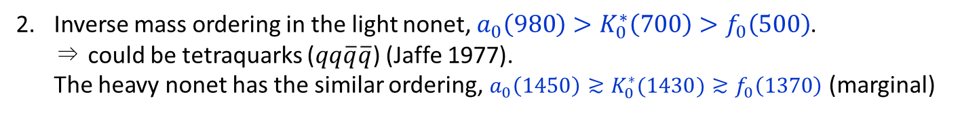
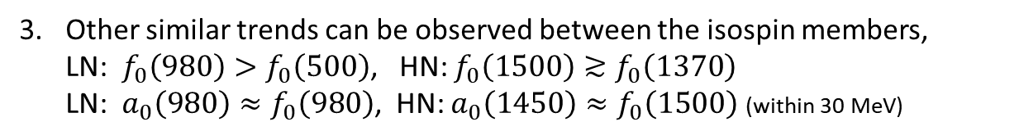
Some reasons to motivate tetraquarks with $9_{f}$ for the two nonets
The same isospin composition as ($π,Κ,η,η^{′}$), ($ρ,K^{∗},ω,φ$).
☞ Both nonets may form a SU(3) flavor nonet, $9_{f}$, also.
Inverse mass ordering in the light nonet, $a_{0}\left(980\right)>K_{0}^{∗}\left(700\right)>f_{0}\left(500\right)$.
⇒ could be tetraquarks ($qq\overline{q}\overline{q}$) (Jaffe 1977).
The heavy nonet has the similar ordering, ${a_{0}\left(1450\right)≳K}_{0}^{∗}(1430)≳f_{0}\left(1370\right)$ (marginal)
☞ Both nonets could be tetraquarks forming $9_{f}$.
Other similar trends can be observed between the isospin members,
LN: $f_{0}\left(980\right)>f_{0}\left(500\right)$, HN: ${f_{0}\left(1500\right)≳f}_{0}\left(1370\right)$
LN: $a_{0}\left(980\right)≈f_{0}\left(980\right)$, HN: $a_{0}\left(1450\right)≈f_{0}\left(1500\right)$ (within 30 MeV)
☞ Both nonets can have similar flavor structure maybe forming $9_{f}$.

Slide 22

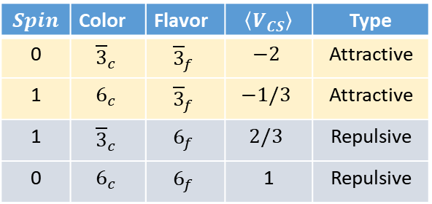



Why two diquark types ?
The two diquark types, $qq∈\left({J=0,{\overline{3}}_{c},\overline{3}}_{f}\right)$, $qq∈\left({J=1,6_{c},\overline{3}}_{f}\right)$, are adopted in constructing $\left.|000\right\rangle , \left.|011\right\rangle$ respectively, as their hyperfine potential is negative, $\left\langle V_{CS}\right\rangle <0$.
〈Possible $qq$ structure〉
$$Spin$$ | Color | Flavor | $$\left\langle V_{CS}\right\rangle$$ | Type
0 | $${\overline{3}}_{c}$$ | $${\overline{3}}_{f}$$ | $$−2$$ | Attractive
1 | $$6_{c}$$ | $${\overline{3}}_{f}$$ | $$−1/3$$ | Attractive
1 | $${\overline{3}}_{c}$$ | $$6_{f}$$ | $$2/3$$ | Repulsive
0 | $$6_{c}$$ | $$6_{f}$$ | 1 | Repulsive
$$V_{CS}∝−\sum_{i<j}{λ_{i}∙λ_{j}\frac{J_{i}∙J_{j}}{m_{i} m_{j}}}$$
Hyperfine color-spin interaction
$λ_{i}$: Gell-Mann matrix for color
$J_{i}$: spin
$m_{i}$: constituent quark mass $\sim 330$ MeV

Slide 23







digression
additional nonets ?
The spin-1 diquark scenario requires additional nonets to be found in $J^{P}=1^{+−}$, $2^{++}$ corresponding to the configurations
$${\left.|111\right\rangle }_{{6_{c},\overline{6}}_{c}}$$
$${\left.|211\right\rangle }_{{6_{c},\overline{6}}_{c}}$$
※ One can prove that C-parity is negative for $J=1$, positive for $J=2$.
Are there such nonets in PDG ? My answer is ‘Maybe’.
There are lots of resonances to choose but the candidate selection is not definite.
$J^{P(C)}=1^{+(−)}$ resonances
Highlighted members can be selected but with some ambiguity,
  unknown isospin of $h_{1}\left(1380\right),$
  the mass ordering, slightly violated, $M\left[b_{1}\left(1235\right)\right]<M[K_{1}\left(1270\right)]$
$J^{P(C)}=2^{+(+)}$ resonances
Notes:
Before we move on, we make one question that comes out naturally.

Slide 24

digression
The selection is ambiguous
maybe due to further mixings with additional tetraquarks constructed by other diquarks, and possible contamination from two-quark component with $ℓ=1$.
This ambiguity does not mean that $|\left.111\right\rangle , |\left.211\right\rangle$ do not exist.
⇒ It simply says that the candidates do not stand out in a well-separated entity.
⇒ It does not rule out our mixing framework in the $0^{+}$ channel.

Slide 25
Other models to explain the two nonets
with some limitations.

Slide 26









$q\overline{q}$ ($ℓ=1$) [I]
The two-quark picture($q\overline{q}$) with $ℓ=1$
can make nonets also with ${J^{P}=0}^{+}.$
Does this picture explain the two nonets in PDG ? My answer is `No’
$$q\overline{q}:(S=0,1)⨂(ℓ=1)⟹J=0,1,2$$
Total $J$ | Configuration | # of confs.
$$J=0$$ | $$(S=1,ℓ=1)$$ | one
$$J=1$$ | $$\left(S=0,ℓ=1\right), (S=1,ℓ=1)$$ | two
$$J=2$$ | $$(S=1,ℓ=1)$$ | one
This picture has only one configuration in ${J^{P}=0}^{+}$, not enough to explain the two nonets in $J^{P}=0^{+}$.
$$ℓ=1$$
$$q$$
$$\overline{q}$$
Notes:
To justify the tetraquarks for the two nonets, we discuss other approaches and their problems

Slide 27







$q\overline{q}$ ($ℓ=1$) [II]
Alternatively, one may claim that
the heavy nonet can be represented by $q\overline{q}$ ($ℓ=1$) and the light nonet by $qq\overline{q}\overline{q}$.
The heavy nonet must have the configuration
($S=1$, vector nonet) $⨂(ℓ=1)⟹J=0$
⇒ orbital excitations of the vector mesons, $ρ,ω,K^{∗},φ$.
In this picture, the spin-orbit (SO) coupling can make the heavy nonet ‘heavier’ than the vector nonet.
$≈$116 MeV
$≈−50$ MeV
$$⇒$$
$(ℓ=1)$
The mass ordering is reversed.
To reproduce the reversed gap ($≈−50$ MeV), SO must have strong isospin dependence, strong enough to flip the mass ordering established by the quark masses. ☞ not realistic !
Notes:
If our model works, then one can ask,
where are the resonances fitted to the $q\overline{q}$ with $ℓ=1$ ?
Alternatively, if the heavy nonet is the excited states of $q\overline{q}$, then I ask,
where the two nonets fitted to the two tetraquarks?

Slide 28




Mixing model
Mixture of $q\overline{q}$, $qq\overline{q}\overline{q}$
One may view the two nonets as a mixture of $q\overline{q}$ $(ℓ=1)$ and $qq\overline{q}\overline{q}$ ?
Black et.al, PRD 59(1999)
Black et.al introduce the effective fields corresponding to $q\overline{q}$ and $qq\overline{q}\overline{q}$ nonets and make SU(3) invariant Lagrangian among them.
As pointed by Maiani et.al. EPJC50(2007), the required mixing seems too large given the fact that very different configurations are involved.
$q\overline{q}(ℓ=1)$, $qq\overline{q}\overline{q}$ do not mix under the color-spin interaction !
$\left\langle q\overline{q} | qq\overline{q}\overline{q}\right\rangle =0$, $\left\langle q\overline{q} | V_{CS}|qq\overline{q}\overline{q}\right\rangle =0$.
It is hard to establish such a mixing from well-known quark-quark interactions.

Slide 29



meson molecule
One may view the two nonets as meson-meson bound states.
Since mesons are colorless, this model suggests shallow bound states.
ex) $f_{0}\left(980\right)\sim K\overline{K}$ since ${M[f}_{0}(980)]\sim 2M_{K}$.
But it is hard to view $f_{0}\left(500\right)$ as a shallow bound state of $ππ$.
Why meson-meson states form nonet only (?)
⇒Since the lowest-lying mesons form a nonet in flavor, the meson-meson states can form various multiplets including the 27-plet
$8⊗8=27⊕10⨁\overline{10}⊕8⊕8⊕1$
⇒ PDG does not support this picture. (ex. no $0^{+}$ resonances with $I=2$.)
$${27}_{f}$$
But note Jido et.al(PRL2006)

