Slide 1

Kaonic atoms measurements performed by SIDDHARTA-2 collaboration: results and expectations.
Florin Sirghi o behalf of SIDDHARTA-2 Collaboration
17th International Workshop on Meson Physics
KRAKÓW, POLAND, 22nd - 27th June 2023

Slide 2
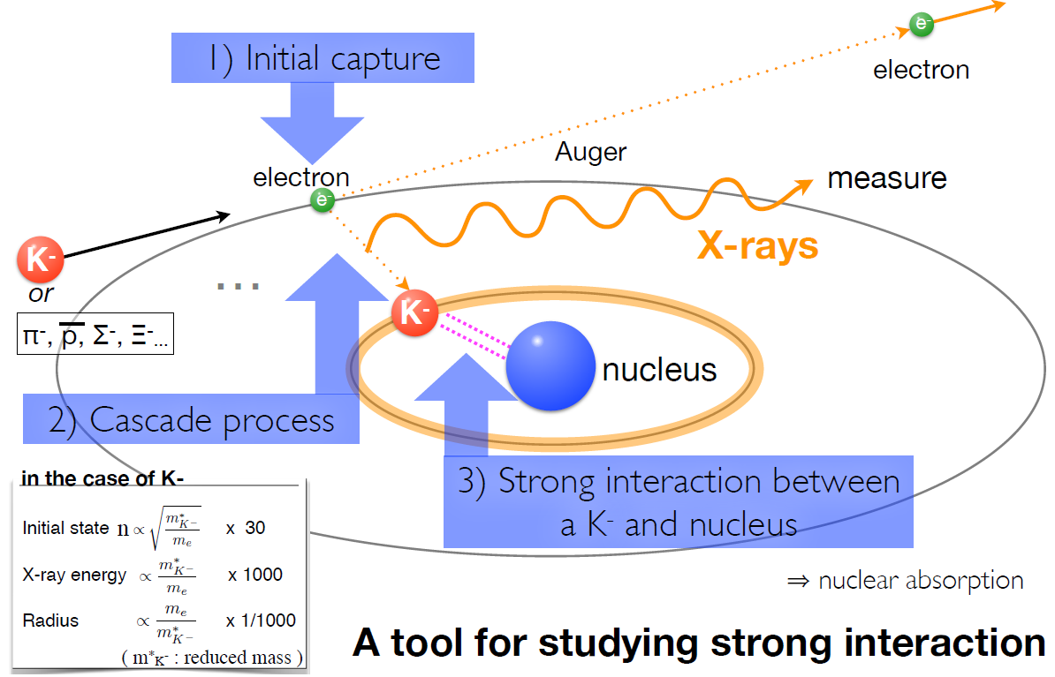
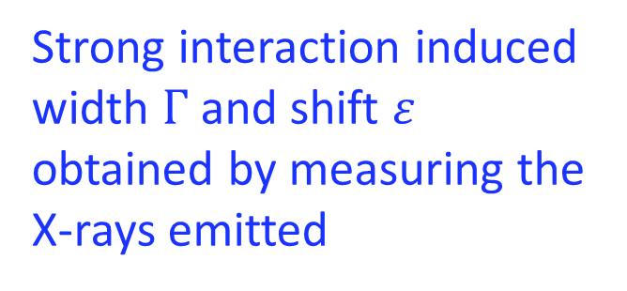
Kaonic Atoms
Kaonic atoms are formed
by stopping a
negatively charged kaon
in a target medium
H, He, D, N, …
Li, Be, C, Al, ...
Strong interaction induced
width $Γ$ and shift $ε$ obtained by measuring the X-rays emitted

Slide 3
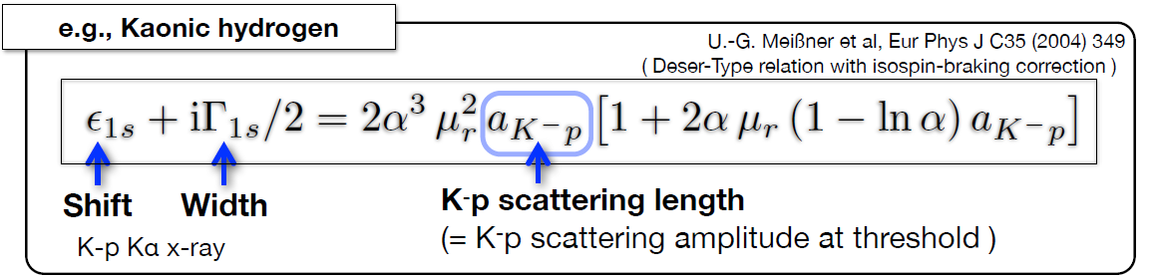
Scientific Goal of SIDDHARTA-2
  The first measurement of kaonic deuterium transitions to the fundamental 1s level
  to extract the antikaon-nucleon isospin dependent scattering lengths
  (using also the measurement of kaonic hydrogen performed by SIDDHARTA)
Experimental determination of the isospin-dependent
K-N scattering length

Slide 4
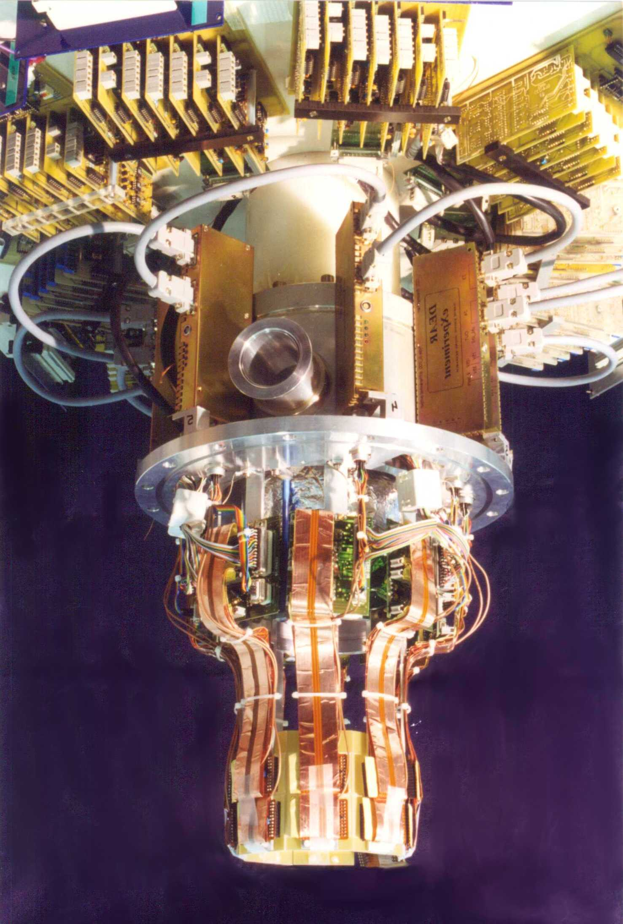
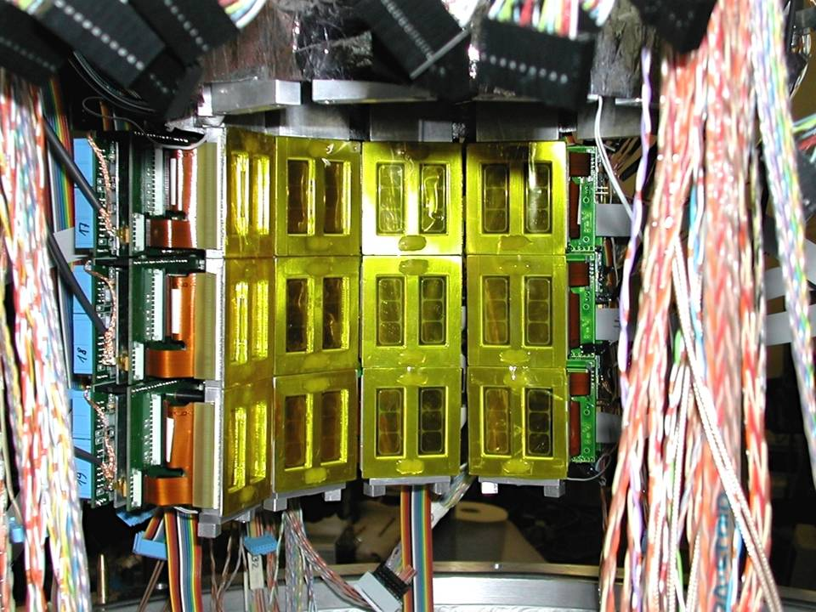
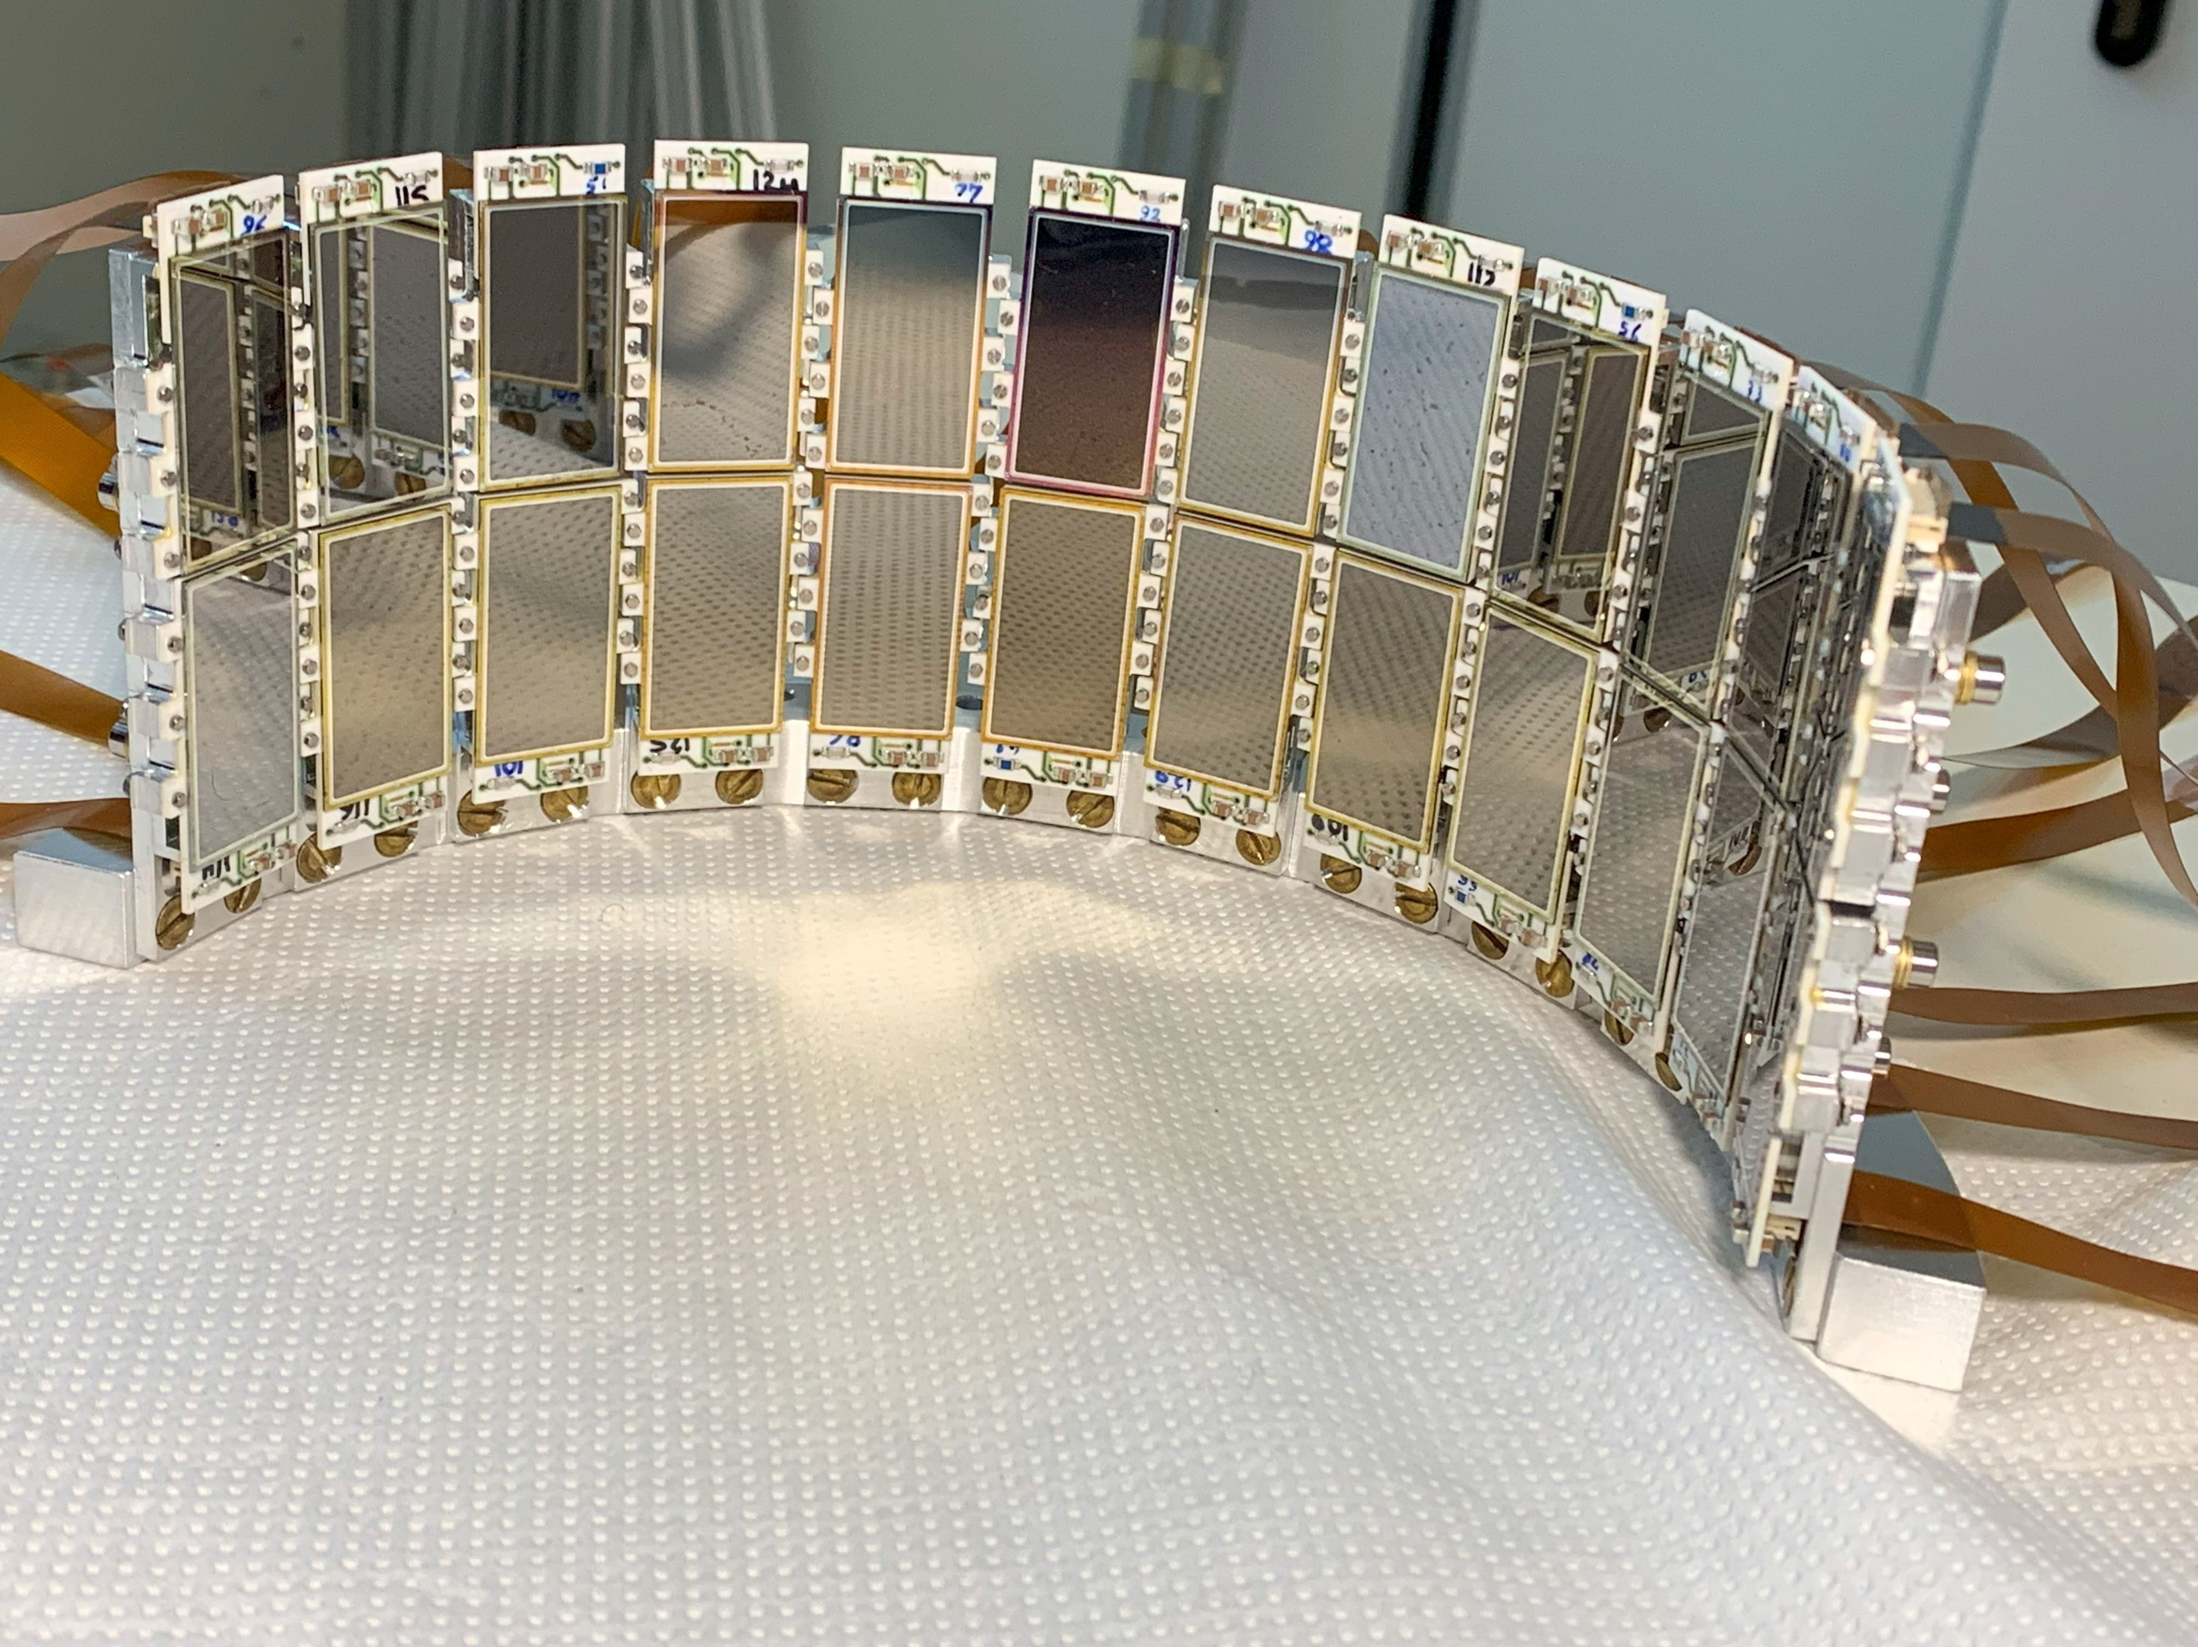
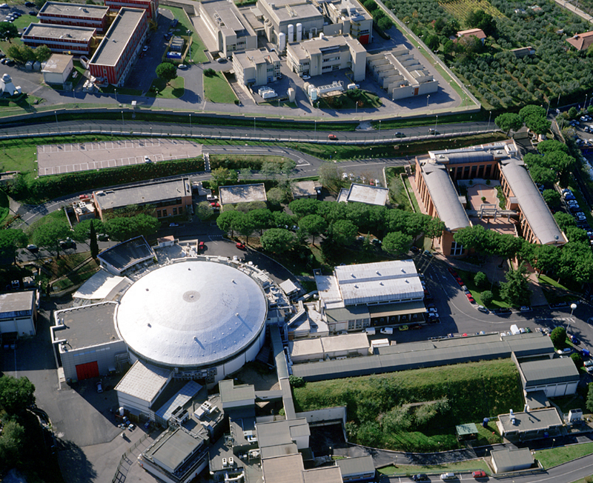
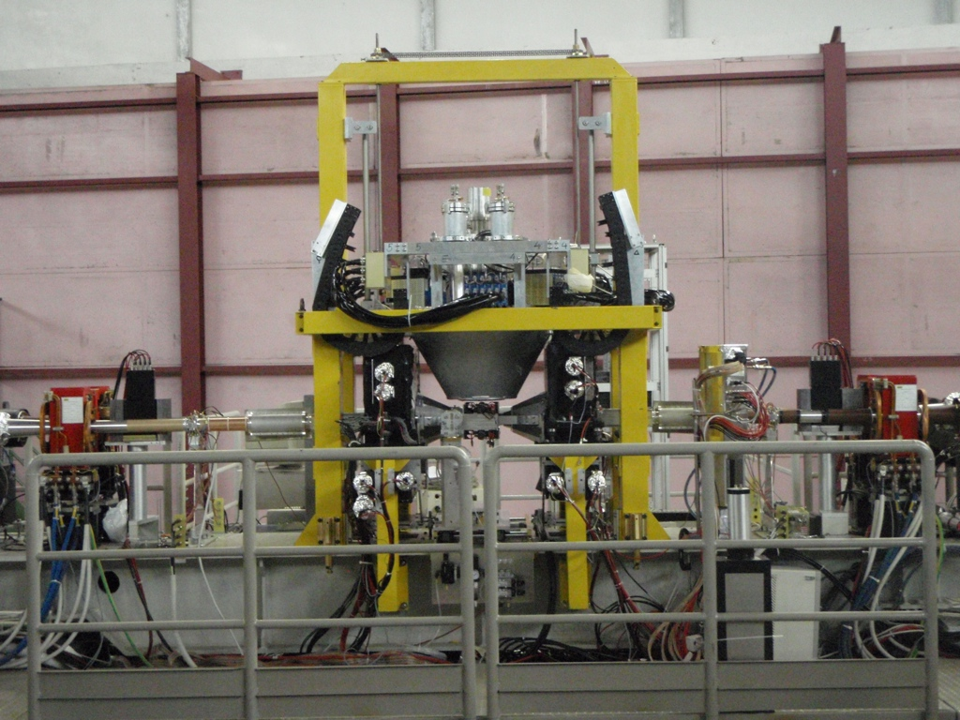
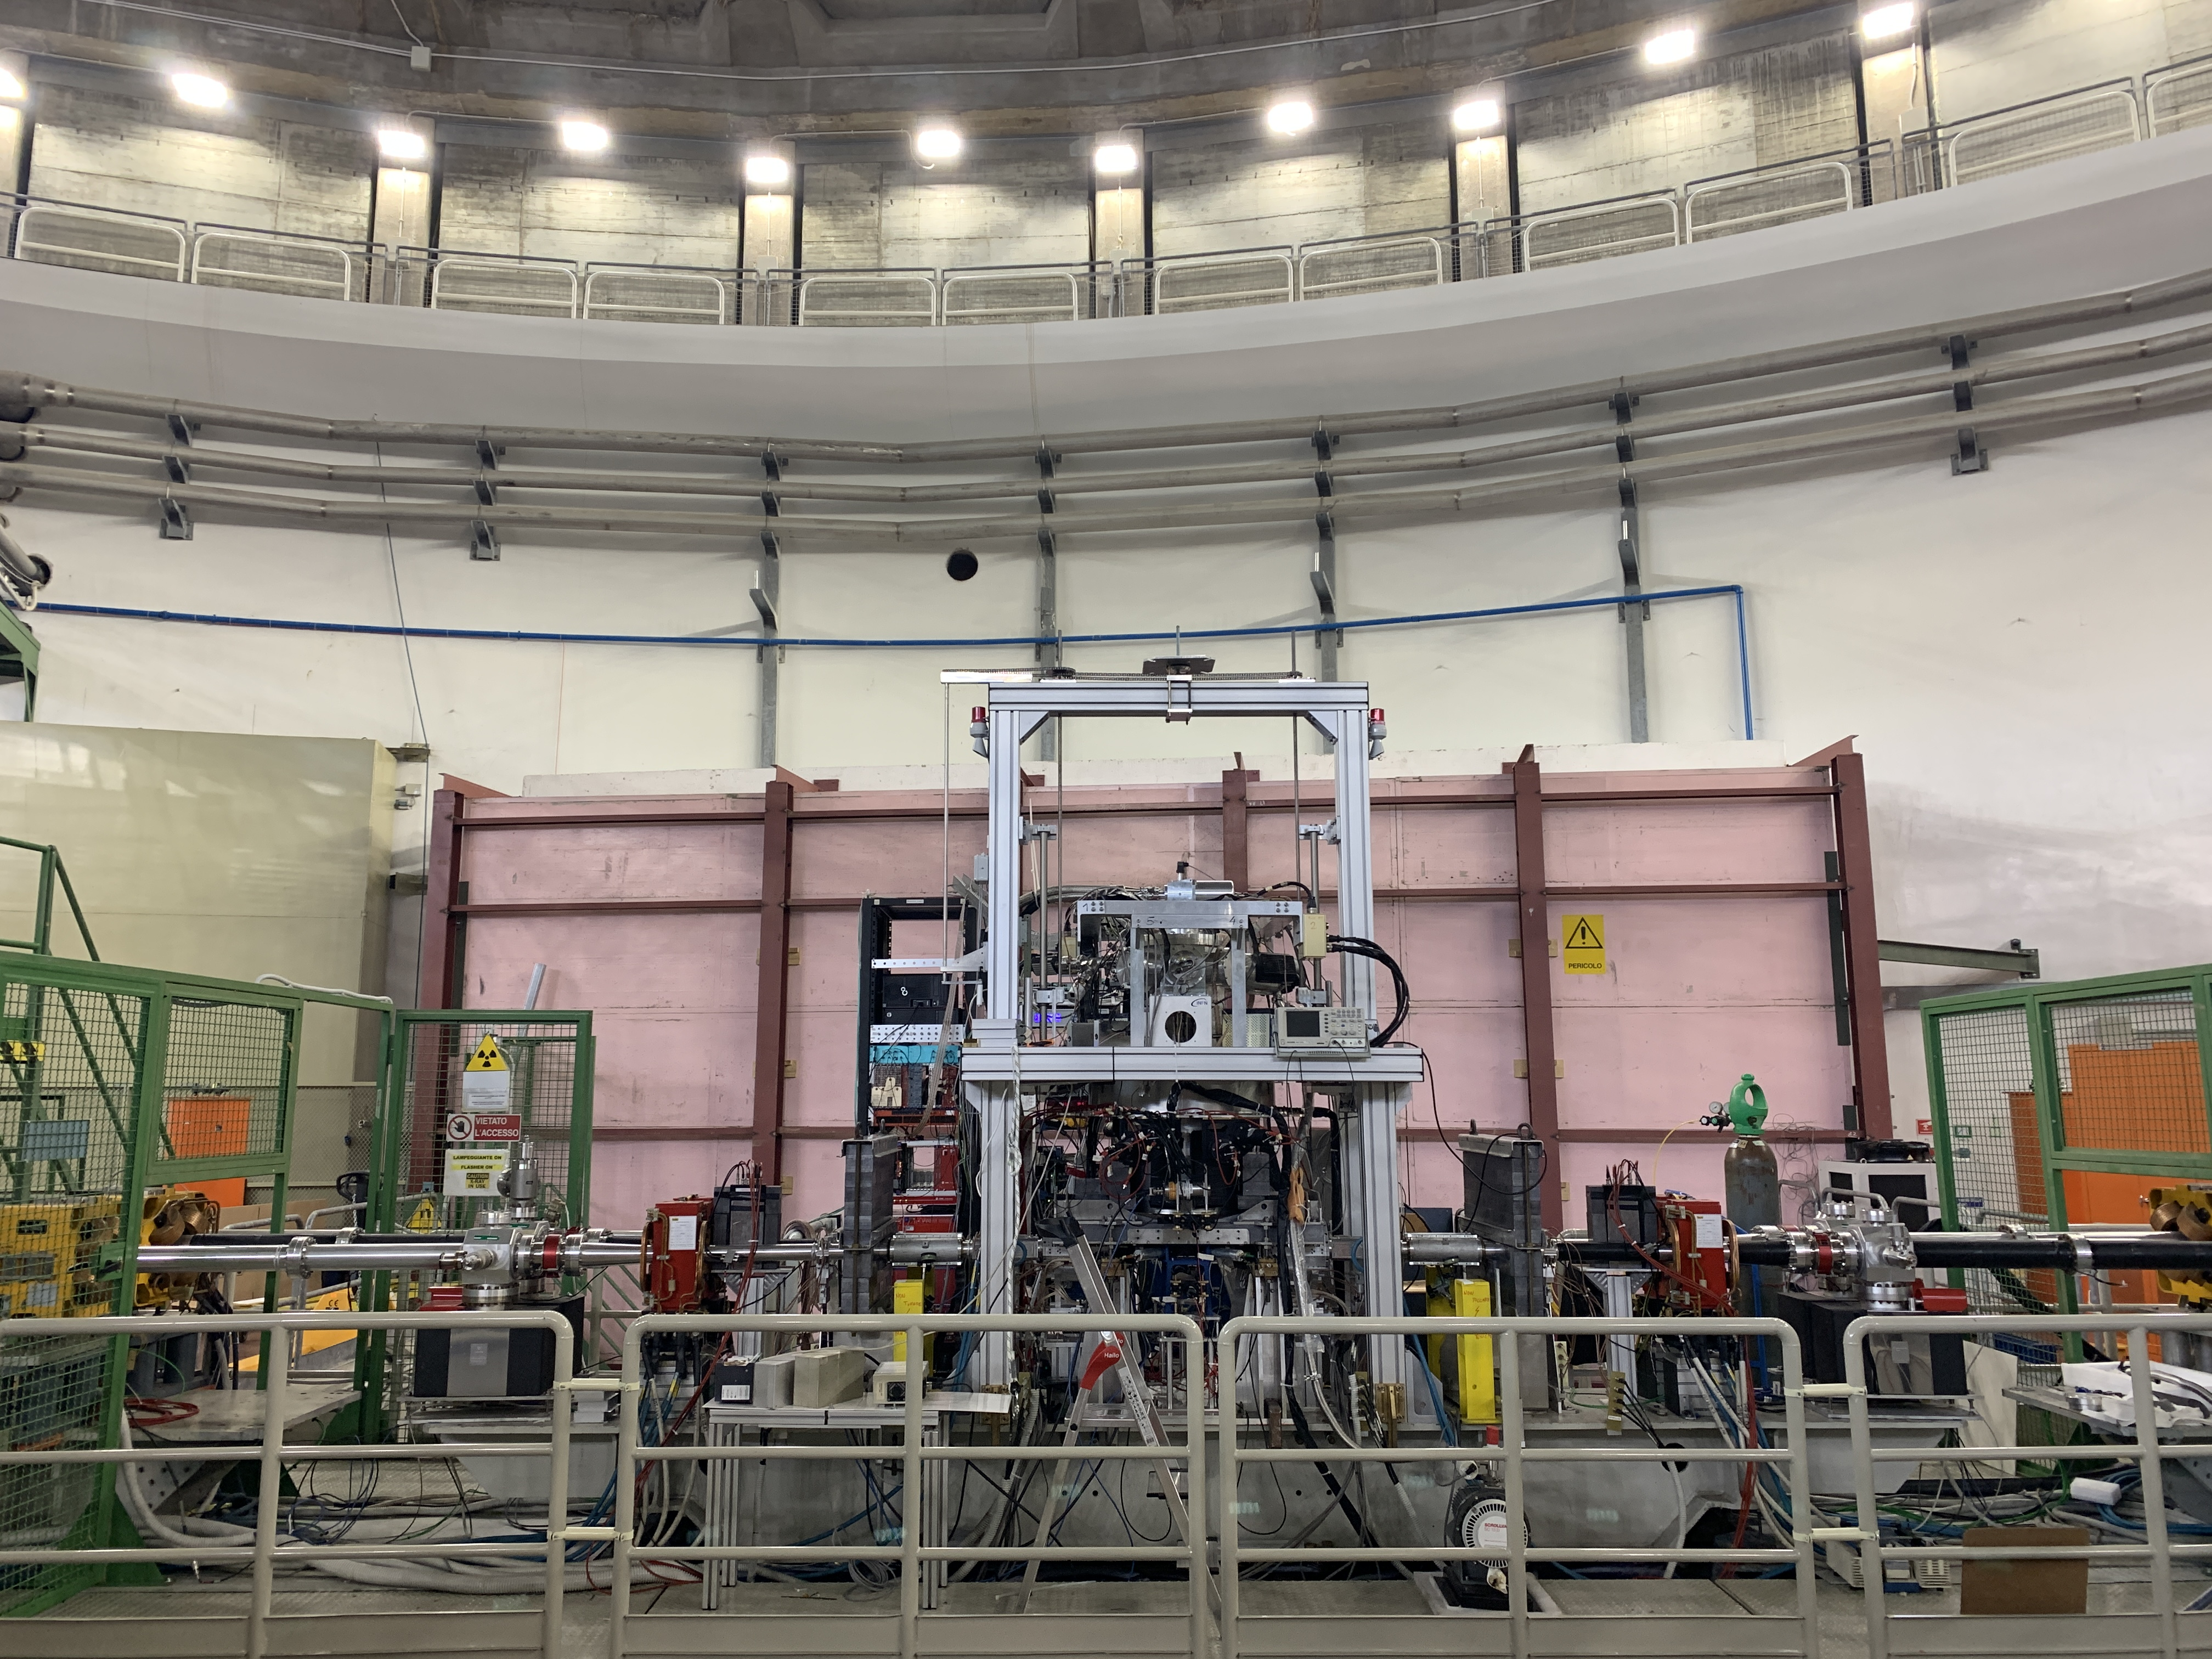
0.64 cm² x 384 new SDDs
1 cm² x 144 SDDs
The modern era of light kaonic atom experiments
Rev. Mod. Phys. 91, 025006 – June 2019
7.4 cm² x 16 CCDs
DEAR
2002
SIDDHARTA
2009
SIDDHARTA-2 2022
DAΦNE at Laboratori Nazionali di Frascati of INFN
KAONIC
HYDROGEN
Nitrogen
KAONIC
HYDROGEN
Helium
KAONIC
DEUTERIUM
Helium, neon
Kaon beam

Slide 5
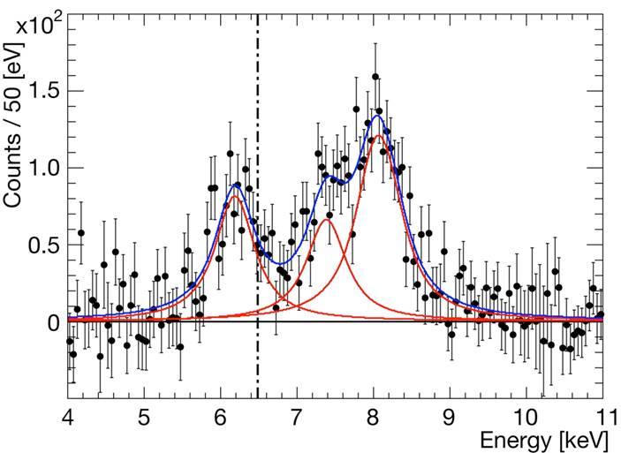
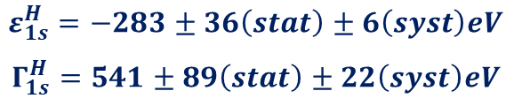
SIDDHARTA (2009)
Kaonic hydrogen
Some considerations:
The result itself put very strong constrains on various theoretical models
Better precision < 10eV is desired
Kaonic deuterium is a MUST
Stable kaon source (not only high luminosity but also low background conditions)
New setup design (maximize the signal, new detectors, target, veto systems, shielding’s, ….)
Kα
Kβ
higher
EM value
K-p Kα
$$ε_{1s}^{H}=−283±36\left(stat\right)±6\left(syst\right)eV$$
$$Γ_{1s}^{H}=541±89\left(stat\right)±22\left(syst\right)eV$$
C. Curceanu et al., Phys. Lett. B 704 (2011) 113

Slide 6
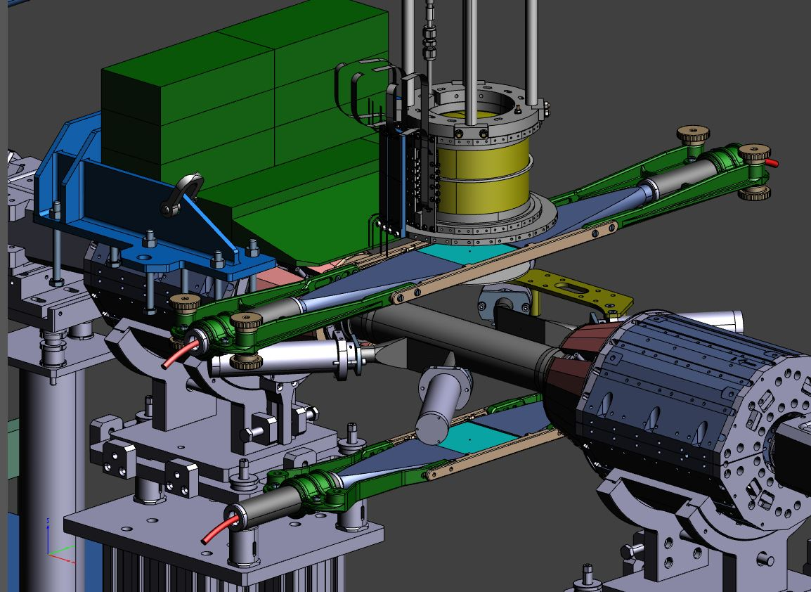
SIDDHARTINO setup (2019-2021)
The SIDDHARTA-2 apparatus with reduced SDD’s channels
Target cell
64 SDD’s channels
Kaon Trigger
Luminosity detector
commissioning of DAΦNE: new optics designed for our experiment, interaction region (new beam pipe, focusing magnets, …..)
AIM: confirm when background conditions are similar to
SIDDHARTA 2009

Slide 7
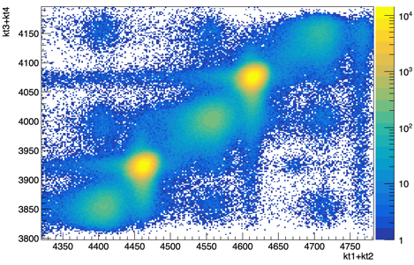
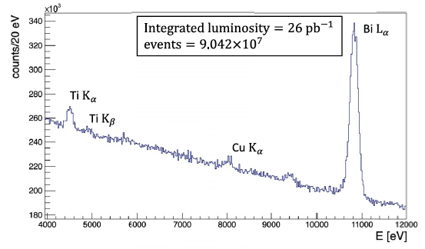
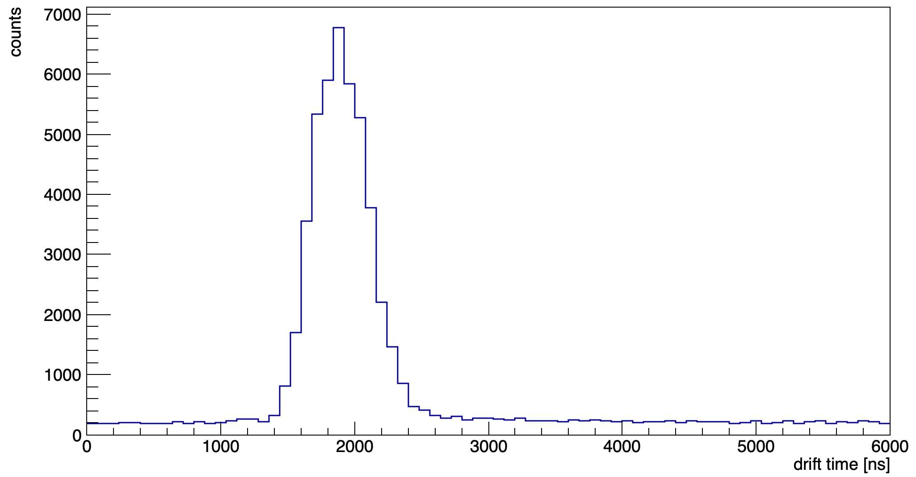

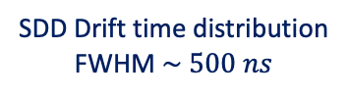
SIDDHARTINO (2021)
The kaonic ⁴He 3d->2p ($L_{α}$) measurement
Optimization of the trigger and new SDDs
during the DAΦNE beams commissioning phase in preparation for the K-d run through the measurement of K-⁴He 3d->2p transition
Kaon Trigger
Kaons
MIPS
SDD Drift time distribution
FWHM $\sim 500 ns$
SIDDHARTINO spectrum before applying the kaon trigger and the drift time rejection

Slide 8
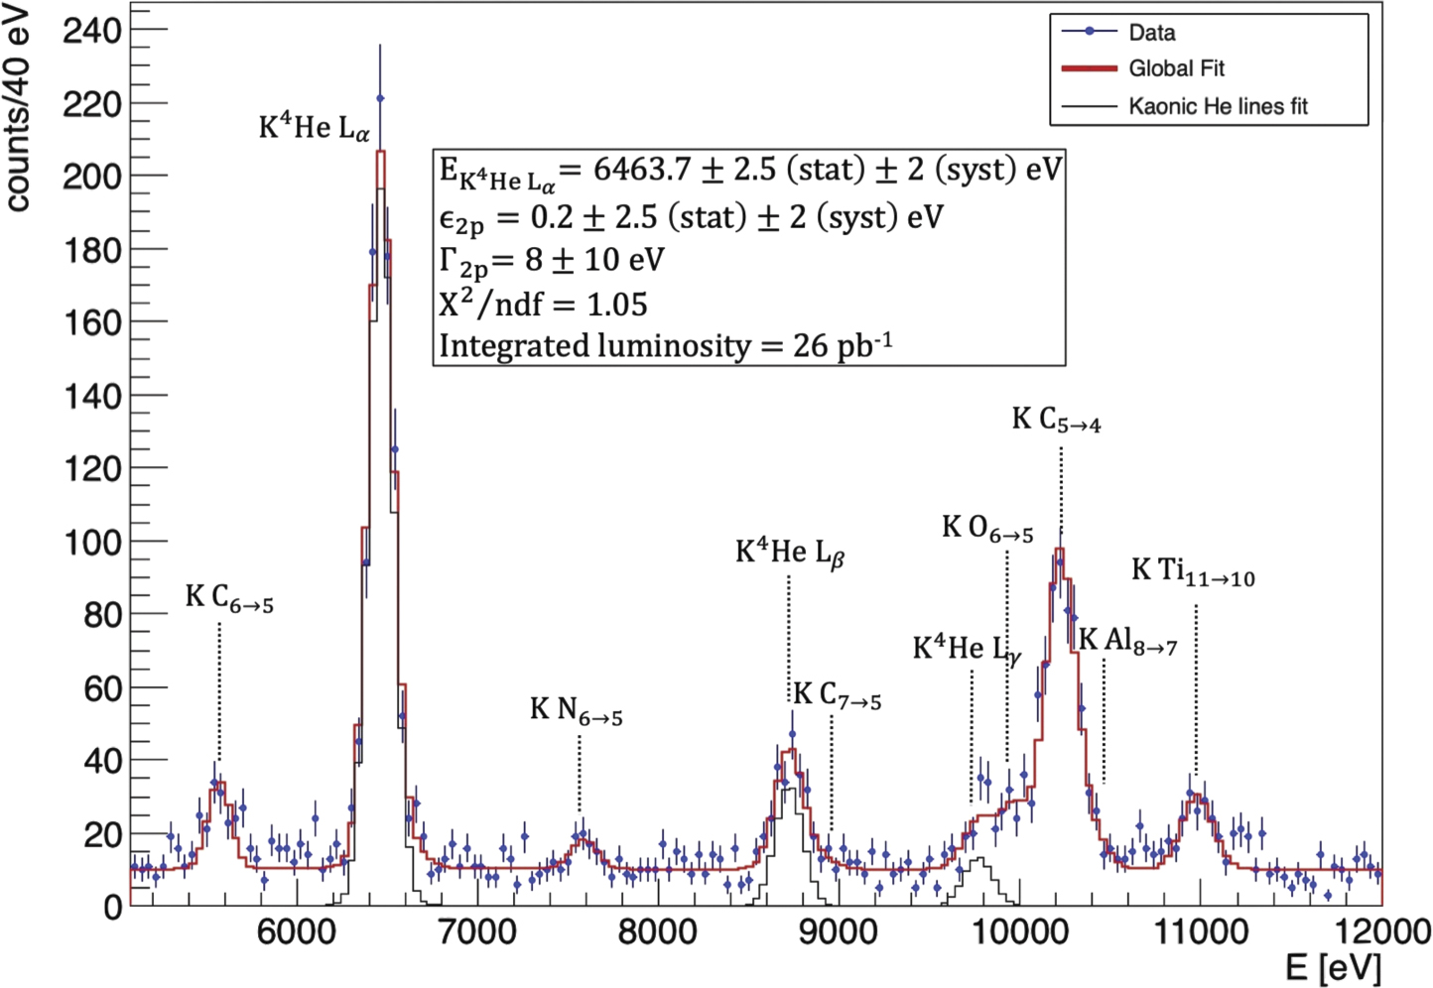

SIDDHARTINO (2021)
The kaonic ⁴He 3d->2p ($L_{α}$) measurement
K-⁴He 3d->2p shift and width:
the most precise measurement in gas!
D Sirghi et al 2022 J. Phys. G: Nucl. Part. Phys. 49 055106

Slide 9
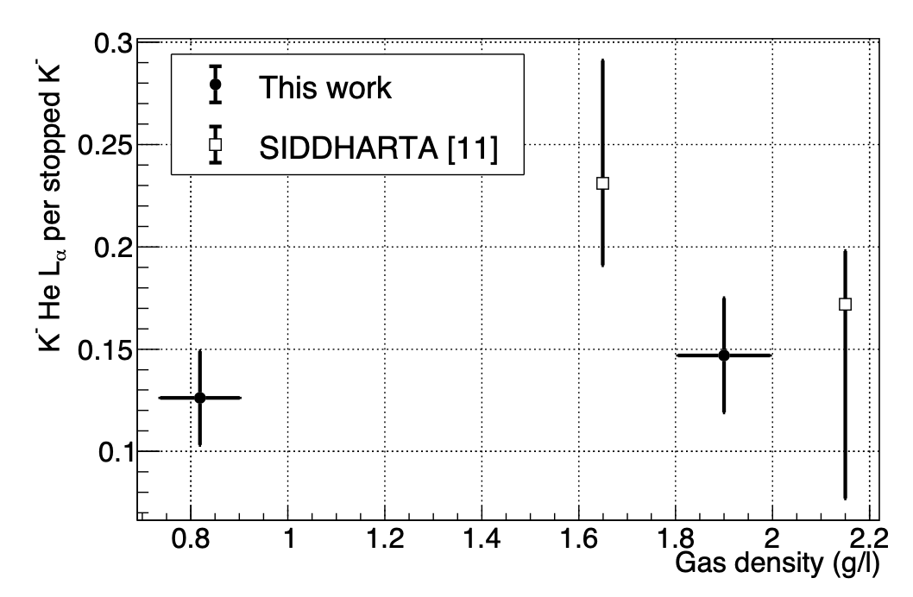
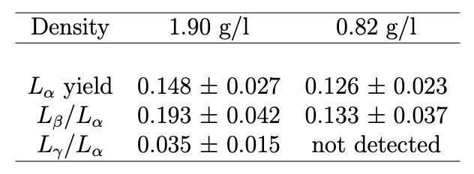
K-⁴He low density run: 0.75% liquid helium density -> yields at lowest measured density
SIDDHARTINO (2021)
The kaonic ⁴He yield measurement
Target optimization with He
D.L. Sirghi, et al. Nuclear Physics A 1029 (2023) 122567

Slide 10
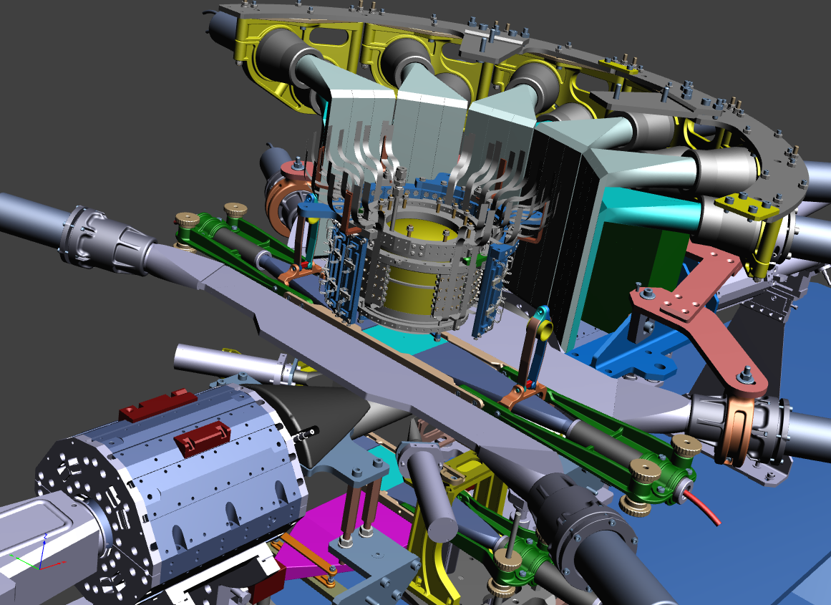
SIDDHARTA-2 apparatus
Veto-1
Target
Veto-2
384 SDDs
Kaon Trigger
Veto-3
Charged kaon

Slide 11
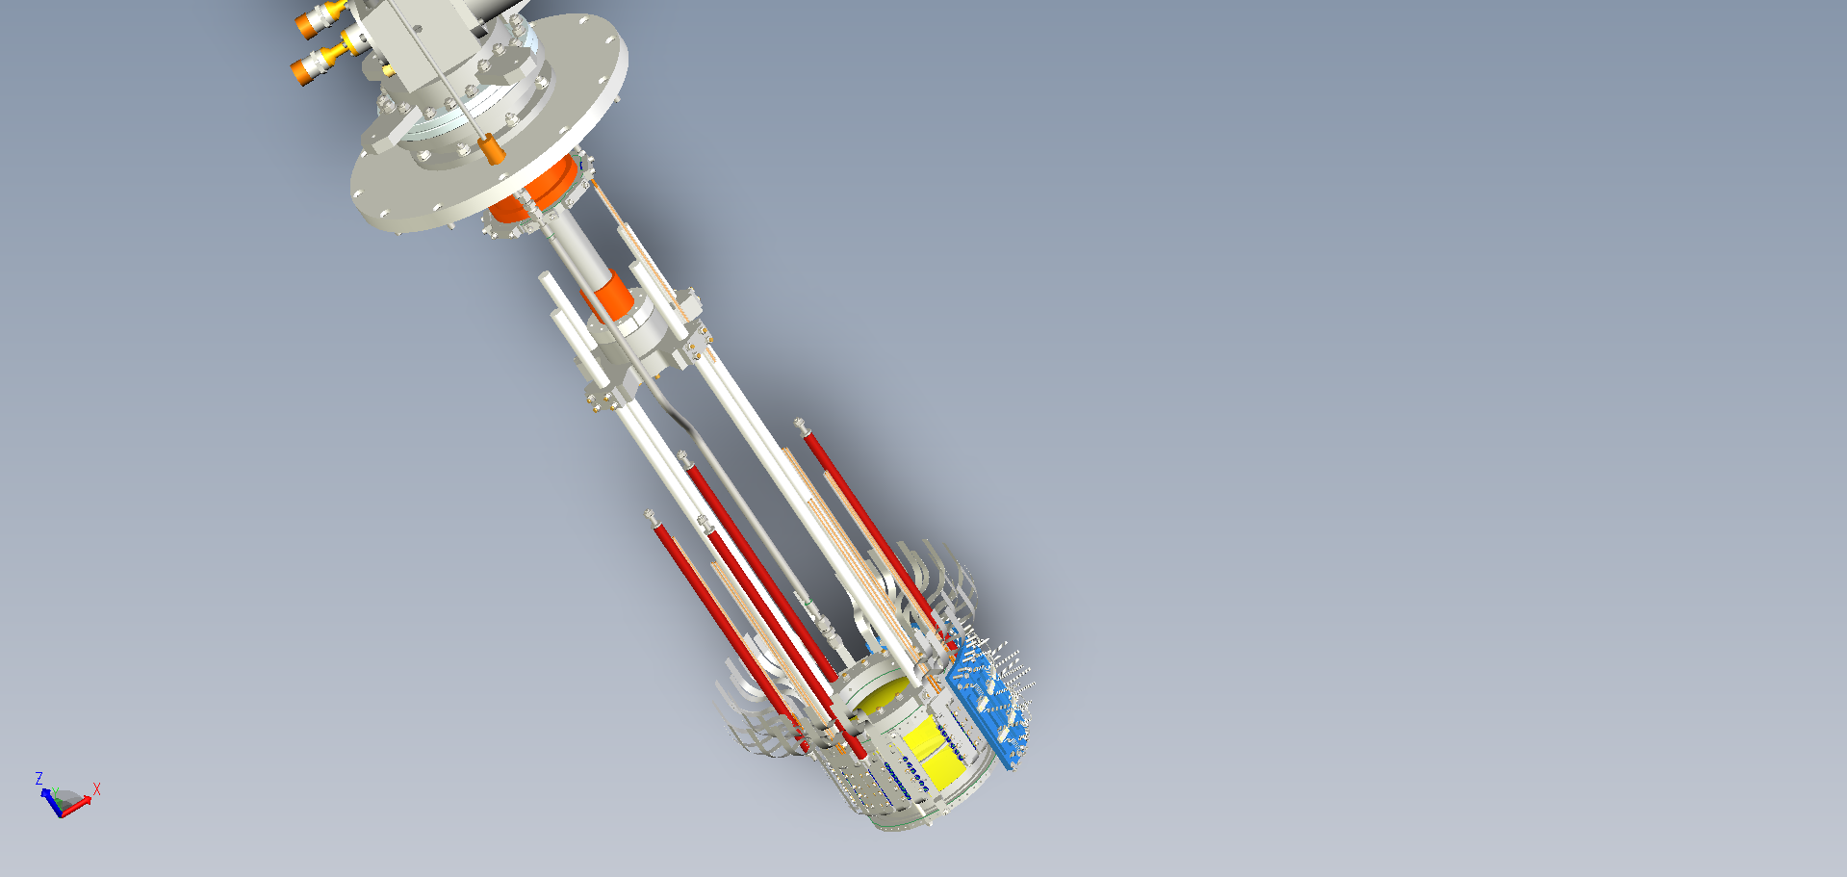
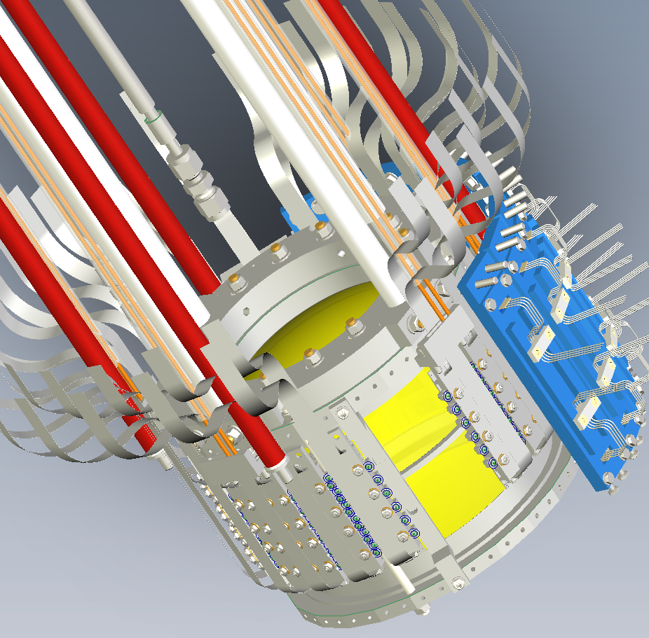
Optimization of SIDDHARTA-2 setup
new cooling scheme for target and SDD
Better control of target parameters (pressure, temperature, density,….)
copper with high thermal conductivity
Second stage
dedicated to target cooling
Target + SDD cooling
Leybold MD10 – 18 W @ 20 K
target cell and SDDs are cooled
via ultra pure aluminum bars
T_{TC} = 20-30 K
T_{SDD} ~ 130 K
First stage
dedicated only to SDD cooling
Cooling power
1st stage ~ 115 W @ 80 K
2nd stage ~ 18 W @ 20 K

Slide 12
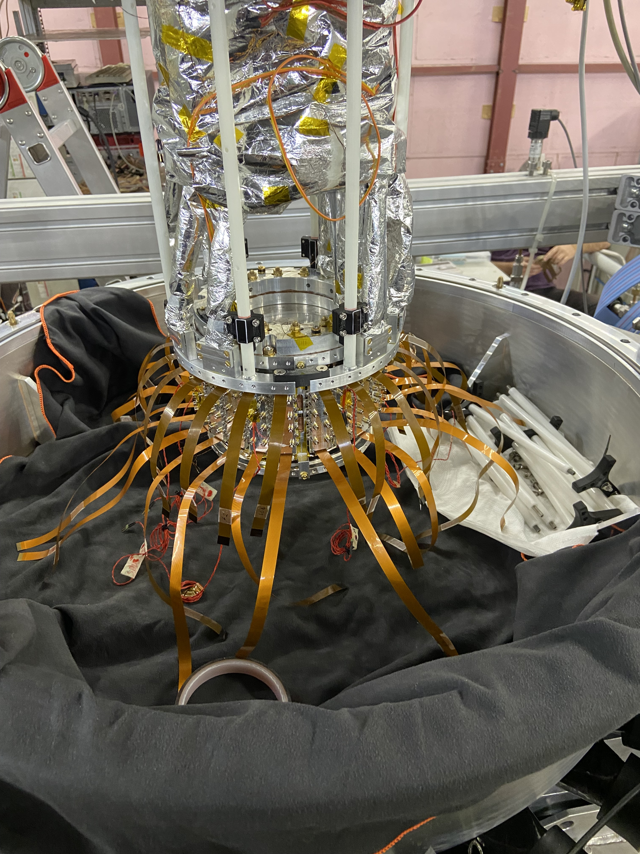
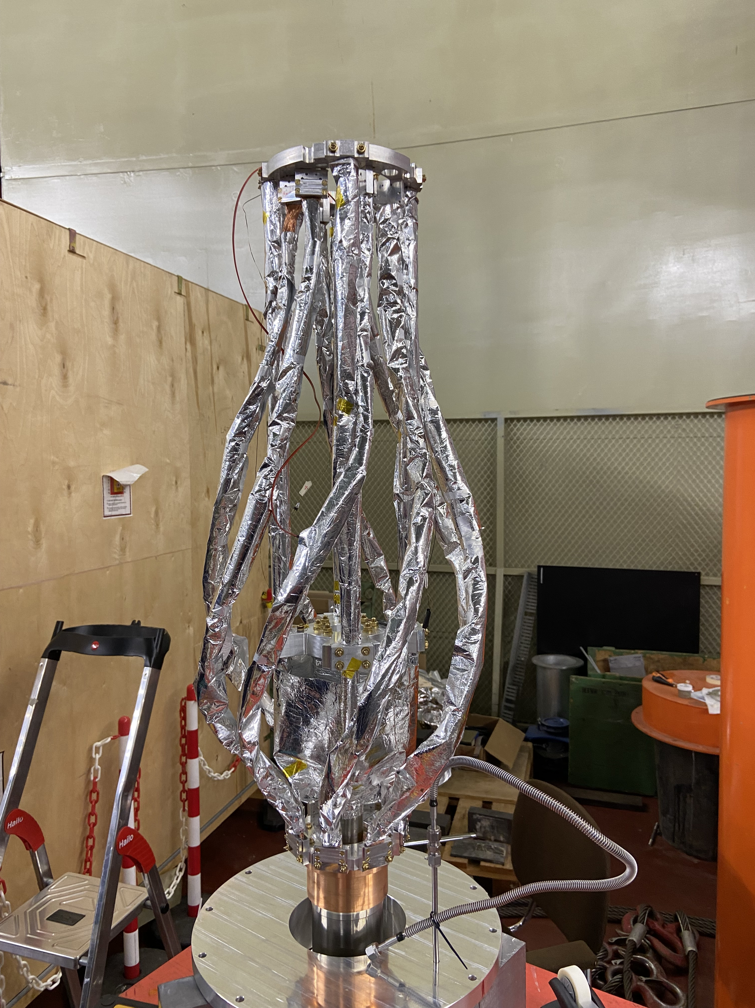
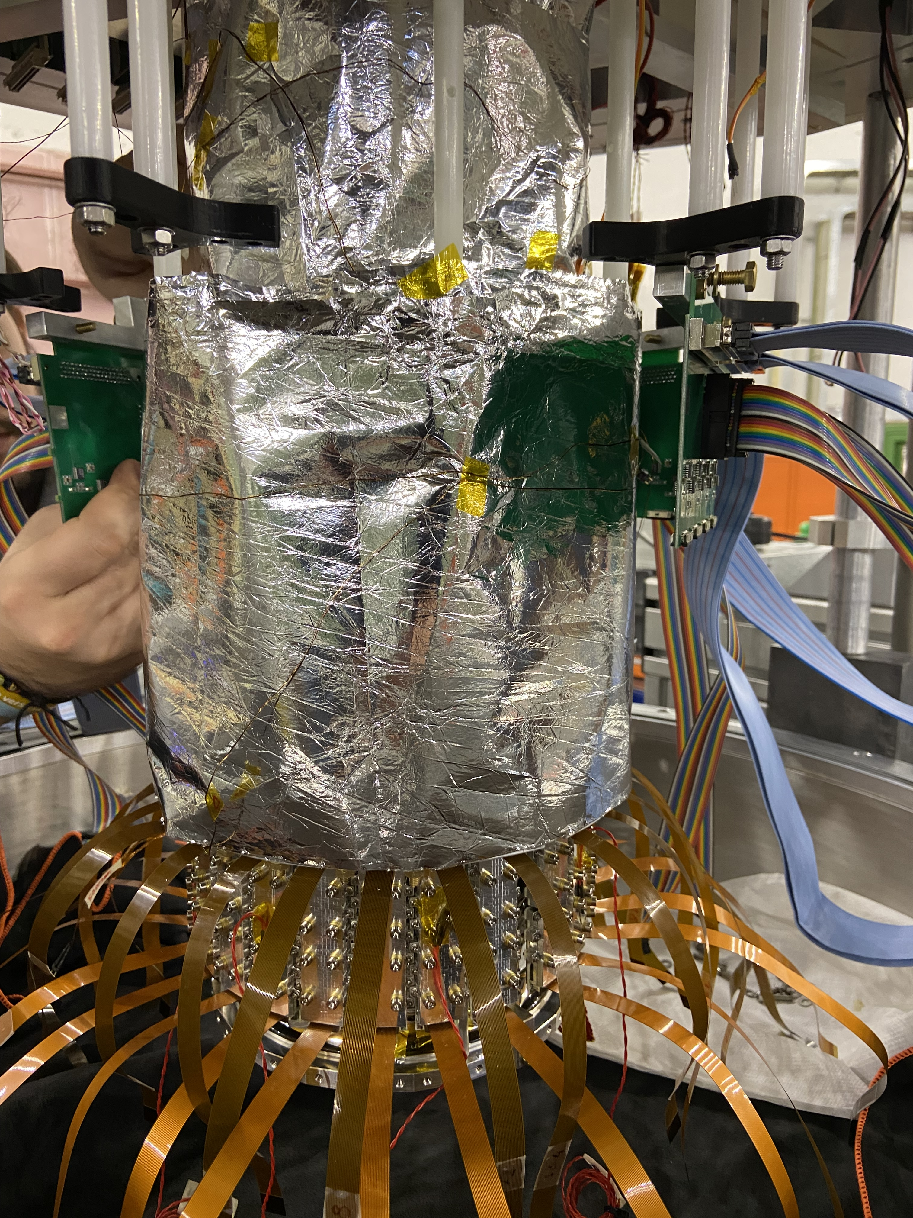
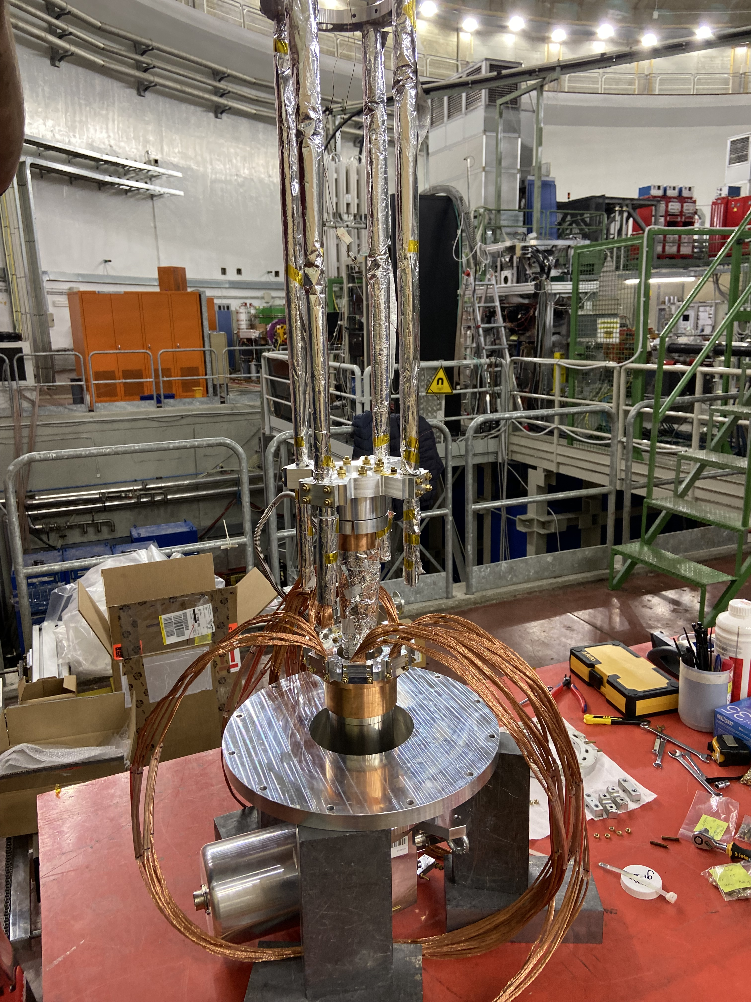
Optimization of SIDDHARTA-2 setup
First stage
dedicated only to SDD cooling

Slide 13
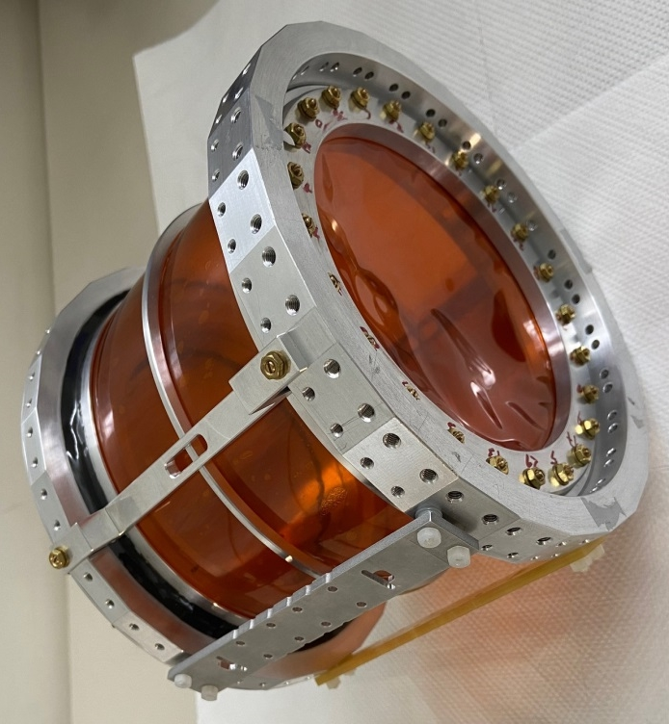

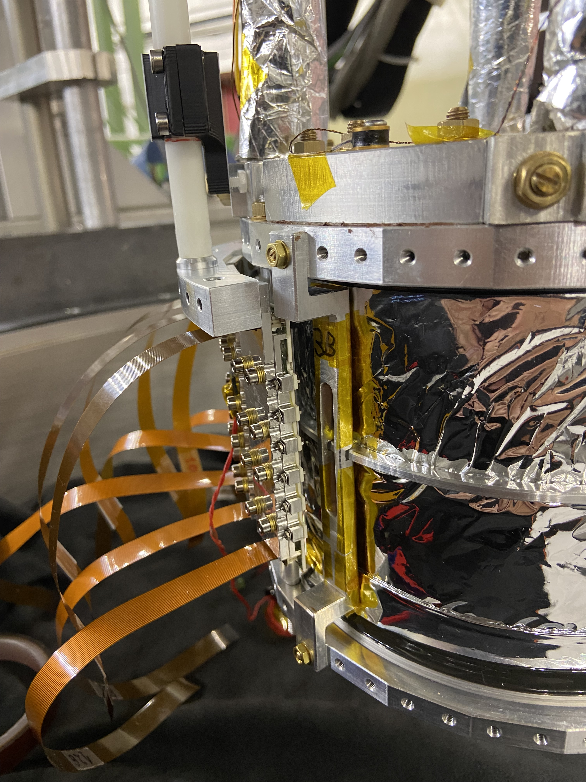
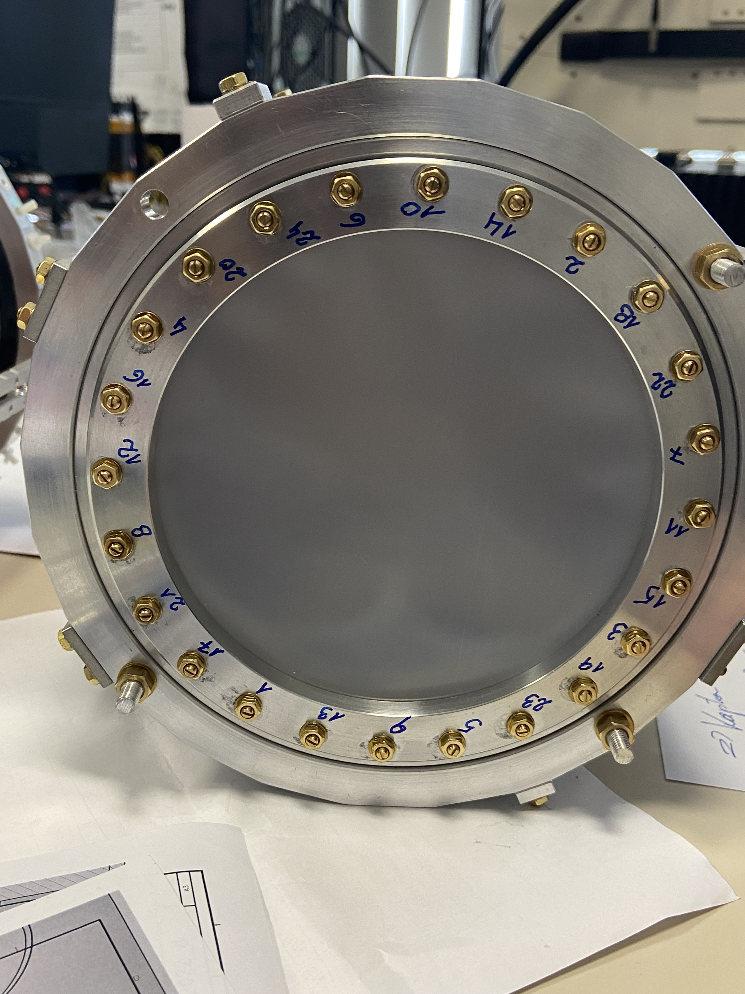
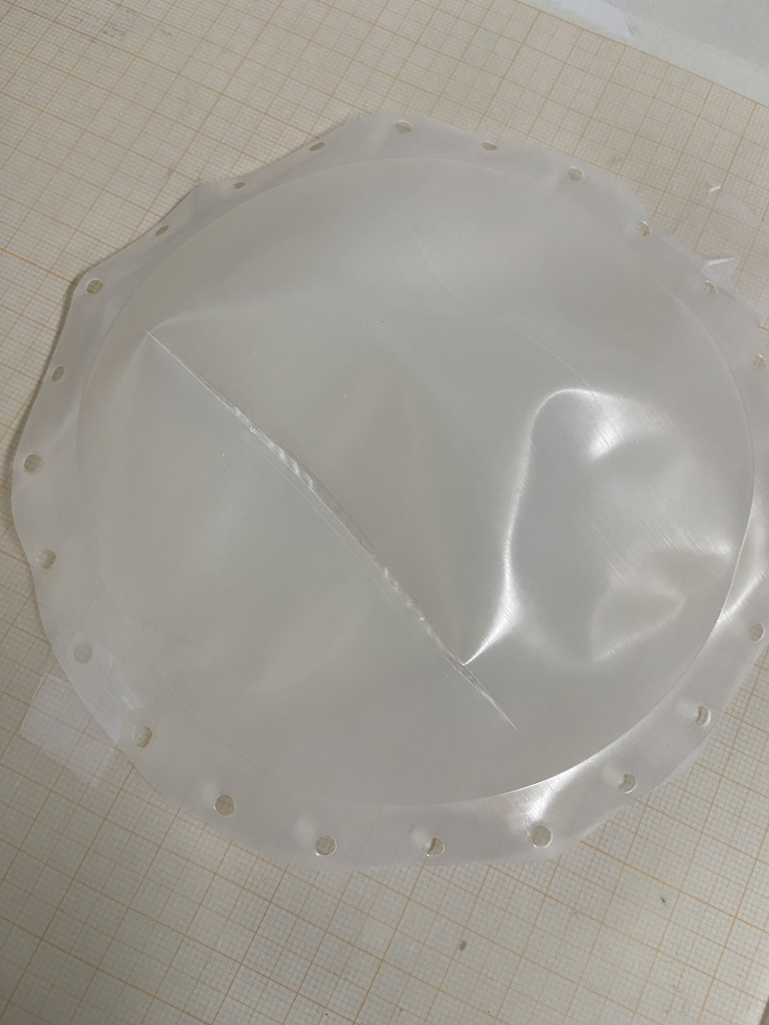
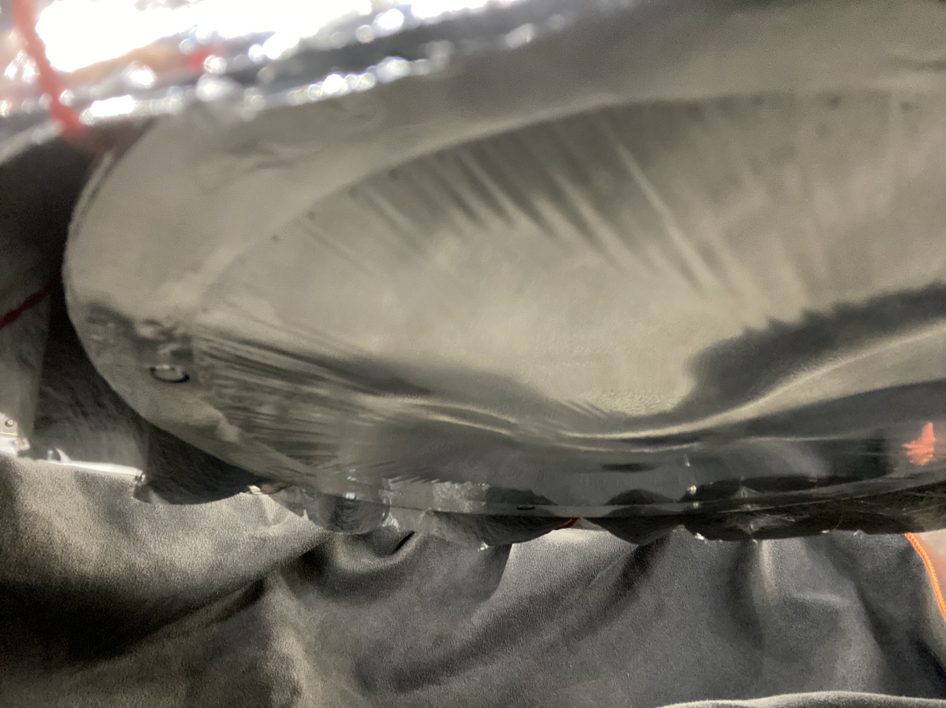
Optimization of SIDDHARTA-2 setup
UHMWPE – new entrance windows material
for target super-strong form of polyethylene,
would eliminate both Nitrogen and Oxygen
contamination
Successful tests done
in laboratory in Vienna
Installation and test in Dafne
… after two weeks failure
in the material composition
Replace with the back-up Mylar window

Slide 14
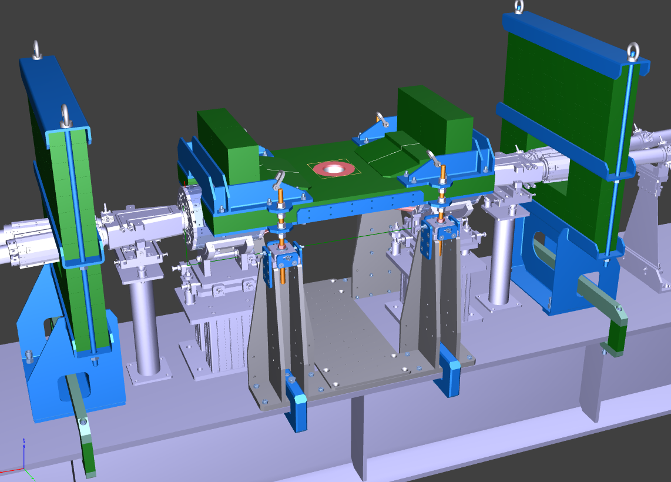
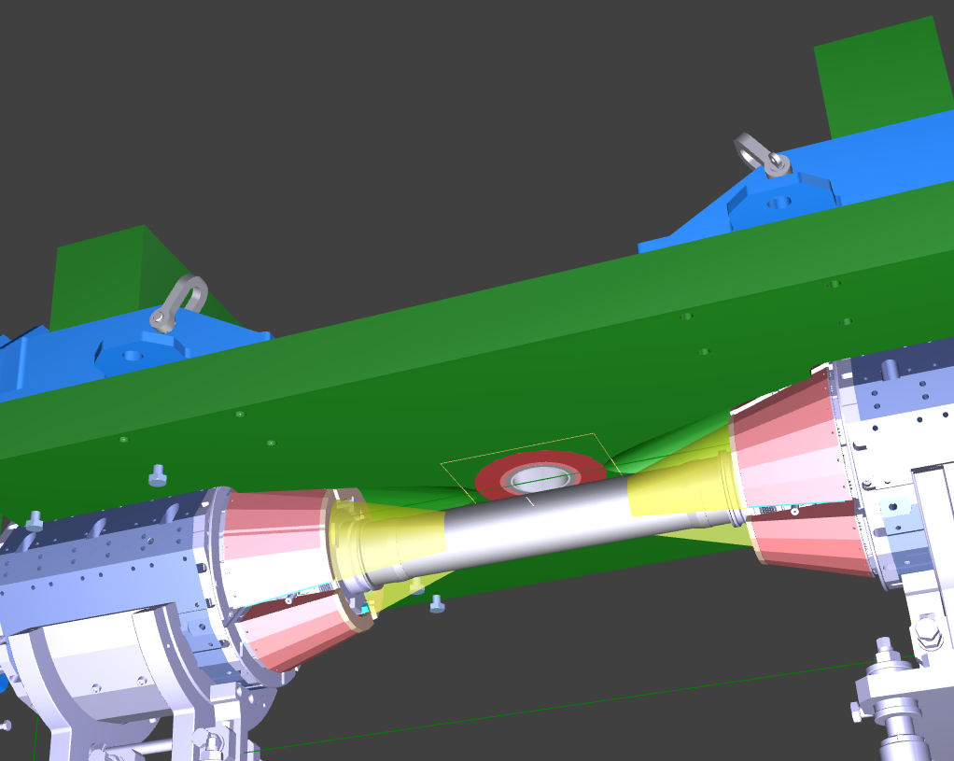
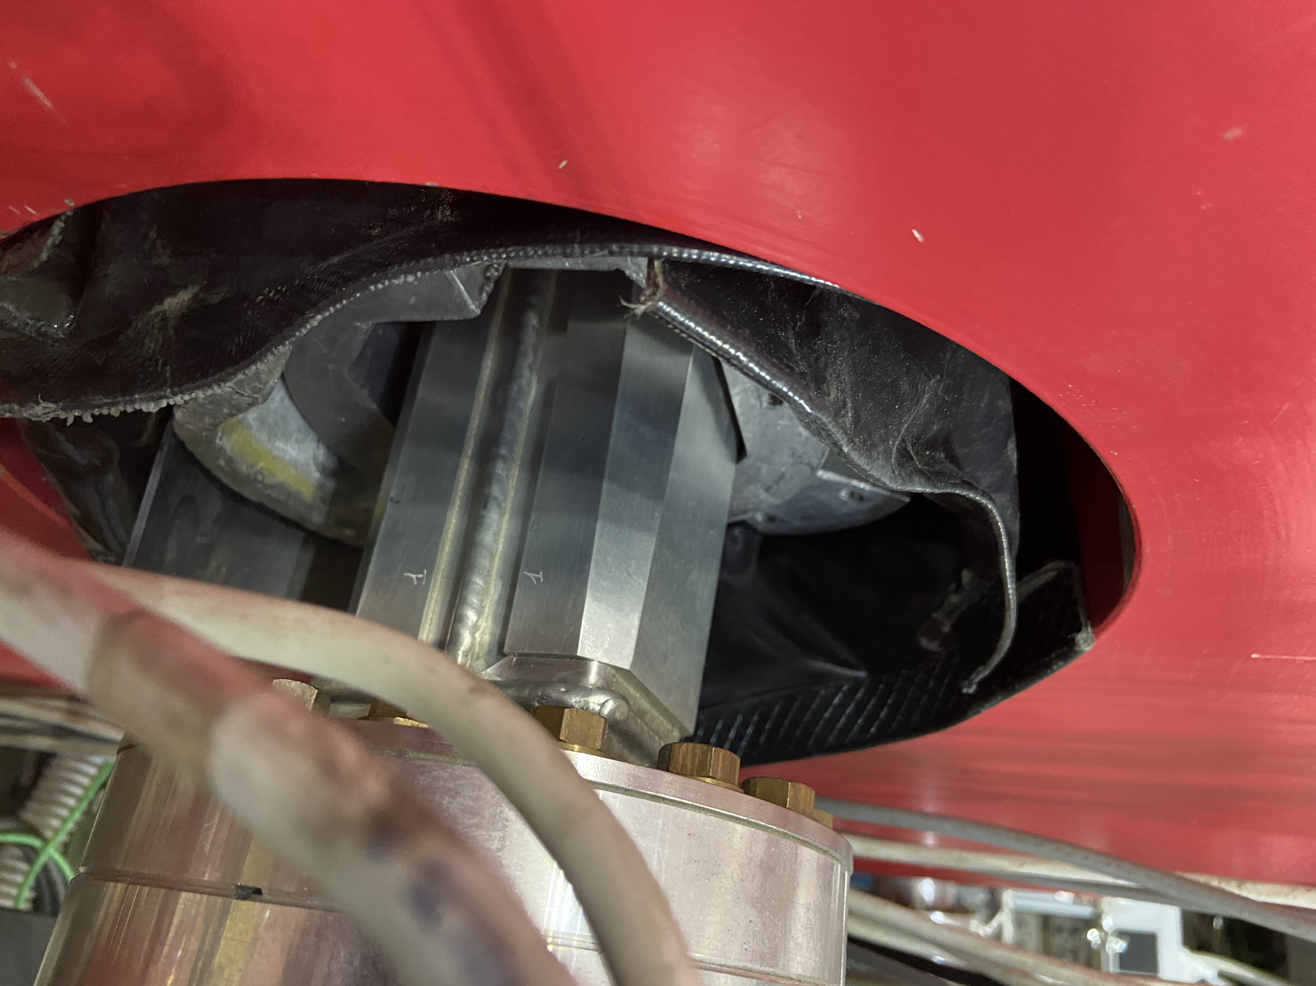
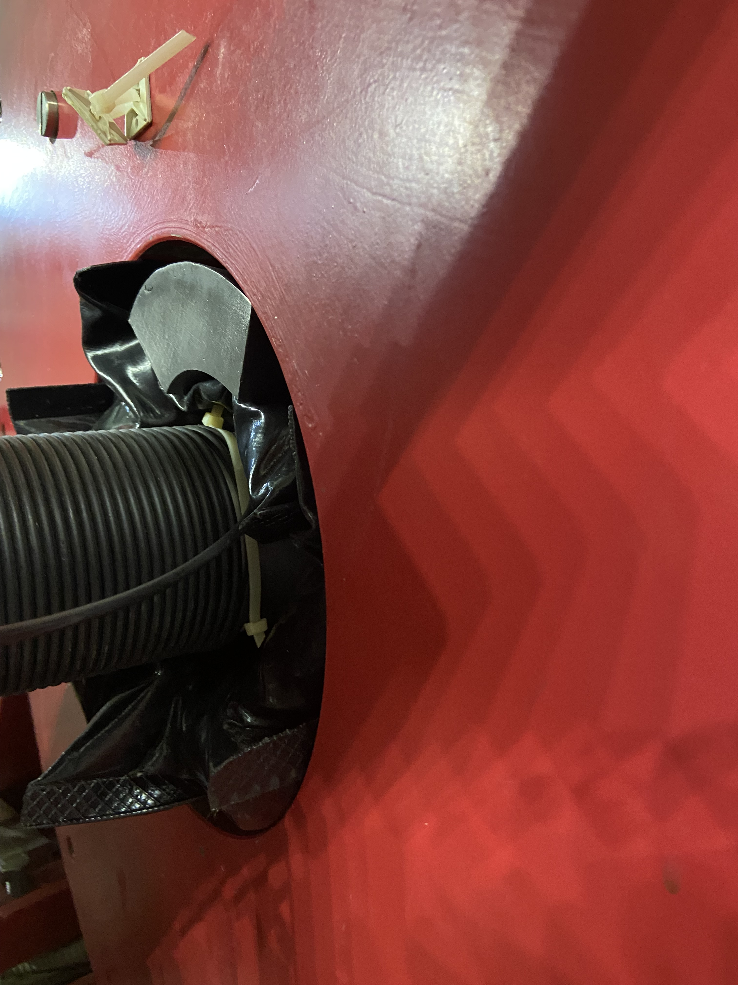
Optimization of SIDDHARTA-2 setup
Improve the lateral shielding around the vacuum chamber after adding VETO3 detector
Redesign and complete the bottom shielding near to interaction point
In collaboration with DAΦNE team to fill gaps in compensator magnets

Slide 15
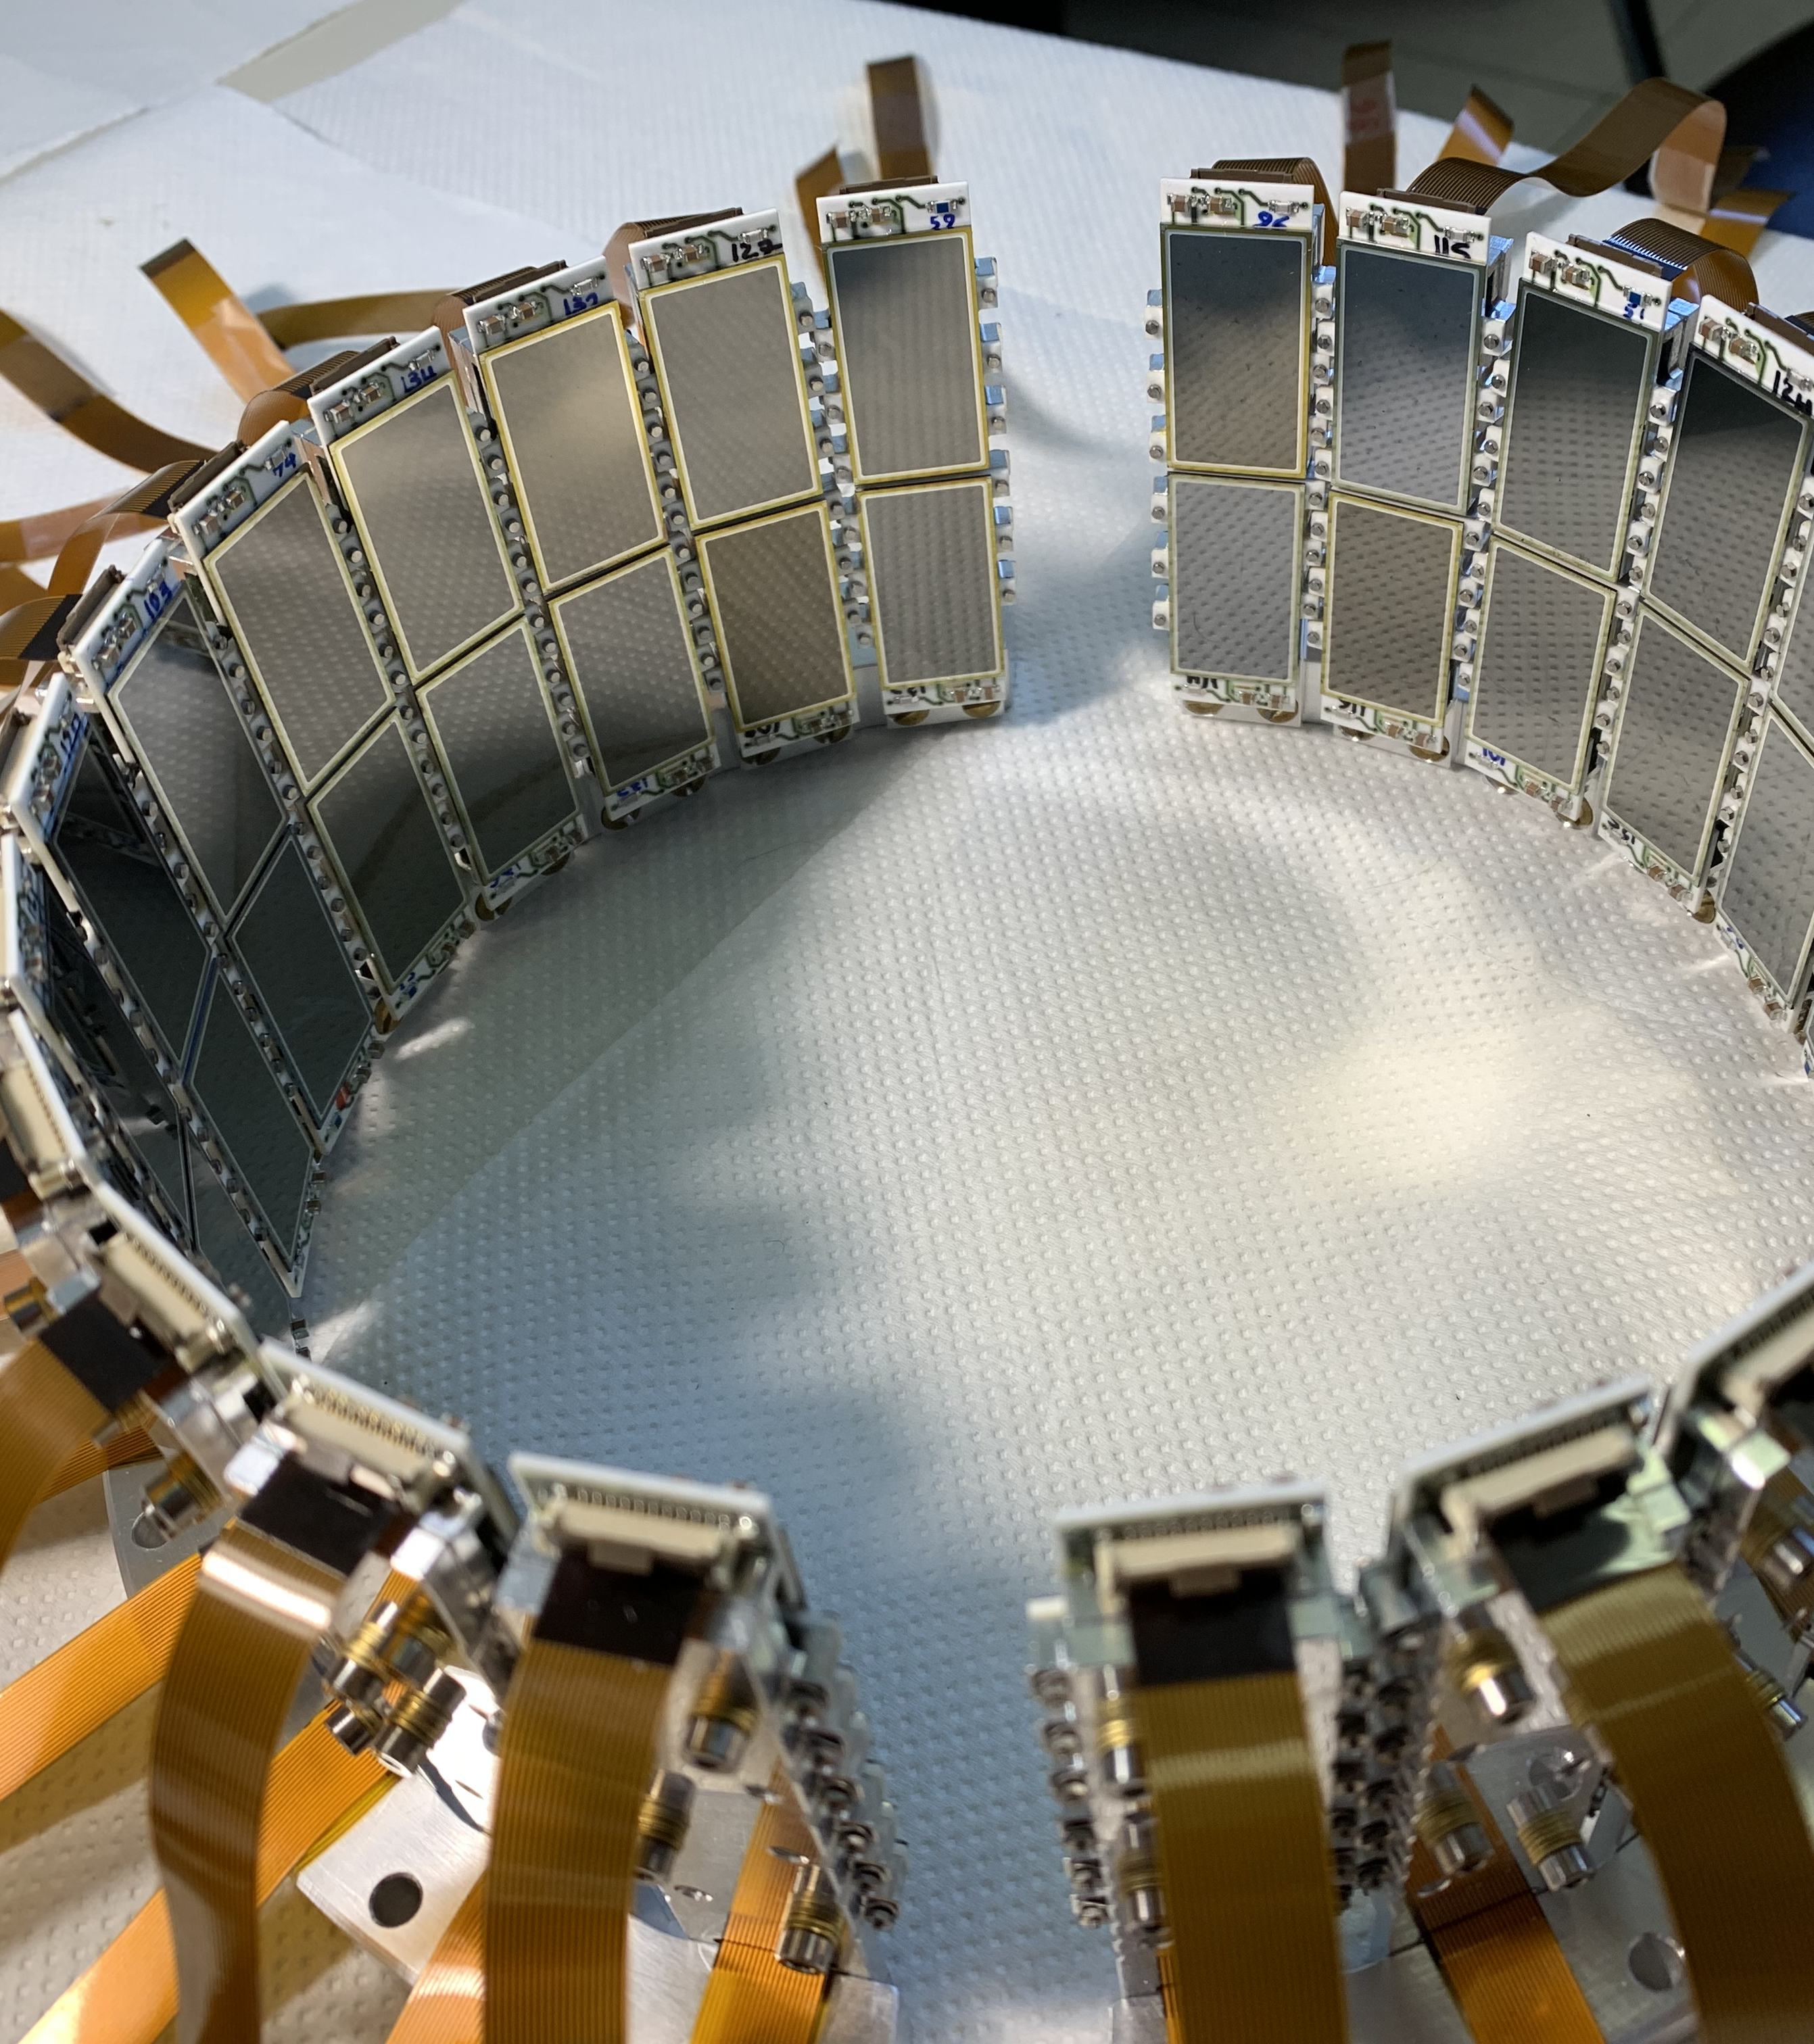
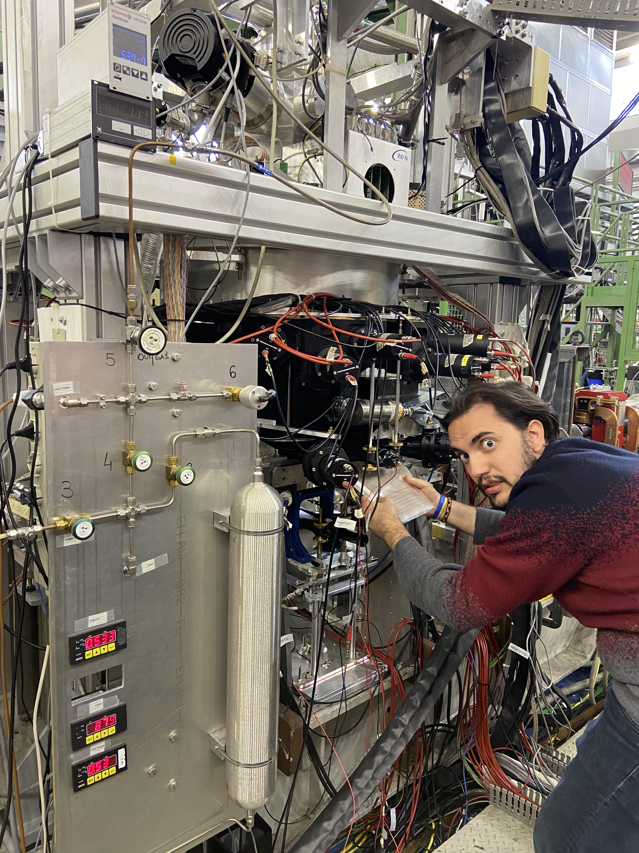
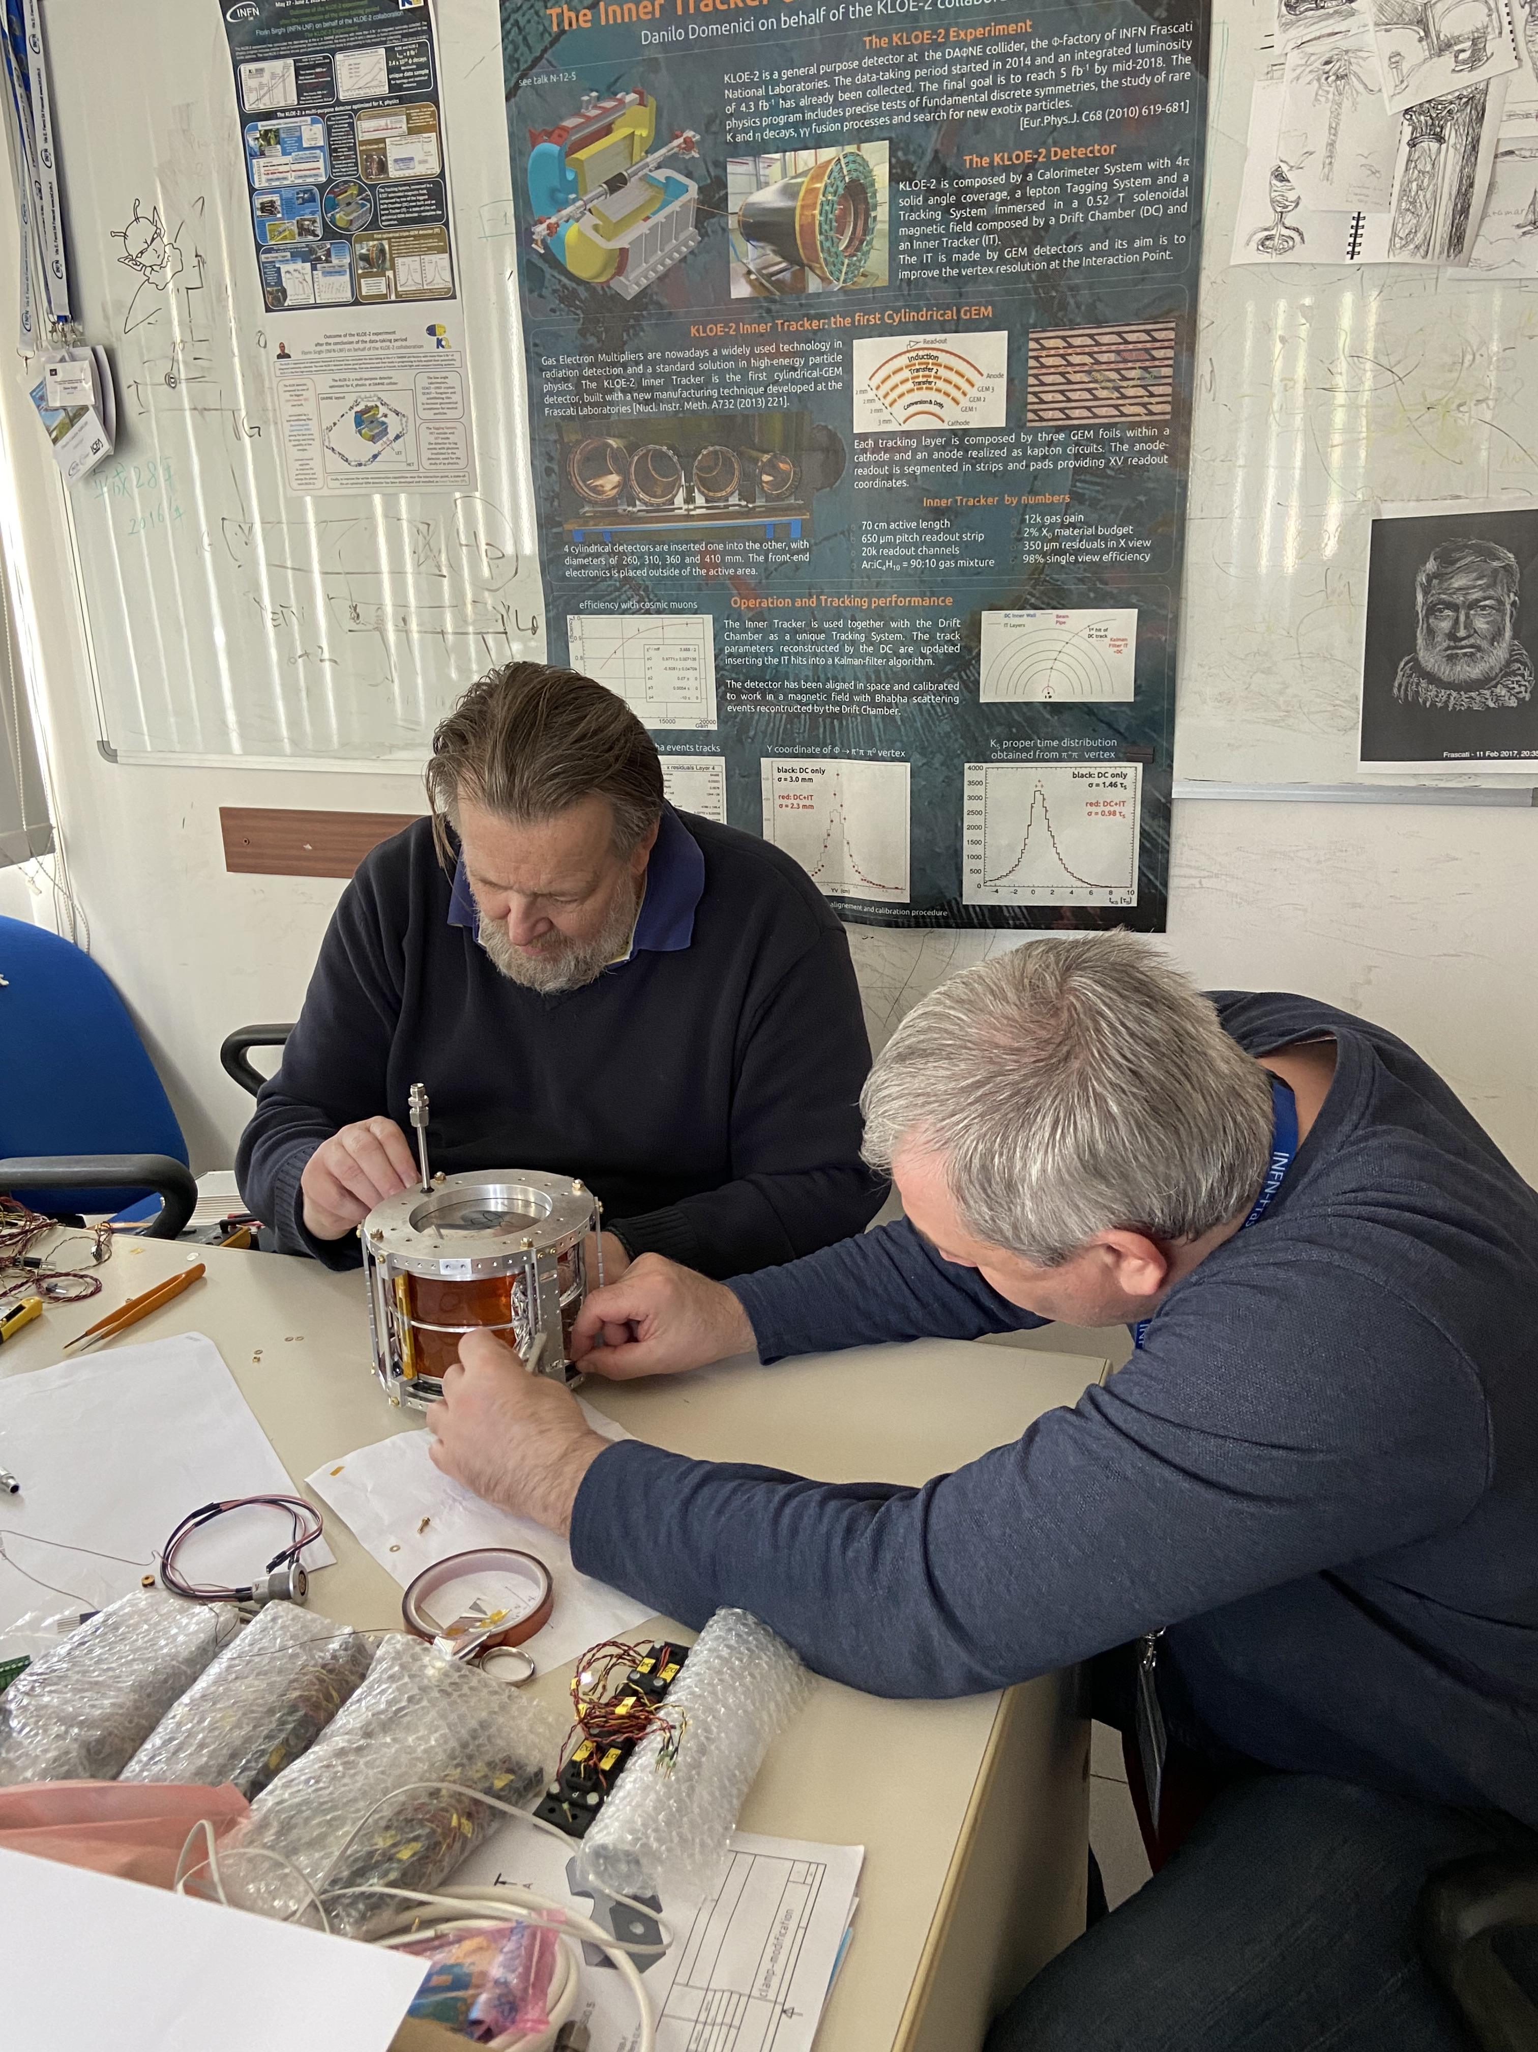
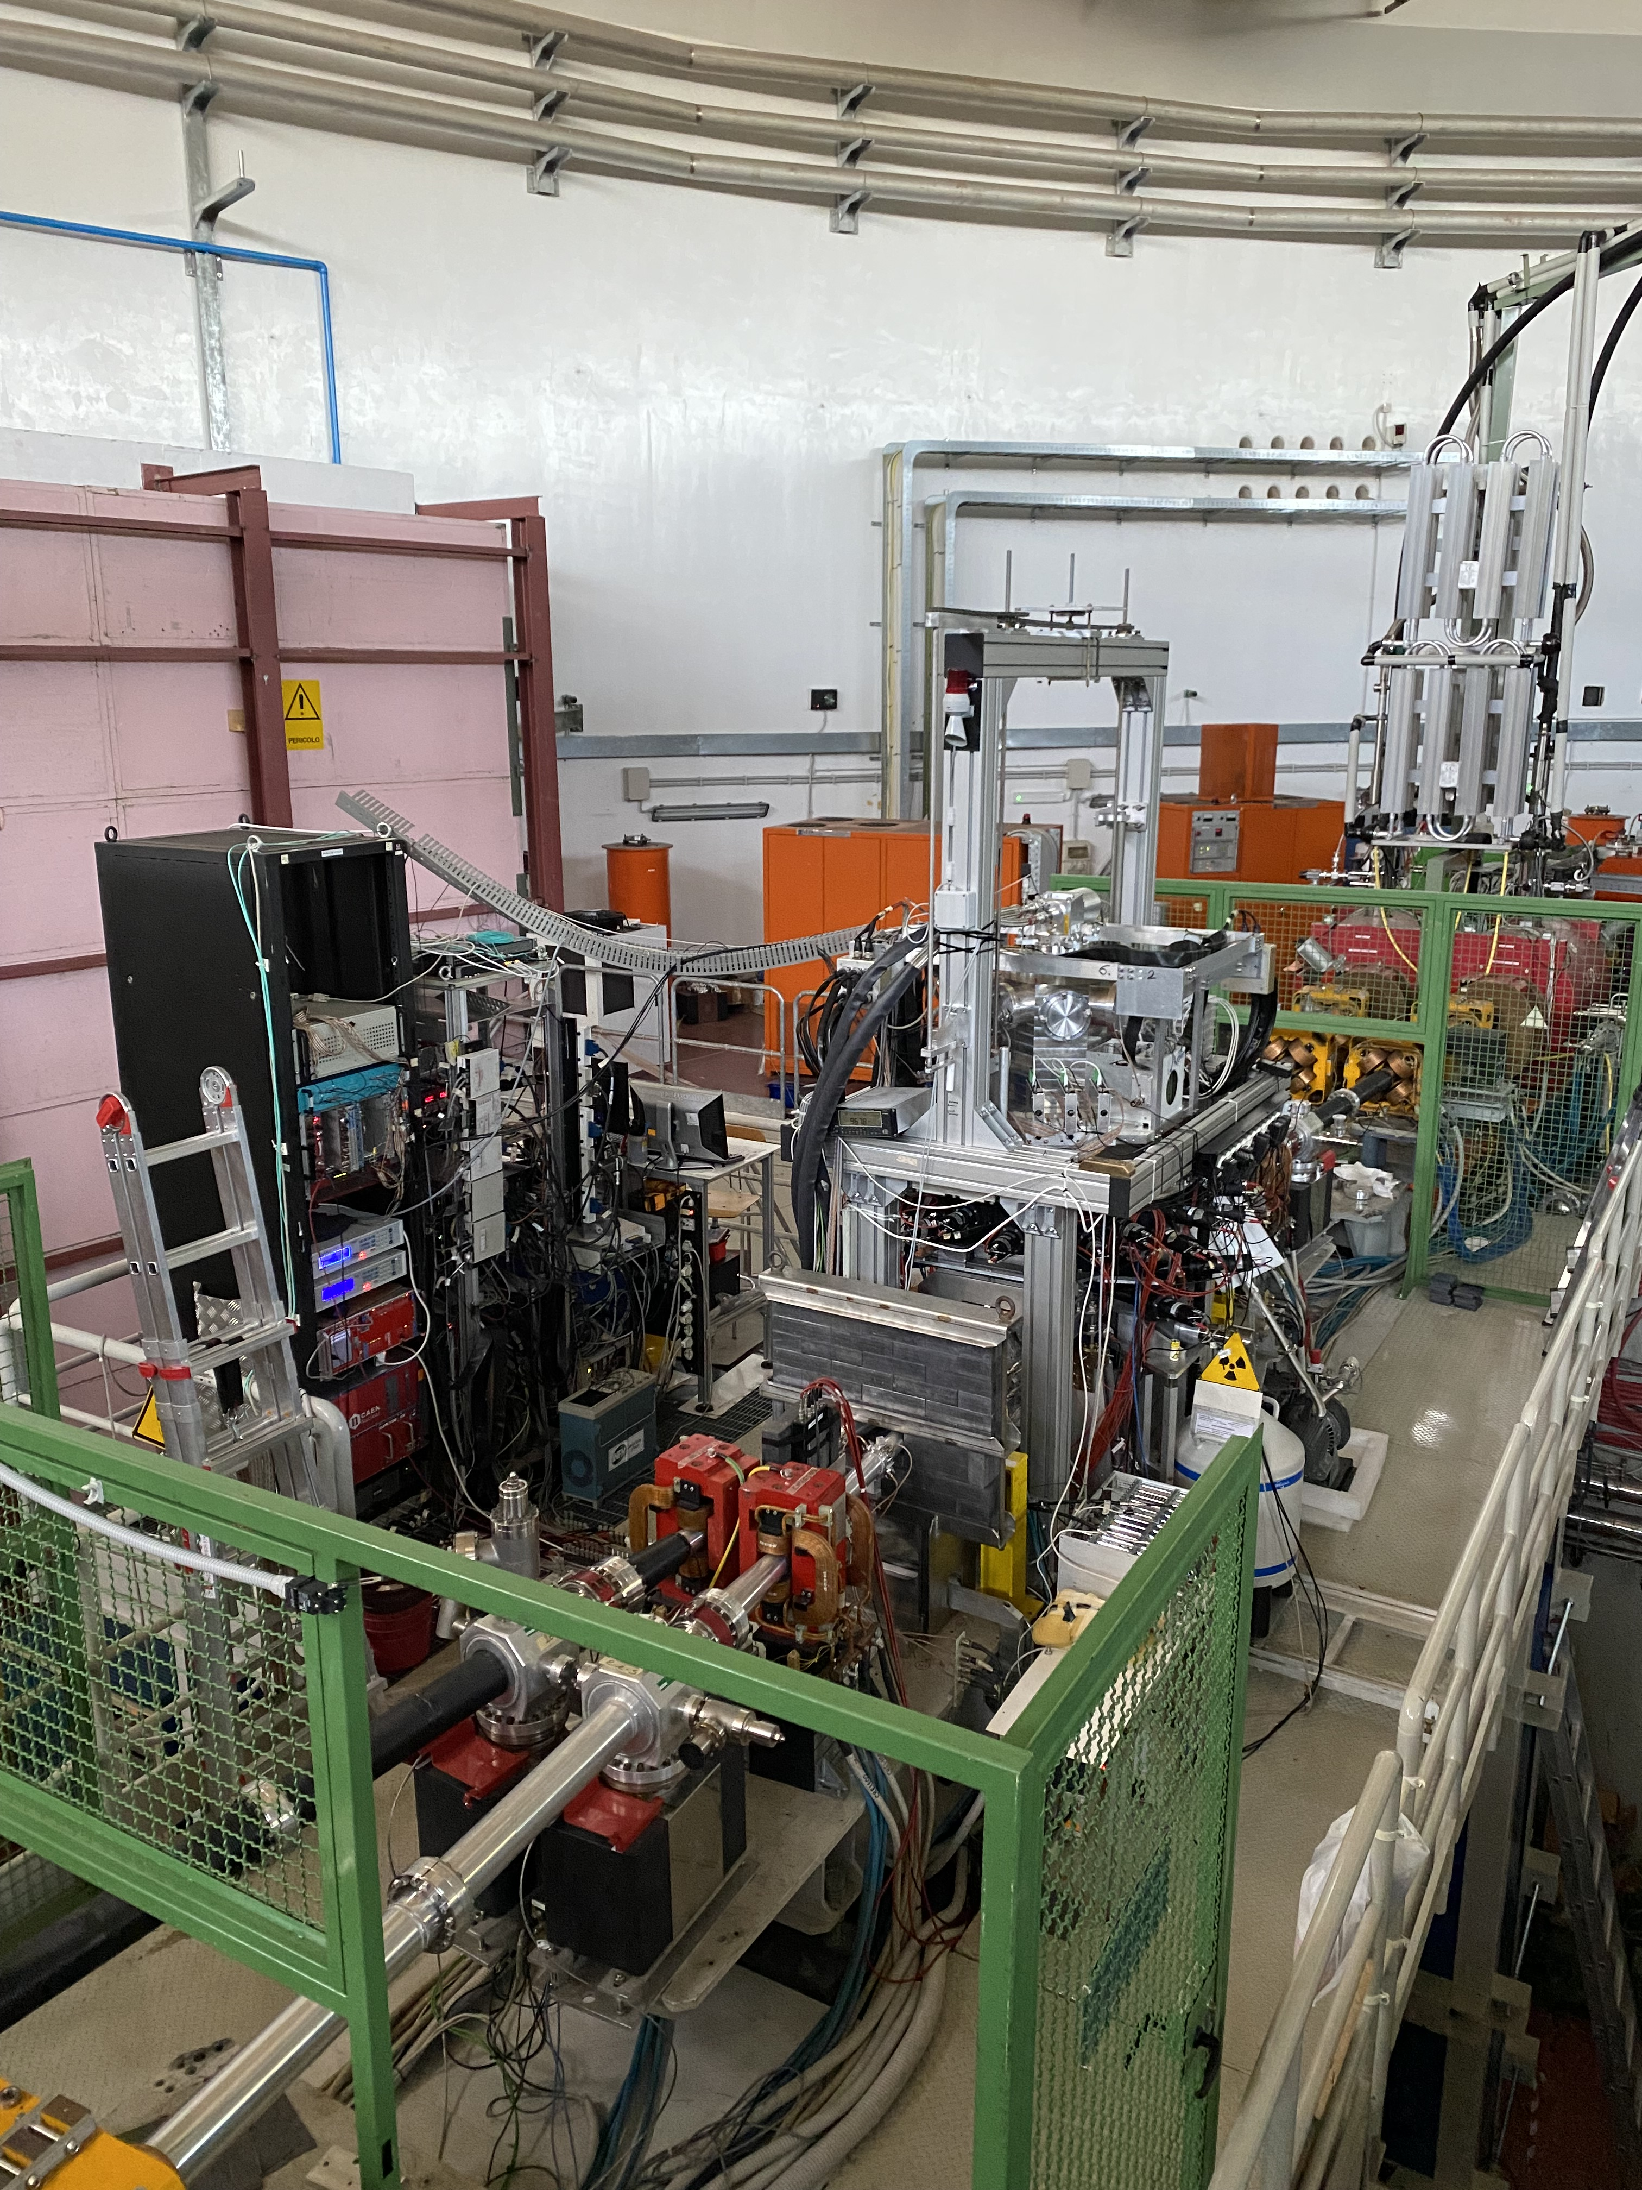
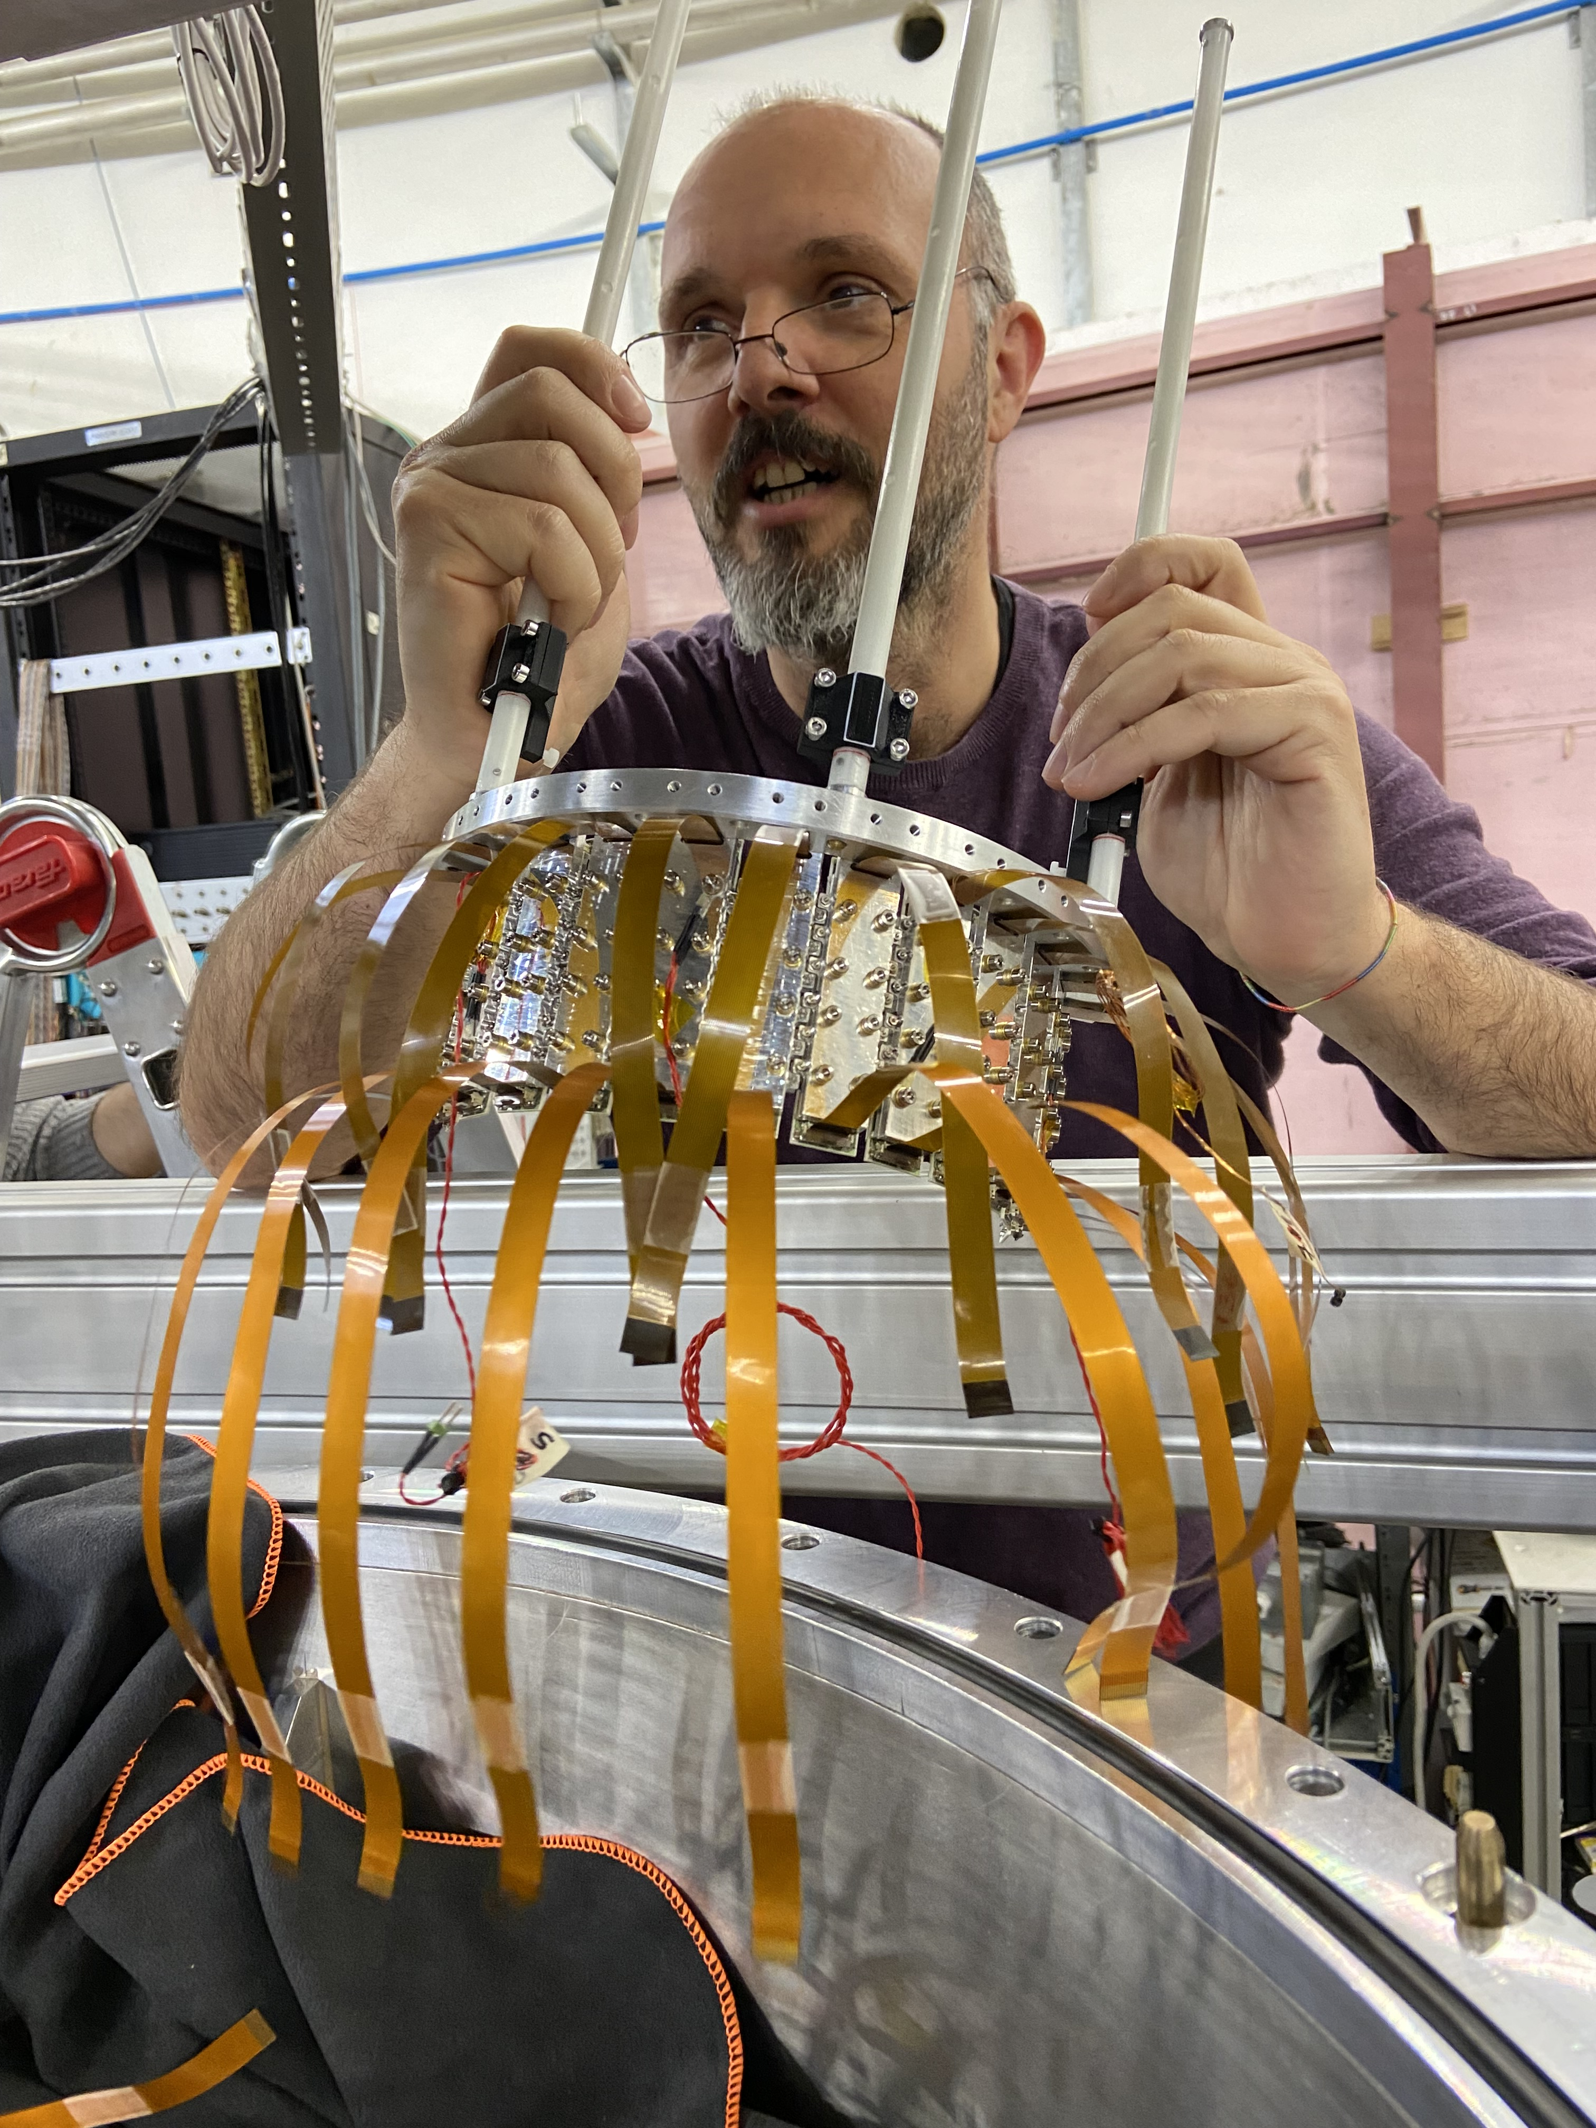

Slide 16
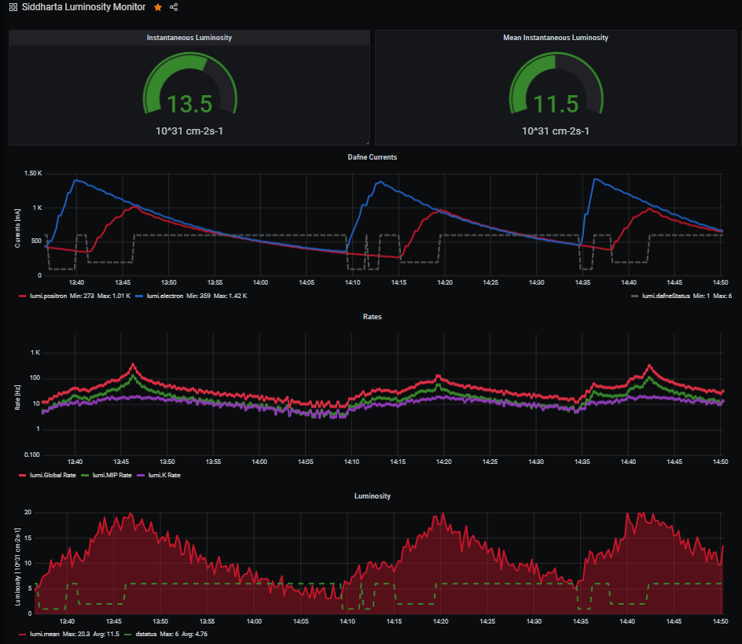
Optimization of SIDDHARTA-2 setup - results
Reduce background and improve KAON/SDD ratio – online tools
Online monitoring tools for fast feedback
Dafne
currents
Background estimation
luminosity estimation

Slide 17
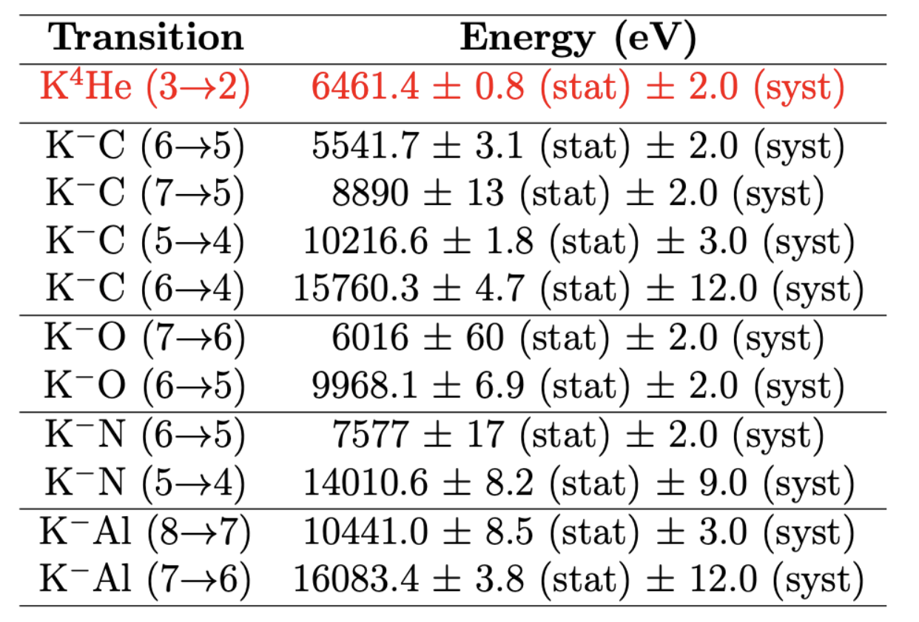
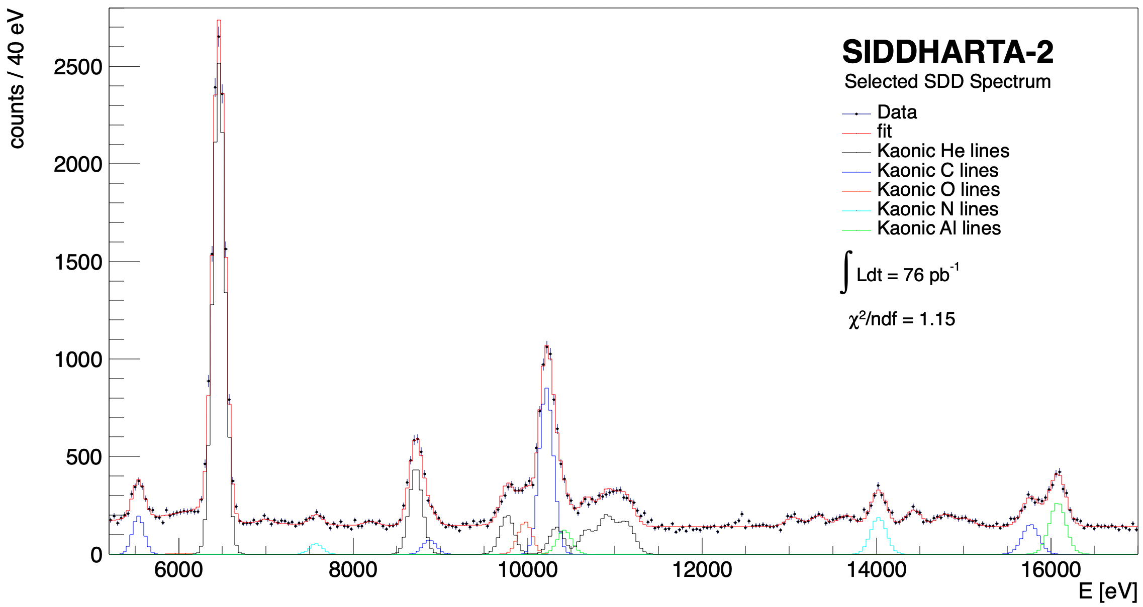
SIDDHARTA-2 (2022)
Measurements of high-n transitions in intermediate mass kaonic atoms
K⁴He 3->2
KAl 8->7
KO 6->5
K⁴He 5->2
KC 5->4
KC 7->5
KO 7->6
K⁴He 4->2
KAl 7->6
KC 6->5
K⁴He L-high
KN 5->4
KC 6->4
KN 6->5
Sgaramella, F., al. Eur. Phys. J. A 59, 56 (2023)

Slide 18
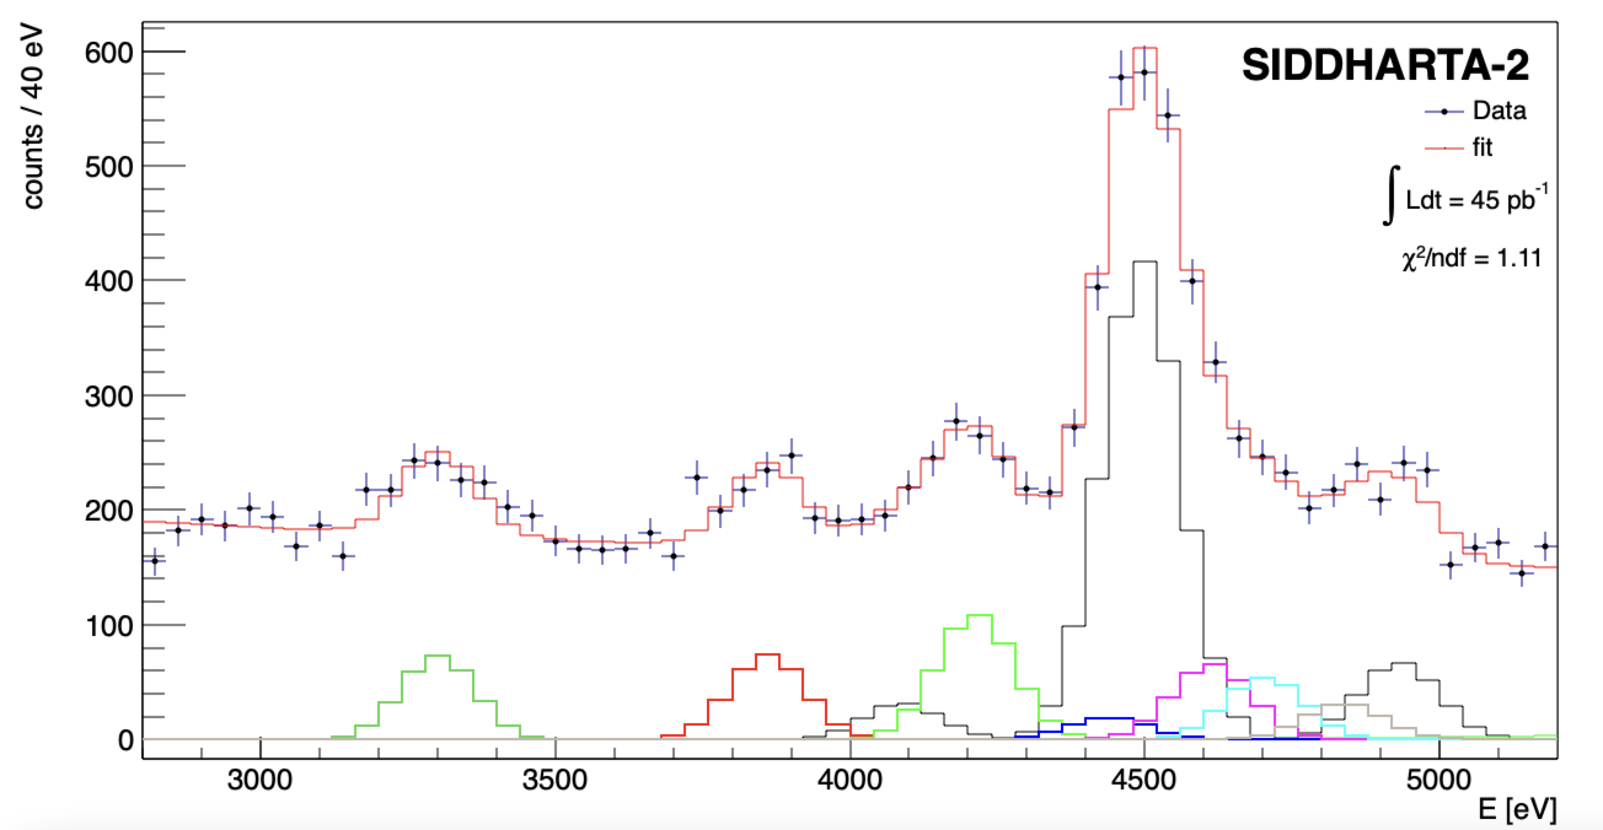
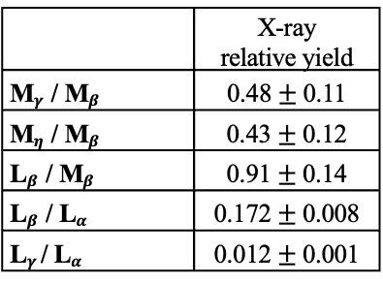





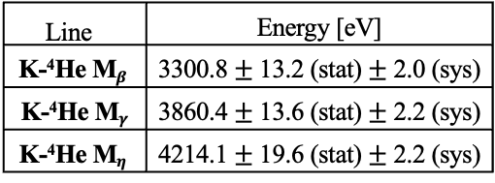
SIDDHARTA-2 (2022)
Kaonic ⁴He – M-type transitions
Line | Energy [eV]
K-⁴He M$β$ | 3300.8 $±$ 13.2 (stat) $±$ 2.0 (sys)
K-⁴He M$γ$ | 3860.4 $±$ 13.6 (stat) $±$ 2.2 (sys)
K-⁴He M$η$ | 4214.1 $±$ 19.6 (stat) $±$ 2.2 (sys)
KHe 6->3
(M$γ$)
KHe 7->3
(M$η$)
KHe 8->3
4435.4 eV
KHe 9->3
4587.3 eV
KHe 11->3
4696.6 eV
 | X-ray relative yield
M$γ$/ M$β$ | 0.48 $±$ 0.11
M$η$/ M$β$ | 0.43 $±$ 0.12
L$β$/ M$β$ | 0.91 $±$ 0.14
L$β$/ L$α$ | 0.172 $±$ 0.008
L$γ$/ L$α$ | 0.012 $±$ 0.001
KHe 10->3
4696.6 eV
Preliminary
Ti K$α$
KHe 5->3
(M$β$)
Ti K$β$

Slide 19
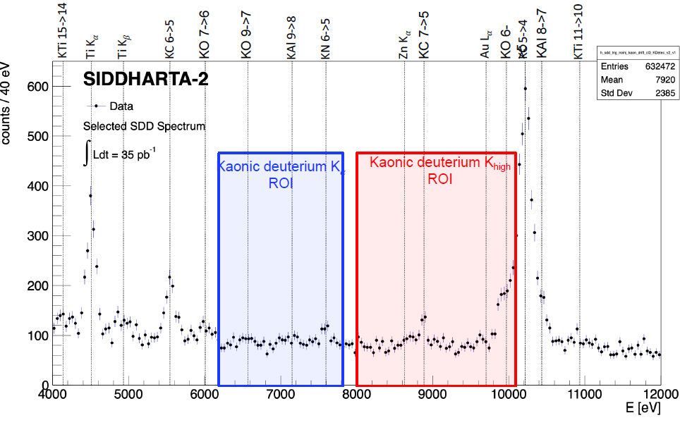
SIDDHARTA-2 (2022)
Kaonic deuterium technical run

Slide 20
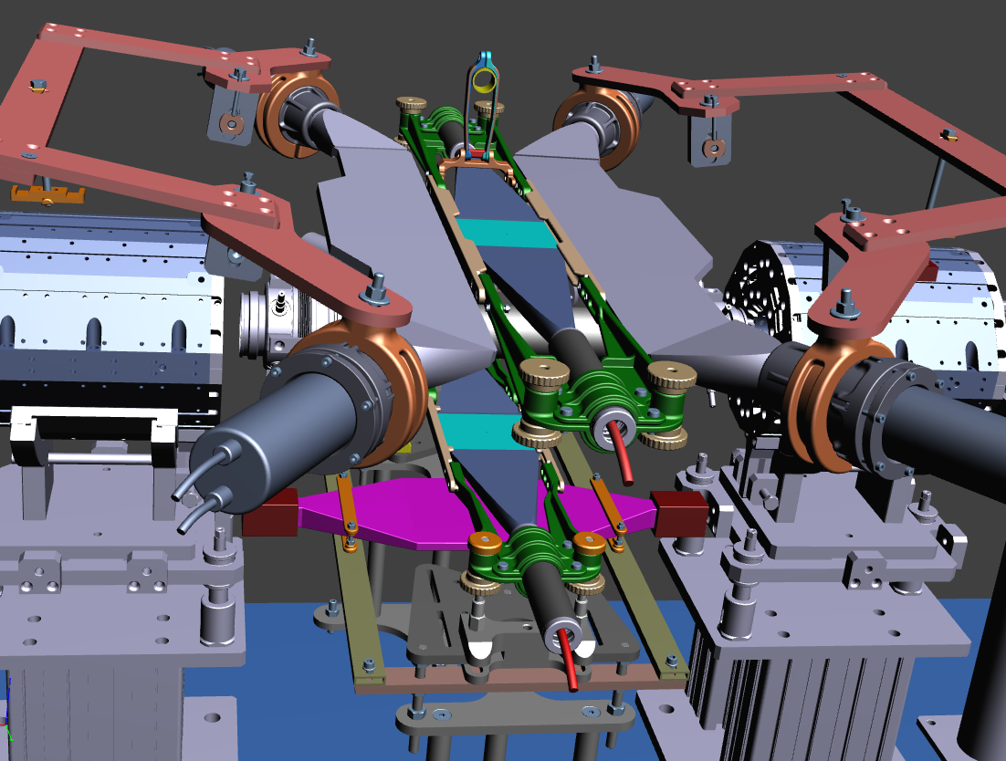
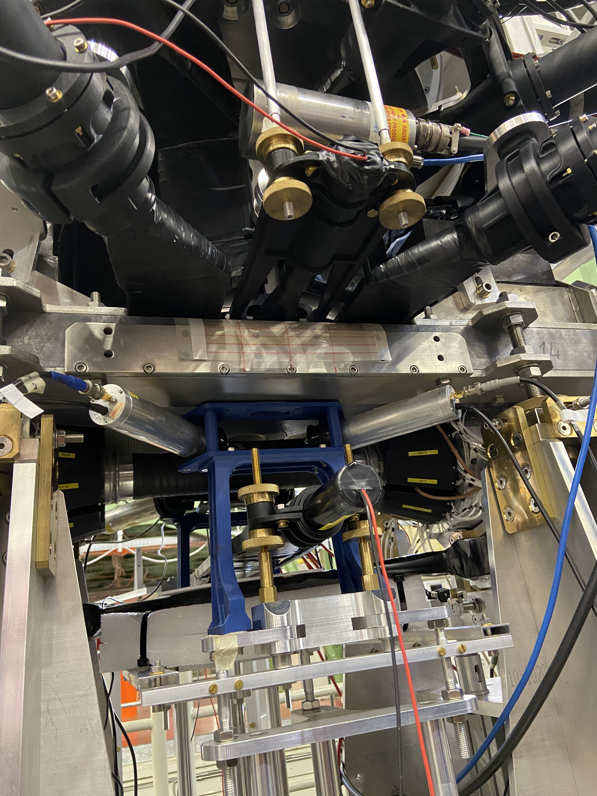
Optimization of SIDDHARTA-2 setup
● 2 pairs of scintillator
640 x 130 x 10 mm³ Scionix EJ-200
● R10533 PMTs Hamamatsu
VETO system adds – VETO3
● light-guides
● Al tube + μMetal (0.1mm)
● reflective and light proof foil
● optical cement

Slide 21
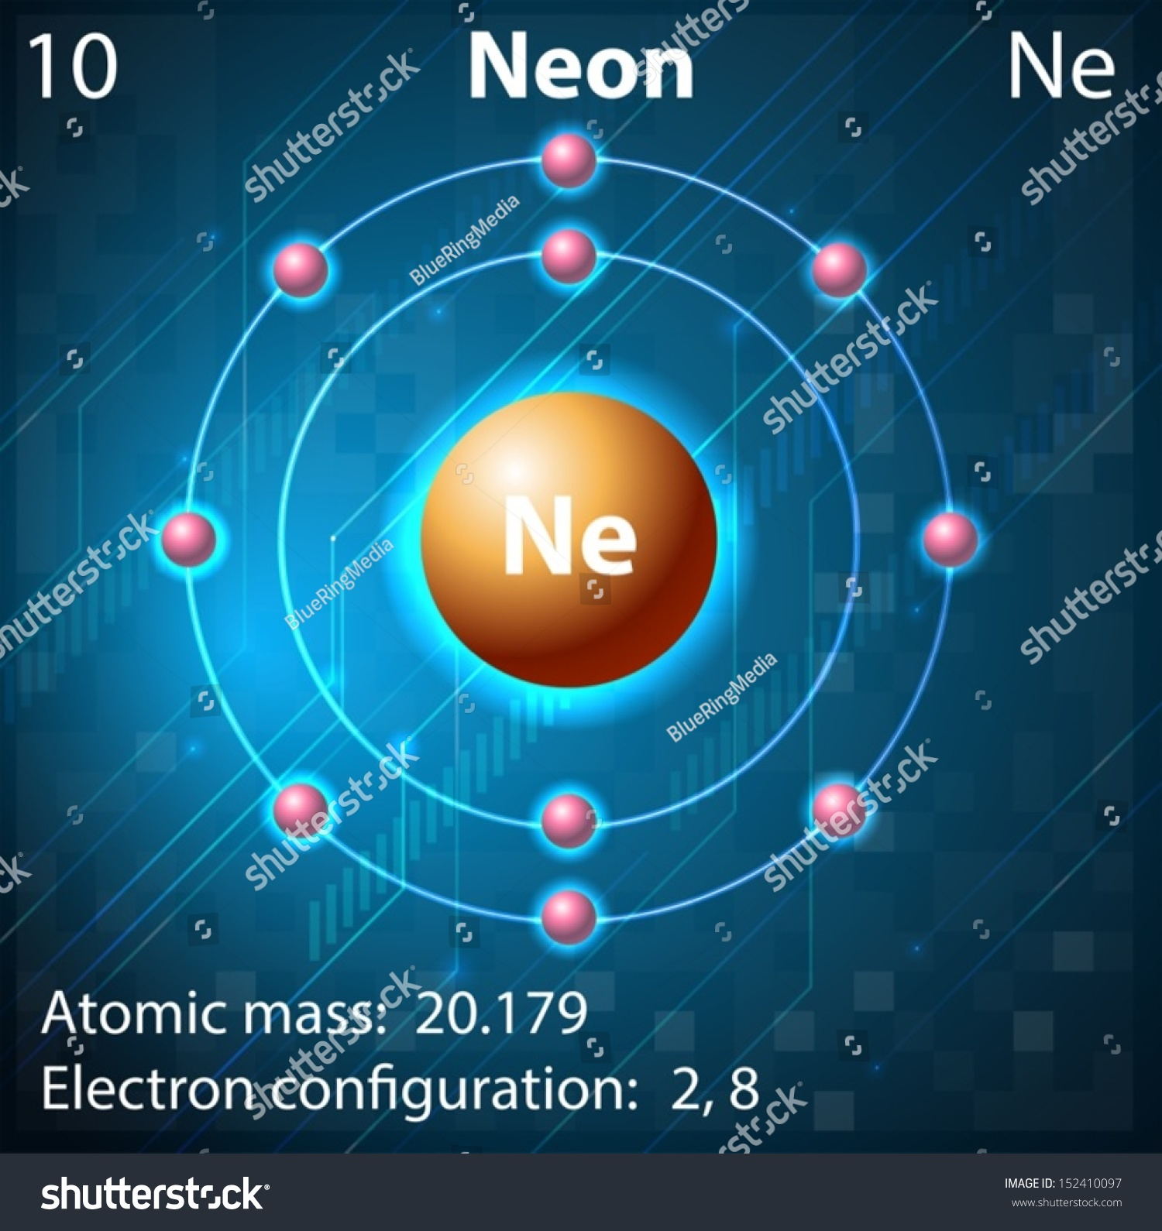

SIDDHARTA-2 (2023)
Kaonic Neon
Calibration
technical run
Kaonic Neon transitions energies
kaonic Neon 6-->5 transition = 15.6354 keV
kaonic Neon 7-->6 transition = 9.42765 keV
kaonic Neon 8-->7 transition = 6.11891 keV
Never measured – scientific goal
High yield from theoretical prediction
Controlled parameters
of target and
SDD detectors
kaonic Neon 9-->8 transition = 4.1951 keV
kaonic Neon 10-->9 transition = 3.00073 keV
kaonic Neon 11-->10 transition = 2.2202 keV

Slide 22




SIDDHARTA-2 Kaonic Neon
Degrader optimization
Sample data for
one degrader
thickness

Slide 23






SIDDHARTA-2
Kaonic Neon (2023)
K-Ne 7->6
K-Ne 6->5
Preliminary
Line | Energy [eV]
K-Ne 9$⟶$8 | 4218.96$±$ 3.28 (stat)
K-Ne 8$⟶7$ | 6156.83 $±$ 0.84 (stat)
K-Ne 7$⟶6$ | 9450.76$±$ 0.42 (stat)
K-Ne 6$⟶5$ | 15614.80 $±$ 0.70 (stat)
K-Ne 8->7
KO 6->5
KC 5->4
K-Ne 9->8
KAl 7->6
KC 6->4
KC 7->5
KAl 8->7
KO 5->4
First K-Ne measurements – possible implications on
K- multinucleon interaction and kaon mass

Slide 24


Kaonic deuterium data taking
Kaonic deuterium run ongoing 2023/24
Monte Carlo for an integrated luminosity
of 800 pb⁻¹
to perform the first measurement of the strong interaction induced energy shift and width of the kaonic deuterium ground state
(similar precision as K-p) !
achievable precision
Monte Carlo Simulation
Significant impact in the theory of strong interaction with strangeness

Slide 25
Kaonic deuterium shift and width
Liu 2020
SIDDHARTA-2
achievable precision
Weise 2017
Oset 2001
Mizutani 2013
Meißner 2011
Gal 2007
Shevchenkov 2012
Francesco Sgaramella
High precision kaonic atoms X-ray spectroscopy with the SIDDHARTA-2 experiment at the DAFNE collider

Slide 26

SIDDHARTA-2
Kaonic deuterium measurement plan
First Kaonic deuterium run started in MAY
optimized setup for about 300 pb⁻¹ integrated luminosity
(from May to July 2023)
Second Kaonic deuterium run
with optimized shielding, readout, veto, add 1mm SDD bus and other necessary optimizations
(for remaining integrated luminosity, 400-500 pb⁻¹)
end 2023 - 2024
Calibration/technical runs
KHe, Neon, solid targets Li, Be

Slide 27
Future plans
proposal to perform fundamental physics at the strangeness frontier at DAFNE
for a 3-years period (post-SIDDHARTA-2)
We propose to do precision measurements along the periodic table at DAΦNE
Kaonic Hydrogen: 200 pb⁻¹ – with SIDDHARTA-2 setup – to get a precision < 10 eV (KH)
Selected light kaonic atoms (LHKA)
Selected intermediate and heavy kaonic atoms charting the periodic table (IMKA)
Ultra-High precision measurements of Kaonic Atoms (UHKA)
EXtensive
Kaonic
Atoms research: from
LIthium and
Beryllium to
URanium
Dedicated runs with different types of detectors:
CZT detectors, HpGe, SDD 1mm, crystal HAPG spectrometer from VOXES project
EXKALIBUR

Slide 28

Take advantage of “free space” in DAΦNE
DAΦNE delivers
almost 4π Kaons
Intermediate Kaonic Atoms
CdZnTe
(30-300 keV)

Slide 29







Future plans
SDD 1mm detector
development
Thicker detectors are produced by FBK with larger guard rings
Samples of detector under test in Milano
Same active area
New Focusing electrodes added
Li, Be, B
solid targets

Slide 30

Future plans
Gantt chart
possible implementation of the kaonic atoms measurements
Total integrated Luminosity:
200 + 400 (200) + 400 (200) + 400 pb-1
Fast, handy and significant physics measurements with very low costs and human efforts

Slide 31




Conclusions
Kaonic ⁴He $3d→2p$ sub eV (stat) precision measurement
Several solid target high-n transition energies measured for the first time
The SIDDHARTA-2 NEON run (technical run) ended
(high interest from theoreticians)
We are confident in machine performance, ready and very motivated to continue the SIDDHARTA-2
Kaonic deuterium measurement
Future measurements proposal
we put forward several proposals for solid targets measurements with SIDDHARTA-2 setup and dedicated detectors systems for 200 - 300 pb-1

Slide 32
SPARE

Slide 33










Kaon Charge Detector
Stop both $K^{+}$ and $K^{−}$ in a passive layer (Teflon) and detect secondaries in a scintillator
$$K^{−}$$
$$K^{−}$$
Count
$$K^{+} decay$$
$$K^{+}$$
kaon charge detector
tdc (1 ch=100 ps)

