Slide 1
Grant no. 12135007
Craig Roberts … http://inp.nju.edu.cn/
Origin of mass through studies
of hadron spectra and structure
Notes:
25+5

Slide 2
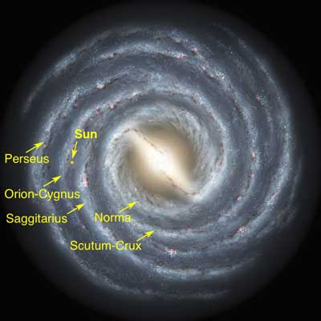
Emergent Phenomena … in the Standard Model(?)
Existence of our Universe depends critically on, inter alia, the following empirical facts:
Proton is massive
i.e., the mass-scale for strong interactions is vastly different to that of electromagnetism
Proton is absolutely stable
Despite being a composite object
constituted from three valence quarks
Pion is unnaturally light (not massless, but lepton-like mass)
Despite being a strongly interacting composite object built from a valence-quark and valence antiquark
Emergence: low-level rules producing high-level phenomena, with enormous apparent complexity

Slide 3
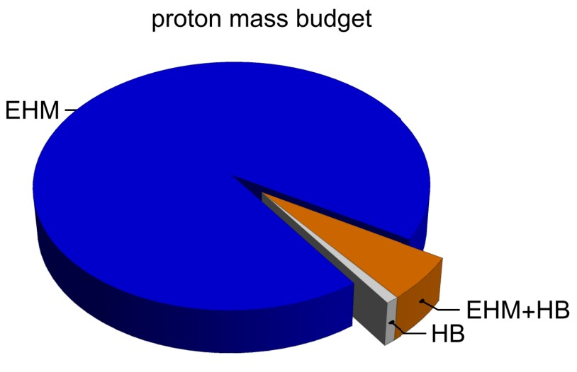
Emergence of Hadron Mass
Standard Model of Particle Physics has one obvious mass-generating mechanism
= Higgs Boson … impacts are critical to evolution of Universe as we know it
However, Higgs boson alone is responsible for just ∼ 1% of the visible mass in the Universe
Proton mass budget … only 9 MeV/939 MeV is directly from Higgs
Evidently, Nature has another very effective mechanism for producing mass:
Emergent Hadron Mass (EHM)
Alone, it produces 94% of the proton’s mass
Remaining 5% is generated by constructive interference between EHM and Higgs-boson

Slide 4
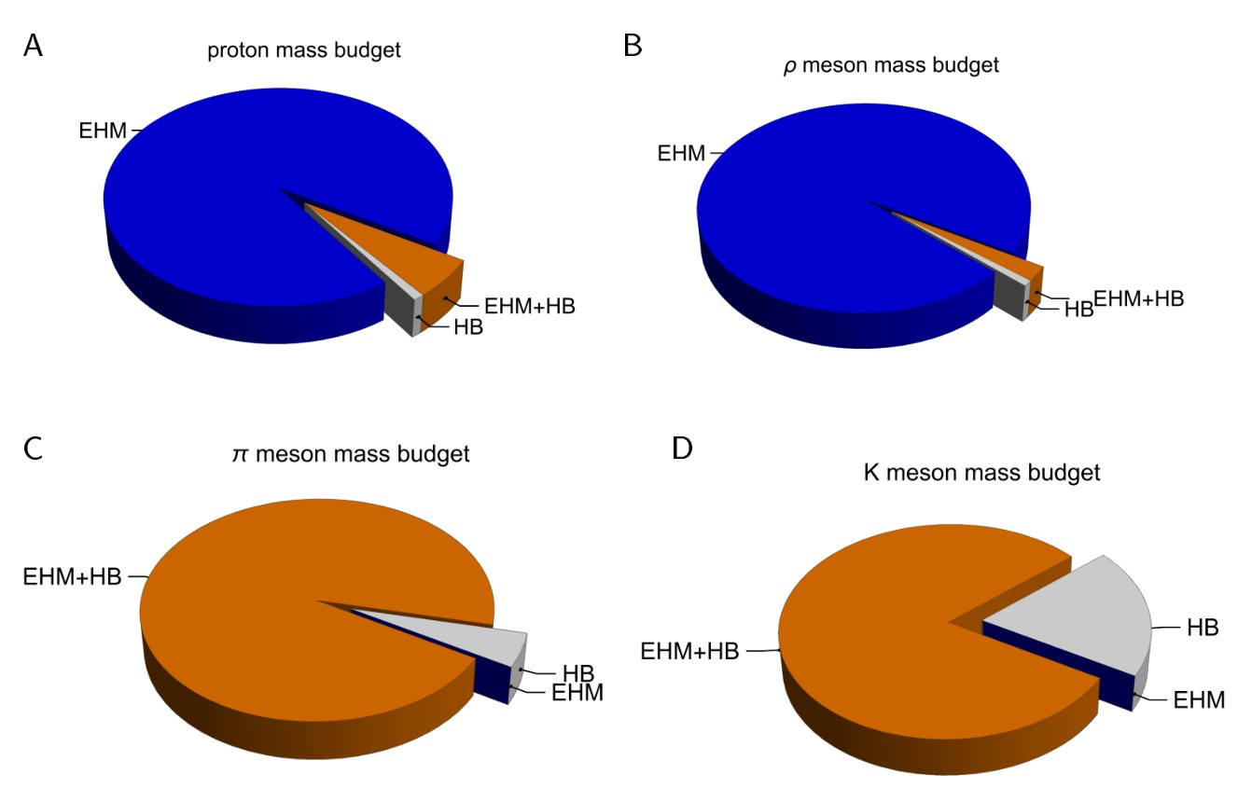
Emergence of Hadron Mass - Basic Questions
What is the origin of EHM?
Does it lie within QCD?
What are the connections with …
Gluon and quark confinement?
Dynamical chiral symmetry breaking (DCSB)?
Nambu-Goldstone modes = π & K?
What is the role of Higgs in modulating observable properties of hadrons?
Without Higgs mechanism of mass generation, π and K would be indistinguishable
What is and wherefrom mass?
Proton and $ρ$-meson mass budgets are practically identical
$π$- and $K$-meson mass budgets
are essentially/completely different from those of proton and $ρ$

Slide 6
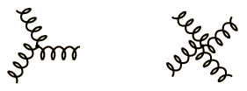
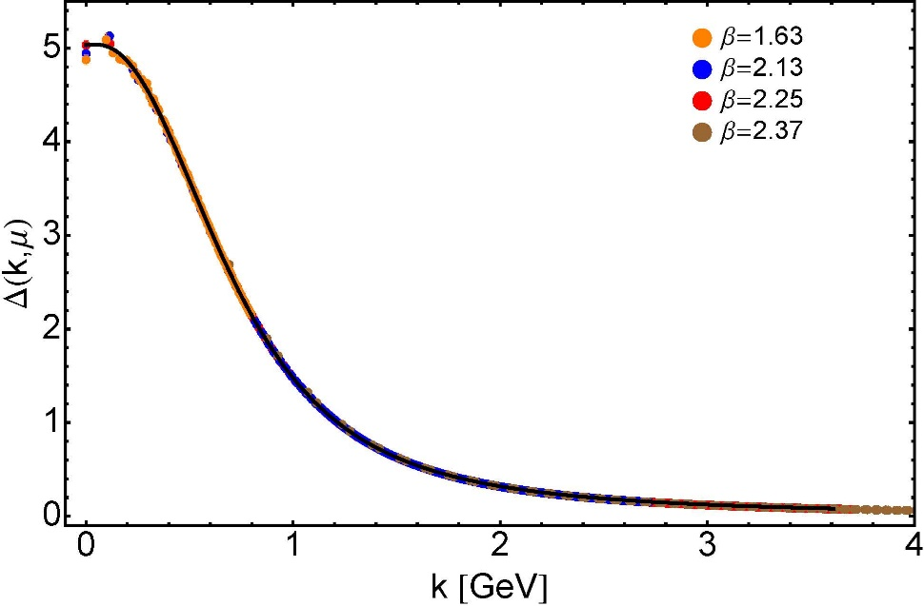
Modern Understanding Grew Slowly from Ancient Origins
More than 40 years ago
Dynamical mass generation in continuum quantum chromodynamics,
J.M. Cornwall, Phys. Rev. D 26 (1981) 1453 … $∼1100$ citations
Owing to strong self-interactions, gluon partons $⇒$ gluon quasiparticles,
described by a mass function that is large at infrared momenta
3-gluon vertex
4-gluon vertex
$$\frac{1}{m_{g}^{2}}$$
Truly mass from nothing
An interacting theory, written in terms of massless gluon fields, produces dressed gluon fields that are characterised by a mass function that is large at infrared momenta
Gluon propagator … continuum and lattice QCD agree
QCD fact
Continuum theory and lattice simulations agree
Empirical verification?

Slide 7
Modern Understanding Grew Slowly from Ancient Origins
EHM means
Gluons are massive
More than 40 years ago
Dynamical mass generation in continuum quantum chromodynamics,
J.M. Cornwall, Phys. Rev. D 26 (1981) 1453 … $∼1050$ citations
Owing to strong self-interactions, gluon partons $⇒$ gluon quasiparticles,
described by a mass function that is large at infrared momenta
3-gluon vertex
4-gluon vertex
$$\frac{1}{m_{g}^{2}}$$
Truly mass from nothing
An interacting theory, written in terms of massless gluon fields, produces dressed gluon fields that are characterised by a mass function that is large at infrared momenta
Gluon propagator … continuum and lattice QCD agree
QCD fact
Continuum theory and lattice simulations agree
Empirical verification?

Slide 8
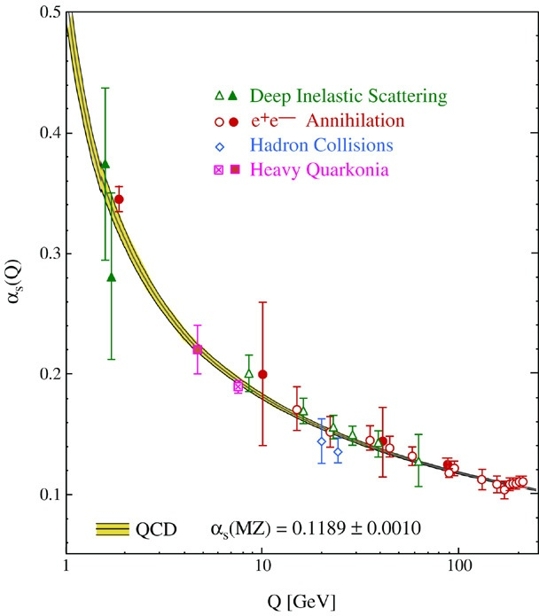
QCD’s Running Coupling
This is where we live
⇐
What’s happening
out here?!

Slide 9
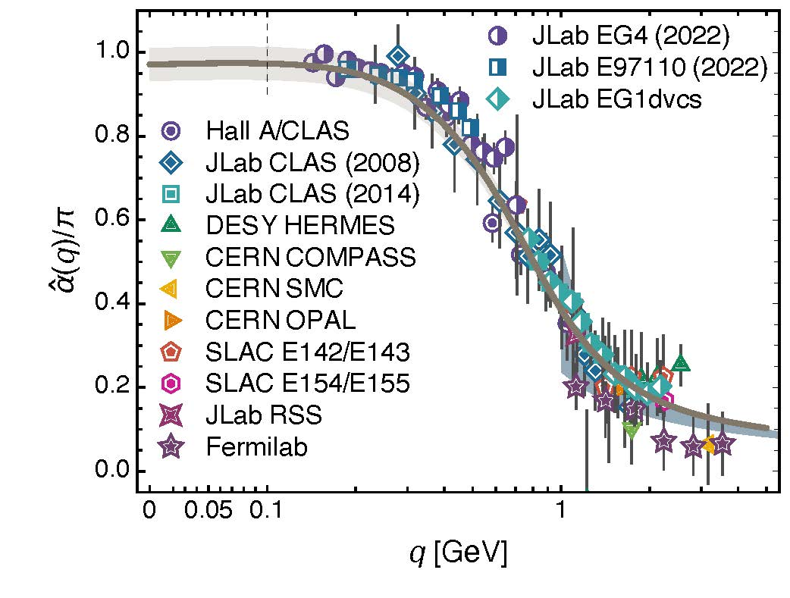
Process independent effective charge = running coupling
W orkshop on Dyson-Schwinger Equations in Modern Mathematics
and Physics (DSEMP2014) Trento, Italy, September 22-26, 2014
Modern theory enables unique QCD analogue of
“Gell-Mann – Low”
running charge to be rigorously defined and calculated
Analysis of QCD’s gauge sector
yields a parameter-free prediction
N.B. Qualitative change in α̂_{PI}(k) at k ≈ ½ m_{p}
No Landau Pole
“Infrared Slavery” picture – linear potential – is not correct explanation of confinement
Below $k∼{{\hat{m}}_{0}}_{ },$interactions become scale independent, just as they were in the Lagrangian; so, QCD becomes practically conformal again
The QCD Running Coupling,
A. Deur, S. J. Brodsky and G. F. de Teramond, Prog. Part. Nucl. Phys. 90 (2016) 1-74
Process independent strong running coupling
Daniele Binosi et al., arXiv:1612.04835 [nucl-th], Phys. Rev. D 96 (2017) 054026/1-7
Effective charge from lattice QCD, Zhu-Fang Cui et al., NJU-INP 014/19, arXiv:1912.08232 [hep-ph], Chin. Phys. C 44 (2020) 083102/1-10
QCD Running Couplings and Effective Charges, A. Deur, S. J. Brodsky, C. D. Roberts – arXiv:2303.00723 [hep-ph]

Slide 10
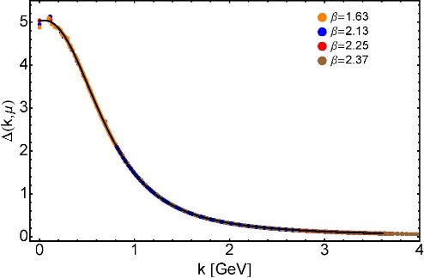
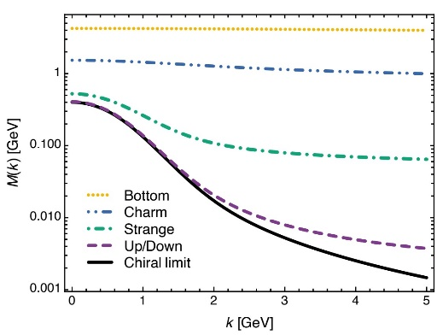
EHM Basics
Absent Higgs boson couplings, the Lagrangian of QCD is scale invariant
Yet …
Massless gluons become massive
A momentum-dependent charge is produced
Massless quarks become massive
EHM is expressed in
EVERY strong interaction observable
Challenge to Theory =
Elucidate all observable consequences of these phenomena
and highlight the paths to measuring them
Challenge to Experiment =
Test the theory predictions so that
the boundaries of the Standard Model can finally be drawn
Three pillars of EHM

Slide 11
Focus of experiments at New Generation Facilities

Slide 12
Exposing & Charting EHM
Proton was discovered 100 years ago
It is stable; hence, an ideal target in experiments
But just as studying the hydrogen atom ground state didn’t give us QED,
focusing on the ground state of only one form of hadron matter will not solve QCD
New Era dawning
High energy + high luminosity
$⇒$ science can move beyond the monomaniacal focus on the proton
Enable precision studies of, e.g.,
Structure of Baryon excited states
Baryons are the most fundamental three-body systems in Nature
If we don’t understand how QCD, a Poincaré-invariant quantum field theory, builds each of the baryons in the complete spectrum, then we don't understand Nature.
Structure of Nature’s most fundamental Nambu-Goldstone bosons ($π$ & K)
Spectrum of mesons and their structure
AMBER @ CERN
EIC
EicC
JLab12 & JLab20+

Slide 13
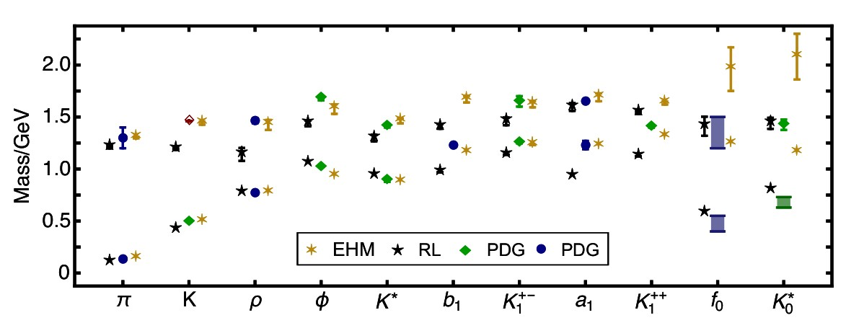
Spectrum of Mesons with Strangeness

Slide 14
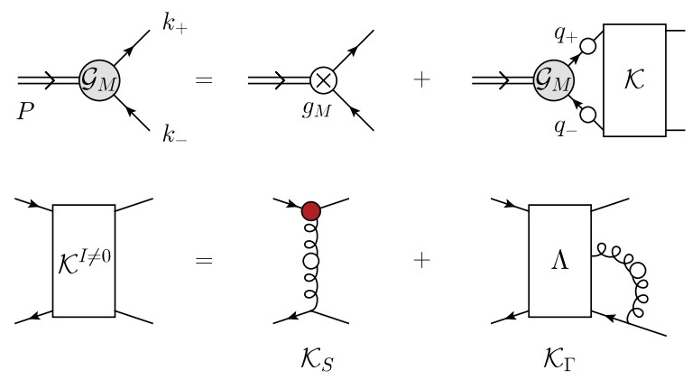
EHM and the Meson Spectrum
Systematic approach to continuum bound-state problems in QCD was introduced almost thirty years ago
Amongst other things, the scheme
highlighted importance of preserving continuous and discrete symmetries when formulating bound-state problems
enabled proof of Goldberger-Treiman identities & Gell-Mann–Oakes–Renner relation
opened door to symmetry-preserving, Poincaré-invariant predictions of hadron observables
Leading-order (RL – rainbow-ladder) truncation
good for ground-state hadrons which possess little rest-frame orbital angular momentum between valence constituents
Limitation: RL inability to realistically express impacts of EHM on hadron observables
weakness not overcome at any finite order of elaboration

Slide 15
EHM and the Meson Spectrum
Bethe-Salpeter kernel and properties of strange-quark mesons,
Zhen-Ni Xu (徐珍妮) et al., NJU-INP 065/22, e-Print: 2208.13903 [hep-ph]
Eur. Phys. J. A 59 (Lett.) (2023) 39/1-10
Improved schemes, expressing EHM in kernels of bound-state equations, have been identified
Shown promise in applications to ground-state mesons built from u, d valence quarks and/or antiquarks
But that is a small subset of hadron spectrum; so, recent extension to the spectrum and decay constants of u, d, s meson ground- and first-excited states is important step forward
EHM entails generation of dressed-quark anomalous chromomagnetic moment (ACM) … means gluon+quark interaction acquires a new, dynamically generated piece:
$Γ_{ν}\left(q,k\right)=γ_{ν}+{η κ\left({\left(q−k\right)}^{2}\right) σ}_{νρ}{\left(q−k\right)}_{ρ}$
$η∼1$ is strength; $κ\left(s=0\right)=1$ and falls to zero like quark+quark interaction
Dressed-quark anomalous magnetic moments,
Chang, L.; Liu, Y.X.; Roberts, C.D., Phys. Rev. Lett. 2011, 106, 072001.

Slide 16
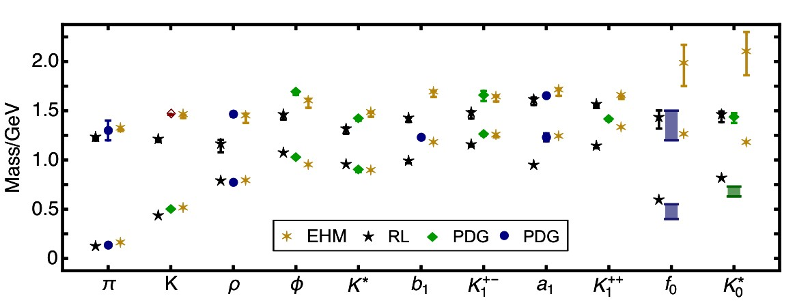
RL and Meson Spectrum
Bethe-Salpeter kernel and properties of strange-quark mesons, Zhen-Ni Xu (徐珍妮), Zhao-Qian Yao (姚照千), Si-Xue Qin (秦思学), Zhu-Fang Cui (崔著钫) and Craig D. Roberts, NJU-INP 065/22, e-Print: 2208.13903 [hep-ph]
Features & flaws of RL truncation are
evident in figure
Overall, mean absolute relative
difference between RL masses
and central experimental = 13(8)%.
Fair agreement, perhaps …
but $∃$ substantial scatter & many qualitative discrepancies, e.g.,
$m_{K}^{excited}<m_{π}^{excited}$ in RL, whereas empirical ordering is opposite
Also : $m_{ρ}^{excited}<m_{π}^{excited}$, $m_{ρ}^{excited}<m_{K^{∗} }^{excited}$ = wrong ordering
$m_{a_{1}}−m_{ρ}$ & $m_{b_{1}}−m_{ρ}$are just $\frac{1}{3}$ of empirical values because $m_{a_{1}}$& $m_{b_{1}}$are far too small
$m_{φ}^{excited}−m_{φ}$ is just $\frac{1}{2}$ experimental value
Level ordering of $K_{1}^{+−}$ and $K_{1}^{++}$ is incorrect
RL truncation produces light quark+antiquark scalar mesons, which are not seen in Nature

Slide 17
EHM and Meson Spectrum
Bethe-Salpeter kernel and properties of strange-quark mesons, Zhen-Ni Xu (徐珍妮), Zhao-Qian Yao (姚照千), Si-Xue Qin (秦思学), Zhu-Fang Cui (崔著钫) and Craig D. Roberts, NJU-INP 065/22, e-Print: 2208.13903 [hep-ph]
EHM/ACM improved kernel
brings significant improvement
Mean absolute relative
difference between EHM masses
and central experimental = 3(3)%
= factor 4.6 improvement over RL
Now, e.g.,
$m_{K}^{excited}>m_{π}^{excited}$
Also : $m_{ρ}^{excited}>m_{π}^{excited}$, $m_{ρ}^{excited}≈m_{K^{∗} }^{excited}$ = correct ordering
$m_{a_{1}}−m_{ρ}$ & $m_{b_{1}}−m_{ρ}$match empirical values
$m_{φ}^{excited}−m_{φ}$ matches experiment
Level ordering of $K_{1}^{+−}$ and $K_{1}^{++}$ is correct
quark+antiquark scalar mesons are pushed to very large masses, leaving room for necessary final-state interaction contributions
Both gross and fine details
of spectrum of
u, d, s, mesons
are very sensitive
to expressions of EHM
in gluon+quark interaction

Slide 18
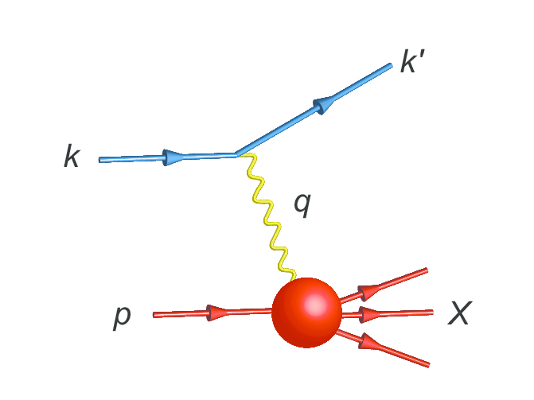
Parton Distributions

Slide 19
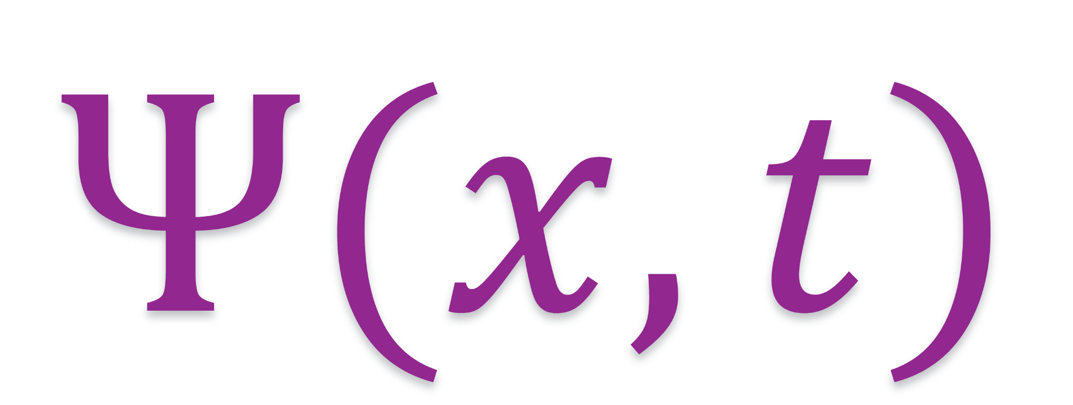
$π \& K$ DAs

Slide 20
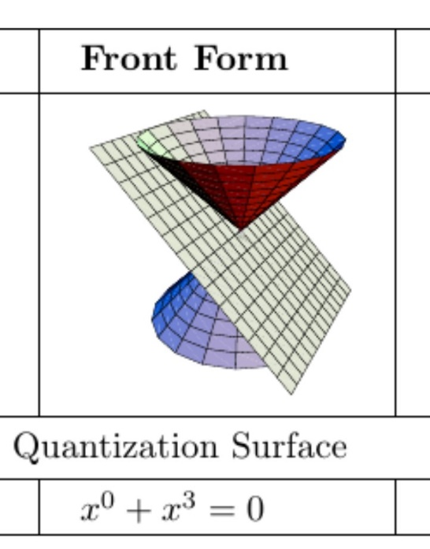
Wave Functions of Nambu Goldstone Bosons
DAs are 1D projection of hadron’s light-front wave function, obtained by integration $∼\int{d^{2}k_{⊥}Ψ(x,k_{⊥})}$
Physics Goals:
Pion and kaon distribution amplitudes (DAs – φ_{π,K})
Nearest thing in quantum field theory to Schrödinger wave function
Consequently, fundamental to understanding π and K structure.
Scientific Context:
For 40 years, the x-dependence of the pion's dominant distribution amplitude (DA) has been controversial.
Modern theory $⇒$EHM expressed in x-dependence of $φ_{π,K}\left(x\right)$
$φ_{π}\left(x\right)$ is direct measure of dressed-quark running mass in chiral limit.
Kaon DA = asymmetric around midpoint of its domain of support (0<x<1)
Degree of asymmetry is signature of constructive interference between EHM and HB mass-generating mechanisms
LF longitudinal direction
Insights into the Emergence of Mass from Studies of Pion and Kaon Structure, Craig D. Roberts, David G. Richards, Tanja Horn and Lei Chang, NJU-INP 034/21, arXiv: 2102.01765 [hep-ph], Prog. Part. Nucl. Phys. 120 (2021) 103883/1-65

Slide 21
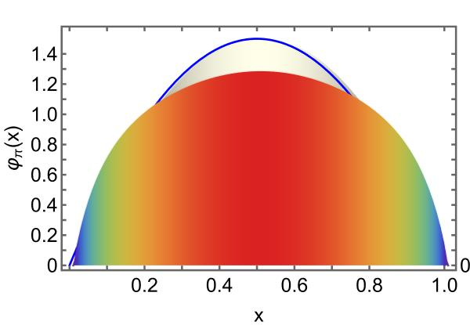
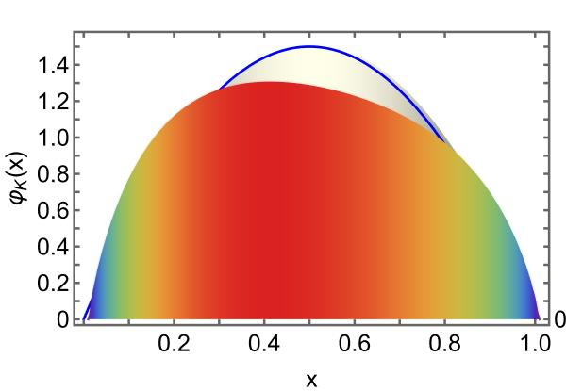
$π$ & K DAs cf. asymptotic profile
Exposing strangeness: projections for kaon electromagnetic form factors, Fei Gao et al., arXiv:1703.04875 [nucl-th], Phys. Rev. D 96 (2017) 034024/1-8
These features have widespread impact in studies of (hard) exclusive processes.
Broadening can be verified, e.g., in $π$ and $K$ elastic form factor measurements at large $Q^{2}$
EHM generates broadening in both $π$ & K
EHM + Higgs-boson interference is responsible for skewing in kaon
HB-only $⇒$ peak shifted to $\frac{m_{u}^{HB}}{m_{s}^{HB}}×\frac{1}{2}≈0.02$ … wrong
Instead, EHM*HB for u and s quarks … $\frac{{EHM m_{u}→M}_{u}}{EHM m_{s}→M_{s}}×\frac{1}{2}≈0.4$

Slide 22
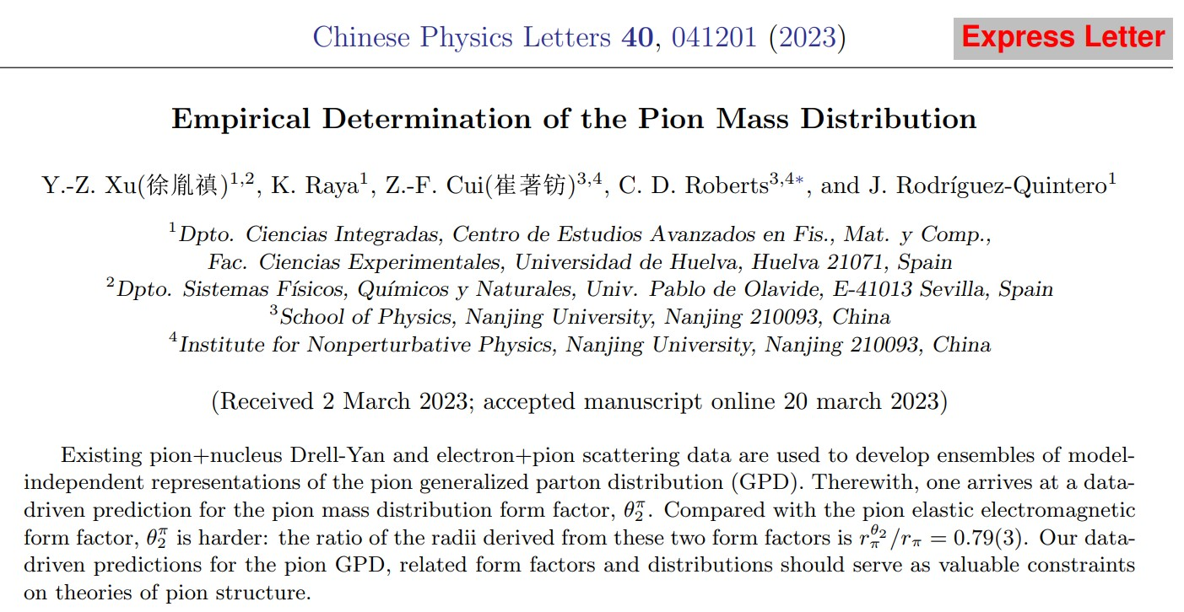

Slide 23
Generalised Parton Distributions
“Standard” parton DFs
1D picture – dependence of in-hadron parton properties on the light-front (LF) fraction, $x$, of the hadron’s total momentum
Generalised parton distributions (GPDs)
Provide extension of 1D parton distribution functions into 3D images
Also describe hadron’s distributions of partons in plane perpendicular to bound-state's total momentum, i.e., within the light front itself.
LF longitudinal direction
LF transverse plane
Data relating to GPDs
deeply virtual Compton scattering
$γ^{∗}(q)T\left(p\right)→γ^{∗}\left(q^{′}\right)T(p^{′})$ – so long as at least one photon possesses large virtuality
deeply virtual meson production
$γ^{∗}(q)T\left(p\right)→M\left(q^{′}\right)T(p^{′})$, where $M$ is a meson
GPDs connect DFs with hadron form factors because
any DF may be recovered as forward limit $(p^{′}=p)$ of relevant GPD
any elastic form factor can be expressed via a GPD-based sum rule
GPD measurement … numerous experimental programmes – underway or planned at JLab, EIC, and EicC

Slide 24
$π$ mass distribution
Expectation value of the QCD energy-momentum tensor in the pion
= pion gravitational current
Contract with $δ_{μν}$: $Λ_{μμ}^{g}\left(K,0\right)=2m_{π}^{2}θ_{2}^{π}(Q^{2})$
$θ_{2}^{π}\left(Q^{2}=0\right)=1$ (canonical mass-normalisation)
$θ_{2}^{π}(Q^{2})$ measures mass distribution in $π$
$θ_{2}^{π}$ can be obtained as the first Mellin moment of the pion GPD
Zero owing to energy+momentum conservation
Pion GPD

Slide 25
Empirical determination of the pion mass distribution
Can reconstruct $π$ GPD from data on
$π$ em form factor
$π$ valence quark DF
GPDs connect DFs with hadron form factors because
any elastic form factor can be expressed via a GPD-based sum rule
any DF may be recovered as forward limit $(p^{′}=p)$ of relevant GPD
Working solely with
electron+pion scattering data
CERN – 1984, 1986
JLab 2000, 2006, 2007, 2008
existing pion + nucleus Drell-Yan data (CERN and FNAL – 1989)
two phenomenological fits to this data [Aicher:2010cb, Barry:2021osv] … use both
Used a $χ^{2}$-based selection procedure to develop ensembles of model-independent representations of the three-dimensional pointwise behaviour of the pion generalised parton distribution (GPD).
These ensembles yield data-driven prediction for pion GPD

Slide 26
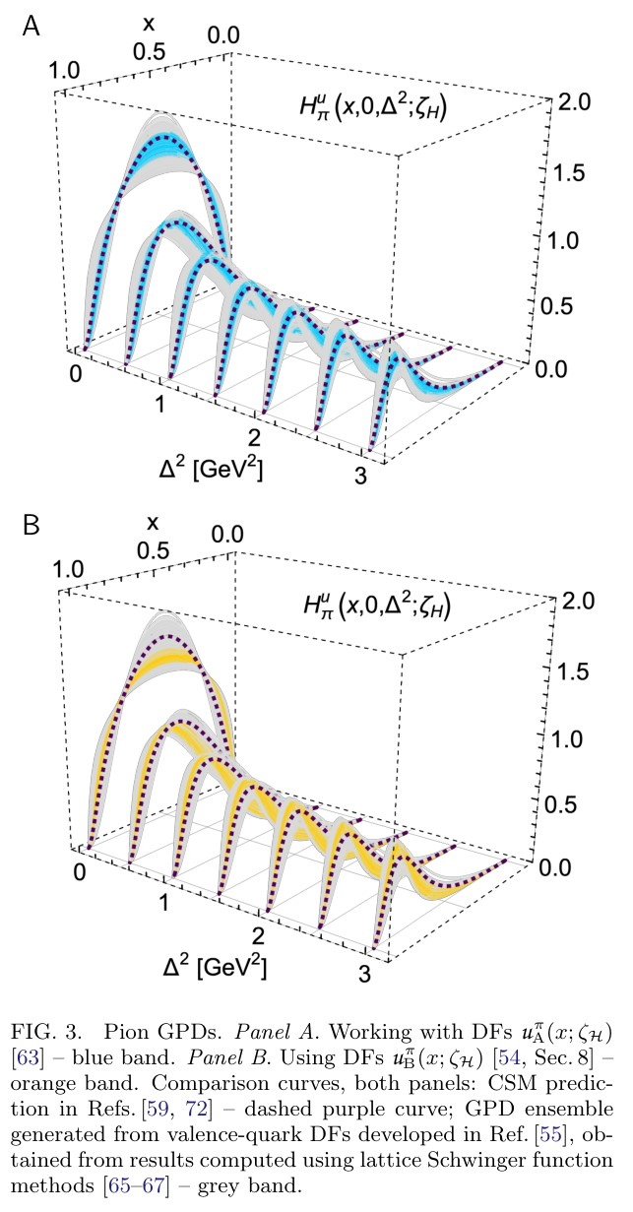
Pion Generalised Parton Distribution
Pion GPDs, reconstructed from available analyses of relevant Drell-Yan and electron+pion scattering data
Different ensembles only marginally compatible, owing to differences between analyses in
A = Aicher:2010cb; B = Barry:2021osv
Yet, both agree with lQCD based ensembles, within mutual uncertainties, because lQCD-constrained ensemble has large uncertainty – improvement of lQCD results useful
CSM prediction favours $u_{A}^{π}\left(x;ζ_{5}\right)$ensemble
In all cases, support of valence-quark GPD becomes increasingly concentrated in neighbourhood $x≃1$ with increasing $Δ^{2}$
Namely, greater probe momentum focuses attention on domain whereupon one valence-quark carries a large fraction of pion's light-front momentum
Revealing pion and kaon structure via generalised parton distributions, K. Raya, Z. –F. Cui (崔著钫) et al.,
NJU-INP 051/21, e-Print: 2109.11686 [hep-ph], Chin. Phys. C 46 (01) (2022) 013107/1-22

Slide 27
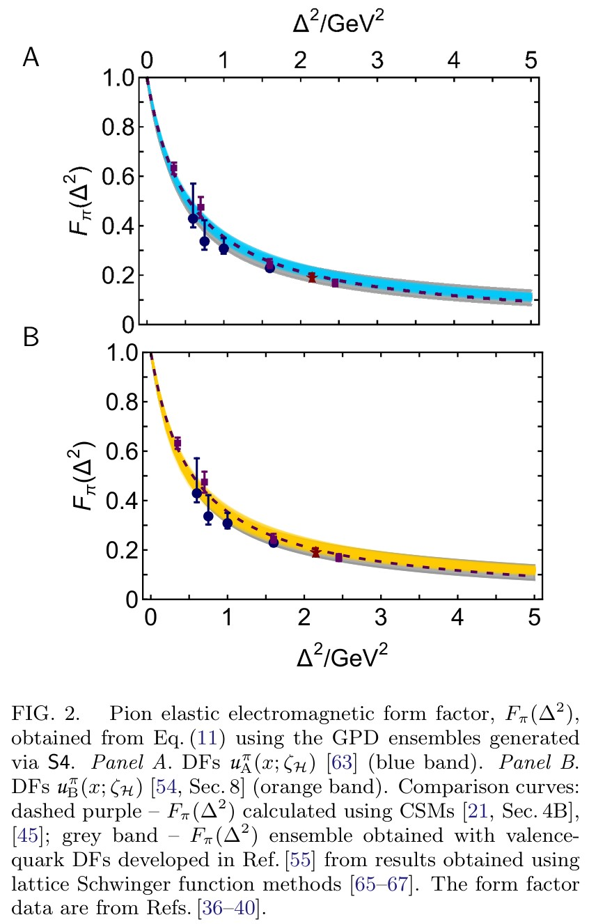
Pion charge distribution form factor
0th Moment of
pion GPD
All ensembles reproduce empirical $F_{π}\left(Δ^{2}\right)$
Blue – based on $u_{A}^{π}\left(x;ζ_{5}\right)$ ensembles
Orange – based on $u_{B}^{π}\left(x;ζ_{5}\right)$ ensembles
Comparison curves
dashed purple – CSM prediction for $F_{π}\left(Δ^{2}\right)$
grey band – Ensemble of $F_{π}\left(Δ^{2}\right)$results developed from DFs based on lattice-QCD results
Again, data-driven results in accord with modern theory predictions.
See, e.g., Sec. 4B in
📖 Insights into the Emergence of Mass from Studies of Pion and Kaon Structure,
C.D. Roberts, D.G. Richards, T. Horn and L. Chang,
NJU-INP 034/21, arXiv: 2102.01765 [hep-ph], Prog. Part. Nucl. Phys. 120 (2021) 103883/1-65

Slide 28
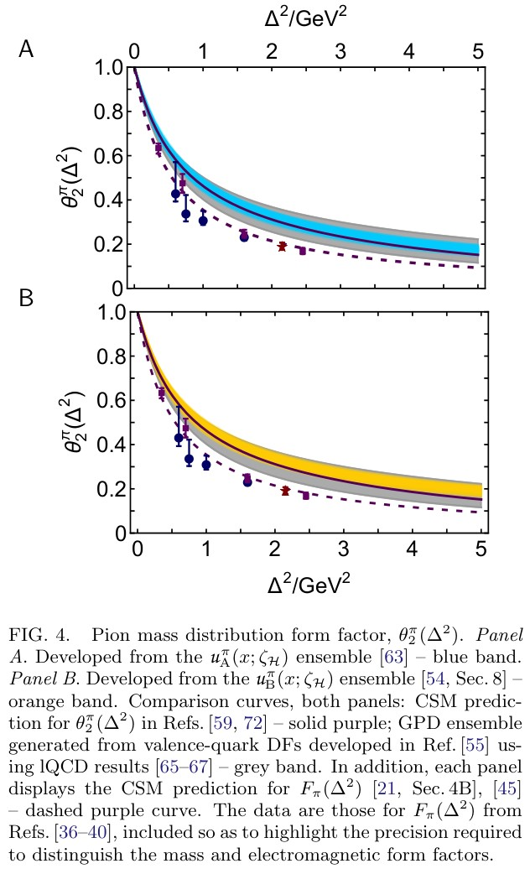
$π$ mass distribution
Expressed as $1^{st}$ Mellin-moment of pion GPD
Principal, dynamical coefficient in expectation value of the QCD energy-momentum tensor in the pion
= pion gravitational current
Plainly … $θ_{2}(Δ^{2})$ is harder than $F_{π}(Δ^{2})$
i.e., the distribution of mass in the pion is more compact than the distribution of electric charge.
This is an empirical fact

Slide 29
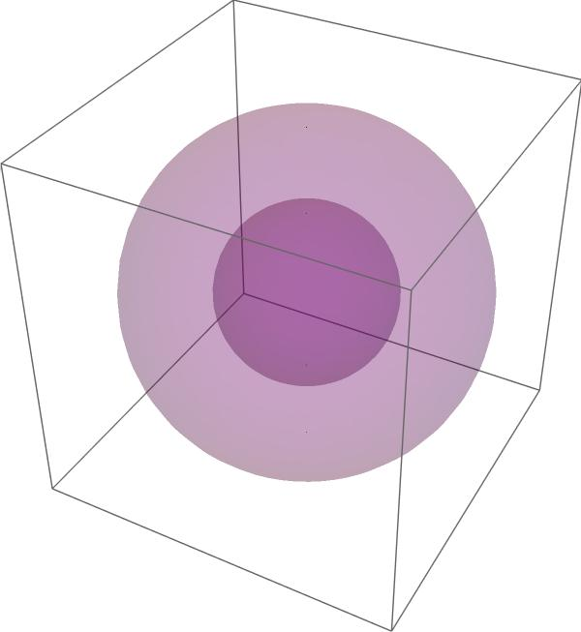
$π$ mass radius
Comparison value for charge radius: $r_{π}=0.64(2)$
Data-driven prediction: $\frac{r_{π}^{θ_{2}}}{r_{π}}=0.79(3)$
Translates into spacetime volume ratio = $0.40(6)$
Pion mass distribution is concentrated within
just 40% of the spacetime volume of the charge distribution
charge
mass

Slide 30
$π$ mass distribution is harder
Empirical fact is readily understood physically
Pion wave function (hence, pion GPD) is independent of the probe.
It's the same whether 1 photon or 2 photons or graviton is the probing object.
However, probe itself focuses on different features of the target constituents
Target quark carries same charge, irrespective of its momentum.
So, pion LFWF alone controls distribution of charge.
Gravitational interaction of target quark depends on its momentum.
(The current = the energy momentum tensor)
Pion effective mass distribution therefore depends on interference between quark momentum growth and LFWF momentum suppression with increasing $Δ^{2}x^{2}$.
This pushes support to a larger momentum domain in the pion = smaller distance domain.
“Is there a specific aspect of the pion GPDs driven by the data which is responsible?”
Yes. EHM induced broadening of pion LFWF = GPD.
Given GPD overlap representation, they’re the same thing.

Slide 31
Emergent Hadron Mass
Grant no. 12135007
QCD is unique amongst known fundamental theories of natural phenomena
The degrees-of-freedom used to express the scale-free Lagrangian are not directly observable
Massless gauge bosons become massive, with no “human” interference
Gluon mass ensures a stable, infrared completion of the theory through the appearance of a running coupling that saturates at infrared momenta, being everywhere finite
Massless fermions become massive, producing
Massive baryons and simultaneously Massless mesons
These emergent features of QCD are expressed in every strong interaction observable
They can also be revealed via
EHM interference with Nature’s other known source of mass = Higgs
We are capable of building facilities that can validate these concepts, proving QCD to be
the 1st well-defined four-dimensional quantum field theory ever contemplated
This may open doors that lead far beyond the Standard Model

Slide 32
Emergent Hadron Mass
Grant no. 12135007
$${\text{L}}_{Nature}= ?$$
QCD is unique amongst known fundamental theories of natural phenomena
The degrees-of-freedom used to express the scale-free Lagrangian are not directly observable
Massless gauge bosons become massive, with no “human” interference
Gluon mass ensures a stable, infrared completion of the theory through the appearance of a running coupling that saturates at infrared momenta, being everywhere finite
Massless fermions become massive, producing
Massive baryons and simultaneously Massless mesons
These emergent features of QCD are expressed in every strong interaction observable
They can also be revealed via
EHM interference with Nature’s other known source of mass = Higgs
We are capable of building facilities that can validate these concepts, proving QCD to be
the 1st well-defined four-dimensional quantum field theory ever contemplated
This may open doors that lead far beyond the Standard Model
There are theories of many things,
But is there a theory of everything?

Slide 33
$${\text{L}}_{Nature}= ?$$
There are theories of many things,
But is there a theory of everything?
Thankyou

Slide 35
Quark Models and the Meson Spectrum
Regarding spectrum of hadrons, results from nonrelativistic or somewhat relativised quark models are still often cited as benchmarks
PDG: “The spectrum of baryons and mesons exhibits a high degree of regularity. The organizational principle which best categorizes this regularity is encoded in the quark model. All descriptions of strongly interacting states use the language of the quark model.”
And it was long ago claimed [Godfrey & Isgur] “. . . all mesons – from the pion to the upsilon – can be described in a unified framework.”
Despite following facts:
neither the “quarks” nor the potentials in quark models have been shown to possess any mathematical link with QCD – rigorous or otherwise
Orbital angular momentum and spin used to label quark model states are not Poincaré-invariant (not observable) quantum numbers.
Quark models break many symmetries known to be critical to hadron spectra
No means of systematic improvement
Quark models can be tuned to fit the spectrum …
but they can’t explain it nor reveal new insights

Slide 36
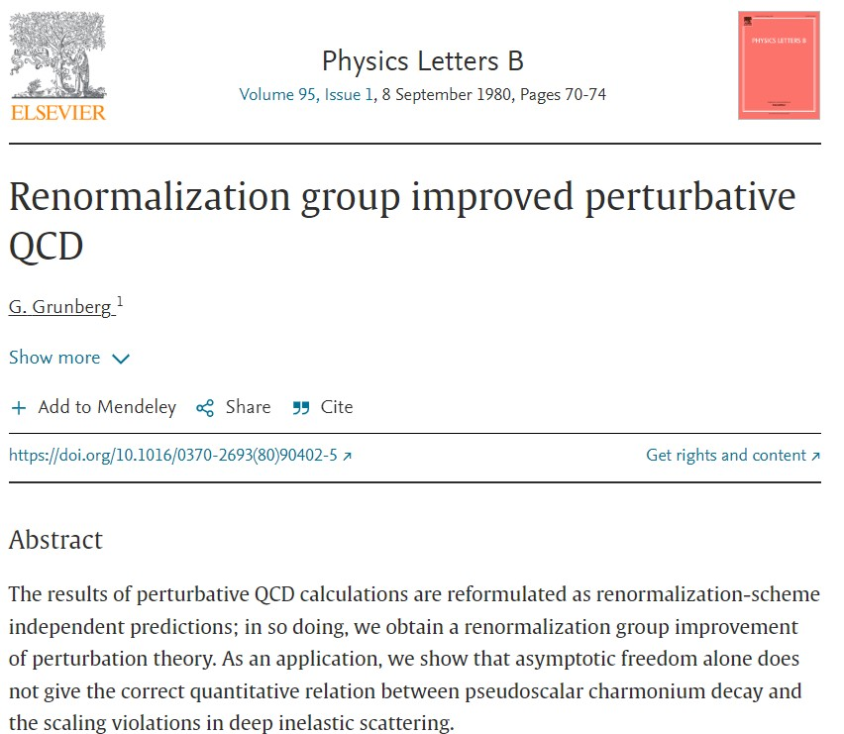
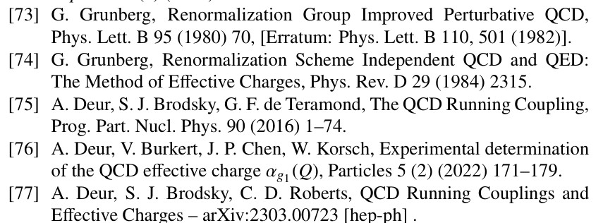
All-orders evolution
All-Orders Evolution of Parton Distributions: Principle, Practice, and Predictions
Pei-Lin Yin (尹佩林), NJU-INP 075/23, e-Print: 2306.03274 [hep-ph]
P1 – In the context of Refs. [73, 74], there exists at least one effective charge, $α_{1ℓ}(k^{2})$, which, when used to integrate the leading-order perturbative DGLAP equations, defines an evolution scheme for parton DFs that is all-orders exact.
CSM Process-Independent charge serves this purpose
Hadron scale, $ζ_{H}$
Scale at which all properties of a given hadron are carried by valence degrees-of-freedom

