Slide 1
Prospects for XYZ studies at future facilities
Alessandro Pilloni
Meson2023, June 23rd, 2023

Slide 2
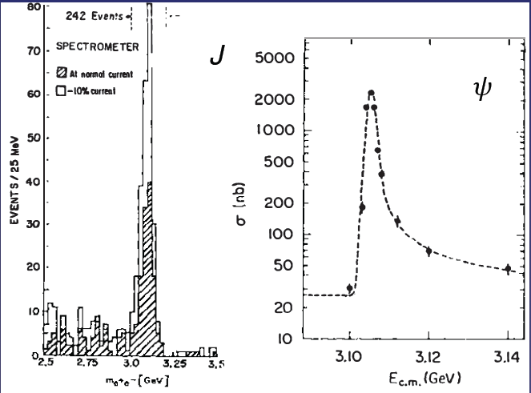
Quarkonium orthodoxy
$$Q$$
$$\overline{Q}$$
Potential models
(meaningful when $M_{Q}→∞$)
$$V\left(r\right)=−\frac{C_{F}α_{s}}{r}+σr$$
(Cornell potential)
$$α_{s}\left(M_{Q}\right)∼0.3$$
(perturbative regime)
OZI-rule, QCD multipole
Solve NR Schrödinger eq. → spectrum
Effective theories
(HQET, NRQCD, pNRQCD...)
Heavy quark spin flip suppressed by quark mass, approximate heavy quark spin symmetry (HQSS)
Integrate out heavy DOF
↓
(spectrum), decay & production rates
A. Pilloni – Prospects for XYZ studies at future facilities
Notes:
2 slides su Zc, a Bes e a Belle
2 slide su tetraquark model: dall’hamiltoniana di Jaffe al calcolo delle masse
1 slide su molecular models, dove sono i carichi? (non in Tornqvist, si in Hanhart, vedere Braaten, citare Nefediev)
2 slides su decay channels, dove si dovrebbe vedere, e a seconda del modello, vedere qualche plot
1 slide su Y(4260), tetraquark? C’è lo strano (si vede la f0)
1 slide su Zc a cleo (anche il neutro)

Slide 3
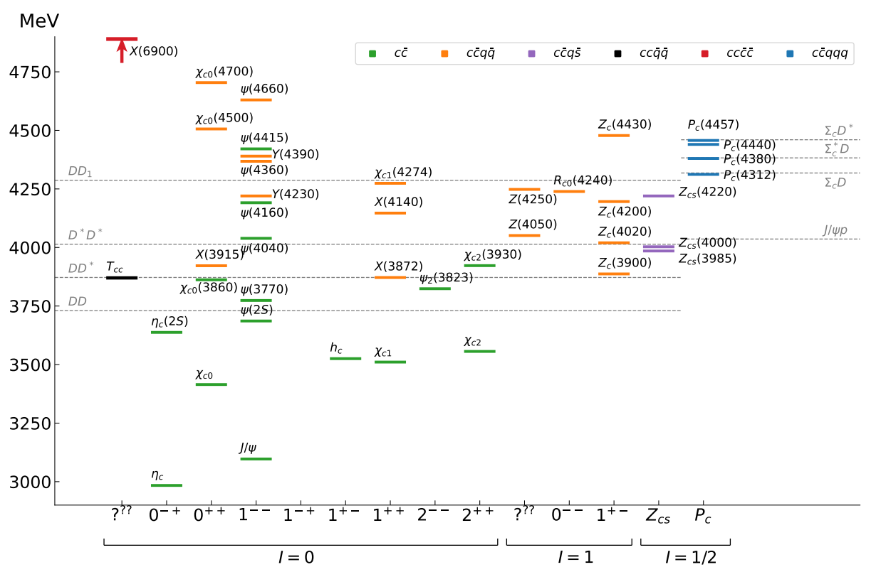
Exotic landscape in $c\overline{c}$
Esposito, AP, Polosa, Phys.Rept. 668
JPAC, arXiv:2112.13436
A host of unexpected resonances have appeared
decaying mostly into charmonium + light Hardly reconciled with usual $q\overline{q}$ pheno
A. Pilloni – Prospects for XYZ studies at future facilities
Notes:
2 slides su Zc, a Bes e a Belle
2 slide su tetraquark model: dall’hamiltoniana di Jaffe al calcolo delle masse
1 slide su molecular models, dove sono i carichi? (non in Tornqvist, si in Hanhart, vedere Braaten, citare Nefediev)
2 slides su decay channels, dove si dovrebbe vedere, e a seconda del modello, vedere qualche plot
1 slide su Y(4260), tetraquark? C’è lo strano (si vede la f0)
1 slide su Zc a cleo (anche il neutro)

Slide 4
Exotic landscape
Broad mesons seen in $b$ decay:
$X(4140)$, $Z(4430)$, $Z_{cs}(4000)$...
Narrow structures seen in $b$ decay:
$X\left(3872\right), P_{c}$, $(P_{cs})$
Scarce consistency between various production mechanisms
Narrow structures seen in $e^{+}e^{−}$:
$X(3872)$, $Y(4260)$, $Z_{c,b}^{(′)}$
A. Pilloni – Prospects for XYZ studies at future facilities

Slide 5
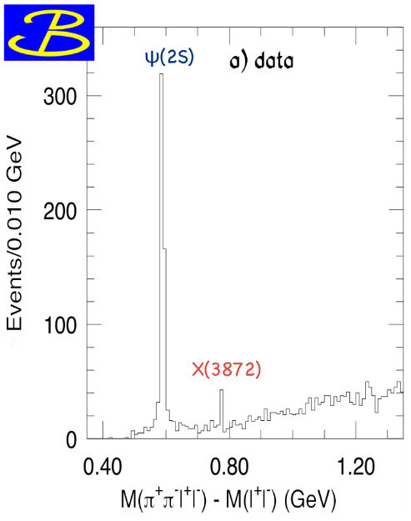
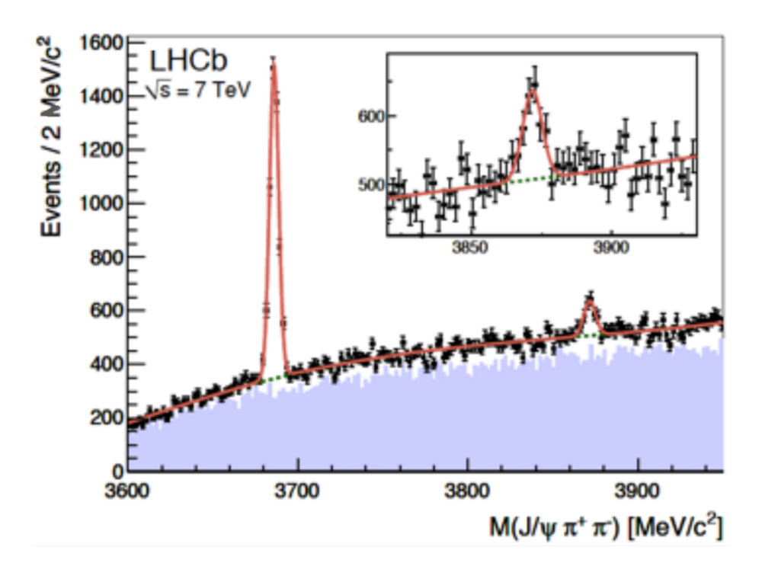
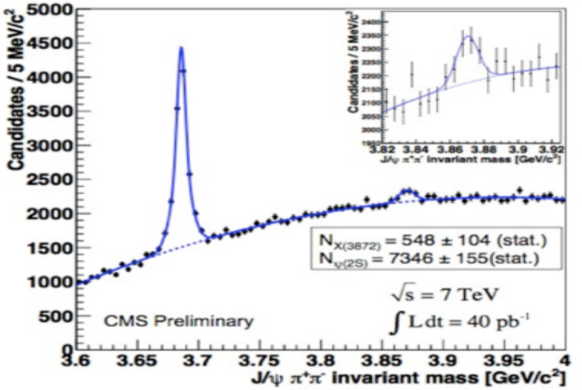
$X(3872)$
Discovered in $B→K X→K J/ψ ππ$
Quantum numbers $1^{++}$
Very close to $DD^{∗}$ threshold
Too narrow for an above-treshold charmonium
Isospin violation too big $\frac{Γ\left(X→J/ψ ω\right)}{Γ\left(X→J/ψ ρ\right)}\sim 1.1±0.4$
Mass prediction not compatible with $χ_{c1}(2P)$
$M=3871.65±0.06$MeV
$$M_{X}−M_{DD^{∗}}=−3±192 \text{keV}$$
$Γ=1.19±0.2\text{1 }\text{MeV}$
A. Pilloni – Prospects for XYZ studies at future facilities

Slide 6
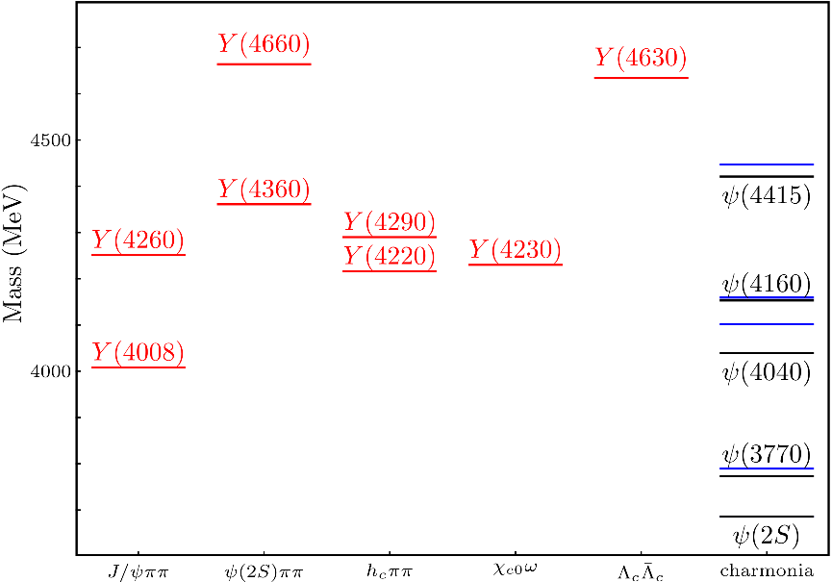
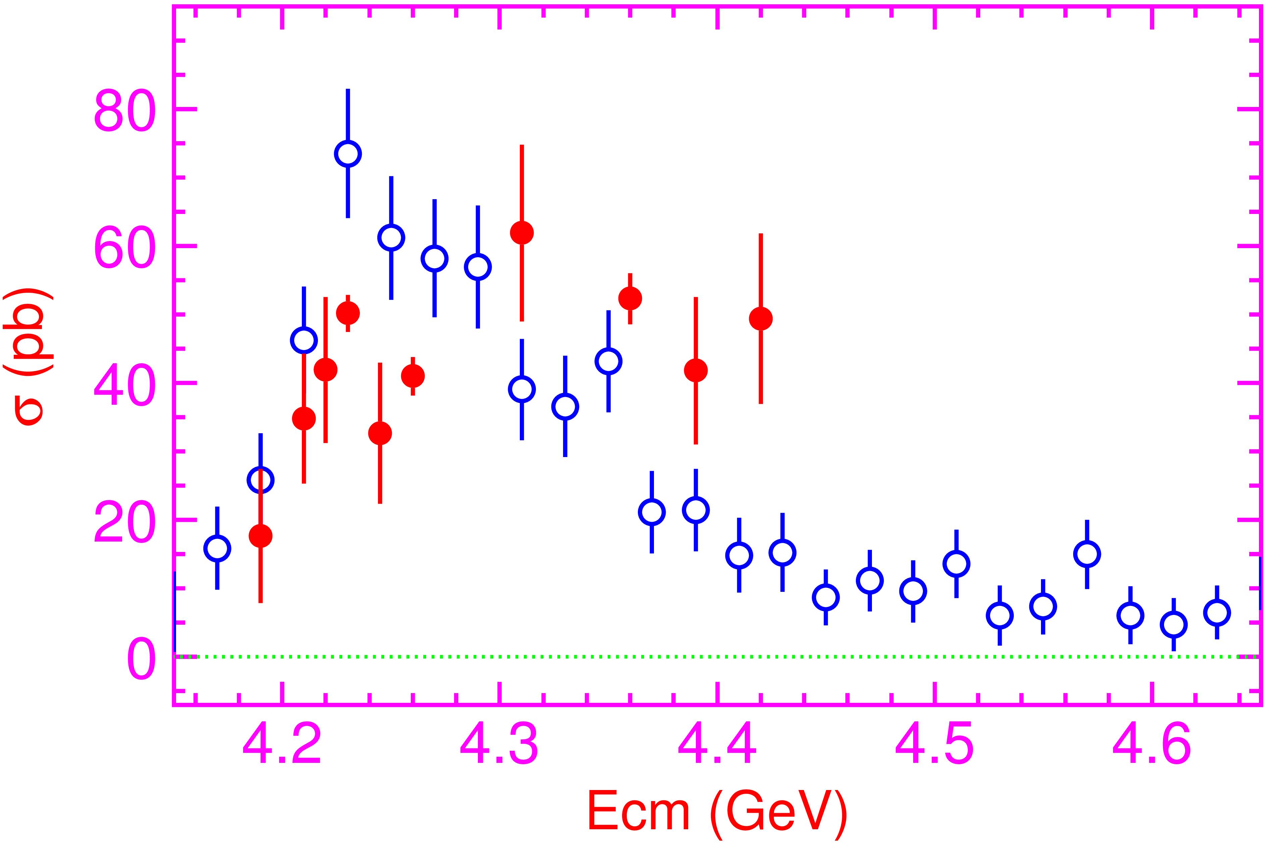
Vector $Y$ states
Lots of unexpected ${J^{PC}=1}^{−−}$ states found in ISR/direct production (and nowhere else!)
Seen in few final states, mostly $J/ψ ππ$ and $ψ\left(2S\right) ππ$
Large HQSS violation
Belle $J/ψππ$
BES $h_{c}ππ$
A. Pilloni – Prospects for XYZ studies at future facilities
Notes:
Y(4260), M=4263 +- 5, Gamma = 95+-14
D_1(2420)^0, M=2421.3 ±0.6, Gamma =27.1 ±2.7
D_1(2420)^+-, M=2423.4 ±3.1, Gamma =25 ±6
I D_1 hanno J^P = 1^+
La molecola D_1 D sta 22 MeV sotto
Se la Y è D_1 D, il pione lega fortemente, come fa la Y a essere così larga?
Come funziona lo scambio del pione???

Slide 7
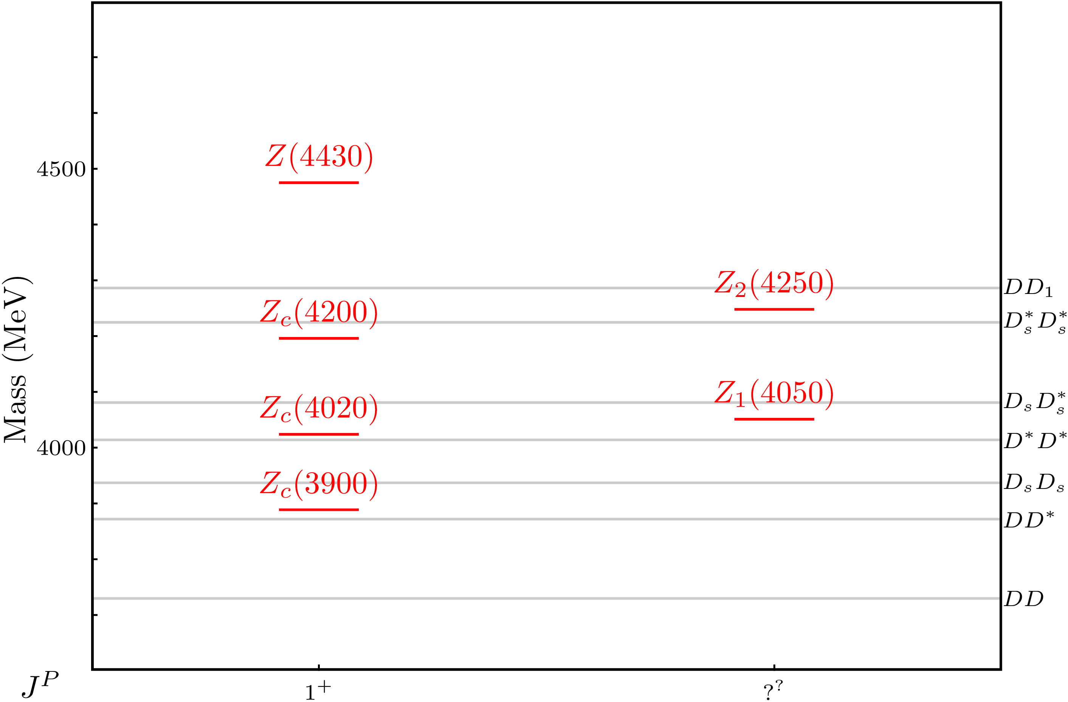
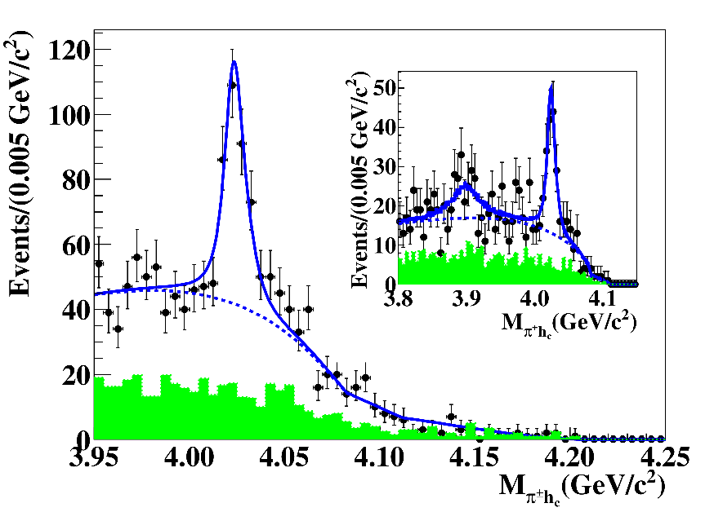
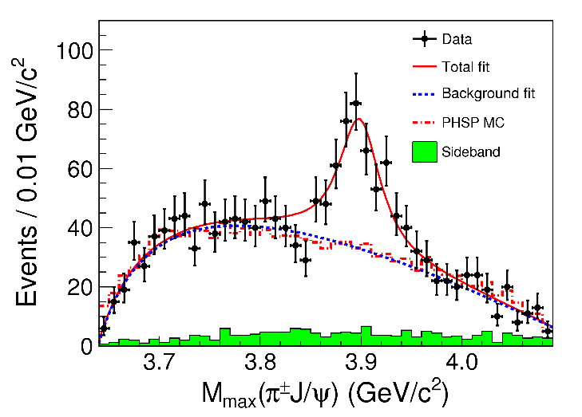
Charged $Z$ states: $Z_{c}\left(3900\right), Z_{c}^{′}(4020)$
Charged quarkonium-like resonances have been found, 4q needed
Two states $J^{PC}=1^{+−}$ appear slightly above $D^{(∗)}D^{∗}$ thresholds
$e^{+}e^{−}→Z_{c}{\left(3900\right)}^{+}π^{−}→J/ψ{ π}^{+}π^{−}$ and $→{\left(DD^{∗}\right)}^{+}π^{−}$ $M=3888.7±3.4$MeV, $Γ=35±7$ MeV
$e^{+}e^{−}→Z_{c}^{′}{\left(4020\right)}^{+}π^{−}→h_{c}{ π}^{+}π^{−}$ and $→{\overline{D}}^{∗0}D^{∗+}π^{−}$
$M=4023.9±2.4$MeV, $Γ=10±6$ MeV
A. Pilloni – Prospects for XYZ studies at future facilities
Notes:
Y(4260), M=4263 +- 5, Gamma = 95+-14
D_1(2420)^0, M=2421.3 ±0.6, Gamma =27.1 ±2.7
D_1(2420)^+-, M=2423.4 ±3.1, Gamma =25 ±6
I D_1 hanno J^P = 1^+
La molecola D_1 D sta 22 MeV sotto
Se la Y è D_1 D, il pione lega fortemente, come fa la Y a essere così larga?
Come funziona lo scambio del pione???

Slide 8
Models
Compact
Hybrids
Containing gluonic degrees of freedom
Multiquark
Several (cluster) of valence quarks
Hadroquarkonium
Heavy core interacting with a light cloud via Van der Waals forces
$$π$$
$$π$$
$$J/ψ$$
$$π$$
Rescattering effects
Structures generated by cross-channel rescattering, very process-dependent
Molecule
Bound or virtual state generated by long-range exchange forces
Extended
A. Pilloni – Prospects for XYZ studies at future facilities

Slide 9
Why photoproduction?
It’s new: no XYZ state has been uncontroversially seen so far
It is free from rescattering mechanisms that could mimic resonances in multibody decays
The framework is (relatively) clean from a theory point of view
Radiative decays offer another way of discerning the nature of the states
Once seen, $Q^{2}$ of transition form factors will give new observables crucial to assess the nature of these exotics
A. Pilloni – Prospects for XYZ studies at future facilities

Slide 10
Where XYZ?
Electromagnetic machines
$$e^{+}e^{−}→γ^{∗}→\text{hadrons}$$
Electrohadron machines
Cross sections
Cleanliness
$$e^{−}→e^{−}γ^{(∗)}$$
$$\text{and} γ^{(∗)}p,γ^{(∗)}A→\text{hadrons}$$
Hadron machines
$$pp,p\overline{p},π^{−}p,pA,AA→ \text{hadrons}$$
A. Pilloni – Prospects for XYZ studies at future facilities

Slide 11
Why photoproduction?
It’s new: no XYZ state has been uncontroversially seen so far
It is free from rescattering mechanisms that could mimic resonances in multibody decays
The framework is (relatively) clean from a theory point of view
Radiative decays offer another way of discerning the nature of the states
A. Pilloni – Prospects for XYZ studies at future facilities

Slide 12
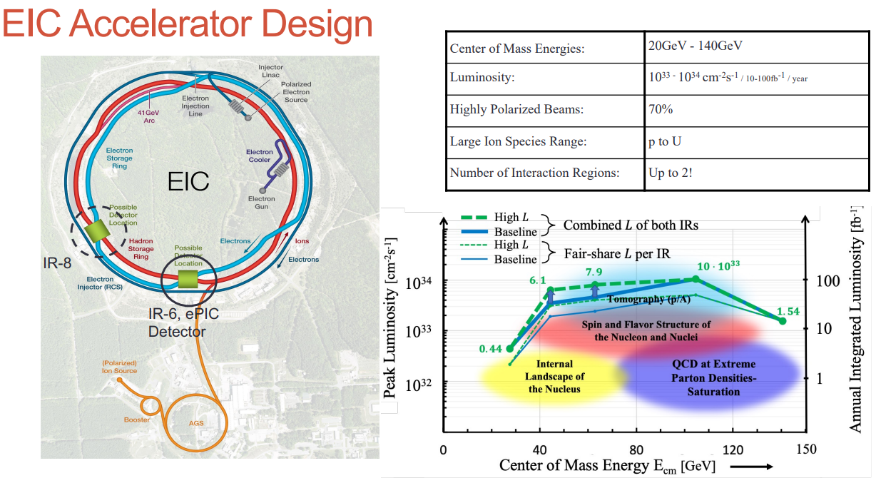
An Electron Ion Collider @BNL
A. Deshpande
arXiv:2103.05419
A. Pilloni – Prospects for XYZ studies at future facilities

Slide 13
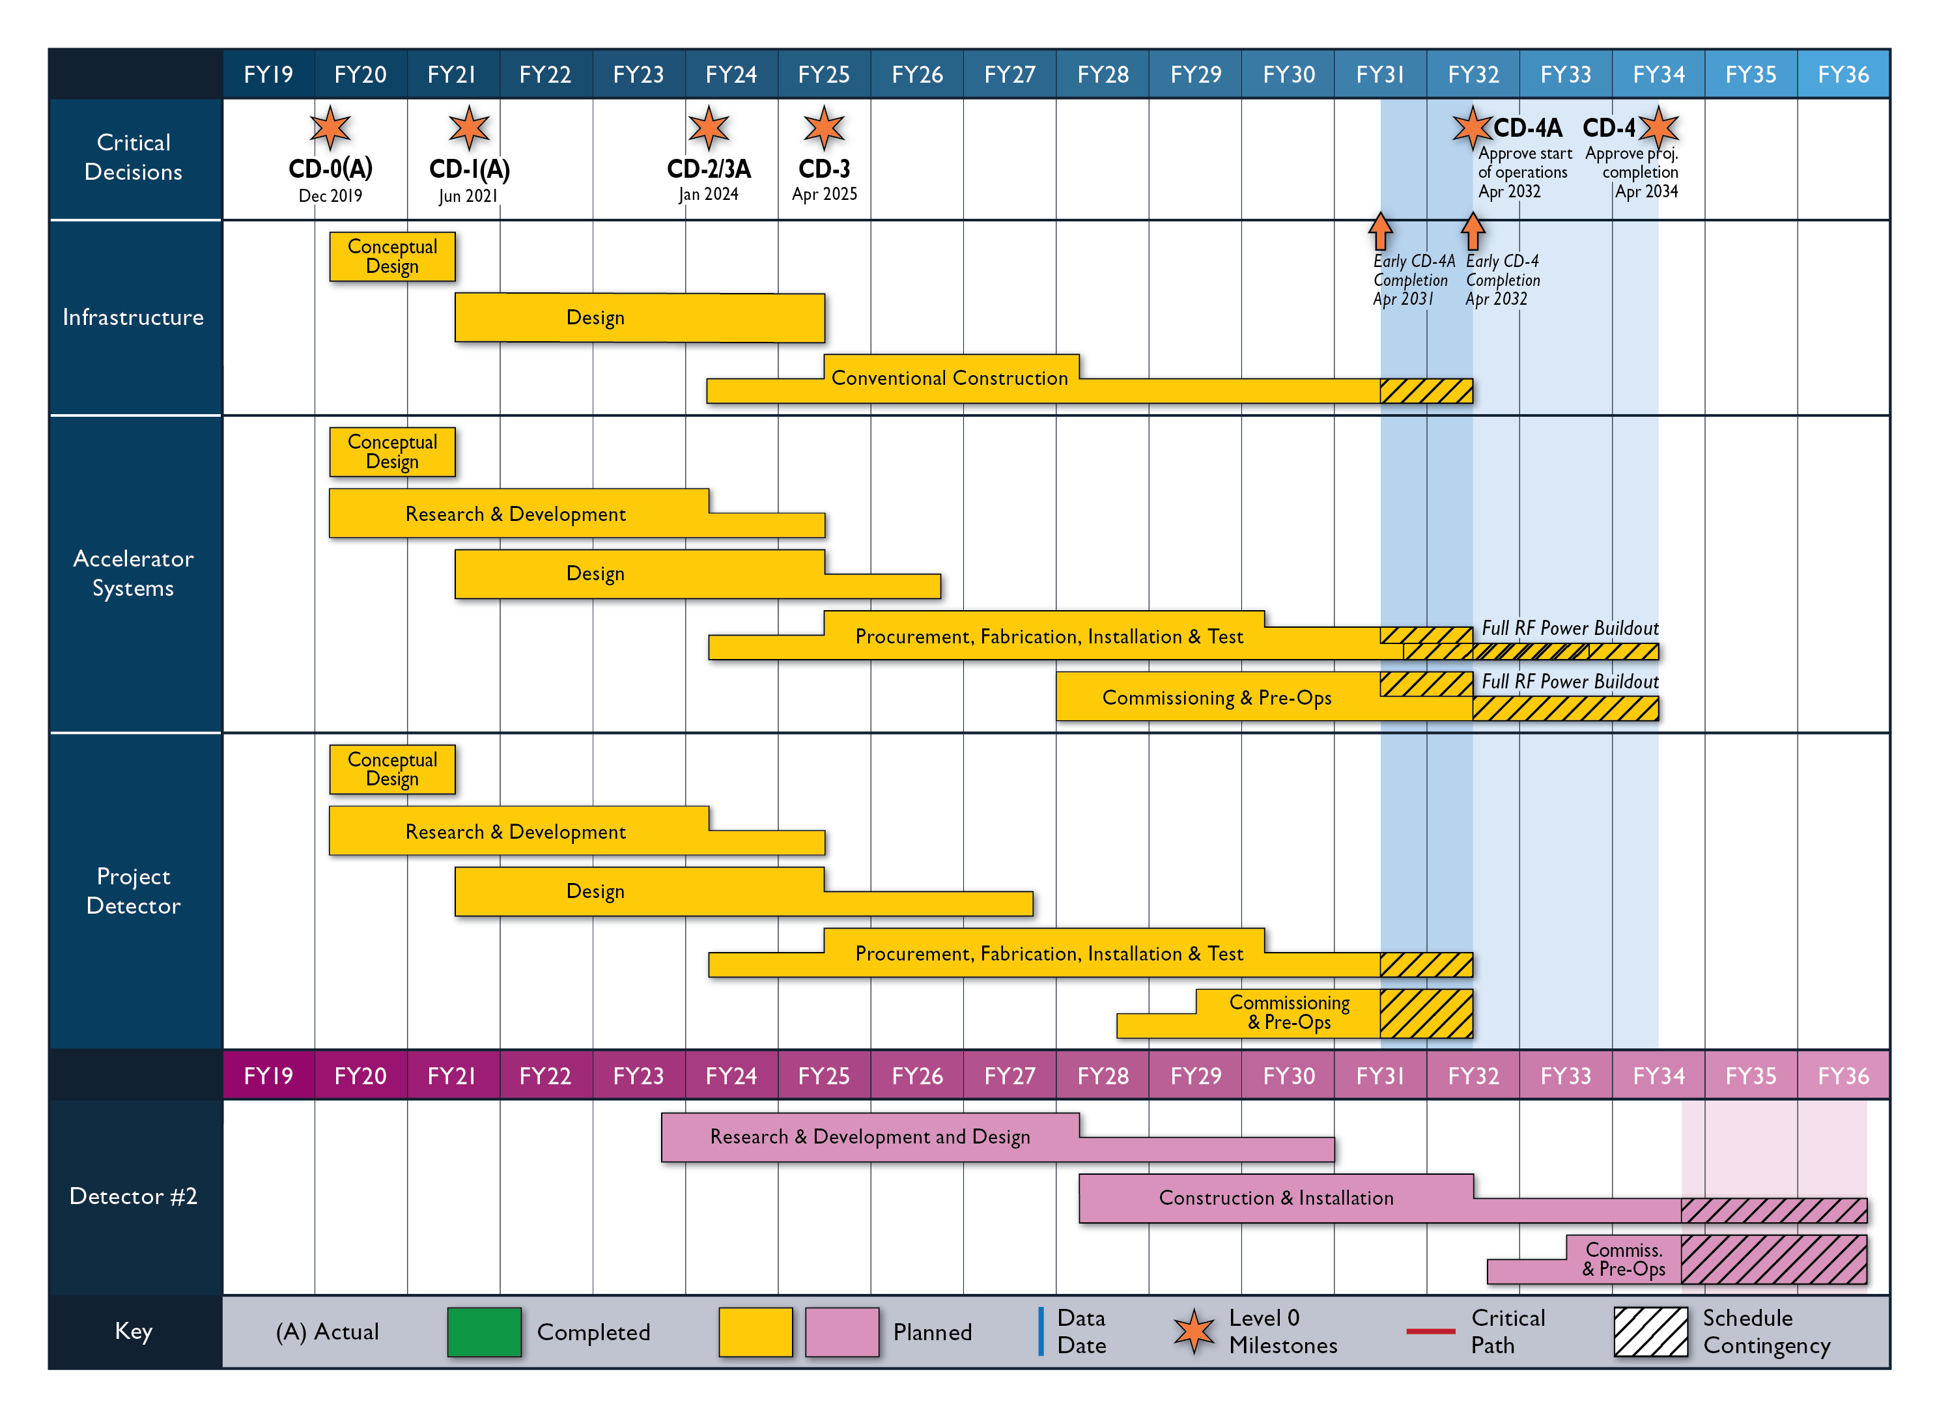
An Electron Ion Collider @BNL
A. Deshpande
2nd Detector and IR 5yrs behind IR-1
Today
A. Pilloni – Prospects for XYZ studies at future facilities

Slide 14
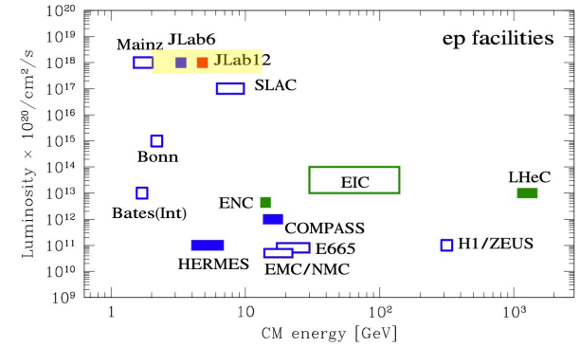
XYZ at Jefferson Lab
arXiv:2203.08290
LoI RF7_RF0_120
arXiv:2112.00060
arXiv:2306.09360
JLAB 22?
Explore the complementarity wrt the forthcoming Electron Ion Collider
A. Pilloni – Prospects for XYZ studies at future facilities

Slide 15
JLab vs. EIC
Variety of target species, polarization
Detectors well known (zero-angle cal required)
High intensity
Smaller acceptance
Variety of beam species, polarization
Big «if» on timescale, accelerator and detector performances
Low intensity
High acceptance
A. Pilloni – Prospects for XYZ studies at future facilities

Slide 16
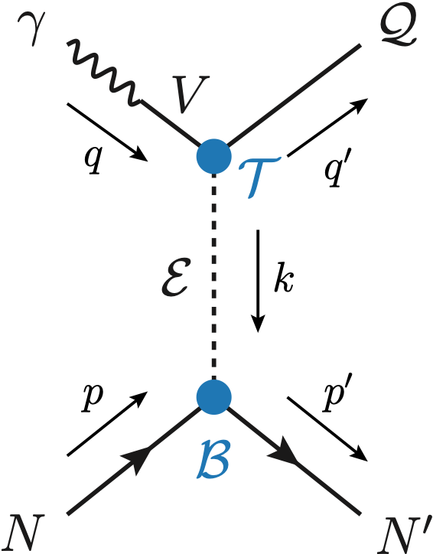
Exclusive (quasi-real) photoproduction
We study near-threshold (LE) and high energies (HE)
At this stage, we need yields to assess the feasibility of an observation
Couplings extracted from data as much as possible, not relying on the nature of XYZ
M. Albaladejo et al. [JPAC], PRD
$$<λ_{𝒬}λ_{N}^{′}|T|λ_{γ}λ_{N}>=\underset{V,ℰ}{∑}\frac{ef_{V}}{m_{V}}𝒯_{λ_{V}=λ_{γ},λ_{𝒬}}^{α_{1}⋯α_{j}}𝒫_{α_{1}⋯α_{j};β_{1}⋯β_{j}}ℬ_{λ_{N}λ_{N}^{′}}^{β_{1}⋯β_{j}}$$
Bottom vertex from standard photoproduction pheno, exponential form factors to further suppress large t
VMD is used to couple the incoming photon to a vector quarkonium V
Top vertex from measured $𝒬→Vℰ$ decay width
Further comments on this, see A. Szczepaniak on Tue 9am
A. Pilloni – Prospects for XYZ studies at future facilities

Slide 17
Threshold vs. high energy
Fixed-spin exchanges expected to hold in the low energy region
$t$ channel grows as $s j$, exceeding unitarity bound, Regge physics kicks in: Reggeized tower of particles with arbitrary spin at HE
$$s^{j}⟶s^{α_{0}+α^{′}t }$$
Holds at low energy, fixed spin
Holds at high energy, resummation of leading $s$ power
If $ε≠$IP, $α_{0}<1$, $dσ/dt$ decreases with energy
Exchange of heavy particles further suppressed
A. Pilloni – Prospects for XYZ studies at future facilities

Slide 18
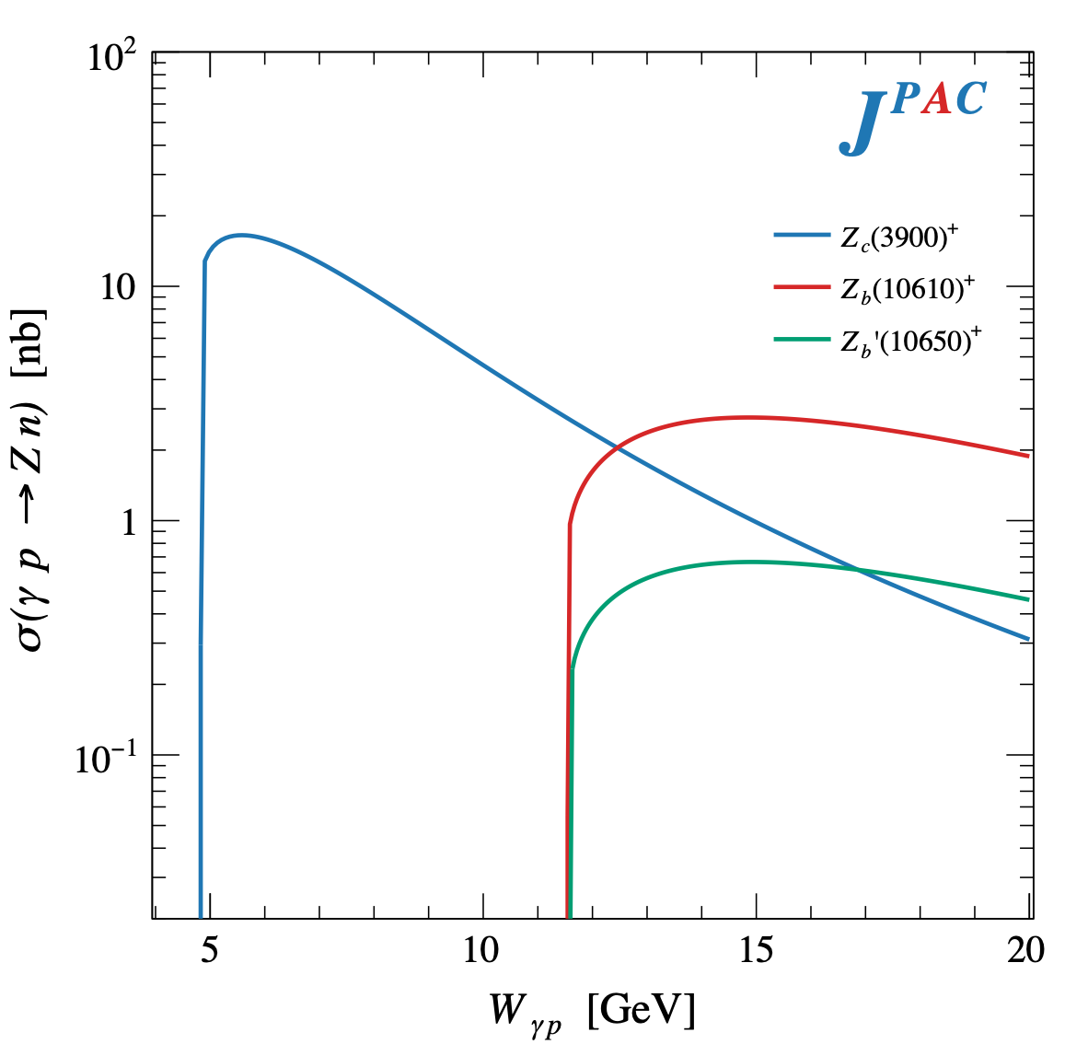
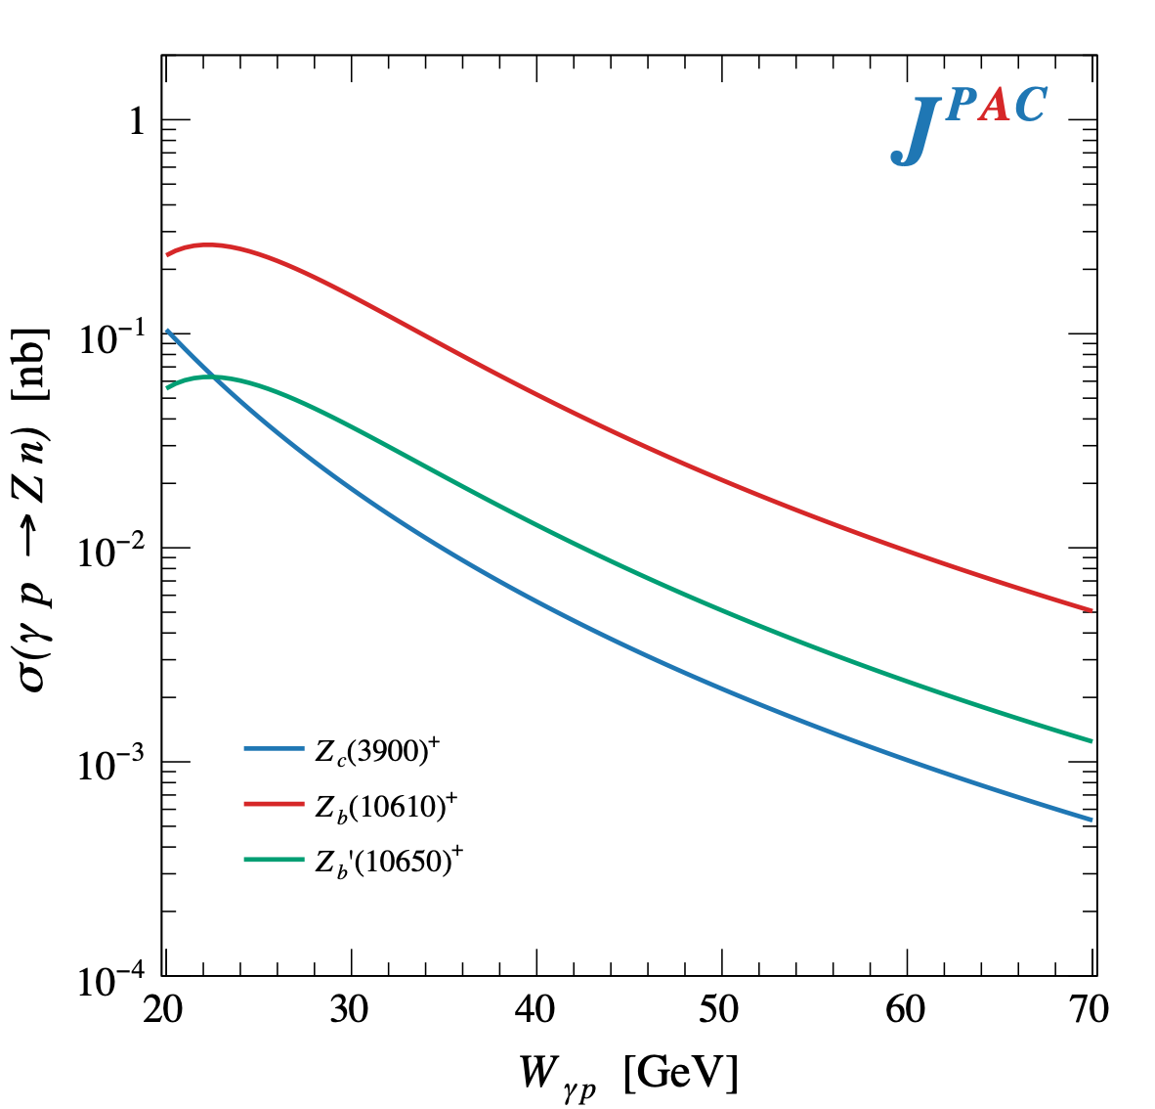
$Z$ photoproduction
The $Zs$ are charged charmoniumlike $1^{+−}$ states close to open flavor thresholds
Focus on $Z_{c}{\left(3900\right)}^{+}→J/ψ π^{+}$, $Z_{b}{\left(10610\right)}^{+},Z_{b}^{′}{\left(10650\right)}^{+}→Υ(nS) π^{+}$
The pion is exchanged in the $t$-channel
A. Pilloni – Prospects for XYZ studies at future facilities

Slide 19
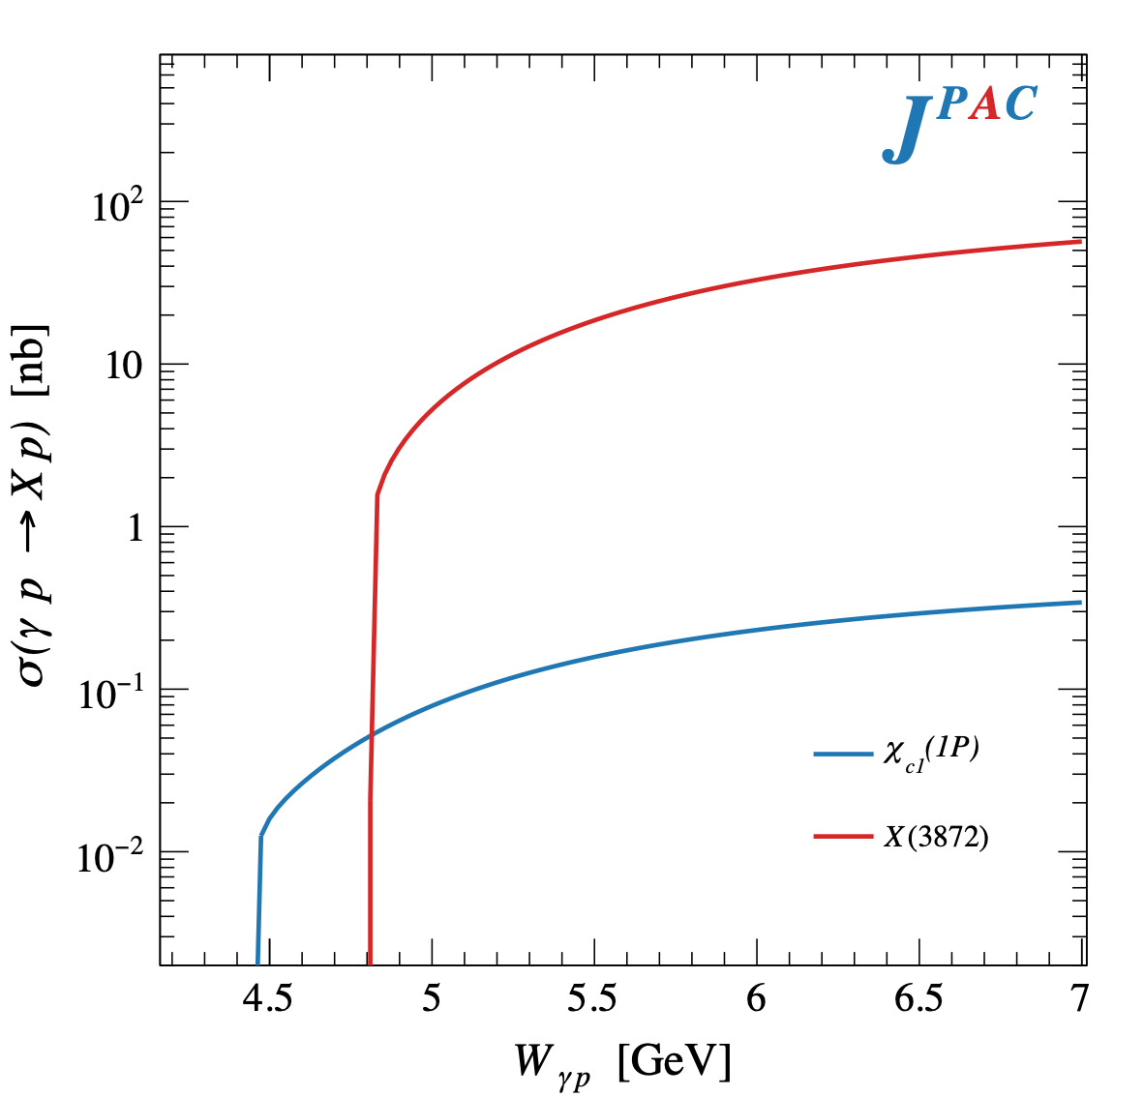
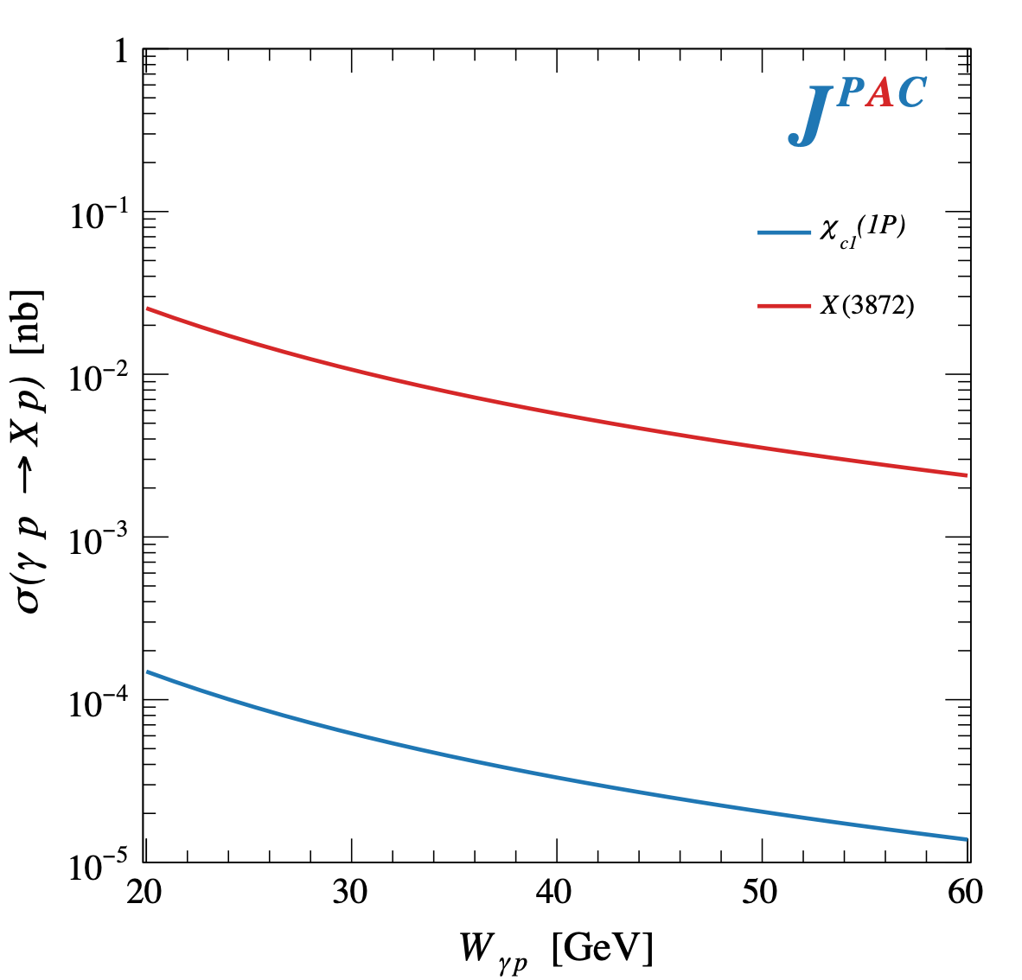
$X$ photoproduction
Focus on the famous $1^{++} X\left(3872\right)→J/ψ ρ,ω$
𝛚 and 𝛒 exchanges give main contributions:
Large theory uncertainty in the intermediate region
A. Pilloni – Prospects for XYZ studies at future facilities

Slide 20
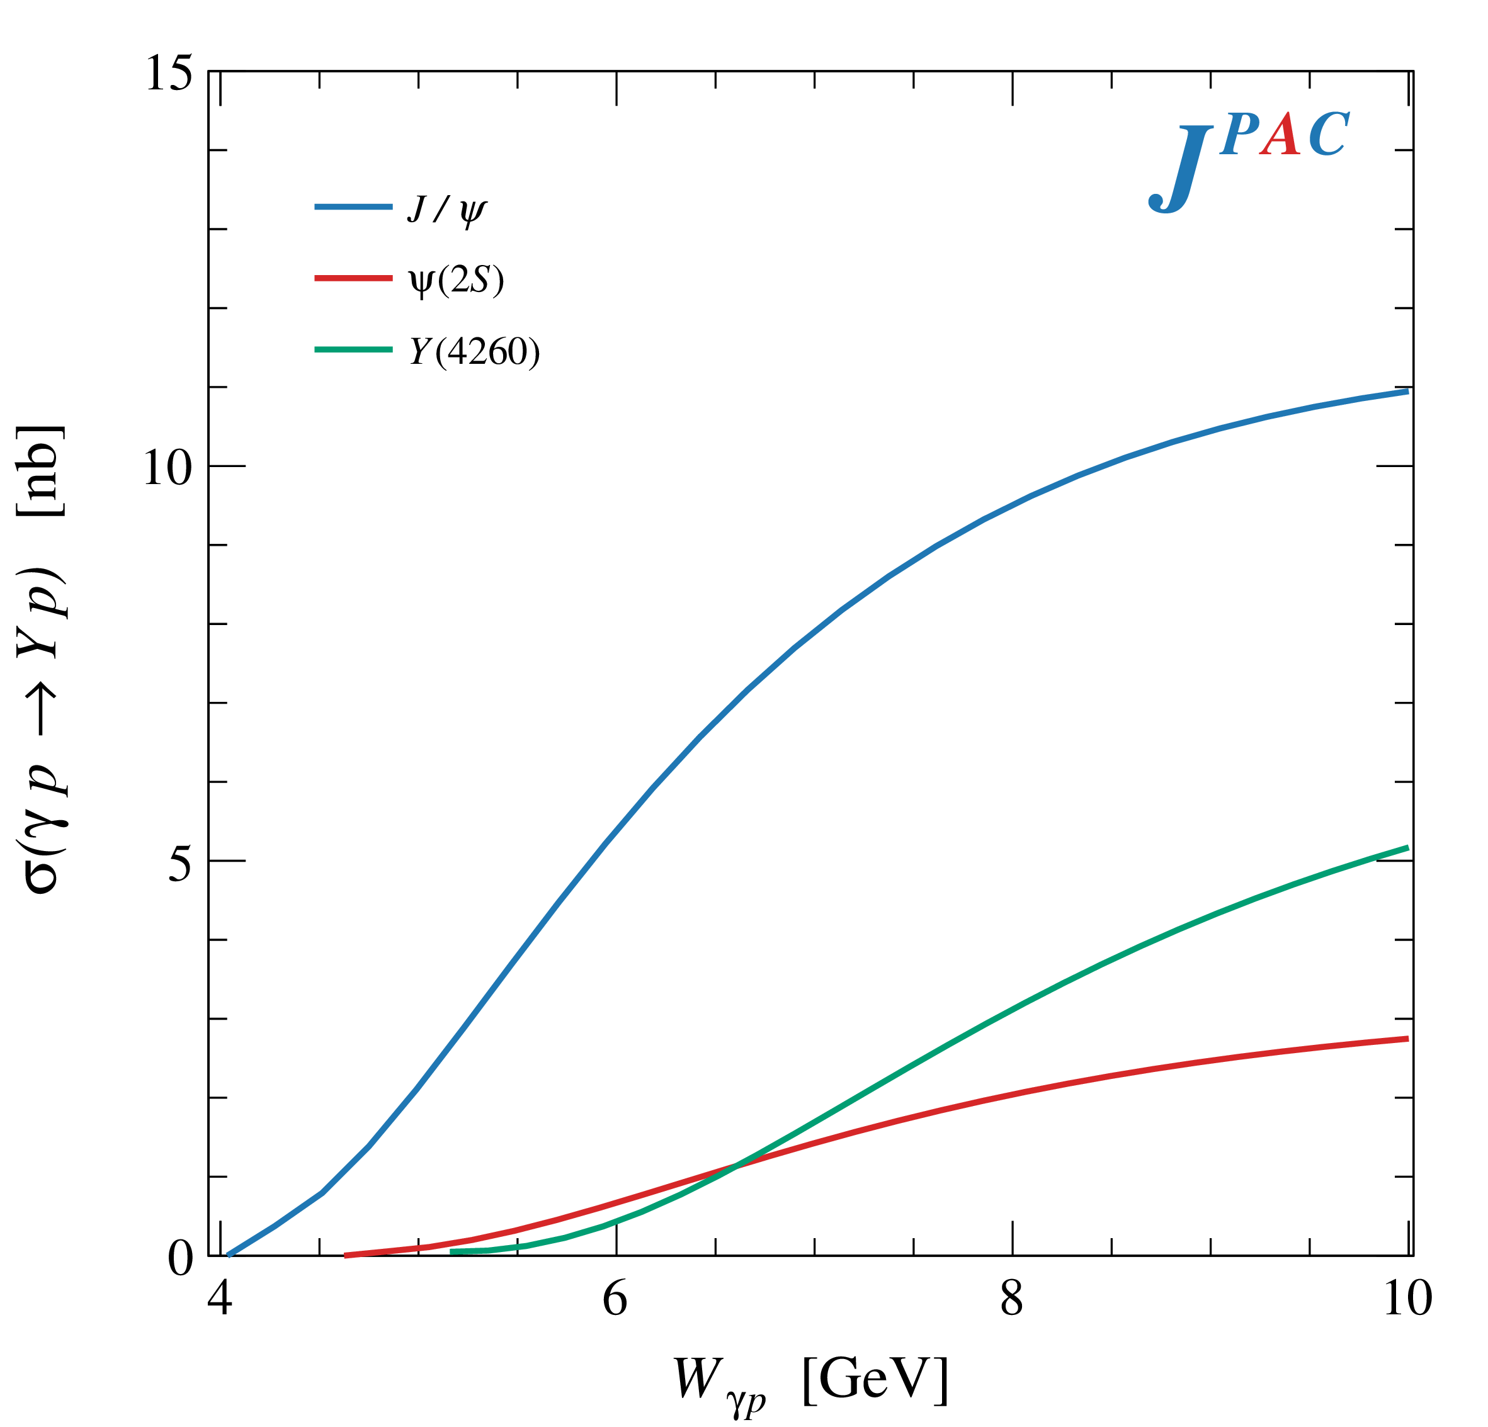
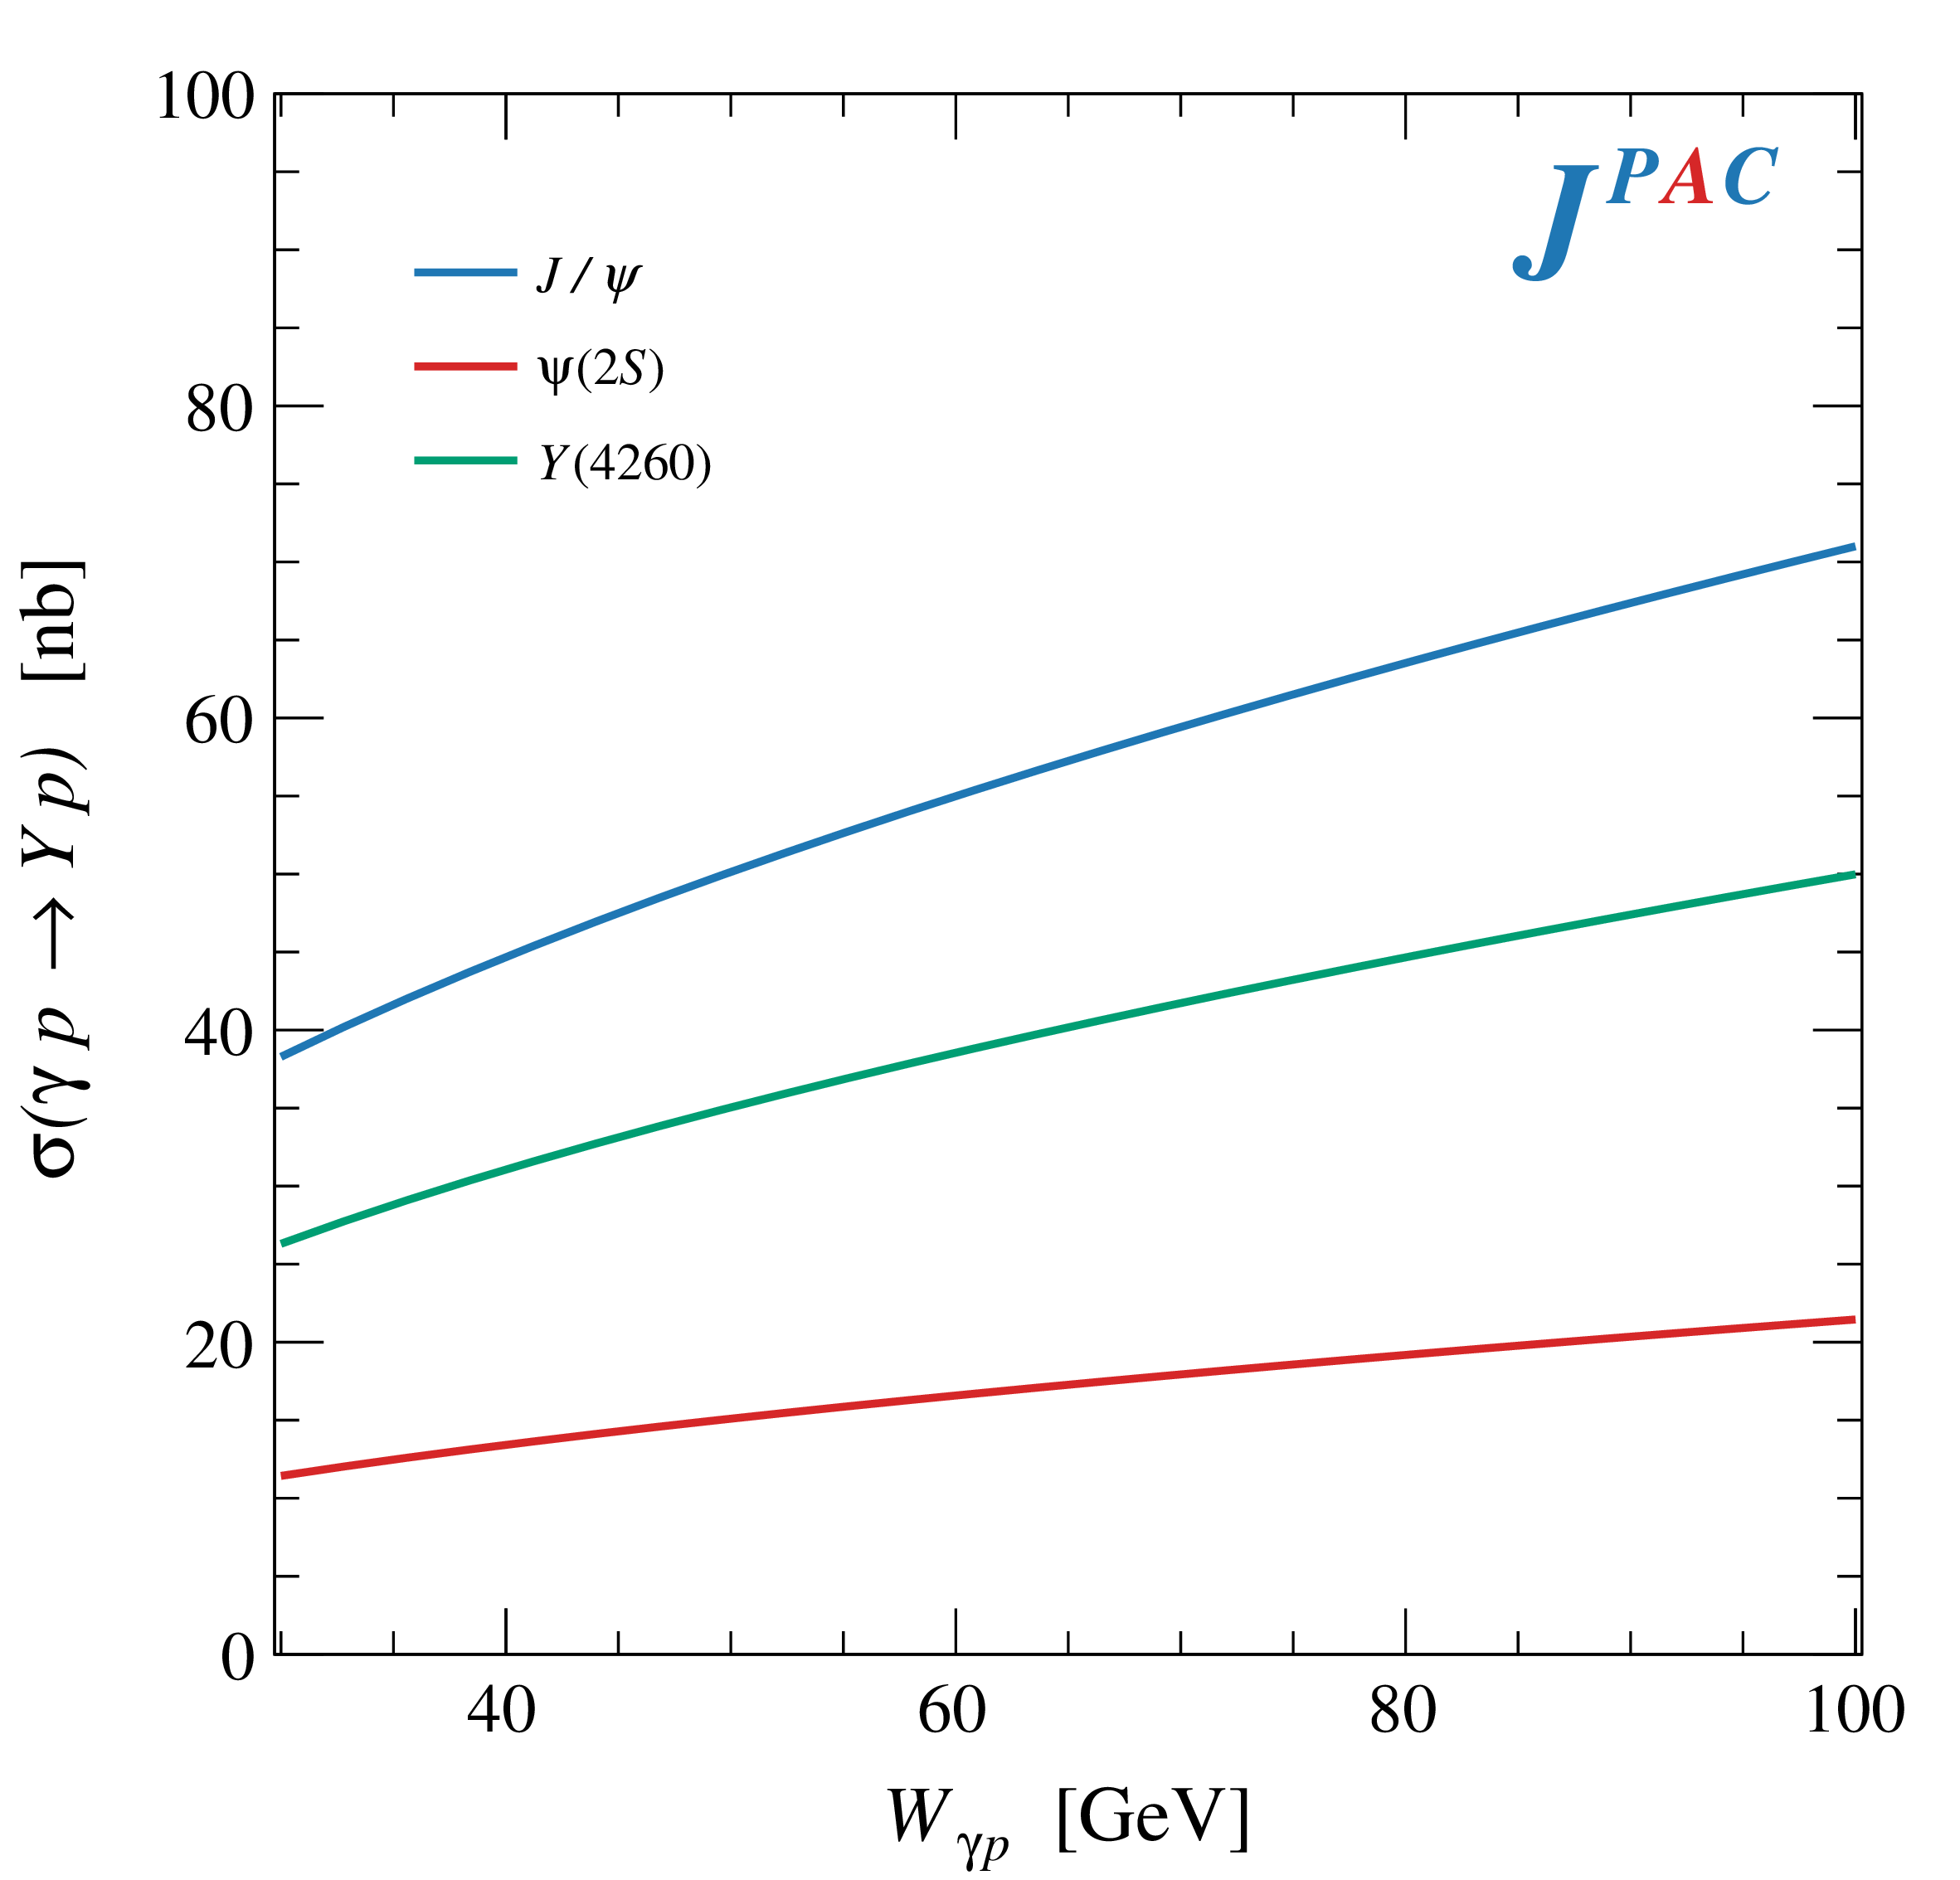
$Y$ (vector) photoproduction
Diffractive production, dominated by Pomeron (2-gluon) exchange
Existing data allow to put a 95% upper limit on the ratio of $ψ′/Y(4260)$ yields
Assuming previous formula, one gets: $Γ_{ee}^{Y}=930 eV$
(cfr. hep-ex/0603024, 2002.05641)
$BR\left(Y→J/ψππ\right)=0.96\%$
$R_{Y}=0.84$
$$R_{Y}=\frac{ef_{ψ}}{m_{ψ}}\sqrt{\frac{g^{2}(Y→ψππ)}{g^{2}(ψ→γgg)}\frac{g^{2}(ψ^{′}→ψgg)}{g^{2}(ψ^{′}→ψππ)}}$$
A. Pilloni – Prospects for XYZ studies at future facilities

Slide 21
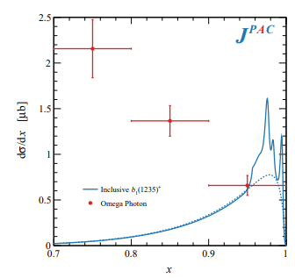
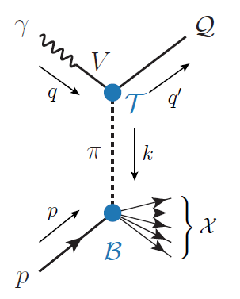
Semi-inclusive photoproduction
Semi-inclusive cross sections are typically larger
For small $t$ and large $x$, one can assume the process to be dominated by pion exchange
The bottom vertex depends on the (known) pion-proton total cross section
The pion is exchanged in the $t$-channel
Model benchmarked on $b_{1}$ production
Model underestimates lower bins, conservative estimates
The model is expected to hold in the highest bin
A. Pilloni – Prospects for XYZ studies at future facilities

Slide 22
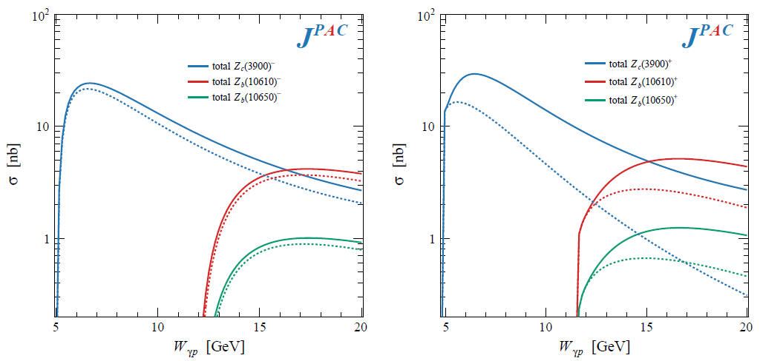
Semi-inclusive photoproduction
For the $Z_{c}^{+}$, the inclusive cross section is sizably larger than the exclusive process
$$Z_{c}^{−}Δ^{++}$$
$$Z_{c}^{+}n$$
A. Pilloni – Prospects for XYZ studies at future facilities

Slide 23
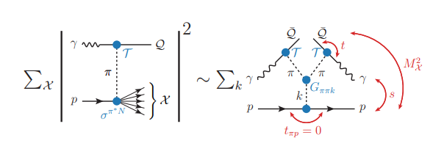
Semi-inclusive photoproduction
At higher energies the triple Regge regime is reached, cross sections saturate
A. Pilloni – Prospects for XYZ studies at future facilities

Slide 24
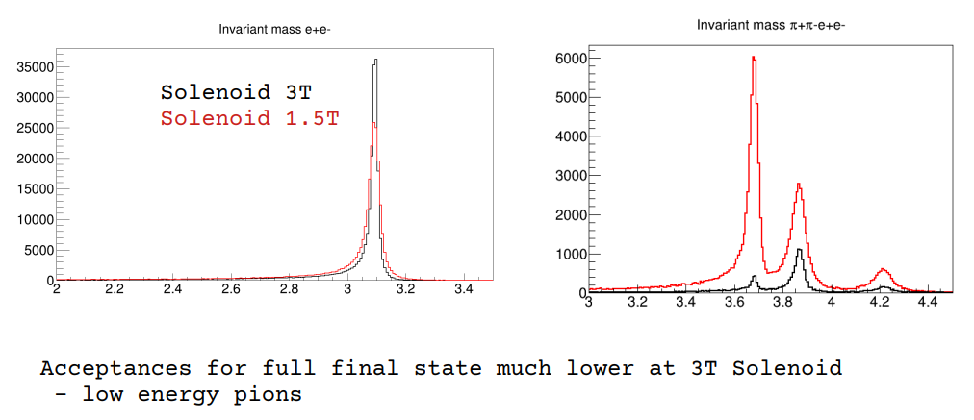
In practice
Burkert et al. 2211.15746
Desiderata
Low beam energies
Low solenoidal field strength
Require far forward and backward acceptance and resolution
We should expect to reconstruct around 10% fully exclusive events (most events lost in far forward/backward regions)
$$ψ′$$
$$X$$
$$Y$$
D. Glazier
A. Pilloni – Prospects for XYZ studies at future facilities

Slide 25
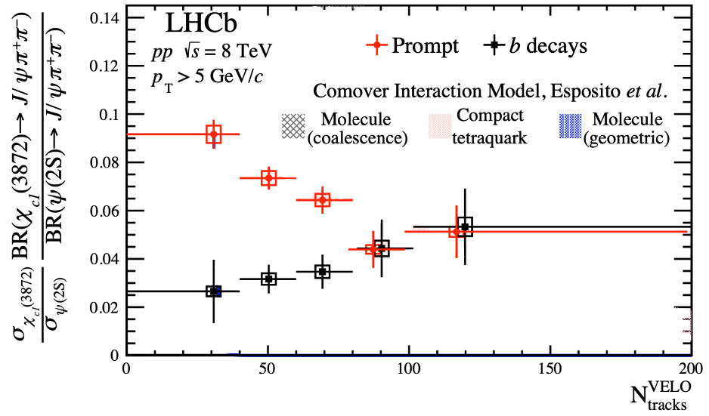
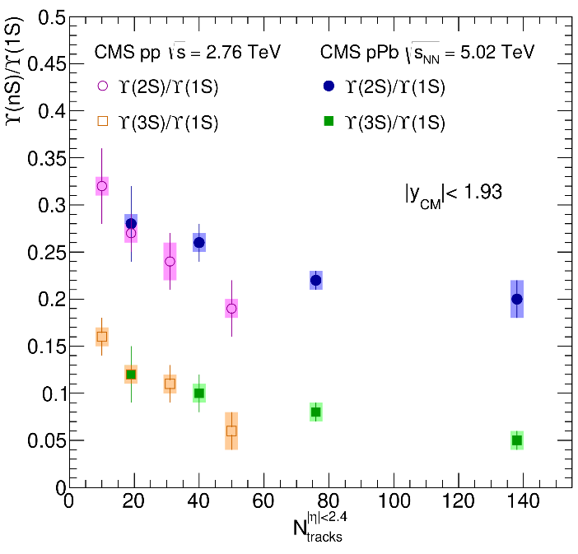
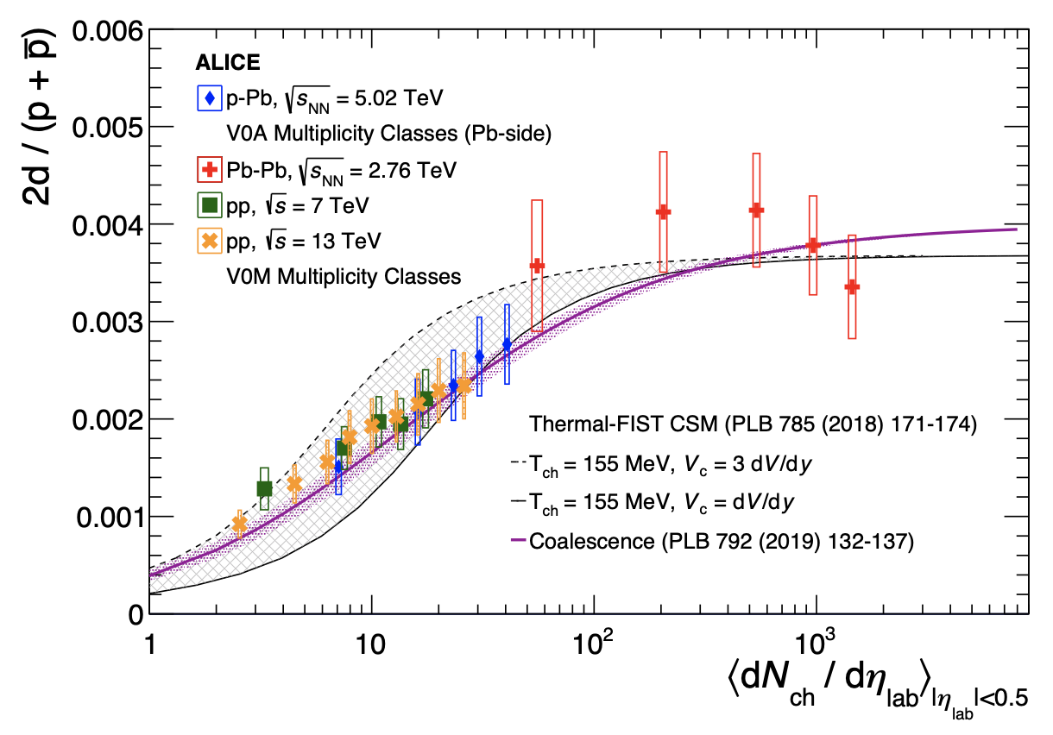
Multiplicity dependence
The $X(3872)$is more and more suppressed wrt $ψ(2S)$when more comovers are present Does it make the $X(3872)$a fragile molecule?
The $X(3872)$is more and more suppressed wrt $ψ(2S)$when more comovers are present Does it make the $X(3872)$a fragile molecule? No.
LHCb 2009.06619
Deuteron is a molecule, but it increases
CMS JHEP04(2014), 103
ALICE EPJC80, 9, 889
$Υ(2S)$ and $Υ\left(3S\right)$ are not molecules, but they decrease
$Υ(2S)$ and $Υ\left(3S\right)$ are not molecules, but they decrease
A. Pilloni – Prospects for XYZ studies at future facilities
Notes:
2 slides su Zc, a Bes e a Belle
2 slide su tetraquark model: dall’hamiltoniana di Jaffe al calcolo delle masse
1 slide su molecular models, dove sono i carichi? (non in Tornqvist, si in Hanhart, vedere Braaten, citare Nefediev)
2 slides su decay channels, dove si dovrebbe vedere, e a seconda del modello, vedere qualche plot
1 slide su Y(4260), tetraquark? C’è lo strano (si vede la f0)
1 slide su Zc a cleo (anche il neutro)

Slide 26
The comover model
The interaction with final state comoving particles can help create/destroy a hadron
Baym PLB138, 18
For a compact state in 𝑝𝑝 collisions the number evolves following
hadron yield
destruction cross section
$$τ\frac{dN_{𝒬}}{dτ}=−⟨vσ⟩_{𝒬}ρ_{c}N_{𝒬}$$
comover density at initial time (Glauber model) $∝N_{ch}$
In the Comover Interaction Model one takes $⟨vσ⟩_{𝒬}∼πr_{𝒬}^{2}$
This has proved to be successful at describing 𝑝Pb and PbPb data
Ferreiro PLB749, 98
Ferreiro, Lansberg JHEP10(2018), 94
A. Pilloni – Prospects for XYZ studies at future facilities
Notes:
2 slides su Zc, a Bes e a Belle
2 slide su tetraquark model: dall’hamiltoniana di Jaffe al calcolo delle masse
1 slide su molecular models, dove sono i carichi? (non in Tornqvist, si in Hanhart, vedere Braaten, citare Nefediev)
2 slides su decay channels, dove si dovrebbe vedere, e a seconda del modello, vedere qualche plot
1 slide su Y(4260), tetraquark? C’è lo strano (si vede la f0)
1 slide su Zc a cleo (anche il neutro)

Slide 27
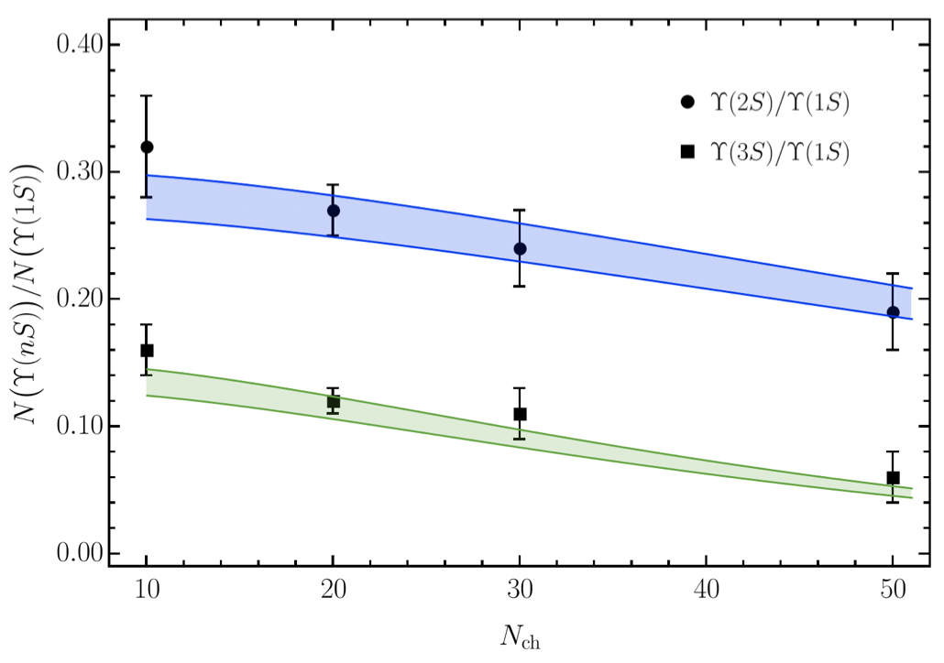
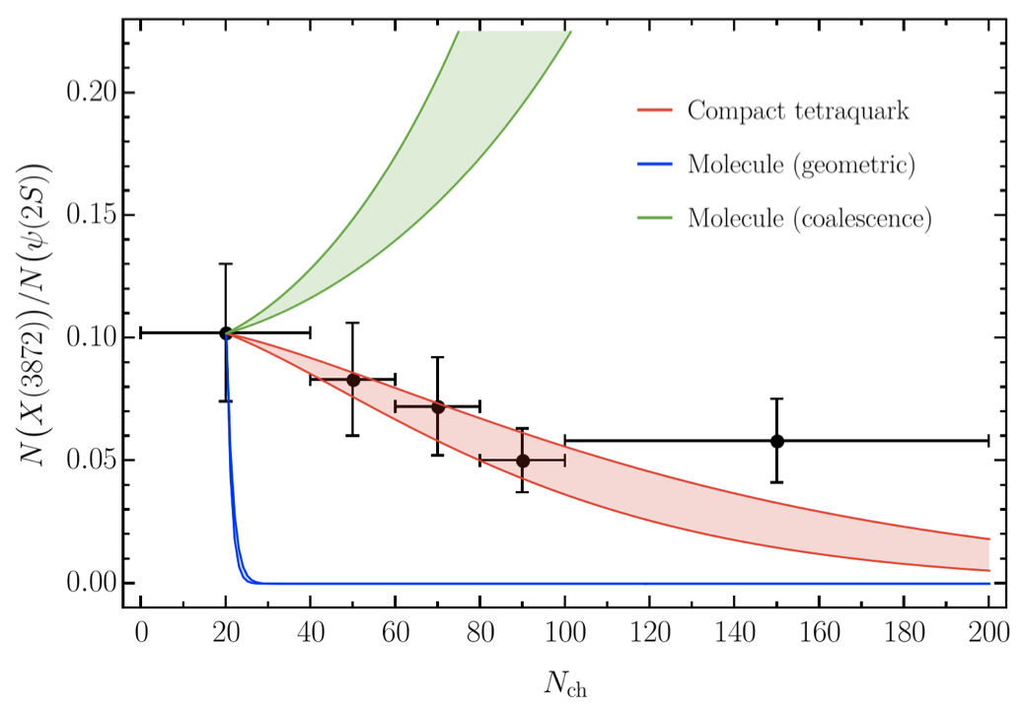
Bottomonia & $X(3872)$
Further validate the model using CMS $pp$ data Using same cross sections as in 𝑝Pb and PbPb
Same model for a compact $X(3872)$
Esposito, Ferreiro, AP, Polosa, Salgado EPJC 81 (2021) 7, 669
A. Pilloni – Prospects for XYZ studies at future facilities
Notes:
2 slides su Zc, a Bes e a Belle
2 slide su tetraquark model: dall’hamiltoniana di Jaffe al calcolo delle masse
1 slide su molecular models, dove sono i carichi? (non in Tornqvist, si in Hanhart, vedere Braaten, citare Nefediev)
2 slides su decay channels, dove si dovrebbe vedere, e a seconda del modello, vedere qualche plot
1 slide su Y(4260), tetraquark? C’è lo strano (si vede la f0)
1 slide su Zc a cleo (anche il neutro)

Slide 28
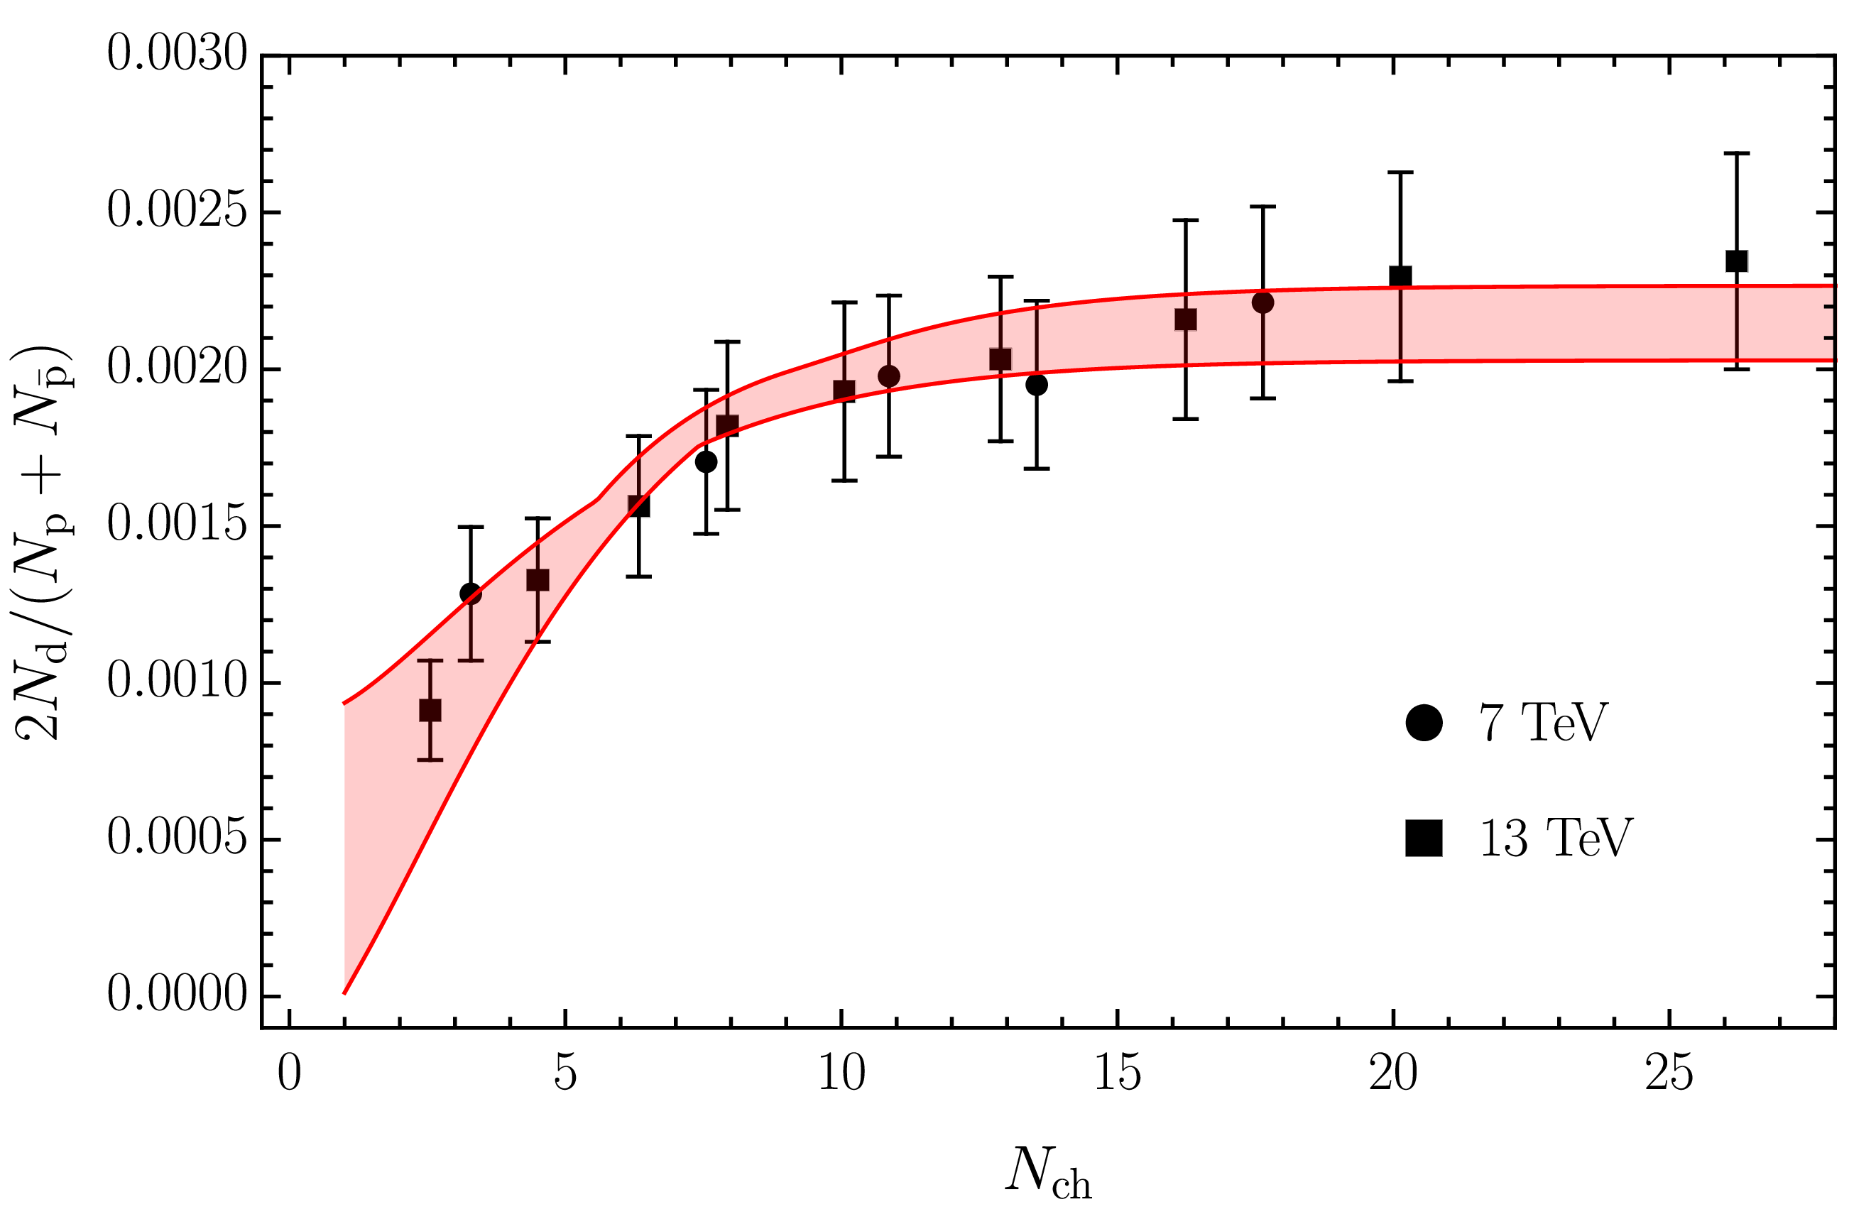
Deuteron in coalescence model
Solution of the evolution equation with recombination
$$\frac{N_{m}}{N_{h}}=\frac{{\left\langle vσ\right\rangle }_{m}}{{\left\langle vσ\right\rangle }_{m}+{\left\langle vσ\right\rangle }_{hh}}+\left(\frac{N_{m}^{0}}{N_{h}^{0}}−\frac{{\left\langle vσ\right\rangle }_{m}}{{\left\langle vσ\right\rangle }_{m}+{\left\langle vσ\right\rangle }_{hh}}\right)e^{−\left({\left\langle vσ\right\rangle }_{m}+{\left\langle vσ\right\rangle }_{hh}\right)ρ_{c}\ln\left(ρ_{c}/ρ_{c}^{pp}\right)}$$
Numbers of molecule at $t=0$,
$≈0$ in Pythia
The coalescence momentum for deuteron is known to be $Λ=50 ÷200 \text{MeV}$
Cross sections calculated from scattering of constituents
A. Pilloni – Prospects for XYZ studies at future facilities
Notes:
2 slides su Zc, a Bes e a Belle
2 slide su tetraquark model: dall’hamiltoniana di Jaffe al calcolo delle masse
1 slide su molecular models, dove sono i carichi? (non in Tornqvist, si in Hanhart, vedere Braaten, citare Nefediev)
2 slides su decay channels, dove si dovrebbe vedere, e a seconda del modello, vedere qualche plot
1 slide su Y(4260), tetraquark? C’è lo strano (si vede la f0)
1 slide su Zc a cleo (anche il neutro)

Slide 29
$X(3872)$ again
The coalescence momentum for the $X(3872)$ is $Λ=30 ÷300 \text{MeV}$
Controversies for $N_{m}/N_{h}$: How is the 𝑋 produced?
Through ${\overline{D}}^{0}D^{∗0}$: $N_{m}/N_{h}≈0$
Through $χ_{c1}(2P)$: $N_{m}/N_{h}≈1$
The difference shown with a green band
A. Pilloni – Prospects for XYZ studies at future facilities
Notes:
2 slides su Zc, a Bes e a Belle
2 slide su tetraquark model: dall’hamiltoniana di Jaffe al calcolo delle masse
1 slide su molecular models, dove sono i carichi? (non in Tornqvist, si in Hanhart, vedere Braaten, citare Nefediev)
2 slides su decay channels, dove si dovrebbe vedere, e a seconda del modello, vedere qualche plot
1 slide su Y(4260), tetraquark? C’è lo strano (si vede la f0)
1 slide su Zc a cleo (anche il neutro)

Slide 30
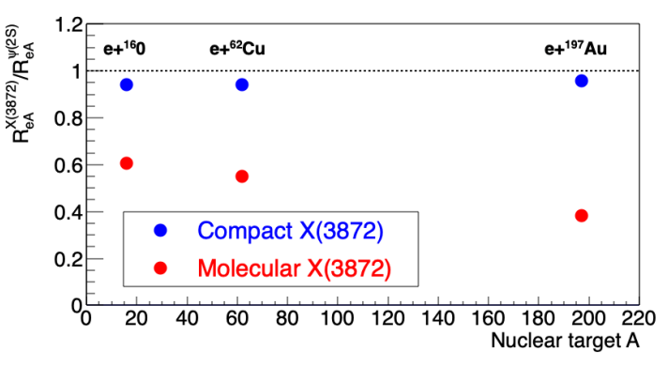
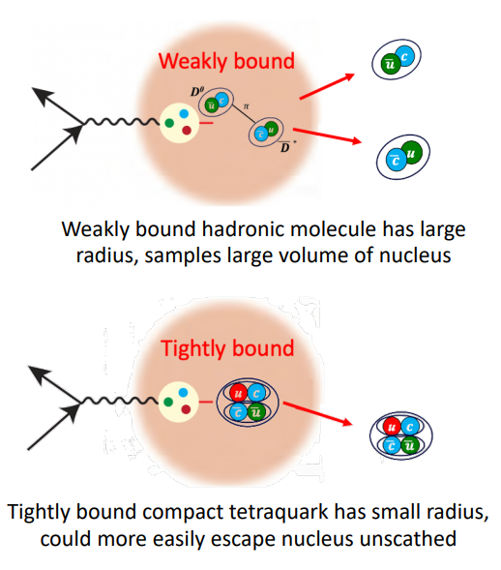
$X(3872)$ at the EIC
M. Durham
Switching from high multiplicity to high density environments, the picture does not change
Study of nuclear modification factors is informative about the size, thus the structure
A. Pilloni – Prospects for XYZ studies at future facilities
Notes:
2 slides su Zc, a Bes e a Belle
2 slide su tetraquark model: dall’hamiltoniana di Jaffe al calcolo delle masse
1 slide su molecular models, dove sono i carichi? (non in Tornqvist, si in Hanhart, vedere Braaten, citare Nefediev)
2 slides su decay channels, dove si dovrebbe vedere, e a seconda del modello, vedere qualche plot
1 slide su Y(4260), tetraquark? C’è lo strano (si vede la f0)
1 slide su Zc a cleo (anche il neutro)

Slide 31
Conclusions
Photoproduction is a valuable tool to study exotic states, cross sections expected to be sizeable
Production of exotics in cold nuclear matter can offer complimentary information on the nature of exotics
The EIC as well as an upgraded JLab to study photoproduction at low energies are very welcome to pursue this program
Thank you!
A. Pilloni – Prospects for XYZ studies at future facilities
Notes:
2 slides su Zc, a Bes e a Belle
2 slide su tetraquark model: dall’hamiltoniana di Jaffe al calcolo delle masse
1 slide su molecular models, dove sono i carichi? (non in Tornqvist, si in Hanhart, vedere Braaten, citare Nefediev)
2 slides su decay channels, dove si dovrebbe vedere, e a seconda del modello, vedere qualche plot
1 slide su Y(4260), tetraquark? C’è lo strano (si vede la f0)
1 slide su Zc a cleo (anche il neutro)

Slide 32
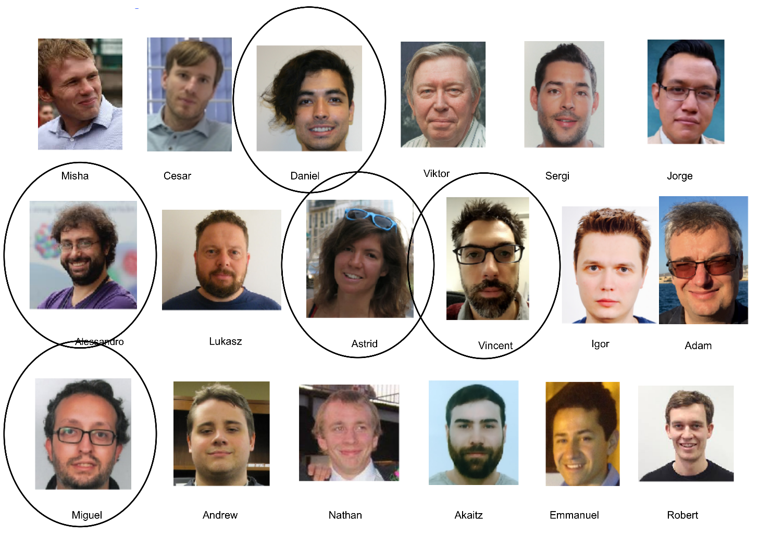
Joint Physics Analysis Center
Exclusive reactions: 2008.01001
Inclusive reactions: 2209.05882
Code available on https://github.com/ dwinney/jpacPhoto
A. Pilloni – Prospects for XYZ studies at future facilities

Slide 33
Backup

Slide 34
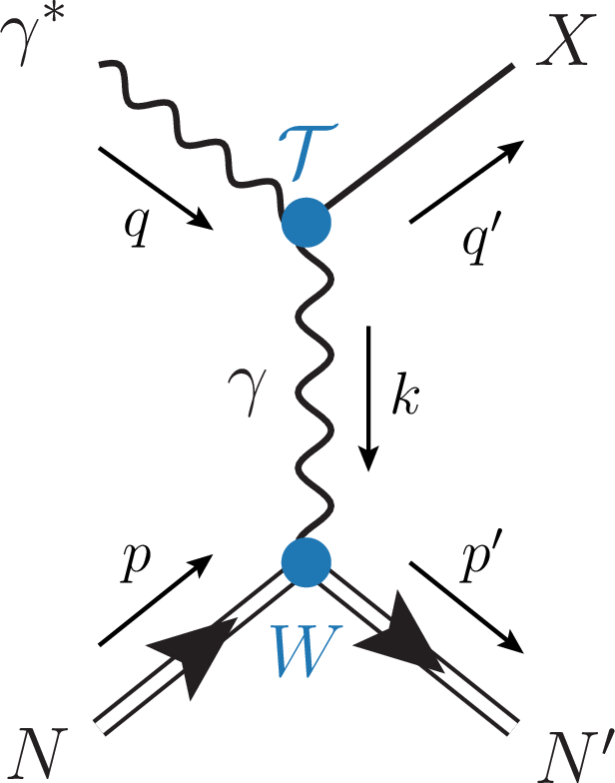
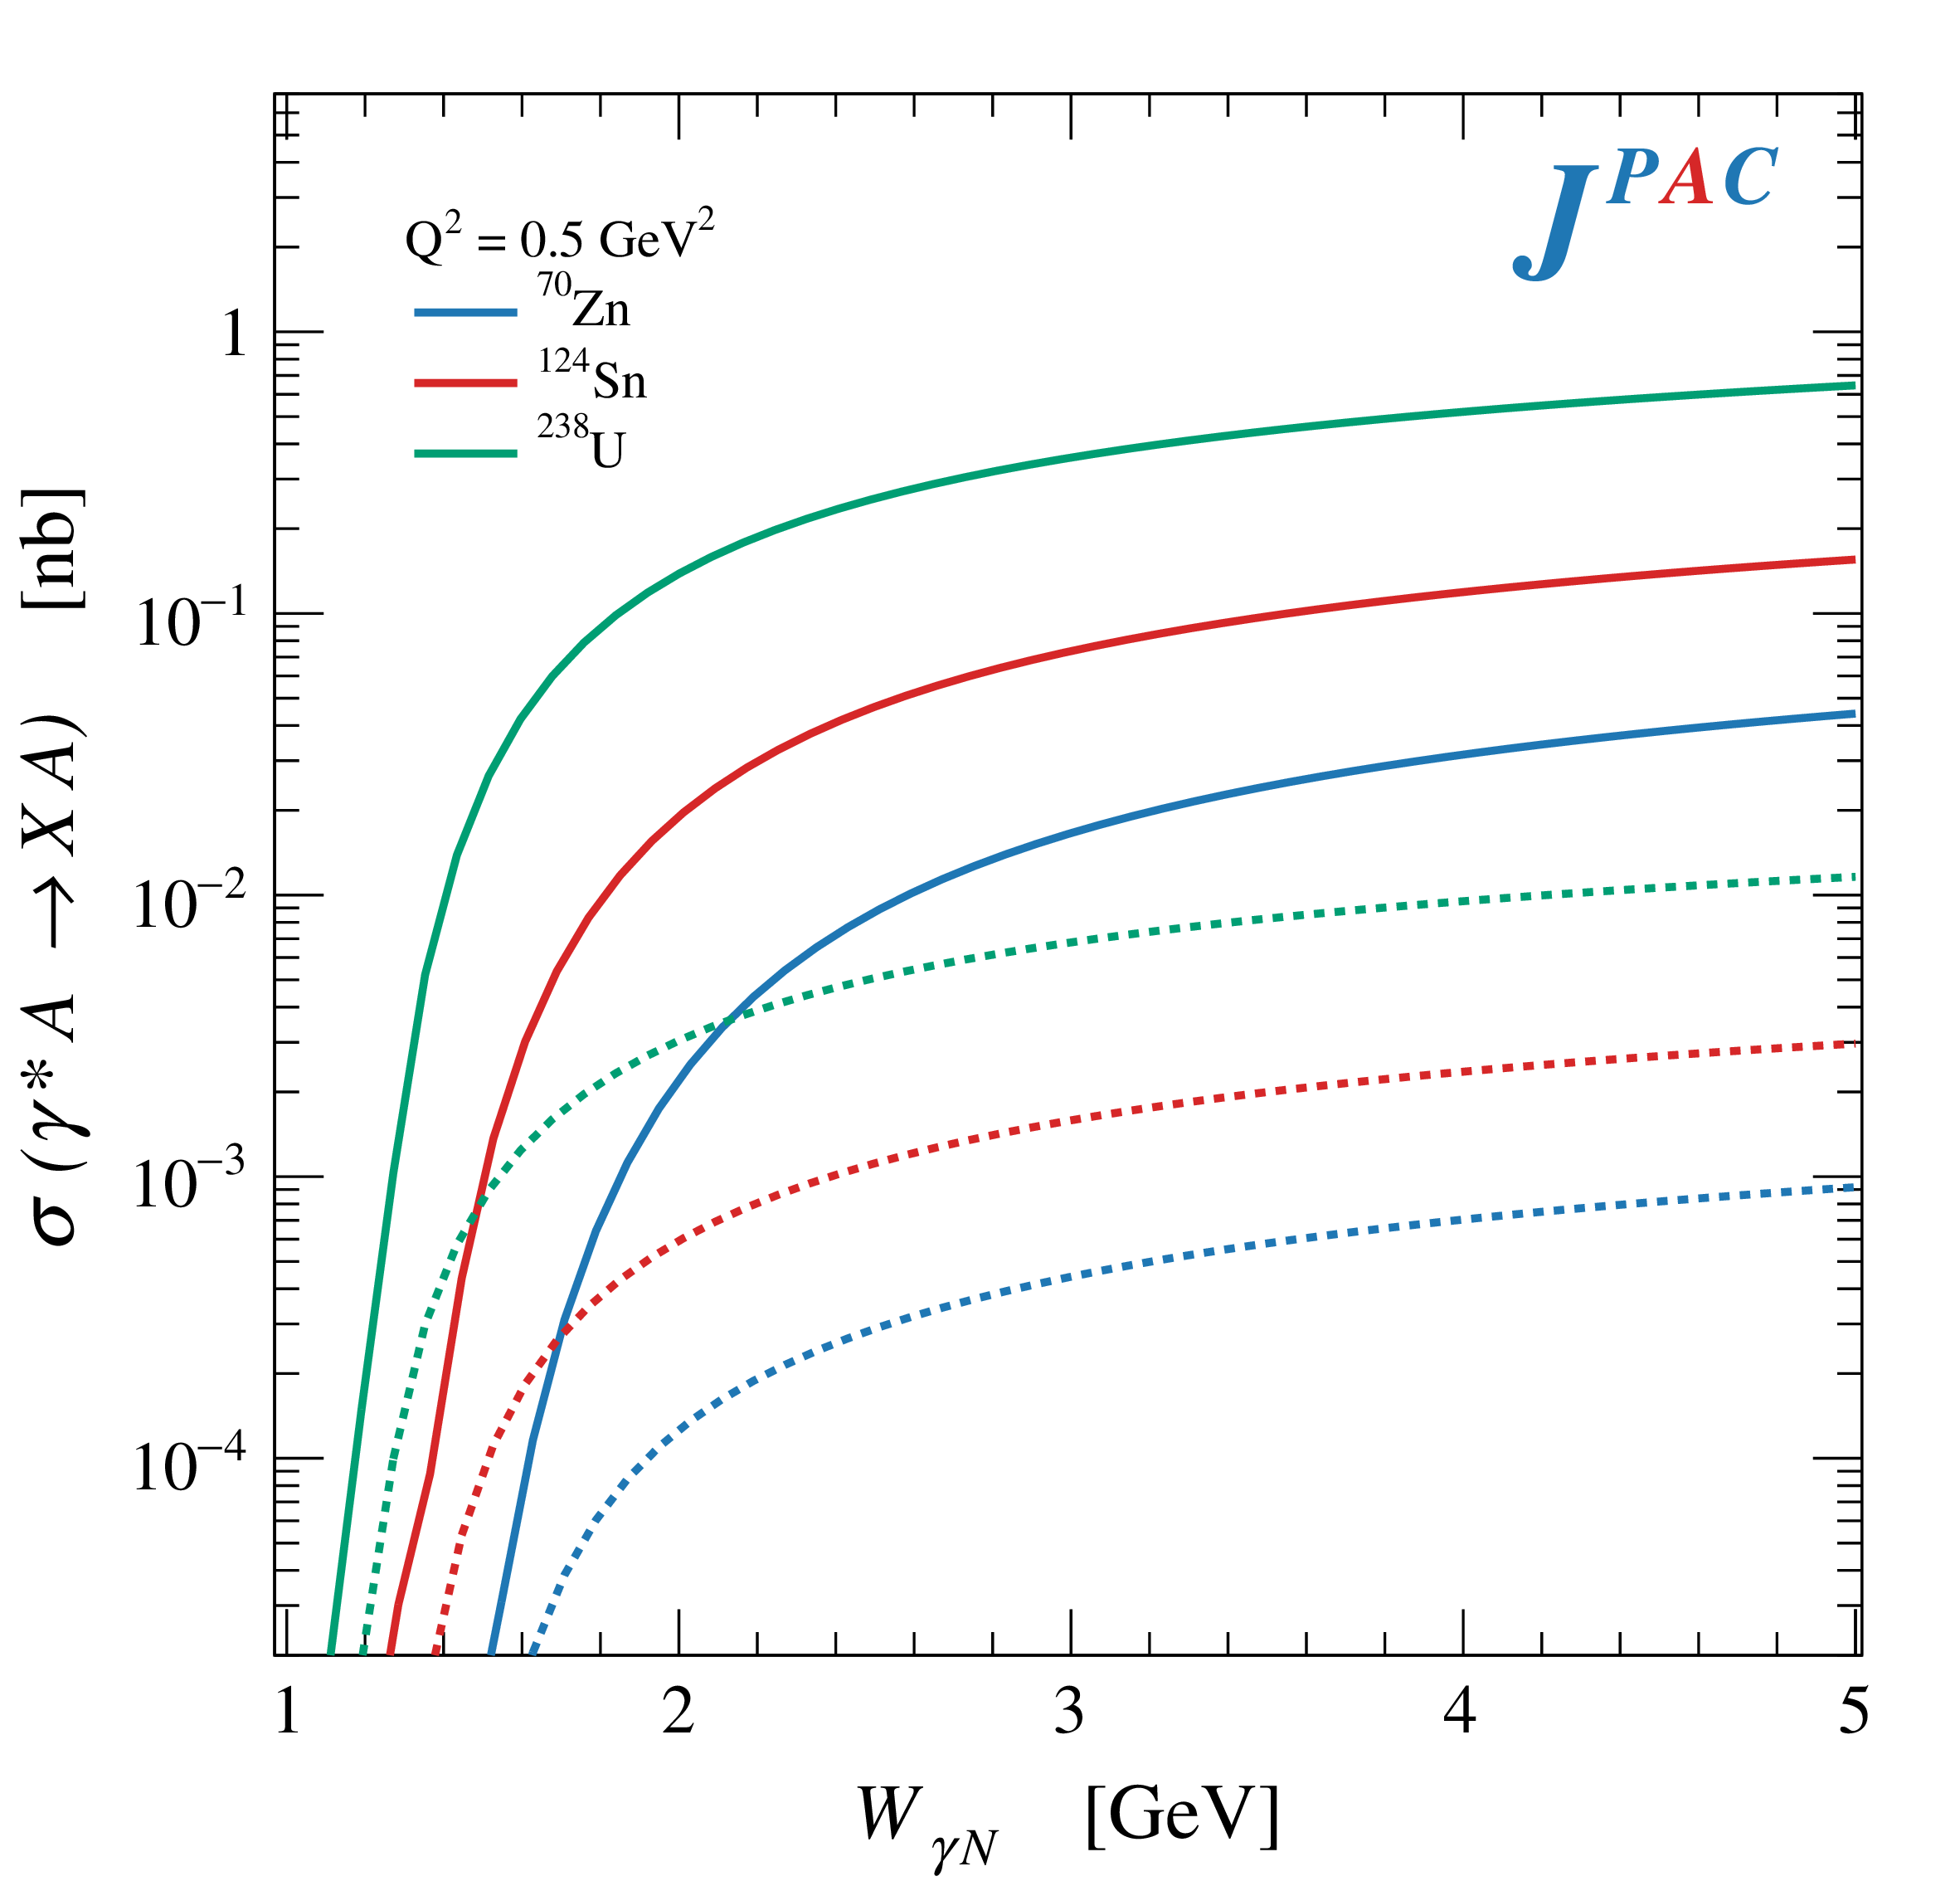
Primakoff X photoproduction
Using measurement of $Γ(X→γγ^{∗})$ from Belle, one can get predictions for Primakoff
Makes use of ion beams, enhancement of cross sections as $Z^{2}$
W. Schafer
$$X(3872)$$
$$X(6900)$$
A. Pilloni – Prospects for XYZ studies at future facilities

Slide 35
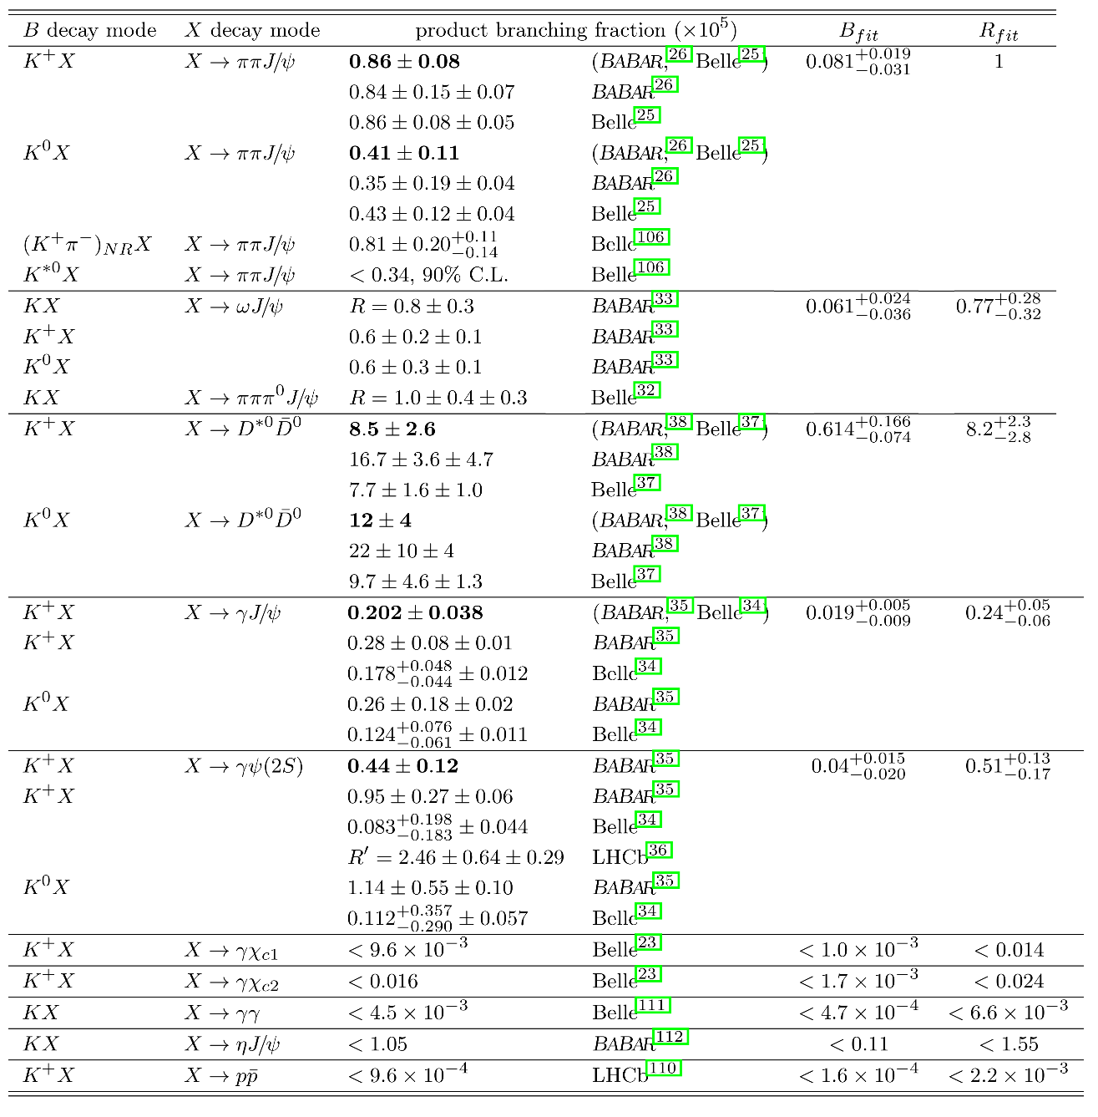
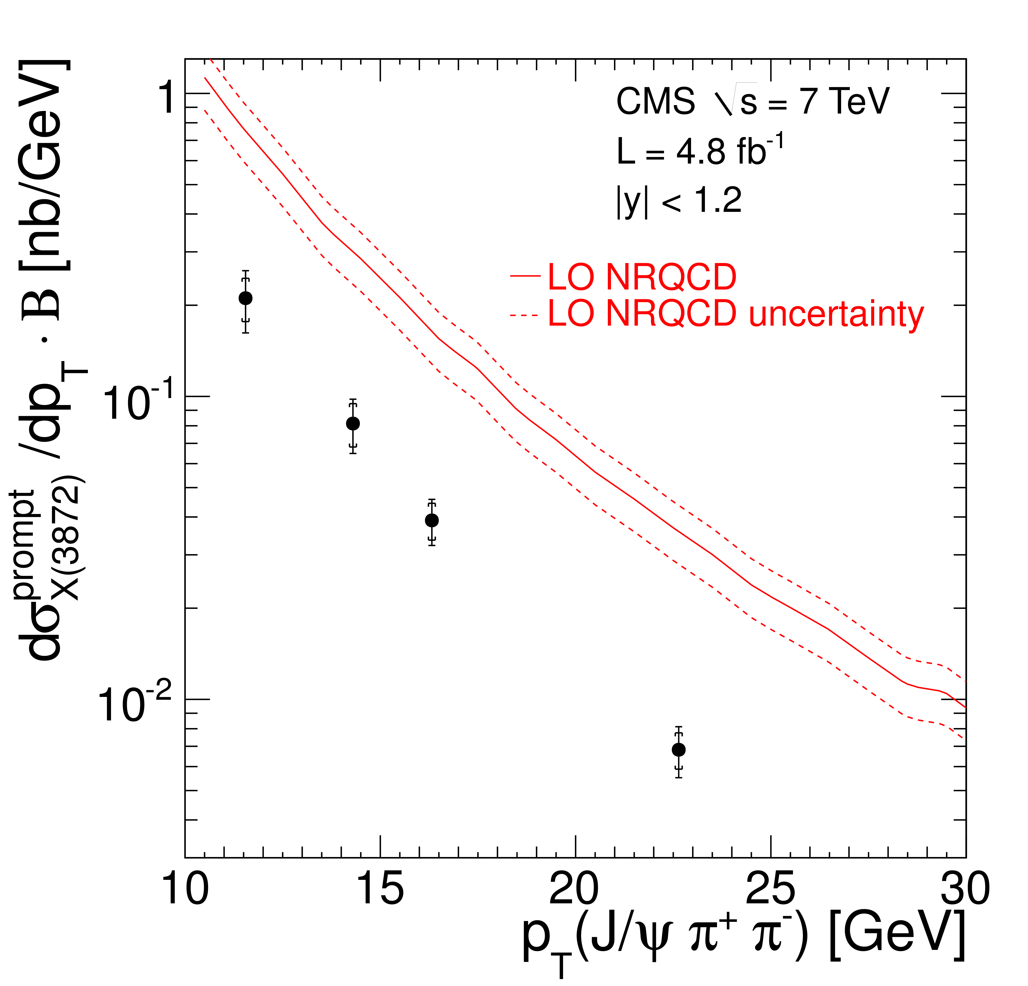
$X(3872)$
Large prompt production at hadron colliders
$$σ_{B}/σ_{TOT}=\left(26.3±2.3±1.6\right)\%$$
$$σ_{PR}×B(X→J/ψππ)=\left(1.06±0.11±0.15\right) \text{nb}$$
CMS, JHEP 1304, 154
A. Pilloni – Prospects for XYZ studies at future facilities

Slide 36
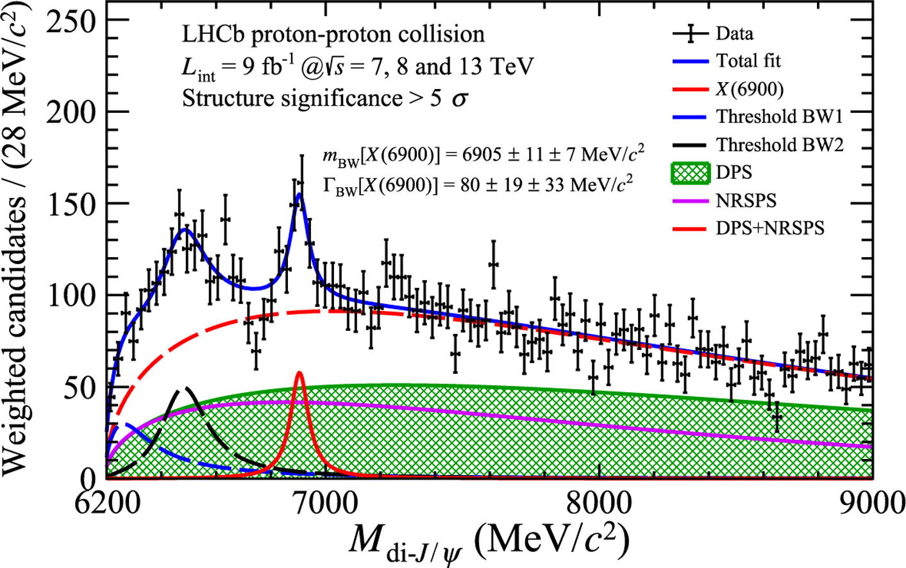
Fully charm: the $X(6900)$
Two structures are seen in the $J/ψ J/ψ$ spectrum
The heavier one is narrower and well assessed
The nature of the lighter one is unclear
A. Pilloni – Prospects for XYZ studies at future facilities
Notes:
Y(4260), M=4263 +- 5, Gamma = 95+-14
D_1(2420)^0, M=2421.3 ±0.6, Gamma =27.1 ±2.7
D_1(2420)^+-, M=2423.4 ±3.1, Gamma =25 ±6
I D_1 hanno J^P = 1^+
La molecola D_1 D sta 22 MeV sotto
Se la Y è D_1 D, il pione lega fortemente, come fa la Y a essere così larga?
Come funziona lo scambio del pione???

Slide 37
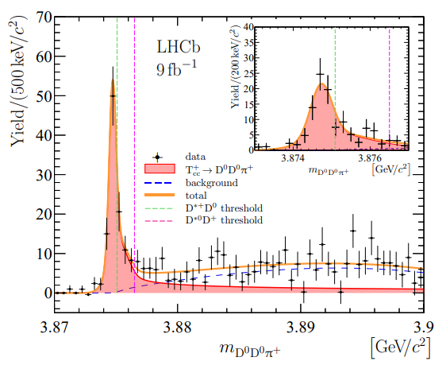
Very open charm: the $T_{cc}^{+}$
A supernarrow state is seen at the $D^{∗+}D^{0}$ threshold
BW parameters give
$δm_{BW}=−273±61 \text{keV}$
$Γ_{BW}=410±65 \text{keV}$
It cannot mix with ordinary charmonia It does not have lighter open channels
A. Pilloni – Prospects for XYZ studies at future facilities
Notes:
Y(4260), M=4263 +- 5, Gamma = 95+-14
D_1(2420)^0, M=2421.3 ±0.6, Gamma =27.1 ±2.7
D_1(2420)^+-, M=2423.4 ±3.1, Gamma =25 ±6
I D_1 hanno J^P = 1^+
La molecola D_1 D sta 22 MeV sotto
Se la Y è D_1 D, il pione lega fortemente, come fa la Y a essere così larga?
Come funziona lo scambio del pione???

Slide 38
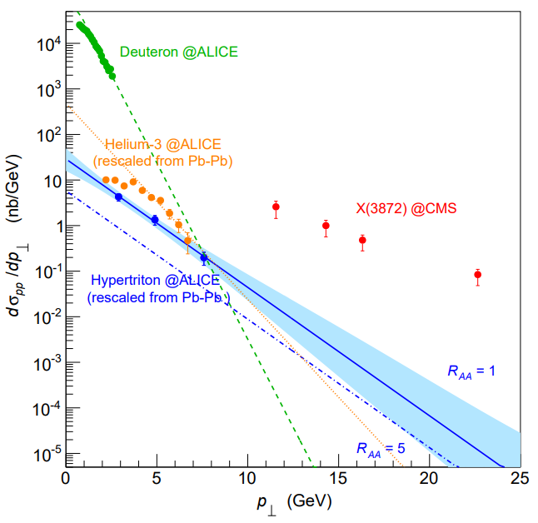
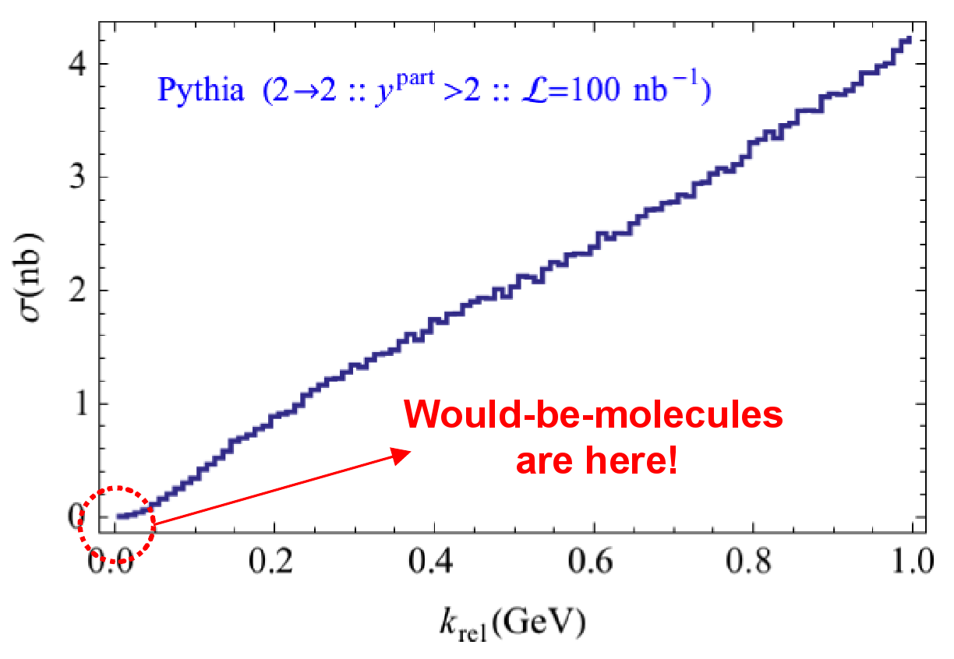
Prompt production of $X(3872)$
However, the applicability of Watson theorem is challenged by the presence of pions that interfere with $DD^{∗}$ propagation
$$D^{∗}$$
$$π$$
$$π$$
(CDF acceptance)
$$π$$
$$π$$
$$π$$
$$\overline{D^{0}}$$
A solution can be FSI (rescattering of $DD^{∗}$), which allow $k_{max}$ to be as large as $5m_{π}$, $σ\left(p\overline{p}→DD^{∗}|k<k_{max}\right)≈230 \text{nb}$
Artoisenet and Braaten, PRD81, 114018
However, this is controversial because of the presence of comovers that interfere with $DD^{∗}$ propagation
Bignamini et al. PLB684, 228-230
Esposito, Piccinini, AP, Polosa, JMP 4, 1569
Guerrieri, Piccinini, AP, Polosa, PRD90, 034003
$$σ_{MC}\left(p\overline{p}→DD^{∗}|k<k_{max}\right)≈0.1 \text{nb}$$
$σ_{exp}\left(p\overline{p}→X(3872)\right)≈30−70 \text{nb}$!!!
The comparison of production of other light nuclei suggests a different behavior
Esposito, Guerrieri, Maiani, Piccinini, AP, Polosa, Riquer, PRD92 (2015) 3, 034028
Bignamini et al. PRL103 (2009) 162001
A. Pilloni – Prospects for XYZ studies at future facilities
Notes:
2 slides su Zc, a Bes e a Belle
2 slide su tetraquark model: dall’hamiltoniana di Jaffe al calcolo delle masse
1 slide su molecular models, dove sono i carichi? (non in Tornqvist, si in Hanhart, vedere Braaten, citare Nefediev)
2 slides su decay channels, dove si dovrebbe vedere, e a seconda del modello, vedere qualche plot
1 slide su Y(4260), tetraquark? C’è lo strano (si vede la f0)
1 slide su Zc a cleo (anche il neutro)

Slide 39
Multiscale system
Systematically integrate out the heavy scale,
$$m_{Q}≫Λ_{QCD}$$
$$m_{Q}≫m_{Q}v≫m_{Q}v^{2}$$
$$m_{b}∼5 \text{GeV}, m_{c}∼1.5 \text{GeV}$$
$$v_{b}^{2}∼0.1, v_{c}^{2}∼0.3$$
Full QCD
NRQCD
pNRQCD
Factorization (to be proved) of universal LDMEs
Good description of many production channels, some known puzzles (polarizations)
A. Pilloni – Prospects for XYZ studies at future facilities
Notes:
2 slides su Zc, a Bes e a Belle
2 slide su tetraquark model: dall’hamiltoniana di Jaffe al calcolo delle masse
1 slide su molecular models, dove sono i carichi? (non in Tornqvist, si in Hanhart, vedere Braaten, citare Nefediev)
2 slides su decay channels, dove si dovrebbe vedere, e a seconda del modello, vedere qualche plot
1 slide su Y(4260), tetraquark? C’è lo strano (si vede la f0)
1 slide su Zc a cleo (anche il neutro)

Slide 40
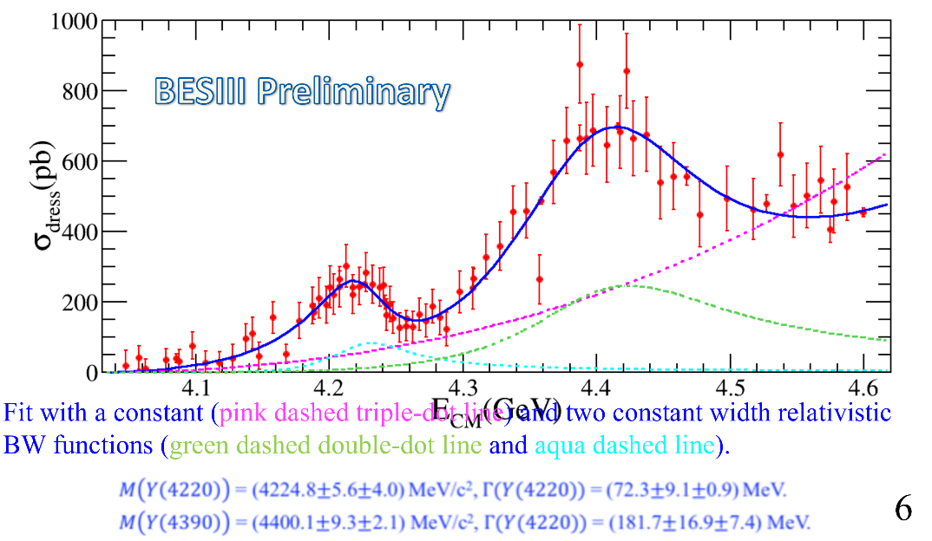
Vector $Y$ states in BESIII
BESIII, PRL118, 092002 (2017)
BESIII, PRL118, 092001 (2017)
$$e^{+}e^{−}→J/ψ ππ$$
New BESIII data show a peculiar lineshape for the $Y(4260)$
The state appear lighter and narrower, compatible with the ones in $h_{c}ππ$ and $χ_{c0}ω$
A broader old-fashioned $Y(4260)$ is appearing in $\overline{D}D^{∗}π$, maybe indicating a ${\overline{D}D}_{1}$
dominance
$$e^{+}e^{−}→π^{+}D^{0}D^{∗−}$$
A. Pilloni – Prospects for XYZ studies at future facilities
Notes:
Y(4260), M=4263 +- 5, Gamma = 95+-14
D_1(2420)^0, M=2421.3 ±0.6, Gamma =27.1 ±2.7
D_1(2420)^+-, M=2423.4 ±3.1, Gamma =25 ±6
I D_1 hanno J^P = 1^+
La molecola D_1 D sta 22 MeV sotto
Se la Y è D_1 D, il pione lega fortemente, come fa la Y a essere così larga?
Come funziona lo scambio del pione???
Close propone che la Y è D_1 D^* col pione scambiato in onda S,
La Y però non va in Ds come se fosse tetraquark

Slide 41
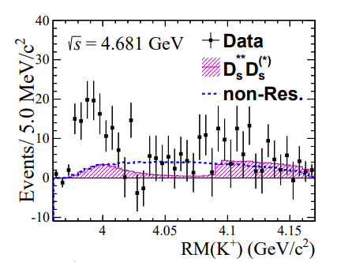
A Strange partner : $Z_{cs}\left(3985\right)$
A strange partner of the $Z_{c}\left(3900\right)$seems to appear in open charm decays
$$e^{+}e^{−}→Z_{cs}{\left(3985\right)}^{+}K^{−}→D_{s}^{+}\overline{D^{∗0}}{ K}^{−}$$ $M={3982.5}_{−2.6}^{+1.8}±2.1$MeV, $Γ={12.8}_{−4.4}^{+5.3}±3.0$ MeV
A. Pilloni – Prospects for XYZ studies at future facilities
Notes:
Y(4260), M=4263 +- 5, Gamma = 95+-14
D_1(2420)^0, M=2421.3 ±0.6, Gamma =27.1 ±2.7
D_1(2420)^+-, M=2423.4 ±3.1, Gamma =25 ±6
I D_1 hanno J^P = 1^+
La molecola D_1 D sta 22 MeV sotto
Se la Y è D_1 D, il pione lega fortemente, come fa la Y a essere così larga?
Come funziona lo scambio del pione???

Slide 42
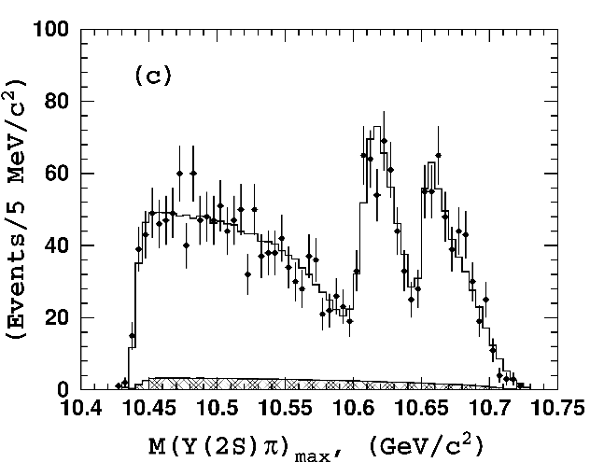
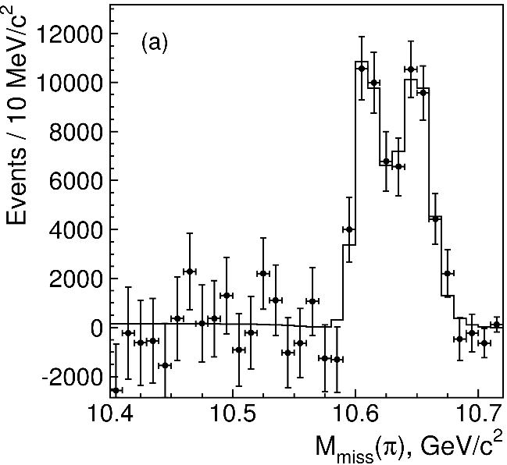
Charged $Z$ states: $Z_{b}\left(10610\right), Z_{b}^{′}(10650)$
Anomalous dipion width in $Υ\left(5S\right)$,
2 orders of magnitude larger than $Υ\left(nS\right)$
Moreover, observed $Υ\left(5S\right)→h_{b}\left(nP\right)ππ$ which violates HQSS
$Υ\left(5S\right)→Z_{b}{\left(10610\right)}^{+}π^{−}→Υ\left(nS\right){ π}^{+}π^{−},h_{b}\left(nP\right){ π}^{+}π^{−}$ and $→{\left(BB^{∗}\right)}^{+}π^{−}$ $M=10607.2±2.0$MeV, $Γ=18.4±2.4$ MeV
$Υ\left(5S\right)→Z_{b}^{′}{\left(10650\right)}^{+}π^{−}→Υ\left(nS\right){ π}^{+}π^{−},h_{b}\left(nP\right){ π}^{+}π^{−}$ and $→{\overline{B}}^{∗0}B^{∗+}π^{−}$
$M=10652.2±1.5$MeV, $Γ=11.5±2.2$ MeV
2 twin resonances!
A. Pilloni – Prospects for XYZ studies at future facilities
Notes:
Y(4260), M=4263 +- 5, Gamma = 95+-14
D_1(2420)^0, M=2421.3 ±0.6, Gamma =27.1 ±2.7
D_1(2420)^+-, M=2423.4 ±3.1, Gamma =25 ±6
I D_1 hanno J^P = 1^+
La molecola D_1 D sta 22 MeV sotto
Se la Y è D_1 D, il pione lega fortemente, come fa la Y a essere così larga?
Come funziona lo scambio del pione???

Slide 43
Tetraquarks: the $B^{+}→J/ψ φ K^{+}$ decay
$$\text{In} J/ψ φ: \left\{\begin{aligned}\text{1}× 1^{−+} \\ \text{2}× 0^{++} \\ 3× 1^{++}\end{aligned}\right.$$
$$In J/ψ K^{+}:2×1^{+}$$
Widths from 50 to 230 MeV
A. Pilloni – Prospects for XYZ studies at future facilities
Notes:
Y(4260), M=4263 +- 5, Gamma = 95+-14
D_1(2420)^0, M=2421.3 ±0.6, Gamma =27.1 ±2.7
D_1(2420)^+-, M=2423.4 ±3.1, Gamma =25 ±6
I D_1 hanno J^P = 1^+
La molecola D_1 D sta 22 MeV sotto
Se la Y è D_1 D, il pione lega fortemente, come fa la Y a essere così larga?
Come funziona lo scambio del pione???
Close propone che la Y è D_1 D^* col pione scambiato in onda S,
La Y però non va in Ds come se fosse tetraquark

Slide 44
Broad exotics in $B$ decays
Lots of new exotics have been seen by LHCb with multidimensional amplitude analyses of $B→$ 3+ body
Most of these are broad, and the precise determination can crucially depend on the amplitude model, so that the resonant nature cannot be assessed with the same strong statements as for the narrow guys
A. Pilloni – Prospects for XYZ studies at future facilities
Notes:
Y(4260), M=4263 +- 5, Gamma = 95+-14
D_1(2420)^0, M=2421.3 ±0.6, Gamma =27.1 ±2.7
D_1(2420)^+-, M=2423.4 ±3.1, Gamma =25 ±6
I D_1 hanno J^P = 1^+
La molecola D_1 D sta 22 MeV sotto
Se la Y è D_1 D, il pione lega fortemente, come fa la Y a essere così larga?
Come funziona lo scambio del pione???

Slide 45
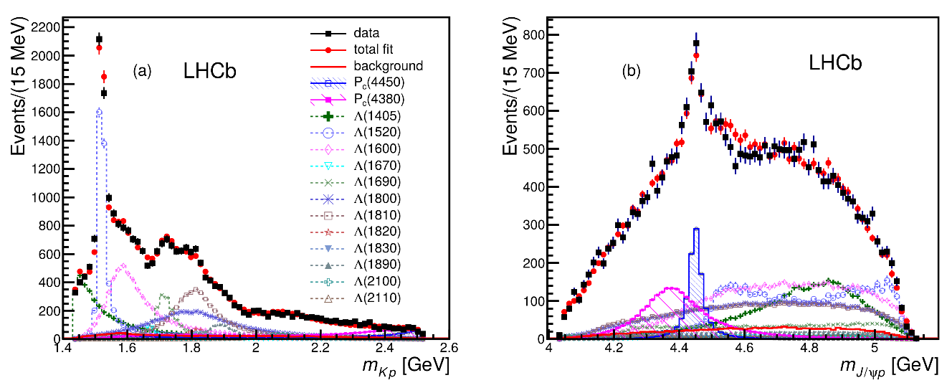
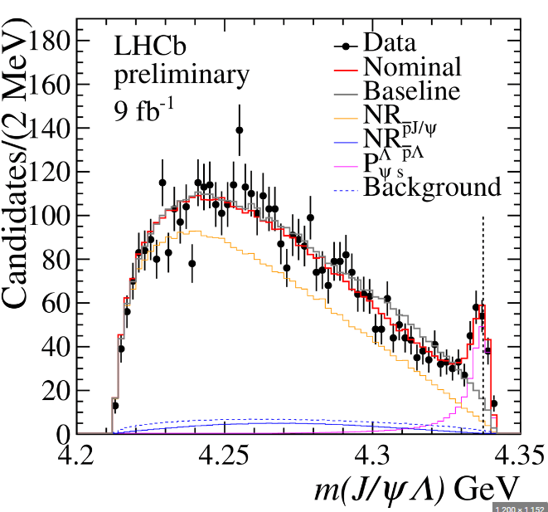
Pentaquarks!
LHCb, PRL 115, 072001
LHCb, PRL 117, 082003
The 2015 4D-analysis observed a narrow and a broad state in $Λ_{b}→\left(J/ψ p\right) K^{−}$,
Likely opposite parity
Possible contamination by models for $Λ^{∗}$
The 2019 1D-analysis resolved the composite structure of the narrow peak, as well as observed a lighter isolated state
LHCb, PRL 122, 222001
Pentaquark candidates with strangeness have been observed in $Ξ_{b}$ and $B^{+}$ decay
LHCb, Sci.Bull. 66 (2021) 1278-1287
LHCb, 2210.10346
A. Pilloni – Prospects for XYZ studies at future facilities
Notes:
Y(4260), M=4263 +- 5, Gamma = 95+-14
D_1(2420)^0, M=2421.3 ±0.6, Gamma =27.1 ±2.7
D_1(2420)^+-, M=2423.4 ±3.1, Gamma =25 ±6
I D_1 hanno J^P = 1^+
La molecola D_1 D sta 22 MeV sotto
Se la Y è D_1 D, il pione lega fortemente, come fa la Y a essere così larga?
Come funziona lo scambio del pione???

Slide 46
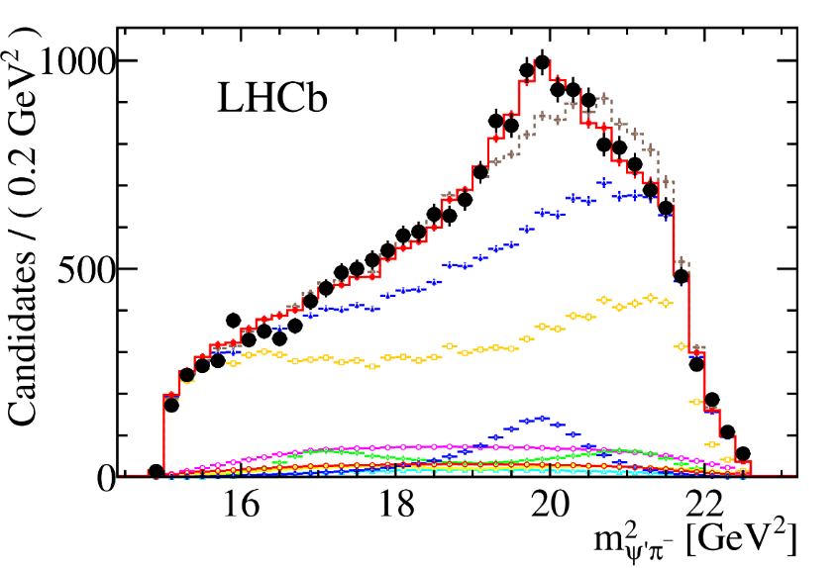
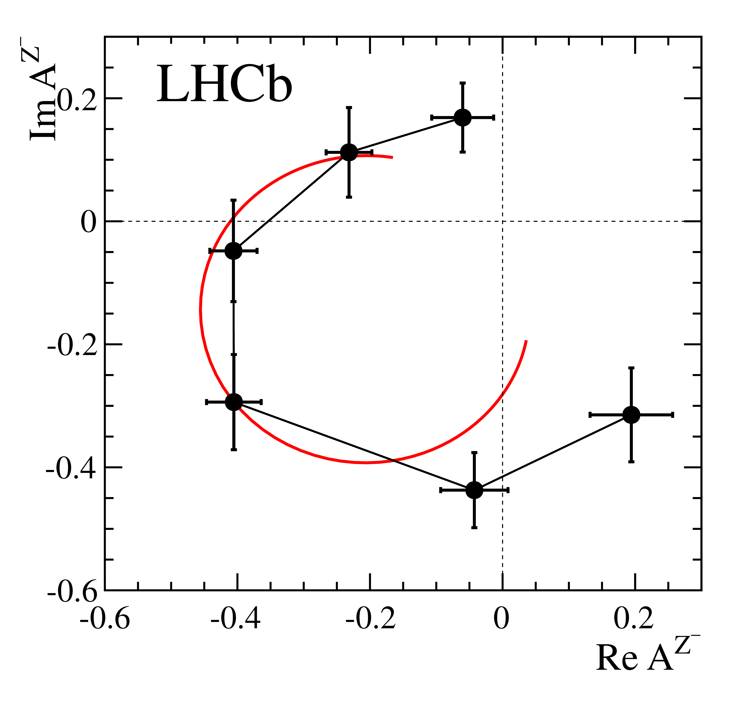
Charged $Z$ states: $Z(4430)$
$$Z{\left(4430\right)}^{+}→ψ(2S){ π}^{+} \\ {I^{G}J}^{PC}=1^{+}1^{+−}$$
$M=4475±7_{−25}^{+15}$MeV
$Γ=172±{13}_{−34}^{+37}$MeV
Far from open charm thresholds
If the amplitude is a free complex number, in each bin of $m_{ψ^{′}π^{−}}^{2}$, the resonant behaviour appears as well
A. Pilloni – Prospects for XYZ studies at future facilities
Notes:
Y(4260), M=4263 +- 5, Gamma = 95+-14
D_1(2420)^0, M=2421.3 ±0.6, Gamma =27.1 ±2.7
D_1(2420)^+-, M=2423.4 ±3.1, Gamma =25 ±6
I D_1 hanno J^P = 1^+
La molecola D_1 D sta 22 MeV sotto
Se la Y è D_1 D, il pione lega fortemente, come fa la Y a essere così larga?
Come funziona lo scambio del pione???

Slide 47
How to proceed?
Top-down: you study models, and verify predictions
Bottom-up: you study data (lineshapes), and try and infer the physics
$$f(s)$$
A. Pilloni – Prospects for XYZ studies at future facilities
Notes:
Y(4260), M=4263 +- 5, Gamma = 95+-14
D_1(2420)^0, M=2421.3 ±0.6, Gamma =27.1 ±2.7
D_1(2420)^+-, M=2423.4 ±3.1, Gamma =25 ±6
I D_1 hanno J^P = 1^+
La molecola D_1 D sta 22 MeV sotto
Se la Y è D_1 D, il pione lega fortemente, come fa la Y a essere così larga?
Come funziona lo scambio del pione???

Slide 48
$P_{c}$ photoproduction
Karliner & Rosner, PLB752, 329
Hiller Blin, AP et al. (JPAC), PRD94, 034002
D. Winney, C. Fanelli, AP et al. (JPAC) PRD100, 034019
The background is described via an Effective Vector Pomeron
Vector meson dominance relates radiative width to hadronic one
Fit the model to GlueX and SLAC data, upper limit $BR_{J/ψp}<4.3\%$ for $J^{P}={\frac{3}{2}}^{−}$
A. Pilloni – Prospects for XYZ studies at future facilities
Notes:
Controlla la parte su Regge

Slide 49
Polarization observables
One can take advantage of the polarized beam at Jlab Need polarized target ($A_{LL}$) or polarization of recoiling proton ($K_{LL}$)
$$K_{LL}$$
(in SBS acceptance)
A. Pilloni – Heavy quark Spectroscopy
Notes:
Controlla la parte su Regge

Slide 50
Threshold vs. high energy
Fixed-spin exchanges expected to hold in the low energy region
$t$ channel grows as $s j$, exceeding unitarity bound, Regge physics kicks in: Reggeized tower of particles with arbitrary spin at HE
$$s^{j}⟶s^{α_{0}+α^{′}t }$$
Holds at low energy, fixed spin
Holds at high energy, resummation of leading $s$ power
If $ε≠$IP, $α_{0}<1$, $dσ/dt$ decreases with energy
Exchange of heavy particles further suppressed
A. Pilloni – Prospects for XYZ studies at future facilities

Slide 51
$Y$ (vector) photoproduction
Focus on the $1^{−−} Y\left(4260\right)→J/ψ π^{+}π^{−}$, check with $ψ′→J/ψ π^{+}π^{−}$
Diffractive production, dominated by Pomeron (2-gluon) exchange
Good candidates for EIC: diffractive production increases with energy!
We have $γψ$-pomeron coupling from our analyses 1606.08912, 1907.09393
How to rescale from $J/ψ$ to $ψ′$ ?
$$R_{ψ^{′}}=\sqrt{\frac{g^{2}(ψ^{′}→γgg)}{g^{2}(ψ→γgg)}}∼0.55$$
$$g^{2}(ψ→γgg)=\frac{6m_{ψ}ℬ(ψ→γgg)Γ_{ψ}}{PS(ψ→γgg)}$$
A. Pilloni – Prospects for XYZ studies at future facilities

Slide 52
$Y$ (vector) photoproduction
Focus on the $1^{−−} Y\left(4260\right)→J/ψ π^{+}π^{−}$, check with $ψ′→J/ψ π^{+}π^{−}$
Diffractive production, dominated by Pomeron (2-gluon) exchange
Good candidates for EIC: diffractive production increases with energy!
We have $γψ$-pomeron coupling from our analyses 1606.08912, 1907.09393
How to rescale from $J/ψ$ to $Y(4260)$ ?
We assume VMD and $g^{2}\left(Y→ψππ\right)=g^{2}\left(Y→ψgg\right)×g^{2}(gg→ππ)$ (Novikov & Shifman)
$$R_{Y}=\frac{ef_{ψ}}{m_{ψ}}\sqrt{\frac{g^{2}(Y→ψππ)}{g^{2}(ψ→γgg)}\frac{g^{2}(ψ^{′}→ψgg)}{g^{2}(ψ^{′}→ψππ)}}$$
Caveat : $BR(Y→ψππ)$ only known times the leptonic width $Γ_{ee}^{Y}$
A. Pilloni – Prospects for XYZ studies at future facilities

Slide 53
Nuclear modification factors
We can use deuteron data to extract the values of the nuclear modification factors (caveat: for RAA data have different $\sqrt{s}$)
$$R_{CP}=\frac{N_{coll}^{P}{\left(\frac{dN}{dp_{T}}\right)}_{\text{C}}}{N_{coll}^{C}{\left(\frac{dN}{dp_{T}}\right)}_{P}}$$
$$R_{AA}=\frac{{\left(\frac{dN}{dp_{T}}\right)}_{\text{Pb}\text{−}\text{Pb}}}{N_{coll}{\left(\frac{dN}{dp_{T}}\right)}_{pp}}$$
Larger than 1 at $p_{T}>2\text{.5 }\text{GeV}$
A. Pilloni – Prospects for XYZ studies at future facilities
Notes:
2 slides su Zc, a Bes e a Belle
2 slide su tetraquark model: dall’hamiltoniana di Jaffe al calcolo delle masse
1 slide su molecular models, dove sono i carichi? (non in Tornqvist, si in Hanhart, vedere Braaten, citare Nefediev)
2 slides su decay channels, dove si dovrebbe vedere, e a seconda del modello, vedere qualche plot
1 slide su Y(4260), tetraquark? C’è lo strano (si vede la f0)
1 slide su Zc a cleo (anche il neutro)

Slide 54
Light nuclei at ALICE vs. $X(3872)$
Esposito, Guerrieri, Maiani, Piccinini, AP, Polosa, Riquer, PRD92, 034028
We assume a pure Glauber model (RAA = 1) and a value RAA = 5 to rescale Pb-Pb data to pp
The $X\left(3872\right)$ is way larger than the extrapolated cross section
Are they similar objects?
Exponential extr.
Blast-wave extr.
A. Pilloni – Prospects for XYZ studies at future facilities
Notes:
2 slides su Zc, a Bes e a Belle
2 slide su tetraquark model: dall’hamiltoniana di Jaffe al calcolo delle masse
1 slide su molecular models, dove sono i carichi? (non in Tornqvist, si in Hanhart, vedere Braaten, citare Nefediev)
2 slides su decay channels, dove si dovrebbe vedere, e a seconda del modello, vedere qualche plot
1 slide su Y(4260), tetraquark? C’è lo strano (si vede la f0)
1 slide su Zc a cleo (anche il neutro)

Slide 55
Minimal(istic) model for $P_{c}(4312)$
( data)
Fernandez-Ramirez, AP et al. (JPAC), PRL 123, 092001
Effective range expansion We can set $c_{ii}=0$ to reduce to the scattering length approximation
$$c_{ii}=0$$
Finite $c_{ii}$
A. Pilloni – Prospects for XYZ studies at future facilities
Notes:
2 slides su Zc, a Bes e a Belle
2 slide su tetraquark model: dall’hamiltoniana di Jaffe al calcolo delle masse
1 slide su molecular models, dove sono i carichi? (non in Tornqvist, si in Hanhart, vedere Braaten, citare Nefediev)
2 slides su decay channels, dove si dovrebbe vedere, e a seconda del modello, vedere qualche plot
1 slide su Y(4260), tetraquark? C’è lo strano (si vede la f0)
1 slide su Zc a cleo (anche il neutro)

Slide 56
Minimal(istic) model for $P_{c}(4312)$
Effective range expansion We can set $c_{ii}=0$ to reduce to the scattering length approximation
$$c_{ii}=0$$
Finite $c_{ii}$
A. Pilloni – Prospects for XYZ studies at future facilities
Notes:
2 slides su Zc, a Bes e a Belle
2 slide su tetraquark model: dall’hamiltoniana di Jaffe al calcolo delle masse
1 slide su molecular models, dove sono i carichi? (non in Tornqvist, si in Hanhart, vedere Braaten, citare Nefediev)
2 slides su decay channels, dove si dovrebbe vedere, e a seconda del modello, vedere qualche plot
1 slide su Y(4260), tetraquark? C’è lo strano (si vede la f0)
1 slide su Zc a cleo (anche il neutro)

Slide 57
Minimal(istic) model for $P_{c}(4312)$
Effective range expansion We can set $c_{ii}=0$ to reduce to the scattering length approximation
Points to a virtual state
$$c_{ii}=0$$
Finite $c_{ii}$
A. Pilloni – Prospects for XYZ studies at future facilities
Notes:
2 slides su Zc, a Bes e a Belle
2 slide su tetraquark model: dall’hamiltoniana di Jaffe al calcolo delle masse
1 slide su molecular models, dove sono i carichi? (non in Tornqvist, si in Hanhart, vedere Braaten, citare Nefediev)
2 slides su decay channels, dove si dovrebbe vedere, e a seconda del modello, vedere qualche plot
1 slide su Y(4260), tetraquark? C’è lo strano (si vede la f0)
1 slide su Zc a cleo (anche il neutro)

Slide 58
Minimal(istic) model for $P_{c}(4312)$
Effective range expansion We can set $c_{ii}=0$ to reduce to the scattering length approximation
Points to a virtual state
Doesn’t point to a resonance
$$c_{ii}=0$$
Finite $c_{ii}$
A. Pilloni – Prospects for XYZ studies at future facilities
Notes:
2 slides su Zc, a Bes e a Belle
2 slide su tetraquark model: dall’hamiltoniana di Jaffe al calcolo delle masse
1 slide su molecular models, dove sono i carichi? (non in Tornqvist, si in Hanhart, vedere Braaten, citare Nefediev)
2 slides su decay channels, dove si dovrebbe vedere, e a seconda del modello, vedere qualche plot
1 slide su Y(4260), tetraquark? C’è lo strano (si vede la f0)
1 slide su Zc a cleo (anche il neutro)

Slide 59
Minimal(istic) model for $P_{c}(4312)$
Effective range expansion We can set $c_{ii}=0$ to reduce to the scattering length approximation
Points to a virtual state
Doesn’t point to a resonance
$$c_{ii}=0$$
Finite $c_{ii}$
A. Pilloni – Prospects for XYZ studies at future facilities
Notes:
2 slides su Zc, a Bes e a Belle
2 slide su tetraquark model: dall’hamiltoniana di Jaffe al calcolo delle masse
1 slide su molecular models, dove sono i carichi? (non in Tornqvist, si in Hanhart, vedere Braaten, citare Nefediev)
2 slides su decay channels, dove si dovrebbe vedere, e a seconda del modello, vedere qualche plot
1 slide su Y(4260), tetraquark? C’è lo strano (si vede la f0)
1 slide su Zc a cleo (anche il neutro)

