Slide 1
MESON2023 @ Kraków
Overview of hadron photoproduction experiments in SPring-8 LEPS2 project
Plenary Session (24 June, 2023)
Norihito Muramatsu
ELPH, Tohoku University

Slide 2
Introduction of SPring-8 LEPS2 project (5 pages)

Slide 3
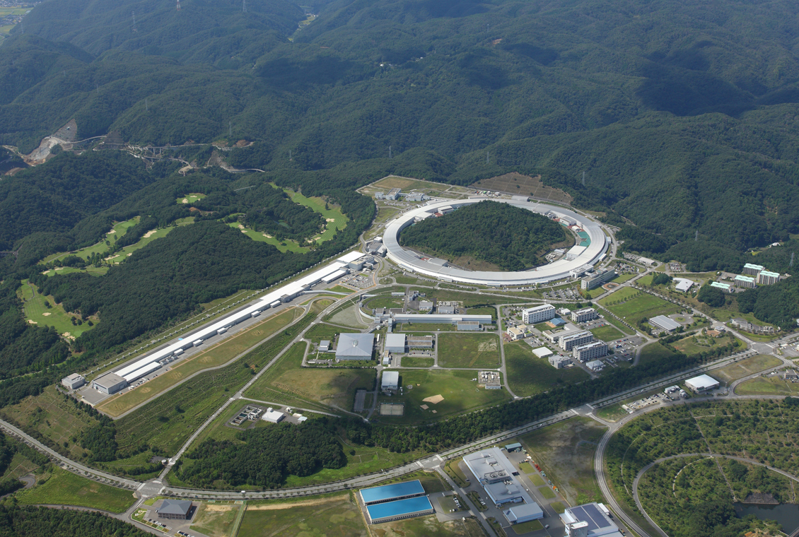
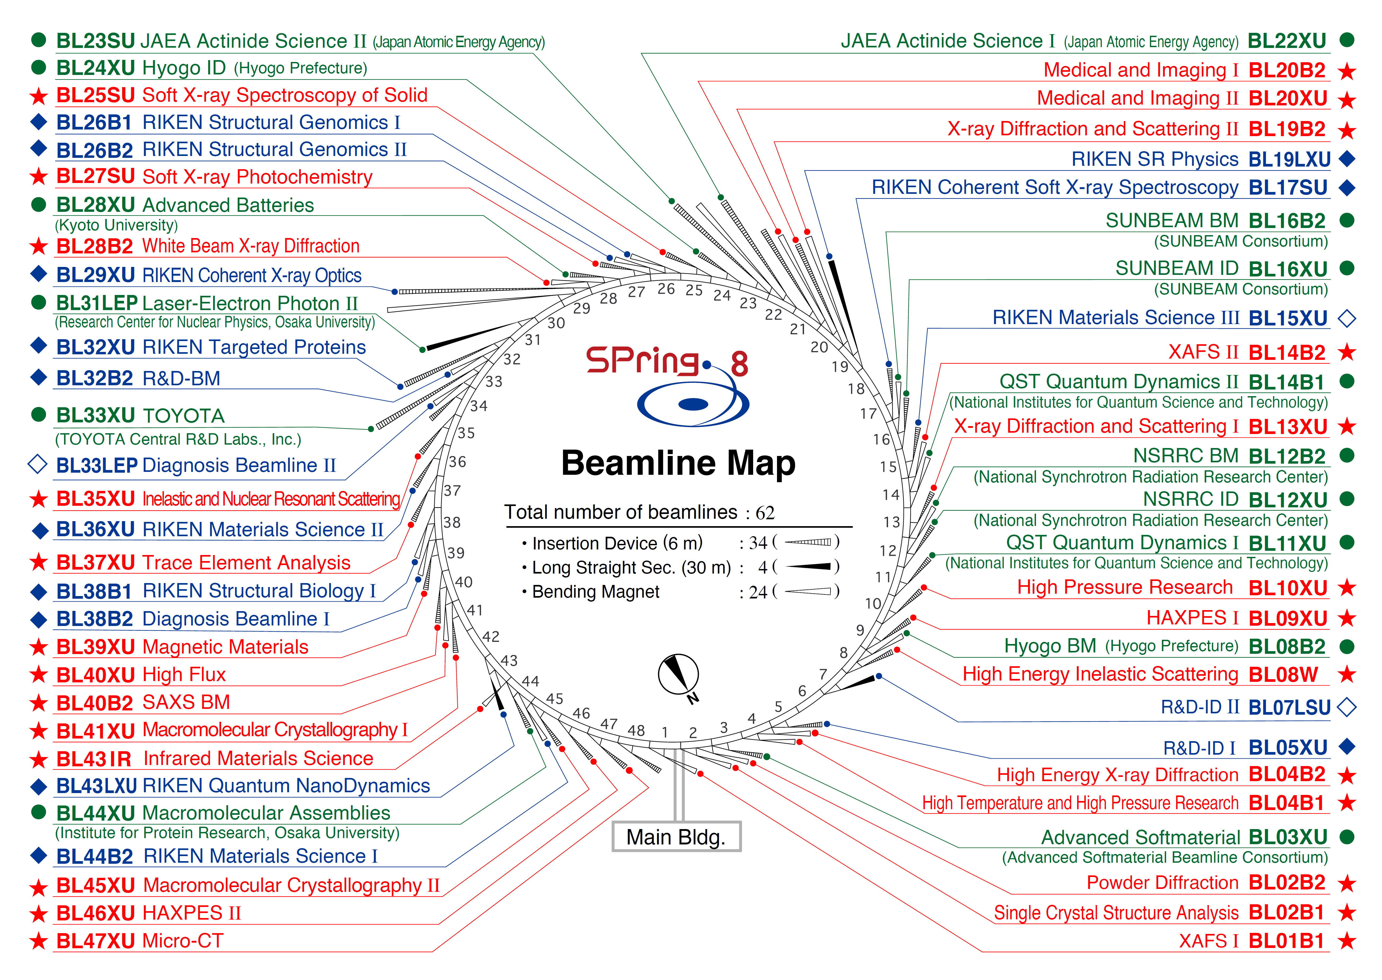
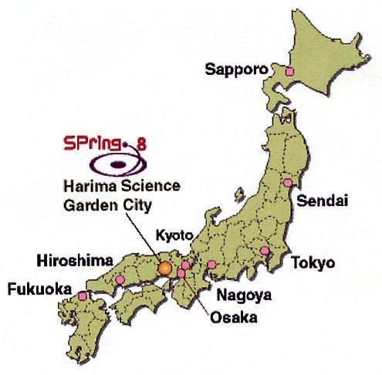
SPring-8 LEPS2 Project
LEPS Beamline
(1999∼2021)
LEPS2 Beamline (2013∼)
SPring-8
8GeV e⁻ 100mA
457 m
1 / 26

Slide 4
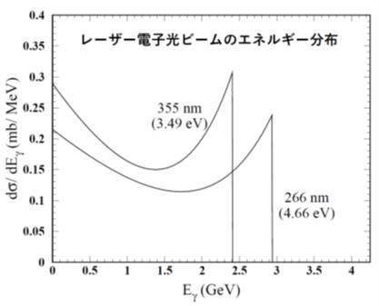

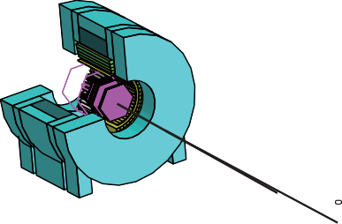


LEPS2 Beamline
NIM A 1033 (2022) 166677
Laser Compton
Scattering
Compton edge
8 GeV electron
Recoil electron
(Tagger)
${dσ}/{dE_{γ}}$ [mb/MeV]
1.3<E_{γ}<2.4 GeV
Storage
ring
Bending magnet
UltraViolet laser
355 nm (3.5 eV)
Tagged event by event.
Front-end
photon energy [GeV]
Ring tunnel
Long straight
section
Max. 2.4 GeV photon beam
31.5 m
∼130 m
Storage ring
building
Laser injection
room
18 m
Photon beam intensity : ≈2M cps
by injecting multiple lasers.
10 m
LEPS2 experimental
building
Beam
dump
12 m
2 / 26

Slide 5
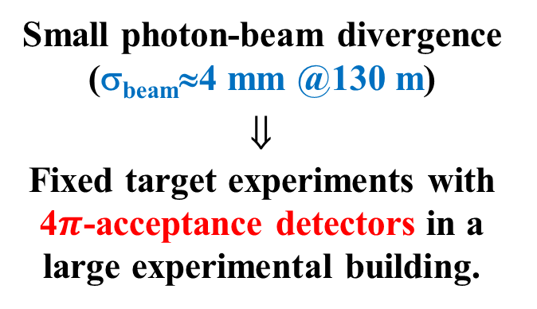
LEPS2 Beamline
NIM A 1033 (2022) 166677
Laser Compton
Scattering
Small photon-beam divergence (σ_{beam}≈4 mm @130 m)
⇓
Fixed target experiments with 4$π$-acceptance detectors in a large experimental building.
8 GeV electron
Recoil electron
(Tagger)
Storage
ring
Bending magnet
UltraViolet laser
355 nm (3.5 eV)
Front-end
Ring tunnel
Long straight
section
Max. 2.4 GeV photon beam
31.5 m
∼130 m
Storage ring
building
Laser injection
room
18 m
Photon beam intensity : ≈2M cps
by injecting multiple lasers.
10 m
LEPS2 experimental
building
Beam
dump
12 m
2 / 26

Slide 6
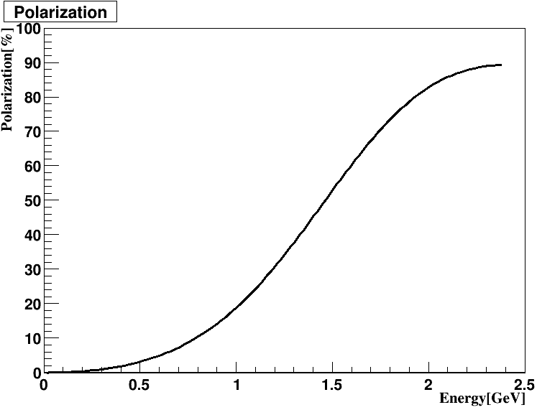
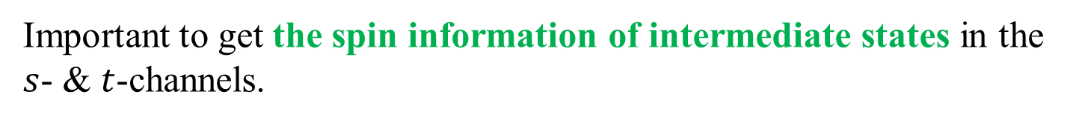



Linear polarization
Laser Compton Scattering
100
80
60
40
20
0
Linear Polarization $[\%]$
1.3<E_{γ}<2.4 GeV
0 0.5 1 1.5 2 2.5
$$E_{γ}[GeV]$$
Important to get the spin information of intermediate states in the $s$- & $t$-channels.
γ beam
γ beam
meson
meson
$N^{∗}$ or $Δ^{∗}$
meson exchange
p target
recoil p
recoil p
p target
3 / 26

Slide 7
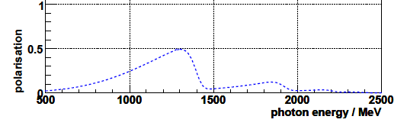
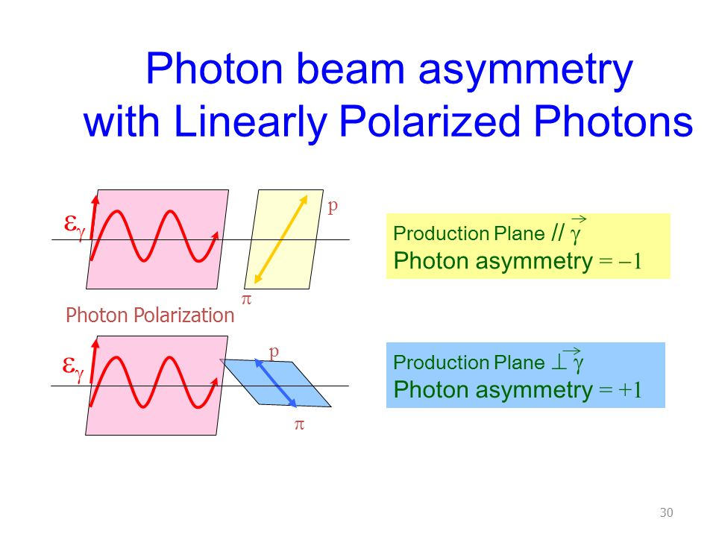

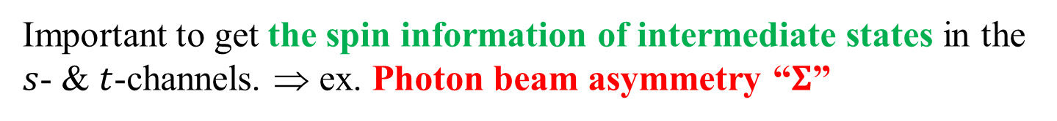

Linear polarization
Laser Compton Scattering
Coherent Brems. [EPJA33 (2009) 147.]
100
80
60
40
20
0
100
80
60
40
20
0
The LEPS2 beamline is unique over the world.
polarization $≈10\%$
at $E_{γ}≳1.5$ GeV
Linear Polarization $[\%]$
Linear Polarization $[\%]$
1.3<E_{γ}<2.4 GeV
0 0.5 1 1.5 2 2.5
0.5 1 1.5 2 2.5
$$E_{γ}[GeV]$$
$$E_{γ}[GeV]$$
Important to get the spin information of intermediate states in the $s$- & $t$-channels. ⇒ ex. Photon beam asymmetry “$Σ$”
p
p
meson
meson
Σ = −1
Σ = +1
3 / 26

Slide 8
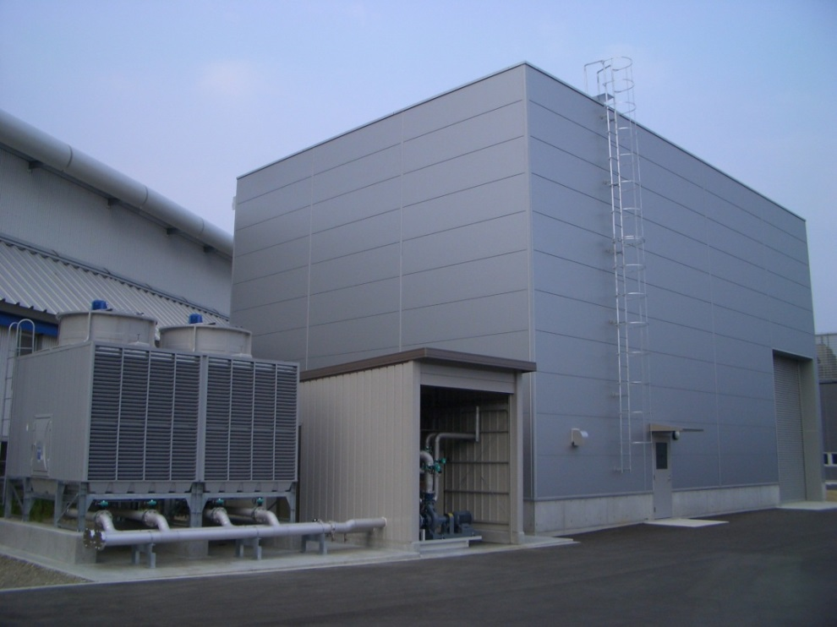
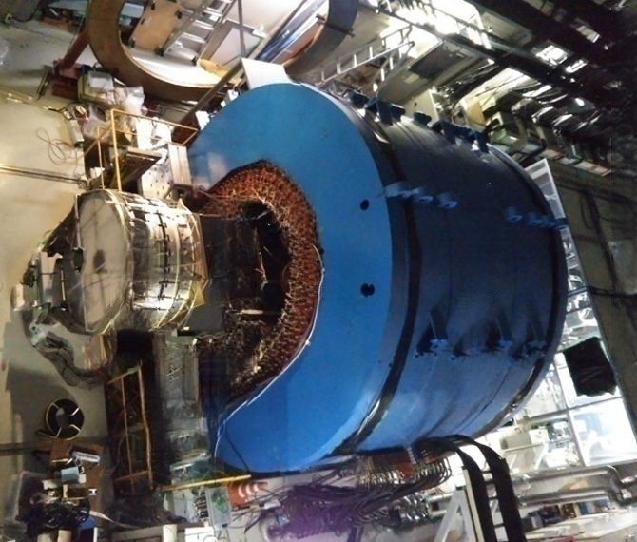
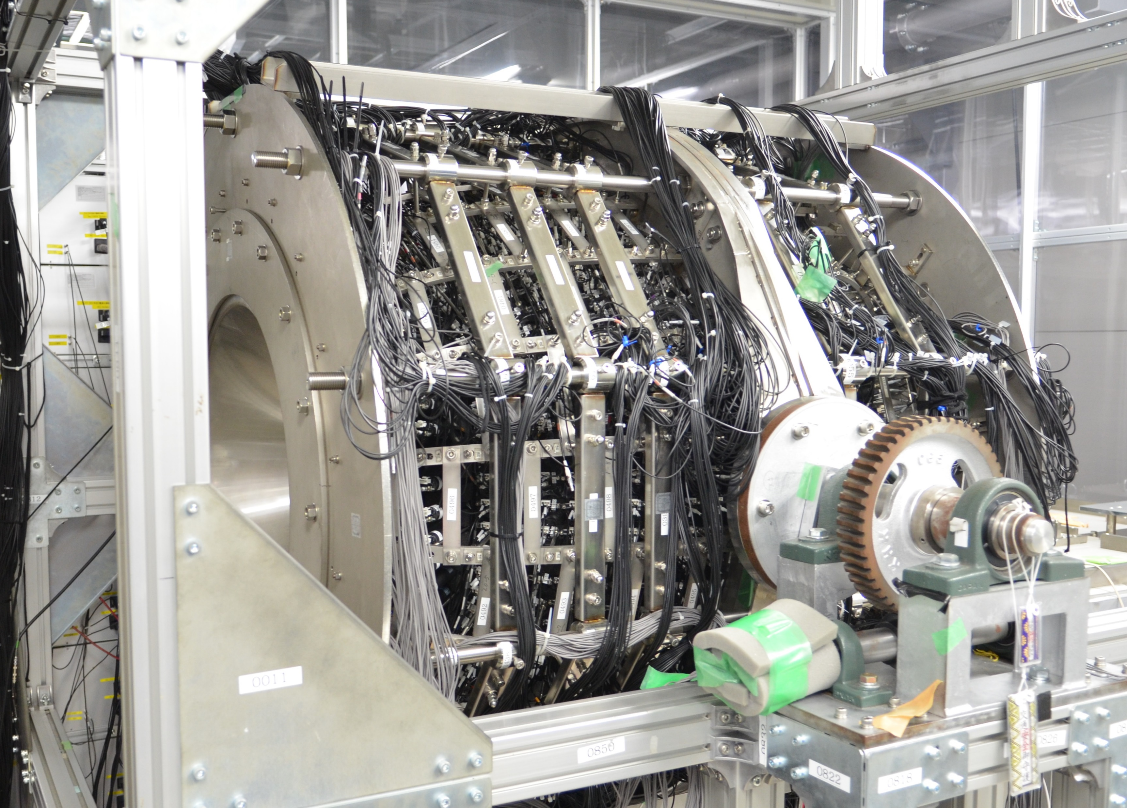
LEPS2 experimental setup
SPring-8 ring building
Two detector systems are alternately operated with individual fixed targets for various hadron photoproduction experiments.
LEPS2 Exp. Bldg.
(12 m x 18 m)
LEPS2 Solenoid Spectrometer
Mainly for detecting neutral particles.
E.M. Calorimeter “BGOegg”
Mainly for detecting charged particles.
4 / 26

Slide 9
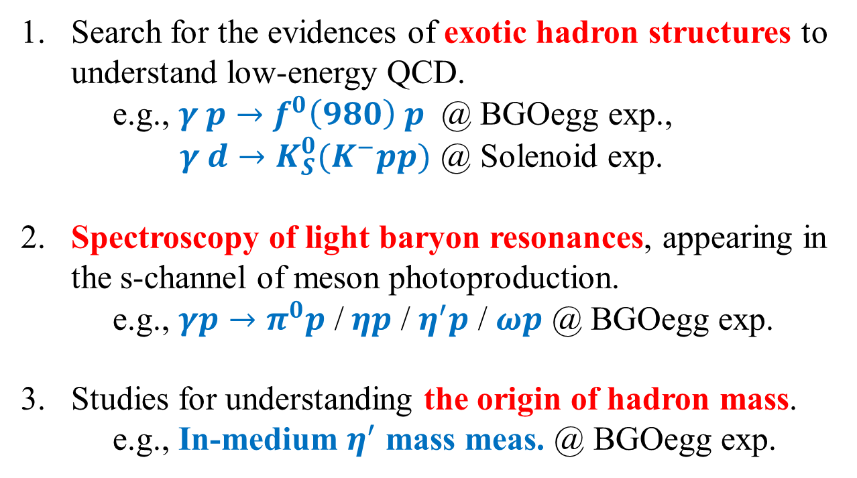
Physics subjects in LEPS2 project
1. Search for the evidences of exotic hadron structures to
understand low-energy QCD.
e.g., $γ p→f^{0}\left(980\right) p$ @ BGOegg exp.,
$γ d→K_{S}^{0}(K^{−}pp)$ @ Solenoid exp.
2. Spectroscopy of light baryon resonances, appearing in
the s-channel of meson photoproduction.
e.g., $γp→π^{0}p$ / $ηp$ / $η^{′}p$ / $ωp$ @ BGOegg exp.
3. Studies for understanding the origin of hadron mass.
e.g., In-medium $η^{′}$ mass meas. @ BGOegg exp.
5 / 26

Slide 10
Recent results from LEPS2/BGOegg experiment (18 pages)

Slide 11
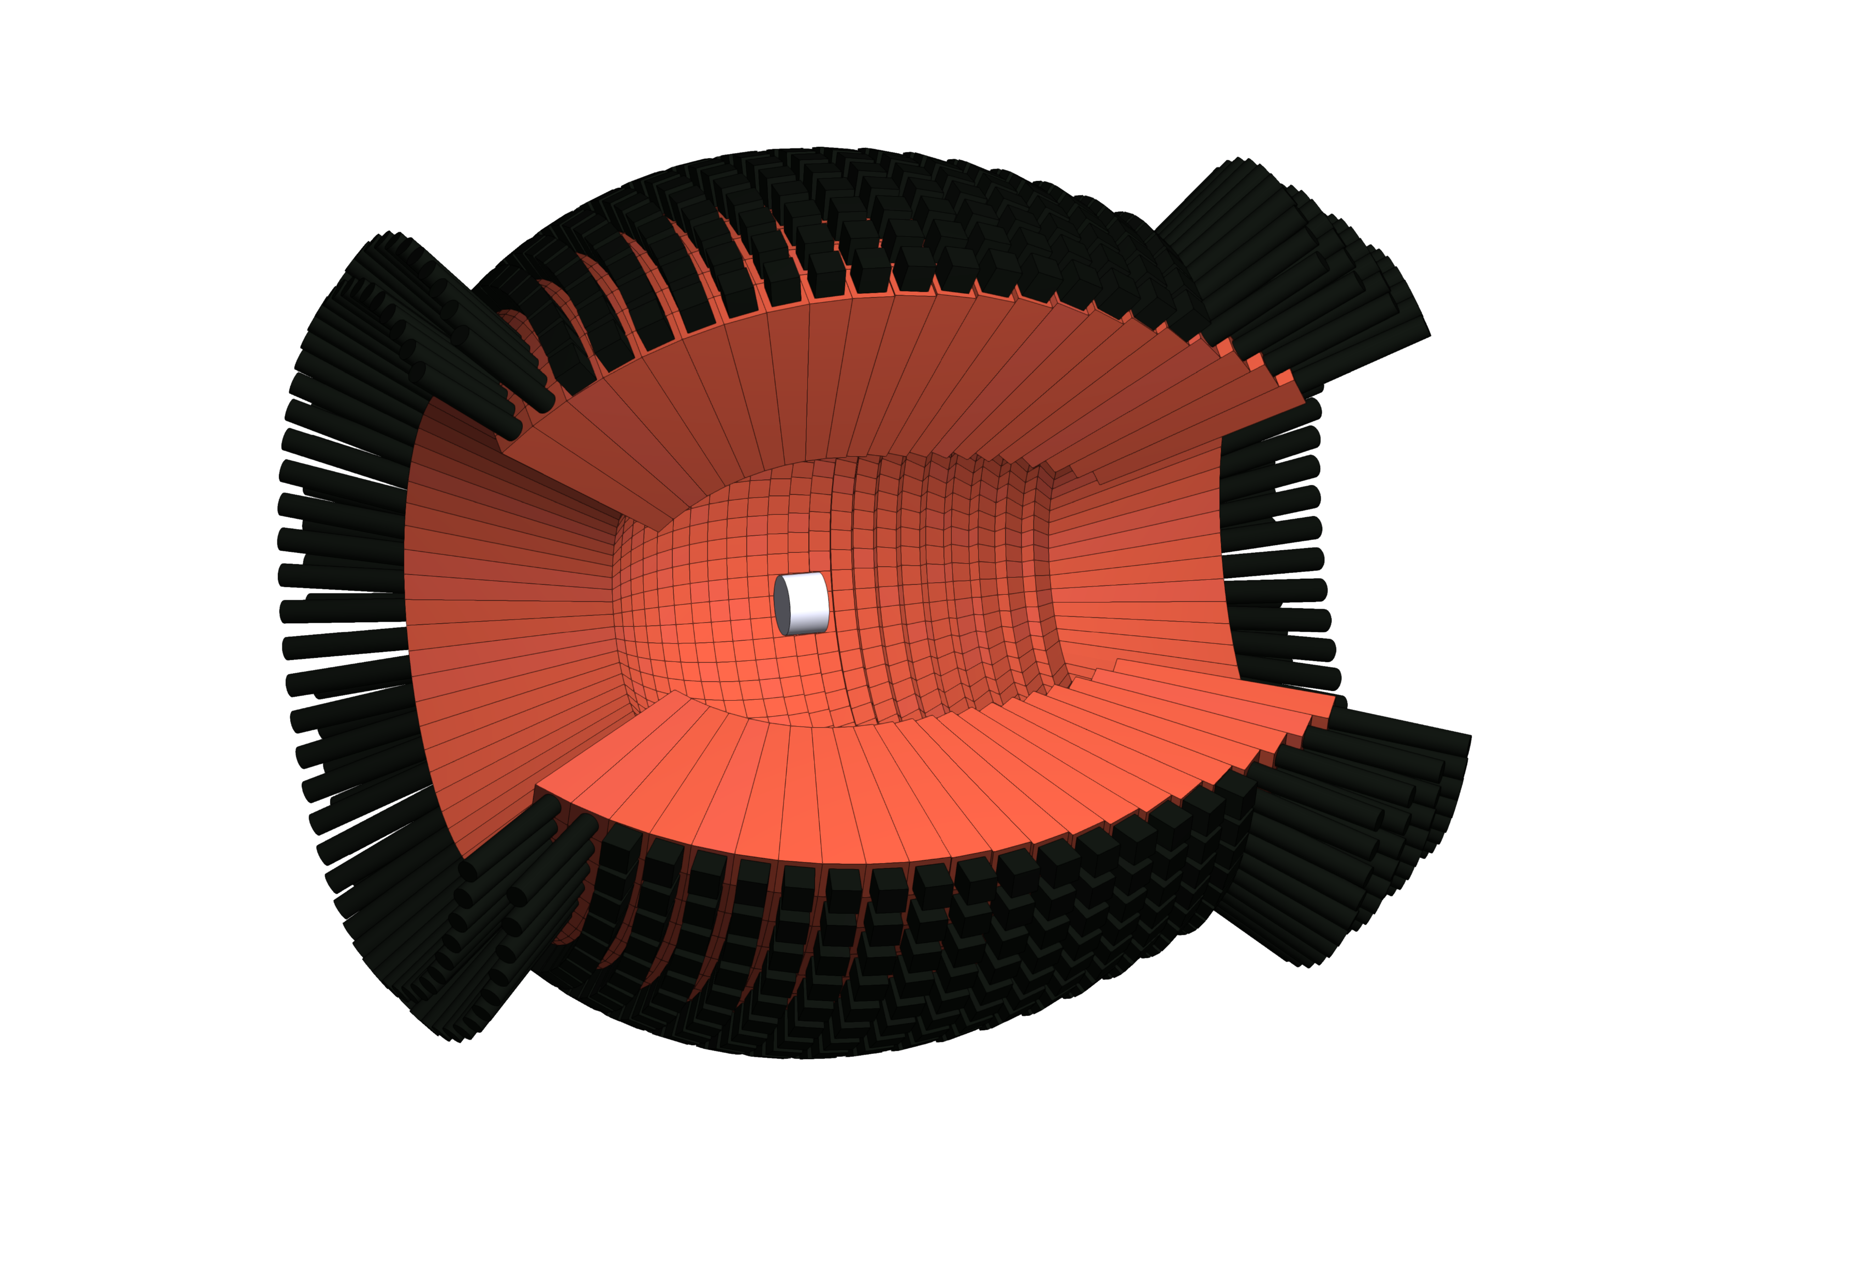
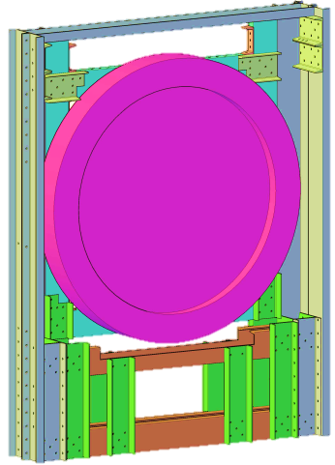
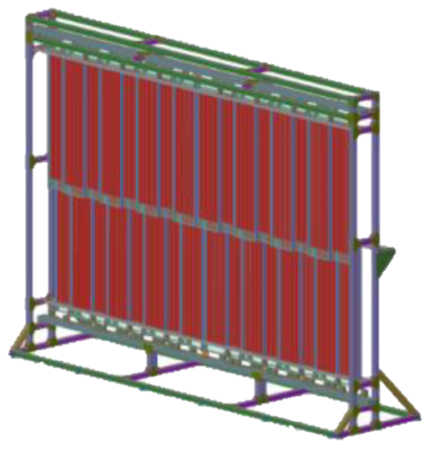
BGOegg experiment (2014~)
Target : LH₂ (54 mm) or Carbon (20 mm)
θ_{p}<22°
θ_{p}<7°
Inner Plastic
Scintillators
for charge ID
γ
proton
1.3 - 2.4 GeV
photon beam
@ LEPS2
γ
Drift Chamber
z = 1.6m
Resistive Plate Chamber
(ToF meas. for protons)
z = 12.5 m
BGOegg calorimeter
Covering 24°<θ_{γ}<144° by 1320 BGO crystals.
6 / 26

Slide 12
BGOegg experiment (2014~)
Target : LH₂ (54 mm) or Carbon (20 mm)
θ_{p}<22°
θ_{p}<7°
π⁰ (σ=6.7 MeV/c²)
Inner Plastic
Scintillators
for charge ID
γ
η (σ=14.4 MeV/c²)
ω (1γ missing)
counts / 4 MeV
proton
η’
1.3 - 2.4 GeV
photon beam
@ LEPS2
γ
Carbon (20 mm)
Drift Chamber
z = 1.6m
Resistive Plate Chamber
(ToF meas. for protons)
z = 12.5 m
BGOegg calorimeter
Covering 24°<θ_{γ}<144° by 1320 BGO crystals.
2γ invariant mass (MeV/c²)
World’s highest performance for the energies around 1 GeV or less.
6 / 26

Slide 13



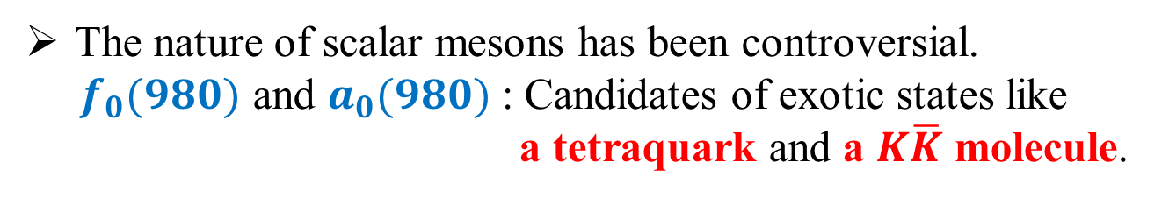








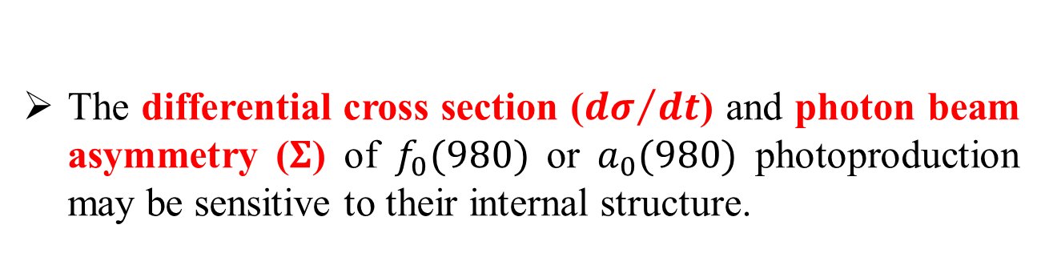



Photoproduction of scalar mesons
The nature of scalar mesons has been controversial.
$f_{0}(980)$ and $a_{0}(980)$ : Candidates of exotic states like
a tetraquark and a $K\overline{K}$ molecule.
The differential cross section (${dσ}/{dt}$) and photon beam asymmetry ($Σ$) of $f_{0}(980)$ or $a_{0}(980)$ photoproduction may be sensitive to their internal structure.
Theoretical prediction
in PRC93 (2016) 025203
No Structure
$$γ$$
$$f_{0}$$
${3.0<E}_{γ}<3.8$ GeV
$$vector meson$$
CLAS meas.
$$p$$
$$p$$
$\frac{dσ}{dt}$ [μb/GeV²]
Kaon Loop
$$γ$$
$$f_{0}$$
$$f_{0}\left(980\right)→π^{+}π^{−}$$
$$vector meson$$
$−t$ [GeV²]
$$p$$
$$p$$
7 / 26

Slide 14


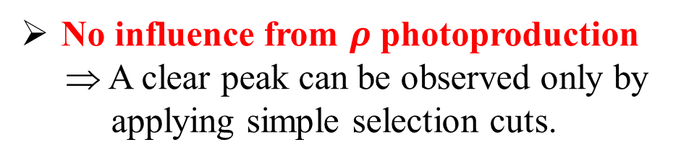
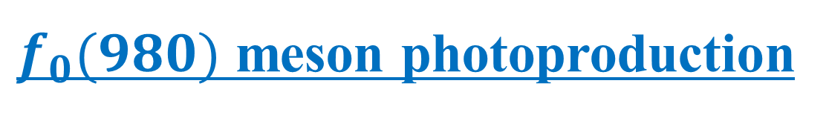


$f_{0}(980)$ meson photoproduction
[PRC 107 (2023) L042201]
π⁰p
$E_{γ}>$ 1450 MeV
$γp→f_{0}\left(980\right)p→π^{0}π^{0}p→4γp$
No influence from $ρ$ photoproduction
⇒ A clear peak can be observed only by
applying simple selection cuts.
N*s
Δ(1232)
First measurement of $Σ$ in any decay
mode and $\frac{dσ}{dt}$ in the $π^{0}π^{0}$ decay mode.
CLAS [PRL102(2009)102001]
π⁺π⁻ P-wave
2110 < W < 2320 MeV
1898 < W < 2110 MeV
ρ⁰
π⁰π⁰
f₀(980)
π⁰π⁰
f₀(980)
π⁺π⁻ S-wave
$f_{0}$(980)
8 / 26

Slide 15


Differential cross section of γp→$f_{0}$(980)p→π⁰π⁰p
● : without 1σ N* cuts, □ : with 1σ N* cuts
$$\frac{dσ}{dΩ}$$
1898<W<2110 MeV
$$\frac{dσ}{dt}$$
1898<W<2110 MeV
2110<W<2320 MeV
2110<W<2320 MeV
Forward enhancement of $\frac{dσ}{dΩ}$ is seen at the higher energy region.
9 / 26

Slide 16

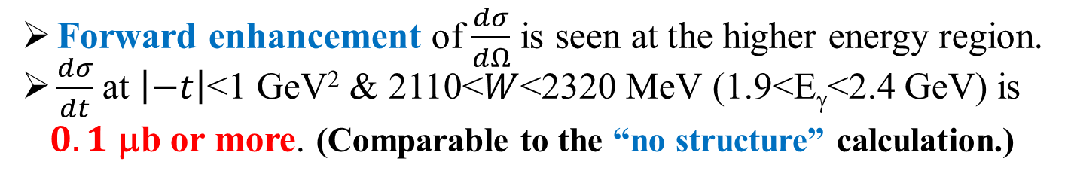




Differential cross section of γp→$f_{0}$(980)p→π⁰π⁰p
● : without 1σ N* cuts, □ : with 1σ N* cuts
$$\frac{dσ}{dΩ}$$
1898<W <2110 MeV
$$\frac{dσ}{dt}$$
1898<W <2110 MeV
PRC93 (2016) 025203
No Structure Model
2110<W <2320 MeV
2110<W <2320 MeV
$E_{γ}=3.5$ GeV
$\frac{dσ}{dt}$ [μb/GeV²]
$5.0$ GeV
$$f_{0}\left(980\right)→π^{0}π^{0}$$
$9.0$ GeV
$−t$ [GeV²]
Forward enhancement of $\frac{dσ}{dΩ}$ is seen at the higher energy region.
$\frac{dσ}{dt}$ at $\left|−t\right|$<1 GeV² & 2110<$W$<2320 MeV (1.9<E_{γ}<2.4 GeV) is
$0.1$ μb or more. (Comparable to the “no structure” calculation.)
9 / 26

Slide 17
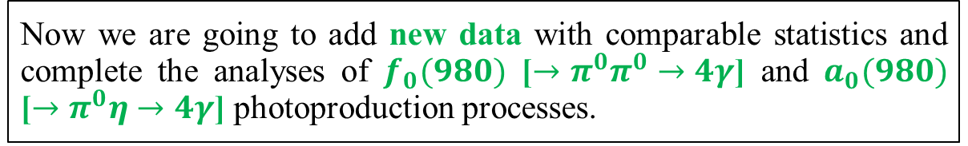
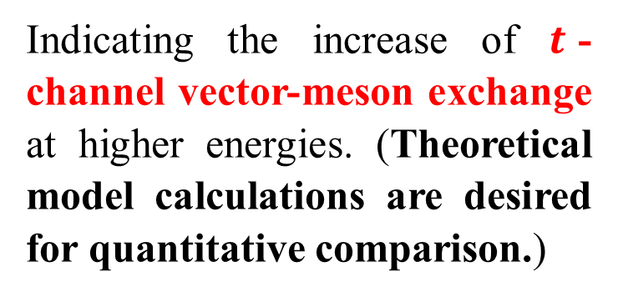
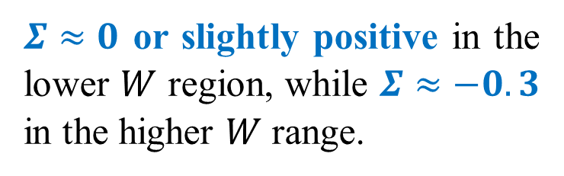

Photon Beam Asymmetry Σ
● : without 1σ N* cuts, □ : with 1σ N* cuts
$Σ≈0$ or slightly positive in the lower $W$ region, while $Σ≈−0.3$ in the higher $W$ range.
$$Σ$$
1898<W <2110 MeV
2110<W <2320 MeV
Indicating the increase of $t$-channel vector-meson exchange at higher energies. (Theoretical model calculations are desired for quantitative comparison.)
Now we are going to add new data with comparable statistics and complete the analyses of $f_{0}(980)$ [$→π^{0}π^{0}→4γ$] and $a_{0}(980)$ [$→π^{0}η→4γ$] photoproduction processes.
10 / 26

Slide 18
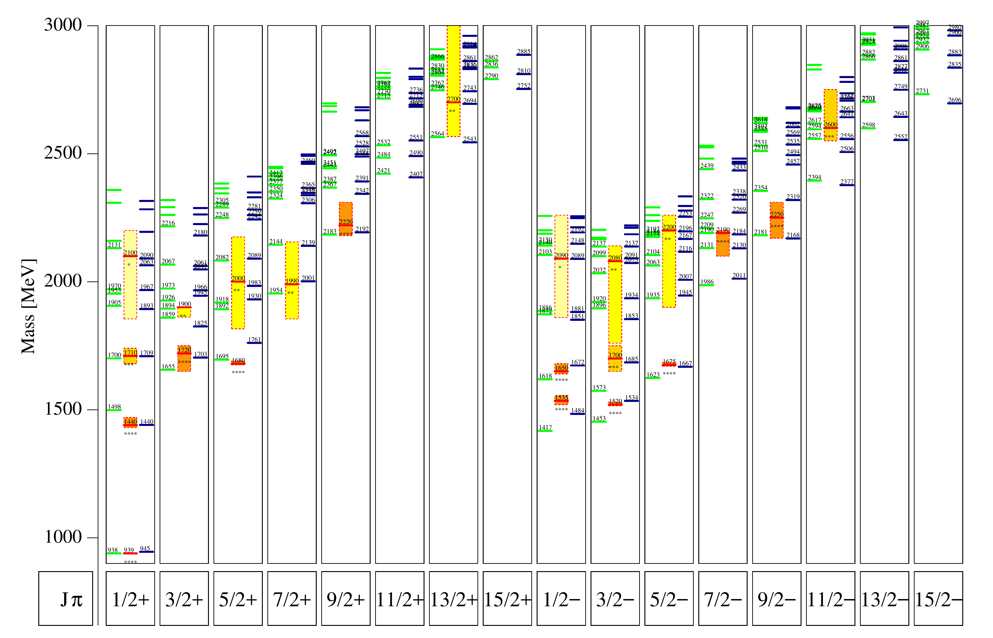
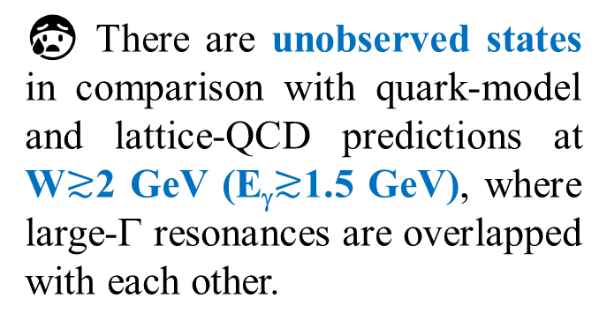
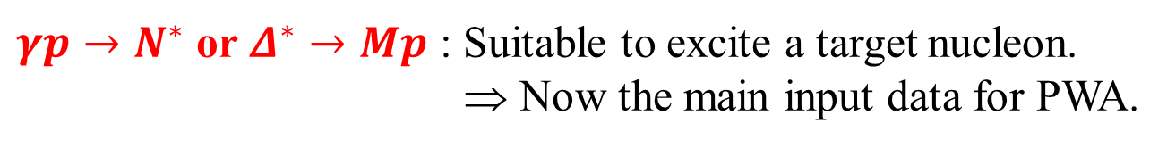
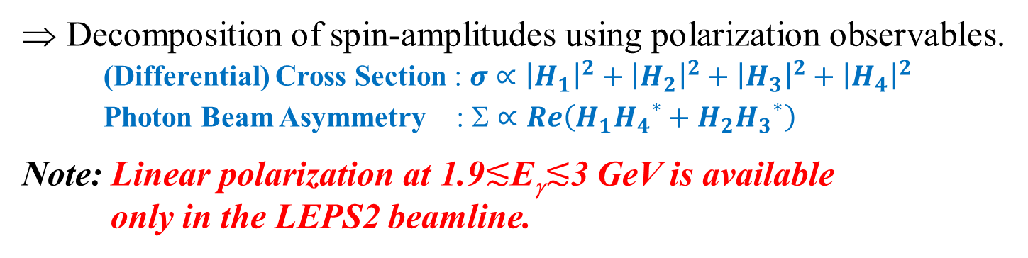
Light baryon spectroscopy
$γp→N^{∗}$ or $Δ^{∗}→Mp$ : Suitable to excite a target nucleon.
⇒ Now the main input data for PWA.
EPJA47 (2011) 162
3000
2500
2000
1500
1000
experiment
😰 There are unobserved states in comparison with quark-model and lattice-QCD predictions at W$≳$2 GeV (E_{γ}$≳$1.5 GeV), where large-Γ resonances are overlapped with each other.
Mass [MeV]
Quark model
calculations
N*
J^{P}
⇒ Decomposition of spin-amplitudes using polarization observables.
(Differential) Cross Section : $σ∝{\left|H_{1}\right|}^{2}+{\left|H_{2}\right|}^{2}+{\left|H_{3}\right|}^{2}+{\left|H_{4}\right|}^{2}$
Photon Beam Asymmetry : $∝Re\left(H_{1}{H_{4}}^{∗}+H_{2}{H_{3}}^{∗}\right)$
Note: Linear polarization at 1.9$≲$E_{γ}$≲$3 GeV is available
only in the LEPS2 beamline.
11 / 26

Slide 19
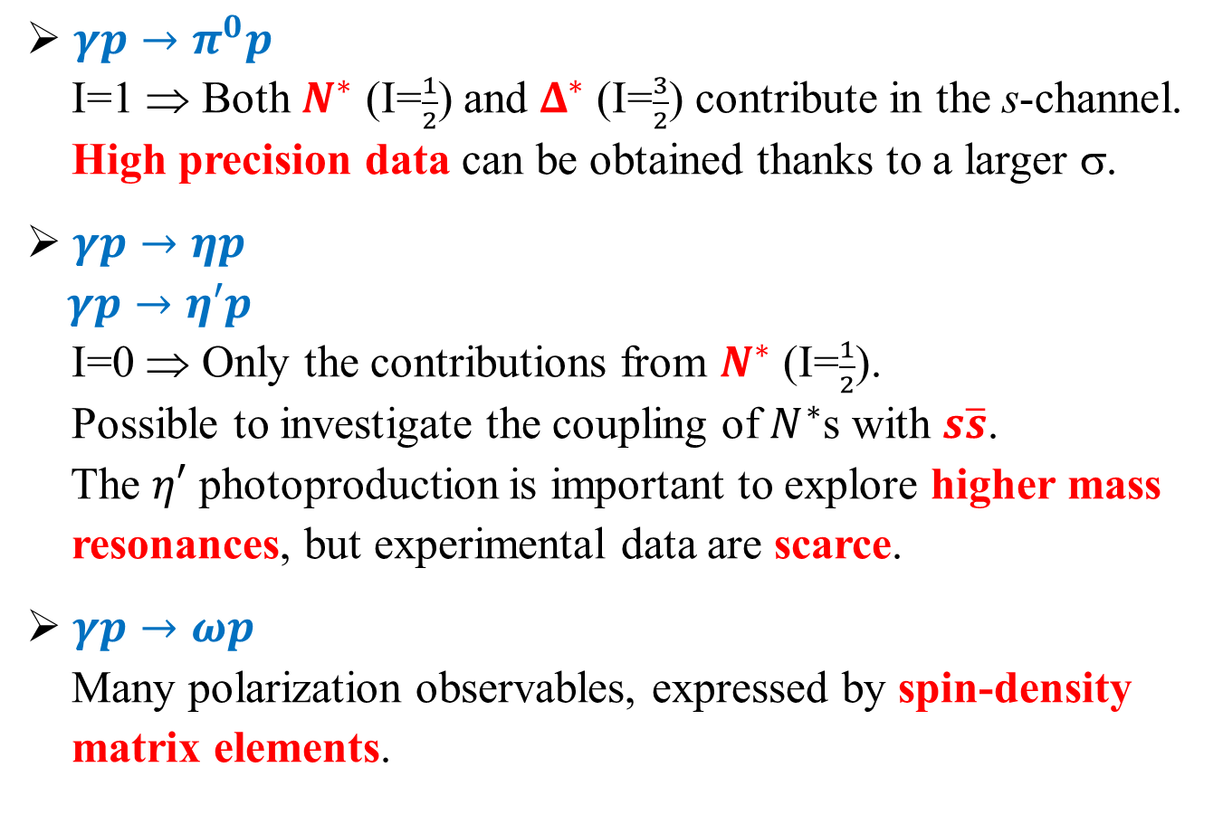
Single meson photoproduction
$γp→π^{0}p$
I=1 ⇒ Both $N^{∗}$ (I=$\frac{1}{2}$) and $Δ^{∗}$ (I=$\frac{3}{2}$) contribute in the s-channel.
High precision data can be obtained thanks to a larger σ.
$γp→ηp$
$γp→η′p$
I=0 ⇒ Only the contributions from $N^{∗}$ (I=$\frac{1}{2}$).
Possible to investigate the coupling of $N^{∗}$s with $s\overline{s}$.
The $η′$ photoproduction is important to explore higher mass
resonances, but experimental data are scarce.
$γp→ωp$
Many polarization observables, expressed by spin-density
matrix elements.
PRC 100 (2019) 055202
PRC 106 (2022) 035201
In progress
Isospin filter
PRC 102 (2020) 025201
12 / 26

Slide 20
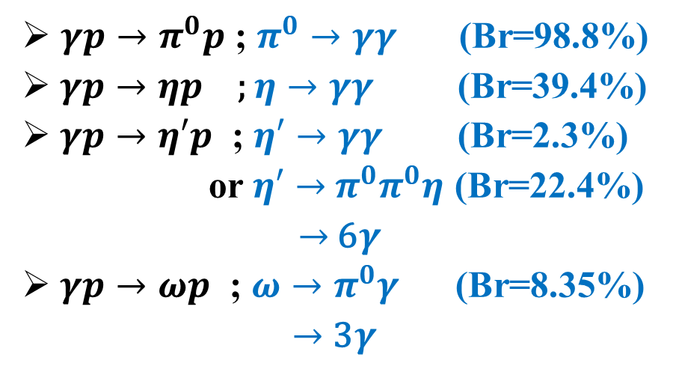
Single meson photoproduction
$γp→π^{0}p$ ; $π^{0}→γγ$ (Br=98.8%)
$γp→ηp$ ; $η→γγ$ (Br=39.4%)
$γp→η′p$ ; $η′→γγ$ (Br=2.3%)
or $η′→$ $π^{0}π^{0}η$ (Br=22.4%)
$→$ 6$γ$
$γp→ωp$ ; $ω→π^{0}γ$ (Br=8.35%)
$→$ 3$γ$
BGOegg calorimeter
LH₂ target
UpVeto
γ
21°
γ
p
z=0 m
1.28 m
Detection of all the final-state products
γ’s @ BGOegg & a proton @ DC or BGOegg
⇒ Kinematic fit with the constraints of
4-momentum cons. & π⁰ / η mass.
γ
Inner
Plastic
Scintillators
z=1.6 m
21°
Drift
Chamber
13 / 26

Slide 21
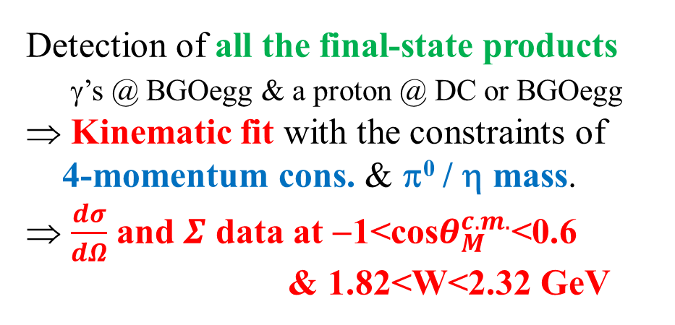
Single meson photoproduction
$γp→π^{0}p$ ; $π^{0}→γγ$ (Br=98.8%)
$γp→ηp$ ; $η→γγ$ (Br=39.4%)
$γp→η′p$ ; $η′→γγ$ (Br=2.3%)
or $η′→$ $π^{0}π^{0}η$ (Br=22.4%)
$→$ 6$γ$
$γp→ωp$ ; $ω→π^{0}γ$ (Br=8.35%)
$→$ 3$γ$
η′→γγ
σ=10.5 MeV
M(γγ) [MeV/c²]
η′→π⁰π⁰η
Detection of all the final-state products
γ’s @ BGOegg & a proton @ DC or BGOegg
⇒ Kinematic fit with the constraints of
4-momentum cons. & π⁰ / η mass.
⇒ $\frac{dσ}{dΩ}$ and $Σ$ data at −1<cos$θ_{M}^{c.m.}$<0.6
& 1.82<W<2.32 GeV
σ=6.3 MeV
M(π⁰π⁰η) [MeV/c²]
13 / 26

Slide 22
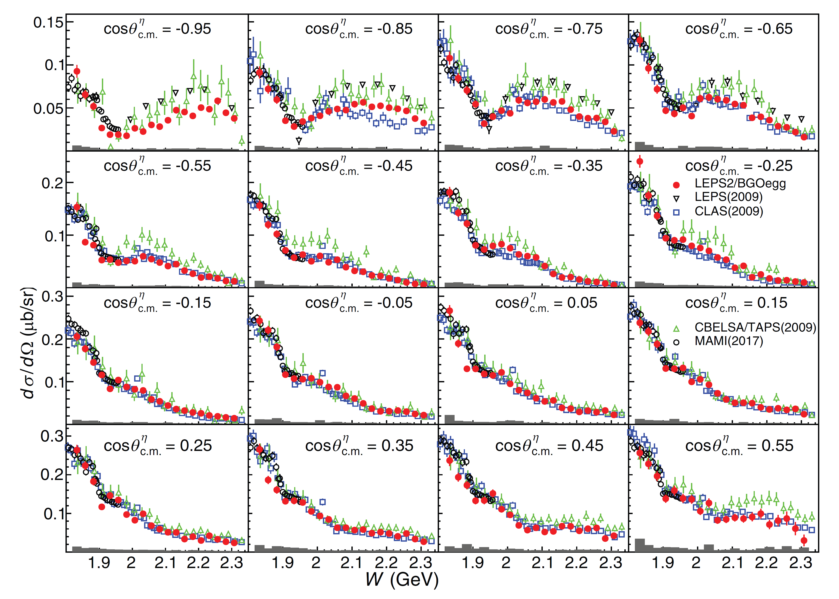
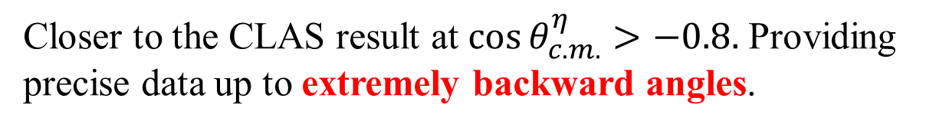
Differential Cross Section of γp→ηp
20 energy bins for 1820<$\sqrt{s}$<2320 MeV & 16 polar angle bins for −1.0<$\cos{θ_{η}^{CM}}$<0.6
Enhancement at higher energies.
Closer to the CLAS result at $\cos{θ_{c.m.}^{η}}>−0.8.$ Providing precise data up to extremely backward angles.
14 / 26

Slide 23




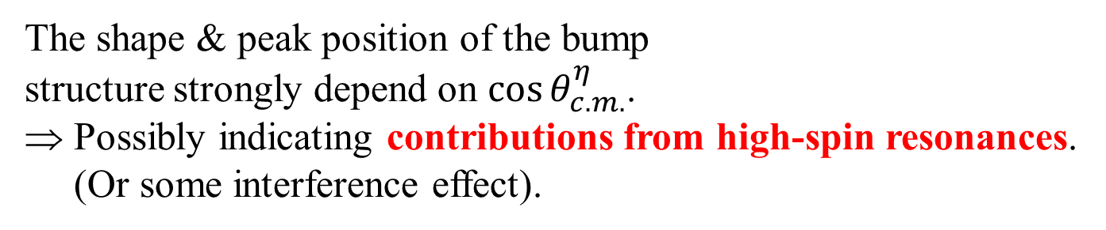
Differential Cross Section of γp→ηp
$$γp→ηp$$
$$γp→π^{0}p$$
N(1895) ${\frac{1}{2}}^{−}$ contribution &
the opening of η′p decays
$$γp→ωp$$
The shape & peak position of the bump
structure strongly depend on $\cos{θ_{c.m.}^{η}}$.
⇒ Possibly indicating contributions from high-spin resonances.
(Or some interference effect).
15 / 26

Slide 24


Photon Beam Asymmetry of γp→π⁰p
2200 < E_{γ} < 2300 GeV
●: this work (BGOegg), ✞：LEPS [PLB657 (2007) 32], ★：Daresbury [NPB104(1976)253]
Σ
1
Σ
1
0.5
0.5
0
0
−0.5
PWA models
⎯⎯ : Bonn-Gatchina
⎯⎯ : GWU SAID
−0.5
⎯⎯ : SAID L≤4
⎯⎯ : SAID L≤5
−1
−1
−1
0
1
−1
0
1
$$\cos{θ_{π^{0}}^{c.m.}}$$
$$\cos{θ_{π^{0}}^{c.m.}}$$
The existing PWA models deviate from our new data at higher energies.
The backward dip structure comes from a higher multipole amplitude (M₅₋),
which corresponds to high spin resonances (H₁₉ & H₃₉ with J^{P}=9/2⁺).
16 / 26

Slide 25




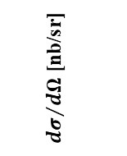


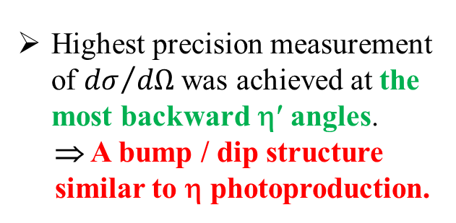
New results for $γp→η′p$
● BGOegg $η′→2γ$ ● BGOegg $η′→π^{0}π^{0}η→6γ$
Differential cross section
Photon beam asymmetry
200
100
200
100
0
$$\cos{θ_{η′}^{c.m.}}=−0.7$$
$$\cos{θ_{η′}^{c.m.}}=−0.9$$
Preliminary
${dσ}/{dΩ}$ [nb/sr]
$$\cos{θ_{η′}^{c.m.}}=−0.5$$
$$\cos{θ_{η′}^{c.m.}}=−0.3$$
1800 2000 2200 2000 2200 2400
Preliminary
$E^{c.m.}$ [MeV]
Highest precision measurement of ${dσ}/{dΩ}$ was achieved at the most backward η′ angles.
⇒ A bump / dip structure
similar to η photoproduction.
□ CLAS 2017 [PLB771, 213]
★ Graal 2015 W=1903 MeV
♢ Graal 2015 W=1912 MeV
[EPJA51 77]
17 / 26

Slide 26



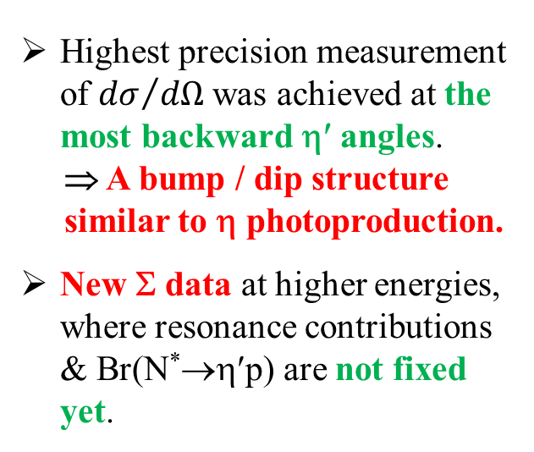
New results for $γp→η′p$
● BGOegg $η′→2γ$ ● BGOegg $η′→π^{0}π^{0}η→6γ$
Differential cross section
Photon beam asymmetry
200
100
200
100
0
PRC73 (2006) 045211.
$$\cos{θ_{η′}^{c.m.}}=−0.9$$
$$\cos{θ_{η′}^{c.m.}}=−0.7$$
1
0
−1
0
−1
Preliminary
${dσ}/{dΩ}$ [nb/sr]
$$\cos{θ_{η′}^{c.m.}}=−0.5$$
$$\cos{θ_{η′}^{c.m.}}=−0.3$$
$$Σ$$
1800 2000 2200 2000 2200 2400
Preliminary
$E^{c.m.}$ [MeV]
Highest precision measurement of ${dσ}/{dΩ}$ was achieved at the most backward η′ angles.
⇒ A bump / dip structure
similar to η photoproduction.
New Σ data at higher energies, where resonance contributions & Br(N*→η′p) are not fixed yet.
−1 −0.5 0 0.5 1
$$\cos{θ_{η′}^{c.m.}}$$
□ CLAS 2017 [PLB771, 213]
★ Graal 2015 W=1903 MeV
♢ Graal 2015 W=1912 MeV
[EPJA51 77]
17 / 26

Slide 27
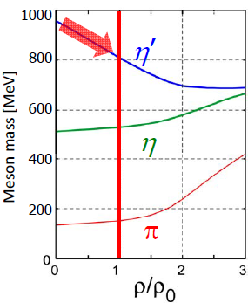
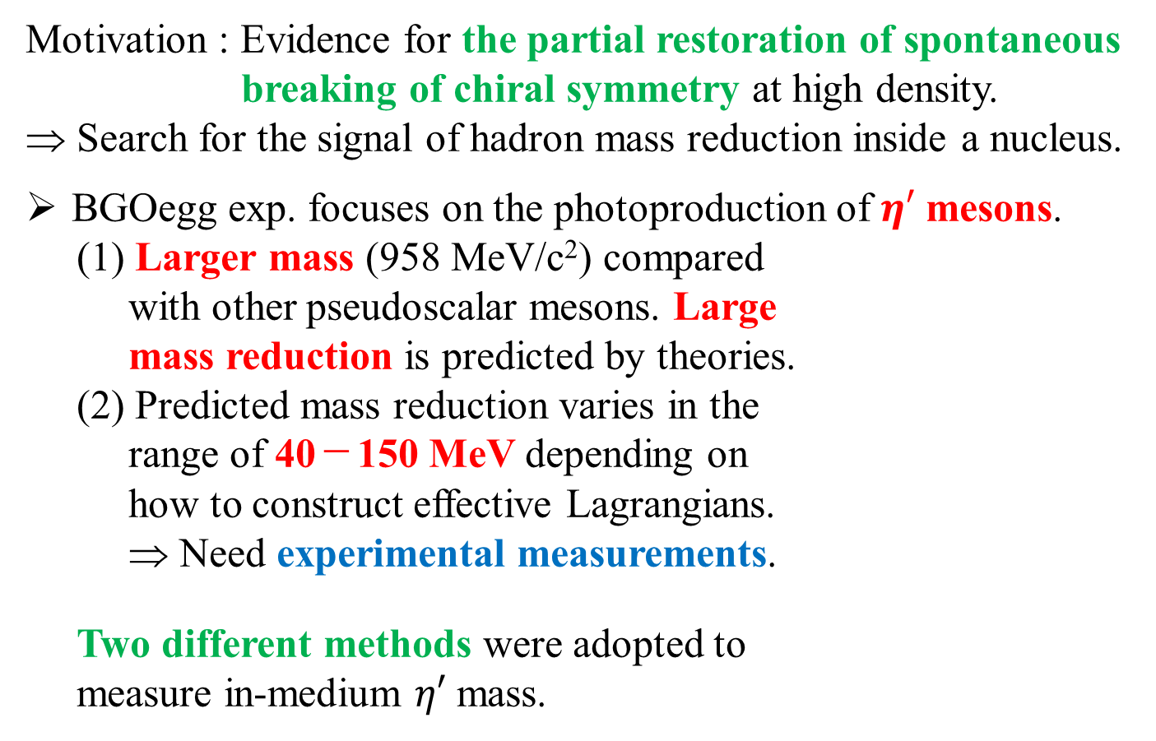
Studies for the origin of hadron mass
Motivation : Evidence for the partial restoration of spontaneous
breaking of chiral symmetry at high density.
⇒ Search for the signal of hadron mass reduction inside a nucleus.
BGOegg exp. focuses on the photoproduction of $η′$ mesons.
(1) Larger mass (958 MeV/c²) compared
with other pseudoscalar mesons. Large
mass reduction is predicted by theories.
(2) Predicted mass reduction varies in the
range of 40－150 MeV depending on
how to construct effective Lagrangians.
⇒ Need experimental measurements.
Two different methods were adopted to
measure in-medium $η′$ mass.
PRC74 (2006) 045203
18 / 26

Slide 28



BGOegg result (1) : η′ bound nuclei
$$γ+12C→η′⨂11B+p$$
PRL 124 (2020) 202501.
$E_{beam}$ meas.
rest mass
$P_{p}$ meas.
Excitation energy
E_{ex}−E₀ = MM_{12C(γ,p)}−M_{11B}−M_{η’}
PRC 74 (2006) 045203.
Signal amount
below threshold
19 / 26

Slide 29

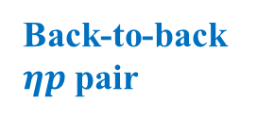
BGOegg result (1) : η′ bound nuclei
$$γ+12C→η′⨂11B+p$$
PRL 124 (2020) 202501.
1N absorption signal
$${η^{′}p→ηp→γγp}_{ }$$
Excitation energy
Simultaneously detected for better S/N, for the first time.
E_{ex}−E₀ = MM_{12C(γ,p)}−M_{11B}−M_{η’}
PRC 74 (2006) 045203.
γ
Back-to-back $ηp$ pair
η
p
γ
Signal amount
below threshold
η′
p
proton ID by the correlation of dE and kinetic energy
19 / 26

Slide 30
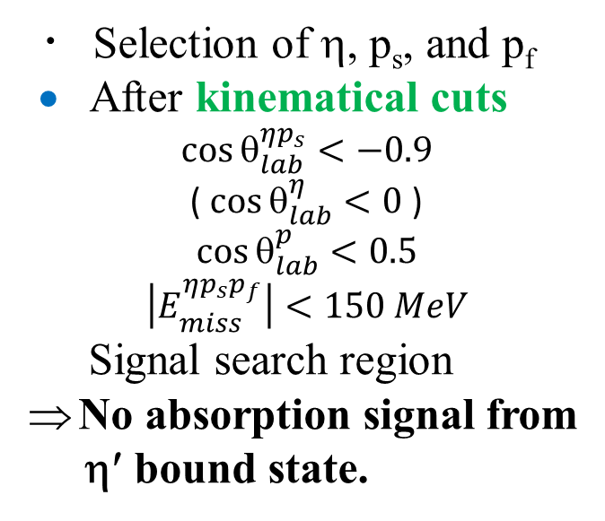

BGOegg result (1) : η′ bound nuclei
・ Selection of η, p_{s}, and p_{f}
• After kinematical cuts
$$\cos{θ_{lab}^{ηp_{s}}}<−0.9$$
( $\cos{θ_{lab}^{η}}<0$ )
$$\cos{θ_{lab}^{p}}<0.5$$
$$\left|E_{miss}^{ηp_{s}p_{f}}\right|<150 MeV$$
Signal search region
No absorption signal from
η′ bound state.
Upper limit : 2.2 nb/sr
BG: γ + ¹²C → p_{f} + η + ¹¹B
γ + ¹²C → p_{f} + η + π⁰ + ¹¹B
γ + ¹²C → p_{f} + η + π⁻ + ¹¹C
w/ secondary interaction of η/p_{f}/π⁻
Indicate $ΔM≪100$ MeV.
20 / 26

Slide 31

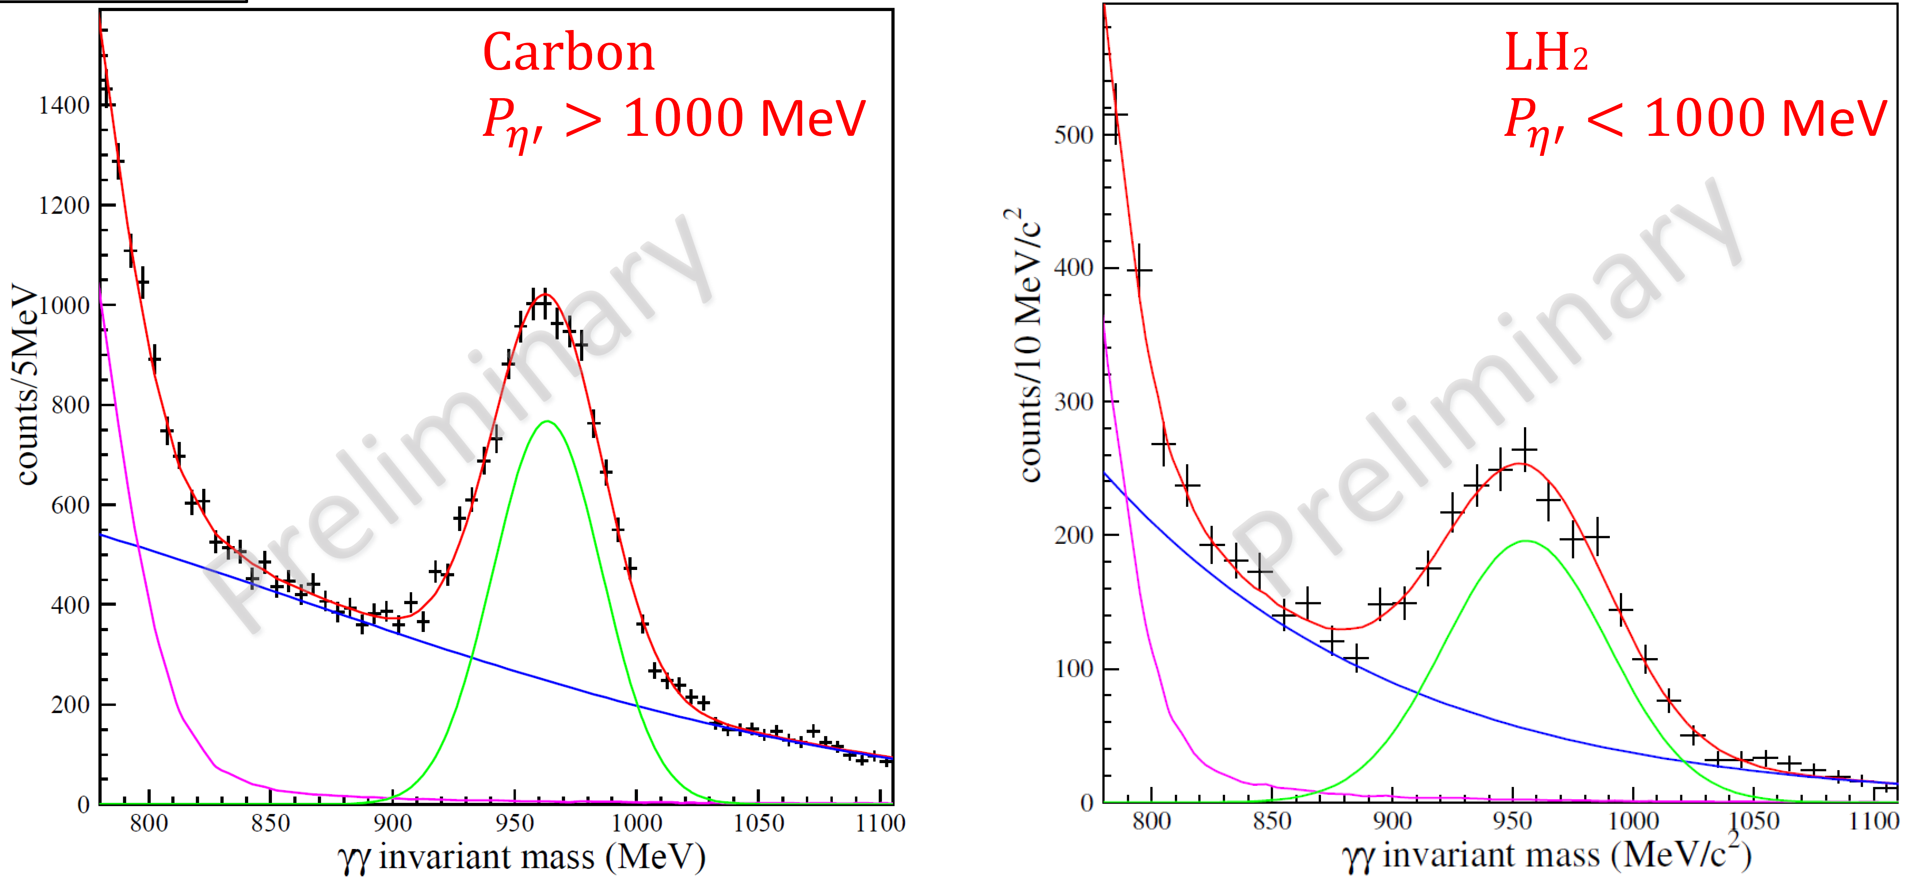
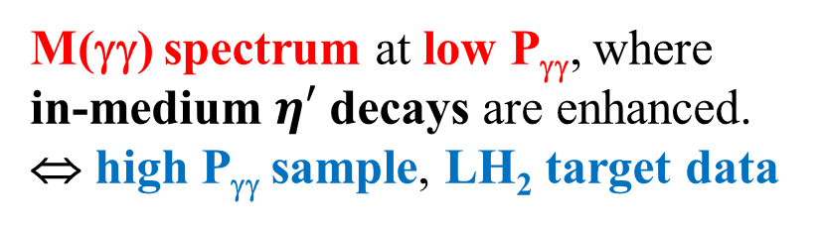

BGOegg result (2) : direct measurement
PhD Thesis of Tohoku Univ. (2021)
$$γC→η^{′}X→γγX$$
Nucleus
γ
M(γγ) spectrum at low P_{γγ}, where
in-medium $η′$ decays are enhanced.
⇔ high P_{γγ} sample, LH₂ target data
η′
γ
① Quasi-free η′ BG
Gaussian w/ fixed mass resolutions
② multi-π⁰ photoproduction BG
③ In-medium η′ signal
Simulation w/ various (k₁, k₂)
①
③
？
②
The use of a high resolution calorimeter is essential.
21 / 26

Slide 32
BGOegg result (2) : direct measurement
χ² difference test by comparing
the fits w/ & w/o a signal function.
Signal significance : 3.7σ
@ k₁ = 0.06 & k₂ = 125
(∼60 MeV) (∼25 MeV)
⇔ high P_{γγ} sample : 0.9σ
LH₂ target data : 0.6σ
Robust for several systematic
studies, but the significance is not
enough. We are examining new
data, that has similar statistics.
In addition, we started Phase-II experiment with high statistics &
low backgrounds from 2021 to confirm our observation.
22 / 26

Slide 33
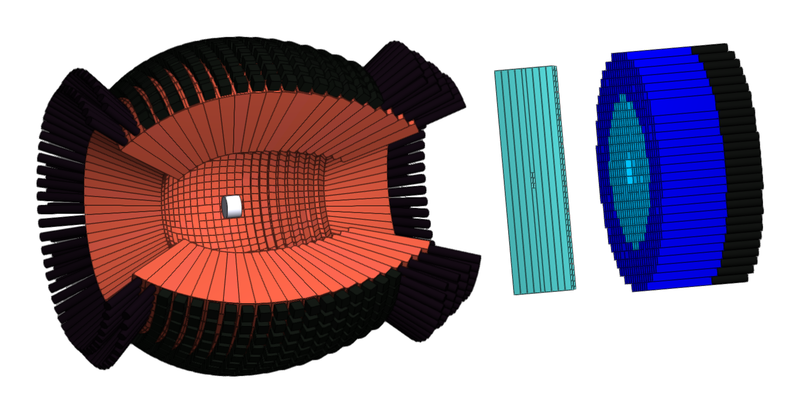
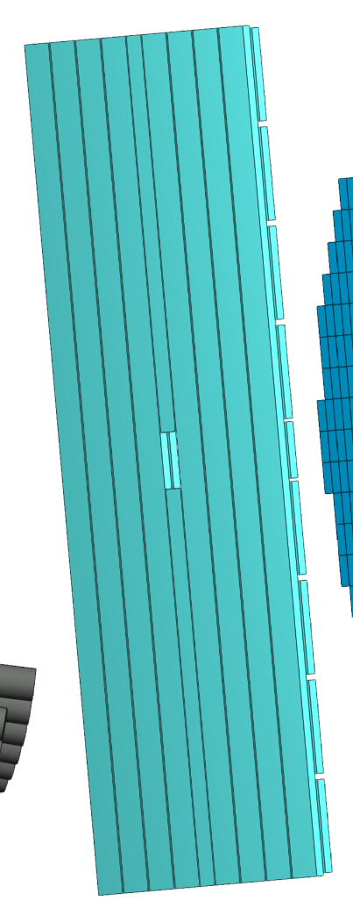
BGOegg Phase-II experiment
(1) Upgrade the detector setup.
⇒ Multi-meson BG (γp→π⁰π⁰p) ×1/40
BGOegg
calorimeter
Forward PWO
calorimeter
Carbon
P_{η′} ≤ 1000 MeV/c
Preliminary
Forward Plastic
Scintillators
Cu target
23 / 26

Slide 34
BGOegg Phase-II experiment
(1) Upgrade the detector setup.
⇒ Multi-meson BG (γp→π⁰π⁰p) ×1/40
(2) Change a target from C [20 mm] to Cu [7 mm].
⇒ R_{nucleus} ×1.8, # of nucleons ×1.8, σ(M_{γγ}) ×0.6
(3) Increase a photon beam intensity.
Replacement to synchronous pulsed lasers ⇒ ≈5M cps
BGOegg
calorimeter
Forward PWO
calorimeter
Cu nucleus
γ-rays
η′ life
Carbon
nucleus
Forward Plastic
Scintillators
Cu target
23 / 26

Slide 35
BGOegg Phase-II experiment
(1) Upgrade the detector setup.
⇒ Multi-meson BG (γp→π⁰π⁰p) ×1/40
(2) Change a target from C [20 mm] to Cu [7 mm].
⇒ R_{nucleus} ×1.8, # of nucleons ×1.8, σ(M_{γγ}) ×0.6
(3) Increase a photon beam intensity.
Replacement to synchronous pulsed lasers ⇒ ≈5M cps
Cu target P(γγ)<600 MeV/c
If the Phase-1 result is assumed, we will get 28σ in a few months. Here the forward PWO calorimeter covers only θ<16°.
Now a large part of preparation has been done, and new data-taking will start soon.
η′
MC simulation
M(γγ) [MeV]
23 / 26

Slide 36
Status of LEPS2/Solenoid experiment (2 page)

Slide 37
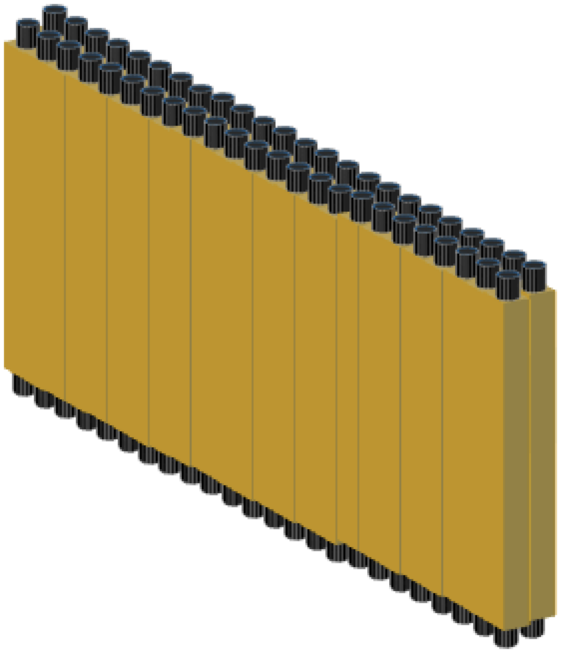
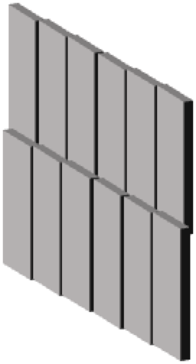
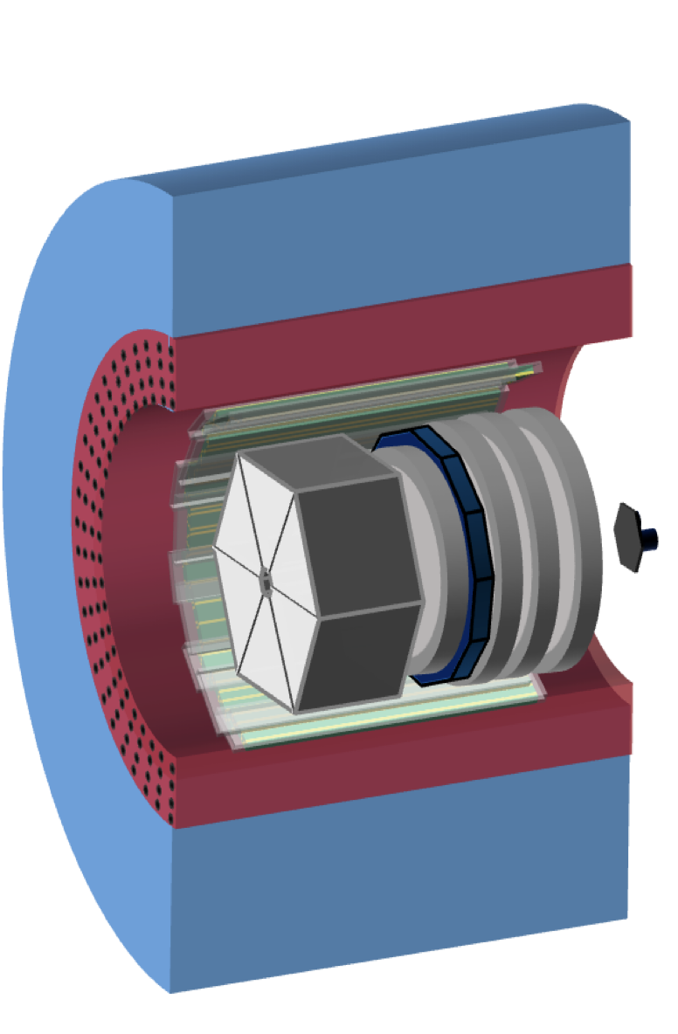


LEPS2/Solenoid Experiment (2021~)
Time
Projection
Chamber
sampling
calorimeter
Drift Chambers
forward
RPCs
Plastic Scintillators
solenoid
magnet
0.9 T
veto
counter
2 m
photon beam
@LEPS2
Aerogel Čerenkov Counter
Covered range in lab system | Particle type
0°-7° | neutrons
7°-12° | neutrons, charged particles
12°-40° | charged particles
40°-110° | charged particles, photons
barrel RPCs
Target (LH₂, LD₂)
Trigger counters
inside TPC
24 / 26

Slide 38





LEPS2/Solenoid Experiment (2021~)
Event display
Time
Projection
Chamber
sampling
calorimeter
Drift Chambers
forward
RPCs
Plastic Scintillators
solenoid
magnet
0.9 T
veto
counter
2 m
photon beam
@LEPS2
Aerogel Čerenkov Counter
Mass reconstruction from ToF (RPC) & P (TPC)
Covered range in lab system | Particle type
0°-7° | neutrons
7°-12° | neutrons, charged particles
12°-40° | charged particles
40°-110° | charged particles, photons
Momentum [GeV/c]
$$p$$
barrel RPCs
$$π$$
$$K$$
Target (LH₂, LD₂)
Trigger counters
inside TPC
Mass [GeV/c²]
24 / 26

Slide 39










Data analysis using TPC & barrel RPC
$$γp→K^{+}(MissingMass)$$
$$π^{−}p Invariant Mass$$
$$Λ$$
$$Σ^{0}$$
2022
LH₂ data
2022
LH₂ data
$$Λ$$
$Λ$(1405)
$Σ$(1385)
preliminary
$Λ$(1520)
preliminary
Currently, searching for the $\overline{K}NN$state in the photoproduction reaction $γd→K_{S}^{0}\left(K^{−}pp\right)$_{B.S.}$→K_{s}^{0}Λp$. (as Kobayakawa’s PhD thesis)
A mass resolution of ∼17 MeV is expected while existing data indicate 40<B.E.<120 MeV.
missing mass
measured at TPC &bRPC
25 / 26

Slide 40

Summary
SPring-8 LEPS2 facility uniquely provides a linearly-polarized photon beam in the energy range of 1.3–2.4 GeV.
LEPS2/BGOegg experiment has successfully obtained physics results on (1) scalar-meson photoproduction, (2) light-baryon spectroscopy, and (3) in-medium $η′$ mass measurement by using a large-acceptance electromagnetic calorimeter which has world’s-best resolutions. BGOegg Phase-II experiment has just started by covering all the solid angles with electromagnetic calorimeters.
LEPS2/Solenoid experiment is now running in parallel to the BGOegg experiment. Search for the $K^{−}pp$ bound state is on-going by using a large charged-particle spectrometer.
26 / 26

