Slide 1
Rare b→d decays in covariant confined quark model
Aidos Issadykov
JINR & INP Kazakhstan
In collaboration with N. Soni & J. Pandya (MSU Baroda, India)
*Based on arXiv:2008.07202 [hep-ph]

Slide 2
Motivation

Slide 3
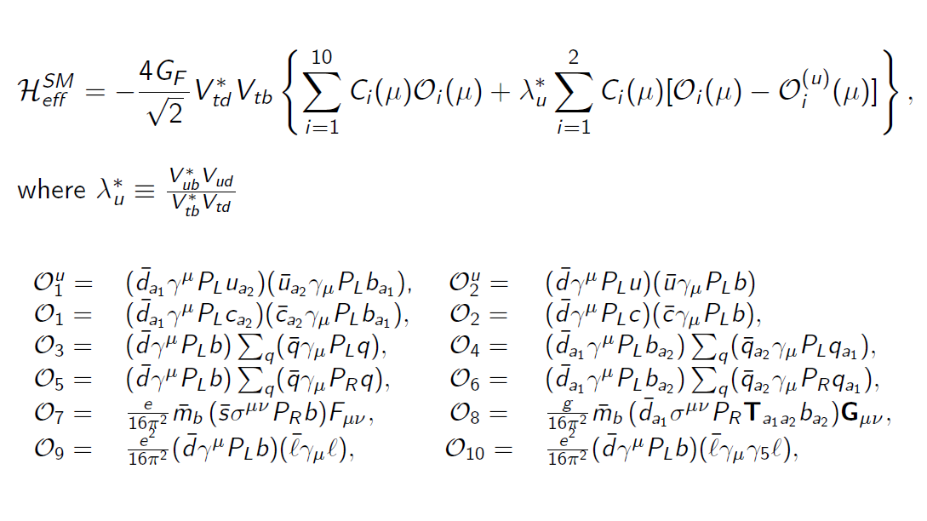
Effective Hamiltonian for b→dℓ⁺ℓ⁻

Slide 4
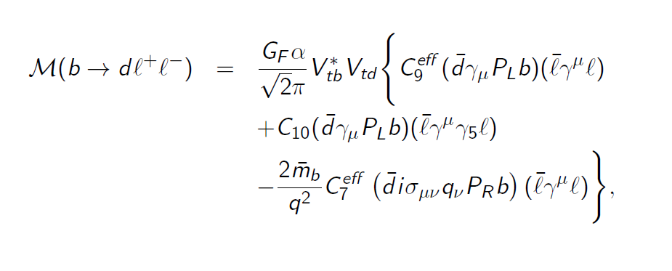
Matrix element for b→dℓ⁺ℓ⁻

Slide 5
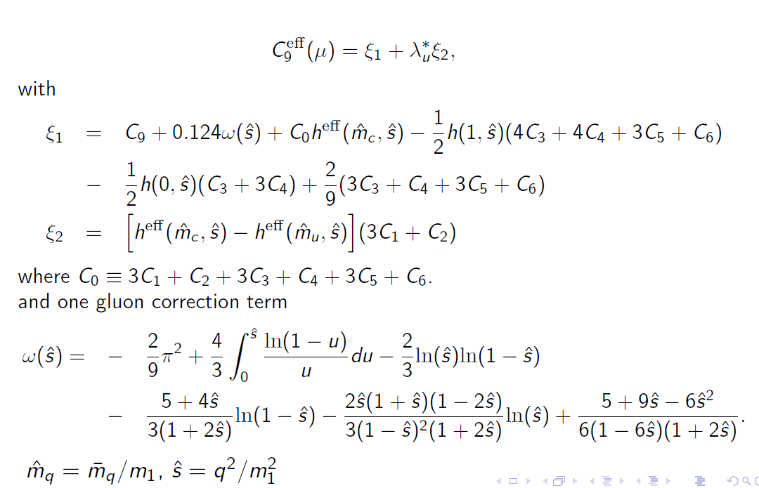
Wilson coefficients

Slide 6
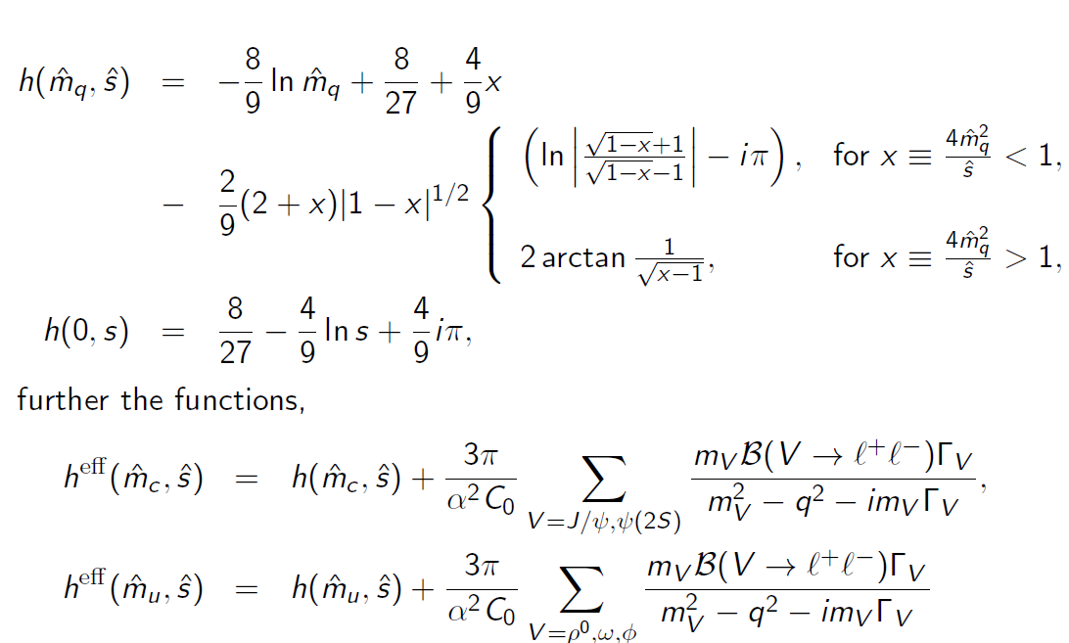
Wilson coefficient: Charm loop function

Slide 7
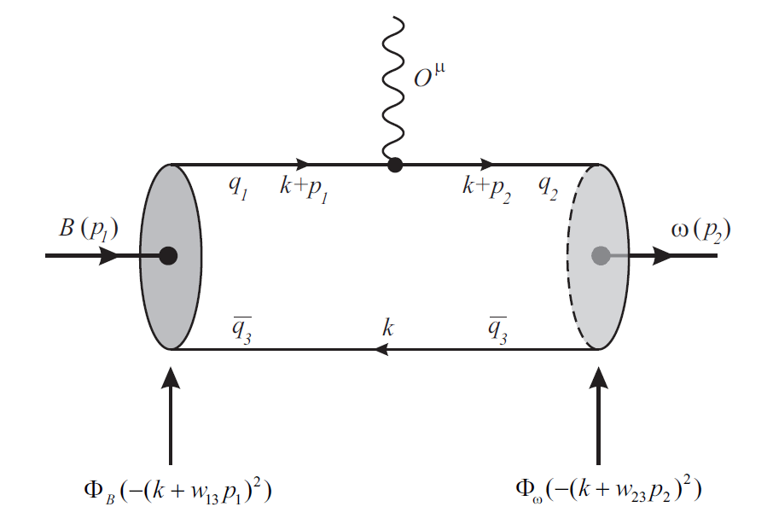
Feynman diagram for b→dℓ⁺ℓ⁻

Slide 8
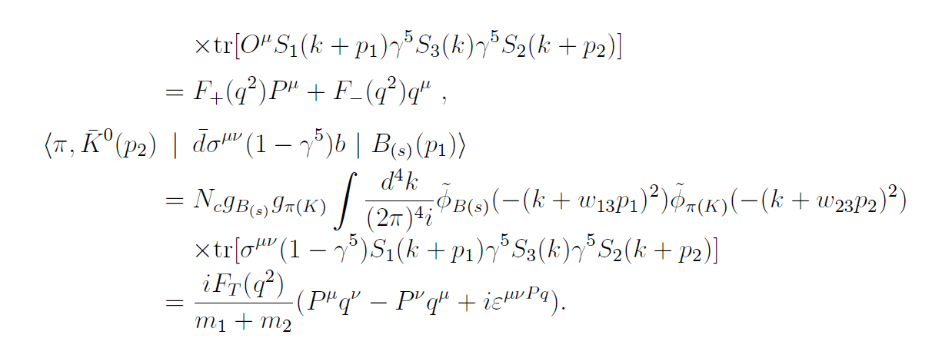
form factors for B(s) → (π, K ) in CCQM

Slide 9
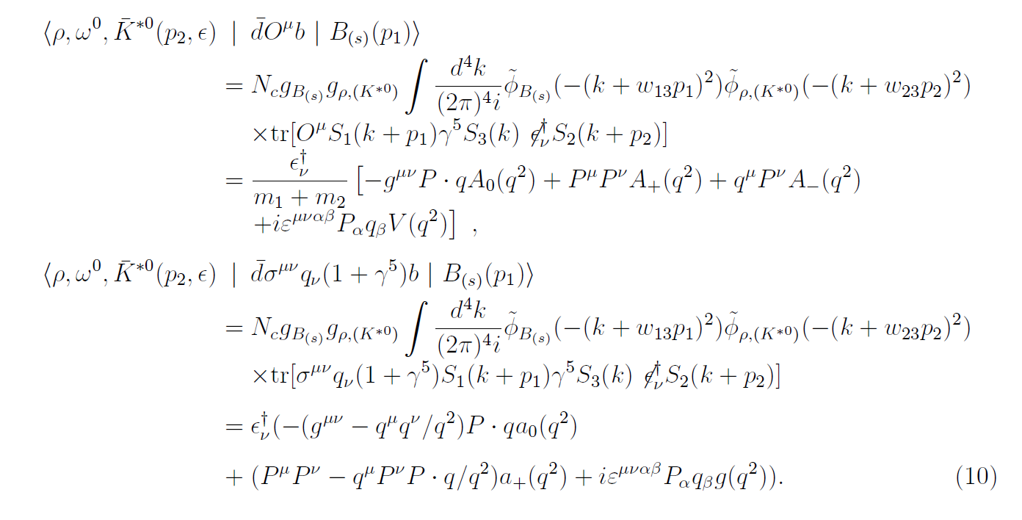
form factors for B(s) → (ρ, ω, K^{∗0}) in CCQM

Slide 10
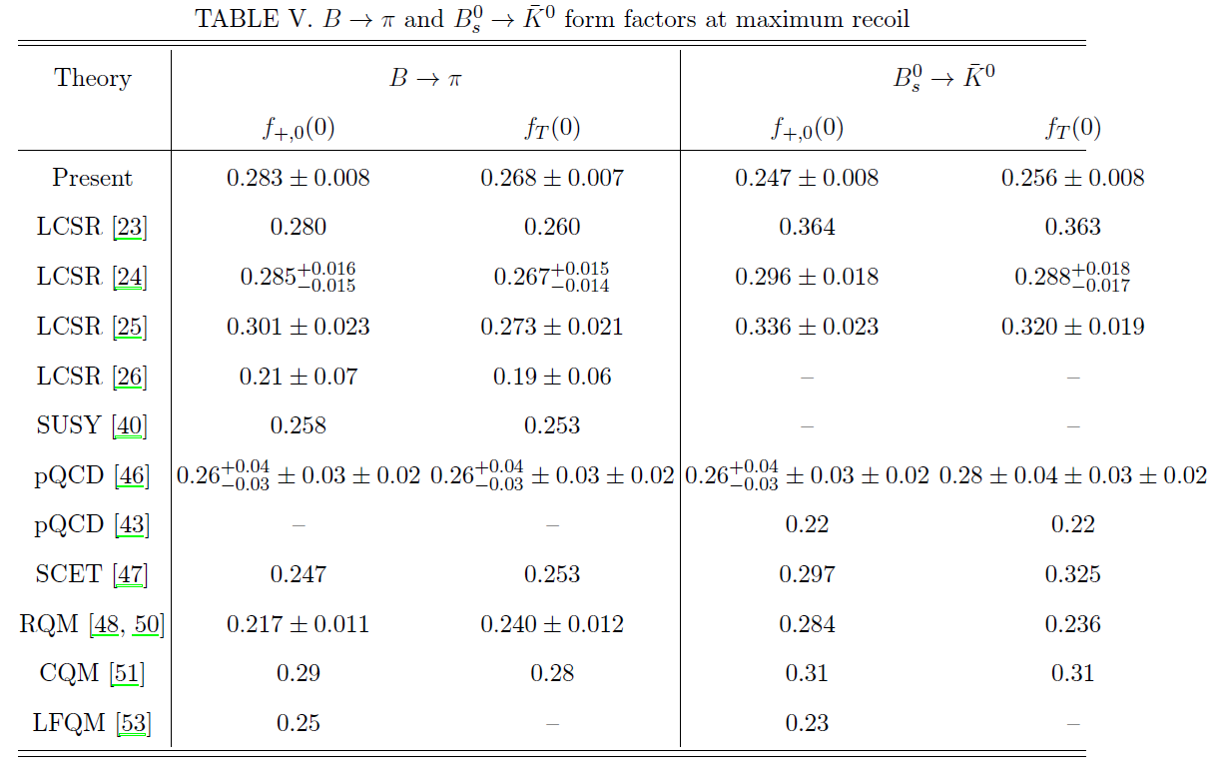
Comparison of ff with results from other models

Slide 11
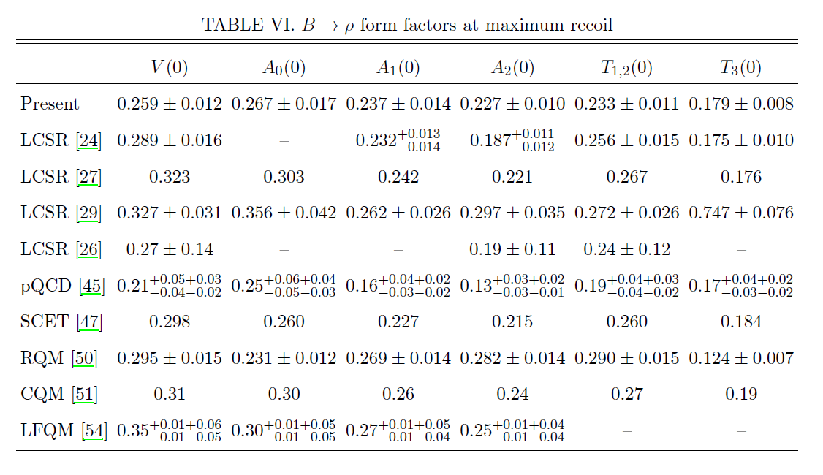
Comparison of ff with results from other models

Slide 12
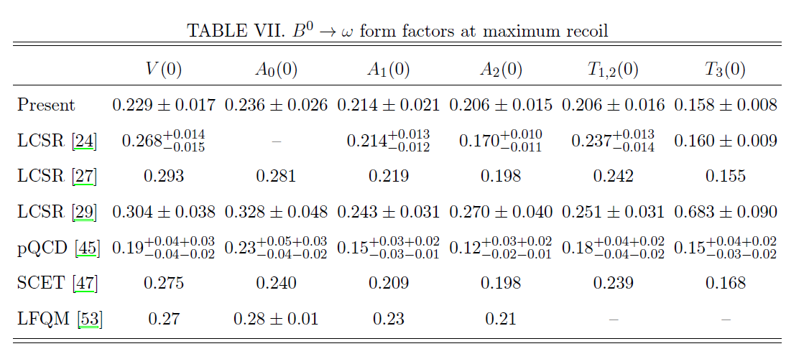
Comparison of ff with results from other models

Slide 13
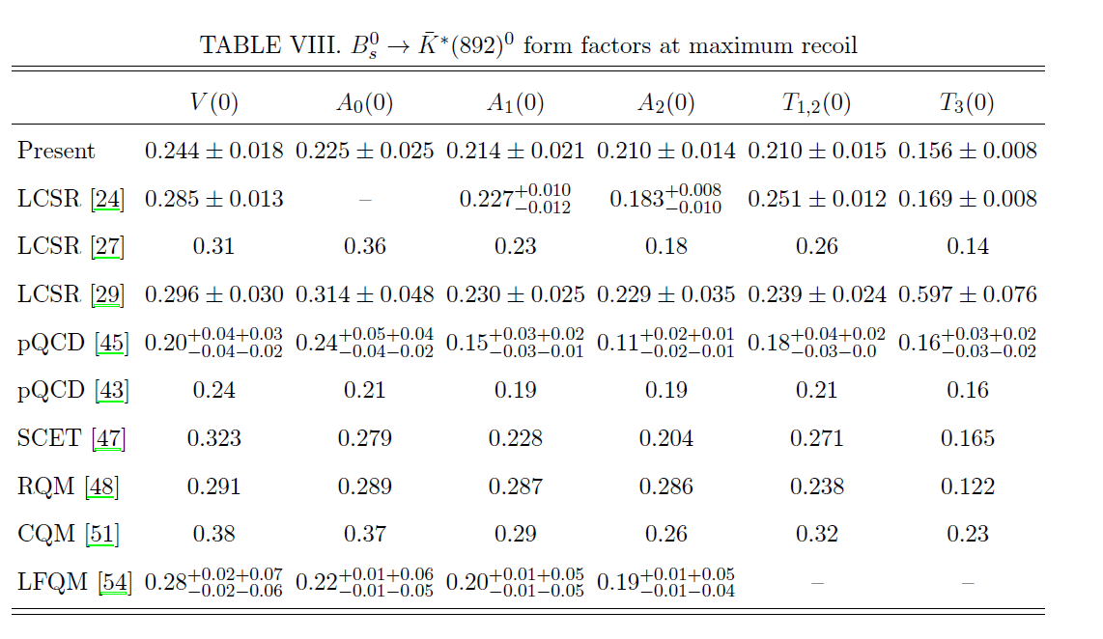
Comparison of ff with results from other models

Slide 14
Differential branching fractions

Slide 15
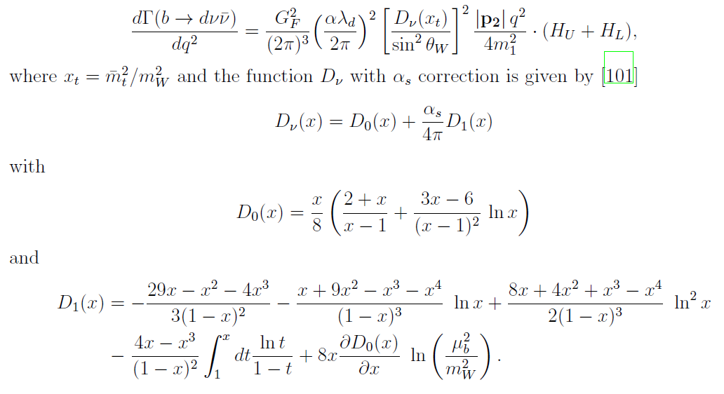
Branching fractions corresponding to b → dνν decays

Slide 16
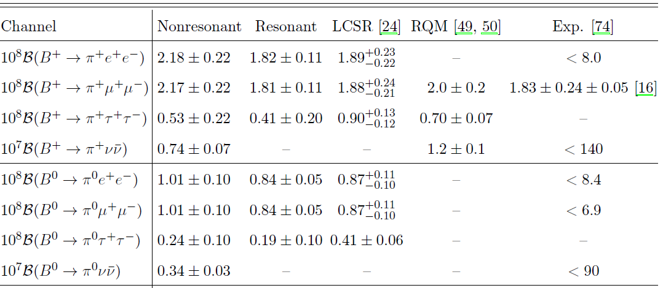
Comparison of branching fractions

Slide 17
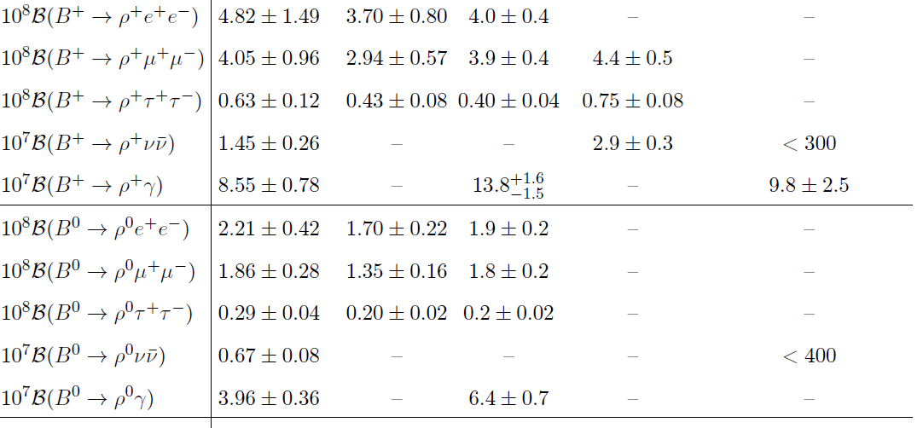
Comparison of branching fractions

Slide 18
Comparison of branching fractions

Slide 19
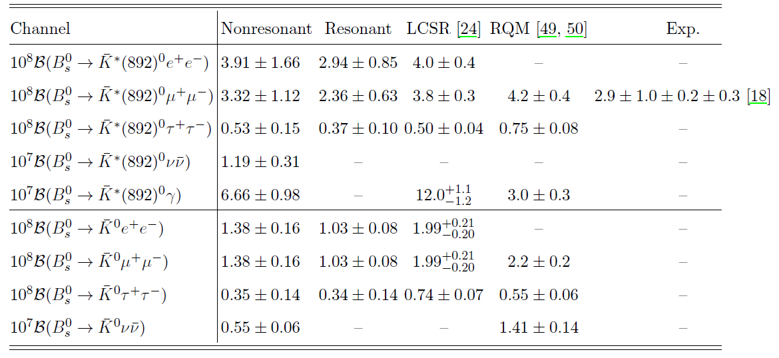
Comparison of branching fractions

Slide 20
Ratios of the Branching fractions

Slide 21
Conclusion
We have reported comprehensive study of rare decays corresponding to b → dℓ⁺ℓ⁻ within the standard model framework of covariant confined quark model with built-in infrared confinement. We first compute the transition form factors in the whole physical range of momentum transfer (0 ≤ q²≤ q²_{max}) and utilized for computations of different physical observables such as branching fractions, forward backward asymmetry, transverse and longitudinal polarizations and angular observables. The observables are computed considering both nonresonant (without vector resonances) and resonant (with light vector and charm resonances) contributions. The resonance contributions are computed by excluding the experimentally vetoed q² regions. We have computed the branching fractions considering both the contributions while the other physical observables are from the vector resonance contributions only. The computed B(B⁺→ π⁺μ⁺μ⁻) is a bit lower and B(B⁰_{s} → ¯K∗(892) μ⁺μ⁻) branching fraction is within the uncertainty predicted by experimental data from LHCb collaboration, while the nonresonant B(B⁺ → ρ⁺μ⁺μ⁻) is in good agreement within the uncertainty predicted in RQM and LCSR approaches.

Slide 22
Thank you
*2.05.2021 @vkadre_kz Almaty region

