Slide 1
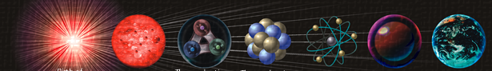
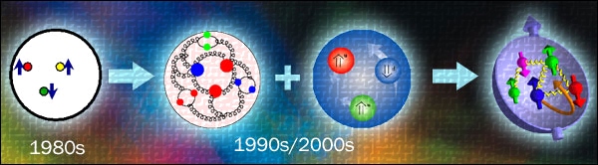


LHCb results on exotic spectroscopy
Yanxi ZHANG
Peking university
On behalf of the LHCb collaboration
17/May/2021

Slide 2
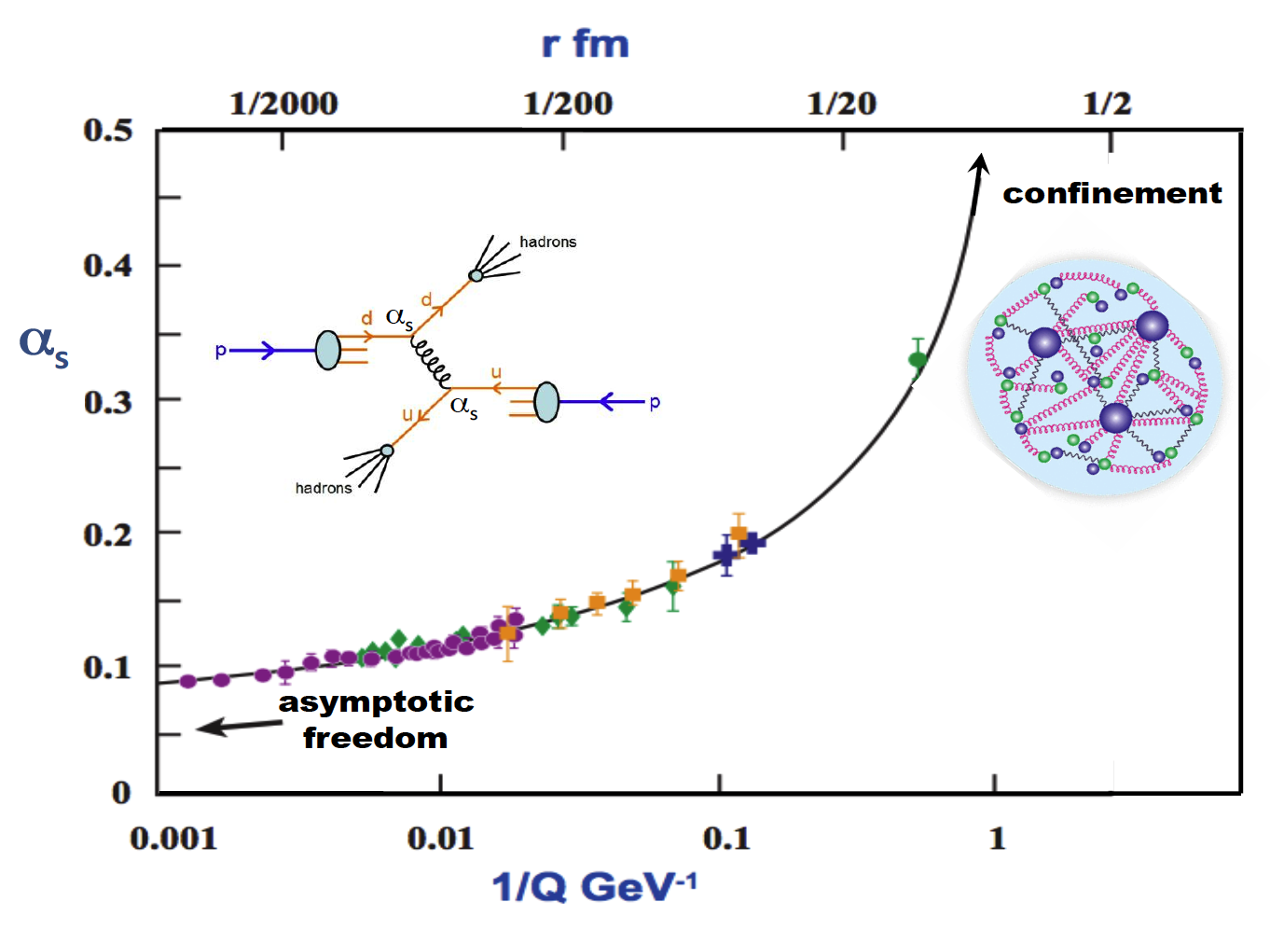
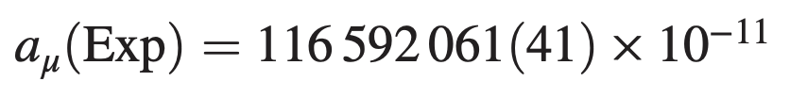
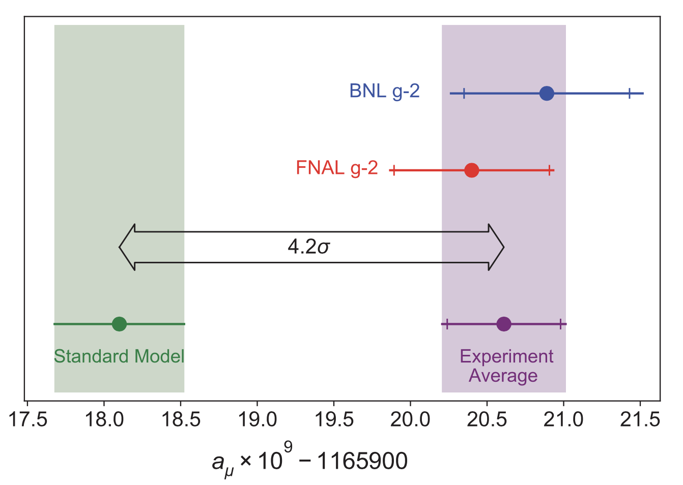
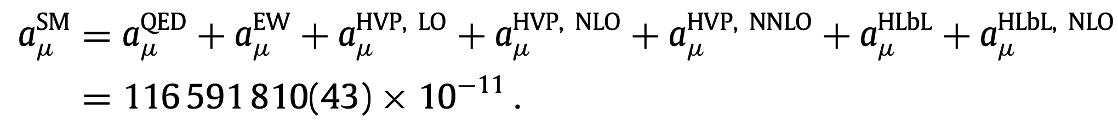
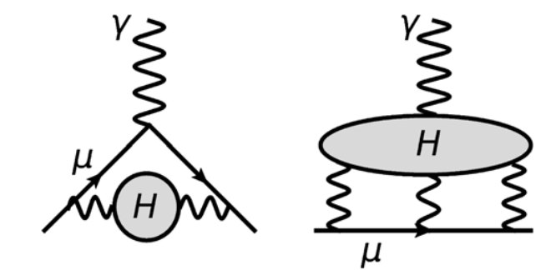
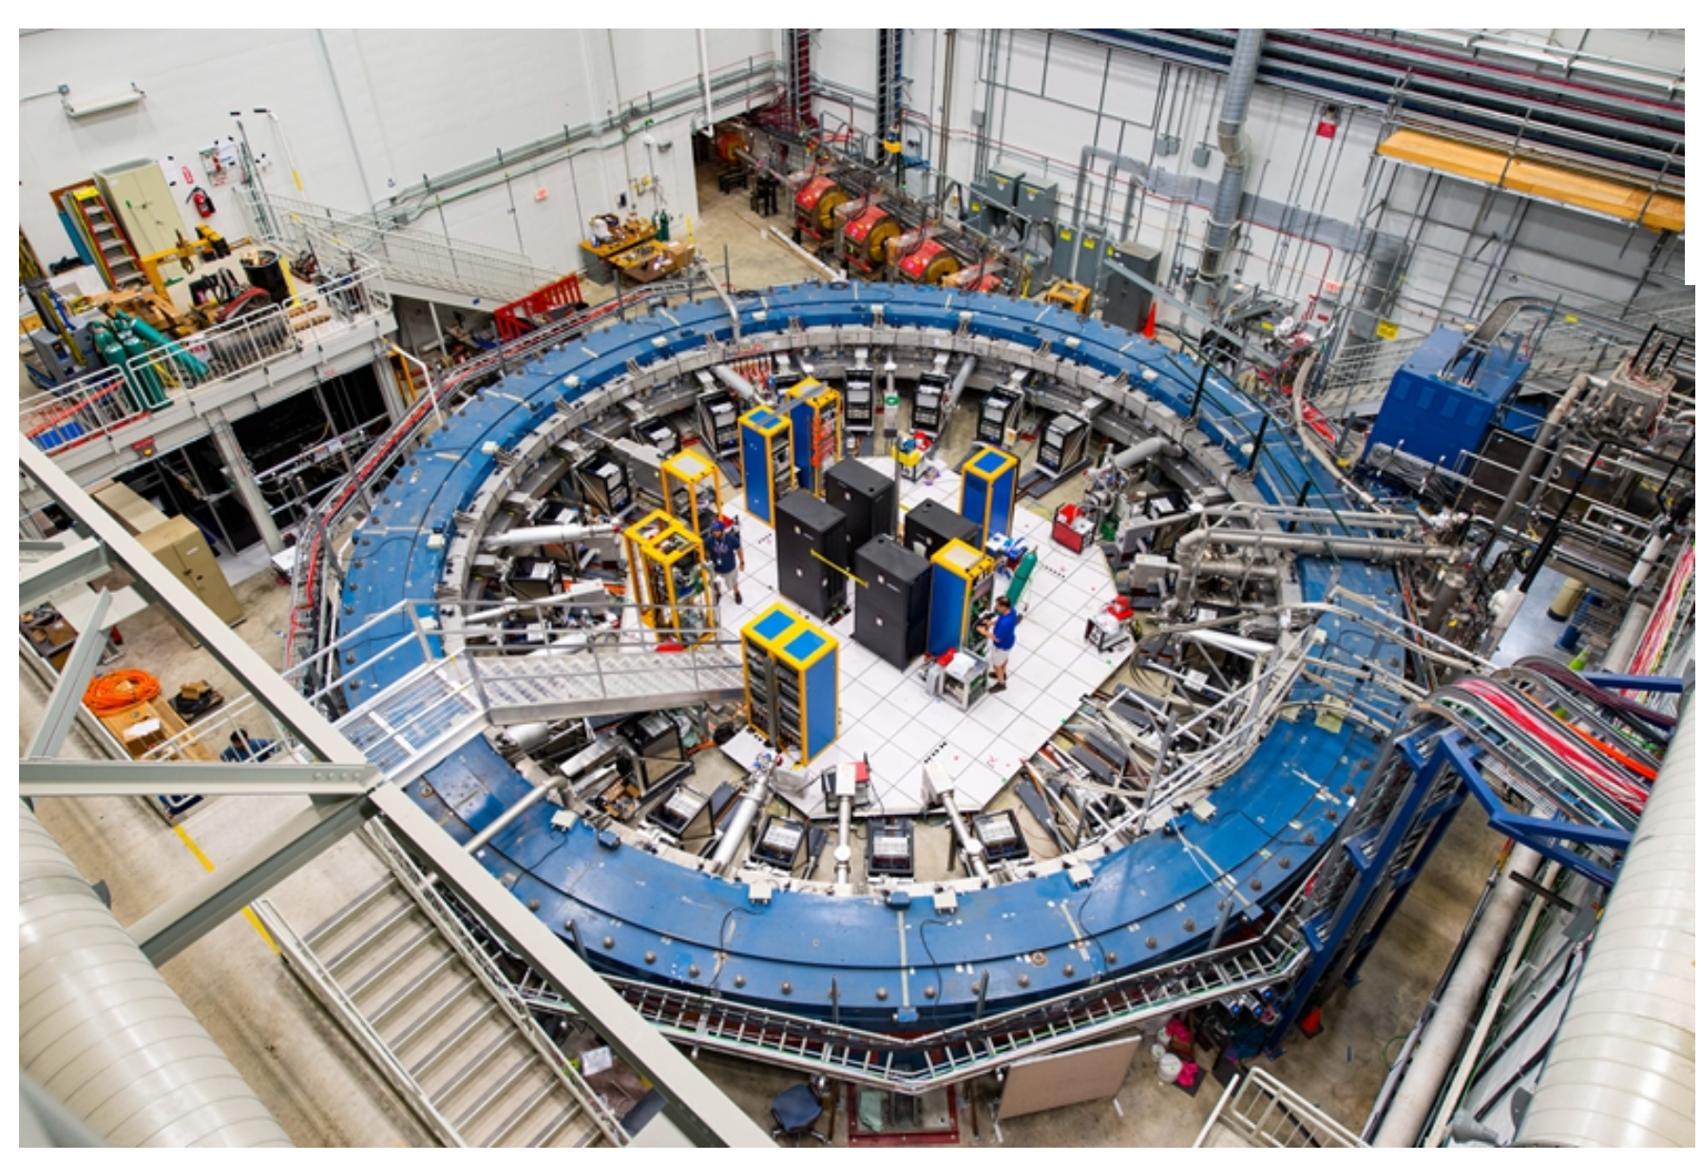



The QCD
Involved in all aspects in particle physics, less known than EW in SM
  Perturbative and non-perturbative
Limit precision SM tests
Hardon
dynamics
$$g_{μ}−2$$
Phys.Rep.887(2020)1
PRL126(2021)141801
Experiment inputs are essential to improve

Slide 3
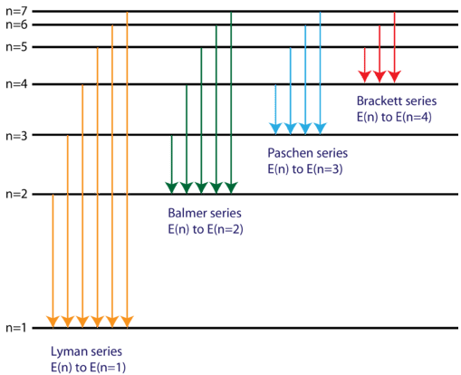
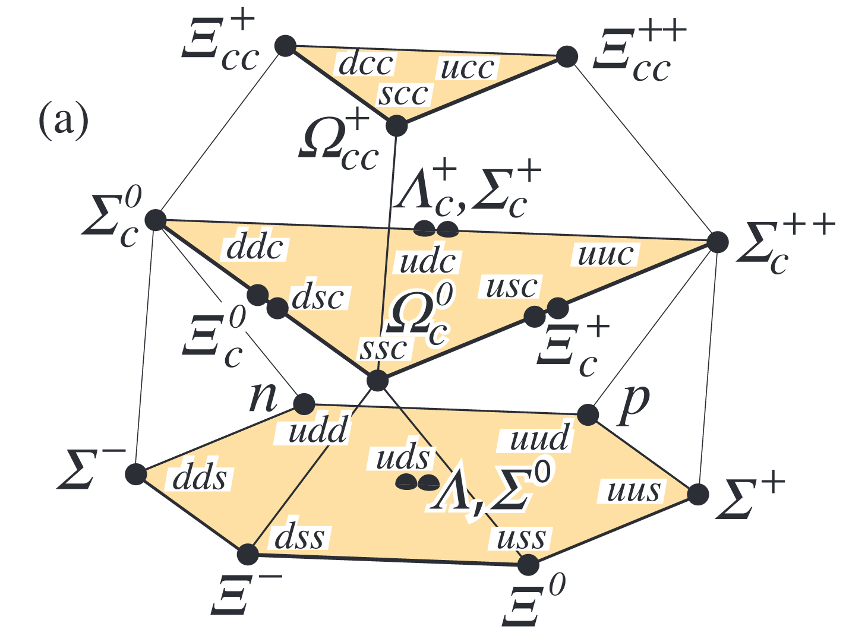
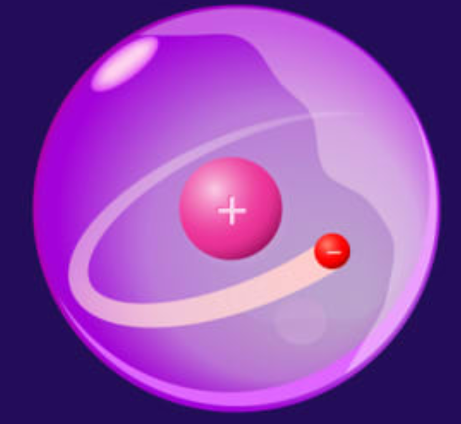
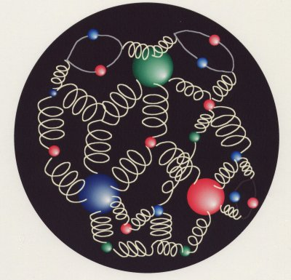





Hadron spectroscopy
Probing low-energy non-perturbative QCD dynamics
How are quarks confined
New problem
Light spectrum
Hadron spectrum
….
Dynamics?
Mesons
Baryons
Tetraquark
Pentaquark
Conventional hadrons
Exotic hadrons
Internal sub-structure?
Molecule
Compact

Slide 4
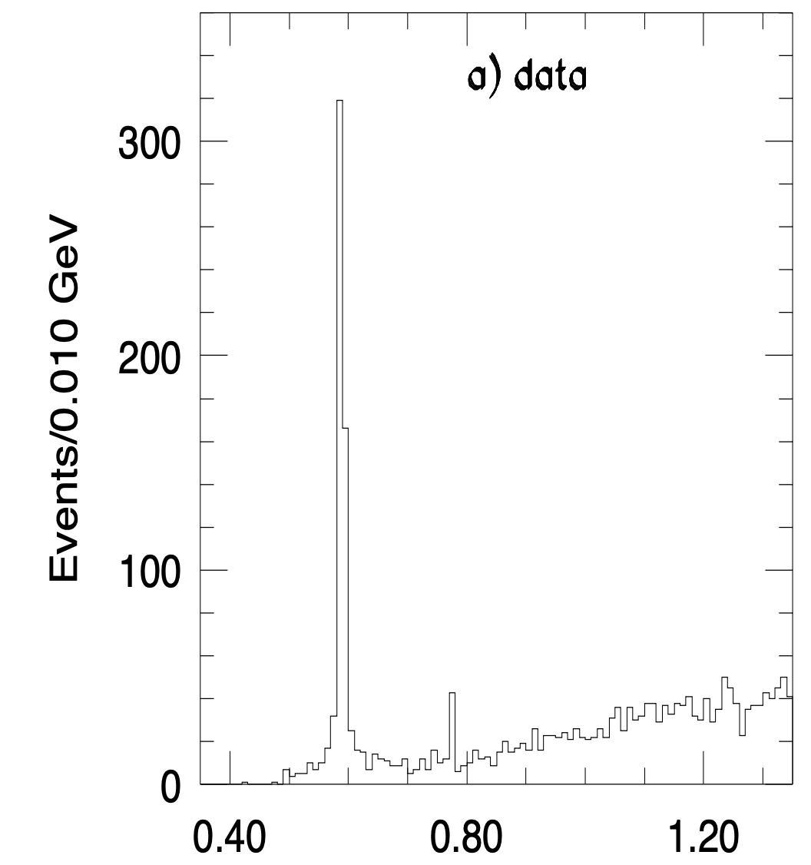

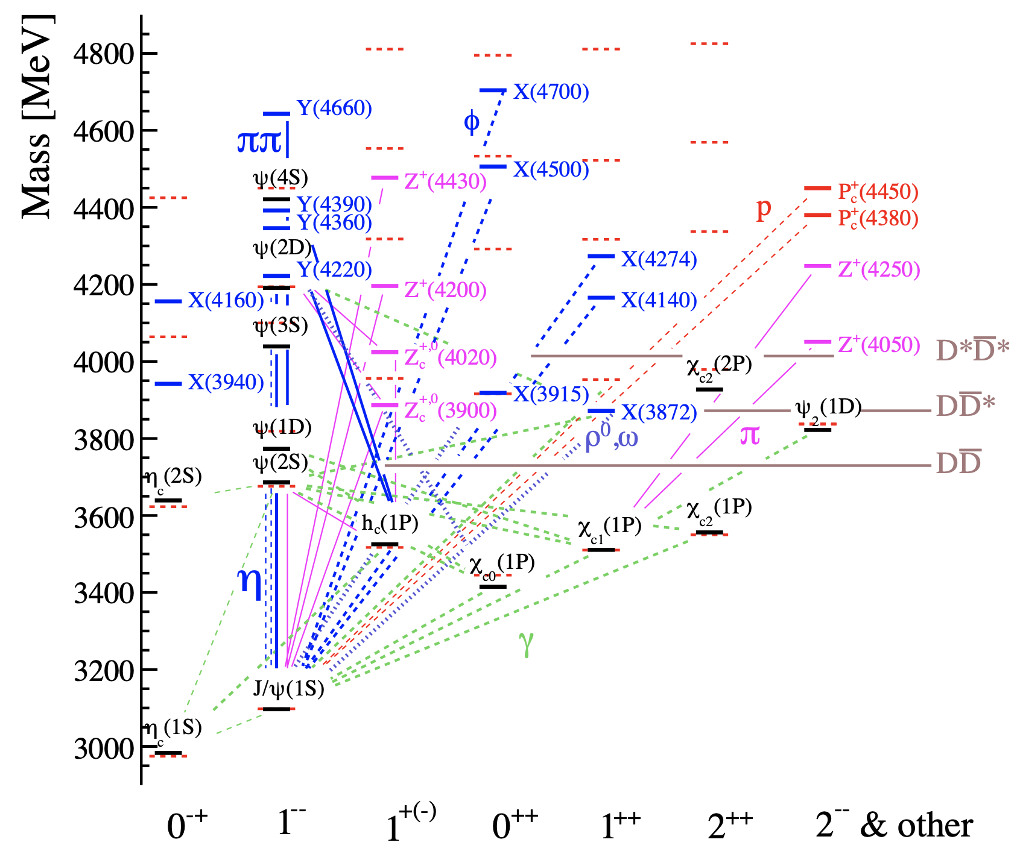

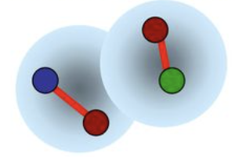

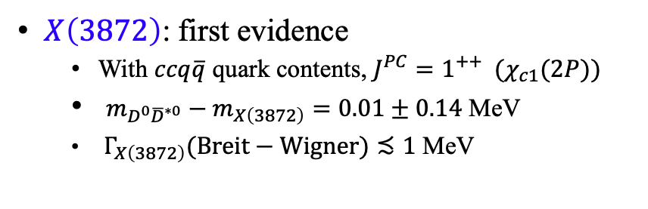
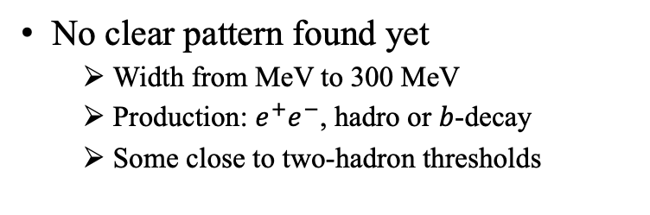
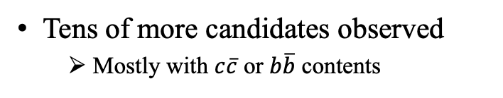
Status of exotic hadrons
$X\left(3872\right)$: first evidence
  With $ccq\overline{q}$ quark contents, $J^{PC}=1^{++} (χ_{c1}(2P))$
  $m_{D^{0}{\overline{D}}^{∗0}}−m_{X\left(3872\right)}=0.01±0.14$ MeV
  $Γ_{X\left(3872\right)}(Breit−Wigner)≾1$ MeV
PRL 91 (2003) 262001
$$X(3872)$$
Tens of more candidates observed
  Mostly with $c\overline{c}$ or $b\overline{b}$ contents
(4312)
(4440, 4457)
No clear pattern found yet
  Width from MeV to 300 MeV
  Production: $e^{+}e^{−}$, hadro or $b$-decay
  Some close to two-hadron thresholds
Rev.Mod.Phys. 90 (2018) 015003
Hadron molecular?
Notes:
There is no clear pattern as for normal hadrons yet

Slide 5
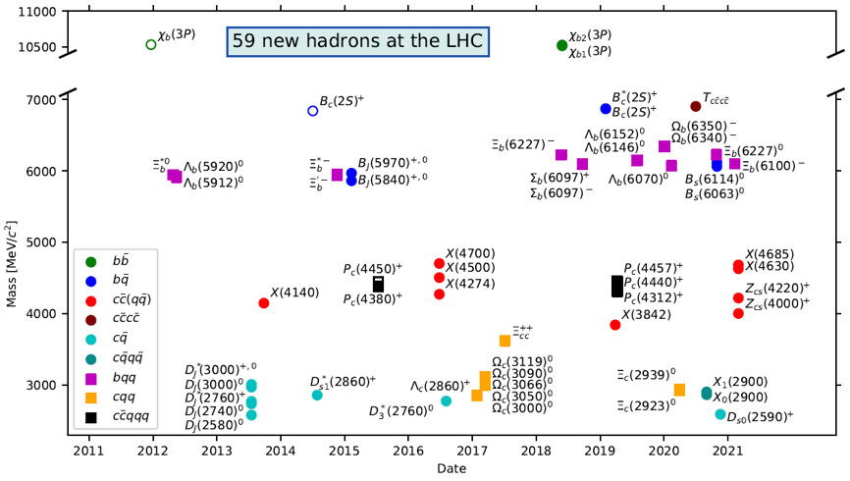
New hadron states at LHC(b)
https://cerncourier.com/a/lhcb-observes-four-new-tetraquarks

Slide 6
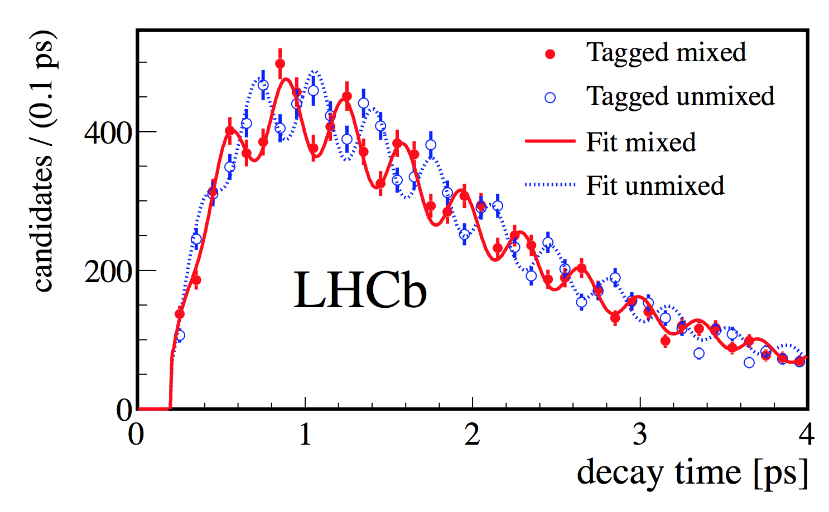
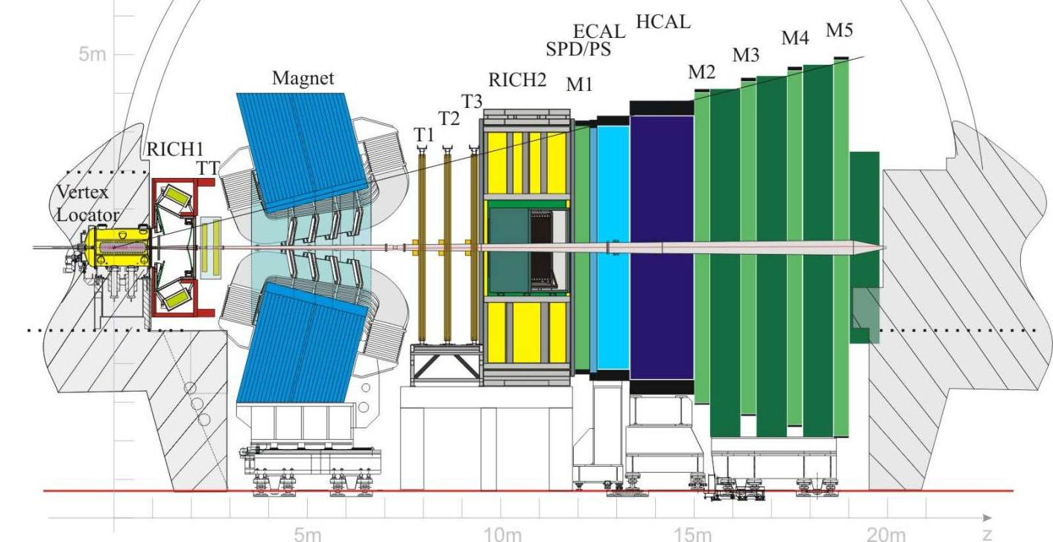
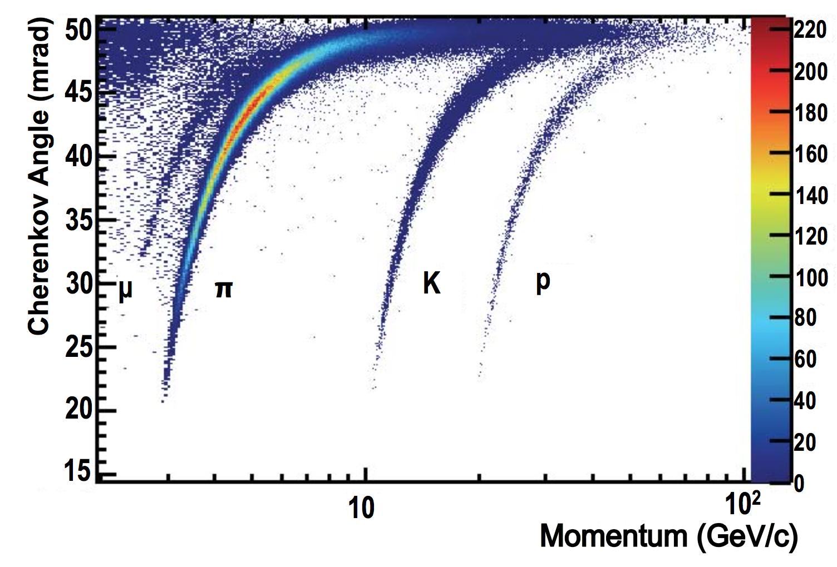
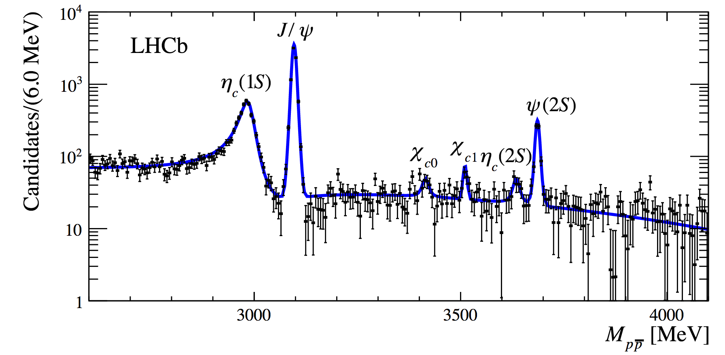
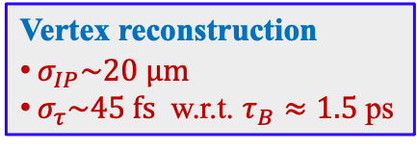
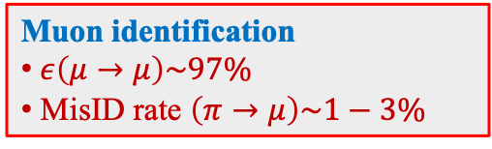
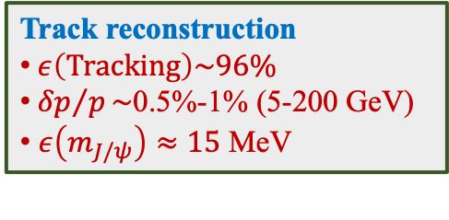

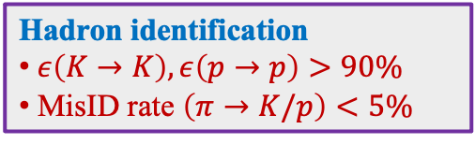
The LHCb experiment
Dedicated heavy flavor experiment at CERN, covering $p_{T}≥ 0$
Vertex reconstruction
$σ_{IP}\sim 20 μm$
$σ_{τ}\sim 45 fs$ w.r.t. $τ_{B}≈1.5$ps
Muon identification
$ε\left(μ→μ\right)\sim 97\%$
MisID rate $\left(π→μ\right)\sim 1−3\%$
JINST 3 (2008) S08005
IJMPA 30 (2015) 1530022
$pp$ collision
Track reconstruction
$ε\left(Tracking\right)\sim 96\%$
${δp}/p\sim$0.5%-1% (5-200 GeV)
$ε\left(m_{J/ψ}\right)≈15$ MeV
Hadron identification
$ε\left(K→K\right),ε\left(p→p\right)>90\%$
MisID rate $\left(π→K/p\right)<5\%$

Slide 7
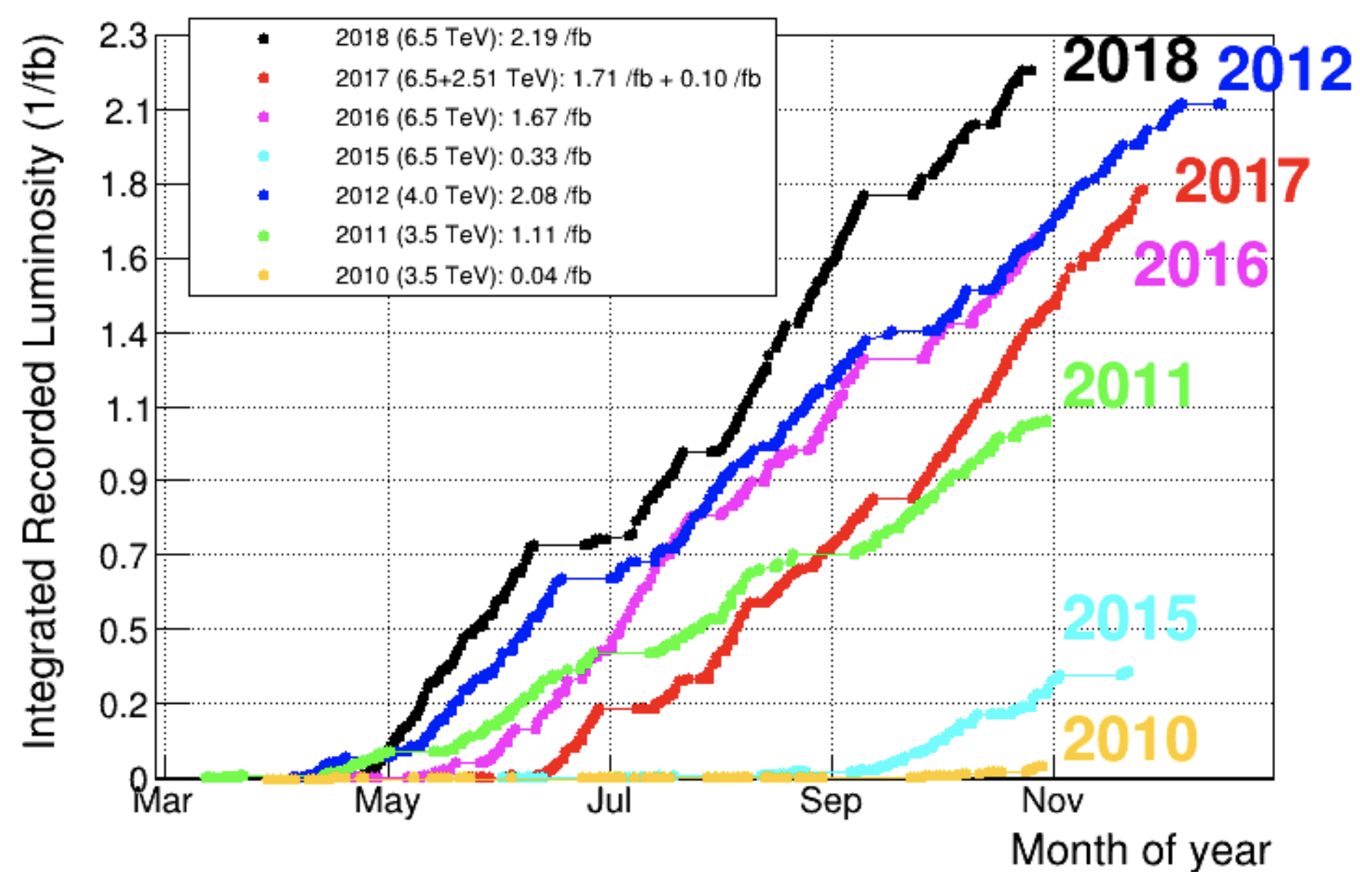
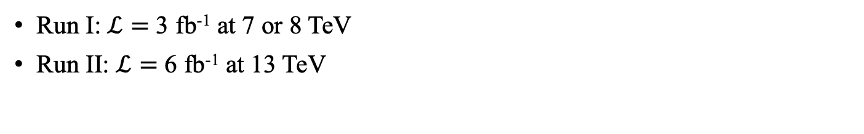

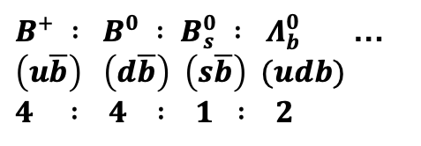
LHCb data
Run I: $ℒ=$ 3 fb⁻¹ at 7 or 8 TeV
Run II: $ℒ=$ 6 fb⁻¹ at 13 TeV
All possible states are produced
$pp$ collisions
$B^{+} : B^{0} : B_{s}^{0} : Λ_{b}^{0}$ …
$\left(u\overline{b}\right) \left(d\overline{b}\right) \left(s\overline{b}\right) (udb)$
$4 : 4 : 1 : 2$
All run I and run II data are studied

Slide 8


Pentaquark studies
Observation of narrow $P_{c}{\left(4312\right)}^{+}$ state and two-peak structure of $P_{c}{\left(4450\right)}^{+}$
$$c\overline{c}uud$$
PRL(2019)222001
Evidence of a $J/ψΛ$ structure in $Ξ_{b}^{−}→J/ψΛK^{−}$ decays
$$c\overline{c}uds$$
LHCb-PAPER-2020-039, arXiv:2012.10380

Slide 9
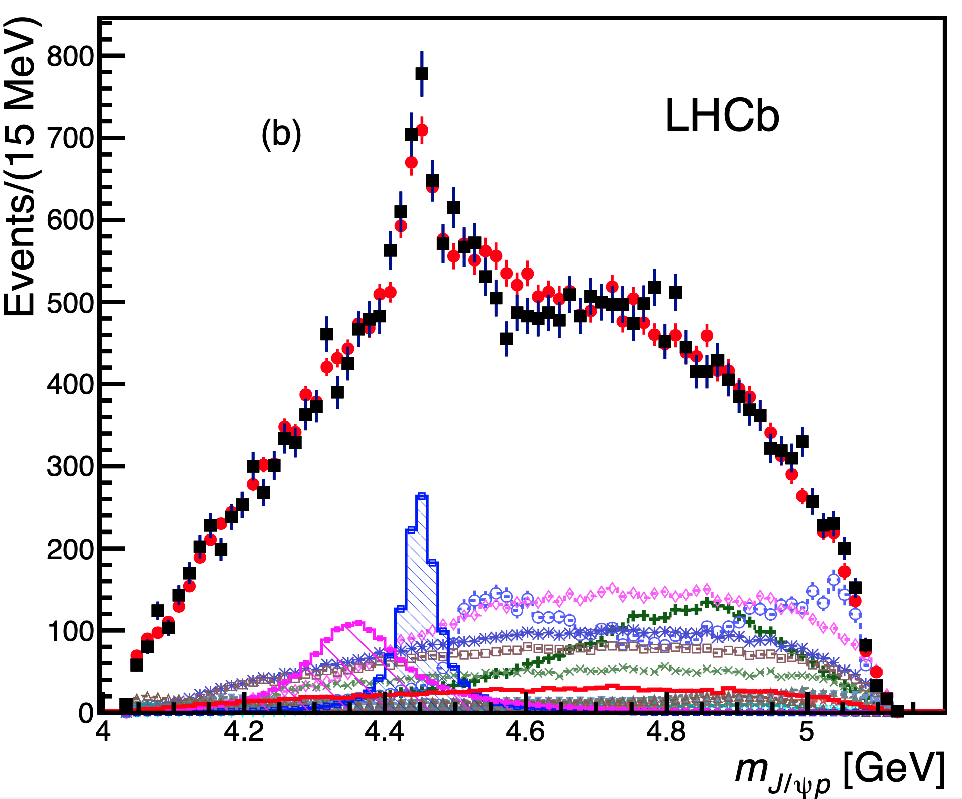
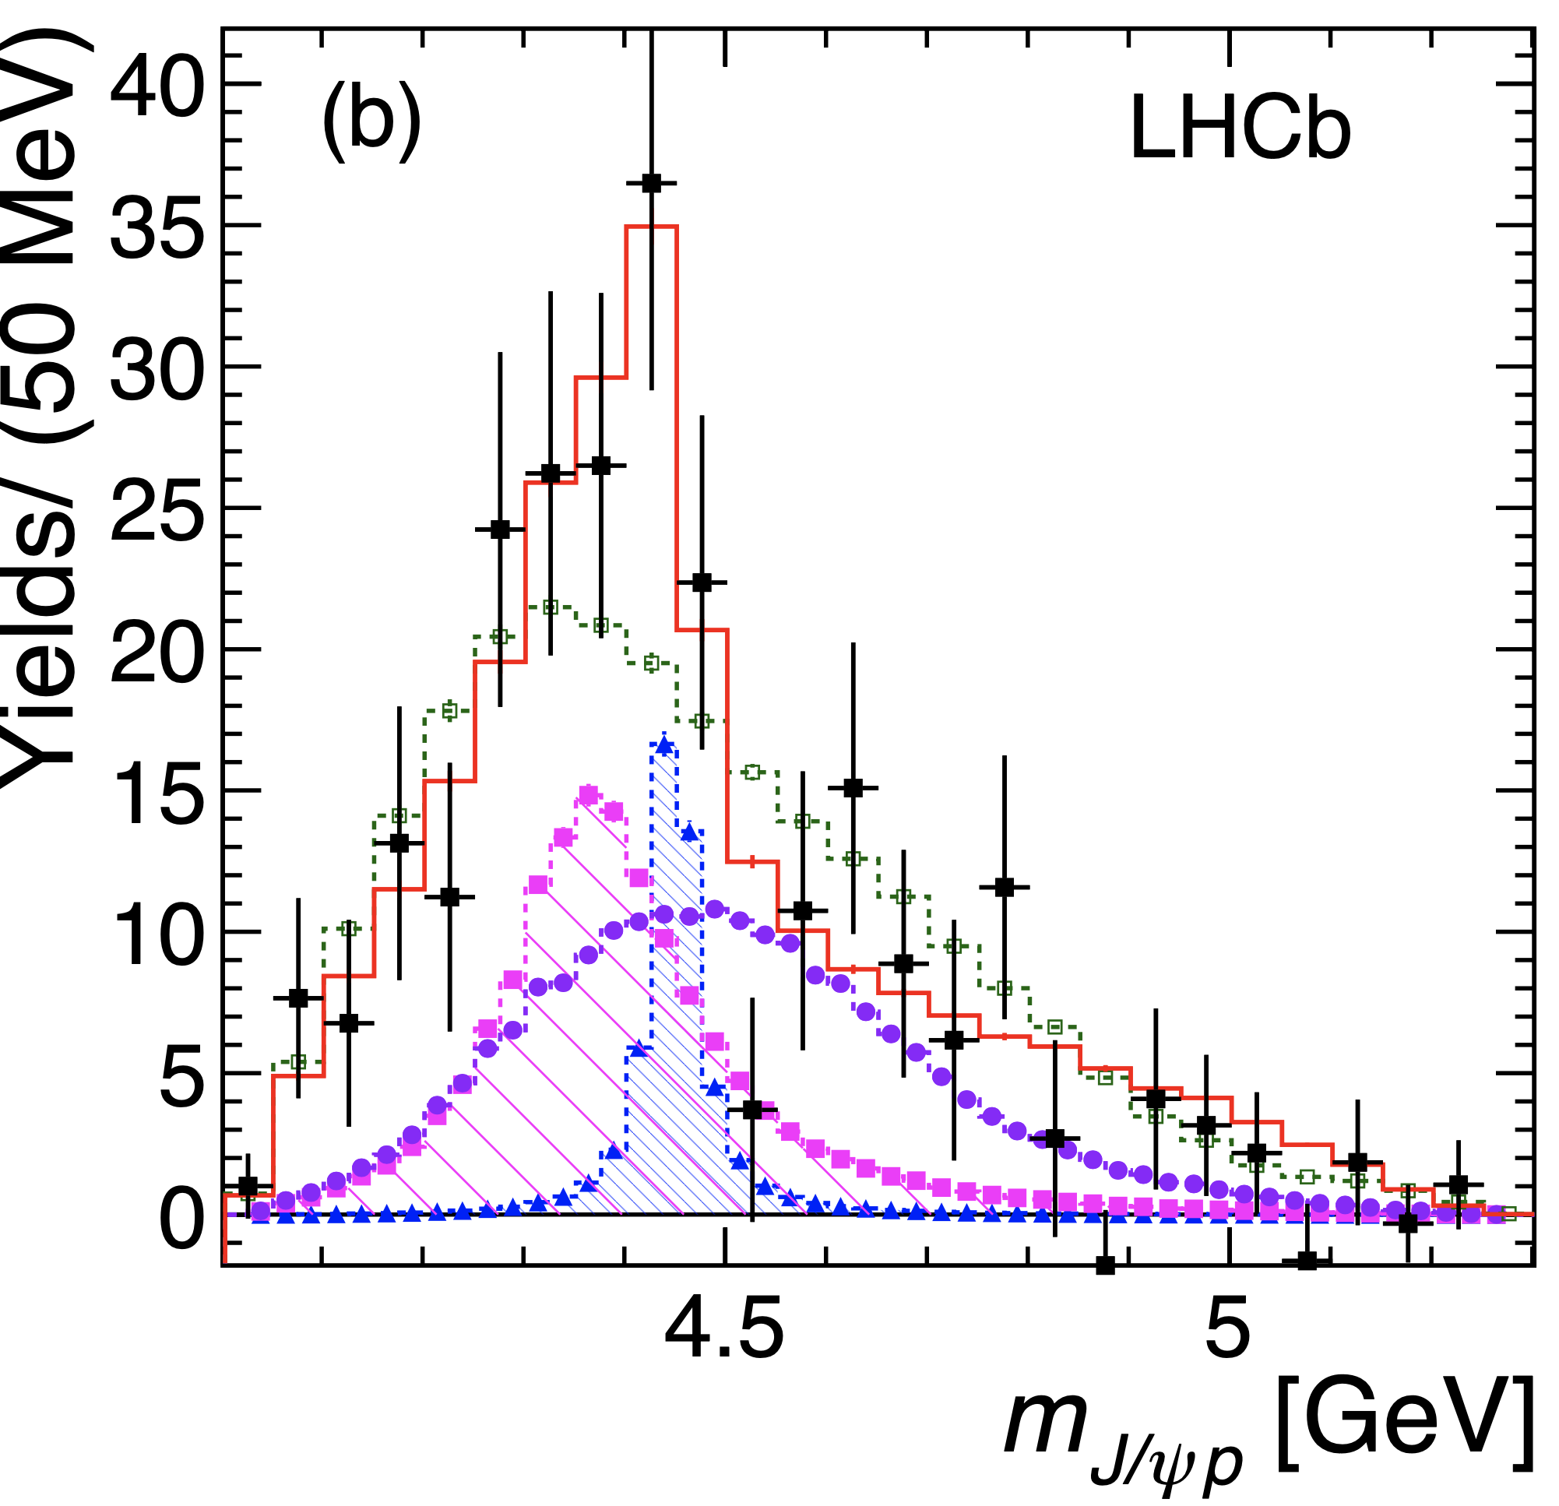
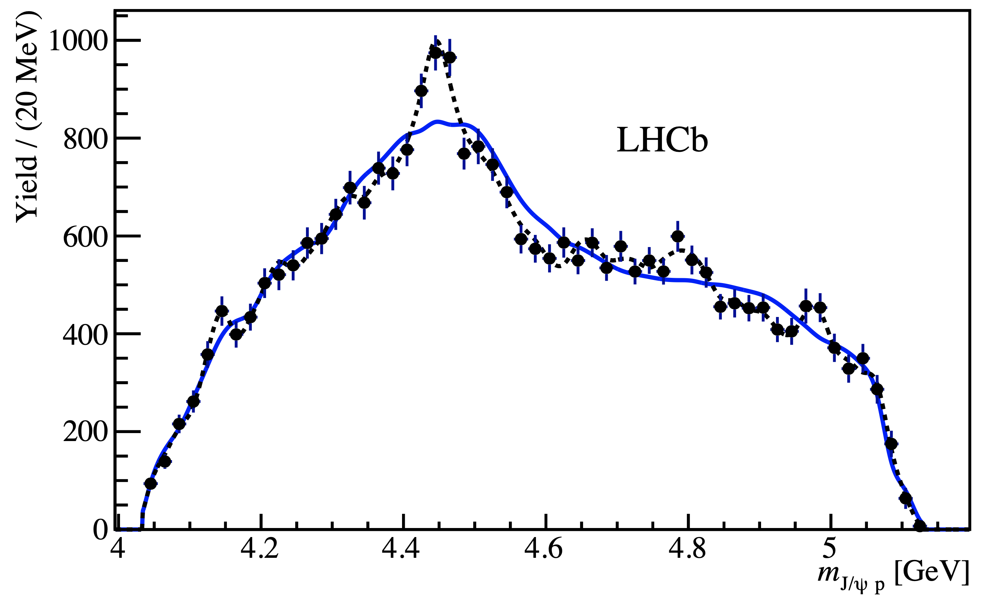


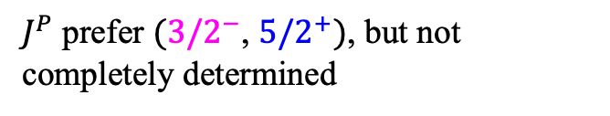

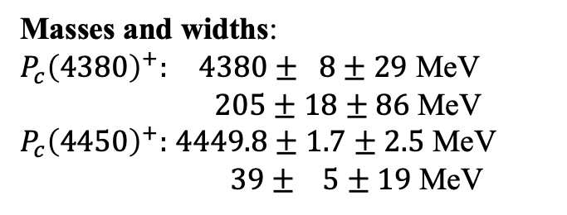
Observation of $P_{c}^{+}$ at LHCb
$P_{c}{\left(4380\right)}^{+}$ and $P_{c}{\left(4450\right)}^{+}$ in $Λ_{b}^{0}→J/ψpK^{−}$ decays with 2011+2012 data
Masses and widths:
$P_{c}{\left(4380\right)}^{+}:$ $4380± 8±29$ MeV
$205±18±86$ MeV
$P_{c}{\left(4450\right)}^{+}:$ $4449.8±1.7±2.5$ MeV
$39± 5±19$ MeV
PRL(2015)072001
Branching fractions: $≈8.4\%，4.1\%$
$J^{P}$ prefer $(3/2^{−}$, $5/2^{+})$, but not completely determined
Evidence in $Λ_{b}^{0}→J/ψpπ^{−}$ decays
Confirmed by model-independent analysis
PRL(2016)082002
PRL(2016)082003

Slide 10
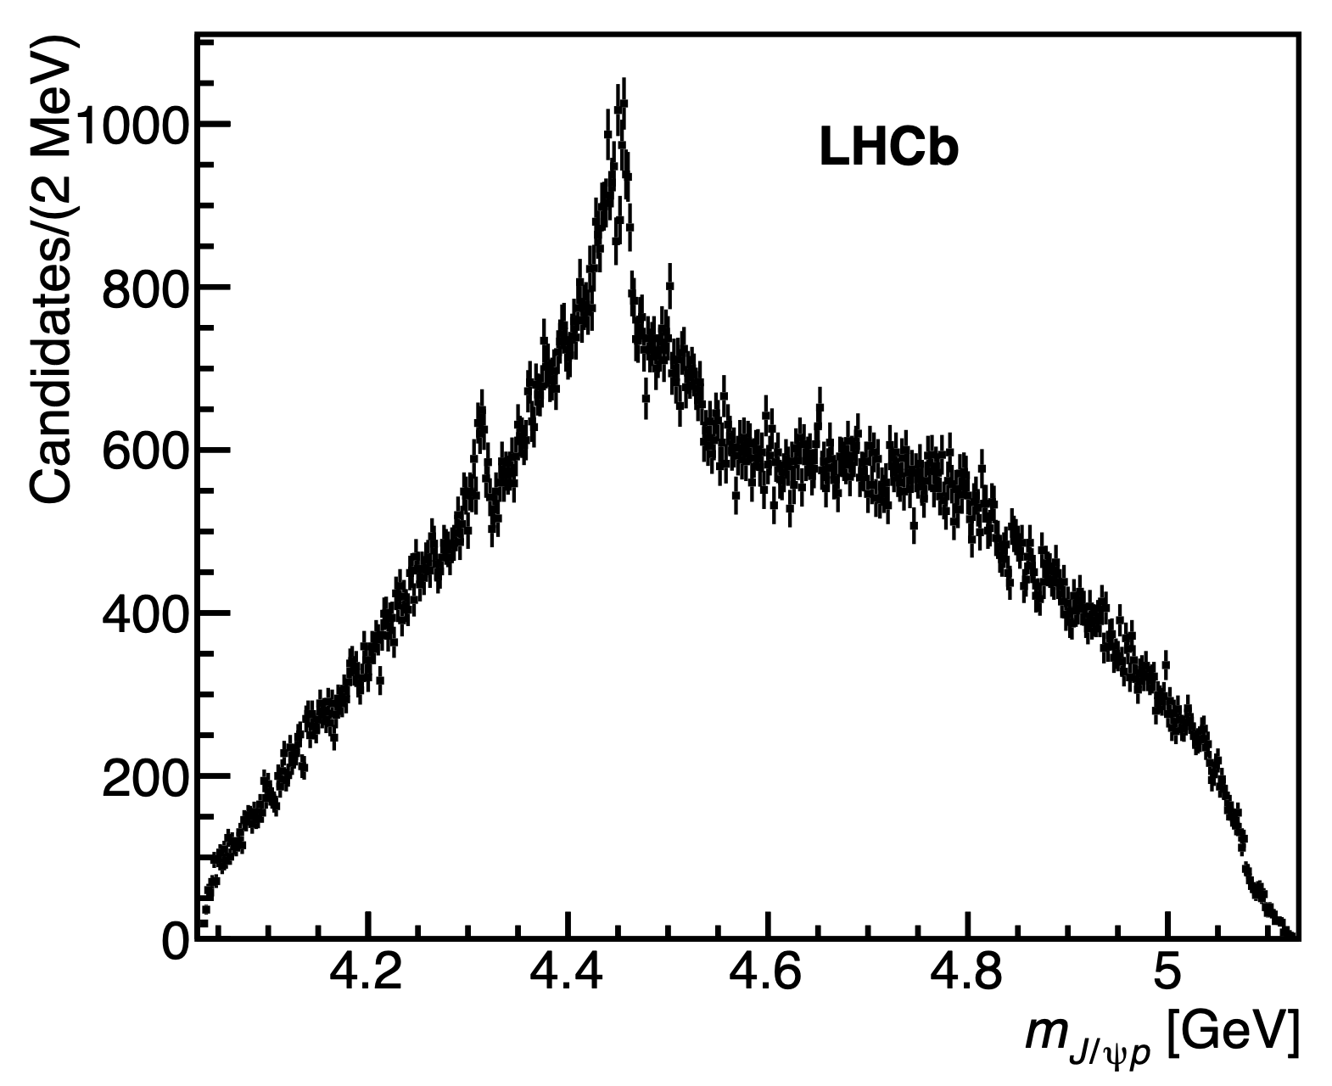
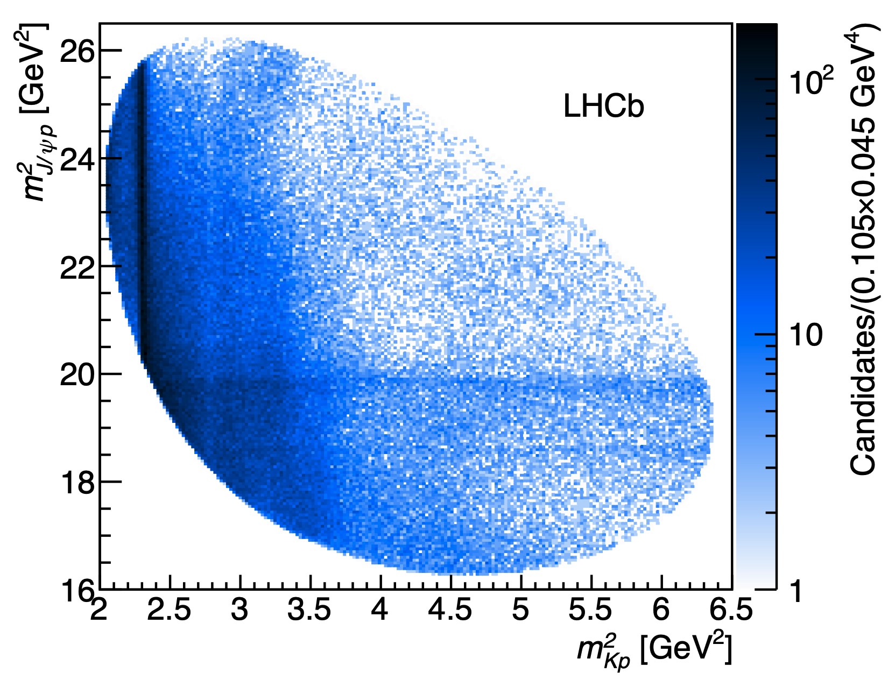


Analysis with full data
PRL(2019)222001
An order of magnitude increases in $Λ_{b}^{0}→J/ψpK^{−}$ yields
Focusing on narrow structures, only small influence due to interference
1D $m_{J/ψp}$ distribution studied. $Λ^{∗}$ contribution reduced by $m_{pK}>1.9$ GeV
4.5 GeV
$m_{pK}>1.9$ GeV
4.3 GeV

Slide 11
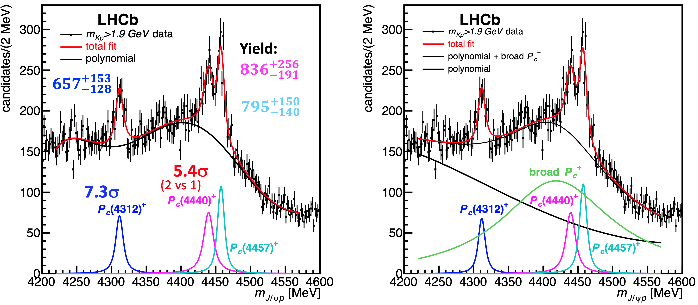
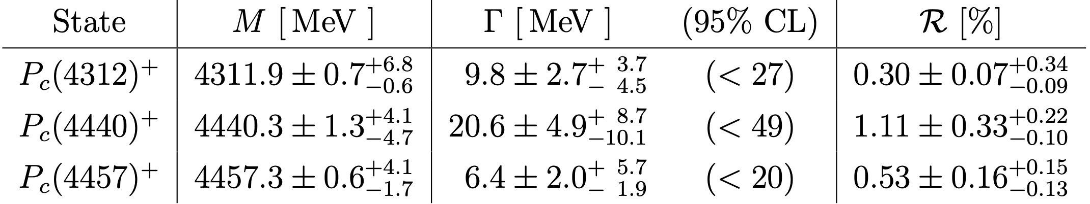



1D fit result
$P_{c}{\left(4312\right)}^{+}$ with significance $7.3σ$
At 4450 MeV: two peaks preferred by $5.4σ$ over one
Not sensitive to $J^{PC}$ or broad $P_{c}{\left(4380\right)}^{+}$ contribution
Mass, width and branching fractions:
PRL(2019)222001
$$≈m(Σ_{c}^{+}{\overline{D}}^{0})$$
Hadron molecules?
$$≈m(Σ_{c}^{+}{\overline{D}}^{∗0})$$

Slide 12
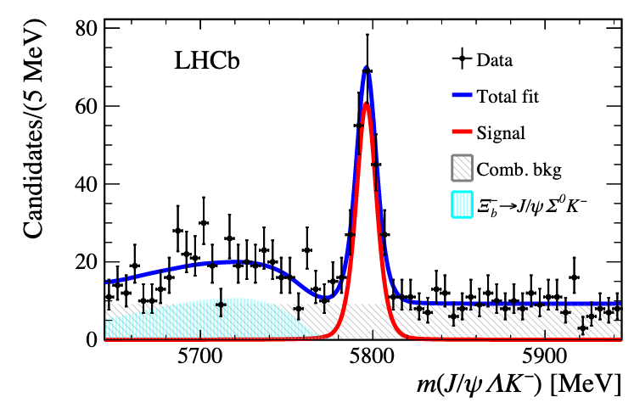




$Ξ_{b}^{−}→J/ψΛK^{−}$ at LHCb
Prediction: $P_{cs}$ states possibly produced in $Ξ_{b}^{−}→P_{cs}K^{−}$, $P_{cs}→J/ψΛ$
$Ξ_{b}^{−}→J/ψΛK^{−}$ studied in full data
PRL 105 (2010) 232001,
PRC 93(2016) 064203,
PRD 93(2016)094009
Symmetry 12 (2020) 10
…
LHCb-PAPER-2020-039
About 1800 signal decays
Dominant by $Ξ(1690)$, $Ξ\left(1820\right)→ΛK^{−}$ contributions
Dalitz mass distribution
Run I
Long category
$$Ξ(1690)$$
$$Ξ(1820)$$

Slide 13
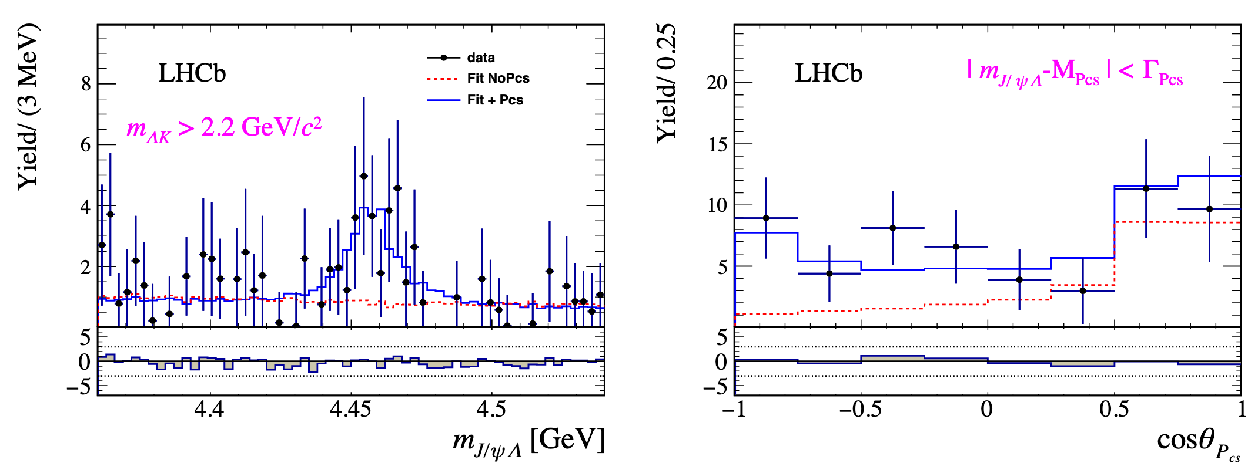

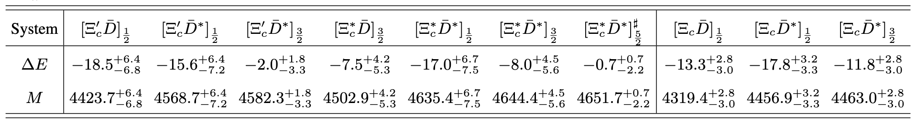
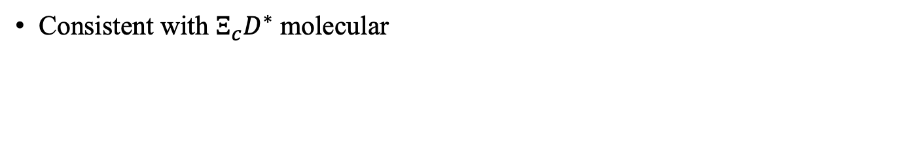

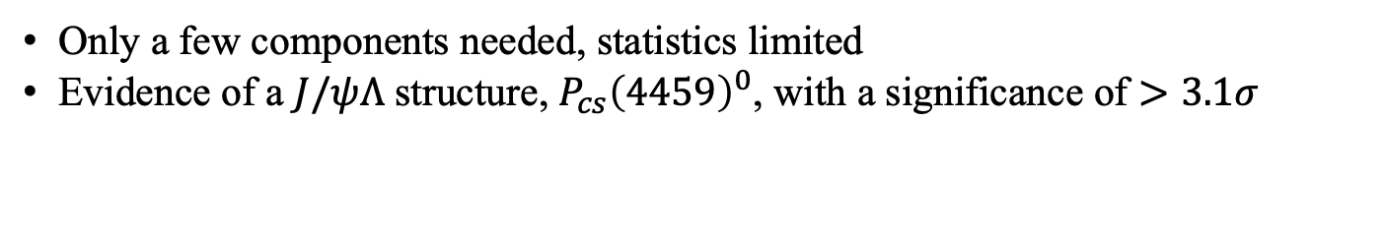


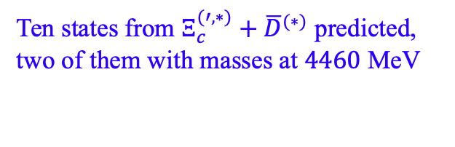

$Ξ_{b}^{−}→J/ψΛK^{−}$ amplitude analysis
LHCb-PAPER-2020-039
Only a few components needed, statistics limited
Evidence of a $J/ψΛ$ structure, $P_{cs}{\left(4459\right)}^{0}$, with a significance of $>3.1σ$
$m=4458.8±{2.9}_{−1.1}^{+4.7}$ MeV, $Γ=17.3±{6.5}_{−5.7}^{+8.0}$ MeV
$$P_{cs}{\left(4459\right)}^{0}$$
$$P_{cs}{\left(4459\right)}^{0}$$
Consistent with $Ξ_{c}D^{∗}$ molecular
$$Ξ_{c}{\overline{D}}^{∗}$$
Ten states from $Ξ_{c}^{(′,∗)}+{\overline{D}}^{(∗)}$ predicted,
two of them with masses at $4460$ MeV
$1/2$
$3/2$
PRD101(2020)034018

Slide 14




Tetraquark studies
Observation of structure in $J/ψJ/ψ$ mass spectrum
$$c\overline{c}cc$$
Science Bulletin 65 (2020) 1983
$D^{−}K^{+}$ structure in $B^{+}→{D^{+}D}^{−}K^{+}$decays
PRD102(2020)112003, PRL125(2020)242001
$$\overline{c}\overline{s}ud$$
$J/ψK^{+}$ and $J/ψφ$ structure in $B^{+}→J/ψφK^{+}$ decays
$c\overline{c}\overline{s}u$ and $c\overline{c}\overline{s}s$
LHCb-PAPER-2020-044, arXiv:2103.01803

Slide 15
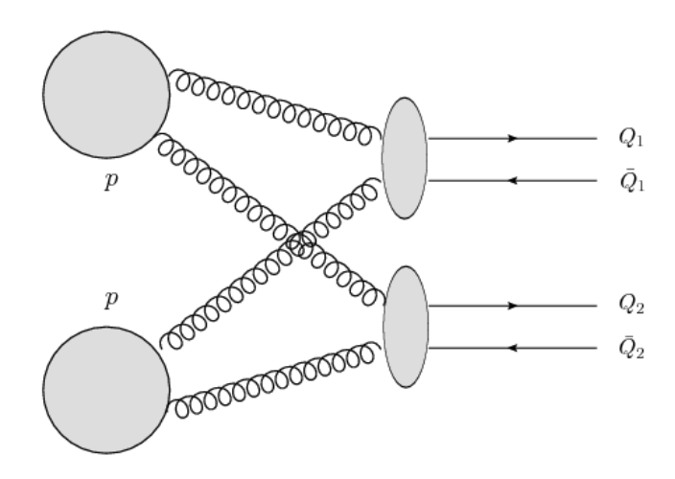





Di-$J/ψ$ sample at LHCb
Full Run1 and Run2 data
Two production processes
$J/ψ$ from b and pileup background suppressed using vertexing information
JHEP 06 (2017) 047
Double Parton Scattering (DPS)
Science Bulletin 65 (2020) 1983
About 34K di-$J/ψ$ signals
Smooth continuum
Single Parton Scattering (SPS)
Both smooth continuum and resonant $cc\overline{c}\overline{c}$ structures.
Averagely larger $p_{T}$

Slide 16





Di-$J/ψ$ invariant mass (I)
Science Bulletin 65 (2020) 1983
Efficiency vs di-$J/ψ$ mass
6200
Broad structure at $6.2−6.8$ GeV close to di-$J/ψ$ mass threshold
Narrow peak at 6.9 GeV
Hint of another structure at 7.2 GeV
Structure not present in $J/ψ$ background sample
Not caused by detection effect: only marginal variation of efficiency

Slide 17





Di-$J/ψ$ mass modeling (I)
DPS model: constructed from single $J/ψ$ kinematics
SPS model: empirical function $Φ_{2}\left(m\right)×e^{c∙m}$
Breit-Wigner (BW) for peaking structures
  Threshold structure ($6.2−6.8$ GeV): two BWs, significance > $6 σ$
  Structure at 6.9 GeV: single BW, significance > $5 σ$
  Hint at 7.2 GeV: significance < $1 σ$
Science Bulletin 65 (2020) 1983
Difficulty to model the dip at 6.8 GeV !
Notes:
To understand the properties of these structure, we perform fits to the mass spectrum by including components to describe these structures in addition to non resonant sps+dps contributions.

Slide 18






Di-$J/ψ$ mass modeling (II)
A wide BW interfering with SPS, a second BW for 6.9 GeV peak
  Fit quality improve from $P\left(χ^{2}\right)=4.6\%$ to $15.5\%$
  Caveat: too simple, SPS assumed to have $J^{P}$ of the wide BW
Science Bulletin 65 (2020) 1983
Wide BW
$m=6741 MeV/c^{2}$
$Γ=288 MeV/c^{2}$
Notes:
This motivates to study the second model, introducing possible interference between different components

Slide 19





Other models
One BW for threshold structure + X(6900), $P\left(χ^{2}\right)=1.2\%$
Only one BW, interfering with SPS, $P\left(χ^{2}\right)=2.8\%$
Threshold structure due to feed-down decays of excited charmonia (e.g. $χ_{c}J/ψ$)
Including a component for 7.2 GeV peak
Science Bulletin 65 (2020) 1983
I
II
IV
III
Notes:
Fits are als

Slide 20




Fits summary and structure
Nontrivial structures in the spectrum
Structure at threshold: one BW, two BWs or feed-down from excited states
  Interference between a BW and SPS preferred
Structure at 6.9 GeV: consistent with a BW, reported as $X(6900)$
$X(6900)$ production (no-interference hypothesis):
First candidate of $cc\overline{c}\overline{c}$tetraquark
  Existence predicted early after charm quark discovery
  Explained using $cc−\overline{c}\overline{c}$ diquarks, compactly bound
  Structure at threshold : in regions of ground and P-wave states
  $X(6900):$ P- or D-wave state
$$R≡\frac{σ_{X}×ℬ\left[X→J/ψJ/ψ\right]}{σ_{J/ψJ/ψ}}=\left[1.1±0.4±0.3\right]\%$$
  [PLB36(1976)1266, Z.Phys.C7(1981)317, EPJC80(2020)1004, PLB(2017)247 …]
  [PRD102(2020)114030, PRD102(2020)074003, EPJC80(2020)871,PRD102(2020)114039, arXiv2006.13756,…]
To perform $J^{P}$ studies

Slide 21





$B^{+}→D^{+}D^{−}K^{+}$ at LHCb
PRD102(2020)112003, PRL125(2020)242001
Only charmonia expected for conventional hadrons in $B^{+}→D^{+}D^{−}K^{+}$ decays
No conventional $D^{+}K^{+}$ nor $D^{−}K^{+}$ hadrons
Model independent studies using charmonia
Moments extracted from $m(D^{+}D^{−})$
Can’t be described by $[c\overline{c}]$ up to $J_{max}=2$, rejected with a significance of $3.9σ$
Prominent discrepancy at $m\left(D^{−}K^{+}\right)∼2.9$ GeV

Slide 22










$B^{+}→D^{+}D^{−}K^{+}$ amplitude analysis
For $c\overline{c}→D^{+}D^{−}$, $P=C={\left(−\right)}^{J}$: ${J^{PC}=0}^{++}(χ_{c0}),1^{−−}(ψ),2^{++}(χ_{c2})$…
$$χ_{c0}(3930)$$
$$ψ(3770)$$
$$χ_{c2}(3930)$$
$$ψ(4160)$$
$$ψ(4040)$$
$$ψ(4415)$$
Reflections difficult to generate this “narrow” structure

Slide 23













Observation of $D^{−}K^{+}\left(\overline{c}\overline{s}ud\right)$ structure
Adding two $D^{−}K^{+}$ structures: $0^{+}, 1^{−}$
Note: no $D^{+}K^{+}[cu\overline{s}\overline{d}]$ structure needed
$$χ_{c0}(3930)$$
$$ψ(3770)$$
$$χ_{c2}(3930)$$
$$X_{1}(2900)$$
$$ψ(4160)$$
$$ψ(4040)$$
$$X_{0}(2900)$$
$$ψ(4415)$$
States | Mass/MeV | Width/MeV | Fraction/%
$$X_{0}(2900)$$ | $2866±7±2$ | $57±12±4$ | $5.6±1.4±0.5$
$$X_{1}(2900)$$ | $2904±5±1$ | $110±11±4$ | $30.6±2.4±2.1$
Quite large contribution!

Slide 24








The $B^{+}→J/ψφK^{+}$ decay
arXiv:2103.01803
Run I + Run II data
$$φ[s\overline{s}]$$
$$K^{+}[u\overline{s}]$$
$$K^{∗+}→φK^{+}$$
$$B^{+}$$
$$X→J/ψφ$$
$$Z_{cs}^{+}→J/ψ K^{+}$$
24k signals
$$J/ψ[c\overline{c}]$$
6D amplitude analysis to decouple all resonant contributions
$PDF=|{\left.​…H_{S_{1}S_{2}}M\left(m_{0},Γ_{0}\right)d_{λs_{1}−s_{2}}^{J}…\right|}^{2}$
Parity
Mass
Spin

Slide 25







$K^{∗+}→φK^{+}$ contribution
Guided by Godfrey-Isgur Model
Conventional $K^{∗}$
Mass/width floated for unconfirmed states
9 states with significance $>4σ$
Other states not significant, systematic test
$$φ[s\overline{s}]$$
$$K^{+}[u\overline{s}]$$
$$B^{+}$$
PRD 32 (1985) 189
$$J/ψ[c\overline{c}]$$
Established
Unconfirmed
arXiv:2103.01803

Slide 26






$X→J/ψφ$ contribution
CDF observed a narrow $X(4140)$ ($Γ≈15$ MeV)
$$φ[s\overline{s}]$$
$$K^{+}[u\overline{s}]$$
X(4140): 19±6 [>5σ]
X(4274): 22±8 [~3.1σ]
$$B^{+}$$
PRL102(2009)242002
Mod.Phys.Lett.A32(2017)26
PLB734(2014)261
$$X$$
Confirmed by CMS
$$J/ψ[c\overline{c}]$$
arXiv:2103.01803
1D analyses, interference/reflections not included

Slide 27













$Z_{cs}^{+}→J/ψK^{+}$ contribution
Charged $Z_{c}^{+}→ψπ^{+}$ observed in $B$ decays
$Z_{c}{\left(4430\right)}^{+}, Z_{c}{\left(4200\right)}^{+}$
PRL 112(2014)222002
$$φ[s\overline{s}]$$
$$K^{+}[u\overline{s}]$$
$$B^{+}$$
$$Z_{cs}^{+}$$
and in $e^{+}e^{−}$ machines
$$Z_{c}{\left(3900\right)}^{+}$$
PRL 110(2013)252001
PRL 126(2021)102001
$Z_{cs}^{+}$ $5.3σ$
$$J/ψ[c\overline{c}]$$
$$D^{0}D_{s}^{∗−}+D^{∗}D_{s}^{−}$$
arXiv:2103.01803
No other experimental evidence of $Z_{cs}^{+}$, though predicted by calculations
[Phys. Soc. 55(2009)424, PRL 110(2013)232001, PRD88(2013)096014, PLB 798(2019)135022, JHEP 04(2020)119]

Slide 28
















Amplitude fit of $B^{+}→J/ψφK^{+}$ at LHCb
Need 10 $J/ψX$ components to describe data
  8 $X→J/ψφ$ components
  2 $Z_{cs}→J/ψK^{+}$ components
arXiv:2103.01803
$$X$$
15$σ$
18$σ$
20$σ$
17$σ$
15$σ$
5.5$σ$
4.8$σ$
$$Z_{cs}$$
$$K^{∗}$$
15$σ$
5.9$σ$

Slide 29




Fit parameters
All states are relatively wide: 50 – 200 MeV
New $J/ψφ$
New $J/ψφ$
Large width
New $J/ψφ$
New $Z_{cs}^{+}$ states: width inconsistent with $Z_{cs}{\left(3985\right)}^{+}$ at BESIII. Different state!

Slide 30




Fit projections
$Z_{cs}^{+}$ essential to describe data
arXiv:2103.01803
All angular distribution well modelled
I II
I II
Angles in $B^{+}→J/ψK^{∗}$ chain

Slide 31



$J^{P}$ analysis
All $X$ have $C=1$
$L=0$ for $J/ψφ$ system
Exotic
$$J^{P}$$ | $$0^{+(+)}$$ | $$0^{−(+)}$$ | $$1^{+(+)}$$ | $$1^{−(+)}$$ | $$2^{+(+)}$$ | $$2^{−(+)}$$
$$X(4630)$$ | 6.7σ | 5.3σ | 5.8σ | Prefer | 5.9σ | 3.0σ
$$X(4500)$$ | Prefer | 18σ | 18σ | 18σ | 18σ | 18σ
$$X(4700)$$ | Prefer | 18σ | 18σ | 18σ | 14σ | 17σ
$$X(4140)$$ | 14σ | 15σ | Prefer | 14σ | 13σ | 14σ
$$X(4274)$$ | 18σ | 18σ | Prefer | 18σ | 18σ | 18σ
$$X(4685)$$ | 16σ | 16σ | Prefer | 15σ | 16σ | 15σ
$$Zcs(4000)$$ | - | 17σ | Prefer | 17σ | 15σ | 16σ
$$Zcs(4220)$$ | - | 8.6σ | Prefer | 2.4σ | 4.9σ | 5.7σ
Same as $Z_{c}{\left(4430\right)}^{+},Z_{c}{\left(4200\right)}^{+},Z_{c}{\left(3900\right)}^{+}$, $L=0$ for $ψπ^{+}$ system

Slide 32











Interpretations
Some $X→J/ψφ$ may be $D_{s}^{(∗)}{{\overline{D}}^{(∗)}}_{s}$ molecular states ?
States | $$J^{PC}$$ | Mass | Width | Nearest thresholds/MeV
$$X(4140)$$ | $$1^{++}$$ | $4118$ | 162 | $D_{s}^{+}D_{s}^{∗}− :$ 4080
$$X(4150)$$ | $$2^{−+}$$ | $4146$ | 135 | $D_{s}^{+}D_{s}^{∗}− :$ 4080
$$X(4274)$$ | $$1^{++}$$ | $4294$ | 53 | $D_{s}^{+}D_{s0}^{∗}{\left(2317\right)}^{−}$: 4286
$$X(4500)$$ | $$0^{++}$$ | $4474$ | 77 | $D_{s}^{+}D_{s1}^{∗}{\left(2536\right)}^{−}$: 4503
$$X(4630)$$ | $$1^{−+}$$ | $4626$ | 174 | ${D_{s}^{∗}}^{−}D_{s1}^{∗}{\left(2536\right)}^{−}$: 4636
$$X(4685)$$ | $$1^{++}$$ | $4684$ | 126 | $D_{s}^{∗+}D_{s2}^{∗}{\left(2573\right)}^{−}$: 4681
$$X(4700)$$ | $$0^{++}$$ | $4694$ | 87 | $D_{s}^{∗+}{\overline{D}}_{s2}^{∗}{\left(2573\right)}^{−}$: 4681
S-wave
$J^{P}=1^{+}$
$J^{P}=1^{+}$
$J^{P}=0^{−}$
$J^{P}=1^{−}$
$J^{P}=J^{−}$
$J^{P}=J^{−}$
$J^{P}=J^{−}$
Can’t rule out conventional charmonia either, $c\overline{c}→J/ψφ$ not forbidden
$Z_{cs}{\left(4000\right)}^{+}$ and $Z_{cs}{\left(4220\right)}^{+}$:
May be SU(3) flavor partners of $Z_{c}{\left(3900\right)}^{+}$ and $Z_{c}{\left(4020\right)}^{+}$, molecular sates, $m_{D∗}+m_{D_{s}}\sim 4 GeV$
arXiv:2011.08725
arXiv:2103.08331

Slide 33






Summary and prospect
Three $J/ψp$ pentaquark states in $Λ_{b}^{0}→J/ψpK^{−}$ decay
Evidence of $J/ψΛ$ pentaquark in $Ξ_{b}^{−}→J/ψΛK^{−}$ decay
Structures in $J/ψJ/ψ$ mass spectrum
$D^{−}K^{+}$ structure observed in $B^{+}→D^{+}D^{−}K^{+}$ decay
Structures of $J/ψK^{+}$, $J/ψφ$ observed in $B^{+}→J/ψφK^{+}$ decays
$$c\overline{c}uud$$
$$c\overline{c}usd$$
$$c\overline{c}cc$$
$$\overline{c}\overline{s}ud$$
$$c\overline{c}s\overline{s}, c\overline{c}\overline{s}u$$
A lot of similar studies being performed, coming out soon!
Thank you for your attention

Slide 34
Backup slides

Slide 35


Relativistic tetraquarks [arXiv:2103.01763]

Slide 36


$X(6900)$ signal stability

Slide 37

Systematic uncertainties
Science Bulletin 65 (2020) 1983

Slide 38



Di-$J/ψ$ invariant mass (II)
Science Bulletin 65 (2020) 1983
Same structures in all high di-$J/ψ$ $p_{T}$ bins, evidence increasing with $p_{T}$

Slide 39



Signal significance
Global significance from a $χ^{2}$-test against DPS+SPS continuum
  DPS model: constructed from single $J/ψ$ kinematics
  SPS model: empirical function $Φ_{2}\left(m\right)×e^{c∙m}$
  Hypothesis without any structures in $6.2−7.4$ GeV rejected at $6.0σ$
Science Bulletin 65 (2020) 1983
$χ^{2}/ndf$ mainly from $<7$ GeV region

Slide 40



Interpretations
$cc\overline{c}\overline{c}$ tetraquark candidate (?)
Existence predicted after charm quark discovery
New studies using $[cc]$ diquark model
  $[cc]$ diquark uccessfully predicted $Ξ_{cc}^{++}$ mass
  Tightly bound between $[cc]$ and $[\overline{c}\overline{c}]$
  A series of states from spin and orbital configurations
  Threshold structure: in regions of ground and P-wave states
  $X(6900):$ 2S- or D-wave state
Dynamically generated?
  LHCb data fit with di-charmonium channels
A further support of tetraquark $QQ\overline{q}\overline{q}′$?
  [PRD90(2014)094007]
  [EPJC80(2020)1004, PLB(2017)247 …]
  [PRD102(2020)114030, PRD102(2020)074003, EPJC80(2020)871,PRD102(2020)114039, arXiv2006.13756,…]
  [arXiv:2009.07795]
  [arXiv:2009.07795]
  [PLB36(1976)1266, Z.Phys.C7(1981)317, EPJC80(2020)1004, PLB(2017)247 …]

Slide 41



The bottom partner
Searched for in $Υμ^{+}μ^{−}$final state by LHCb and CMS
LHCb: 6.3 fb⁻¹
CMS: 35.9 fb⁻¹
PLB 808 (2020) 135578
JHEP 10 (2018) 086
No obvious signals. Eager to see full data analysis at CMS/ATLAS

Slide 42

Compare with BESIII
BESIII experiment recently reported $5.3σ$ observation of a very narrow $Z_{cs}^{−}$ in $D_{s}^{−}D^{∗}+DD_{s}^{∗−}$ mass distributions
Their masses are close, but
$Z_{cs}{\left(4000\right)}^{+}$ is $\sim 10×$ broader
Tests are applied:
  Fix $Z_{cs}{\left(4000\right)}^{+}$ to BESIII’s
  result; 2$lnL$ is worse by 160
  Adding on top of the default
  model almost doesn’t improve
  the fit likelihood
No evidence that $Z_{cs}{\left(4000\right)}^{+}$
is the same as $Z_{cs}{\left(3985\right)}^{−}$
seen by BESIII

Slide 43






Observation of $D^{−}K^{+}\left(\overline{c}\overline{s}ud\right)$ structure
$0^{+}$and $1^{−}$ states needed to describe $cos(D^{−}K^{+})$ distribution
$2.75<m\left(D^{−}K^{+}\right)<3.05$ GeV
$0^{+},1^{−}$ combined $Δ$NLL
Preference over other models
X states | No $X$ | $X_{0}+X_{1}$ | $$X_{0}$$ | $$X_{1}$$ | $$X_{2}$$ | $X_{1}+X_{2}$
$Δ2$NLL | $$−$$ | $−316$ | $−218$ | $−230$ | $−162$ | $−308$
$Δχ^{2}$ | $$−$$ | $−203$ | $−113$ | $−172$ | $−136$ | $−197$
$X_{1}+X_{2}$ only slightly worse than $X_{1}+X_{0}$

Slide 44
$B^{+}→J/ψφK^{+}$ dalitz
arXiv:2103.01803
Four obvious structures
Hint of a broad structure

Slide 45

$J^{PC}$ of $X$ states
For $X→J/ψφ$, S-wave decays: ${J^{PC}=\left(0,1,2\right)}^{++}$, expected to dominate
P-wave decays ${J^{PC}=\left(0,1,2,3\right)}^{−+}$
Legendre momentums

